Slide 1
Understanding the Link between Individual and Organisational Performance: 5KIOP
3 April 2019

Slide 2
Learning Outcomes for Unit
Understand the concept of high-performance working (HPW) and how it can benefit individuals and the organisation.
Understand the contribution of the performance management process to high levels of performance.
Understand the role of line managers in performance management processes.

Slide 3

HRM: People and Organisations
Chapter 9
Improving Organisational Performance

Slide 4
Contents
What is high performance working?
Links with organisational performance
Criticisms of the research on high performance working practices
Formal Performance management systems
Problems with performance appraisal
360-degree feedback
HRM and formal performance management
Updating traditional performance management
Building a high performance culture

Slide 5
Performance
The people–performance link (Purcell et al 2003) draws attention to performance as a function of people’s ability, motivation, and opportunity (AMO).
  Eleven HR policies and practices are required to turn this into action: ‘performance infrastructure’.
  The ways in which front-line managers deliver the policies are key: ‘differentiators’.
  This connects with Herzberg’s two-factor theory of motivation.
Notes:
Herzberg connection – the policies and practices are the hygiene factors whilst the way in which line managers deliver the policies are the differentiators (motivators).

Slide 6
People performance model
Ability
and skill
Motivation
and incentive
Opportunity
to participate
Organisation
commitment
Motivation
Job Satisfaction
Discretionary
behaviour
Performance outcomes
Front-Line
Management
Notes:
Source: Purcell/CIPD

Slide 7
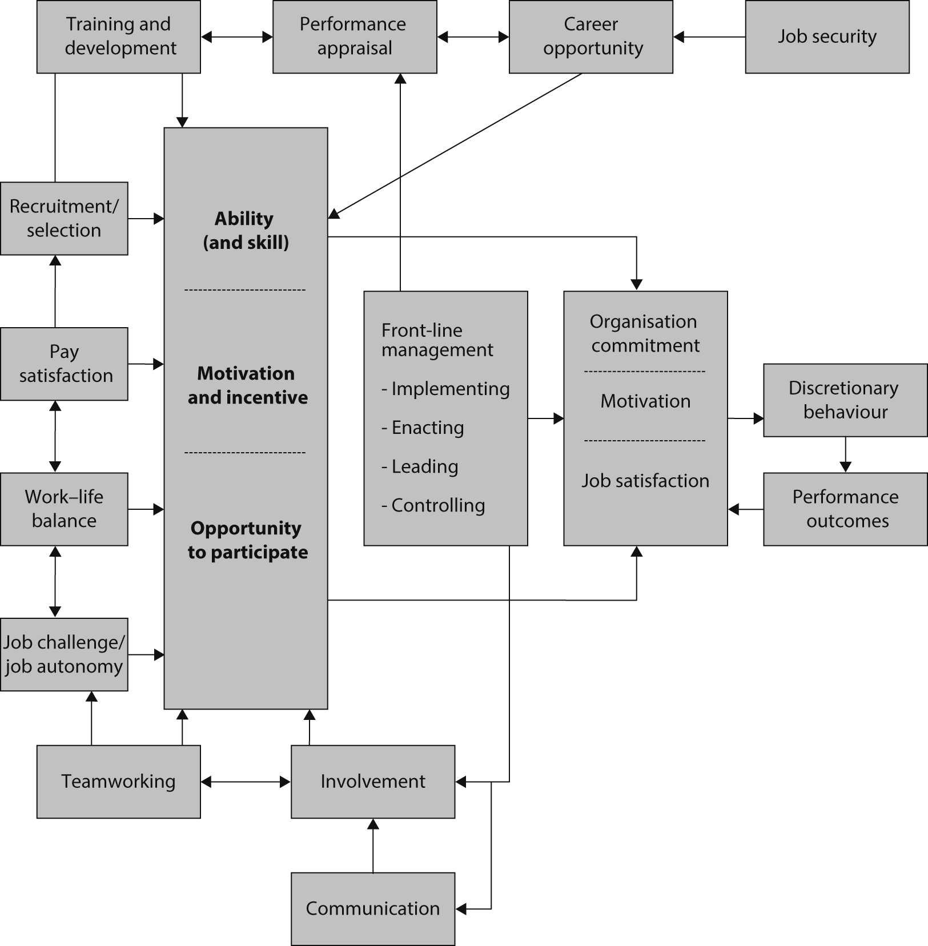
The people and performance model
Notes:
See page 144. Hutchinson, S. and Purcell , J. (2003) Bringing Policies to Life: The vital role of front-line managers in people management. With the permission of the publisher, CIPD, London

Slide 8
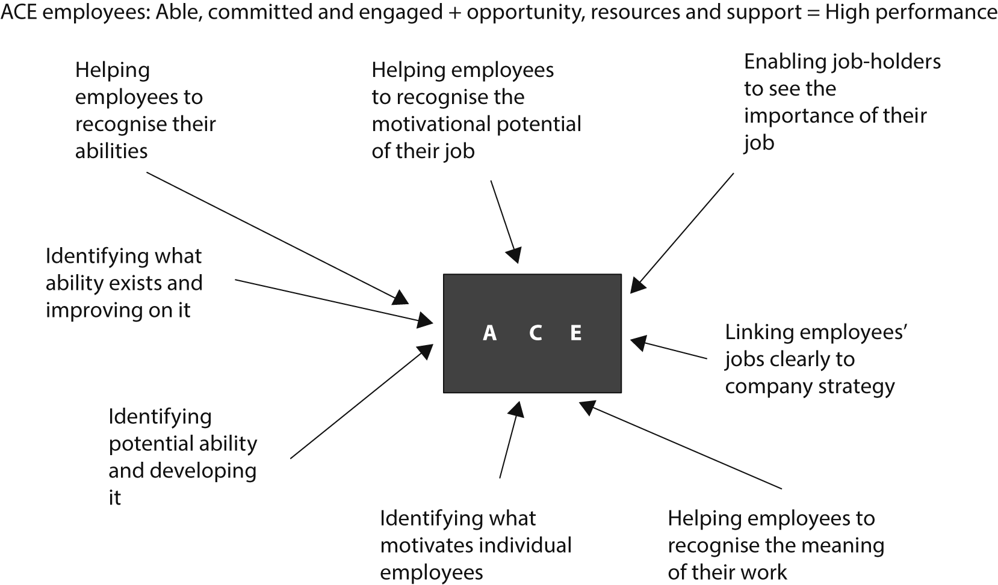
ACE Model
Notes:
(Tymon and Rees 2013)

Slide 9
What is HPW?
High Performance Work Systems are best understood as comprising a bundle of distinct human resource management policies and procedures which are introduced in an organisation at the same time and are mutually reinforcing.
Also known as high commitment HRM, high involvement work practices, best practice HRM.
Believed to be associated with relatively high levels of organisational performance because people want to work for organisations that take this best practice approach (employer of choice – able to attract and retain) and once employed, staff are more likely to be engaged, committed and release ‘discretionary effort’.

Slide 10
What is high performance working?
Rigorous and sophisticated recruitment and selection
Investment in training and development
Performance-based pay
Internal promotion
Team-based approaches
Grievance systems
Employee participation
Information sharing
Performance appraisal
Flexible working
Job security
Work-life balance
Harmonisation of terms and conditions

Slide 11
Linking HPWS with Superior Organisational Performance (1)
Lots of research that has sought to test the proposition that the adoption of HPW practices leads to superior business performance. The results have been encouraging, but not all are convinced by them.
Pfeffer (1994) – a mix of policies along the lines of the best practice bundle were used in the majority of the successful organisations he studied.

Slide 12
Linking HPWS with Superior Organisational Performance (2)
Huselid (1995): Proof that HR adds value
  A 1 standard deviation increase in HR practices yields:
  a 7.05% decrease in staff turnover
  $27,044 in increased sales per employee
  $18,641 more in market value per employee
  $3,814 more in profit per employee.
Coombs et al (2006):
  Meta-analysis – 92 separate studies combined
  4.6% increase on return on assets
  4.4% reduction in staff turnover

Slide 13
Explaining the Link (1)
Purcell et al (2003)- CIPD ‘Black Box’ studies:
  Progressive HRM leads to positive employee responses of job satisfaction, motivation or organisational commitment which leads them to work harder and release discretionary effort
  Big ideas that glue organisations together – mission, values embedded in policies. Strong sense of shared purpose.
  Line mangers who ‘bring HRM to life’
  AMO – one of the conditions that must be satisfied if the bundle is to underpin high levels of performance
  The ability to perform well
  The motivation to perform well
  The opportunity to perform well
Notes:
A number of findings seek to explain the link and have been very influential.
Line managers are a crucial component of the black box.

Slide 14
Explaining the Link (2)
The Gallup Studies - engagement
Harter et al (2002)
12 question employee engagement instrument
  Greater variation between business units in the same organisation than between organisations (so difference is due to quality of line managers)
  Impressive correlations between engagement scores and unit performance
  Strong relationship between engagement and staff turnover
Other studies have focussed on well-being and performance and in the case of Peccei (2013), on the development of human capital and the employee relations climate
Notes:
Message – HR policies and practices help to generate superior business performance because they help to motivate employees positively to perform well in their individual roles. The black box studies use the term ‘discretionary effort’ to describe this whilst Gallup use ‘Employee engagement’. But both contend that Huselid’s link can be largely explained by the fact that most employees respond positively to the presence in their organisation of best practice bundle of high performance work practices and that tends to lead (provided that other important conditions are also in place) to improved individual work performance. When this is true for most employees this leads to substantially improved organisational performance.

Slide 15
Criticisms of the Research
Best practice HRM may have a positive impact but:
  this cannot be measured
  this cannot be proved
Correlation does not prove causation
  superior performance may lead to sophisticated HRM
  independent variables
Rhetoric and reality
  fluffy words disguise an uglier situation (actually longer hours, tight management control may cause stronger performance)
  work intensification – squeezing out more for less

Slide 16
Fleetwood & Hesketh (2010)
It is impossible accurately to predict the financial impact of HR interventions
People deliver performance rather than the ‘HRM architecture’
HR plays an enabling role, it can not cause high performance

Slide 17
Activity – 20 minutes
Read the passage on Google and answer the questions.

Slide 18
What is Performance Management?
Performance Management is the continuous process of improving performance by setting individual and team goals which are aligned to the strategic goals of the organisation, planning performance to achieve those goals, reviewing and assessing progress, and developing the knowledge, skills and abilities of people (Armstrong, 2016).

Slide 19
Performance Management Cycle
Performance management takes the form of a continuous self-renewing cycle which in turn is concerned with:
The performance and development agreement which leads to
Managing performance throughout the year which leads to
Performance review and assessment which leads back to the performance and development agreement.
Notes:
Handout.

Slide 20
THE PERFORMANCE MANAGEMENT CYCLE
Performance and
development planning -
performance agreement:
role definition
objectives
competencies
performance improvement
personal development
Review Performance
dialogue and feedback
agree strengths and any
areas for improvement
build on strengths – ‘You are
particularly strong in this area –
how can you make
even greater use of them?’
Act
carry out role
implement performance
improvement plan
implement personal
development plan
Manage performance
throughout the year
monitor performance
provide continuous feedback
provide coaching
deal with under-performers
Notes:
Performance management is a natural process of management. It is not an HRM technique or tool.
As a natural process of management the performance management cycle shown in the slide corresponds with William Deming’s (1965) Plan-Do-Check-Act model.

Slide 21
Main stages and key aspects of the PM Cycle
Communication of organisational vision and objectives
Setting departmental and individual objectives
Measuring performance
Reviewing performance
Identifying training and development needs
Evaluation
Linking of individual outcomes back to team and organisational outcomes

Slide 22
Formal Performance Management
Appraisal, evaluation and development
Annual reviews – formal – recorded – action points
Bloom et al (2012): Organisations are 23% more productive when they had these in place:
  TARGETS - objectives
  INCENTIVES – reward/recognition
  MONITORING
Aims
  improving individual and collective performance
  raising morale
  reinforcing control
  Identifying developmental opportunities
  Communicating goals and expectations
Notes:
Many organisations have formal performance management systems in place.

Slide 23
Underpinning Theories
Goal Theory
Control Theory
Social Cognitive Theory
Notes:
Goal – Latham and Locke (1979) – goals direct attention to priorities, stimulate effort, challenge people to bring their skills to bear to increase the chance of success, the more challenging the goal, the more people will draw on their full repertoire of skills.
Control – feedback as a means of shaping behaviour. People recognise what they have to do to improve.
SC – helps encourage self-belief (self-efficacy – I can do this) which encourages performance.

Slide 24
Impact of Performance Management
Results of research is mixed but still possible to believe in the benefits of performance management:
People are more likely to respond positively and are more likely to improve and develop their capabilities if they share in the processes of defining expectations and reviewing performance and competency against those expectations and are involved in creating and implementing plans for developing their skills and competencies.
If carried out properly PM can reward people by recognition through feedback, the provision of opportunities to achieve, the scope to develop skills and guidance on career paths (Armstrong, 2016)

Slide 25
Activity – 20 minutes
In your groups brainstorm the advantages and disadvantages of yearly appraisals. Think of examples to support your points.
Decide as a group how to overcome some of the problems with appraisals.

Slide 26
Formal Performance Appraisal (1)
Limited evidence that it improves performance
Widely criticised and now regularly abandoned or replaced
Difficult to do well
Paper exercise / box ticking
Evaluation v developmental objectives
Behavioural assessment v output-based assessment
SMART objectives (specific, measurable, achievable, realistic, time-bound)
SMART criticised - DUMB objectives (defective, unrealistic, misdirected, bureaucratic)
Rate of change means objectives need to flexible and focus on aspects that do not change such as the need to provide good service to customers
Notes:
If emphasis is on evaluation – employees may down play development needs, but this is a problem then when looking to the future and how to improve.
For it to work in relation to development, there should be no link to pay/reward. Need to decide if appraisal is evaluative (link to pay possible) or developmental.
Two types of performance management system – behavioural (way results are achieved) and out-put based (results). Difficult to address both at same time.
Behavioural can include competency based systems – which competencies are required. Looks at past performance.

Slide 27
Formal Performance Appraisal
(2) – problem of unfair bias
the tendency to give a good overall assessment on the basis that one particular aspect has been accomplished well
a tendency to avoid giving low ratings, even when deserved, for fear of angering or upsetting a weak performer
the tendency to give a poor overall assessment on the basis of particularly poor performance in one area
the tendency to rate employee performance as ‘average’ or ‘good’ rather than to use the end-points of rating scales

Slide 28
Formal Performance Appraisal (3)
the tendency to give particular weight to recent occurrences in reaching judgements about individual performance
the tendency to give high ratings to people who have performed well historically, whatever their performance over the previous year
a tendency to refrain, on principle, from giving particularly high ratings
a tendency to rate subordinates at a lower level than the appraiser achieved when in their position

Slide 29
Formal Performance Appraisal
Longenecker et al (1987):
‘There is really no getting around the fact that whenever I evaluate one of my people, I stop and think about the impact – the ramifications of my decisions on my relationship with the guy and his future here. I’d be stupid not to. Call it being politically minded, or using managerial discretion, or fine tuning the guy’s ratings, but in the end I’ve got to live with him, and I’m not going to rate a guy without thinking about the fallout. There are a lot of games played in the rating process and whether we admit it or not we are all guilty of playing them at our discretion.’

Slide 30
To overcome issues:
Effective training
Regular evaluation of how appraisal interviewing is working in practice
However there still may be a reluctance by managers to carry out appraisals for a number of reasons – affecting relationships.
Brings into question whether appraisals can ever be objective. They will result in some being demotivated and dissatisfied.

Slide 31
360 Degree Feedback
Peers, subordinates and superiors
Fashionable and widely used in the USA
Theoretically attractive, practically problematic
  Objectivity
  Vindictiveness
  Competition
  Popularity courting
Can be successful if:
Feeding back completed sensitively
Used for Developmental not evaluative purposes
Confidentiality

Slide 32
How am I going?
https://howamigoing.com/about-us/
6 tools for all year round development:
Company 360 feedback
Personal 360 feedback
Goal management
Check-ins
Pulse surveys
Personal note
Anonymous and preserves relationships

Slide 33
HRM and Performance Management
Line manager-led and owned
HR can help by:
Recruiting and selecting employees using competency framework, communicating mission, vision, objectives and values at this stage
Introducing performance management at Induction (information about vision, mission and objectives)
Providing documentation (self appraisal being an important component)
Providing training and development opportunities including CPD opportunities
Providing personal development and career planning advice/training
Providing policies/training/opportunities for recognition and reward
Giving advice on performance issues
Helping line managers identify and address training needs
Acting as co-ordinator of the process

Slide 34
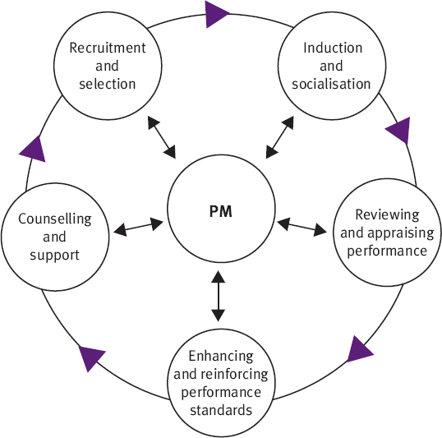
The Performance Management Process
Notes:
Importance of induction in creating the right cultural expectations in new recruits (Marchington et al, 2016).

Slide 35
Video – Changing Trends
https://www.cipd.co.uk/knowledge/fundamentals/people/performance/factsheet#6296

Slide 36
Updating Performance Management
In a fast changing world, do appraisals still have a place?
Baker (2013)
  The five conversations framework
Buckingham & Goodall (2015) - The four criteria framework, rated on a Likert scale (strongly agree to strongly disagree)
Example – ‘Given what I know of this person’s performance, I would always want him or her on my team’.
Notes:
Baker – instead of one appraisal, 5 conversations for each 6 months (10 a year), on separate topics. Need for a more flexible, focussed, frequent and informal approach.
Buckingham – review performance quarterly.

Slide 37
Activity – 30 minutes
Read your allocated article and discuss it with the group. Consider the following:
Do you agree with the viewpoint? Why/why not?
Is this of potential interest to your organisation?
Be prepared to feedback your discussion points to the class.

Slide 38
Building a High Performance Culture
Discretionary effort – widely undertaken
Holbeche (2005):
  building a positive psychological contract
  don’t promise more than you can deliver
  become a values-based organisation
  involve everyone in change management
  encourage innovation and creativity
  Break down silos
  ‘unleash rather than constrain employee potential’
Notes:
We can conclude that organisations are most likely to maximise their performance, achieve their objectives when they operate effective and appropriate formal performance management systems alongside the recognised bundle of high performance work practices and employee centred styles of line management that seek to bring out the best in every individual employee. However to sustain high levels of performance over time there is a need to embed a culture of high performance into the organisation’s culture. Need for managers to build high trust relationships with staff and communicate honestly with them.

Slide 39
Activity – 30 minutes
Read the IES paper on ‘Performance Management – Making it Work’ (2016).
In your groups discuss your organisations’ performance manage systems (even if it is only your experiences of having had an appraisal) and make suggestions for their improvement.
Be prepared to share your recommendations with the class.

Slide 40
Poster Competition
As a group design a poster on the topic of ‘Performance Management in South Wales’.
Include relevant theory such as the performance management cycle, plus research to demonstrate the link between performance management practices and organisational performance. Include examples from your organisation and an evaluation of current trends, plus whether or not your organisation needs to change.
The poster should be planned on 3rd April and completed on 1st May.

