Slide 1
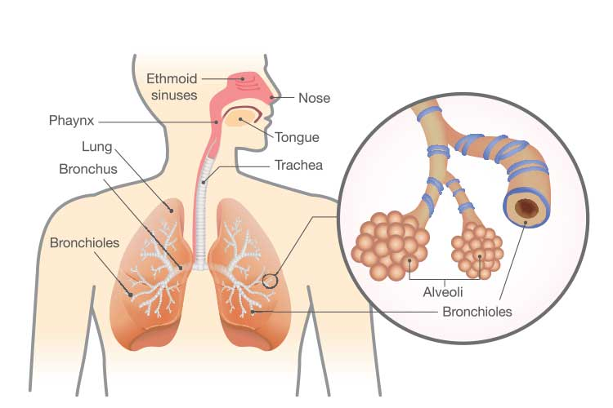

“Management and Diagnostic Strategies for Acute Respiratory Tract Infections among the Adult Population in the United Kingdom: A Systematic Review”
Student Name: Mst. Sima Begum Student ID: 2433426 Programme: MSc Public Health and Social Care in Practice Module Name: Practice-Based Research
Prevalence
Respiratory diseases impact 1 in 5 people, ranking as the third biggest cause of death in England (Al et al., 2023).
Respiratory tract infections (RTIs) are highly prevalent in UK adults, with approximately 1 in 6 people reporting symptoms of influenza-like illness (ILI) during peak periods in early 2023 (GOV.UK, 2025).
Pneumonia emergency admissions in England rose 16% in 2023–2024 to 430 per 100,000, while community-acquired pneumonia affects 0.5–1% of adults annually (Hyams et al., 2024; Johannesen et al., 2025).
In a survey of English general practices, the median antibiotic prescribing rate for adult RTI consultations stood at 54%, with the top 10% of practices reaching 69% (Parekh et al., 2025).
Recent data from the TARGET RTI program (2022–23 and 2023–24) show adults comprising 76–79% of assessed RTI cases, totaling over 174,000 adults annually across participating sites (Rousogianni et al., 2025; Symes et al., 2025).
approximately 25% of the UK population consults a GP annually due to symptoms related to acute respiratory tract infections, and RTIs account for around 15–20% of all GP consultations (Wyatt et al., 2024).
Emergency hospital admissions for pneumonia in England reached 252,912 in the 2023-2024 financial year, with the highest rates in the North West (539 per 100,000) (NHS England, 2024; Osei‐Yeboah et al., 2024).
Age Group | Pneumonia | Non-Pneumonia LRTI | Total aLRTD
18–49 | 116 | ~200 (est.) | ~500
50–64 | 315 | ~300 (est.) | ~800
65–74 | 1,289 | ~800 (est.) | ~2,200
75–84 | 2,442 | ~1,500 (est.) | >4,000
Research Question: What are the most effective clinical strategies for the diagnosis and management of acute respiratory tract infections (RTIs) among adults in the United Kingdom in ensuring optimal patient outcomes and antibiotic stewardship?
Research Aim: The aim of this research is to evaluate and synthesize current evidence regarding the clinical approaches used to manage RTIs in UK adults, identifying best practices that balance effective symptom relief with the reduction of inappropriate antibiotic prescribing.
Research Objectives:
To identify and evaluate the diagnostic tools (such as C-reactive protein testing and clinical scoring systems) currently used in the UK to differentiate between viral and bacterial RTIs in adults.
To assess the effectiveness of different management strategies, including delayed prescribing and supportive care, on patient recovery times and re-consultation rates.
To determine the impact of current UK clinical guidelines (e.g., NICE guidelines) on prescribing behaviours and patient safety within primary and secondary care settings.
Figure 1: Age-Stratified Hospitalization Incidence (Johannesen et al., 2025; Parekh et al., 2025)
Research Impact
This research will benefit the adult population by identifying effective clinical strategies that support accurate diagnosis and appropriate management of RTIs.
Improved diagnostic approaches can help ensure that patients receive the most appropriate treatment, reducing unnecessary exposure to antibiotics and minimizing potential side effects (Hanage and Schaffner, 2024).
Healthcare professionals will get support particularly general practitioners and primary care clinicians, in making evidence-based clinical decisions.
The research will contribute to strengthening antibiotic stewardship initiatives within the UK healthcare system. By identifying management strategies that reduce inappropriate antibiotic prescribing, such as delayed prescribing and supportive care.
The findings may support healthcare policymakers and guideline developers in improving clinical recommendations for RTI management.
Evidence generated from this systematic review can inform updates to national clinical guidelines and support the development of policies that promote responsible prescribing practices across both primary and secondary care settings.
Rational for Research
This research is urgent given AMR's global threat; RTIs account for 60% of primary care antibiotics worldwide, with UK primary care mirroring this (Read B et al., 2023).
Conducting this research is based on the growing clinical and public health challenges associated with the diagnosis and management of acute respiratory tract infections in adults in the United Kingdom.
Another important issue is the difficulty clinicians face in distinguishing between viral and bacterial infections during routine consultations.
Symptoms of RTIs often overlap, making accurate diagnosis challenging without appropriate diagnostic tools (Lay-Flurrie et al., 2019).
In response to this challenge, several diagnostic approaches have been introduced in clinical practice, including C-reactive protein testing, clinical scoring systems, and point-of-care diagnostics.
One of the major concerns surrounding RTI management is the continued overprescribing of antibiotics.
The originality of this research lies in its focus on synthesizing evidence specifically related to diagnostic and management strategies for adult RTIs within the UK healthcare context.
References
Al, A.M., Naser, A.Y., Siraj, R., Alghamdi, A., Alqahtani, J., Yousef Aldabayan, Abdulelah Aldhahir, Ahmed Al Haykan and Yousif Mohammed Elmosaad (2023). Acute upper respiratory infections admissions in England and Wales. Medicine (Baltimore), [online] 102(21), pp.e33616–e33616. doi: https://doi.org/10.1097/md.0000000000033616.
Cleveland Clinic (2023). Upper Respiratory Infection: Symptoms, Contagious, Treatment. [online] Cleveland Clinic. Available at: https://my.clevelandclinic.org/health/diseases/4022-upper-respiratory-infection.
Garg, D.M. (2024). Upper Respiratory Infections: Causes, Symptoms and Care Tips. [online] Maxhealthcare.in. Available at: https://www.maxhealthcare.in/blogs/what-is-upper-respiratory-infection-uri.
GOV.UK (2025). Respiratory disease profile: statistical commentary, June 2025. [online] GOV.UK. Available at: https://www.gov.uk/government/statistics/update-of-indicators-in-the-respiratory-disease-profile-june-2025/respiratory-disease-profile-statistical-commentary-june-2025.
Hanage, W.P. and Schaffner, W. (2024). Burden of Acute Respiratory Infections Caused by Influenza Virus, Respiratory Syncytial Virus, and SARS-CoV-2 with Consideration of Older Adults: A Narrative Review. Infectious Diseases and Therapy. doi: https://doi.org/10.1007/s40121-024-01080-4.
Hyams, C., Lahuerta, M., Theilacker, C., King, J., Adegbite, D., McGuinness, S., Grimes, C., Campling, J., Southern, J., Pride, M.W., Begier, E., Maskell, N., Oliver, J., Jodar, L., Gessner, B.D. and Finn, A. (2024). Surveillance of pneumococcal serotypes in adults hospitalised with acute lower respiratory tract infection in Bristol, UK. Vaccine. doi: https://doi.org/10.1016/j.vaccine.2024.02.007.
Johannesen, C.K., Gideonse, D., Osei-Yeboah, R. (2025). Estimation of respiratory syncytial virus-associated hospital admissions in five European countries: a modelling study. The Lancet Regional Health - Europe, [online] 51, p.101227. doi: https://doi.org/10.1016/j.lanepe.2025.101227.
Lay-Flurrie, S., Mathieu, E., Bankhead, C., Nicholson, B.D., Perera-Salazar, R., Holt, T., Hobbs, F.D.R. and Salisbury, C. (2019). Patient consultation rate and clinical and NHS outcomes: a cross-sectional analysis of English primary care data from 2.7 million patients in 238 practices. BMC Health Services Research, 19(1). doi: https://doi.org/10.1186/s12913-019-4036-y.
NHS England (2024). Statistics» GP Patient Survey 2024. [online] www.england.nhs.uk. Available at: https://www.england.nhs.uk/statistics/2024/07/11/gp-patient-survey-2024/.
Osei‐Yeboah, R., Amankwah, S., Begier, E., Adedze, M., Nyanzu, F., Appiah, P., Ansah, J., Campbell, H., Sato, R., Jodar, L., Gessner, B. and Nair, H. (2024). Burden of Respiratory Syncytial Virus (RSV) Infection Among Adults in Nursing and Care Homes: A Systematic Review. Influenza and Other Respiratory Viruses, 18(9). doi: https://doi.org/10.1111/irv.70008.
Parekh, S., Xu, L., Hand, K., Ashiru-Oredope, D. and Lecky, D.M. (2025). Patient conversations that matter: assessing the role of TARGET TYI leaflets for respiratory care in England’s community pharmacies. JAC-Antimicrobial Resistance, 7(6). doi: https://doi.org/10.1093/jacamr/dlaf196.
Read B, McLeod M, Tonkin-Crine S, Quigley A, Brown CS, Lecky DM and Ashiru-Oredope D (2023). Changes in public health-seeking behaviours for self-limiting respiratory tract infections across England during the COVID-19 pandemic. European Journal of Public Health, [online] 33, pp.987–993. Available at: https://www.phc.ox.ac.uk/publications/1511413.
Rousogianni, E., Perlepe, G., Boutlas, S., Rapti, G., Gouta, E., Mpaltopoulou, E., Mpaltopoulos, G., Papagiannis, D., Exadaktylos, A., Gourgoulianis, K.I. and Rouka, E. (2025). Clinical features and outcomes of viral respiratory infections in adults during the 2023–2024 winter season. Scientific Reports, 15(1). doi: https://doi.org/10.1038/s41598-025-19236-8.
Symes, R., Whitaker, H.J., Ahmad, S., Arnold, D. (2025). Vaccine effectiveness of a bivalent respiratory syncytial virus (RSV) pre-F vaccine against RSV-associated hospital admission among adults aged 75–79 years in England: a multicentre, test-negative, case–control study. The Lancet Infectious Diseases. doi: https://doi.org/10.1016/s1473-3099(25)00546-8.
Wyatt, S., Mohammed, M.A., Lyvia de Dumast and Marshall, T. (2024). Long-term trends in English general practice consultation rates from 1995 to 2021: a retrospective analysis of two electronic health records databases. BMJ Open, [online] 14(12), pp.e088845–e088845. doi: https://doi.org/10.1136/bmjopen-2024-088845.
(Cleveland Clinic, 2023)
(Garg, 2024)

