Slide 1




Improving Efficiency and Digital Safety at Greenfield Home Care Agency using Microsoft 365
Group members:
Affsana Ghumra
Nazma Iqbal
Meryum Alam
Notes:
Good morning/afternoon. Today, we will be presenting our analysis on how Microsoft 365 can improve efficiency, communication, and digital safety at Greenfield Home Care Agency. As part of the Digital Skills and Research Methods module, we have explored the use of various Microsoft 365 applications, such as Excel, Teams, and others, to enhance workflow at Greenfield. Our group has specifically focused on the implementation of these digital tools to address communication challenges and improve data security in a healthcare setting. Our discussion will cover three main points: Microsoft 365 productivity tools, communication tools, and a digital safety action plan.

Slide 2

Contents page
Title page
Introduction
Word - benefits and limitations
Teams – benefits and limitations
Digital safety
Conclusion
References

Slide 3

Module title: To explore how digital technology can improve efficiency, data safety and staff collaboration across the Organisation at Greenfield home care agency.​
Module code: LCHS 4007​
Tutor: Markus Klingelfuss
Group members:​
Affsana Ghumra​
Nazma Iqbal ​
Meryum Alam

Slide 4



Introduction to Greenfield Home Care Agency
Greenfield Home Care Agency is a dedicated care provider that delivers high-quality, person centered support to older adults, promoting dignity, independence and wellbeing.
Care coordinators, visiting carers, nurses and Admin personnel are all agency staff.
The agency also has problems with communication, scheduling, and documentation.
Recent switch to Microsoft 365 is to help in enhancing these aspects.
Many staff continues to gain trust in the entire scope of Microsoft 365 applications.
The management is interested in enhancing efficiency, data security, and employee collaboration.
Notes:
Greenfield Home Care Agency provides person-centred care to older adults living independently. The agency employs a range of staff, including care coordinators, visiting carers, nurses, and administrative personnel. However, the agency faces several challenges, particularly around effective communication, scheduling, and documentation of care activities. The management recently decided to adopt Microsoft 365 tools to enhance internal communication, improve task efficiency, and ensure better data security. Despite the adoption of these tools, many employees are still building their confidence and skills in using Microsoft 365 to its full potential. This presentation will examine how digital technology can address these challenges and support the agency’s operations.

Slide 5

Microsoft Word
Advantages
Easier Documentation & Reporting – allows Greenfield staff to complete administrative tasks quicker such as drafting reports, completing care plans and much more. It also reduces the risk of errors.
Easier and faster word processing (Jalil et al, 2024).
Better collaboration between shifts
Improved security and compliance
Smarter training and support

Slide 6


Disadvantages
Data Integrity – such as missing information, typo errors, data entry errors.
Data security and confidentiality risks – incorrectly shared, saved on unsecure devices
System failures
Limitations
Some people may have a disability which prevents them from being able to use Microsoft word.
Dependant on user practice - Some may find the software too complex (Parker et al, 1983) Staff may need additional training.

Slide 7

Using Microsoft Word can help Greenfield Home Care Agency improve their overall communication and performance. Using Microsoft can also increase productivity (NHS, 2026) as admin tasks can be completed more efficiently providing more time to spend with residents. It can help minimise errors however this is dependant on the user. It can also assist with the coordination and delivery of person centred care resulting in more effective individual outcomes.

Slide 8


Microsoft 365 Productivity Application (Excel for Scheduling)
  Excel has the ability to boost planning of field carers (Mhatre, 2024).
  Enables management of shift and appointments to be efficient.
  Immediate feedback will enhance interaction between coordinators and staff.
  Minimizes the chances of error as opposed to manual booking.
  Limits: Employees should be trained to use advanced functionality (Lawson et al., 2023).
  Excel might not be able to support complex needs of scheduling, it needs add-ons.
Notes:
One of the key productivity tools within Microsoft 365 is Excel. In a care agency like Greenfield, scheduling can be a complex task. Staff need to manage patient appointments, carer shifts, and coordinate with multiple departments. Traditionally, this was done manually, which was prone to errors and inefficiencies. By using Excel, scheduling can be automated and updated in real time. For instance, Excel can track when carers are available, and shift changes can be recorded automatically. This reduces the likelihood of double-bookings or miscommunication. However, the challenge with Excel is that it requires adequate training for staff to use its advanced features, such as pivot tables and conditional formatting, which could complicate the transition process (Lawson et al., 2023).

Slide 9
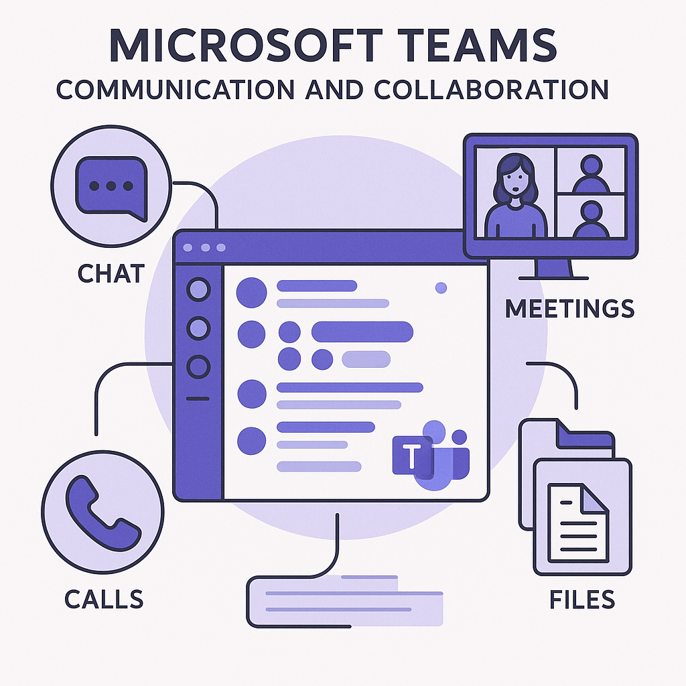
Microsoft 365 Communication Tool (Teams for Communication)
The use of Microsoft Teams facilitates the efficient communication between carers and the main office (Lawson et al., 2023).
Facilitates video-conferencing, email and document sharing in real-time.
Helps lessen communication delays and provides all the staff with the information immediately.
Enhances the total team coordination and reaction speed.
Restricted because of poor connectivity in the rural regions.
Challenges: Needs a stable internet and knowledge of the employees concerning the platform (Mater et al., 2018).
Notes:
Microsoft Teams is a powerful communication and collaboration tool that can greatly benefit Greenfield Home Care Agency. Teams allows carers in the field and those in the office to stay connected in real time, whether it’s through text chats, video calls, or file sharing. This is essential for reducing communication delays and ensuring everyone is on the same page regarding patient care. For example, a care coordinator can send immediate updates about a patient’s condition, ensuring that carers in the field receive the information without delay. While Teams can improve communication and coordination, its full benefits are only realized when staff are familiar with the platform. Some challenges may arise if the internet connection is unstable or if staff members have not been trained in Teams' functionalities (Mater et al., 2018).

Slide 10
Advantages
Offers safety features like privacy protection along with accessibility restrictions,
which can be important when handling private information.
Allows employees to discuss and edit work in Teams, resulting in teamwork.
Boosts relationships among employees in multiple locations through allowing interaction in real time through video, voice, and telephone calls.
Disadvantages
Some employees may find it hard to use Microsoft Teams and find it hard to get used to using it everyday
Can be challenging due to internet problems if employees are working from home or a different place which isn't inside the workplace
Can become a big problem if flies and documents are not put into the right place, which could cause you to stress out and lose important files and documents

Slide 11

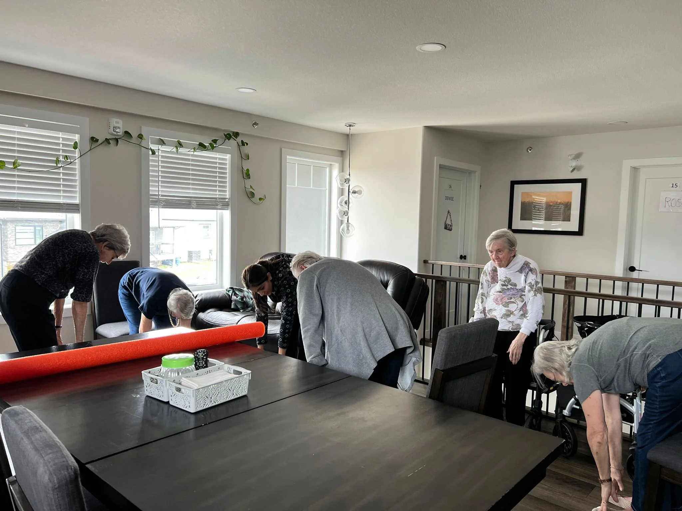
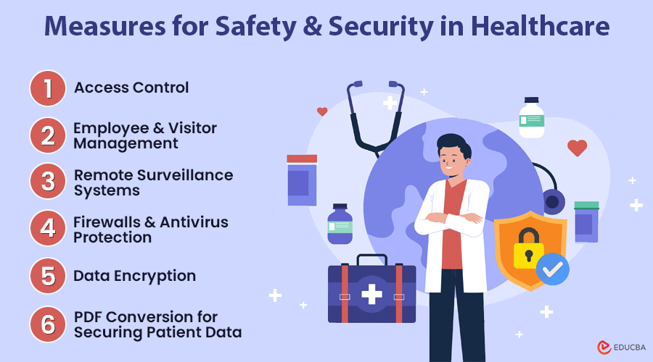
Digital Safety Action Plan (Secure Access)
Consider using multi-factor authentication (MFA) to obtain the access to digital tools (Rhew, 2022).
The use of strong password policies and frequent updates of passwords.
Encrypt patient data by using encrypted connections.
Access control measures that will limit access to sensitive data by authorized employees (Melamed, 2022).
There should be training of staff on best practices in security.
Frequent auditing to ascertain adherence to security measures
The guidance of sets out measures that the Secretary of State expects NHS England to take to protect confidential information when exercising the relevant data functions, as defined by section 253(3) of the 2012 Act.
Notes:
With the growing importance of digital tools in healthcare, ensuring the security of patient data is paramount. The first step in the digital safety plan is to secure access to the systems by implementing multi-factor authentication (MFA). MFA requires users to provide two or more forms of verification before gaining access to sensitive data, making it much harder for unauthorized individuals to access private information. Additionally, having regular password updates and strong password policies can mitigate the risk of data breaches. Encrypted connections should be used when accessing any patient-related data to protect it during transmission. This helps Greenfield ensure that only authorized personnel have access to confidential information (Rhew, 2022).

Slide 12
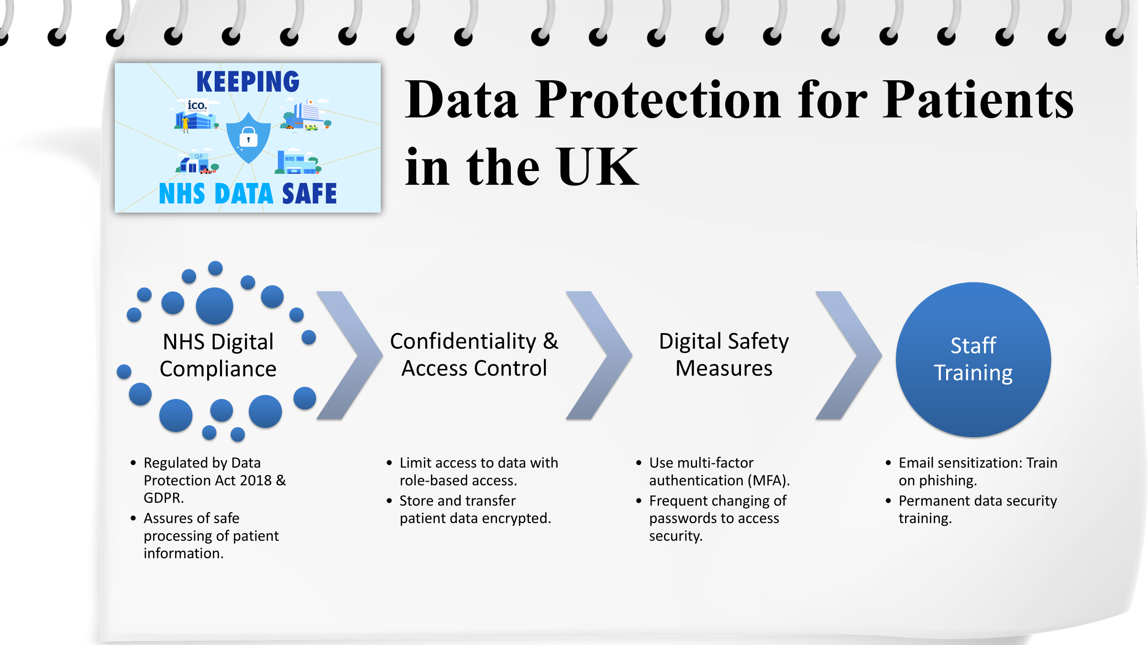

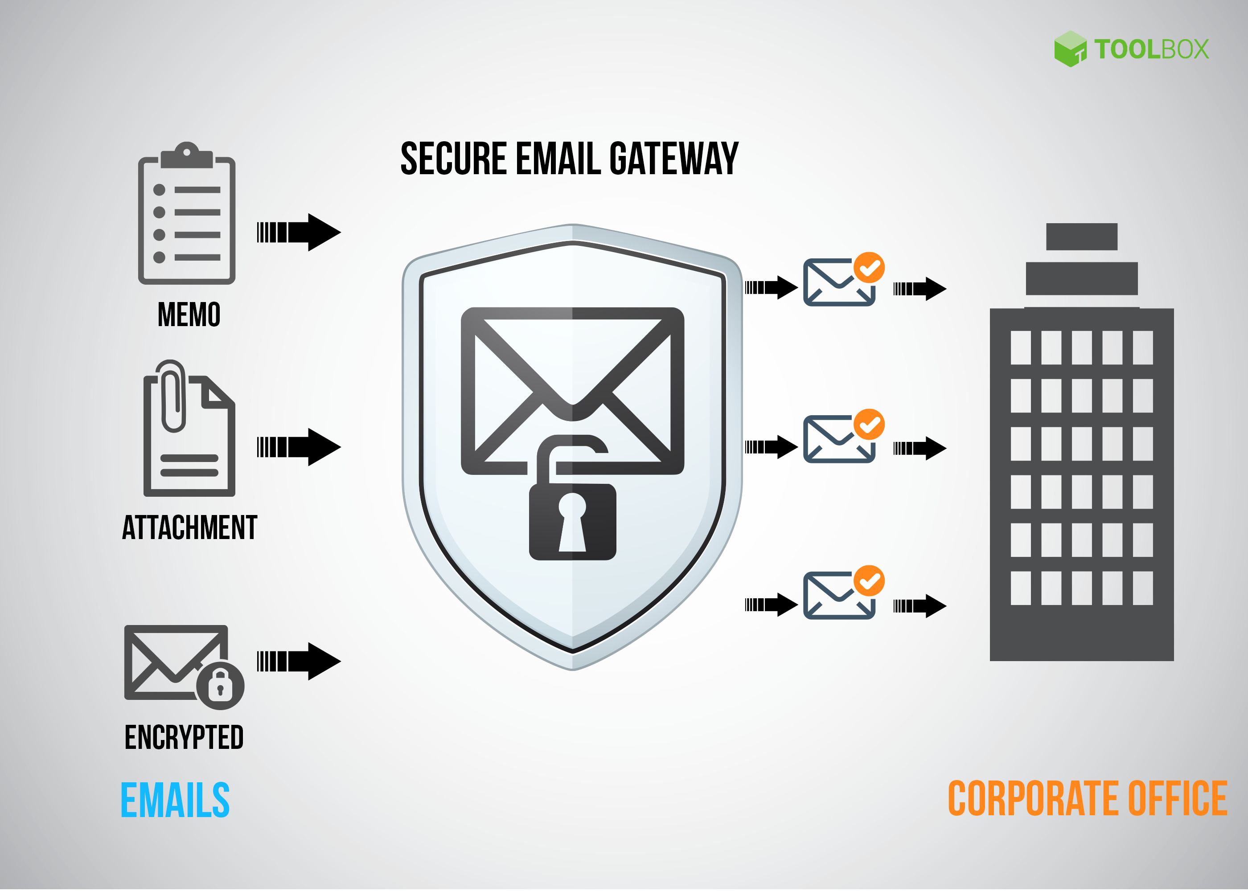
Digital Safety Action Plan (Email Awareness)
Educate the employees to recognize phishing websites and do not fall prey to suspicious links (Dhru, 2018).
Adopt email filtering programs to prevent spam email.
Communication about the patient should be carried out on secure email platforms.
Train employees about the need to be confidential during email communication.
Bring about encryption of sensitive patient data (Melamed, 2022).
Security attacks of email systems periodically monitored.
Notes:
Email remains one of the most common ways in which cybercriminals attempt to breach security systems. Therefore, the second step in the digital safety plan focuses on email awareness. Staff should be trained to recognize phishing attempts, suspicious links, and fake email addresses. Implementing email filtering tools can help block malicious emails before they reach the inbox. Additionally, secure email platforms should be used for communicating sensitive patient information, ensuring that the data remains protected. Staff should be educated on maintaining confidentiality while using email, and email encryption should be mandatory when sharing sensitive data (Melamed, 2022).

Slide 13
Digital Safety Action Plan (Data Management and Confidentiality)
Introduce data backup systems in order to avoid the loss of data (Rhew, 2022).
Encrypt any sensitive information of the patients to ensure confidentiality.
Develop stringent measures on the access and sharing of data (Nidhish Dhru, 2018).
Meet healthcare data protection regulations.
Frequent checkups of data storage system to ascertain safety.
Fraud Staff education of data privacy and patient confidentiality.
appointing members to relevant committees and sub-committees who have specialist data protection and data security expertise
obtaining independent advice from specialists and experts
NHS England should also have procedures in place for how it will obtain advice from the CAG under section 262A of the 2012 Act.
Notes:
The third component of our digital safety plan is data management. Healthcare organizations like Greenfield handle sensitive patient information that must be stored securely. Therefore, implementing robust data backup systems is crucial in preventing data loss due to technical failures. Data should be encrypted to protect it both in transit and at rest. There should also be strict policies regarding data access, ensuring that only authorized individuals can access patient records. Regular audits should be conducted to assess whether data management practices align with industry standards and regulations. Training staff on data privacy and patient confidentiality ensures everyone understands their role in maintaining security (Nidhish Dhru, 2018).

Slide 14

CONCLUSION
To end our presentation, we have come to a conclusion, after weighing out the benefits And limitations that, Greenfield home care agency should adopt Microsoft application to improve its efficiency.
It should also take on board the importance of data protection and security.
Thank you for listening.

Slide 15
References
Anand Laxman Mhatre (2024). Dynamics 365 Transforming Healthcare. INTERANTIONAL JOURNAL OF SCIENTIFIC RESEARCH IN ENGINEERING AND MANAGEMENT, 08(11), pp.1–6. doi:https://doi.org/10.55041/ijsrem38233.
Lawson, L., Di, R., Evans, J. and Saleem, W. (2023). Being a ‘Teams’ player: a quality improvement project expanding the role of Microsoft Teams to improve communication and efficiency of junior doctors in a ward-based hospital setting.. PubMed, [online] 10(Suppl 3), pp.89–90. doi:https://doi.org/10.7861/fhj.10-3-s89.
Mater, W., Aldwairi, M. and Ibrahim, R. (2018). Enhanced Teamwork Communication Model for Electronic Clinical Pathways in Healthcare. The Open Bioinformatics Journal, 11(1), pp.140–163. doi:https://doi.org/10.2174/1875036201811010140.
Melamed, R. (2022). Why the healthcare industry needs microsoft 365 – Linktech Australia. [online] Linktechaustralia.com.au. Available at: https://linktechaustralia.com.au/why-the-healthcare-industry-needs-microsoft-365/ [Accessed 11 Feb. 2026].
Nidhish Dhru and Springerlink (Online Service (2018). Office 365 for Healthcare Professionals : Improving Patient Care Through Collaboration, Compliance, and Productivity. Berkeley, Ca: Apress.
Rhew, D.C. (2022). Advancing medical and healthcare research through Microsoft technologies - Microsoft in Business Blogs. [online] Microsoft in Business Blogs. Available at: https://www.microsoft.com/en-us/industry/microsoft-in-business/security/2022/10/06/advancing-medical-and-healthcare-research-through-microsoft-technologies/ [Accessed 11 Feb. 2026].
Gov.uk, Department of Health & Social Care,(2023)https://www.gov.uk/government/publications/nhs-englands-protection-of-patient-data/nhs-englands-protection-of-patient-data#a-safe-haven-for-data

Slide 16

References
What is Microsoft Teams? How it works, tips and tricks, and more | TechRadar
16 Advantages and Disadvantages of Microsoft Teams
Microsoft Teams pros and cons - Powell Software

Slide 17
References
Jalil, A. ., Rosa, F. ., Affandi, R. ., Aziz, A. ., Saputra, W. N. H. . and Ridho, A. A. . (2024) “Literature Review: Exploration of Features Microsoft Word”, International Applied Science, 3(1), pp. 28–32. doi: 10.32528/ias.v3i1.474.
NHS (2026) Using Microsoft in Healthcare. (https://www.this.nhs.uk/insights/article/mircrosoft-office-365-benefits)
Parker RH, Lander ML. Word processing in healthcare:guidelines and a case study. Comput Healthc. 1983 Jul;4(7):19,21, 26-7. PMID; 10260742.

