Slide 1
Protecting Children & Young People from sexual exploitation

Slide 2
Please note that this lecture may contain information that you find upsetting – please feel free to leave the lecture room at any time. You are welcome to speak with me today during the break or after the lecture.

Slide 3
Definition
Defining child sexual exploitation is difficult, as the boundaries between sexual abuse and exploitation are often hard to determine. Each of the four UK nations has its own definition of CSE. The following points show the factors that are common to all definitions:
It is a form of sexual abuse
It involves under-18s
It is an exploitative situation in which a young person is manipulated, coerced or deceived into sexual activity in order to receive something they want or need, or it is to the advantage of the perpetrator
There is an imbalance of power
The abuse does not always have to be physical and can be perpetrated through the use of technology.
Shephard & Lewis (2017, p5)

Slide 4
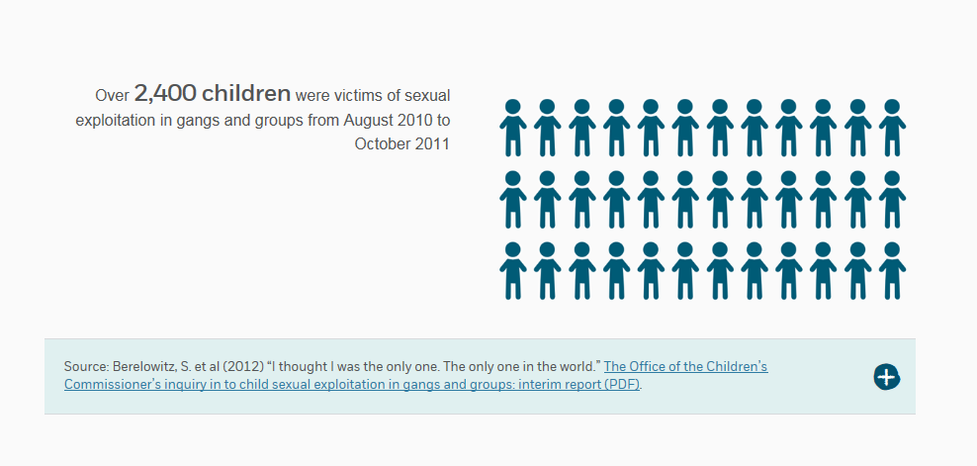
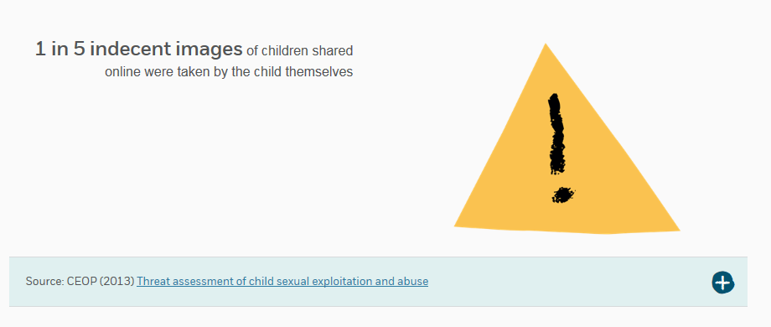
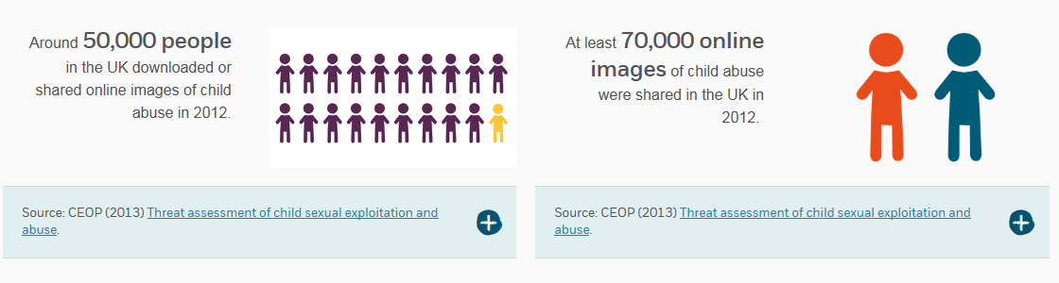
Facts and Statistics
NSPCC (2017)

Slide 5
Signs and Behaviour
In pairs, discuss what the signs and behaviour could be of young person who is already being sexually exploited.
Notes:
missing from home or care
physical injuries
drug or alcohol misuse
involvement in offending
repeat sexually-transmitted infections, pregnancy and terminations
absent from school
change in physical appearance
evidence of sexual bullying and/or vulnerability through the internet and/or social
networking sites
estranged from their family
receipt of gifts from unknown sources
recruiting others into exploitative situations
poor mental health
self-harm
thoughts of or attempts at suicide
poor personal health and/or appearance

Slide 6
Risk Factors
Which factors increase children & young people’s risk of exploitation?
Experiences of childhood abuse
Poverty
Family conflict
Poor parental role models
Unsettled care history
History of running away
Homelessness
Learning and mental health difficulties
Drug and alcohol misuse
Financial problems caused by addictions
In addition, those without the named risk factors are at risk of exploitation through the internet, social media and gaming.
Shephard & Lewis (2017, p5)

Slide 7
Why are some more at risk?
Wealth of research that links attachment, child development, neuroscience, and economic factors.

Slide 8
Attachment
The importance of attachment cannot be underestimated. It is believed that babies are born with the ability and drive to form attachments as an evolutionary necessity. The nature of the interaction with a baby and how well the caregiver is ‘tuned in’ to the child may affect how that child’s brain develops. It is thought that if the child’s attachments are secure, they will grow and form a secure base, with the brain developing the right connections to emotionally self-regulate, develop empathy and relate to others then and in later life. However, if an insecure attachment occurs, the developing brain may overcompensate with the release of the stress hormone cortisol. A chronically traumatised child could then struggle to make rational choices, lack skills in assertiveness and may have developed rigid patterns of thinking, which can render them more vulnerable to feelings of worthlessness, low self-esteem and indifference.
Shephard & Lewis (2017, p6)

Slide 9
Child & Adolescent Development
It is important that practitioners clearly understand the developmental adolescent stage, and how best to engage with this age group. By definition, a teenager is someone between childhood and adulthood – a child developing a sense of who they are and who they are not, complicated by the onset of puberty and increased physiological and psychological change. As the body matures, so too does the cognitive structure of the developing adolescent brain. It accumulates knowledge and begins to make sense of past experiences, including the current and psychosocial environment that surrounds them.
Shephard & Lewis (2017, p6)

Slide 10
Neuroscience
The emerging findings from neuroscience are identifying that childhood abuse and neglect renders children vulnerable to repeated patterns of trauma and abuse when neuropathways have not been fully or healthily developed – due in some cases to ineffective parenting, fractured attachments and/or trauma. When a child experiences severe trauma, sections of the brain appear to overdevelop, which can result in the child acting more impulsively as they overreact to safety and stress responses.
Shephard & Lewis (2017, p6)

Slide 11
Economic Factors
Poverty and neglect are linked to levels of aspiration and achievement.
Government policies and strategies have focused on the impact of – and possible routes out of – poverty. A key aim in all these strategies is to raise the aspirations of children through positive activities and engagement in education, training and employment.
Shephard & Lewis (2017, p6)

Slide 12
It is believed that the need to be involved in physical activity, and in social exploration and experimentation, is a natural part of the developmental phase of adolescence. This is a time when children are likely to be curious and consider wider issues that may concern or trouble them. Their worries and concerns can be at a macro and micro level, as they are often beginning to further explore their world, where they belong, and their identity. They may seek more freedom to develop their circle of peers and to explore intimate relationships and their sexual identity. For some, this can lead to increased risk-taking behaviours.
Shephard & Lewis (2017, p7)

Slide 13
Children may transit through their adolescence based on their early experiences of attachment, trauma, and physical and brain development. Those children who have experienced a loving and connected sense of belonging, with a family/significant other that helps to nurture their sense of responsibility to self and others, tend to have better than average academic attainment and leadership skills, take fewer risks with their health and safety, and develop resilience and coping strategies to deal with life stressors. Therefore, those children who do not experience this are likely to be more vulnerable.
Shephard & Lewis (2017, p7)

Slide 14
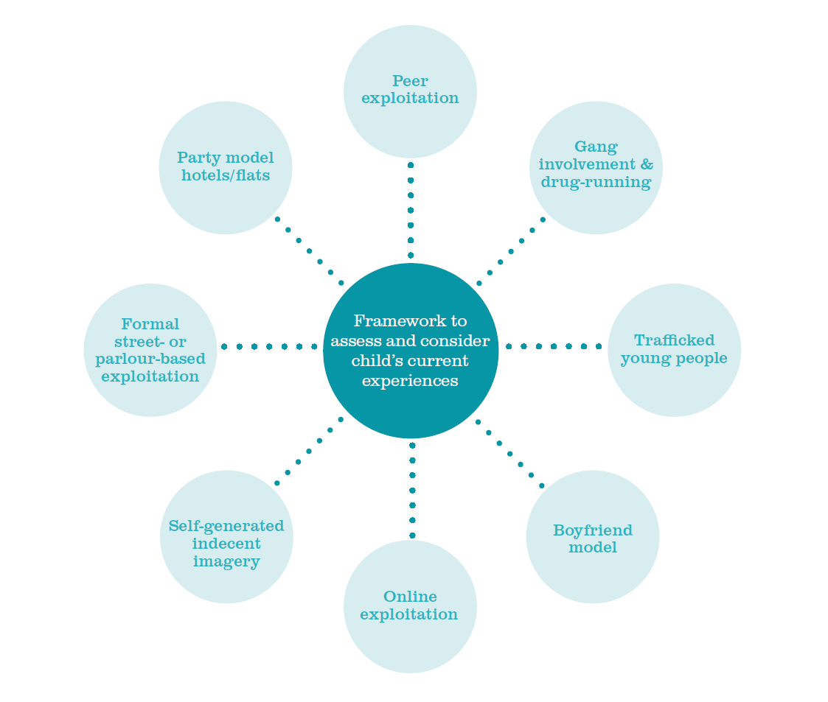
Models of Exploitation
Shephard & Lewis (2017, p10)

Slide 15
Peer Exploitation
Exploitation that takes place within age-appropriate associations.
Example of exploitation – being given alcohol or drugs in exchange for sex.
Can occur concurrently with peer domestic abuse.
Can be linked to gang involvement.
There will inevitably be a form of power, control, manipulation or coercion.
Shephard & Lewis (2017, p11)

Slide 16
Boyfriend/girlfriend
Watch The Story of Jay – NSPCC
https://www.nspcc.org.uk/preventing-abuse/child-abuse-and-neglect/child-sexual-exploitation/
Make notes about the exploitation that takes place.
How does this experience impact on the victim?
Feedback your thoughts.

Slide 17
Gang Involvement
Emma’s Story
Rochdale grooming case: Victim’s story
http://www.bbc.co.uk/news/uk-england-manchester-17914138
Internal gang sexual exploitation
External retribution
Serious organised crime

Slide 18
Process of Exploitation
Barnardo’s identifies four stages within the grooming and exploitation process.
Targeting stage
Friendship-forming stage
Loving relationship stage, and finally
The abusive relationship stage
Shephard & Lewis (2017, p14)

Slide 19
Model of Work
The model comprises four main processes:
Assertive outreach
Advocacy
Attention
Access

Slide 20
Assertive outreach
Identify and engage vulnerable children at risk of sexual exploitation.
Using assertive techniques – delivering outreach sessions within the community in areas frequented by young people.
Building a relationship and getting to know the young person.
Offering opportunities for individual or group work activities.
This model takes into account an individual’s relationship and attachment patterns from childhood to the present by creating a respectful, reassuring and trusting relationship based on empathy and clearly-set goals and boundaries.
Shephard & Lewis (2017, p19-20)

Slide 21
Advocacy
Effective support for children has to involve a range of agencies. Many of the young people receiving a service from Barnardo’s have been failed by previous services and a key role of staff is to ensure that they can advocate for the provision they need.
Shephard & Lewis (2017, p22)

Slide 22
Attention
Many sexually exploited children have few, if any, concerned, attentive adults in their lives. Our services aim to provide a different kind of attention – attention that will ‘hook’ a young person out of unsafe relationships into safe and positive ones. Consistent and persistent attention from a specific worker enables the development of a protective, supportive relationship within which children feel safe enough to examine their lives and start to make changes.
Shephard & Lewis (2017, p24)

Slide 23
Access
Our services need to be accessible to children with chaotic lives, who may have had poor or challenging experiences with other professionals. That is why we make our services flexible and responsive to their needs, and why we offer children and families ways to access us on their own terms, sometimes providing text and online routes to reach us. It also means that we need to be available whenever children need us.
Shephard & Lewis (2017, p27)

Slide 24
References
NSPCC, (2017). Child sexual exploitation Facts and statistics. [online] Available at: https://www.nspcc.org.uk/preventing-abuse/child-abuse-and-neglect/child-sexual-exploitation/child-sexual-exploitation-facts-and-statistics/ [Accesses 20 Feb 2017].
Shephard, W. & Lewis, B. (2017) Working with children who are victims or at risk of sexual exploitation: Barnardo’s model of practice [pdf]. Barnardo’s. Available at http://www.barnardos.org.uk/cse_barnardo_s_model_of_practice.pdf [Accessed 20 Feb. 2017]

