Slide 1

Are UWTSD students confident in using digital skills online?
  Lecturer Neale Haddon
  Yasmeen 2233492
  Amy 2221378
  Module code LCHS4002
Digital skills & Research Methods

Slide 2

Introduction
This PowerPoint presentation is based on a Quantitative research project proposal.
We will be conducting a survey with ethical consideration by gathering information from students by finding out about their abilities and their confidence on using digital skills online.
Amy

Slide 3
Introduction continued...
This PowerPoint presentation we will be providing a plan on how to conduct this survey.
We will be interacting with UWTSD students and explaining to them the reason why we are conducting this poll and that their answers will be strictly confidential.
Once we have collected enough information from our survey, we will be using this to further our own research and our own abilities.
Amy

Slide 4


Are UWTSD students confident in using their digital skills online?
Rationale
There is a great deal of research that explores the set of skills or competencies that are important and how they should be operationalized for research and practice (Ba et al., 2002; Eshet-Alkalai and Amichai-Hamburger, 2004; Gilster, 1997; Van Deursen, 2010).
Yasmeen

Slide 5
Rationale continued...
The reason we are conducting this research, is to find out if students are confident in using Microsoft Apps online. It enables us to use our own research skills to demonstrate our own abilities in using digital skills.
The purpose of this research is to gather enough evidence to back up our claims that the older generation and the students in their second year are more confident than the students who are not.
Yasmeen

Slide 6
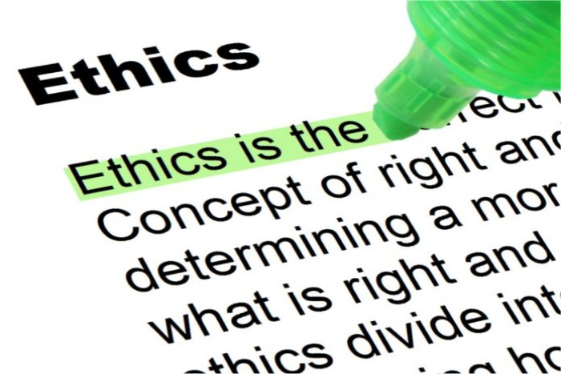
Ethical Consideration
The audience we have chosen for our quantitative research are our own students at UWSTD so we can confirm that the answers to our survey questions are from a reliable source.
Amy

Slide 7
Ethical Consideration
Another ethical consideration we need to consider is confidentiality. Online surveys must be kept confidential and within the parameters of The Data Protection Act. Reassuring students that are participating in a survey, that their responses are strictly confidential can improve the survey response rates.
The Data Protection Act controls how Students information and responses are used.
We will be making sure that the information we are collecting will be fairly used, accurate, stored safely and secure and not kept for longer than needed.
Amy

Slide 8
Research Timeline
In week 3 we will Identify a research question
In week 3 we will also conduct a review of existing literature.
In week 4 we will Plan research methods and consider ethics.
As a group in week 6 we will Presents a proposal for approval
As a group in week 7 we will ask the students and collect data
Week 8 we will indivdually analyse our results.
Week 9 & 10 we will Write up full report with debate and conclusion.
Amy & Yasmeen

Slide 9

The Proposed Method
The proposed method is to find students who will participate in a Survey to discuss their level on confidence when using digital skills online such as MS Word and OneDrive "An important factor to consider when you need the results from your quantitative study, is to ensure that your study generates evidence of a sufficient quality, which may mean obtaining a high level of evidence"(Grey, Laura, Payne Katherine 2014 Chapter 6 pg 83-36)
Yasmeen

Slide 10
The Proposed Method Continued...
To obtain this high level of evidence, We are going to find students of different ages and students working at different levels to try and maintain an even and accurate result.
Here a few questions the survey will include,
Are you confident in using digital skills online?
Do you feel confident using OneDrive?
Do you see the value of using technology online to collaborate?
Yasmeen

Slide 11

Hypothesis
We believe that UWTSD students are confident in using their digital skills online due to the ever-growing technology and using apps such as WhatsApp and social media, however we feel that students may struggle with the ability to use MS Apps such as PowerPoint and Excel.
We also believe that the more studying and research a student does, the more their digital skills will improve.
Overall, we think our students are going to do well providing they do the research that’s needed. However, given the different ages gaps amongst UWTSD students, we believe the younger generation and the students in their second year will be more confident in using digital skills online.
Amy

Slide 12
Reference List
Walker (Ed.). (2014). An Introduction to health services research . SAGE Publications Ltd
Park C (2010) In others peoples words: Plagiarism bu university students-literature and lessons. Pages 471-488
Helsper, E.J. and Eynon, R. (2013) ‘Distinct skill pathways to digital engagement’, European journal of communication., 28(6), pp. 696–713.

Slide 13

Reference List
MedicalPerham (2018). Advance care planning - what’s important to you? [online] Perham Health. Available at: https://www.perhamhealth.org/advance-care-planning/ [Accessed 19 Feb. 2023].
https://training-conditioning.com/article/upholding-professional-values/

