Slide 1

Global Educational Differences: Sweden Vs Wales
Differences in the Secondary School Curriculums

Slide 2
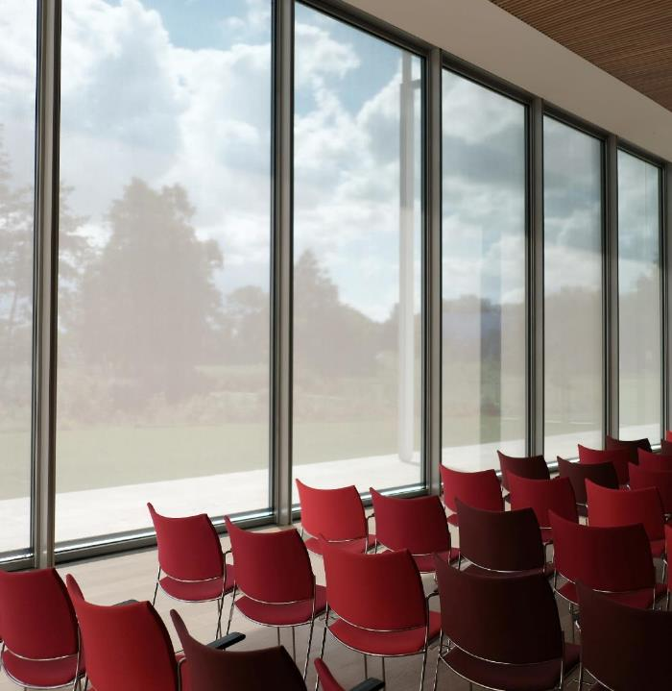
Where to begin?
Education looks vastly different around the globe.
No two countries are the same, but all strive to attain a global standard, and climb up the PISA rankings.
Despite all striving for academic excellence, the style of education seen often varies based on the cultural values of a country.
Sweden is renown for having a progressive education system.
Ranks 11th in the most recent PISA tests, compared to the UK in 14th. (Pisa, 2018)
Widely held as being one of the best places to raise a child. (OECD, 2009)

Slide 3



Swedish Education: how is it structured?
Tax funded from pre-school.
Mandatory 10 years of education, from the year a child will turn six.
Optional continuation, for an additional qualification.
18 National programs:
6 ‘Preparatory’:
  Social Sciences
  Finance
12 ‘Vocational’:
  Electricity and Energy
  Building and Construction
Five ‘Introductory’: 18% of Year Nine students.
(Skolverklet, 2018)
Preschool: Age 1-5
Compulsory Schooling:
  Lågstadiet – Years 1-3
  Mellanstadiet – Years 4-6
  Högstadiet – Years 7-9
  ‘Sameskolor’ – Schools for the Indigenous Sámi People
Additional Needs Schooling.
Upper Secondary Schooling – Years 10-12
90% of students received their diploma.
(Swedish Government, 2019)
3

Slide 4

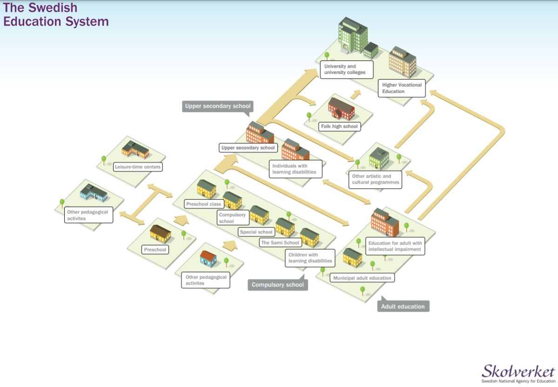
The Education Map: Sweden.

Slide 5
The Education Map: Wales.
PRIMARY
Nursery
Foundation Phase
Up to Year 6
SECONDARY
English/Welsh Comprehensives
Years 7-9
GCSEs
POST-16
A-Levels
BTECs
NVQs
Other Equivalents
TERTIARY
Undergraduate
Apprenticeships
Work

Slide 6

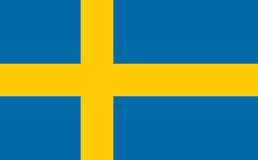
Sweden Vs Wales: The Statistics.
3.9% of Secondary Students in private schools (Stats Wales, 2020)
In 2017, 75% A*-C at A-level. (Stats Wales, 2017)
59% of population educated past Compulsory Schooling (Stats Wales, 2019)
Population of 3.15M
Education spending equates to £4150 per Student (Stats Wales, 2014)
27% of Upper Secondary students in private schools.
90% of Students gain their diploma.
61% of population educated past Compulsory Schooling (Statista, 2019)
Population of 10.1M
Education spending equates to £9352 per Student (OECD, 2014)
6

Slide 7

How does Sweden do it?
It is clear that Sweden is more educationally successful, now we need to see why.

Slide 8




Sweden’s success, how do they approach education?
The ethos of Swedish education lends itself to their goals of creating life-long learners and encouraging an inclusive environment.
It offers schools and teachers great flexibility:
“equivalent education does not mean that teaching should be the same everywhere, or that the resources of the school are to be allocated equally” (Skolverklet, 2013)
Swedish education aims to impart values onto the student and the ability to seek knowledge themselves
They want to deliver a variety of perspectives that will contribute to students having a well-rounded view of the world.
The government curriculum documents set out that any discrimination or intolerance should be met with conversation and education.
As opposed to sitting formal, external testing, grades are assessed and assigned by the class teacher.
This allows teachers to take into account how the student has developed outside of an exam situation, which may not be representative of their true knowledge.
Creates an environment that offers a more comprehensive evaluation of a student, as opposed to the UK being more aimed at recall.
8

Slide 9
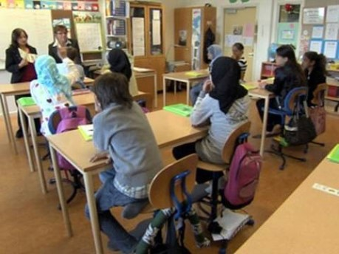
An Inclusive society:
Sweden intends to bring everyone into the mainstream system. (Cities of Migration, 2011)

Slide 10
To round off:
As we can see the Swedish and Welsh education systems are not dramatically different.
There are some key areas however, that may explain the difference in performance between the two countries.
Sweden does not have the perfect system.
Still work to be done.
Is it worth considering their methods of schooling as an alternative to our current system?

Slide 11

THANK YOU,
ANY QUESTIONS?

Slide 12
Reference List:
Cities Of Migration, 2011. Taking the Swedish National Diversity Plan to School. [Online]
Available at: https://citiesofmigration.ca/good_idea/taking-the-swedish-national-diversity-plan-to-school-2/
[Accessed 22 11 2020].
OECD, 2009. Doing Better for Children. s.l.:s.n.
PISA, 2018. PISA 2018 Results, s.l.: s.n.
Skolverklet, 2013. Curriculum for the Upper Secondary School, Stockholm: Fritzes.
Skolverklet, 2018. High School - Student Statistics, s.l.: s.n.
Statista, 2019. Share of the Population in Sweden in 2019, by Level of Education. [Online]
Available at: https://www.statista.com/statistics/532459/sweden-population-2015-by-level-of-education/
[Accessed 21 11 2020].
Stats Wales, 2014. Delegated School Budgets per pupil, by authority. [Online]
Available at: https://statswales.gov.wales/Catalogue/Local-Government/Finance/Revenue/Delegated-School-Budgets/delegatedschoolbudgetsperpupil-by-authority
[Accessed 21 11 2020].
Stats Wales, 2017. A-Level entries and results by subject group. [Online]
Available at: https://statswales.gov.wales/Catalogue/Education-and-Skills/Schools-and-Teachers/Examinations-and-Assessments/Advanced-Level-and-Equivalent/alevelentriesandresultspupilsaged17only-by-subjectgroup
[Accessed 21 11 2020].
Stats Wales, 2019. Full-time equivalent pupils by local authority, region and age group. [Online]
Available at: https://statswales.gov.wales/Catalogue/Education-and-Skills/Schools-and-Teachers/Schools-Census/Independent-Schools/Pupils/fte-by-localauthorityregion-agegroup
[Accessed 21 11 2020].
Stats Wales, 2019. Highest qualification levels of working age adults by region of Wales and qualification. [Online]
Available at: https://statswales.gov.wales/Catalogue/Education-and-Skills/Post-16-Education-and-Training/Lifelong-Learning/Qualification-Levels/highestqualificationlevelsofworkingageadults-by-regionsofwales-qualification
[Accessed 21 11 2020].
Swedish Government, 2019. Education in Sweden. [Online]
Available at: https://sweden.se/society/education-in-sweden/
[Accessed 21 11 2020].
Teams Recording Link: https://web.microsoftstream.com/video/586e10cf-73c7-4b60-b4e0-aff54d2234c3

