Slide 1
Methodology 1
MA Criminal Justice & Policing

Slide 2
Learning Outcomes
Explain what is meant by ‘Research Philosophy’
Understand the different terms of ‘Methodology’ & ‘Research methods’
Describe the difference between ‘Quantitative & Qualitative data’, ‘Primary & Secondary data’
List the different types of methods for data collection
List the 4 main methods of data analysis
How to structure your ‘methodology chapter’

Slide 3
Methodology and Methods
Methodology – overarching strategy and rationale of your research project – a study of the methods, theories and principles
Methods – specific tools and procedures data use to collect and analyse
Notes:
In summary
METHODOLOGY is the overarching strategy and rationale for your research project or dissertation – in other words a study of the methods, theories and principles of your research
METHOD/s - is/are the specific tools and/or procedures that you will use to collect your data and analyse it e.g. survey's, focus groups, interviews etc
Methodology is:
a set of systems, methods, procedures or rules that is used to conduct a structured research process for a dissertation’ or ( Dissertation-help.co.uk. 2022)
‘a system of ways of doing, teaching or studying something’ ( Cambridge English Dictionary online, 2022)
It explains what the exact activities and processes of your research is , through what methods you will be measuring the data and how you will interpret your results and outcome. ( dissertation.help.co.uk, 2022)
Research methods are:
‘ specific procedures for collecting and analysing data.
Integral part of research design ( Scribbr, 2022)

Slide 4
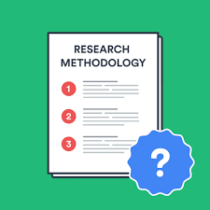
Planning your research methods
Step 1 - Deciding on how you will collect data
Methods will depend on the data required to answer your research question:
Qualitative v quantitative data
Primary v secondary data
Descriptive v experimental
Notes:
Research methods are specific procedures for collecting and analysing data. Developing your research methods is an integral part of your research design. When considering your methods around how you will plan your research , two key steps to consider:
Step 1 – Deciding on how you will collect data
Step 2 - – how will you analyse the data
So firstly - Step 1 - Deciding on how you will collect data
Methods will depend on the data required to answer your research question:
Qualitative v quantitative data – will your data take the form of words or numbers?
Primary v secondary data – will you collect original data yourself or data that has already been collected by someone else?
Descriptive v experimental – will you take measurements of something as it is or will you undertake an experiment
(scribbr, 2022)

Slide 5

Qualitative v Quantitative data
Qualitative data – deals with words
Quantitative – deals with numbers
Notes:
Your choice of qualitative or quantitative data collection depends on the type of knowledge you want to develop
What do we mean by ‘QUALITATIVE’ and ‘QUANTITATIVE’
In its simplest form:
Questions about ideas, experiences and meanings or to study something that can’t be described numerically, collect – QUALITATIVE data
If you want to develop a more systematic/automatic understanding of a subject, or your research involves hypothesis testing, collect – QUANTITATIVE data
So what are the pros and cons of each data method – take 5 mins to discuss with your colleague

Slide 6
Qualitative v Quantitative
 | Pros | Cons
Qualitative | Flexible – you can often adjust your methods as you go to develop new knowledge Can be conducted with small number of participants | Can’t be analysed statistically or generalised to broader populations Difficult to standardise research
Quantitative | Can be used to systematically describe large collections of things Generates reproducible knowledge | May require statistical training to analyse data Requires larger number of participants/sample
Notes:
Here are some others ( source Scribbr, 2022 online)
Advantages: Qualitative
Its affordable method of research
Its predictive in nature – even though experiences/perspectives of participants can vary substantially
Focuses on details of personal choice not the reasons why someone makes such choices
Uses fluid structures – it allows for inclusion of human experiences
Uses individual choices as workable data
It can be open-ended ; doesn’t rely on specific formats or questions to create successful outcomes. Allows open ended questions to gather more data
It aims to remove bias from its collected data
Requires a smaller sample size
Disadvantages
Creates subjective information points - the data can sometimes be questionable. It requires the reseaercher to connect all points to answer their research question
May involve significant amount of repetition – small sample may not always offer a complete representation of the group being studied
Can be difficult to replicate because it never involves every member of a demographic
Relies on knowledge of the researcher
Doesn’t offer statistics
Requires a significant time investment – to collect and review data
(source: ConnectUS, online www.connectusfund.org)

Slide 7
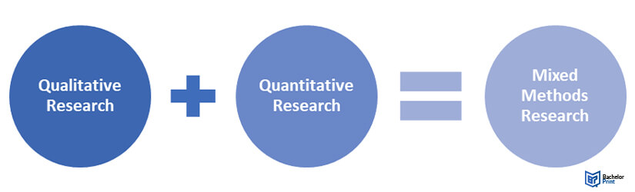
Mixed Methods
Uses both Qualitative & Quantitative methodologies
Used when answer cannot be provided by use of one methodology alone
Notes:
It is the methodology favoured when the answer to the research problem or question cannot be concluded if and when only one data collection and analysis method is adopted.
Whiffin (2021) states that ‘mixed methodologies have therefore more freedom and more techniques available’ (p.42).
However, academic sources highlight that this is not an easy option for the researcher due to the obvious ‘underpinning philosophies and theories guiding the alternative methodologies’ (Whiffin, 2021, p.42).
However, it is argued that despite the overwhelming differences, researchers will often ignore them in favour of focusing on what they consider is best for their research and ultimately what is achievable (Whiffin, 2021.p.42). In addition, it is argued that the researcher should also be aware of the relationship and complexities of integrating the two types of data into coherent and meaningful conclusions (George, 2022).

Slide 8
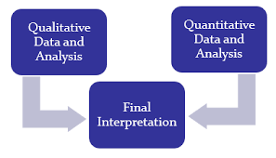
Mixed Methods Research
Mixed methods research is where you use both qualitative and quantitative data collection and analysis methods to answer your research question
Notes:
What about mixed methods approach to your research – what do you think that is ?

Slide 9
Planning your research methods
Step 2 – how will you analyse the data
Quantitative data – you can use statistical analysis methods to test relationships between variable
Qualitative data – you can use methods such as thematic analysis to interpret patterns and meanings in the data
Notes:
Secondly - Step 2 – how will you analyse the data
So having undertaken your interviews/questionnaires/literature reviews etc – you will have gathered a lot of information and data
What are you now going to do with it
If the data is -
Quantitative data – you can use statistical analysis methods to test relationships between variable
Qualitative data – you can use methods such as thematic analysis to interpret patterns and meanings in the data
(scribbr, 2022)
We will cover analysis in future lessons – but for now start thinking about it from even the basics of how you will organise it etc

Slide 10
Primary v Secondary Data
 | Pros | Cons
Primary | Can be collected to answer your specific question You have control over the sample methods Up to date data | May be expensive/time consuming to collect Need to know data collection methods
Secondary | Easier and quicker to access Can collect data over a longer timescale and bigger geographical area | No control over how data was generated Requires extra processing to make sure it works for your analysis Could be too old
Notes:
Content taken from Scribbr , 2022

Slide 11
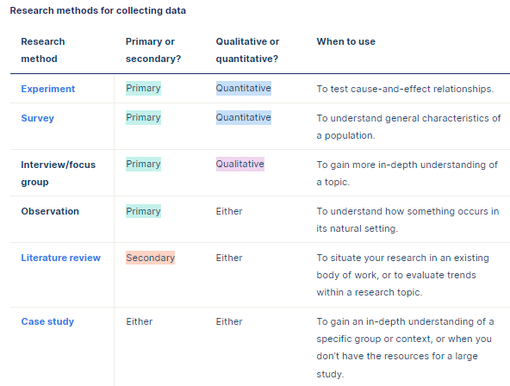
Research methods for collecting data
Notes:
Suggested answers

Slide 12
Writing your Methodology Chapter
All dissertation projects need to be clear on data collection
Include this chapter if undertaking – Primary/secondary
It is the ….who, when, where, why…. of your research

Slide 13
What needs to be included
1.Introduction to the chapter
2. Research strategy
3. Data collection
4. Data Analysis
6. Limitations
5. Ethics
Notes:
When it comes to writing this chapter what do you think you need to cover – think of some subheadings
Lets look at what needs to be included in this chapter and how to structure it
6 areas to cover:
Introduction
Your research strategy
Data collection
Data analysis
Any limitations or problems that you encountered throughout your research

Slide 14

Introduction
Brief introduction to your subject area
Remind reader of your objectives
Explain why you are undertaking this research
  Reflection on literature review
  Gaps within the research
  New legislation
Notes:
Given the word count this subheading will not be very long
What do you think needs to be in your introduction?

Slide 15

Research Strategy
What research methods have you used ( survey, questionnaire, case study etc)
Why did you choose that strategy/model?
How did you choose your sample ( size/participants)?
NB – don’t spend too much time writing about research methods in general
Notes:
Considering the next sub heading of the chapter – what would you consider writing here?

Slide 16
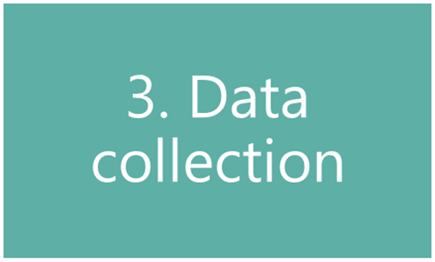
Data Collection
How will you analyse your findings?
  Quantitative = numbers
  Qualitative = focus on words
  Themes
NB – don’t talk about your findings yet!
Notes:
Next sub-heading – data collection – what do you think you need to write about here?

Slide 17
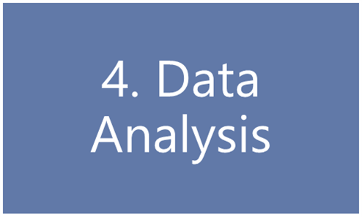
Data Analysis
How you prepared the data before analysis
Quantitative data:
  Any software used
  any statistical methods used
Qualitative data:
  Any coding or categorising of themes/ideas
Notes:
4th sub-heading – data analysis
What will you write here?

Slide 18
Ethics
Include a discussion of how you will deal/dealt with issues of a confidential or ethical nature
5.Ethics

Slide 19
Limitations
Do you foresee any limitations or problems with undertaking your research?
Any limitations to your research strategy
  Access to participants
  Limited data collection
6. Limitations
Notes:
Final sub-heading
QUESTION - What will you write here?
Give some examples
Remember that you are writing about limitations/problems in relation to your data gathering only – not general problems like time management
Questions to ask ( Biggam, 2015. p194)
What are the known criticisms of my chosen research strategy?
Is the approach to my data collection limited in any way? ( e.g. why use Questionnaires when interviews may give more meaningful info)
Is my sample population big enough – too big?
Is it valid? ( have I argued successfully that my methods are appropriate to achieving my objectives)
Is it free from bias and is it fair?
Examples:
Formulation of your research aims and objectives
Implementation of data collection method
Language barriers
Culture bias
Timing of study
Financial resources
Limited access to data
Sample size
Lack of previous research on subject
NB - You must show how you have addressed any limitations that you highlight. Avoid just producing a list – not acceptable
Also – is time management a limitation?
Time limits is a common limitation expressed by students – especially when deadlines are fast approaching – these are more to do with a lack of time management and planning on the students behalf NOT on the research itself
Leave time for your empirical work and plan for any mishaps like people not available

Slide 20
Tips for writing a strong methodology
Don’t just describe – explain how and why you applied them and demonstrate how it was conducted
Focus on your objectives and research question- show why your methods suit your objectives. Keep relating your choices back to the purpose of your research
Cite relevant sources
Write for your audience – consider how much info you need to give. Clear – structured – argues your approach.
Don’t just list details and procedures
Discuss any difficulties you encountered and how you dealt with them – include how you minimised impact as a result or changed methods.
Notes:
And finally some tips for writing a strong methodology chapter:
Don’t just describe – explain how and why you applied them and demonstrate how it was conducted
Focus on your objectives and research question- show why your methods suit your objectives. Keep relating your choices back to the purpose of your research
Cite relevant sources
Write for your audience – consider how much info you need to give. Clear – structured – argues your approach.
Don’t just list details and procedures
Discuss any difficulties you encountered and how you dealt with them – include how you minimised impact as a result or changed methods.
There has to be an element of CRITICAL EVALUATION in this chapter to get the best marks

Slide 21
Additional Sources
Burnett, J. (2009) Doing Your Social Science Dissertation. London: SAGE Publications.
Denscombe, M. (2012) Research proposals a practical guide. Berkshire, McGraw Hill Open University Press.
Walliman, N. (2006) Social research methods. London: SAGE.
https://www.sagepub.com/sites/default/files/upm-binaries/18533_Chapter3.pdf
Notes:
Some useful sources for you – others will be added to Moodle over the next few weeks

Slide 22

Questions/concerns?

