Slide 1
The Power of
Sugar Cane
Materialities in Anthropology
Letícia M da S Pontes
10/22/2023

Slide 2
Introduction
The power of Sugar Cane during the period of Modern history explained by the Marxist theory.

Slide 3
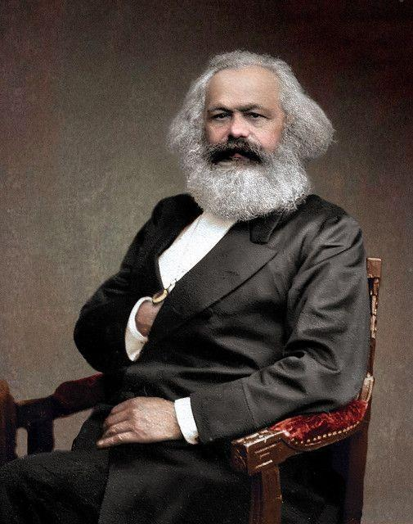
Marxist Theory
Political economy
Power dynamics between the bourgeoisie and the workers.
False Consciousness
Anti - Religion
Argues that the only change comes through Revolution.

Slide 4
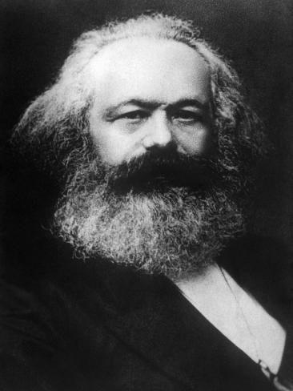
Modes of Production
1. Hunting Stage
2. Domestic Stage
3. Feudalism
4. Capitalism

Slide 5
“[…] (For Marx) opened the door to a solidification, as it were, of materiality itself as irreducibly real regardless of any human effort to conceptualize it as autonomous; and as determinative, in the last instance, of everything else.” - The Handbook o Material Culture, p 14.

Slide 6
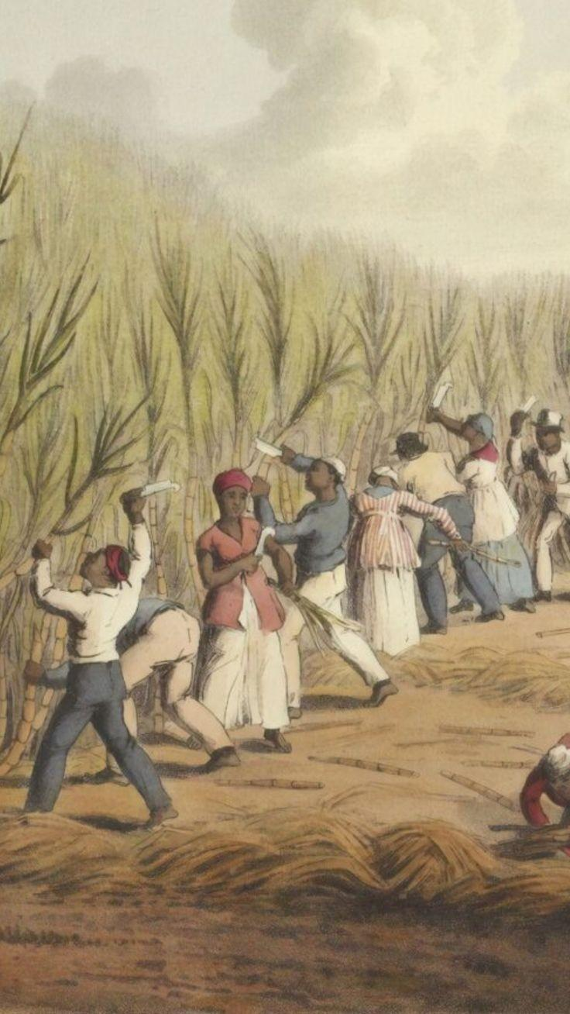
Sugar Cane Plantations in the Americas
Sugar cane had its origin in the regions of Southeast Asia.
Could produce: sucrose (sugar), Rum, syrups, Molasses, Cachaça (alcoholic drink) and ect.
Biggest plantations in Colonial Brazil during the 16th Century.
Also big plantations in the Antilles.

Slide 7
Sugar Cane Plantations in the Americas
The biggest the Plantation the more Power the Colonizer held (Portuguese, Spaniards, Dutch, French)
Helped in the influenced of European culture around the Americas, through Assimilation and Syncretism.
Was responsible for incriseaignthe slave labour in the Americas, a very profitable commerce between Europe, African and the American Colonies.
“Around the 1580s in the Northeast region of Brazil, there were around 2,000 enslaved people working in the sugar cane plantations of the Portuguese Colony.” - Sugar Cane Plantation in the Formation of Brazilian Society: Bahia 1550 - 1835.

Slide 8
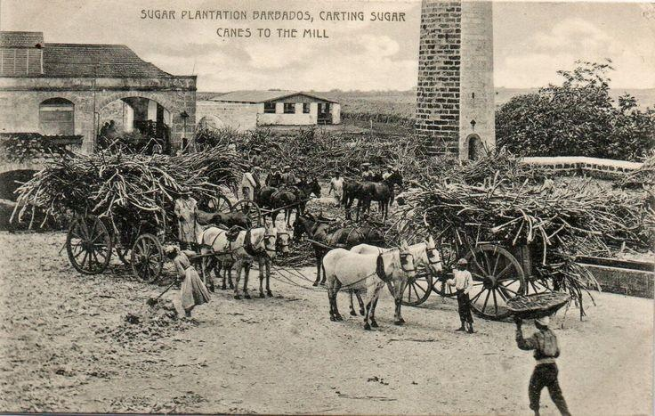
"Sugar Plantation Barbados, Carting Sugar Canes To The Mill"
W. L. Johnson & Co. Ltd., Barbados. No. 15

Slide 9
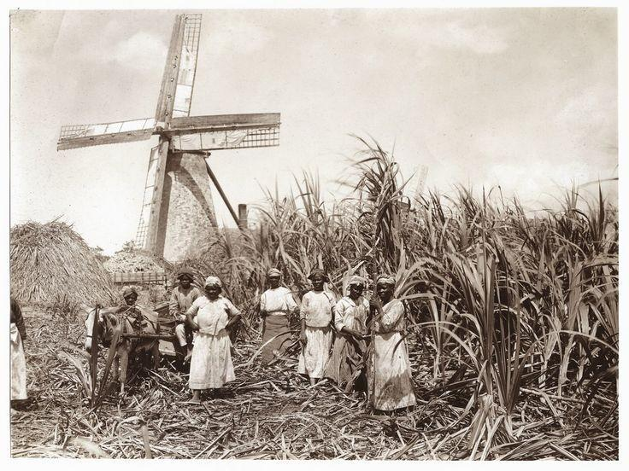

Slide 10
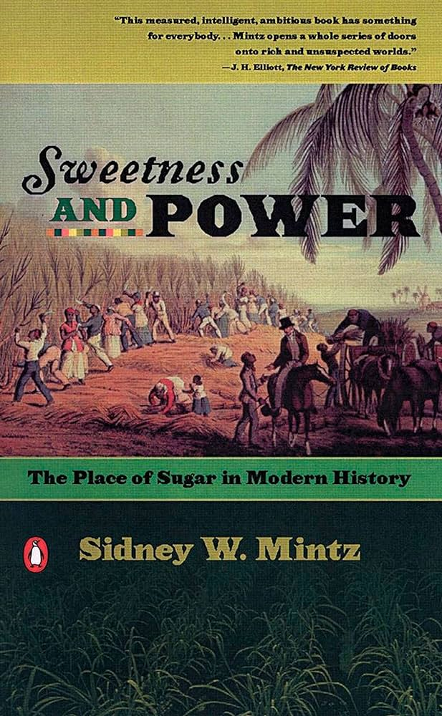
Bibliography
C. Tilley, W. Keane, S. Kulcher et al. “The Handbook of Material Culture” (Sage: London), (eds), p 13–28.
Schwartz, Stuart B. “Sugar Cane Plantation in the Formation of Brazilian Society: Bahia 1550-1835” University of Cambridge Press, 1985.
Sidney W. Mintz “Sweetness and Power: The Place of Sugar in Modern History”. (Penguin Books, New York).

