Slide 1
Human Resource Management
LCBB4014
Week 5 – Session 1

Slide 2
Objectives of the session
  Defining HRM
  Role and importance of HR
  Objectives of HR
  Activities of HRM
  Employee resourcing:
    Recruitment and selection
    Talent management
    Reward
    Training and development
  Equality and diversity
  CIPD

Slide 3


Slide 4
Defining Human Resource Management (HRM)
In many organisations, human resource management as, it is often referred to HRM or HR, performs role and duties formerly ascribed to personnel management.
Human resource management is concerned with recruitment, selection, training, pay, welfare and industrial relations.
HRM deals with all of these, but integrates them within the overall strategy of the enterprise and sees business values

Slide 5
Role and importance of HRM
Attract & retain talent
Generate employment opportunities
Train people for their roles
Develop skills and competencies
Promote team spirit
Improve job satisfaction
Develop loyalty & commitment
Increase productivity and profits

Slide 6
Objectives of HR
To help and support the organisation in achieving their goals and objectives.
To employ skilled people with the right competencies.
To attract and retain the talent of the organisation
To provide the employees with appropriate training.
To develop and maintain a quality of work life.
To communicate HR policies and rules to all employees.
To improve the employee engagement and satisfaction
To promote diversity and inclusion

Slide 7
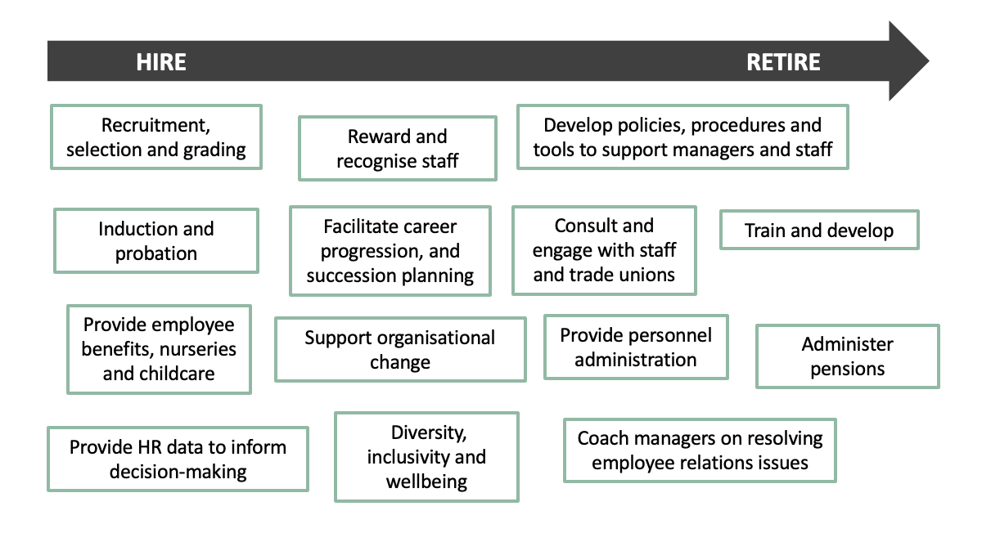
Activities of HR

Slide 8
Employee resourcing
The employee resources is the strategic process of identifying, attracting, selecting, and deploying the right people with the necessary skills, knowledge, and abilities to meet an organisation's current and future business needs. The employee resourcing can be achieved through 4 elements:
    Recruitment and selection
    Talent management
    Reward
    Training and development

Slide 9
Recruitment and selection
Recruitment refers to the process of identifying and attracting potential candidates for job openings within the organisation.
The goal is to generate a pool of qualified applicants from which the selection process can occur.

Slide 10
Recruitment and selection
According to CIPD (2022), the recruitment process will vary depending on an organisation’s size and resources. However, each of the following stages should be followed:
Defining the role.
Attracting applicants.
Managing the application and selection process.
Selection methods
Making the appointment.

Slide 11
Defining the role
Defining the role start with a job analysis, in which the HR specialists will spend time gathering information about a job. The job description the candidate specification should include elements such as the job purpose and duties involved. How and where the work will be carried.
The job should then be advertised. The job advertisement must provide clear, and accurate information about the organization and the role.
Notes:
(CIPD, 2022)

Slide 12
Attracting the applicant
Attracting qualified applicants is a crucial aspect of the recruitment process in human resources. To successfully attract potential candidates, HR professionals and organisations can implement a variety of strategies and practices:
Employee referral scheme
External recruitment
Internal recruitment
Notes:
Employee referral schemes:
These schemes usually incentivise employees to assist in the recruiting friends or contacts. Employers should not rely on such schemes at the expense of attracting a diverse workforce and they should complement other attraction methods. An alternative approach to support greater diversity and inclusion is to use targeted ‘word of mouth’ referrals to encourage current staff to share vacancies with underrepresented groups in their networks.
External recruitment:
Common ways of attracting candidates include the employer’s website, commercial job boards, recruitment agencies, and professional networking sites such as LinkedIn.
Other common approaches include links with local colleges/universities, working with the local jobcentre and using local networks. Using multiple and non-traditional outreach methods widens the talent pool. See our guides to inclusive recruitment for placing job adverts where they are more likely to be seen by marginalised applicants.
Most candidates expect to search and apply for jobs online, meaning employers need to pay attention to their corporate website and their online employee brand.
External recruitment services:
Recruitment agencies or consultants offer services such as attracting candidates, managing candidate responses, screening and shortlisting, or running assessment centres on the employer’s behalf. They need a good understanding of the organisation and its requirements. These services might also be provided by an outsourcing provider - find out more in our HR outsourcing factsheet.
Internal recruitment
Providing opportunities for development and career progression can help retention and support succession planning. For more, see our talent management factsheet.
(CIPD, 2022)

Slide 13
Managing the application and selection process
The HR specialist should treat all applications with confidentiality and care.
Application forms provides information to be presented in a consistent way. It makes easy to collect information from job applicants systematically.
CVs and LinkedIn profile permits to see details about the candidate skills, competencies and abilities.
Selecting a candidate involves shortlisting the candidate based on necessary skills followed by the assessment stage to find out who is the most suitable for the job.

Slide 14
Selection methods
Interviews
Psychometric testing
Skill-based assessment tasks
Assessment centers
Notes:
Interview:
After a short-listing process, interviews are very widely used in the selection process.
For the employer, the interview is an opportunity to:
Gauge candidates’ experience and ability to perform in the role.
Explain the employee value proposition, including learning opportunities and employee benefits.
Give the candidate a positive impression of the organisation as a good employer.
For the candidate, the interview is an opportunity to:
Understand the job and its responsibilities in more detail.
Ask questions about the organisation and the employee value proposition.
Decide whether they would like to take the job if offered it.
Psychometric testing:
Evidence suggests that standardised tests or tests of cognitive ability can be good predictors of job performance, especially for occupations that require complex thinking, although test results should never be the sole basis for a selection decision.
Used correctly, psychometric tests allow employers to systematically assess individual differences (for example in ability, aptitude or personality). They are often administered online, particularly when assessing high volumes of applicants.
Skill-based assessment tasks:
Skill-based assessments are a form of assessment that assess skills and abilities relevant to the role the employee is applying for. They can include work sample tasks, situational judgement tests, simulation exercises, or assessment centres. Skill-based assessments should resemble real tasks in the job as far as possible.
Skill-based assessment tests have been found to be better predictors of performance on the job when compared with traditional approaches such as tests, reviewing job experience, education, or unstructured interviews.
Assessment centres:
Assessment centres are used for selection as well as promotion and professional development purposes. They require candidates to complete several different tasks and often combine behavioural ratings, cognitive and personality assessments obtained from multiple sources.
The tasks set should clearly relate to the person specification and reflect the reality of the job. They must be administered in a systematic way, with candidates being given the same types and numbers of tasks to complete in the same time, so that they have equal opportunity to demonstrate their abilities.
Depending on the nature of the job, tasks might include individual or group work, written and/or oral input, and tasks prepared in advance as well as those performed solely on the day. This could involve delivering a report or presentation, time management or task prioritisation exercises, individual problem solving, group discussions, simulations of business activities, or functional role-play.

Slide 15
Making appointment
When the selection phase is completed. UK employers should move to checking employees right to work and appropriate qualifications and certificates.
References are a common form and frequently sought from the employers to check the candidate credibility.

Slide 16
Talent management
There are many definitions of the term ‘talent’. According to CIPD (2022), talent refers to people who can make a difference to organisational growth and performance, either through their immediate contribution (e.g., skills/competencies) or by reaching their highest levels of potential. While talent management refers to the attraction, identification, development, engagement, retention, and deployment of those people who are of valuable to an organisation because of their high abilities and qualities or because they work in critical roles.

Slide 17
Characteristics of talent management
A talent management is concerned about
How to improve the potential of those working within an organisation
How to reach and retain the talent populations needed
The development path for the individuals who sit within these populations.
Identify critical talent, while supporting the retention and accelerated progression of those capable of excelling.
Ability to work with diverse talent pools.

Slide 18
Benefits of talent management
A talent management strategy has multiple benefits including:
Creating work and growth opportunities for people working in an organisation.
Building a high-performance workplace.
Ensuring inclusion and diversity.
Encouraging continuous learning and development.
Increasing employee’s engagement and productivity.

Slide 19
Pay and reward
A pay structure refers to wage grades, and/or levels related to a specific job within a hierarchy or series. It provides a framework to implement reward strategies and policies.
Reward is concerned about designing and implementing strategies that ensure employees are having rewards in line with the organizational context.

Slide 20
Benefits of pay and reward
Organisations should focus effectively on pay and reward to:
Encourage employee behaviours and increase their engagement.
Maintain pay competitiveness in the market.
Provide a fair and transparent process to determine individual wages and rewards increases.

Slide 21
Training and development
Training and development is concerned about creating the right learning environment for employees to learn and grow.
It’s being able to understand the current and future capability needs of the organisation, as well as how to create a learning content that drives engagement and ensure ongoing professional development.

Slide 22

Training and development: the role of managers
The role of managers in training and development is to shift from course-led learning to making the learning process part of everyday work.

Slide 23
Learning and training methods
Identifying and selecting appropriate tools and techniques for each need will depend on factors such as:
Organisational goals, priorities, budget and expectations.
The performance targets and how that links to employee needs, experience and perception.
Data gathered on the previous learning experiences.
The complexity of the knowledge and skill ought to be learned along with employees existing competencies.

Slide 24
Methods to facilitate learning
Learning methods in various ways includes:
Formal and/or informal techniques.
Digital and/or face-to-face.
Created and/or curated resources.
Formal course and/or a series of accessible resources on a given topic.
Learning directly at the place of work and/or away from the workplace.

Slide 25
Equality
In the UK, equality refers to people have equal right of access, treatment, outcomes and impact in both employment and service delivery.
It is rooted to justice and fairness and to the UK Equality Act 2010 (EA10) which highlights that every people must have an equal opportunity to make the most of their lives.
It is also the understanding that no one must have poor chances in life because of their background, religion, personal identity or experience.

Slide 26
Diversity
Diversity refers to the differences in colour, ethnicity, abilities, age, gender, beliefs, interests, partnership status, sexual orientation, geographic, academic and professional backgrounds, opinions, and many other elements
Diversity recognises that people are different in multiple was that can wither be visible and non-visible, and that those differences must be respected, valued, promoted and celebrated.

Slide 27
Diversity
Research shows that diversity in the workplace is advantageous since it improves decision making, innovation and problem solving since diverse people have different range of backgrounds and experiences with them.
However, it is important to note that having a diverse workforce is not enough. In an effective workplace, people need to feel empowered, have a sense of belonging, and feel that the work environment is safe to contribute with their ideas and viewpoints.

Slide 28
CIPD
CIPD stand for Chartered Institute of Personnel Development and is professional body for HR and people development.
They have been researching and supporting the human resource for over 100 years.

Slide 29

CIPD
CIPD provides a range of learning and certification which are essential and required if anyone is aiming to work in HR
Take about 10-15 min to look into their website and familiarize yourself with the content of CIPD

Slide 30
References
Capon, C. (2009) Understanding the business environment: inside and outside the organisation. Third edition. Harlow, England: Prentice Hall/Financial Times.
Chartered Institute of Personnel and Development, (2017) human resource management, CIPD. (Factsheet available at www.cipd.co.uk).
Needle, D. Burns, J. (2015) Business in context : an introduction to business and its environment. Seventh edition. Andover: Cengage Learning.

