Slide 1
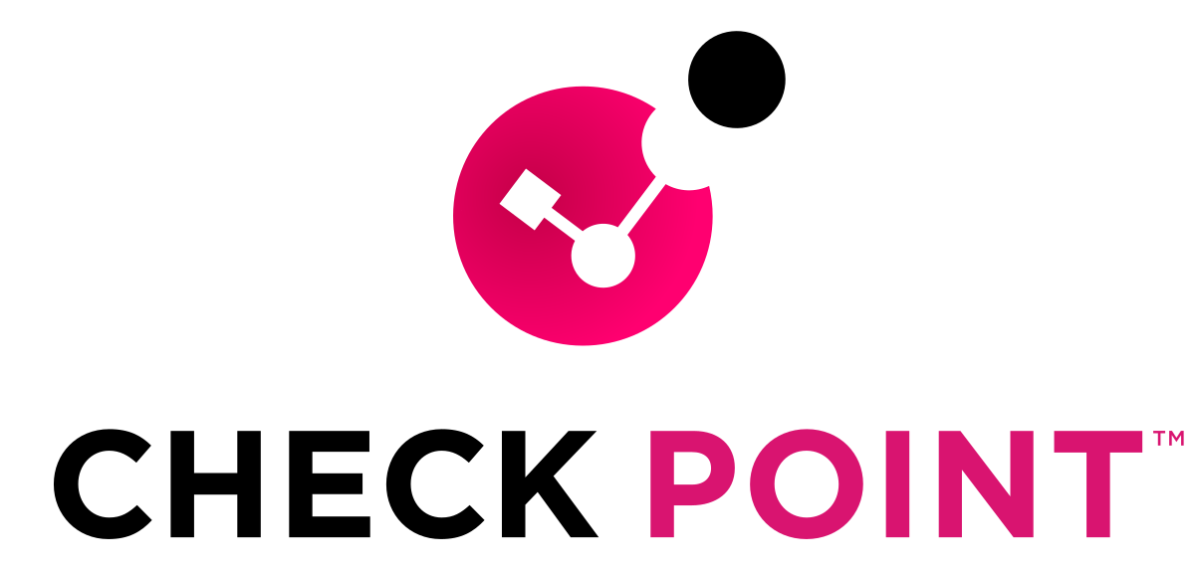
ACCA7032
Enterprise Network Security - Design and Implementation of a Checkpoint Security Solution
Misraoui Oualid

Slide 2
Table of contents
Analysis of TG Enterprise’s network topology
  Analysis of their security posture
    My implementation of a Checkpoint security solution
    Labs implementation
  Suggestions for new security measures

Slide 3

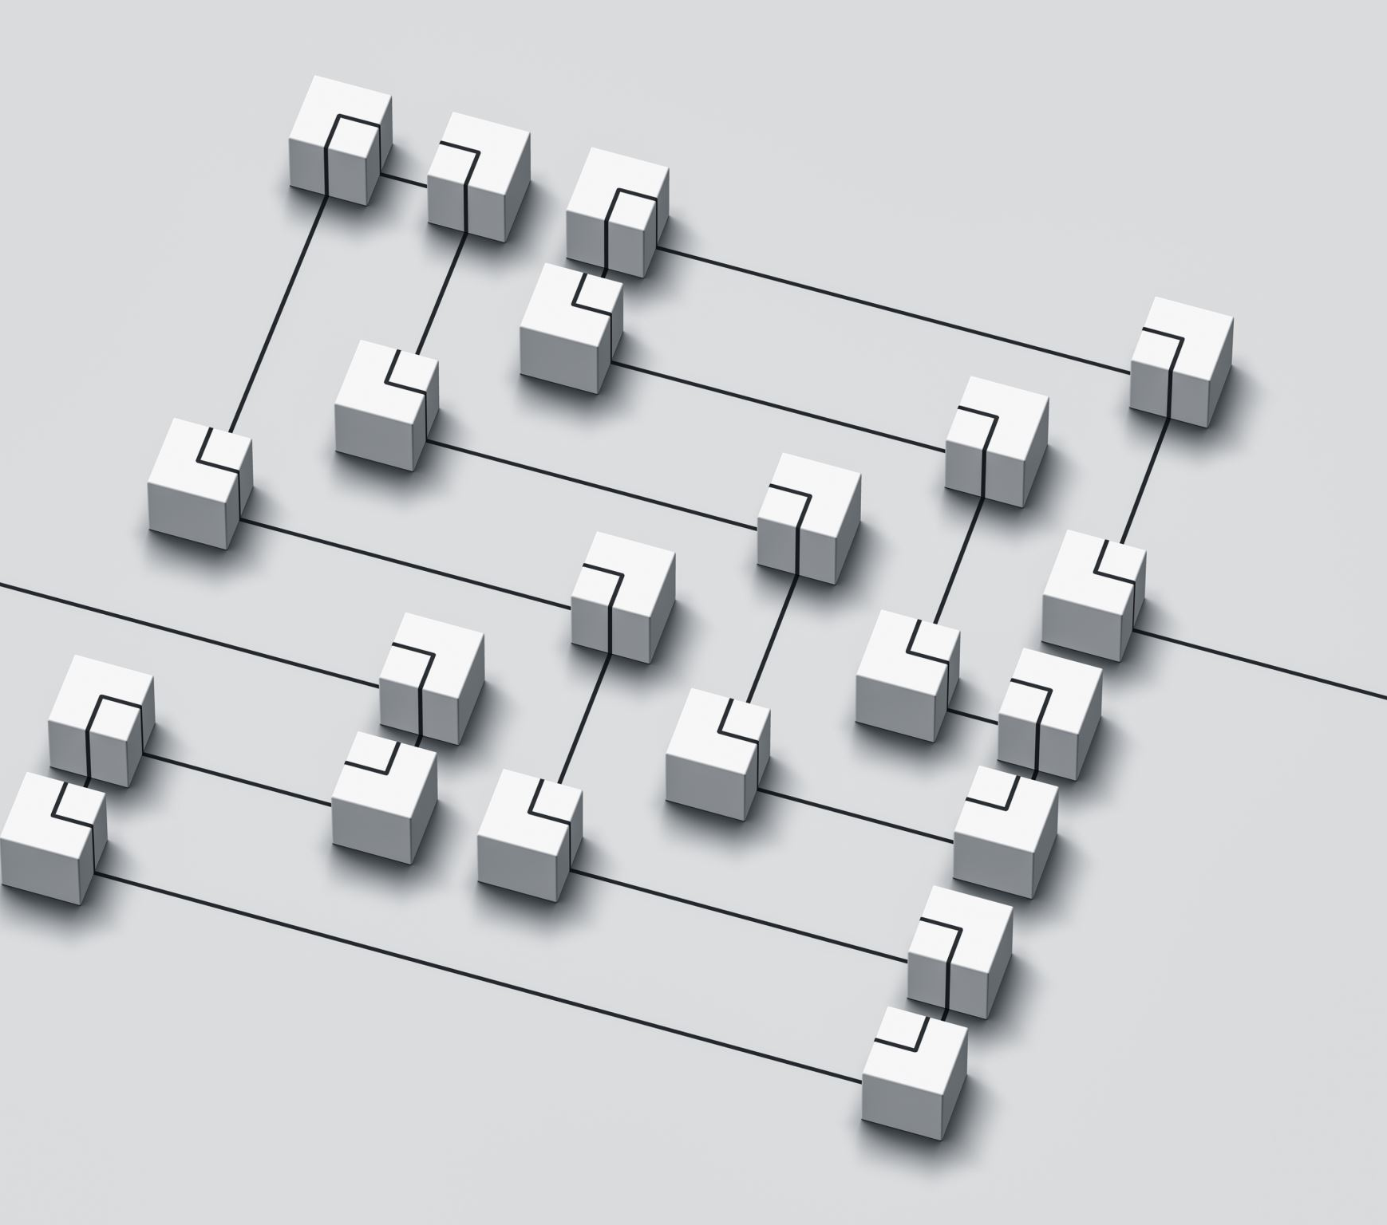




Analysis of TG Enterprise’s network topology

Slide 4
Current known problems
Firstly, Security audits and updates are irregular, leaving the system susceptible to potential vulnerabilities. This inconsistency poses a significant risk to the overall security posture.
There are single points of failure within the existing system, compromising network availability and potentially leading to disruptions in operations.
In terms of policy management, inefficiencies result in inconsistencies and errors, undermining the effectiveness of security measures.
The current licensing structure proves to be costly and includes unnecessary features, suggesting a need for optimization to align with the company's actual requirements and reduce unnecessary expenses.
Undefined roles and permissions contribute to unauthorized access, posing a serious security concern.
Overlapping and conflicting policies further hinder effective security management, creating potential gaps in the Defense against cyber threats.
In the realm of application control and web access, inadequate measures lead to a lack of control over application usage, exposing the organization to security breaches.
The Intrusion Prevention System (IPS) rules are outdated, diminishing its effectiveness in preventing emerging threats.
Lastly, the existing security infrastructure falls short in addressing the unique challenges posed by IoT devices.

Slide 5
Analysis of TG Enterprise’s network topology
Inefficient Policy Management
The topology suggests complex routing and policy definitions that may lead to inefficiencies.
Solution :
  Deploy Checkpoint's Security Management Server to centralize policy management, ensuring consistency and reducing errors. Use role-based access control to define and enforce policies clearly.

Slide 6
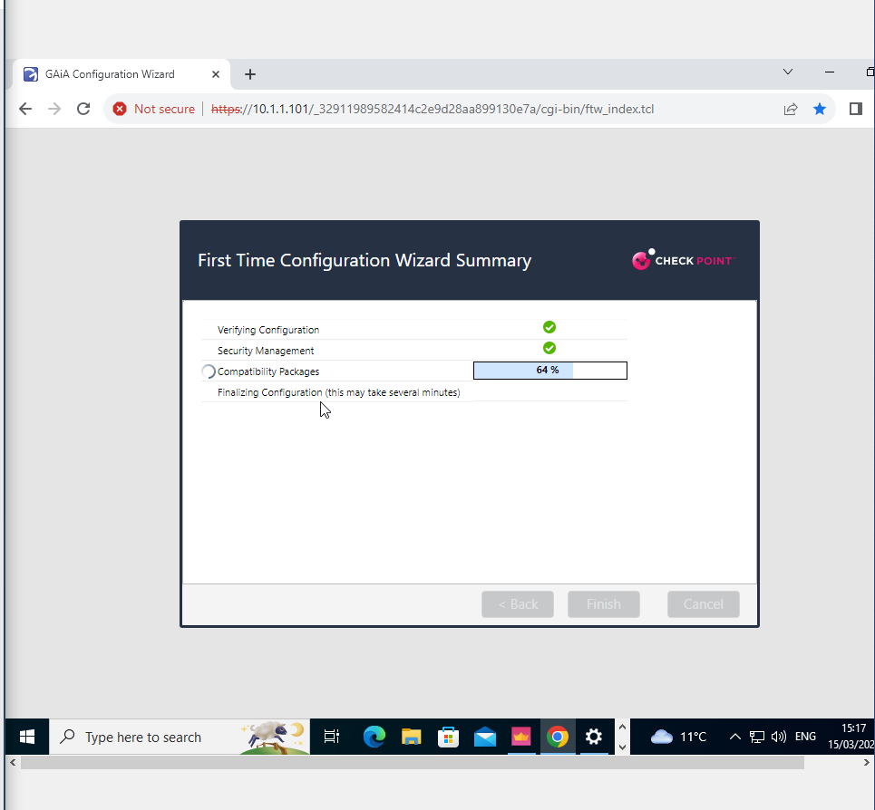
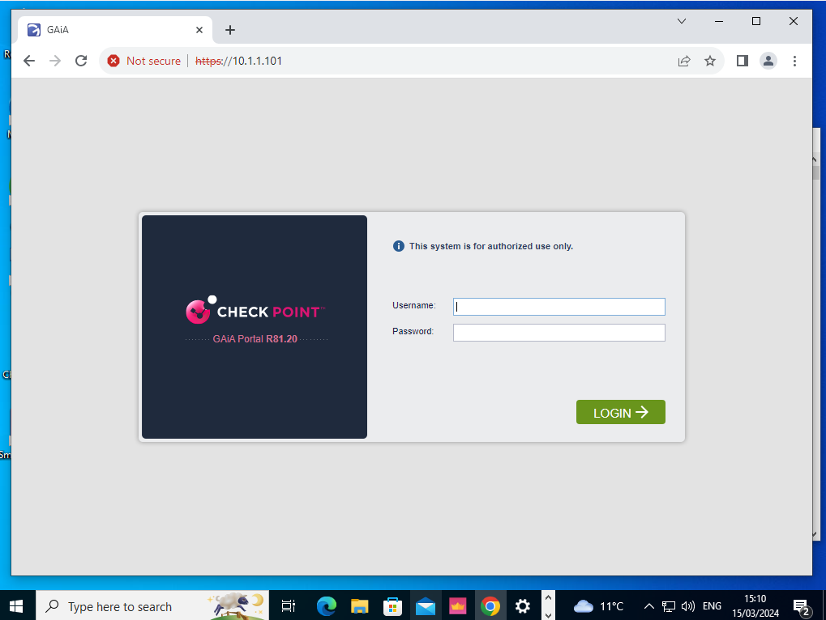
Lab 1 : Implementation of a SMS server

Slide 7
Analysis of TG Enterprise’s network topology
Undefined Roles and Permissions
Potential for unauthorized access due to undefined roles and permissions.
Solution :
  Utilize Checkpoint's Identity Awareness to provide granular access controls and role definitions, ensuring that only authorized personnel have access to sensitive network segments.

Slide 8
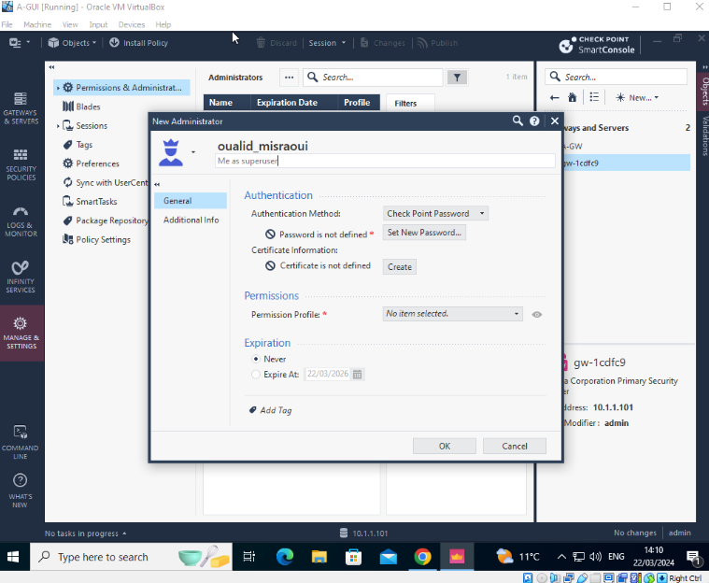
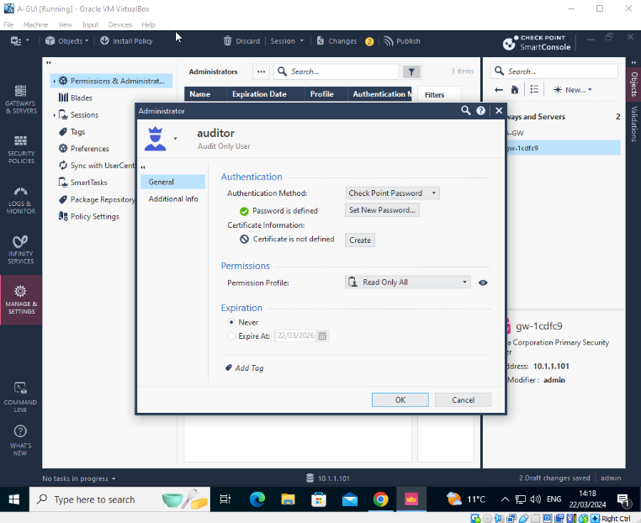
Lab 2 : Implementation of roles and users

Slide 9
Analysis of TG Enterprise’s network topology
Overlapping and Conflicting Policies
Policies between different network segments might overlap, causing conflicts
Solution :
  Rationalize and consolidate security policies using Checkpoint's unified policy management to minimize conflicts and streamline security operations.

Slide 10
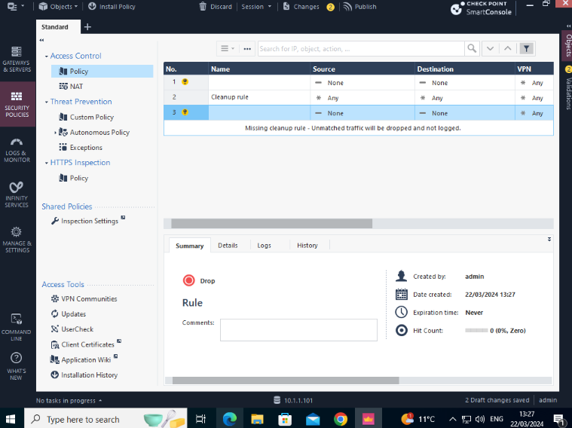
Lab 2 : Implementation of a cleanup rules

Slide 11
Analysis of TG Enterprise’s network topology
Costly and Inefficient Licensing Structure
Excessive costs associated with unnecessary features.
Solution :
  Review and streamline the licensing model to match the specific needs of TG Enterprise, potentially adopting Checkpoint's flexible licensing options that align better with your usage patterns and security requirements.

Slide 12
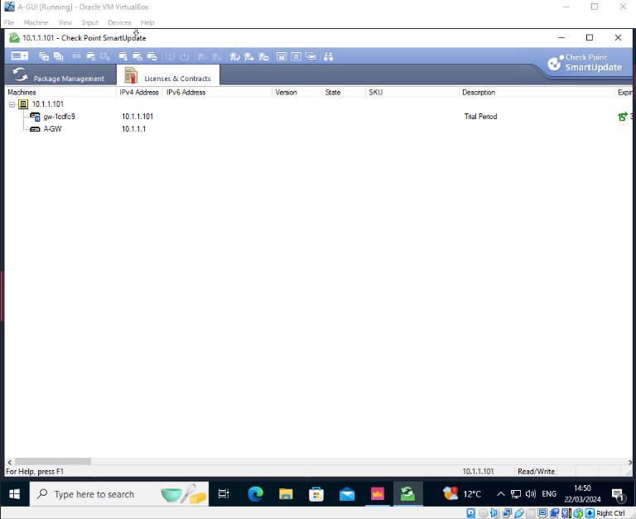
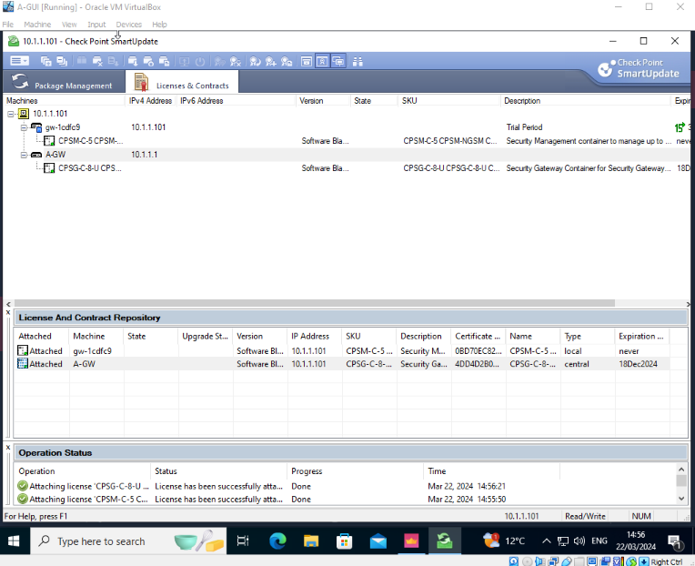
Lab 4 : Using Checkpoint smart update to manage licenses

Slide 13
Analysis of TG Enterprise’s network topology
Irregular security audits and updates
The current topology does not show any dedicated systems for managing updates and audits, which are critical for maintaining security hygiene.
Solution :
  Implement Checkpoint's SmartEvent for real-time event monitoring and incorporate automated patch management systems to ensure continuous updates and consistent security audits across all devices

Slide 14
Analysis of TG Enterprise’s network topology
Single Points of Failure
it appears that each site (Site Alpha and Site Bravo) relies heavily on single gateways (A-GW and B-GW) for connectivity, which can be a critical point of failure.
Solution :
  Introduce redundant pathways and failover gateways using Checkpoint's High Availability technology to ensure uptime and resilience.

Slide 15
Analysis of TG Enterprise’s network topology
Inadequate Application Control and Web Access
Uncontrolled application usage that can introduce security vulnerabilities.
Solution :
  Implement Checkpoint's Application Control and URL Filtering to monitor and regulate web access and application usage, significantly reducing the surface for attacks.

Slide 16
Analysis of TG Enterprise’s network topology
Outdated IPS Rules
Existing IPS rules are outdated, reducing effectiveness against new threats.
Solution :
  Leverage Checkpoint's IPS services with automatic updates to continuously protect against the latest vulnerabilities and exploits.

Slide 17
Analysis of TG Enterprise’s network topology
Challenges with IoT Security
Current infrastructure does not cater to the unique security needs of IoT devices.
Solution :
  Integrate Checkpoint's IoT security solutions to specifically secure and manage IoT devices, which often require different handling compared to traditional IT assets.

Slide 18

  Suggestions for new security measures

Slide 19
Suggestions for new security measures
Segmentation :
  Consider more network segmentation.
Implement ongoing security training for all employees to minimize the risk of human error.

Slide 20
Conclusion

