Slide 1
What challenges do learners face in Welsh educational settings?
Presented by Sally England
Notes:
Hello everyone & welcome to my presentation about, 'What challenges do learner face in Welsh Educational Settings?

Slide 2

Introduction
Allocation of funding for schools
Academic & Literacy Challenges.
Socio-economic issues.
Behavioural & Mental Health Issues.
BBC, March 2022
Notes:
There are multiple challenges that learners face in Welsh educational settings.
Most challenges are interlinked and can be particularly detrimental on the overall wellbeing and progress of individuals or groups of learners in educational establishments.
The following points contribute to whether a learner has a positive or negative experience whilst in an educational setting:
Allocation of funding for schools. Funding for effective provision to meet the ever-increasing and complex needs of learners is linked to the Welsh Government formula for budget allocation. Unfortunately, over recent years this appears to have become woefully underfunded again & could be attributed to the overall outcomes of learners in Wales.
Academic & Literacy Challenges. The Institute for Fiscal studies announced that the levels of literacy and numeracy of learners has decreased in recent years (Institute for Fiscal studies, March 24). The Welsh Government, Local Authorities, ESTYN and individual schools regularly analyse measurable data in order to ensure the efficacy of policies and teaching standards. Although, a variety of reasons for the outcomes of learners are considered when comparing the data.
Socio-Economic & Equality Issues. Wales has areas of extreme poverty, including digital poverty. '25.7% of pupils are eligible for free school meals, up from 24.6% in 2024. This represents almost 2.2 million pupils' (Schools and Pupils Statistics Team, 2025). It has been reported that the lack of opportunities in Wales are increasing the socio-economic and equality gap further.
Behavioural & Mental Health Issues. ACES, anxiety linked to school attendance, inability to follow rules, difficulty following routines and challenging behaviours are thought to be negatively impacting learners in Wales .

Slide 3
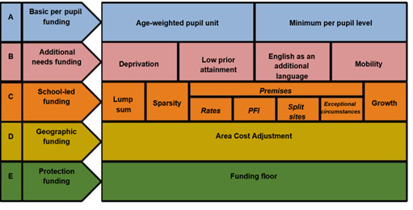
Allocation of funding for schools
(Barry Kramer, July 22
Does this formula fund schools effectively?
Notes:
The Welsh Government does not provide funding directly to schools.
The Welsh Government provides funding to each Local Authority. This is called a Revenue Support Grant.
Each Local Authority use a funding formulae which includes a combination of pupil-led & non-pupil led elements. The accompanying picture on this slide illustrates the factors utilised when calculating funding allocations. These include:
Pupil-led funding
Every learner is claimed to be funded equally.
Learners educated through the medium of Welsh.
The number of learners in a school or in a class.
Residency in relation to the Welsh Index of Multiple Deprivation (WIMD).
Eligibility for free school meals (eFSM).
Test scores.
ALNs of individual Learners
School or site-led funding
A common value allocated to every school. For example, for every Primary School, Secondary School, PRU or bilingual schools.
Floor area.
The condition & age of a building
There is a variability in the Local Authority formula which considers additional learning needs, this can include – assessment of the special needs of individual learners, categories of need, number of IDPs. This particular funding is allocated to schools in addition to a school's delegated budget. (Statswales website: Delegated School Budgets by authority)
Could it be, that funding across Wales does not meet the financial needs of learners?

Slide 4
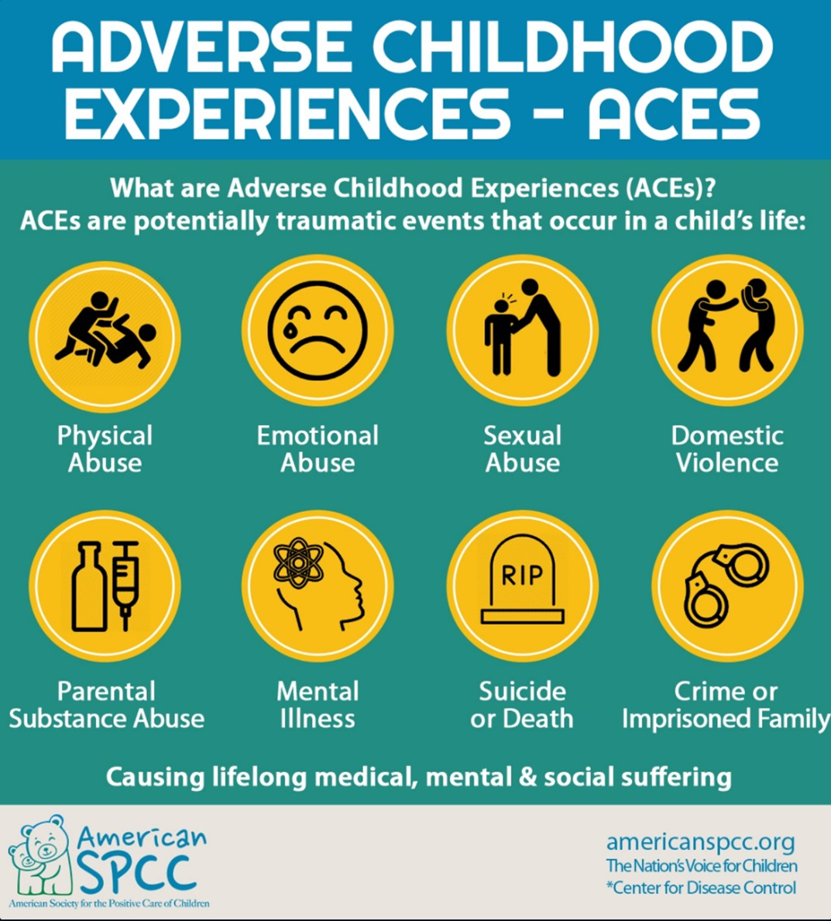
ACES & TRauma linked to mental health issues
‘Adverse Childhood Experiences (ACEs) refer to events that cause children to experience chronic stress, either by directly harming the child (e.g. physical abuse) or the environment in which he/she lives (e.g. domestic violence)’ (Bellis et al, 2015).
​
‘Trauma – An overwhelming experience that is not effectively contained for the child and they are therefore unable to return to a relaxed state. This has both psychological and neurological consequences and can lead to feelings of panic and loss of control’ (Bombèr, 2007).
(Ace Hub Wales, 2022)
Notes:
Adverse Childhood Experiences are stressful or traumatic events during the ages of 0-17 years old.
Abuse, neglect, or household dysfunction can trigger toxic stress, significantly impacting brain development which can increase the risk of chronic health issues, mental illness, substance misuse, and shorter lifespans in adulthood.
There is an elevated level of learners with ACES in Welsh educational settings and understanding the impact of ACES can have on learners can help break cycles of trauma by promoting resilience with supportive relationships and environments.
Types of ACES can include abuse, neglect, household challenges, community and environmental adversities
ACES can cause toxic stress, health risks and behavioural difficulties.
Prevention and support to promote resilience can be offered in a variety of ways. Healthcare providers can screen for ACES to ensure the correct support is received. Nurturing relationships within a safe and secure environment with trusted adults (for example in an educational setting) can help to mitigate the effects of ACES

Slide 5
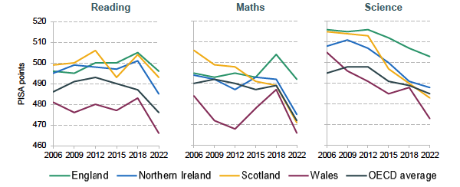
Academic & Literacy Challenges.
Figure 1. PISA scores across UK nations over time
Quality of teaching & learning in schools
The COVID-19 Pandemic
Attendance of learners
Mental health of learners
Underfunding
Source: Based on figures 7.13–7.15 in Sizmur et al. (2019); OECD (2023).
Notes:
'In December 2023, the OECD published the latest round of PISA scores (OECD, 2023)' (Institute for Fiscal studies, March 24).
PISA tests are international comparisons of Reading, Maths and Science skills. Countries saw a decline in the overall scores. The latest tests were taken in 2022 and reflected the effects of school closures during the pandemic.
The quality of teaching and learning in schools. Estyn stated, 'there is a mixed picture for education and training in Wales, with some strong practice but key areas in need of improvement', (Dauncey & Morgan, March 25). The overall message reports that the quality of teaching was not good enough and a high level of schools and educational establishments were recommended to improve teaching. Additionally, the self-evaluation and improvement practices were not effective in meeting the needs of learners; resulting in holding back progress. The needs of learners requiring support to improve Literacy, Numeracy and Digital Skills specifically were not being met effectively.
The COVID-19 pandemic negatively impacted Literacy, Numeracy and Digital skills in Wales and across the world. There was a significant decline in attainment, attendance and the mental health of learners. Educational inequalities linked to disadvantaged pupils were further exacerbated.
Attendance of learners in Wales has historically been below the expected national average and was worsened by the Covid-19 Pandemic. Persistent absence more than doubled between 2018/19 and 2022/23. 47% of eFSM pupils in primary schools and 61% of eFSM pupils in secondary schools were persistently absent in academic year 2023/24. The attendance gap between eFSM pupils and other pupils has widened to 5.5 % in primary schools and 10.3 % in secondary schools. The attendance of disadvantaged pupils remains a significant cause for concern.
The mental health of learners can significantly and negatively affect attainment if not appropriately supported over an agreed prolonged period. Learners with positive or appropriately supported mental health enabling resilience, are endowed with the necessary skills to be able to thrive in any educational establishment, irrespective of life's difficulties.
School budgets to support the acquisition of basic skills in Welsh learning environments has decreased in the last few years. Following the Covid-19 pandemic, the Welsh Government were allocated higher levels of funding from Westminster to invest in basic skills and wellbeing support in education across all authorities in Wales. Senior leaders in most learning environments realised that the most effective means to offer the support needed was to employ additional temporary staff to provide literacy, numeracy and wellbeing sessions, tailored to the individual needs of the learner. Unfortunately, this funding source was withdrawn; the need for this enhanced support remains and as shown in the PISA table, the worst decline is in Wales.

Slide 6
The role of support staff in school
Behaviour Support
Administration duties
IT Support & Facililties Staff
Examinations Officer
Reception Staff
Lunch & break time supervisors
Classroom cover
Pastoral Support
Personalised Learning Support
Safeguarding
Notes:
Support staff are invaluable key members of a whole staff body in educational establishments across Wales.
Figures from the Department for Education, 2019 reported that support staff within education equate to 52% of the workforce in Wales.
Their importance within an educational establishment:
Inclusivity is effectively established enabling learners with a wide range of diverse to thrive daily.
The holistic development of learners' social, emotional and physical growth as well as academic progress is promoted
Daily operational tasks are efficiently managed allowing Teaching staff to concentrate on academic learning
Their key roles and responsibilities:
Classroom & Academic Support: Assisting learners with additional needs (ALNs), one-on-one or in small groups, adapting materials, managing behaviour, and keeping learners on task. Cover of classes during absence & PPA cover.
Administrative Tasks: Management of learner records, reprographics, organising events, handling communications, internal and external examination preparation and freeing up teacher time.
Pastoral support: Emotinal support, beahviour management, welfare monitoring, home to school links, attendance support, mentoring and inclusion.
IT & Facilities Staff: Technical infrastructure and site management.
Lunch/break supervisors & catering staff: preparation and serving of meals, monitoring of learners during unstructured time.

Slide 7
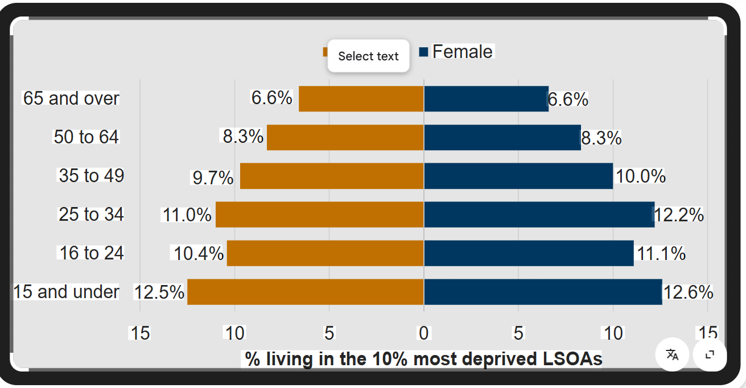
Socio –economic issues
The image on this slide illustrates the percentage of genders in a variety of age groups, living in the 10% most deprived Lower-layer Super Output Areas (LSOAs).
Office of National Statistics, 19)
Notes:
The image on this slide illustrates the percentage of males and females in a variety of age groups, living in the 10% most deprived Lower-layer Super Output Areas (LSOAs).
The link between living in more deprived areas and being within the younger age groups is high.
The proportion of gender living in the most deprived areas is fairly equal, although they do appear to be within the younger age categories and are more likely to be in education and/or training of some description.
Older people are less likely to be living in areas of deprivation.

Slide 8
What challenges do learners face in Welsh educational settings?
Conclusion
Poverty
Equality
Decline in the Welsh Language
ACES
Persistent low attendance
Behavioural difficulties
Poor mental health
Covid-19 pandemic
Quality of Teaching
Underfunding
Basic Skills Deficit
Notes:
Educational attainment, inequality linked with post-pandemic concerns like attendance, mental health & behavioural issues are significant interconnected challenges facing learners in Wales.
ACEs have been proven to lower school engagement, leading to increased absenteeism, and a greater risk of exclusion due to behavioural challenges. Children affected by ACEs struggle with social skills which can impact their ability to apportion trust, negatively affecting their ability to learn and form positive relationships with peers and adults.
The negative impact of the Covid-19 pandemic continues, even 5 years on. Learners' basic skills, particularly oracy has suffered; despite additional funding being allocated to alleviate this. The pandemic resulted in the decline in the use of the Welsh language. Estyn said it has had, "a significant impact on pupils' fluency and inclination to speak Welsh"
Persistent absences(EBSNA) are now recognised as an ongoing concern and Powys CBC developed resources and training for schools and parents to address EBSNA, focusing on early intervention and support with the assistance of the Educational Psychologists.
The link between disadvantage and educational underachievement remains high despite a focus on supporting Wales' most vulnerable learners. Learners from poorer families do not achieve as well as their peers. Schools have a key role to play and serving all learners equally is not sufficient. A specific focus by ESTYN on those children and young people who are growing up in poverty resulted in additional funding being made available by the Welsh Government to support eFSM pupils.
It has been recognised that the role of support staff has evolved significantly. Support staff are doing much more than their routine duties as written in their job descriptions and financial renumeration for this is nowhere near adequate. They play a significant role in pupil progress, school quality, and emotional care. Their broadened role is a sign of a more collaborative structure within educational settings, where all team members take part in the success of the learners and are equally responsible for overall outcomes.
The progress of the new Curriculum for Wales is variable across schools and concerns have been raised regarding the effectiveness of raising standards and pupil outcomes.

Slide 9
REFERENCES
BBC (2022) The learners, series 1, episode 1, BBC Radio Wales. Available at: https://www.bbc.co.uk/programmes/m000yc54 (Accessed: 29 December 2025).
Duauncey, M. and Morgan, L. (2025) What has Estyn said about the quality of education and training in Wales?, Senedd Research. Available at: https://research.senedd.wales/research-articles/what-has-estyn-said-about-the-quality-of-education-and-training-in-wales (Accessed: 29 December 2025).
Egan, D. (2013) Senedd. Available at: https://business.senedd.wales/documents/s14833/CYP4-09-13 Paper 2 - Professor David Egan.pdf (Accessed: 29 December 2025).
Future Generations and Commissioner For Wales (2025) Future Generations - A future to a more equal Wales, A More Equal Wales. Available at: https://futuregenerations.wales/wp-content/uploads/2025/02/FINAL-Equality-Wales-Topic-2.pdf (Accessed: 29 December 2025).
GOV.UK (2025) Schools, pupils and their characteristics, academic year 2024/25, GOV.UK. Available at: https://explore-education-statistics.service.gov.uk/find-statistics/school-pupils-and-their-characteristics/2024-25 (Accessed: 29 December 2025).
Griffiths, C. (2025) Behaviours that challenge and disrupt in schools across Wales: 2025, GOV.WALES. Available at: https://www.gov.wales/behaviours-challenge-and-disrupt-schools-across-wales-2025 (Accessed: 29 December 2025).
Howard, M. (2020) Why should schools aim to achieve support staff excellence?, The National College. Available at: https://nationalcollege.com/news/why-should-schools-aim-to-achieve-support-staff-excellence (Accessed: 29 December 2025).
Kramer, B. (2020) The national funding formulae for schools and high needs 2021 - 2022 July 2020 - gov.uk, ReadkonG.com. Available at: https://www.readkong.com/page/the-national-funding-formulae-for-schools-and-high-needs-6281212 (Accessed: 29 December 2025).
New study highlights impact of childhood adversity and school experiences on adult health (2025) Public Health Wales. Available at: https://phw.nhs.wales/news/new-study-highlights-impact-of-childhood-adversity-and-school-experiences-on-adult-health/ (Accessed: 29 December 2025).
Aces (adverse childhood experiences) (2024) Bristol Early Years. Available at: https://bristolearlyyears.org.uk/trauma-informed-practice/aces-adverse-childhood-experiences/ (Accessed: 29 December 2025).
Supporting your child with Emotionally Based School Avoidance - a guide for parents (2024) Hwb. Available at: https://hwb.gov.wales/playlists/view/cefb50cc-b585-413f-acb1-cf0ca28d31fd/en/1 (Accessed: 29 December 2025).
Education, D. for (2011) The role of School Support Staff, GOV.UK. Available at: https://www.gov.uk/government/publications/school-support-staff-topic-paper (Accessed: 30 December 2025).
Analysis of population characteristics by area deprivation (census 2021) [HTML] (2021) GOV.WALES. Available at: https://www.gov.wales/analysis-population-characteristics-area-deprivation-census-2021-html (Accessed: 30 December 2025).

