Slide 1
MAJORANT OLIVIAN JOZSEF
STUDENT NUMBER:2005325
BMSK4002
EFFECTIVE TEAM WORKING AND COMUNICATION

Slide 2
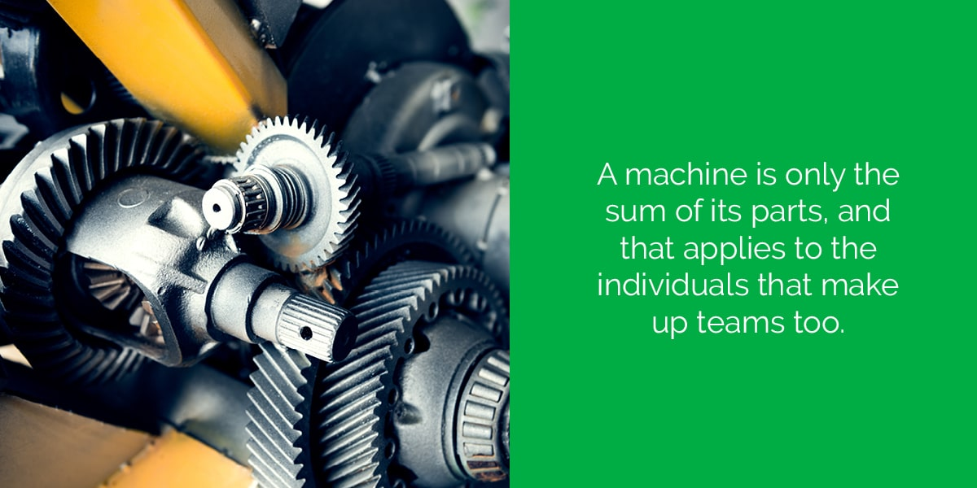
Effective team work

Slide 3
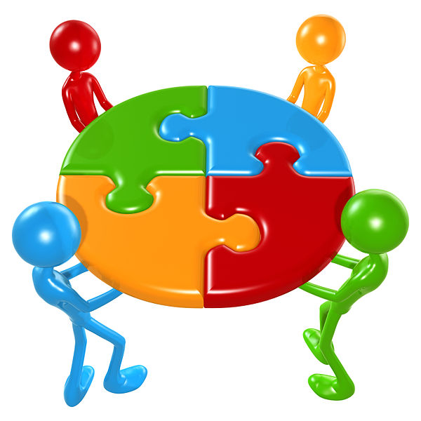
TEAM WORK DEFINITION
Teamwork is defined by Scarnati (2001, p. 5) “as a cooperative process that allows ordinary people to achieve extraordinary results”. Harris & Harris (1996) also explain that a team has a common goal or purpose where team members can develop effective, mutual relationships to achieve team goals.

Slide 4
7 STEPS TO TEAMWORK
LEADERSHIP-teams need leaders ; by rotating leadership tasks,the team becomes unifield ;
Interaction –successful team leaders foster the three C ’ s: communication, collaboration and consensus;
Goals –source of motivation each and every day;
Happiness –team work best when satisfaction fills the workplace;
Techniques –build a spirit of responsability and motivate the members ;
Education –training and guidance ;
Rewards –once a system of team-based rewards is in place ,the team’s responsiveness and flexibility often increase ;

Slide 5
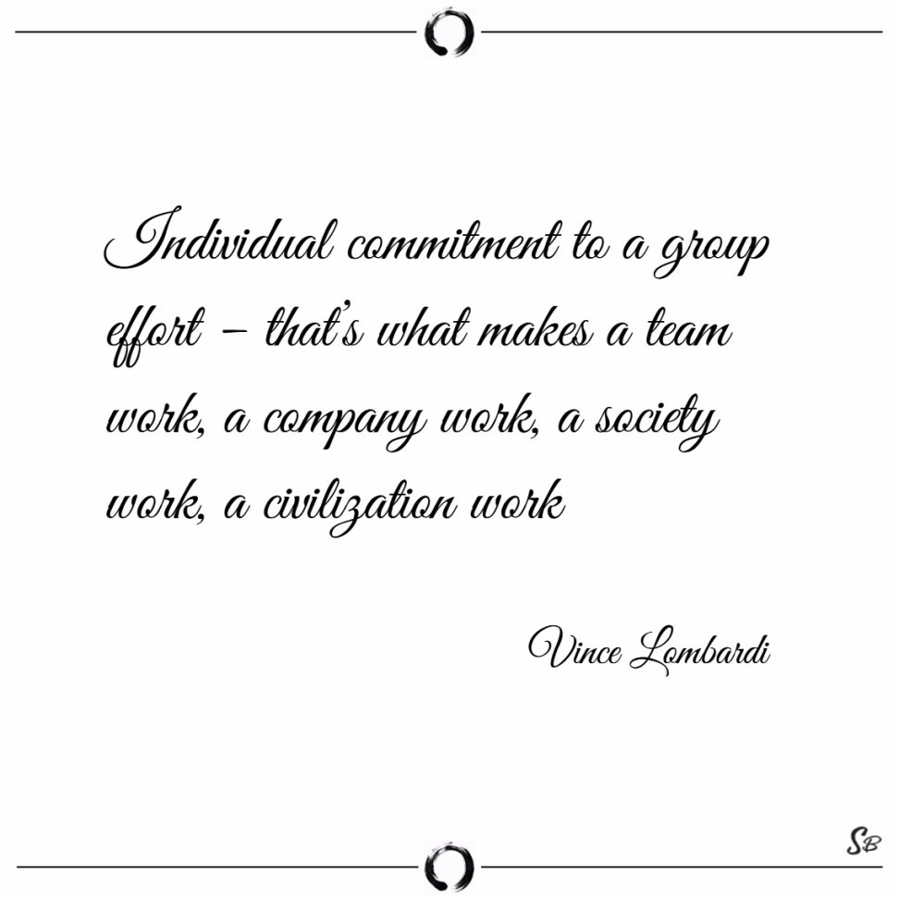
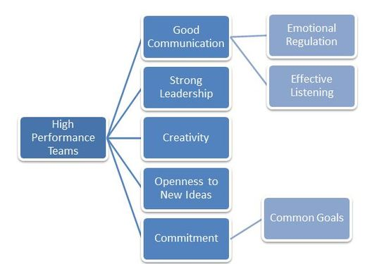
Elements of high performig teams

Slide 6
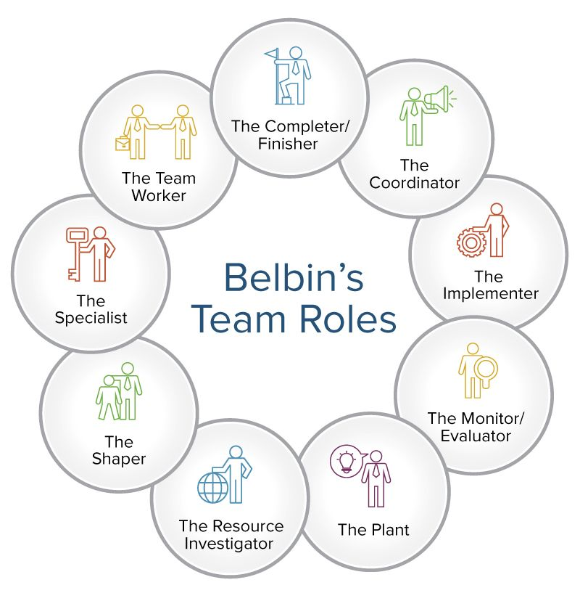
BELBIN’S TEAM ROLE

Slide 7
Belbin ‘s team role model applied to Olivian’s team work experience
Olivian says my characteristic approach to teamwork is that:
I think logically and tend not to get carried away.
I work to get things done as efficiently as possible
I am discreet and sensitive when handling difficult situations .
I thrive on working under pressure.
I am most interested when encountering new people and possibilities.
I make projects more manageable by working to clarify priorities.
I strive to achieve the highest possible standards when producing work.
I relish the opportunity to take an unconventional approach to problems .
I can see what I need to do and can set work for myself.
I believe there should be room for having a good time at work

Slide 8
Belbin ‘s team role model applied to Olivian ‘s team work experience identifying the strenghts and weakneses
Strenghts- training, hard-working skills, communication skills , multi tasking skills ,problem-solving skills ,dynamic ,sociable ;
Weaknesses –long shifts, stress, tiredness,time management skills , difficult condition , difficult co-workers ;

Slide 9
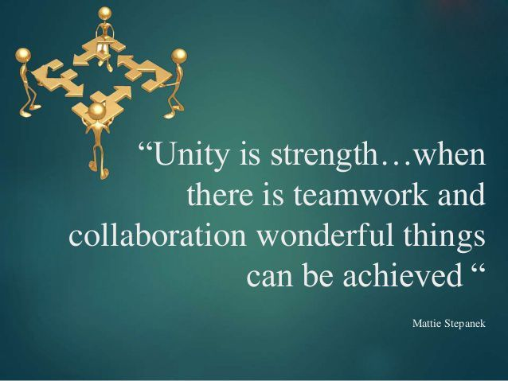
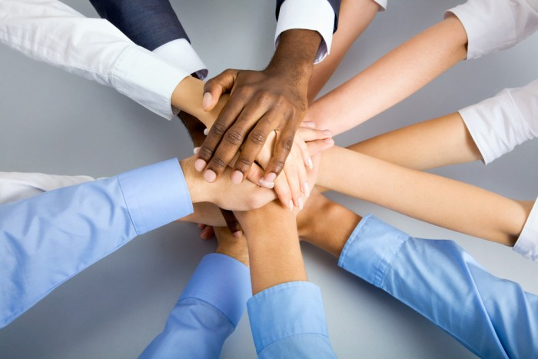
Conclusion

Slide 10
References
Morgan ,P. (2017)The business student’s guide to study and employability-Los Angeles ,SAGE,p.207;
Maund , A. ,Schriek, M. ,Tinkle K.P. ,(2017) Certificate in Higher Education :Skills for the workplace Student Yearbook,-Los Angeles-SAGE,p.21
Morgan ,P. (2017)The business student’s guide to study and employability-Los Angeles ,SAGE,p.210;
Maund,A. ,Schriek, M. ,Tinkler K.P. ,(2017) Certificate in Higher Education :Skills for the workplace Student Yearbook,-Los Angeles-SAGE,p.24
Ensman , R. G. –Seven steps to teamwork ,Successful teamwork: A case study-Available at :
file:///C:/Users/User/Desktop/ppt%20materials/team%20Successful%20teamwork.pdf –Accessed 2 May
2020
* A guide to using Belbin for matching people to jobs –Available at :
http://www.cert-uk.info/Using%20Belbin%20for%20matching%20people%20to%20jobs.pdf -Accessed 2 May 2020;
Understand the stages of team formation – Available at : https://www.mindtools.com/pages/article/newLDR_86.htm -Accessed 2 May 2020;

