Slide 1
Student Name: Shabna Hussain
Student Number: 2123212
Module: F&B BMIH4002
Assignment: Menu
Tutor: Lola Villard

Slide 2

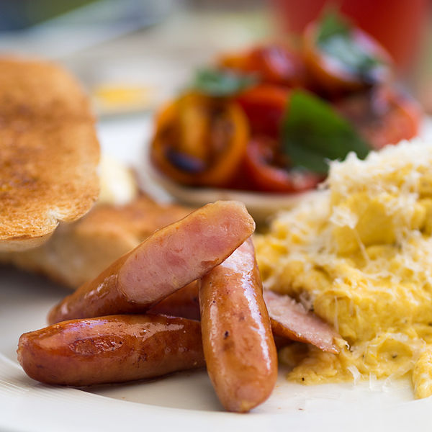
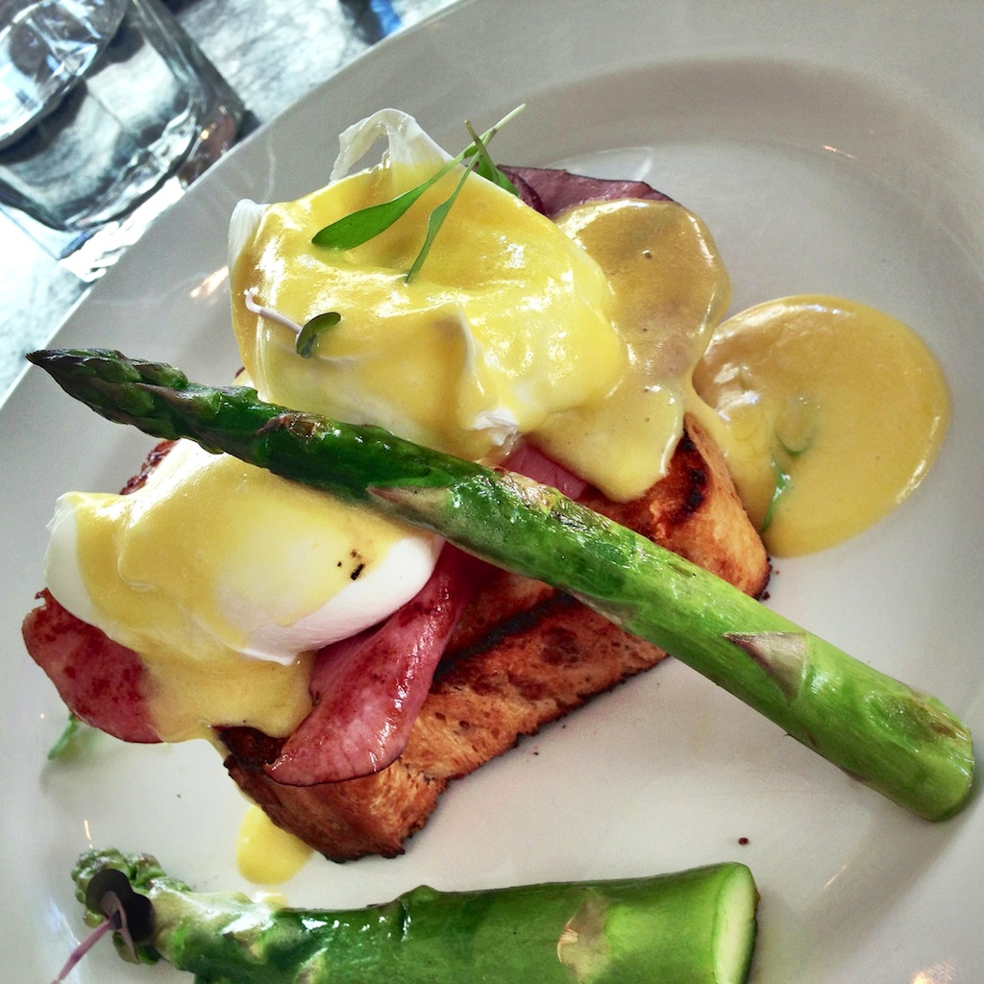
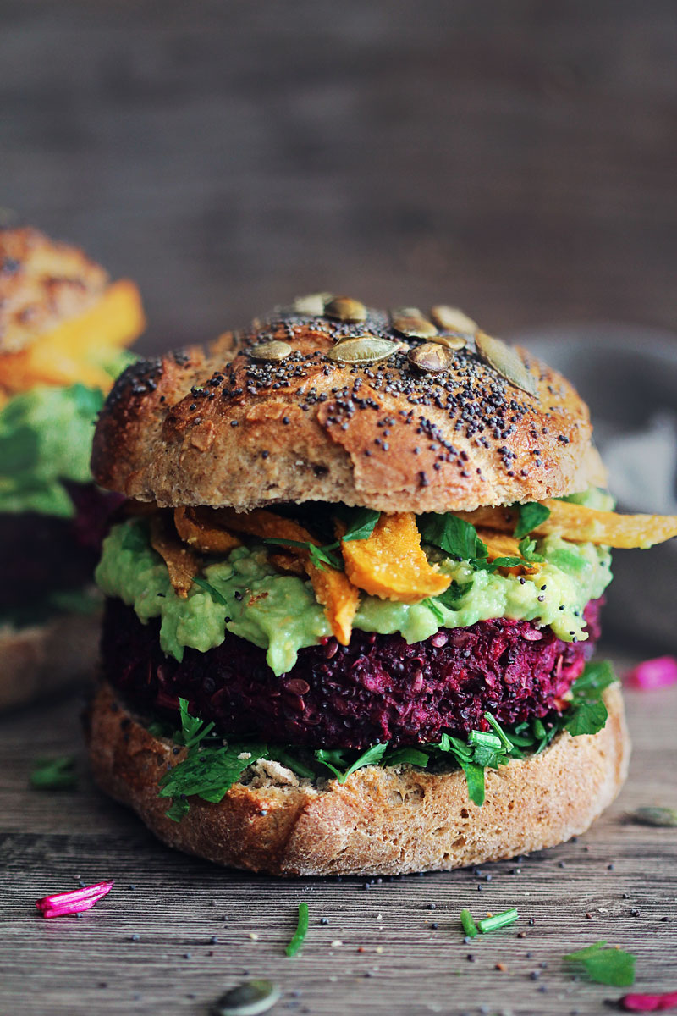
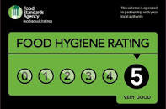

Hotel Trinity
Swansea
Menu card
DISHES
Sausage and Egg - Scrambled eggs with Sausage contain nearly 0.9g total carbs, 0.5g net carbs, 12g fat, 9g protein, and 147 calories.
Ham and Egg - contains 253 Calories along with the fat of 13.4g and 27.9 gram of Protein
The vegetable burger- Contains one sliced onion, four leaves of lettuce loose-leaf, and other ingredients.

Slide 3







Special Dishes
Beverage
Sangiovese Pairs with Pizza - This particular menu is an Italian-style dish that has been served with a particular glass of good Italian wine.
Pinot Grigio Pairs with Seafood Dishes - Seafood has been used for this particular dish in terms of delivering the flavor.
Rosé Pairs with Cheesy Dishes - The present menu has been served by our restaurants to create grown-up grilled cheese sandwiches.
Cabernet Sauvignon Pairs with Steak - Wine and steak have been recognized as the best combo in the world. This particular menu has been served as Cabernet Sauvignon and a nice cut of beef.
Malbec Pairs with Barbecue Dishes - This particular menu is linked to the Korean barbecue that has been also used for classic American barbecue flavors.
Prosecco Pairs with Prosciutto and Melon - Prosciutto and melon skewers are the strongest collaboration that can be used especially for Melon.
Espresso
30 ml/1 fl. Oz.
The Italian-origin drink is made from a variety of coffee beans and roast degrees
Americano
Espresso 60 ml/2 fl. oz.
Hot water 60 ml/2fl. Oz.
The collaboration of hot water and espresso in the form of a unique flavored brewed coffee.
Macchiato
Froth 0.5 fl. Oz.
Espresso 30ml/ 1 fl. Oz.
The over-brewed version of Espresso made the extreme heat have a different flavor.
Special dishes timing:
Sangiovese Pairs with Pizza and Cabernet Sauvignon Pairs with Steak at everyday 12.00 pm to 16.00 pm
Other combos are available only on Saturday and Sunday from 15.00 pm to 18.00 pm
General dishes timing – All dishes are available at the scheduled time which is 10.00 am to 20.00 pm

Slide 4
Essentials of Main Menu
Key factors related to allergens statement - The presence of allergens in the kitchen has to be bound with Food Allergen Labeling and Consumer Protection Act. this particular aspect has been recognized to be linked to the several issues that have been considered by the laws. The collaboration includes various factors such as "wheat/gluten, milk, eggs, peanuts, tree nuts, fish, shellfish”.
Food hygiene statement - The maintenance of safety has been described as the most important factor for this particular statement. The segmentation that has been imposed to differentiate the raw and cooked foods has also much higher importance for this particular aspect.
Legal requirements
food, health, and hygiene quality assurance is a must-needed clause for restaurants.
prevention of crime and disorder on the restaurant premises
protection of children from harm
protection of public nuisance
Protection of copyrighted material
Contactless delivery
Effective communication channels - This particular feature has been developed by addressing the relives that can be distributed among the customers' need for special care by the organization. Uber services are available for the contactless delivery system.
The delivery point - The delivery point for this particular aspect has been decided to be remote as the delivery must be done at the respective doorstep for the respective customers.
The COVID-19 guidelines - It has been observed that every possible security guideline has been maintained properly by the organization within this specific perception.
Payment options
Offline payment - The traditional method for doing the transaction has been recognized as through cash only.
Online payment - Considering this particular aspect, Worldpay, and PayPal have been integrated as the central point of this particular process of the transaction. The outlet has a central network system that has been distributed mainly by a central network having restricted access.
The organization has more focused on the maintenance of the balance within the data security for the devices linked to the central network within the premises.
The payment options are restricted within the unauthorized access in terms of seeking permission to enter the network.
The gateway used for doing the transaction becomes more secure as it is a government funded.
Collection criteria
The order must be placed through the official website only.
Customer can also avail the telephone number accessible only during the working hours to place order.
Home delivery is available only for the customers having the lifetime membership.
Moreover, the customers have to come to the delivery point Swansea Gower - Three Cliffs Bay.

