Slide 1

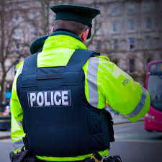
Evidence Based and DECISION MAKING
(BMCP4003)
Sadie France
Bluelightacademy@uwtsd.ac.uk

Slide 2
Scheme of work

Slide 3
Reading lists/ Moodle
Please access the essential reading resources
Online library
All content will be posted to Moodle
Assignments briefs
Turnitin links

Slide 4
Assignment 1
•1500 word report
•Due 7th March by 23:59pm on Turnitin on the Moodle Tile
If submitted late by up to 7 days- capped at 40%
If submitted later than 7 days- 0 FAIL!
Unless an EC is upheld by AO
Now lets take a look at your assignment.....

Slide 5
Common themes from previous assignments
Stick the assignment brief
Cover page missing- Student name, number, module code, number and title of assignment
Referencing- give it a go!!! Use the Harvard Referencing guide
Reference list- subheading needs to be included
Citations- Insert them effectively "According to" "Smith (2020) stresses" "Coleman (2024) agrees"- Link them to your discussion.
Sources- use a variety of sources not just online.
Engage with the reading list- use the online university library

Slide 6

What is evidence based policing (EBP)?
Defined by Lawrence Sherman in 1998
" The use of the best available research on the outcomes of police work to implement guidelines and evaluate agencies, units, and officers. Put more simply, evidence based policing uses research to guide practice and evaluate practitioners. It uses the best evidence to shape the best practice".
Notes:
Sherman is an American Criminologist and Police educator

Slide 7
TWO PROCESSES
1- Use evidence to underpin and develop practice
2- Use evidence to evaluate the effectiveness of ongoing practices
College of Policing has adopted "What works" approach incorporating EBP as the Cornerstone of practice.
Practitioners are encouraged to create, review and use the best available evidence to inform and challenge policies, practices and decisions (College of Policing, 2021)

Slide 8
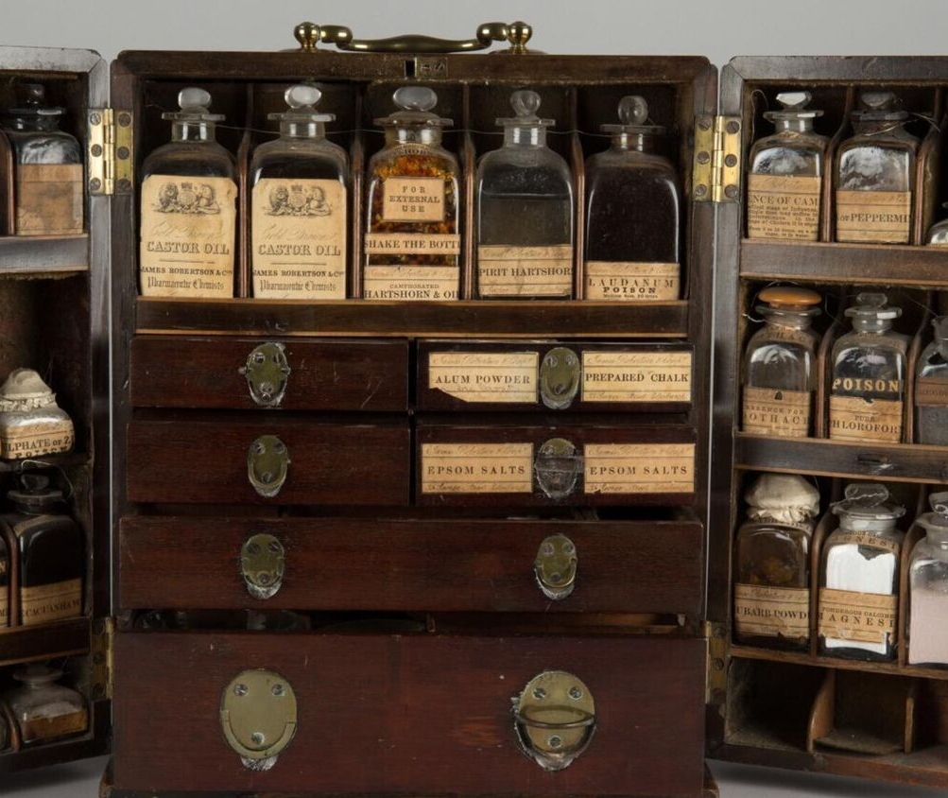
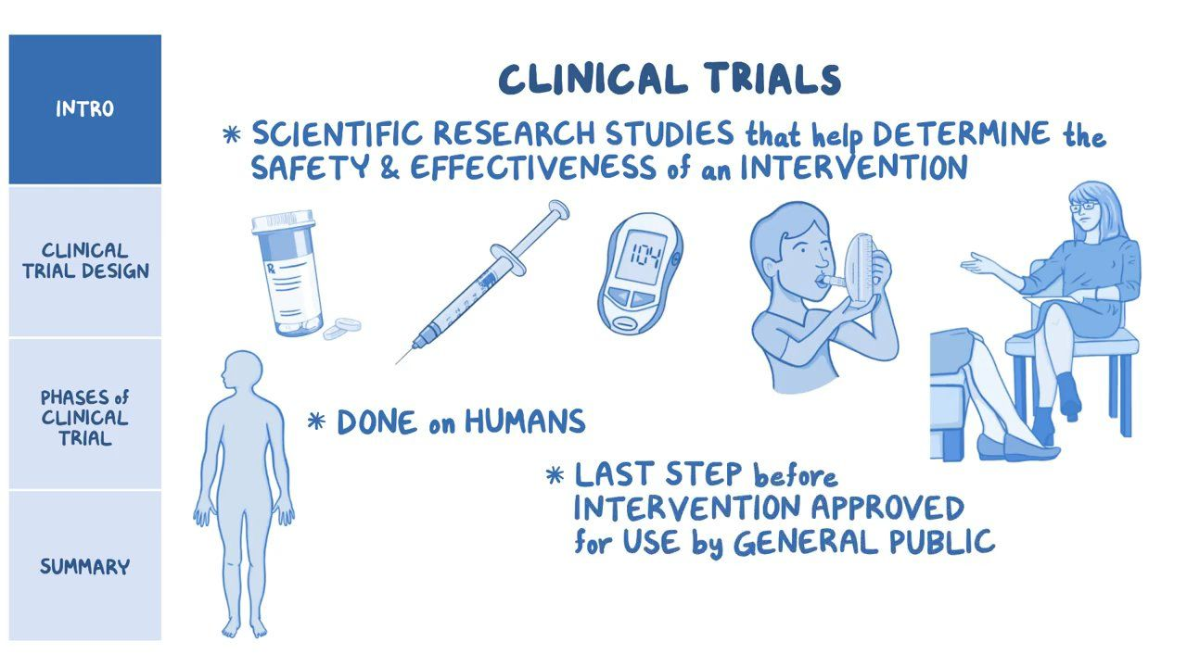
FOR EXAMPLE...
Medical intervention
How do we know what medical intervention works?
How has medicine changed over the years?
Like doctors, police officers serve a role in society to reduce harm where possible
What is Evidence Based Policing? - The University of Sheffield Kaltura Digital Media Hub
Notes:
Medical intervention has grown immensely due to evidence based practice- what works, and what doesn’t.

Slide 9

WHAT IS EVIDENCE?

Slide 10
Oxford English dictionary (2013)
"Information indicating whether something is true or valid"

Slide 11

How do you know if something works?
What types of evidence can you think of to support if something works?
Are some stronger than others?

Slide 12

2 types of evidence
Pre- existing- what is already known and is available (Secondary)
Evidence that you generate directly through your own research (Primary)
"A research project which gathers low- level evidence that is well designed and carried out is much better than one which aims to gather higher- level evidence but is poorly constructed and conducted" (Spooner et al, 2022)
Notes:
Secondary- You will be able to access and learn from it. To do this you will draw on material, usually literature that has already been produced. It is important that you critically review this to ascertain how it relates to your own research project and how it helps provide evidence.
Primary- This is gathered by trialling, testing and evaluating interventions. The evidence needs to be valid and reliable which requires a robust methodology for collecting data.

Slide 13

The value of evidence -based policing
It is a practical tool for policing, rather than a theoretical academic exercise.
"Policing related research will help us to improve police learning and development, and can directly inform practical, frontline policing" (College of Policing, 2020).
EBP adopts a pragmatic approach, looking at how research can support real-life policing issues in practice.

Slide 14
Ebp challenges accepted practices
Do we really understand the problem?
What impact is this approach having?
Are we being effective?
Why do we do things the way we do?
"The benefits of Evidence based policing is maximising the policing response for the public and minimising the risk of causing harm through policing practices" (Kime and Wheller, 2018).

Slide 15
Decision making- experience, routine and habit
"Most police practice is still shaped by local custom, opinions, theories and subjective impressions" (Sherman, 1998)
Observational learning
Experiential learning
Start to develop habits, routines and standard ways of working due to repeated exposure to similar experiences
What do you think is the danger of relying on observations and experiences alone?
Notes:
When Sherman was discussing the emergence of EBP he made the following observation.
Within policing, one of the many ways newly recruited officers learn is through observations. Observation allows you to identify how to behave in a certain situation which you may adopt and start to imitate, learning through the social environment.
Officers also undertake experiential learning, learning from own experiences. By doing this they are likely to adapt their practices and thinking based on their own experiences.
The danger is the view and approach can be narrow.

Slide 16

Group task
There has been a spate of moped thefts. It if your first day off after 4 rest days. Your sergeant asks you to develop a patrol strategy so he can target visible police presence to the maximum effect.
You were working last weekend when several moped thefts took place in a suburb on the outskirts of town at about 10:30pm. The crime analyst then emails you to an analysis of all the thefts over the last month which shows 80% of the thefts have been concentrated within a 200 metre radius of an underpass to the town centre. A total of 95% of the thefts have occurred between 9pm-12am but over the last 3 nights, 75% of the thefts have occurred between 11pm-12am.

Slide 17
What would you do?
A) Decide if you would base the patrol strategy on you own experience or on the analysts product?​
B) Compare the advantages of using the analysts product to develop your patrol strategy to your own experience of where and when robberies took place.

Slide 18
ANSWER
A) You should be basing your decisions on the most reliable data you can obtain and also on the fullest data set that you can proportionately gather. Therefore, in this scenario using the analysts information would be the recommended option.
B) Your own experience is limited to only a few examples. The analyst has oversight of many incidents and can provide a fuller and more detailed and complete analysis. It provided an auditable trail and clear rationale to support your decision making about the deployment of resources.

Slide 19
Questions?

Slide 20
To recap
Introduction to the module
Looked at the scheme of work for the module
Looked at the first assignment

Slide 21
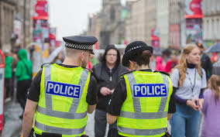
Session 2

Slide 22

Aims for today
Problem solving models

Slide 23
ASSIGNMENTS
ASSIGNMENT 1-
1500 word report
Due 7th March by 23:59pm on Turnitin on the Moodle Tile
ASSIGNMENT 2-
Group presentation- 5 minutes each
28th and 29th April

Slide 24
ASSIGNMENT 2- GROUPS
Group 1 (4)-
Group 2 (4)-
Group 3 (4)-
Group 4 (3)-

Slide 25
What is evidence based policing (EBP)?
Defined by Lawrence Sherman in 1998
" The use of the best available research on the outcomes of police work to implement guidelines and evaluate agencies, units, and officers. Put more simply, evidence based policing uses research to guide practice and evaluate practitioners. It uses the best evidence to shape the best practice".
Notes:
Sherman is an American Criminologist and Police educator

Slide 26
EVIDENCE BASED POLICING APPROACHES- ATLAS
A
T
L
A
S
Ask
Test
Learn
Adapt
Share

Slide 27

ATLAS
‘Using the best available evidence to inform decisions about practices and policies’
ASK Reflect on practice, build hypotheses
SHARE
TEST Seek to answer the question through rigorous testing (e.g. experimental trials, systematic reviews)
SHARE
LEARN Find out about ‘what works?’ (or doesn’t…)
SHARE
ADAPT Change policy/practice to reflect findings
SHARE

Slide 28
Ask (ATLAS)
The start of the problem-solving cycle involves asking questions that will help to understand a particular problem or area of policing better and then using this understanding to develop a theory (or hypothesis) about the effect of doing things differently.

Slide 29

Test (ATLAS)
This stage helps you to understand whether your response will achieve the effect that you wanted e.g. reduce antisocial behaviour.
When testing a new response, you need to be clear about what you did (how the response was implemented) and what change you are expecting to see and how this will be measured (the outcome).
How could you measure ASB?

Slide 30

Learn (ATLAS)
Once you have introduced your intervention then you need to measure your outcomes.
The timing of your measurement will depend on how quickly you think your response will work and this will vary depending on the intervention.

Slide 31

Adapt (ATLAS)
Once you have measured your outcome you should adapt your response to reflect what you found.
If you find that your intervention isn’t having any effect, then you should stop using the resources in this way and use the findings to adapt your understanding of the problem.
If you find that it is working, then you might want to suggest trying it in areas which are experiencing similar problems.

Slide 32

Share (ATLAS)
At all points in the process you should share, for example, your questions, your plans, your findings, your lessons, your experiences of change – and your new questions!
By sharing your questions and findings you might identify others trying to tackle similar problems or you can stop somebody using their resources on something you have found doesn’t work

Slide 33
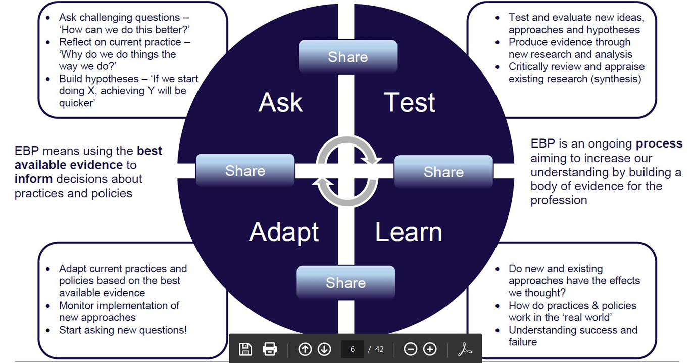

Slide 34
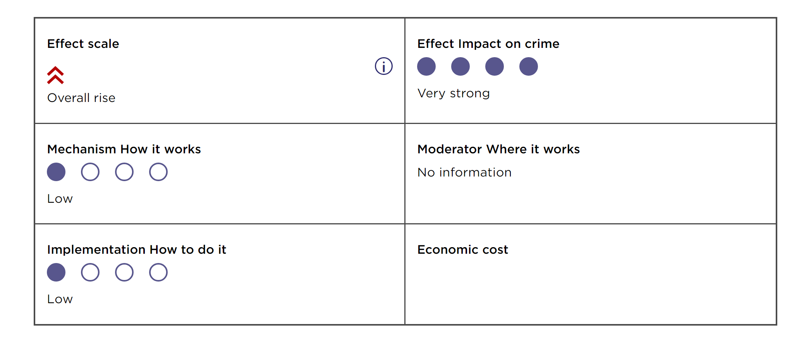
WHAT DOES THE EVIDENCE SAY?
(College of Policing, 2015)

Slide 35

Beyond SCARED STRAIGHT PROGRAMME
Beyond Scared Straight Ethan's Prison Experience S9, E2 - YouTube

Slide 36
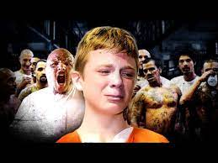
"Estimated that reoffending was 68% higher among those juveniles who participated in the programme compared to those who did not. Participant reoffending was higher compared to offenders who did not receive the intervention in seven of the nine studies."
(College of Policing, 2015)

Slide 37
Group task
On Moodle visit the " College of Policing-What works centre for crime reduction" link and find the "effect" of a crime prevention intervention.
Group 1- Find an intervention that has an overall reduction in crime
Group 2- Find an intervention that has mixed findings
Group 3- Find an intervention that has no overall change in crime
Group 4- Find an intervention that has an overall rise in crime

Slide 38
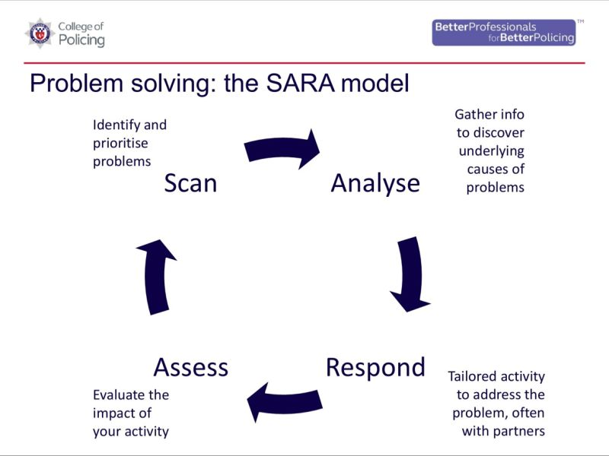
(O)SARA MODEL oBJECTIVE
SCAN
ANALYSE
RESPOND
ASSESS
(College of Policing, 2022)
Notes:
The OSARA model is an approach adopted by Problem- oriented policing (POP) and is used to help approach an evidence based project.

Slide 39
Scanning (Sara)
Identify problems and the consequences of those problems. Within this phase you may explore how frequent the problem is occurring and whether it is a long-term problem or a short- term one.
How it supports EBP:-
Understanding an issue

Slide 40
Analysis (SARA)
Understanding the factors impacting on this problem, identify what is already known about the problem and how it is currently being addressed. In this phase you also identify the relevant data that you need to collect to help you better understand the problem.
How it supports EBP:-
Understanding an issue
Notes:
Who is affected? •
Why is this person or item being targeted (e.g., person harassed each day as pass offender on way to work)?
• What characteristics make the problem likely to recur (e.g., loneliness increases likelihood of romance fraud)?
• Is repeat victimisation occurring?
• Why is this person vulnerable to this specific problem (e.g., victim’s dementia increases the chance of them going missing) Who or what is the cause?
• Why are they causing the problem?
• What objectives/motives do they have (e.g., cancelled after-school clubs mean youths gather and cause ASB)?
• What are their characteristics that mean the problem recurs? • What risks (or lack of) come with offending?
• What facilitates their offending (e.g., drinking alcohol increases the offender's propensity for violence)?
• How do they access the location (e.g., by car or on foot)? • What is their MO (mode of operating)?
• What skills/resources enable them to cause the problem? Where is it happening?
• Why does it occur here (e.g., poor physical design, secluded, lack of lighting, hiding spots, Broken Windows Theory)?
• Is there a hot spot? If there is- why, if not- what do different locations have in common (e.g., is there a high footfall- so there are lots of potential victims, or low security measures)?
• Is there anything else in the area that contributes to the problem

Slide 41
Response (SARA)
In this phase you move on to identifying possible interventions, choosing an intervention and then implementing that intervention.
How it supports EBP:-
Trialling an intervention

Slide 42
Assessment (SARA)
In this phase you need to evaluate the intervention, compare data gathered before and after the intervention, check to see if goals have been achieved, identify any additional strategies required and importantly maintain an ongoing assessment to make sure the effectiveness of the measure continues.
How it supports EBP:-
Assessing an intervention
Notes:
Assessment:- This is where you evaluate the effectiveness of your response. It may include:
• Total elimination of the problem
• Less serious or harmful problems
• Better handling and improved response to the problem A way to see if the assessment has had any impact on the community could be:
• Reduced fear from the community in relation to the problem
• Increased use or footfall in an area
• Decrease in crime and incidents in relation to that location Assessment allows us to look at what effect the response had on a problem.

Slide 43
INTERVENTIONS
EBP is about trialling and evaluating interventions. Some may include:-
Trial by tactic
A new policy
A project
A piece of training, software, technology
A different way of working
New forms
New strategies

Slide 44
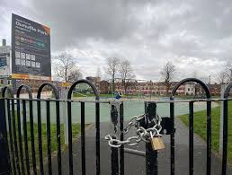
Sara in action
Residents living near a popular public park have reported increasing incidents of antisocial behaviour, including loud gatherings, underage drinking, vandalism, and littering, particularly during the evening at weekends. This has caused some families to avoid the park, and complaints to the local council and police have risen.

Slide 45
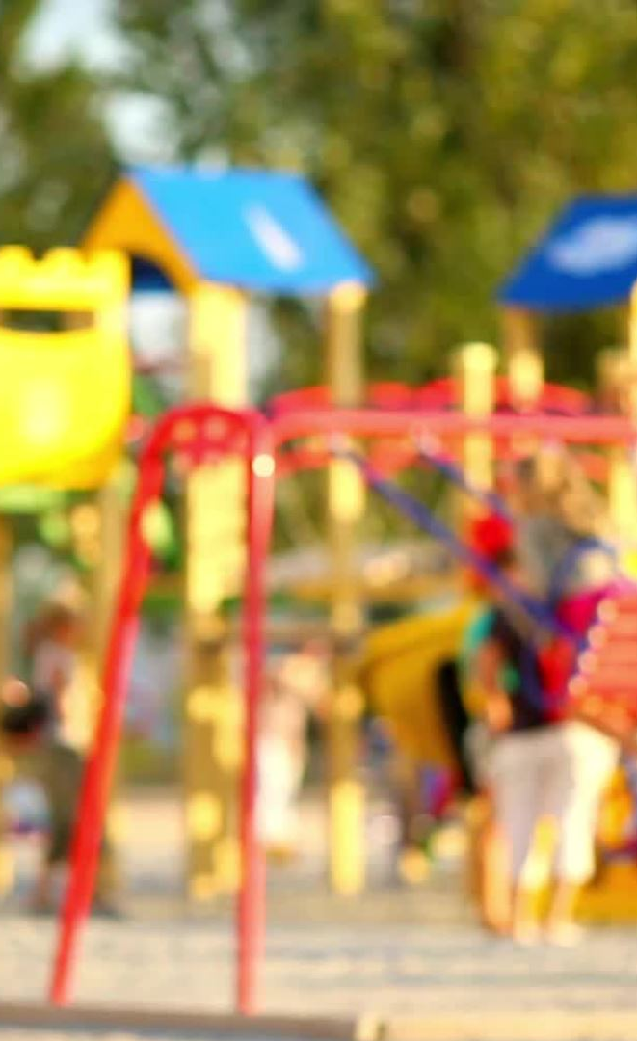
Scanning
Gather data on the problem:
  Review police reports and community complaints related to the park.
  Conduct informal interviews with park users, nearby residents, and local businesses to understand the extent and perception of the problem.
  Observe the park during different times of day to identify when and where antisocial behaviour occurs.
Initial findings reveal peak incidents occur during weekend evenings, involving groups of teenagers and young adults congregating in poorly lit areas.

Slide 46
Analysis
  Investigate the underlying causes:
    Why is the park attracting such behaviour? (e.g., lack of alternative youth spaces, limited police presence, inadequate lighting).
    Are certain features of the park contributing to the problem (e.g., secluded spots or lack of surveillance)?
    Analyse demographics and social factors that may influence the behaviour.
  Review evidence from similar cases in other areas to identify effective interventions, such as the impact of increased lighting or community patrols.

Slide 47

Response
Develop a multi-faceted response strategy, including:
  Improving park infrastructure, such as installing brighter lighting and CCTV cameras in high-risk areas.
  Collaborating with the council to organise youth-friendly activities or programmes to divert young people away from the park during evenings.
  Increasing police patrols during peak times, including both uniformed and plainclothes officers.
  Working with community organisations to create a neighbourhood watch scheme focused on the park.
  Launching a public awareness campaign about respecting public spaces, targeting schools and youth groups.

Slide 48
Assessment
Evaluate the effectiveness of the interventions:
  Monitor changes in police reports and complaints related to the park.
  Conduct follow-up surveys with residents and park users to assess perceptions of safety and satisfaction.
  Use CCTV footage and patrol reports to track changes in antisocial behaviour patterns.
Identify which measures were most successful and consider applying them to other public spaces in the area.

Slide 49
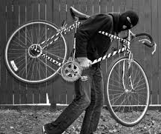
Your turn
A medium-sized neighbourhood has seen a sharp increase in reported bicycle thefts over the past three months. Residents have expressed concerns about the lack of security, and there’s growing dissatisfaction with the perceived lack of police response.
Use the OSARA model to provide a structured, evidence- based approach to solving the problem

Slide 50
SCANNING
Officers identify the problem by reviewing reports of bicycle theft in the area.
Data sources include:
  Crime statistics to determine the scale and frequency of incidents.
  Locations of reported thefts to identify hotspots.
  Resident complaints and social media discussions highlighting specific concerns.
Initial findings show most thefts occur near train stations, parks, and shopping centres during late afternoon and evening hours.

Slide 51
Analysis
Investigate the contributing factors:
  Are there environmental issues, such as a lack of secure bike racks or poor lighting?
  Are specific types of bicycles (e.g., high-value or e-bikes) being targeted?
  Are there common methods being used (e.g., bolt cutters, picking locks)?
Review offender data (if available) to determine whether repeat offenders or organised groups are involved.
Examine research on successful bicycle theft prevention strategies from other jurisdictions to inform potential interventions.

Slide 52
Response
  Develop and implement evidence-based solutions, such as:
    Installing secure bike racks in theft hotspots and increasing lighting in these areas.
    Conducting public awareness campaigns to educate residents about proper bicycle locking techniques and using GPS tracking devices.
    Deploying plainclothes officers to conduct surveillance in high-risk areas.
    Offering free or subsidised high-security locks to cyclists.
  Collaborate with local businesses and community groups to gain support and resources.

Slide 53
Assessment
  Measure the success of the response by tracking:
    Changes in the number of reported thefts.
    Resident satisfaction through follow-up surveys.
    Arrests or disruptions of theft rings if surveillance led to enforcement actions.
  Evaluate the effectiveness of each intervention to determine what worked best and adapt future strategies accordingly.

Slide 54
To conclude
Models for EBP:-
ATLAS
OSARA
Any questions?

Slide 55
Next week...
Policing models and limitations

