Slide 1
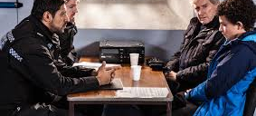
Conducting Investigations
An introduction to Suspect Interviewing

Slide 2
Why do we interview suspects ?
Investigators do have a duty to allow a suspect the opportunity to answer the allegations against them & give their own account before a decision on prosecution is made. An interview under caution may provide:-
Important evidence against the suspect, which you would otherwise be unable to obtain
Important information revealing further lines of inquiry
Relevant information to be considered in the prosecution decision

Slide 3
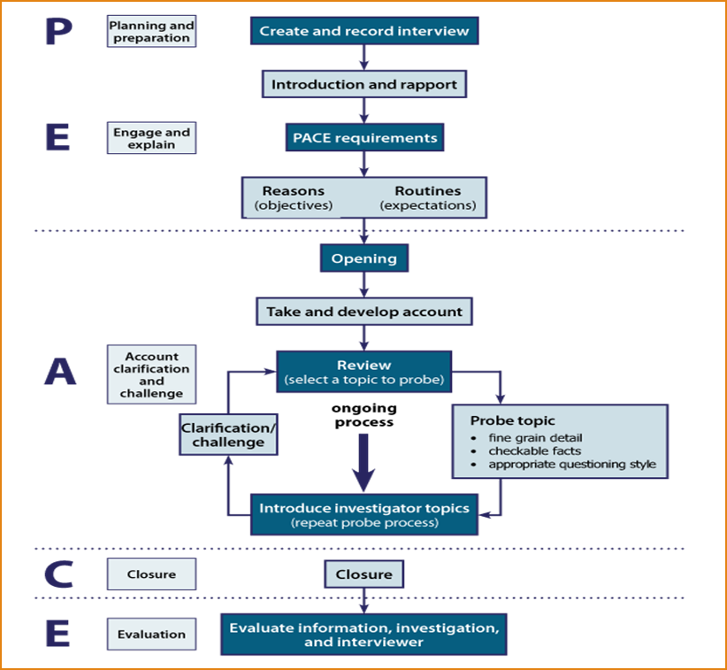
Use the PEACE model

Slide 4


Planning and Preparation

Slide 5
Planning and Preparation
Responsibilities of the Interviewing Officer
Welfare
Security
Legal Rights

Slide 6
Physical and emotional condition of the suspect
Presence & potential impact of drugs &/or alcohol
Presence and potential impact of injuries or illness
Current behavioural/ emotional state of the suspect
Requirement for medical assessment for fitness for detention & interview.

Slide 7
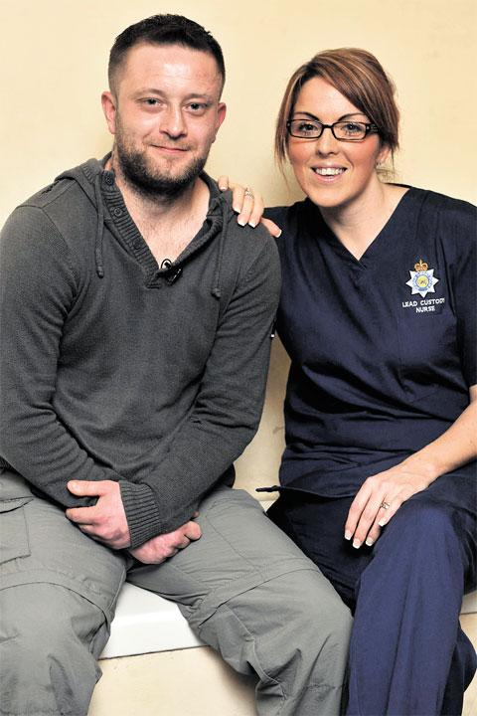
Medical Assessment
Understanding of Questions asked
Understanding of the caution
Understanding of the nature & purpose of the interview.
Significance & purpose of Q & A’s
Mental effects & ability to represent a rational & accurate explanation
Will the nature of the interview harm the detainee

Slide 8
Annex E – Code C
If an Officer has any suspicion, or is told in good faith that a person of any age may be mentally disordered or otherwise mentally vulnerable, or mentally incapable of understanding the significance of questions or their replies that person shall be treated as mentally disordered or otherwise mentally vulnerable for the purposes of this Code
Special care should always be taken when questioning such a person & the appropriate adult should be involved if there is any doubt about a person’s mental state or capacity
Because of the risk of unreliable evidence, it is important to obtain corroboration of any facts admitted whenever possible

Slide 9
Annex G - Code C
Risk to detainee. Consider if conducting the interview would significantly harm the detainee’s physical or mental state
Anything the detainee says about the offence for which they are being interviewed might be considered unreliable because of any physical or mental state (at the time of the interview)

Slide 10
Gather Information about the Suspect
Intelligence
Handover package
Other agencies
Health care professionals

Slide 11
Interview planning
Suspect Assessment
Fit to be detained, fit for interview. Annex G Code C
Previous information
Strategy for pre-interview briefing
Needs of the investigation
Priority lines of enquiry
CSI
Priority actions
Material Time Frame
Interview Objectives
Legal requirements
Aide Memoire
Code C PACE 1984
Code E (audio) & F (video)
Article 6 ECHR

Slide 12
Legal pack
Offence Definition
Points to Prove
Stated Cases
You need to demonstrate knowledge

Slide 13
Appropriate Adult (AA)
AA’s are called to the police station as an important safeguard, providing independent support to detainee’s who are:
Aged 18 or under or
Maybe mentally disordered /vulnerable
They are not simply an observer. Their role is to assist the detainee to ensure that they understand what is happening at the police station during the interview & investigative stages. In particular they should:-
Support, advise & assist the detainee
Ensure that the police act fairly & respect the rights of the detainee
Help communication between the detainee, the police & others
Their role is NOT to provide the detainee with legal advice

Slide 14

Engage and Explain

Slide 15
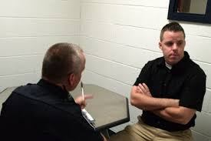
Aide Memoire

Slide 16
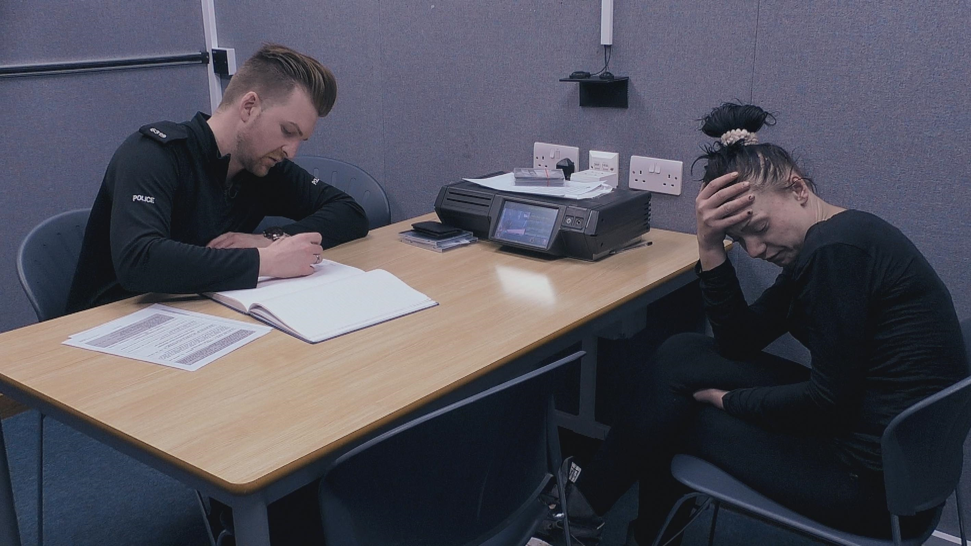
Account

Slide 17
Scenario
John SMITH has been arrested on suspicion of stealing a bottle of vodka at 3pm yesterday from the SPAR shop on HIGH STREET, CWMBRAN
CCTV inside the store shows a male selecting a bottle from the shelf, putting it inside their jacket, & leaving without offering payment. A local Officer PC JONES positively identifies the male on the footage as SMITH & has provided a statement
The shop assistant, Jane EVANS witnesses the theft. She has also identified the culprit as SMITH & knows him as she went to school with him

Slide 18
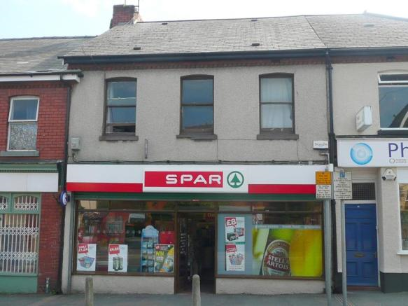
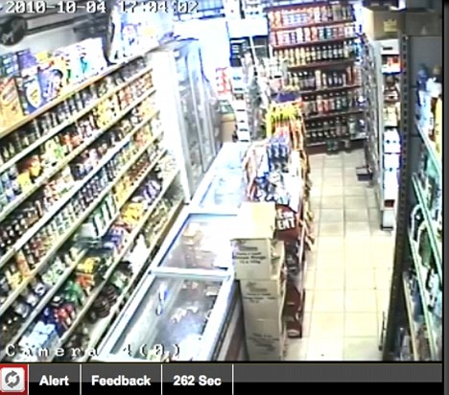
Scenario
You are tasked with interviewing SMITH. From what we know, what are the topics you want to include in your interview plan?
Responsibility
Material time frame
Knowledge of the SPAR
SMITH
CCTV
PC JONES statement
Jane EVANS statement

Slide 19
Scenario
Following the completion of your interview plan, you are ready to obtain SMITH’s account. The account comprises of 3 parts :
Suspect account
Police agenda
Challenge
Notes:
As per the PEACE model for interviewing.

Slide 20
Suspect Account
This is the account given by the suspect
It will be prompted by the responsibility questions, for example:
“Are you responsible for…..”
“Tell me what you know about..”
OR……..The material time frame questions:
“Tell me where you were and what you did on…..”

Slide 21
Suspect Account
This will prompt the suspect to give his/her account which will be one of the following:
Full admission
Denial
Partial admission
Unless…….
The suspect refuses to answer any questions, i.e. no comment
The suspect provides a prepared statement

Slide 22
Full Admission
If the suspect makes a full admission:
Cover the Points to Prove
Explore & if possible negate any defences. E.g, were you acting in self defence (for assault allegations)
It may not be necessary to continue with the Police agenda unless you have identified areas for clarification

Slide 23
Denial
If the suspect denies the offence
Identify topics from the Suspect account
Probe each topic. Gain as much detail as possible
Summarise after each topic & ask any questions missed (2nd interviewer if present)
Once you have exhausted the identified topics from the suspects account:
Move onto the Police agenda

Slide 24
Partial Admission
If the suspect makes a partial admission. E.g, when they admit their involvement but to a lesser degree
Treat the interview as though it is a denial
Identify topics from the Suspects account & probe. Gain as much detail as possible
Summarise after each topic & ask any questions missed
Once you have exhausted the identified topics from the Suspects account:
Move onto the Police agenda

Slide 25
Refusal to answer
If the suspect does not answer questions or answers, “no comment”
Explain to the suspect that you understand that is their right but that you still intend to ask the questions. Inform them you will give them time to answer if they wish.
Work through your interview plan topic by topic in detail
Be mindful of the pace of your questions. Don’t ask them too quickly. Answer the question in your head before asking the next
You can remind them of the caution & the implications of not answering questions however doing this repeatedly can be seen as oppressive
Remember it is their right not to answer questions

Slide 26
Prepared Statement
A prepared statement will usually be produced after the aide memoire
Ask the legal rep or the suspect to read out the prepared statement. Get the suspect to agree & sign it
Ask the legal rep if you can have a copy. Remember the statement is the property of the legal rep & suspect (some will be happy to give you the original)
Once you have a copy, best practice is to stop the interview to examine the statement & identify topics from it. This is the Suspects account

Slide 27
Prepared Statement
If you are refused access to it:
Inform the suspect that you will need to stop the interview to allow you to transcribe the statement as you will need to continue with the interview
Identify topics from the prepared statement & probe them. Once you have exhausted the topics, move onto the Police agenda
The Prepared Statement (or copy of) then becomes an exhibit produced by the Officer

Slide 28
Back to our Scenario
SMITH states he has no knowledge of the offence
He states that at the relevant time he was at home with some friends watching TV & drinking alcohol
He states he knows the shop well & goes there to buy alcohol as he is alcohol dependant
From his account, what topics have you identified to probe?

Slide 29
Possible Topics
SMITH – clothing worn, drinking habits etc
Home
Friends
Alcohol in house
TV
SPAR
After exhausting the topics, refer back to your plan. Whatever is left is the Police agenda

Slide 30
Police Agenda
Once you have exhausted the Suspect account, move onto your Police agenda
If the suspect has covered a topic you have in your plan during their account, there is no need to cover that topic again
Work through your plan topic by topic gaining as much detail as you can
Summarise after each topic & ask any questions you have missed (2nd interviewer if present)
The Police agenda is when we introduce statements, exhibits & forensic evidence. These are not challenges at this point

Slide 31
Back to our Scenario
Police agenda topics left after suspects agenda
Jane EVANS statement
PC JONES statement
CCTV

Slide 32
Challenge
Once we have covered all the topic on our interview plan, it’s time for the challenge phase
‘Challenges’ are anomalies between the evidence we have at our disposal & the suspect’s account or lack of account
The word ‘challenge’ suggests confrontation, however these anomalies should be put to the suspect in a calm, professional manner

Slide 33
How to challenge
Identify anomalies between our evidence & what the suspect has told us or between conflicting accounts given by the suspect
Raise awareness of the anomaly, ask them to confirm their account
Reveal the anomaly. Do not call the suspect a liar
Move onto the next anomaly
Where appropriate disclose, introduce & question in relation to any information you have withheld

Slide 34

Strategic use of evidence
Strongest Evidence
Weakest Evidence
Forensic Evidence
Inconsistencies in Suspect account
Special Warning
Bad Character Evidence

Slide 35
Back to our Scenario
SMITH is currently being interviewed
The Suspect & Police agenda have been exhausted & throughout SMITH has maintained that he was at home with friends (who he has refused to name) at the relevant time. He also refused to tell you what alcohol he was drinking & where he got it from
He does however agree that he knows both PC JONES & Jane EVANS and that they know him. He has stated that he has never had any issues with either JONES or EVANS
He also stated that he knows the SPAR & went there a week ago to buy vodka

Slide 36
Let’s challenge SMITH
What are the anomalies in our scenario between SMITH’s account & the evidence?
The statement of Jane EVANS
The CCTV
The statement of PC JONES

Slide 37
The Smith challenge
“John , I have listened to what you have to say on this matter & there are a few things that I need you to help me understand. Tell me again in as much detail as possible what you did between…….”
We then reveal the anomaly
“Jane EVANS, who by your own admission you have never had a problem with is saying that she witnessed you select & hide the vodka & leave without paying. How do you account for that?”

Slide 38
An effective challenge
Repeat this sequence for all anomalies
Raise awareness of the anomaly & ask the suspect to confirm their version (if appropriate)
Put the anomaly to the suspect
Notes:
I

Slide 39
An effective challenge conclusion
At the end, it may be appropriate to put all the evidence to the suspect in one final challenge & ask for a comment
For example in the case of our scenario
“John you have maintained throughout this interview that you are not responsible for the theft & did not attend the SPAR. You have heard however that Jane EVANS will say she saw you stealing the vodka & PC JONES has identified you as the person on the CCTV seen stealing the vodka. So to be fair to you I will ask you one last time & I want you to think carefully. How do you account for that?”

Slide 40
Closure
Give them one last chance
“Is there anything you wish to add or clarify about what you have said in this interview today John?”
“The time is…..”
“The date is……”
And I am stopping the recording

Slide 41

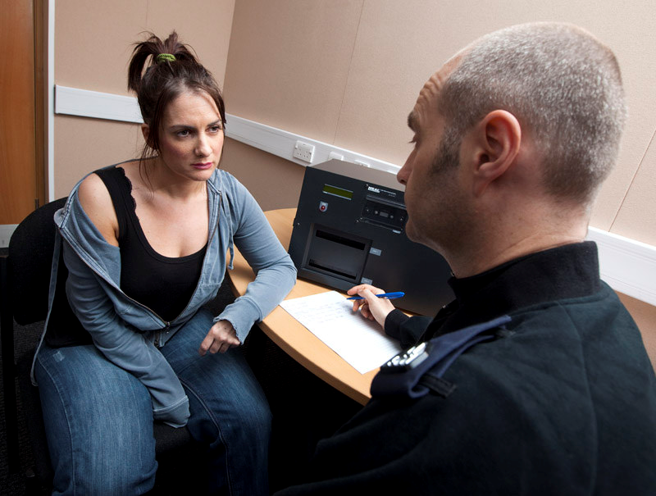
Produce the interview
The interview is conducted by you, you therefore produce it as your exhibit & may be required to play it or read it out in court

Slide 42
Evaluation
Following an interview, the interviewer needs to evaluate what has been said with a view to:
Determining whether any further action is necessary
Determining how the interviewee’s account fits in with the rest of the investigation
Reflecting on the interviewer’s performance

Slide 43
Evaluation
Information
Obtained
URGENT action
Inform case direction
Interviewers performance
Self-reflection
CPD

