Slide 1
Inter-VLAN Routing
Lecture 6

Slide 2
Objectives
How network traffic is routed between VLANs in a converged network.
Configure inter-VLAN routing on a router to enable communications between end-user devices on separate VLANs
Troubleshoot common inter-VLAN connectivity issues.

Slide 3
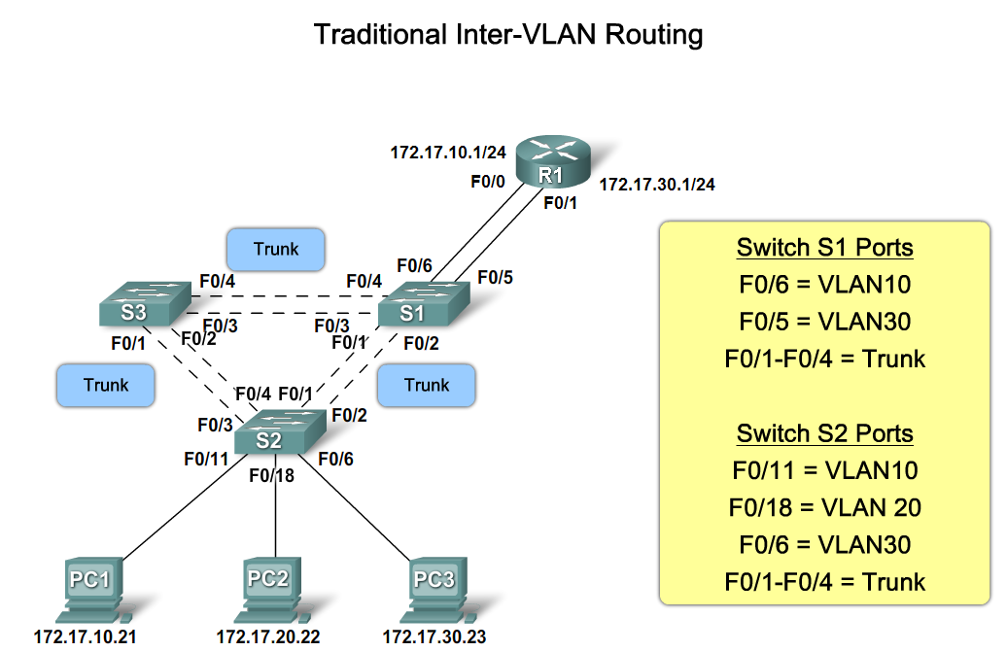
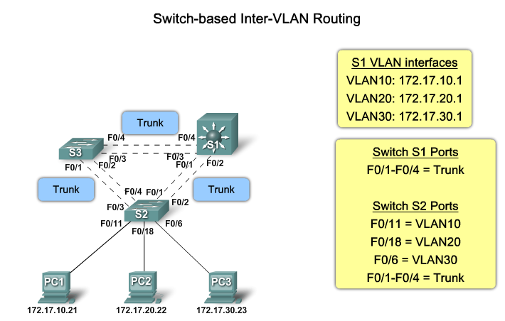
Inter-VLAN routing

Slide 4
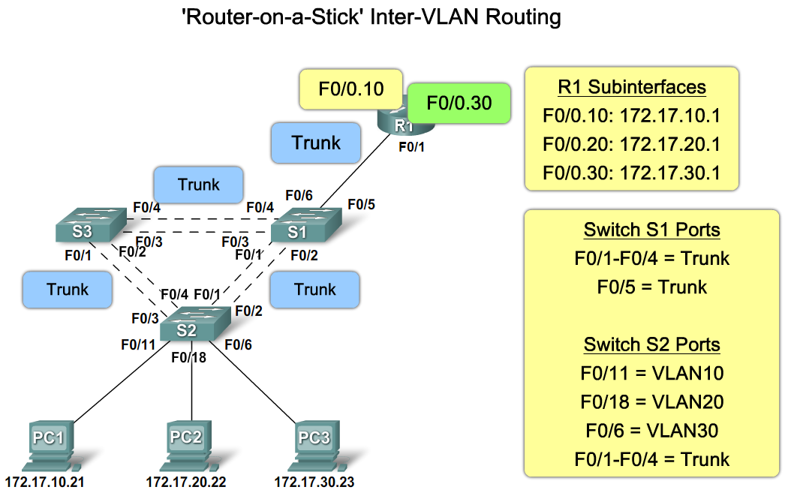
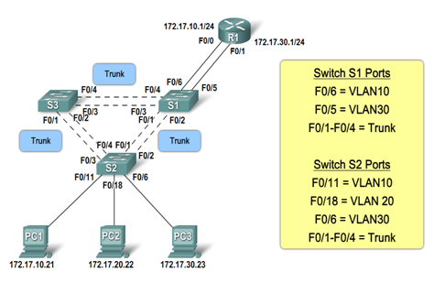
Role of Interface
Router Interface and Inter-VLAN Routing

Slide 5
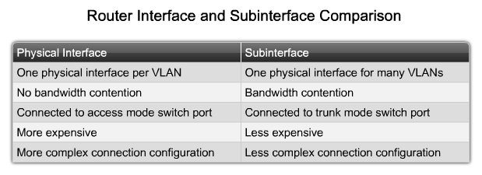
Role of Interface
Notes:
Graphic 6.1.1.3

Slide 6
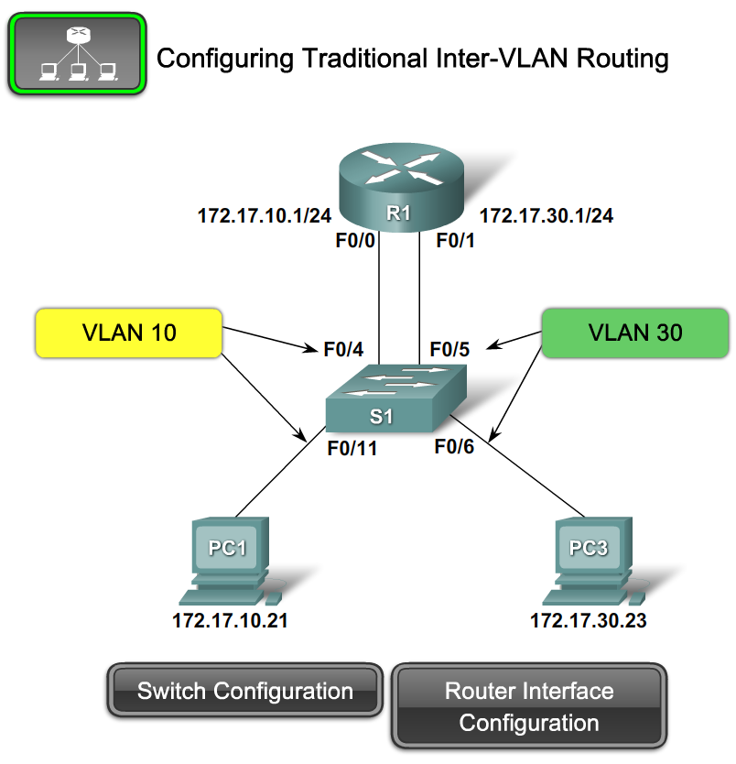
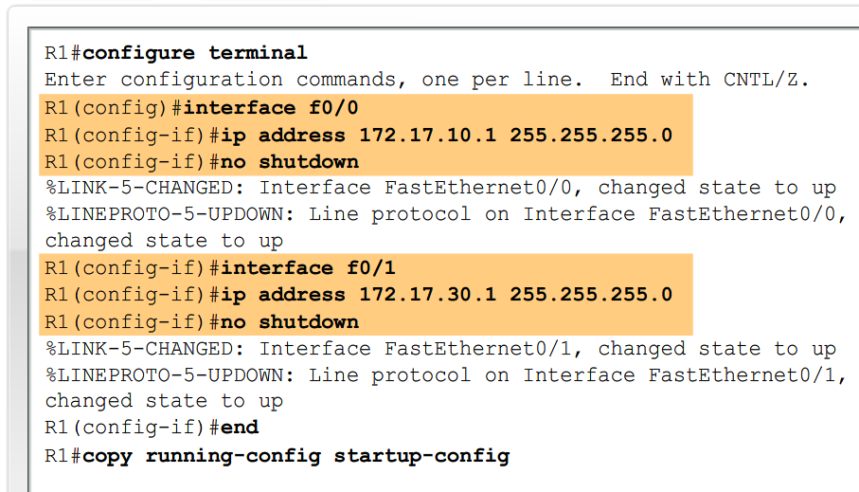
Configure Inter-VLAN Routing
Notes:
Graphic 6.2.1.1

Slide 7
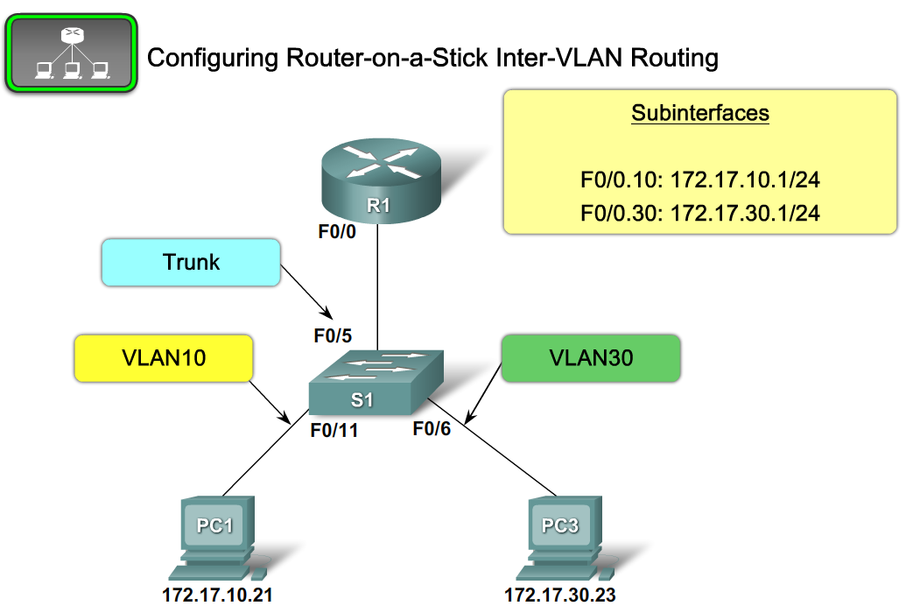
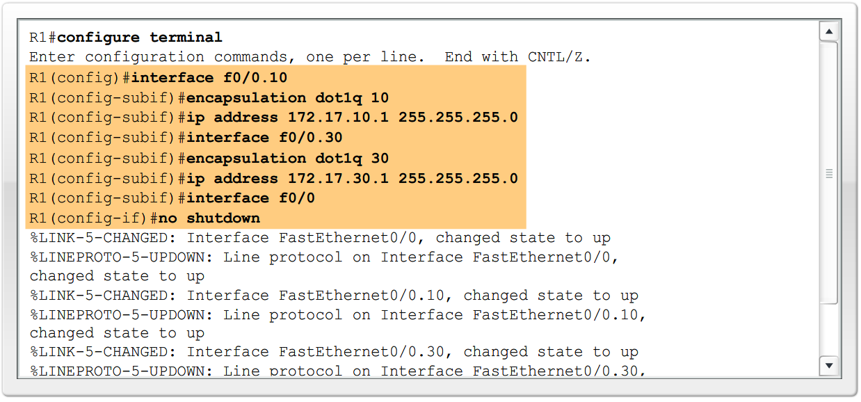
Configure Inter-VLAN Routing
Notes:
Graphic 6.2.2.1

Slide 8
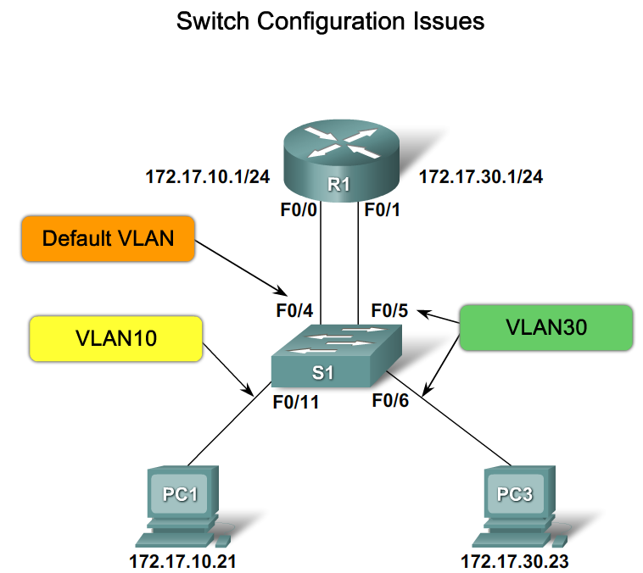
Common Inter-VLAN Connectivity Issues
Switch Configuration Issues
Notes:
Graphic 6.3.1.1

Slide 9
Common Inter-VLAN Connectivity Issues
Switch Configuration Issues
Notes:
Graphic 6.3.1.1

Slide 10
Common Inter-VLAN Connectivity Issues
Router Configuration Issues
Notes:
Graphic 6.3.1.1

Slide 11
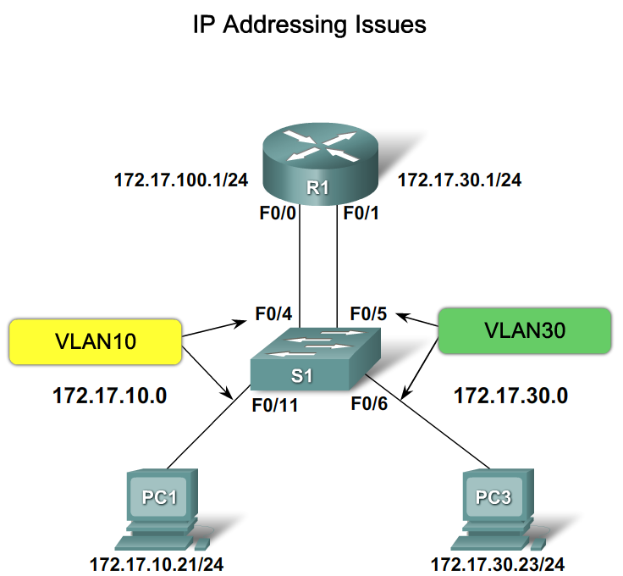
Troubleshoot Common Inter-VLAN Connectivity Issues – IP Address Issues
Notes:
Graphic 6.3.3.1

Slide 12
Troubleshoot Common Inter-VLAN Connectivity Issues – IP Address Issues
Notes:
Graphic 6.3.3.1

Slide 13
Summary
Inter-VLAN routing is the process of routing information between VLANs
Inter-VLAN routing requires the use of a router or a layer 3 switch
Traditional inter-VLAN routing
  Requires multiple router interfaces that are each connected to separate VLANs
Router on a stick
  this is an inter-VLAN routing topology that uses router sub interfaces connected to a layer 2 switch.
  Each Subinterface must be configured with:
  An IP address
  Associated VLAN number
Configuration of inter VLAN routing
  Configure switch ports connected to router with correct VLAN
  Configure each router subinterface with the correct IP address & VLAN ID
Verify configuration on switch and router

