Slide 1
The design & application of an active rear wing
Morgan Plus Four
Interim VIVA
12.12.2024
Notes:
PM – brief introduction to team, mentioning everyones name and roles.
Max 1 min.

Slide 2
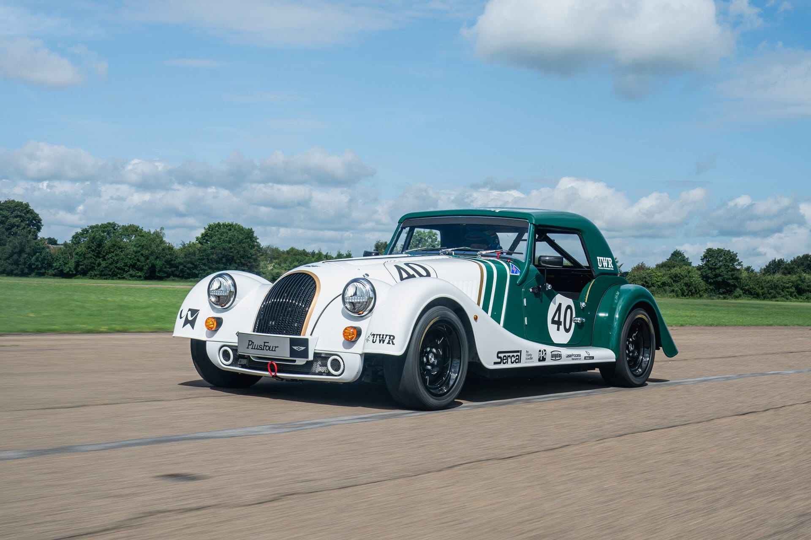
Aims & Objectives
Designing an active rear wing collectively through our different departments and roles within the group.
Innovate a final design for an active rear wing that provides an overall performance benefit which will be validated comparing lap times.
Figure 1
(DeMattia, 2021).

Slide 3
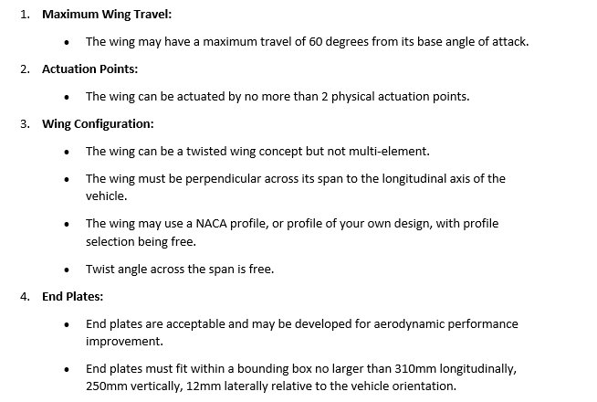
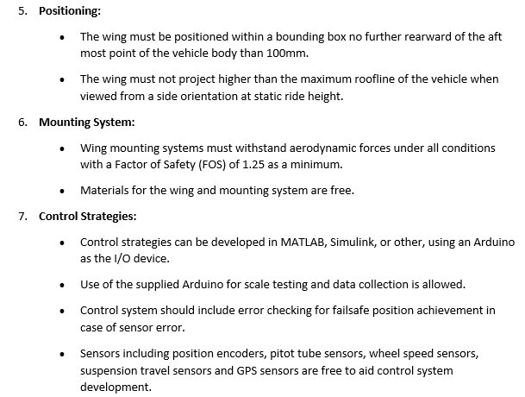
Regulations
Figure 10
(Noble, 2024).

Slide 4
Team Members & roles
Project Management – Efa Jones
Aerodynamics – Harvey Levell & Harvey Hodge
Structural – Hannah Bathgate & Cameron Andrews
Simulation – Tamzin Cooper
Control – Jac Evans & Rhys Thomas
Role deciding factors:
Belbin Team Roles Test Results
"designed to indicate how you would ideally operate in a team environment."
(University of Cambridge, 2024).
Personal interests within the project departments.

Slide 5
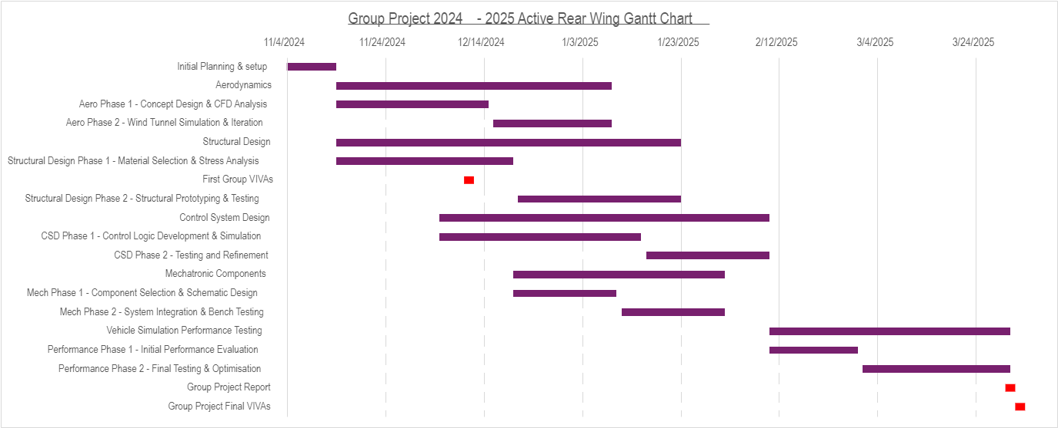
Project Planning
Notes:
PM – Project Planning, created a gantt chart to list everyones tasks, allocate time and keep track of progress to ensure efficiency.
Max. 1-2 min

Slide 6
Project Milestones & Gateways
Task | Department | Milestone/Gateway
Creating a baseline simulation of the Morgan on Optimum Lap. | Simulation | Milestone
Build a circuit that gives a position output dependent on a sensor input signal. | Mechatronics and Control | Gateway
Select an aerodynamic wing profile following research and testing. | Aerodynamics | Milestone
Produce 3 different wing mount designs each ready to be tested using Ansys and SolidWorks FEA. | Structure | Gateway
Structure and lay out the final report with sections for each team member and department, as well as writing my own section. | Project Management | Milestone

Slide 7
Aerodynamics
Led by Harvey Levell & Harvey Hodge

Slide 8
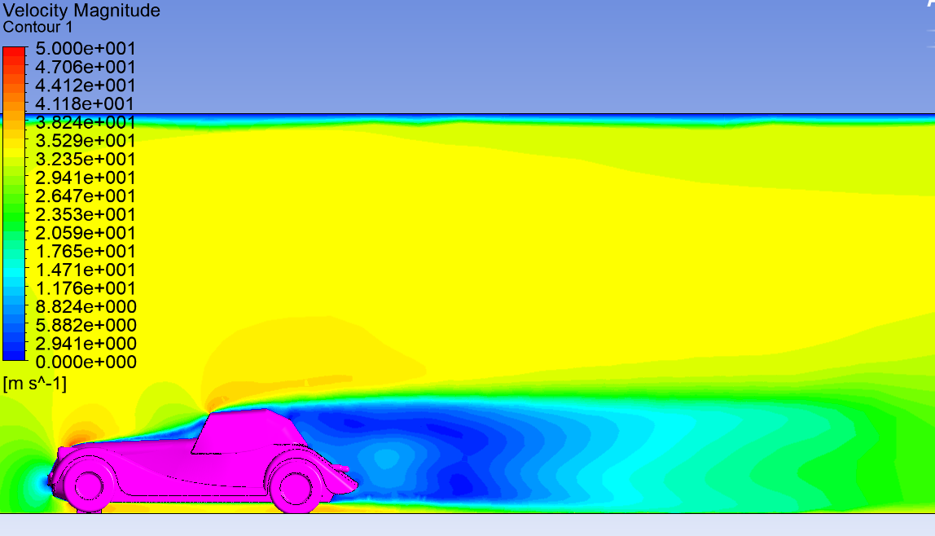
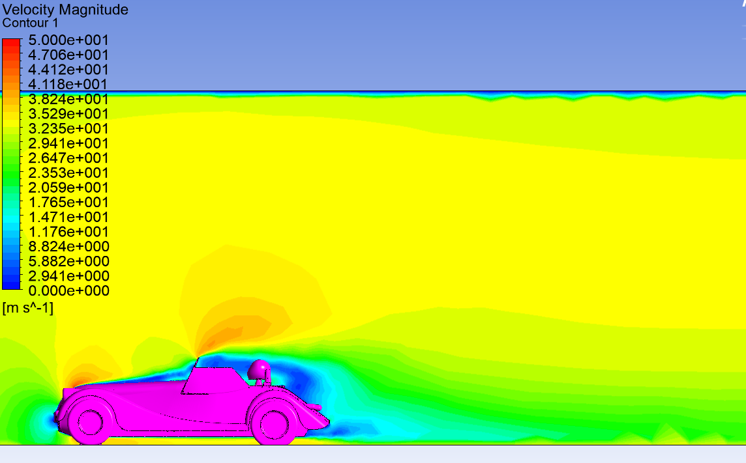
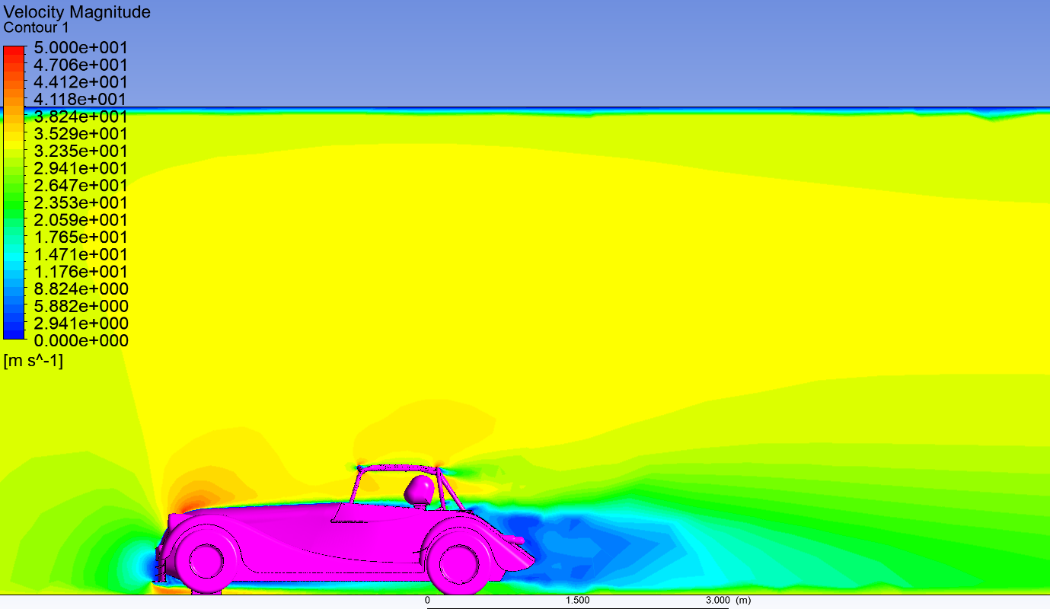
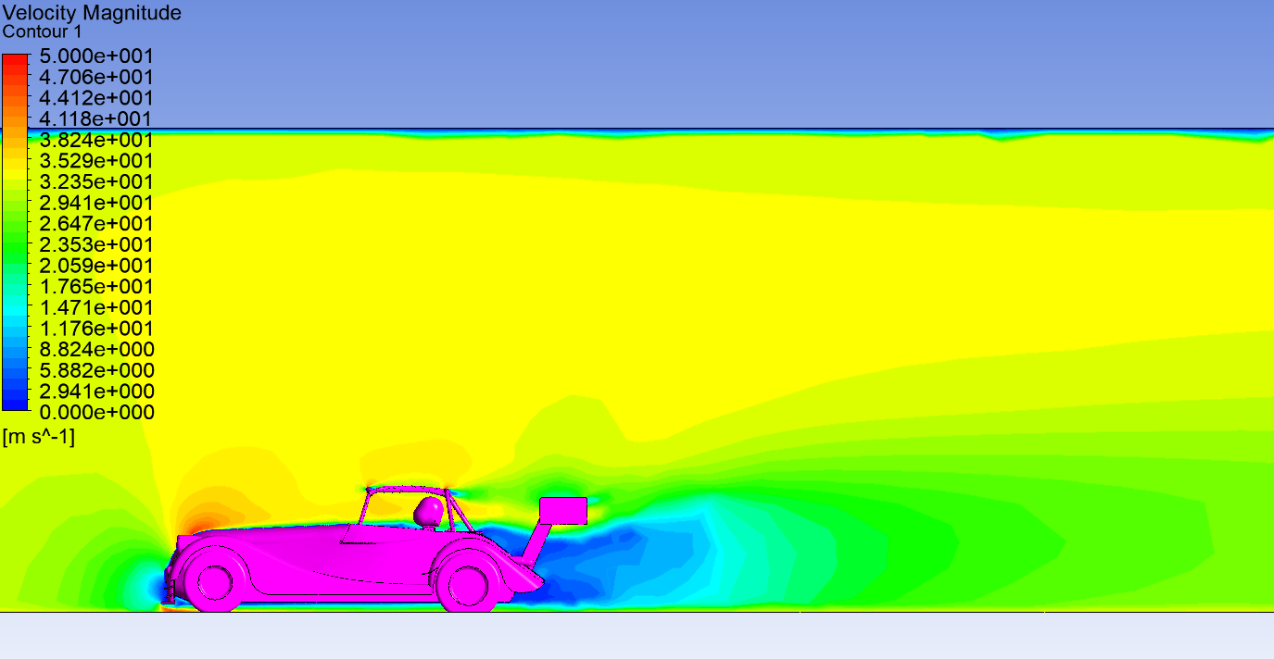
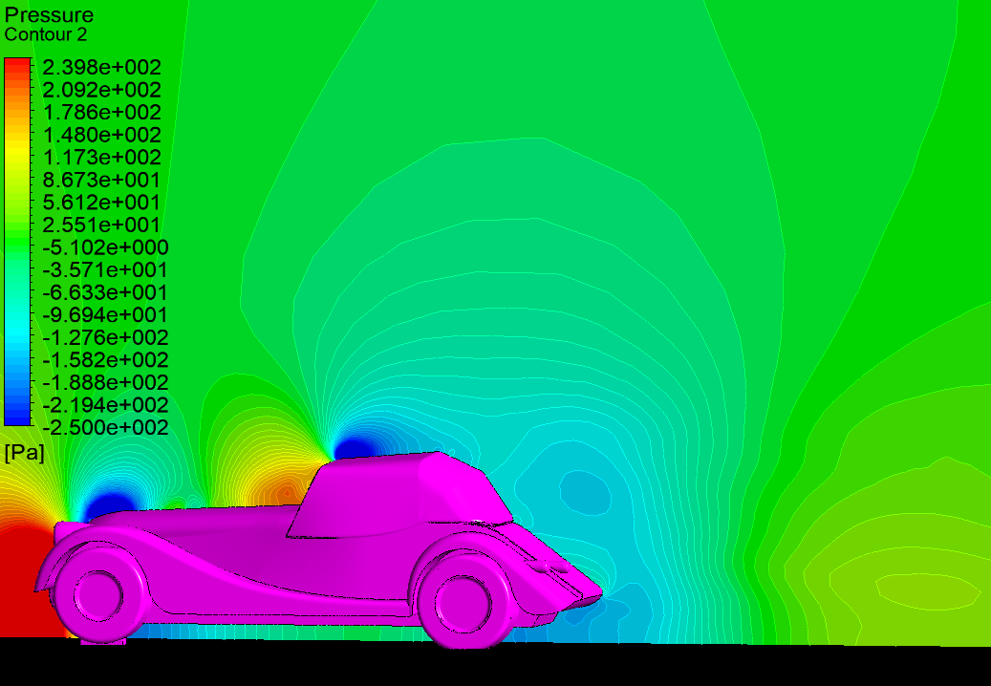
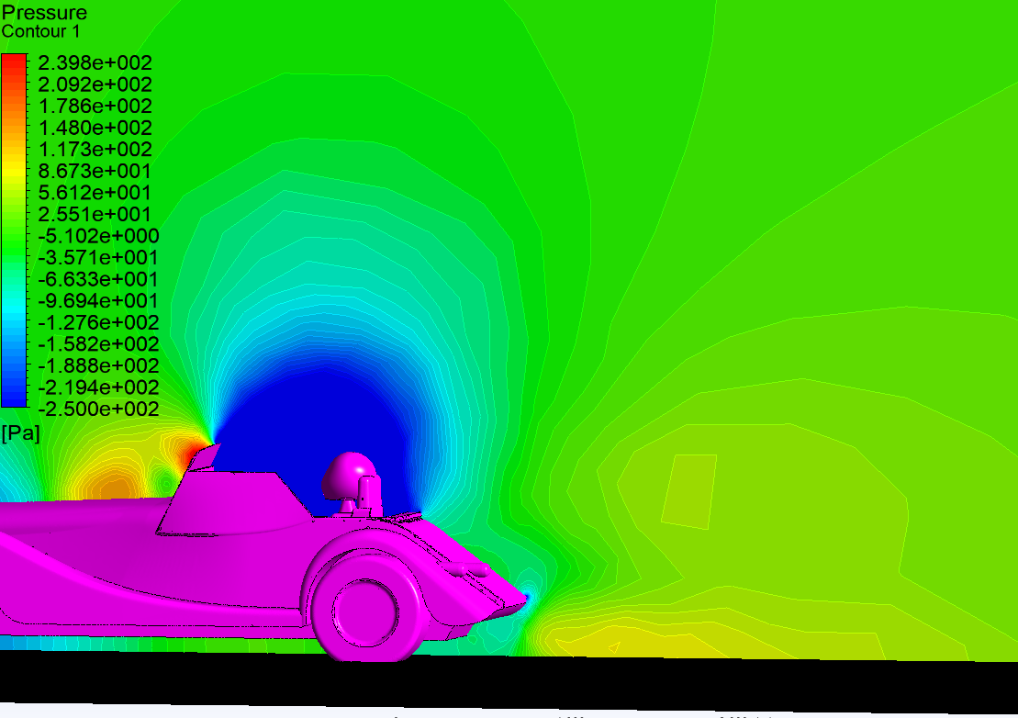
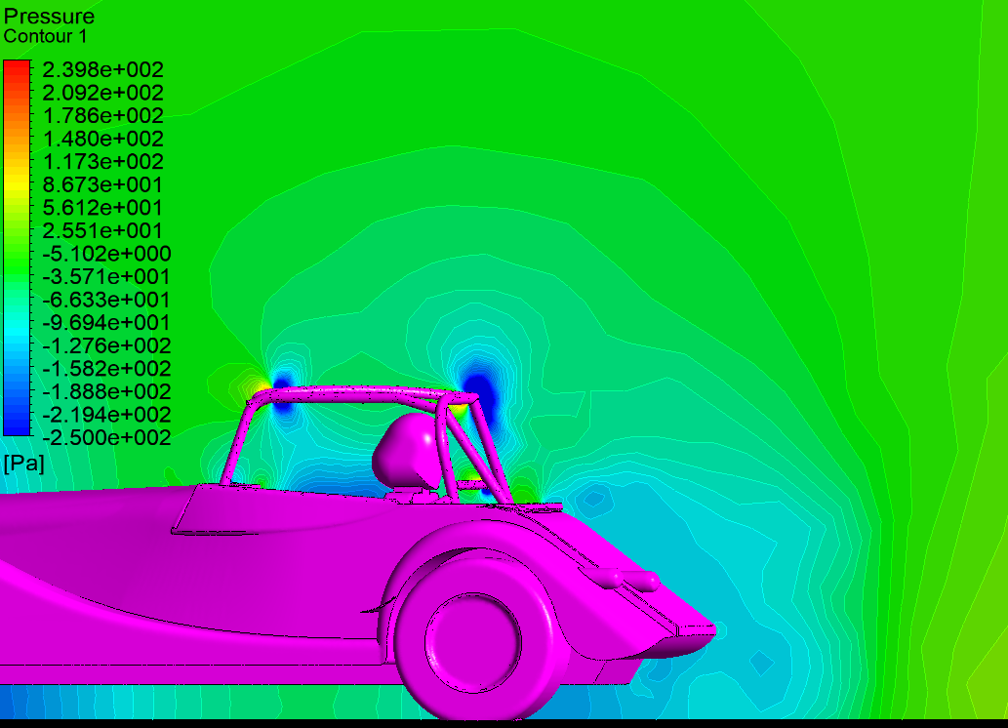
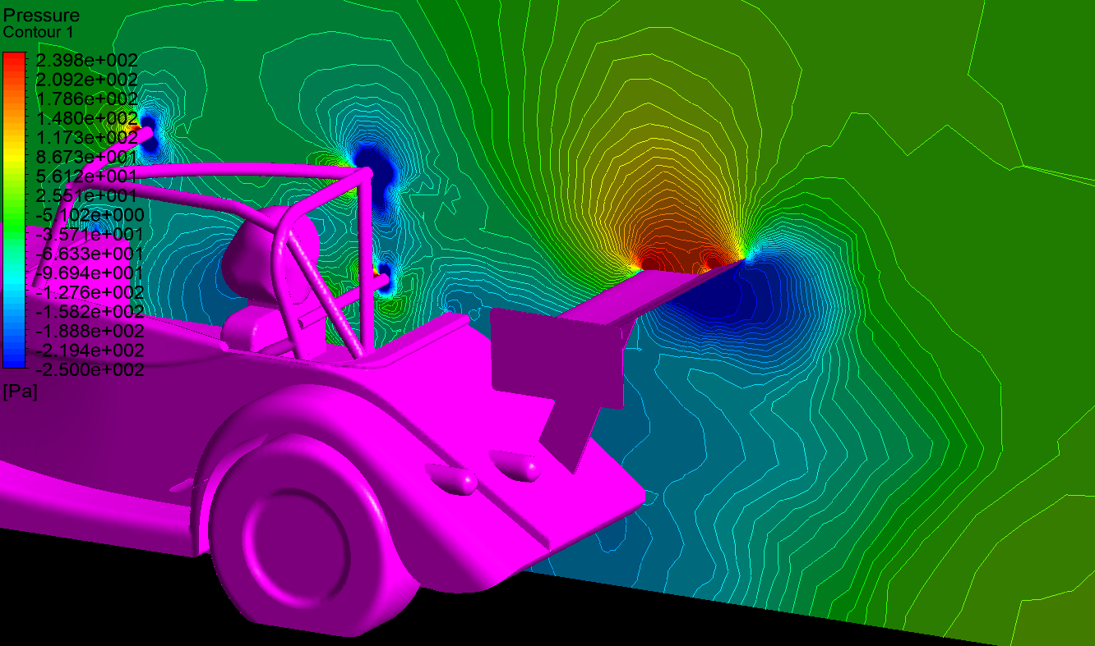
Aerodynamics Phase 1
Vehicle Research & CFD Analysis
2022 Morgan Plus Four
Roof Up
Roof Down
Roll Cage
Roll Cage & Test Wing
Velocity Magnitude Contours
Figure 2
Figure 3
Figure 4
Figure 5
Pressure Contours
Figure 6
Figure 7
Figure 8
Figure 9

Slide 9
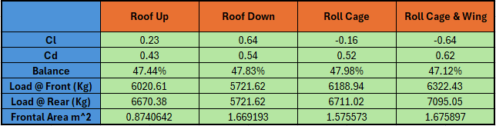
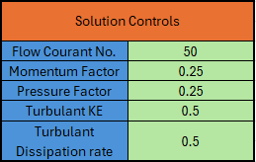
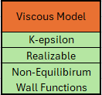
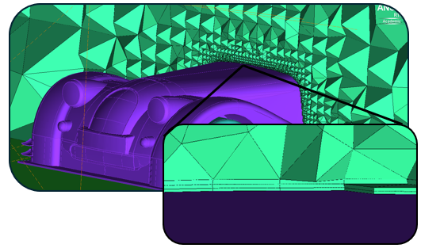

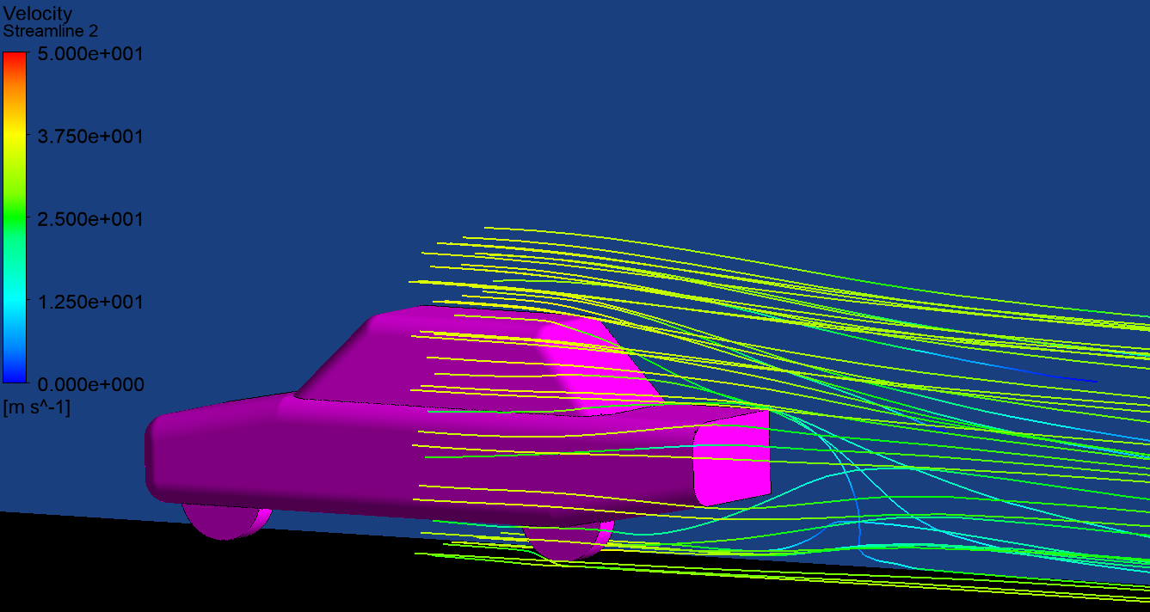
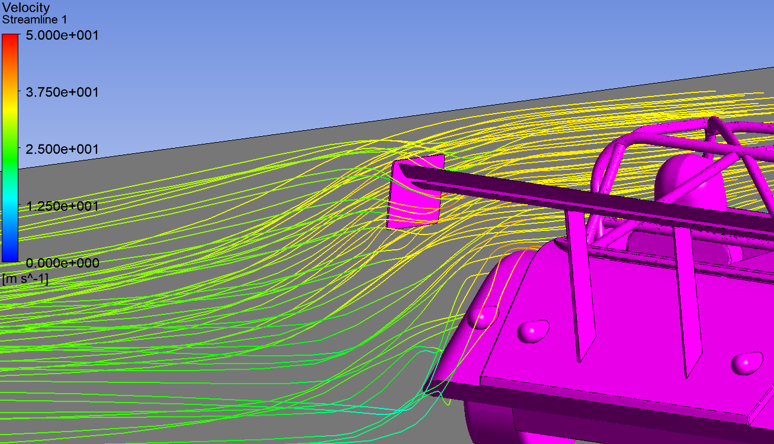
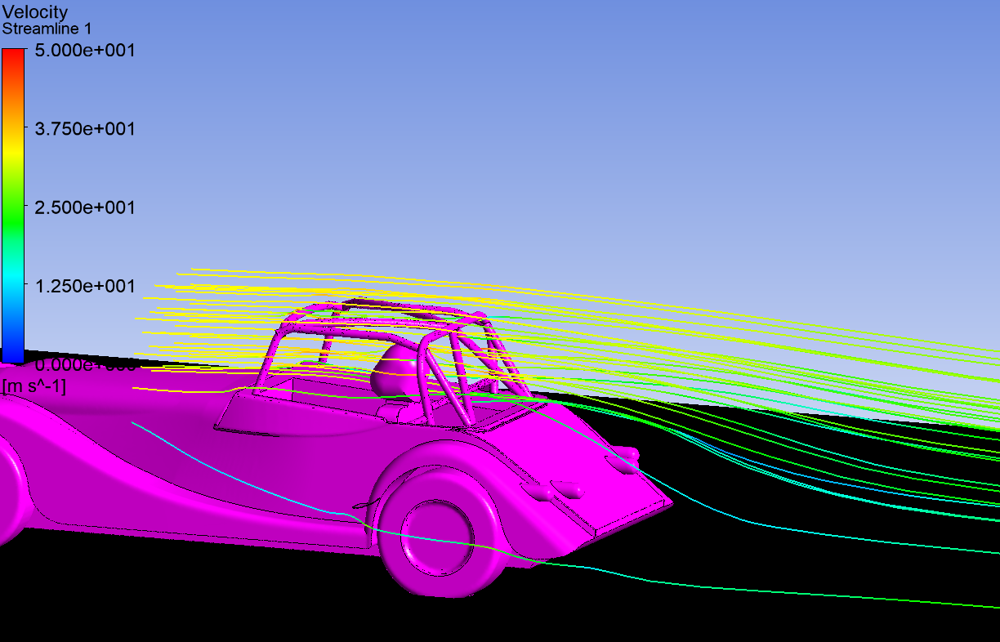
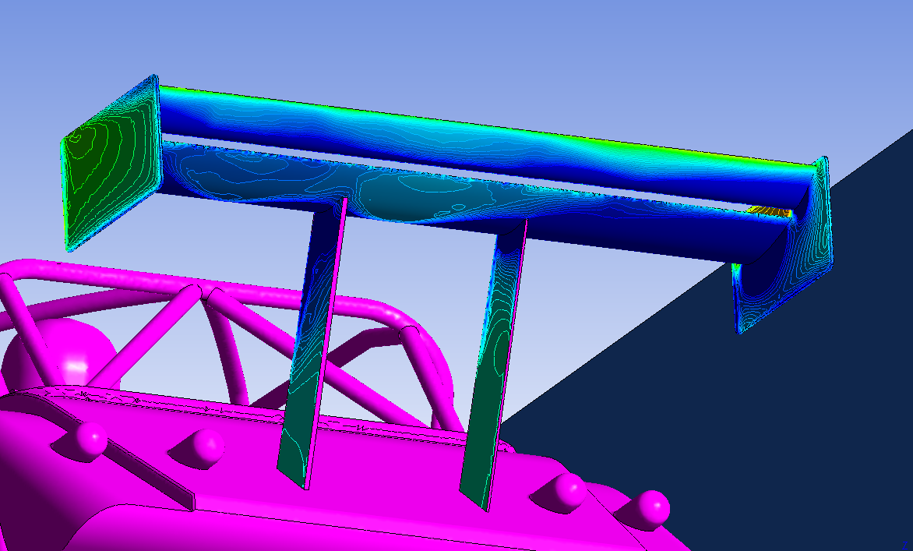
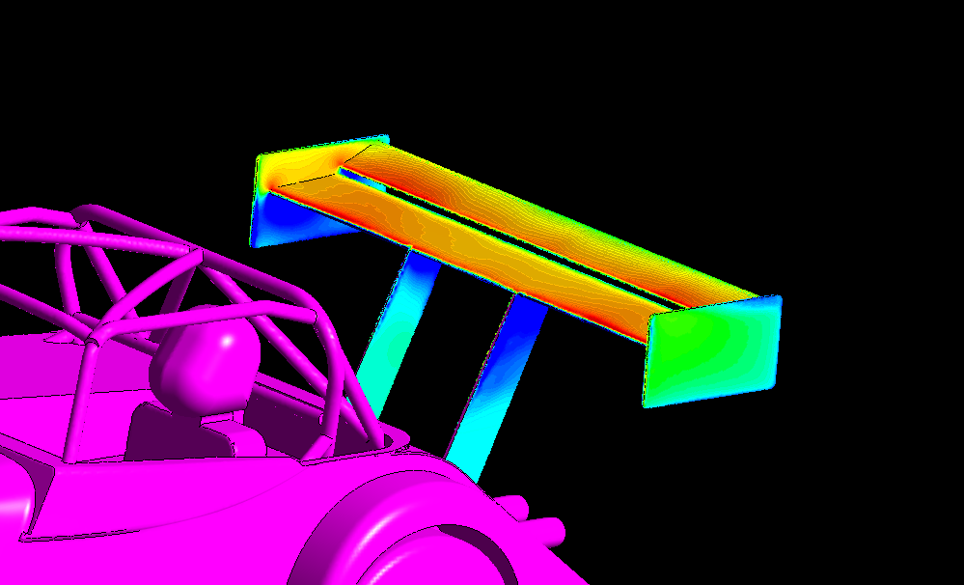
Conducted research, findings and design philosophy
ANSYS CFD PARAMETERS & DATA EVALUATION
Table 3
Table 1
Table 2
MIRA car CFD Analysis under the same parameters
Table 4
(Lanfrits, 2005)
Figure 14
Figure 15
(MIRA, 2022)
Streamlines showing behavior of airflow around end plates
Streamlines showing the speed of airflow through roll cage
Pressure map below wing
Pressure map above wing
Figure 16
Figure 17
Figure 18
Figure 19

Slide 10
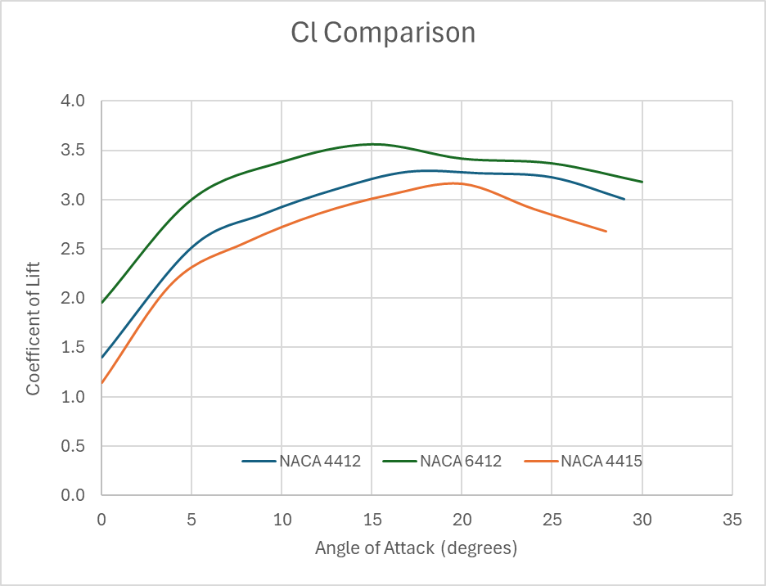
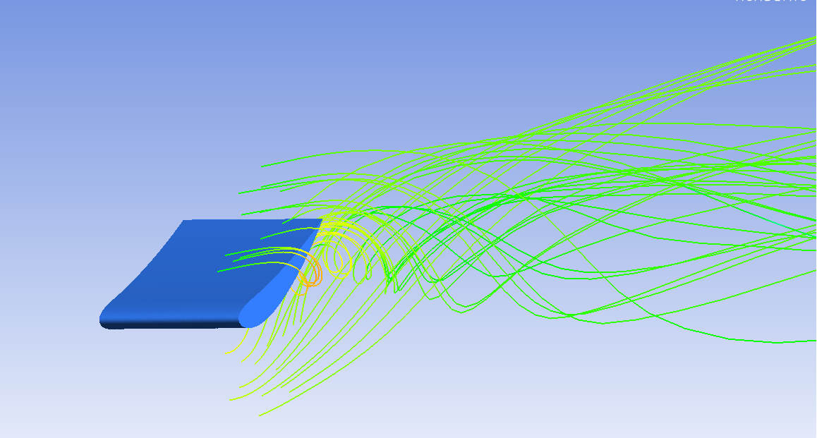



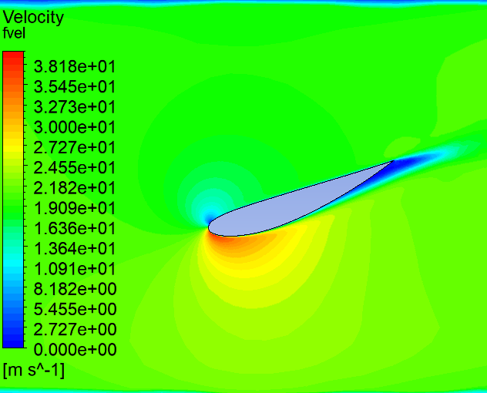
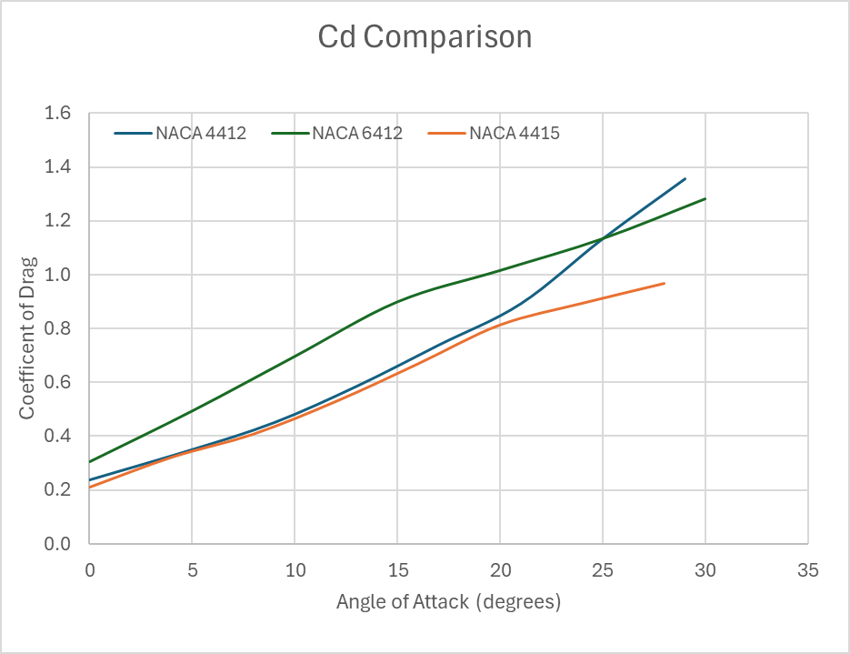
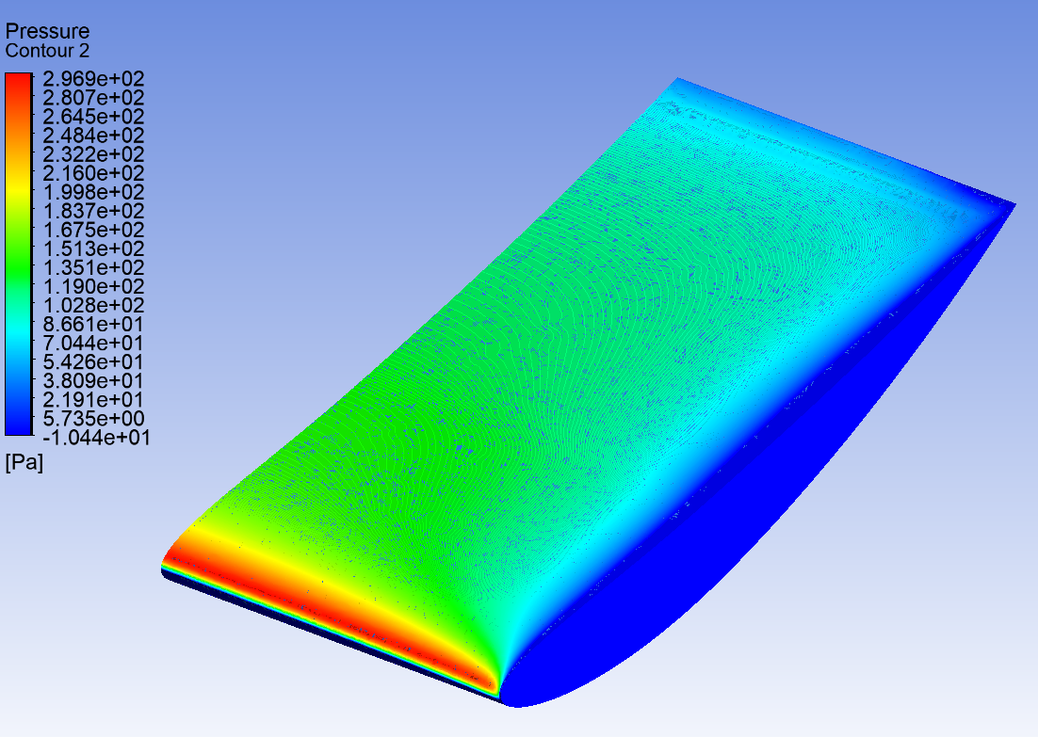
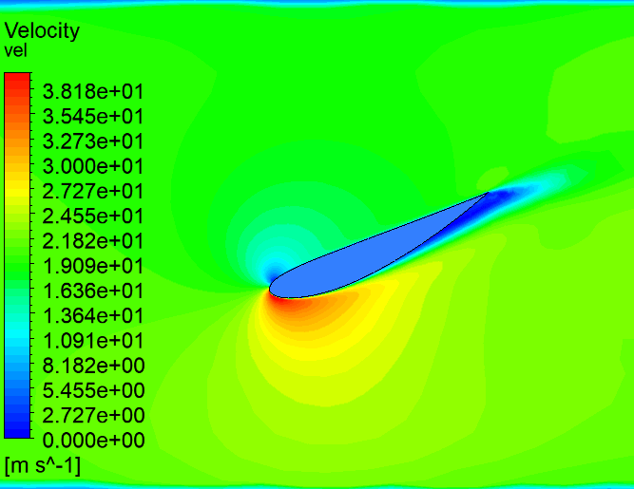
Conducted research, findings and design philosophy
CONDUCTED RESEARCH AND FINDINGS
-ve
Stall points
Pressure distribution
Current findings limits
-ve
Figure 24
NACA 6412 at 15 degrees AoA
Figure 20
NACA 4415 at 20 deg AoA
Figure 22
Figure 25
(Marqués-Bruna and Grimshaw, 2011)
Figure 21
NACA 4415 at 24 deg AoA
Figure 23

Slide 11
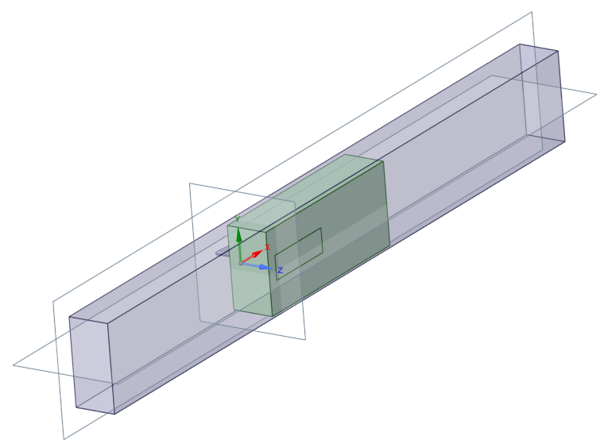
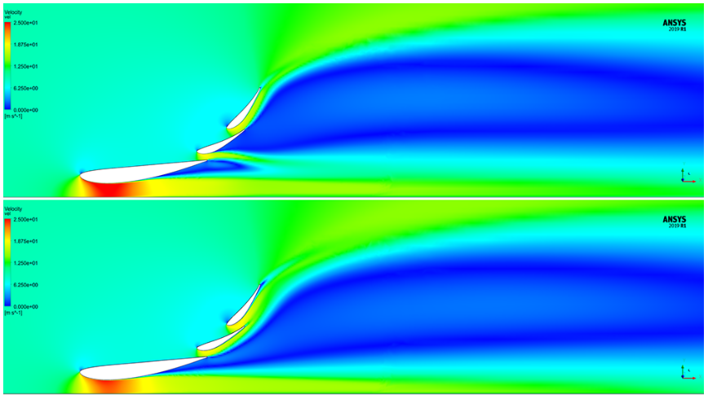
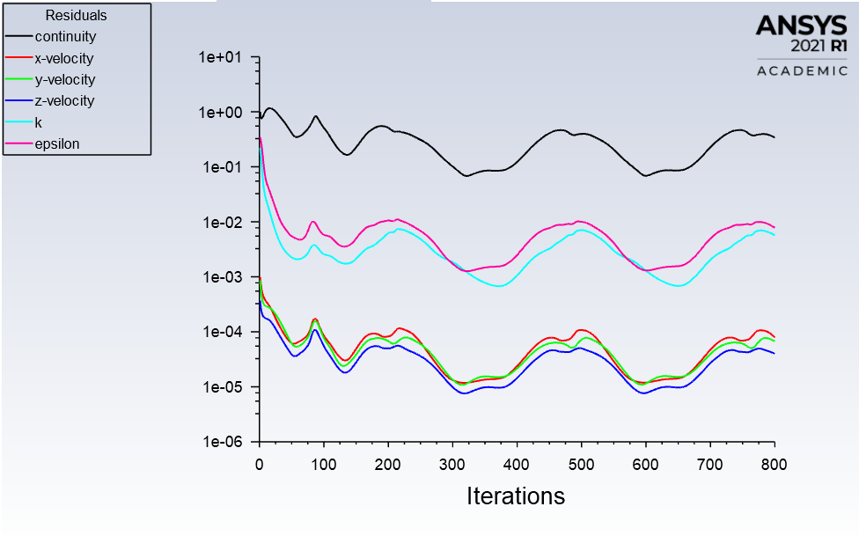
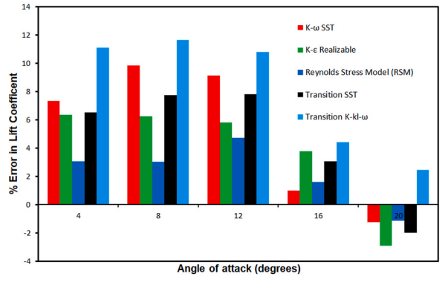
Conducted research, findings and design philosophy
RESEARCH VALIDATION
310 mm
Y+ ~1
Wind tunnel dimensions
Figure 26
2500mm
Y+ ~30
Figure 29
Velocity distribution on the symmetry plane -
310 mm
(Leap CFD team, 2020)
Y+ spacing impacts the resolution of the boundary layer
K epsilon struggles at high AoA but is closer to experimental data at AoA < 16
K omega can solve more accurately to experimental at higher AoA
Residuals of NACA 6412 at 20 degrees AoA – suggesting divergence, K-epsilon model
Figure 28
Figure 27
(Intizar Ali et al, 2023)

Slide 12
Structural Engineering
Led by
Hannah Bathgate & Cameron Andrews

Slide 13
Overview & goals
Research
Design
FEA
Cross-validation
Notes:
All CAD models will be run using three different types of materials and same wing profile to gain a good baseline for validation against each other.
Max loads found in conjunction with sim group
SolidWorks being simpler, ANSYS being more fine-tuned
All done using same wing profile (NACA 4412) for validity
Validation:
Validation methods:
Hand calculations: MacCaulay's Method, beam equations, FEA derivation
Beam testing
SolidWorks vs ANSYS FEA
Validate against another structural engineer

Slide 14
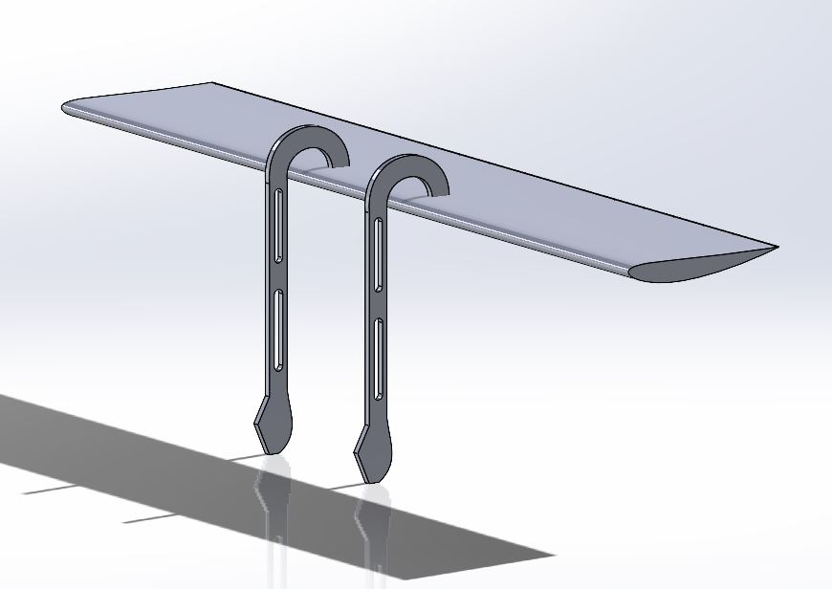
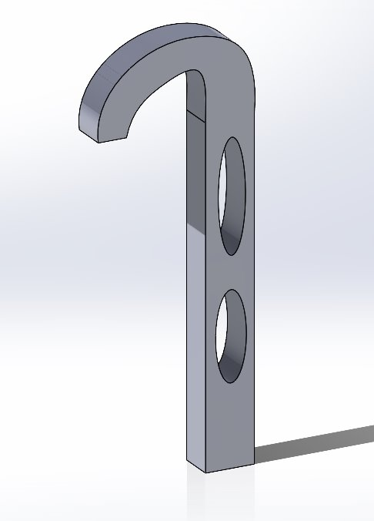
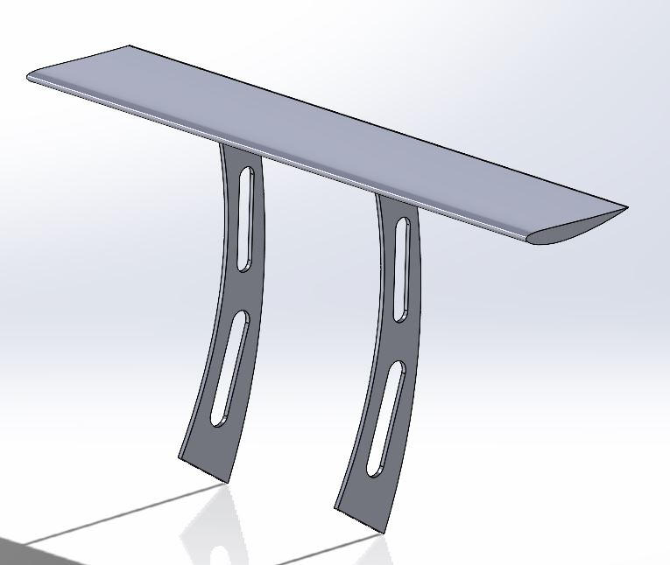
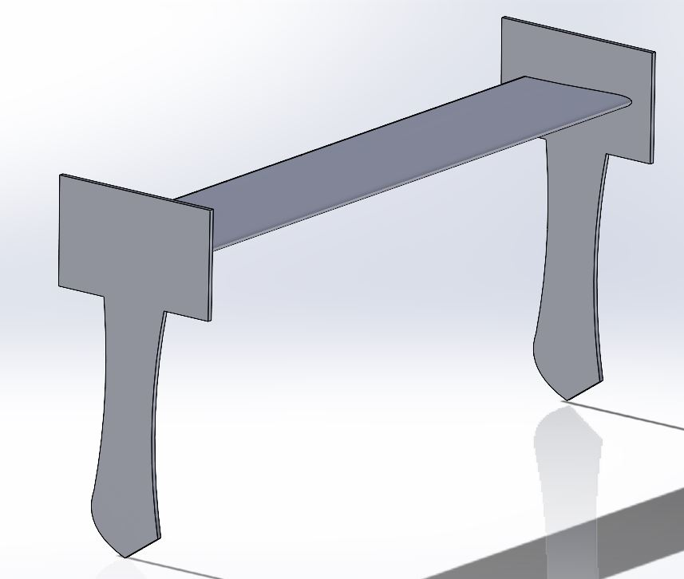
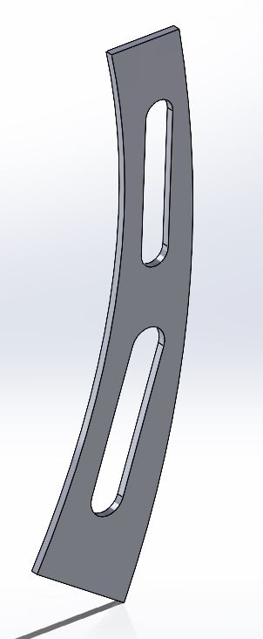
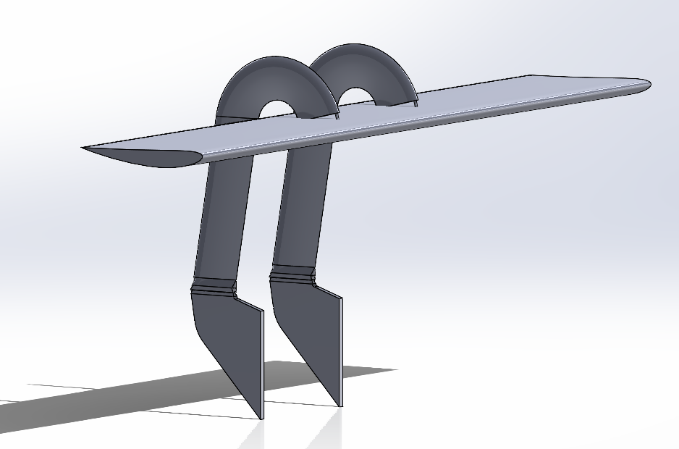
Design
CAD modelling
Mounting: swan neck (BVRLA, 2023) vs endplate (Somerfield, 2023) vs conventional
Figure 34
Figure 31
Figure 32
Figure 33
Figure 30
Figure 35
Notes:
Why we decided to use these loads

Slide 15
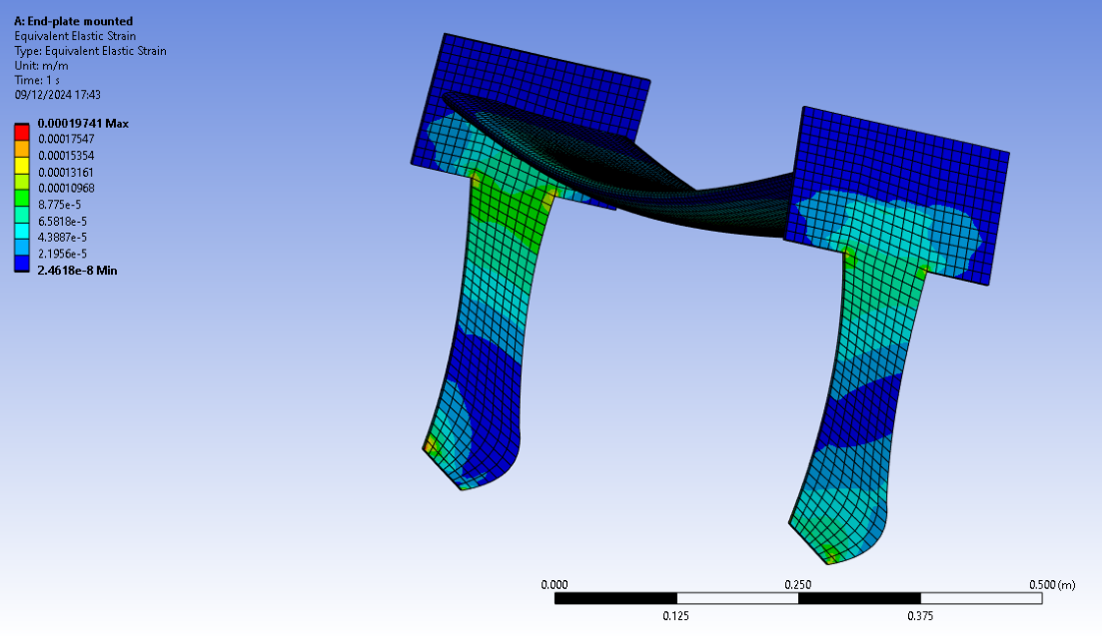
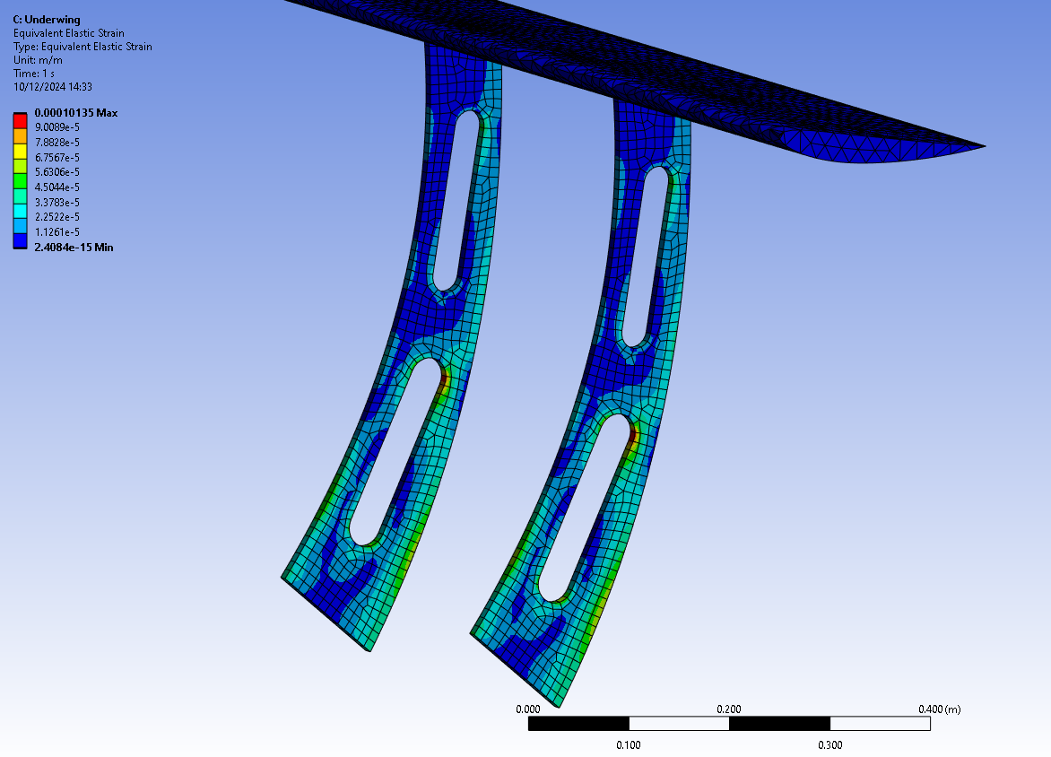
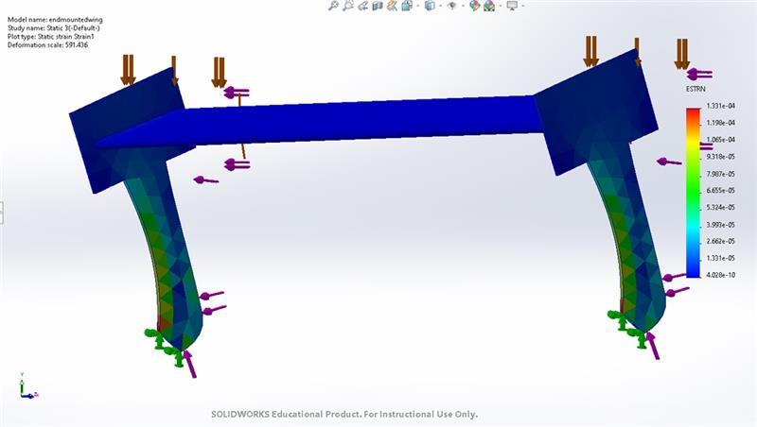
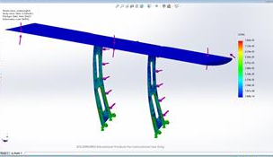
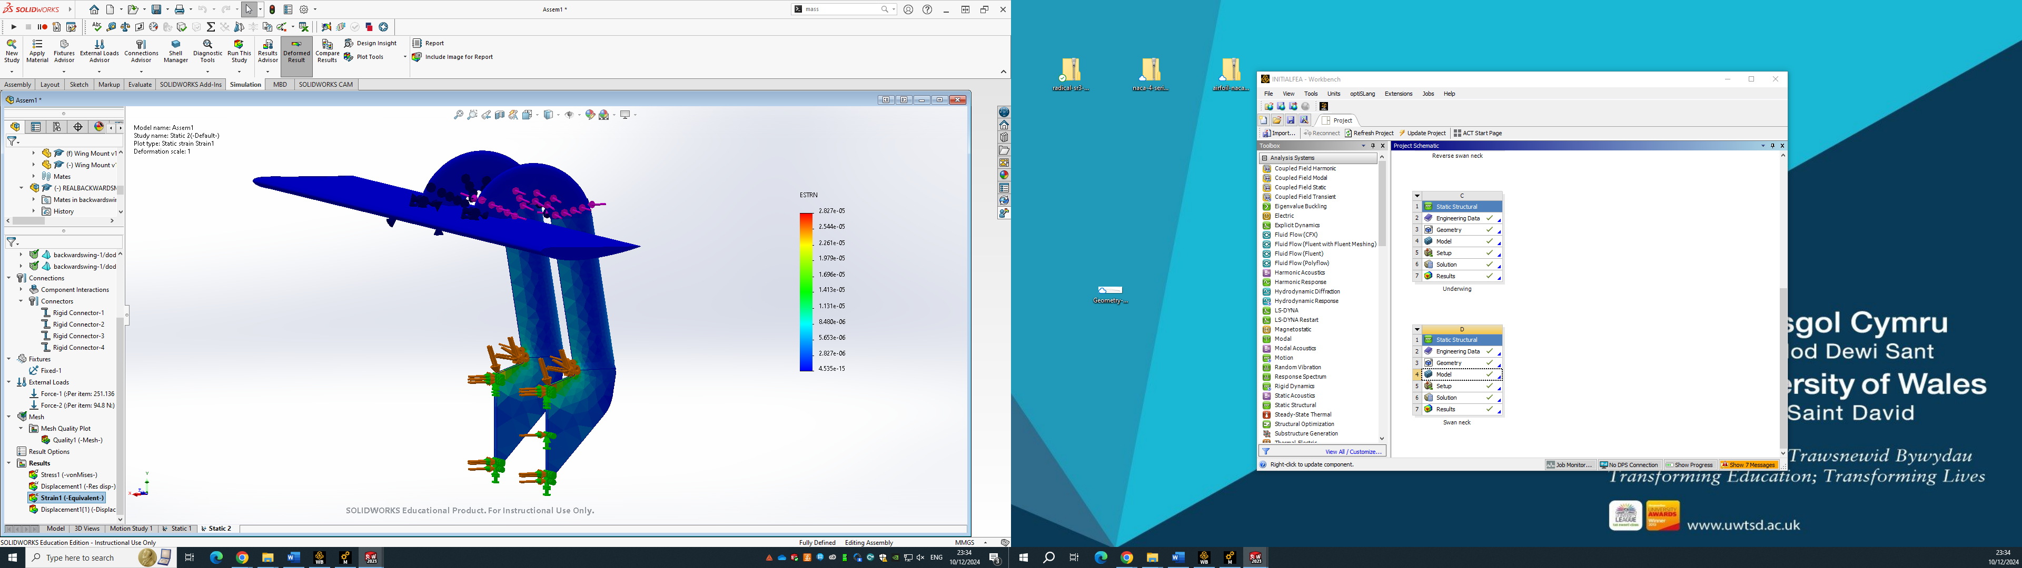
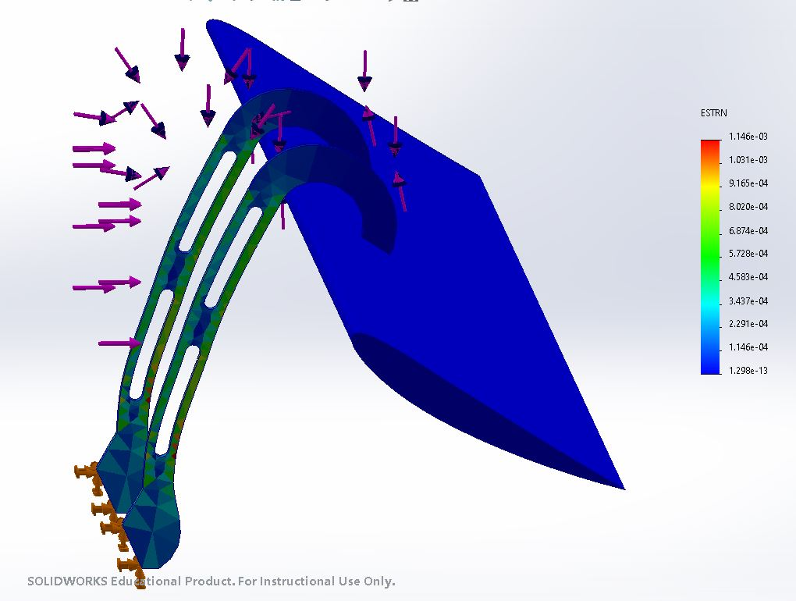
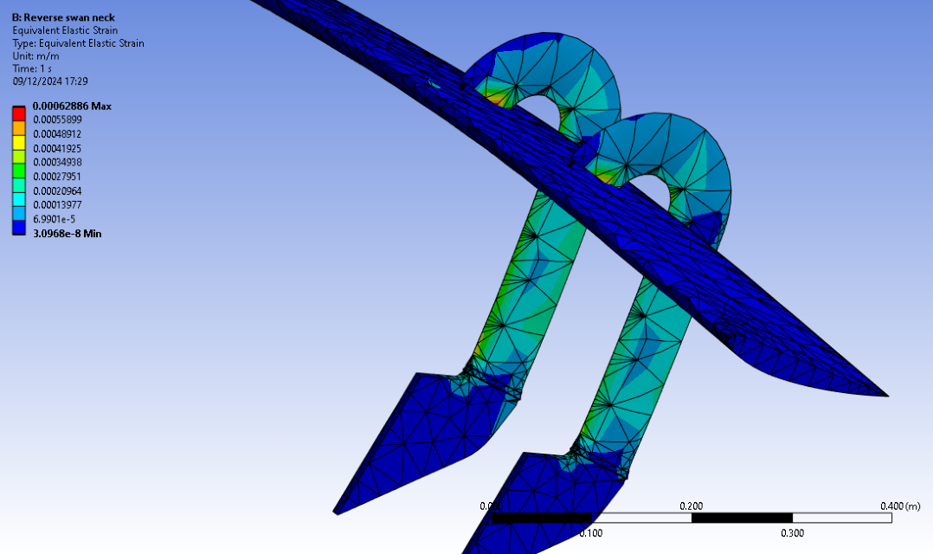
Results
Materials tested: Aluminium 6061 (Raven, 2005), carbon-fibre (Maddiotto, 2015) and steel 4130 (Dd, 2024)
Strain on carbon-fibre for all mounts, Ansys:
Strain on carbon-fibre for all mounts, SolidWorks:
Figure 36
Figure 37
Figure 39
Figure 40
Max deformation = 1.27 x 10⁻⁴ m
Max deformation = 1.15 x 10⁻⁴ m
Max deformation = 1.341 x 10⁻⁴ m
Max deformation = 1.52 x 10⁻⁴ m
Figure 38
Figure 41
Figure 42
Max deformation = 1.1 x 10⁻⁴ m
Max deformation = 1.42 x 10⁻⁴ m
Max deformation = 1.146 x10⁻³ m
Notes:
-highlighted keuy points of weakness in strucututre
-also shows the strength and soundness of the diff materials. H

Slide 16
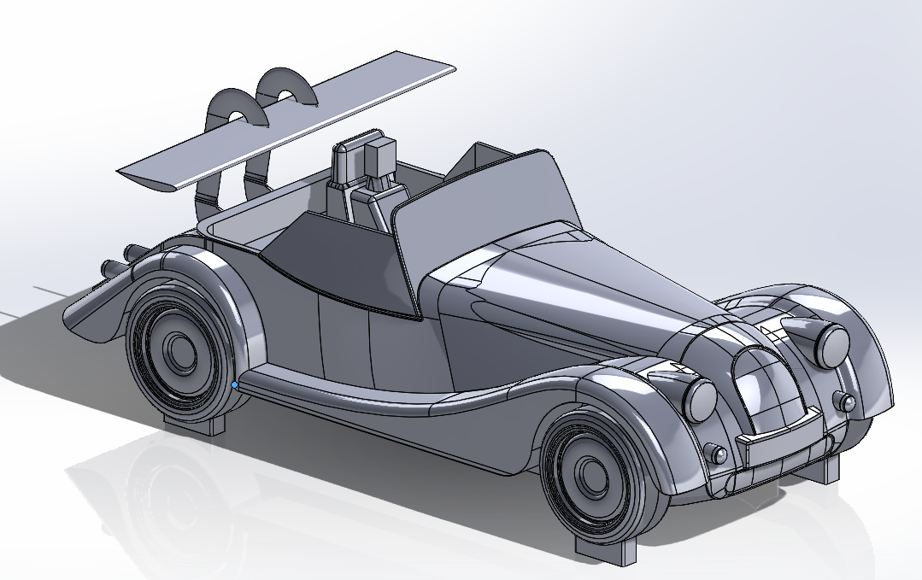
Subsequent work
Finalising mount and mounting
Results validation
Prototype production and testing
Finalised material selection
Mesh study improvement (Ansys, 2021)
Explore wing profile construction
More accurate FEA with non-uniform load
Figure 43
Notes:
Ununiform loads
thorough mesh study
Composites study

Slide 17
Simulation
Led by Tamzin Cooper

Slide 18
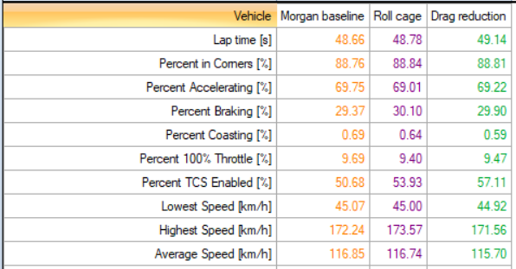
Morgan Setup Variations
Roll Cage
Roof Up
Roof Down
Table 5

Slide 19
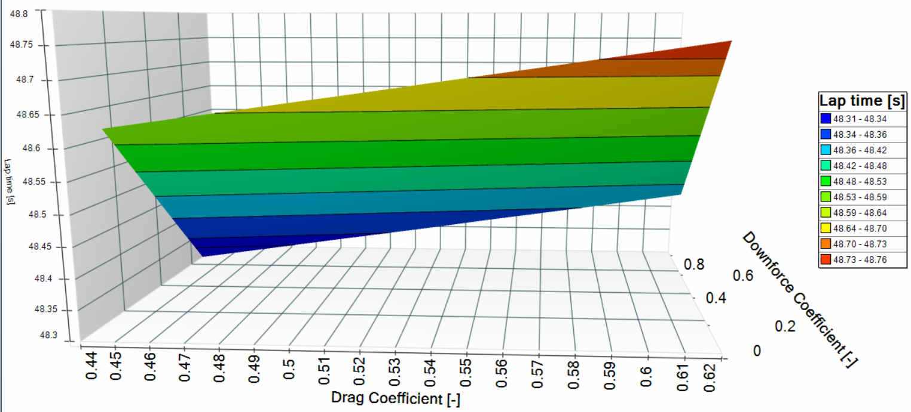
Sensitivity Analysis
Nolte, et al. (2020) explains the importance of a sensitivity analysis to understand the relationship between vehicle parameters and their impact on performance.
Aerodynamic Efficiency Chart
Figure 44

Slide 20
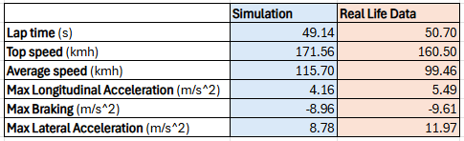
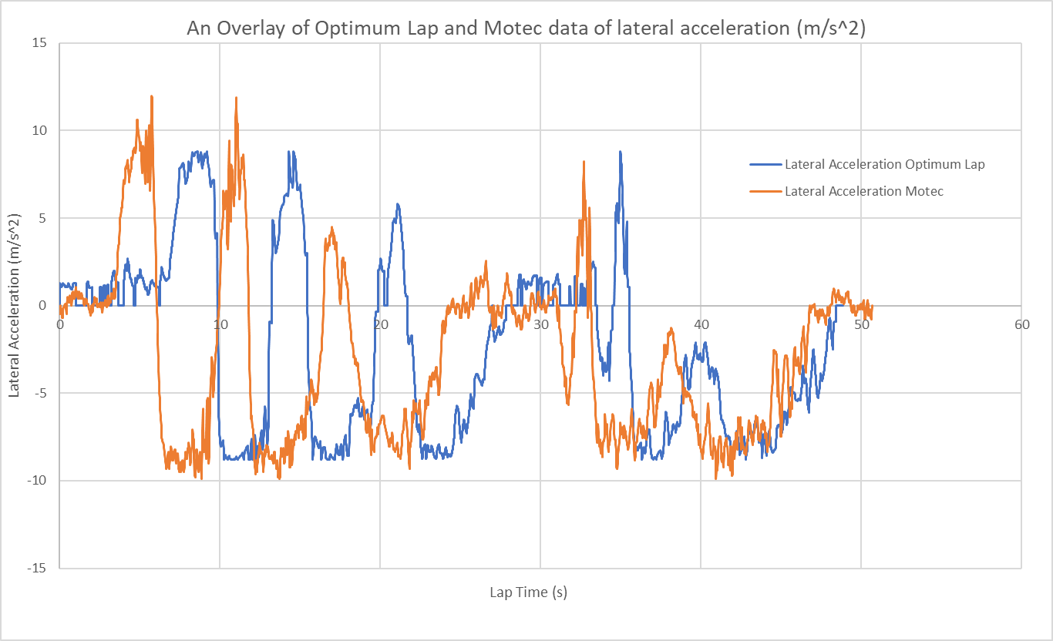
Data validation
Research into the importance of comparing simulated data with real life data to validate results.
(Society of Automotive Engineers, 2001)
Table 6
Figure 45

Slide 21

Going forward
Aerodynamics
Structure
Control Systems
Balance Comparisons
Comparing Wing Designs
Aerodynamic Efficiency
Simulink Integration
Weight Impact Analysis

Slide 22
Mechatronics and Control
Led by Rhys Thomas & Jac Evans

Slide 23
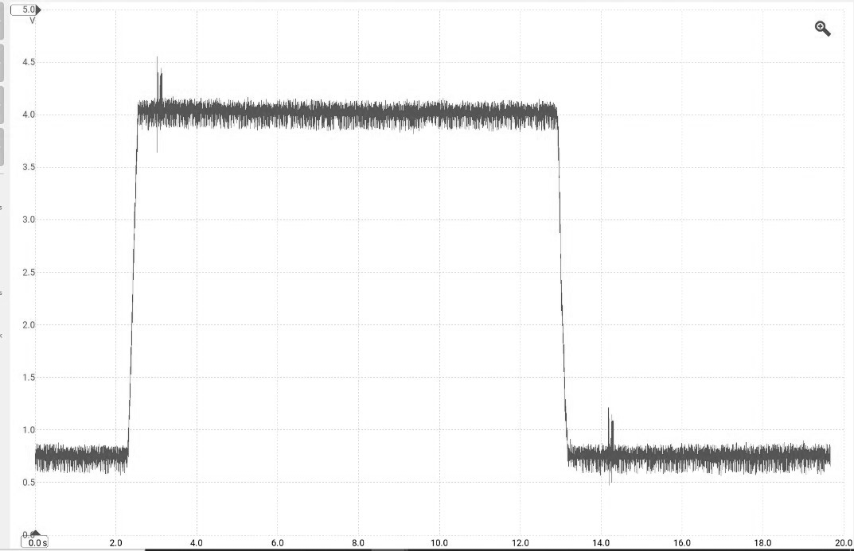
Input sensors
Typical vehicle sensors
Throttle pedal
Wheel speed
Damper potentiometers
Brake pressure
Gear selection
Wind direction sensor
Steering angle
Engine load
Body roll/chassis tilt sensor
Air temperature
Water detection
Ideal sensors
Throttle pedal
Wheel speed
Brake pressure
Steering angle
Useable sensors
Throttle pedal
Throttle Pedal Voltage
Voltage(V)
Figure 46
Time(S)

Slide 24



Simulink model
PID Simulink Model
Brake Pressure vs Time in Excel
Figure 47
Brake Pressure Converted into Voltage
Thresholding calculation:
(Pressure/1871)*5
Voltage (V)
Table 7
Figure 48
Time (S)

Slide 25




Fail safe
Why is a failsafe necessary?
PID Simulink Model With Fail Safe
Brake Pressure Converted into Voltage
Taking the System Further
Figure 51
Voltage (V)
Logical Gates
Time (S)
Figure 49
(ASET, 2019) Explains the importance of a failsafe in an engineering system not just for reliability but also safety.
Figure 50
Figure 52

Slide 26






Prototype System
Figure 55
Figure 58
Figure 59
Figure 53
Figure 54
Figure 56
Figure 57

Slide 27

PID Controller
I
P
D
Figure 60
Benefits
Cost effective
High accuracy
Robust
Easy to construct
Error correction
Real time response
Limitations
Delay
Complex tuning process
Noise sensitivity
Requires accurate feedback

Slide 28



Actuation Methods & FEEDBACK
Linear actuators
​
Actuator specification
​
Safety factor
​
Sacrifices
​
Ingress Protection Rating
​
Feedback loops​
​
What is the purpose of a feedback loop?​
​
Internal motor sensors​
​
Potentiometer​
Specification:
Max load inc. SF – 820N
Max stroke – 65mm
Minimum velocity – 0.13m/s
Figure 61
Figure 62
Figure 63

Slide 29
Next steps
Integrate a system like MoTec onto the Morgan so more sensors can be added into the control system
Define a range of angles of attack
Define reaction time and minimum velocity of the system
Create a model to integrate actuators
Integrate the system into VI Grade software

Slide 30
Thank you for listening
Questions?

Slide 31




Table of Figures

Slide 32
Bibliography
Ahmed, R. (2023). Aluminum Alloys Used in the Automotive Industry. [online] Metal Supermarkets. Available at: https://www.metalsupermarkets.com/aluminum-alloys-used-in-the-automotive-industry/ [Accessed 10 Nov. 2024].
Alhosani, K.I., Al-Sumaiti, A. and Al-Ali, K. (2019) ‘Cascading Failure Analysis Based Early Design for a Complex Engineering System’, in 2019 Advances in Science and Engineering Technology International Conferences (ASET). IEEE, pp. 1–5. Available at: https://doi.org/10.1109/ICASET.2019.8714370.
Aluminium vs carbon fiber – comparison of materials (2020) DexCraft. Available at: http://www.dexcraft.com/articles/carbon-fiber-composites/aluminium-vs-carbon-fiber-comparison-of-materials/ (Accessed: 05 November 2024).
A.Towler (11/02/2018). New McLaren Senna – design, specs and full details. [Online] Available at: https://www.evo.co.uk/mclaren/20491/new-mclaren-senna-design-specs-and-full-details.
Candence. 'Electromagnetic Actuators in Mechatronics'. [Online]. Available at: Electromagnetic Actuators in Mechatronics | System Analysis Blog | Cadence.
Carbon fiber vs. Aluminum: A side-by-side comparison (no date) Carbon Fiber Gear. Available at: https://carbonfibergear.com/blogs/carbonfiber/carbon-fiber-vs-aluminum?srsltid=AfmBOooUhpiAnxy-x2j0G0WJqBOitMvQ0JNWHIH7AOMZTIXjXMeY1lEj (Accessed: 05 November 2024).
CFD Online, 2024. Y+ Wall Distance Estimation. Available at: https://www.cfd-online.com/Tools/yplus.php
DeMattia. (2021). Morgan Plus Four. [Online]. Available at: https://www.bmwblog.com/2021/07/31/the-bmw-powered-morgan-plus-four-race-car-looks-epic/ [Accessed: 11th November 2024].

Slide 33
Bibliography
Dd. (2024). Unlocking the Potential of 4130 Alloy Steel: Applications and Properties. [online] ETCN. Available at: https://etcnmachining.com/blog/material-4130-steel/ [Accessed 10 Nov. 2024].
Editorial. (2024a). The Role of Carbon Fiber in Automotive Innovation and Design - Automotive Quest. [Online] Available at: https://automotivequest.com/carbon-fiber-in-automotive/ [Accessed 10 Nov. 2024].
Editorial, W. (2024). Exploring the Advantages of Carbon Fiber Parts in Automotive Applications - Wheels & Wisdom. [Online] Wheels and Wisdom. Available at: https://wheelsandwisdom.com/carbon-fiber-parts/ [Accessed 11 Nov. 2024].
Figarelli Automotive. (09/05/2020). How to Size Linear Actuators. [Online] Available at: How to Size Linear Actuators? | Linear Actuators by Firgelli.
Garry, K.P. and Le Good, G.M. (2005) ‘An investigation of the sensitivity of rear wing orientation for Saloon Race Cars’, SAE Technical Paper Series [Preprint]. doi:10.4271/2005-01-1018.
Islam, A., Debnath, A.K. and Islam, S. (2022) ‘Numerical analysis of the rear wing mount of a formula 1 type car for material selection’, International Conference on Mechanical, Industrial and Energy Engineering 2022 [Preprint].
Kumar, R. (2022). Properties and Applications of 6061-T6 Aluminum Alloy. [online] Zetwork. Available at: https://www.zetwerk.com/resources/knowledge-base/aluminum-extrusions/6061-t6-aluminum-properties-and-its-uses/ [Accessed 9 Dec. 2024].
Laboratory Metal Co. (2024). Why 4130 Alloy Steel is Ideal for Automotive Manufacturing. [online] Available at: https://liboruimetal.com/why-4130-alloy-steel-is-ideal-for-automotive-manufacturing/ [Accessed 7 Nov. 2024].
Lai, H.F. and Xiao, W.Z. (2012) ‘The Analysis on the Typical Parts in F1 Race Car’, Applied Mechanics and Materials, 215–216, pp. 1136–1139. Available at: https://doi.org/10.4028/www.scientific.net/AMM.215-216.1136.

Slide 34
Bibliography
LEAP CFD Team. (2020). What y+ should I use? Part 3 – Understanding impact of Y+ and number of prism layers on flow resolution. Computational Fluid Dynamics (CFD) Blog – LEAP Australia & New Zealand. Available at: https://www.computationalfluiddynamics.com.au/y-plus_part3_understanding-impact-of-y-and-number-of-prism-layers-on-flow-resolution/.
Marqués-Bruna, P. and Grimshaw, P. (2011). Design of the Grand Touring sports car wing. Proceedings of the Institution of Mechanical Engineers, Part P: Journal of Sports Engineering and Technology, 225(2), pp.22-31. Available at: https://doi.org/10.1177/17543371JSET79.
McBeath, S. and O’Rourke, B. (2000) Competition car composites : a practical handbook. Sparkford: Haynes.
NitPro Composites. (2024). Advantages of Carbon Fiber for Automotive Manufacturing. [online] Available at: https://www.nitprocomposites.com/blog/advantages-of-carbon-fiber-for-automotive-manufacturing [Accessed 11 Nov. 2024].
Noble. (2024). Technical Regulations. [Online]. Available at: Group Project Overview 24_25.pptx. [Accessed: 11th November 2024].
Nolte, M. et al. (2020) Sensitivity Analysis for Vehicle Dynamics Models - An Approach to Model Quality Assessment for Automated Vehicles, IEEE Xplore. Available at: https://www.researchgate.net/publication/341283707_Sensitivity_Analysis_for_Vehicle_Dynamics_Models_--_An_Approach_to_Model_Quality_Assessment_for_Automated_Vehicles (Accessed: 02 November 2024).
OptimumG (2019) Optimumlap, OptimumG. Available at: https://optimumg.com/product/optimumlap (Accessed: 06 December 2024).
Perrelli, M. et al. (2022) Development and validation of a vehicle simulation platform for driver-in-the-loop testing, SpringerLink. Available at: https://link.springer.com/chapter/10.1007/978-3-031-10776-4_41 (Accessed: 07 December 2024).
Rapid Protos. (2023). Understanding 6061 Aluminum: Properties, Applications, and Benefits. [online] Rapid-Protos. Available at: https://www.rapid-protos.com/understanding-6061-aluminum-properties-applications-and-benefits/.
Society of Automotive Engineers (2001) Vehicle Dynamics and Simulation. Warrendale, PA: Society of Automotive Engineers.
Tolomatic. A technical comparison: Performance of pneumatic cylinders and electric rod actuators. [Online]. Available at: A technical comparison: Performance of pneumatic cylinders and electric rod actuators - Tolomatic.
Turbulence model study for aerodynamic analysis of the leading edge tubercle wing for low Reynolds number flows. (2024). Heliyon, [online] 10(11), e32148. Available at: https://www.sciencedirect.com/science/article/pii/S2405844024081799.
University of Cambridge (2024). Belbin's Team Roles. [Online]. Available at: Belbin's team roles. (Accessed: 9th December 2024).
VI-CarRealTime (2023) Carrealtime: Vi-grade, VI. Available at: https://www.vi-grade.com/en/products/vi-carrealtime/ (Accessed: 06 December 2024).

Slide 35
Project Management Appendix
Role | Joint Responsibility
Aerodynamics | Research and make decisions involving the aerodynamic profiles of both the Morgan and the wing, as well as run CFD for both. Liaise and discuss with other specialist areas to produce the optimum design for the wing.
Structural | Research, study and make decisions involving the structural aspects of the rear wing, e.g. mounting points, materials and structural integrity. This role will involve running FEA runs and comparing different materials in conjunction with the research and decisions made by both the aerodynamics, control and simulation specialists.
Control/Mechatronics | Design and choose the actuation and control technique used to make the rear wing active. This will involve researching systems already used in similar applications as well as suitable alternatives that can be presented and discussed with the other departments
Simulation | Create a baseline simulation with no modifications on the desired software ready to compare simulations made with new design concepts. Run simulations of different wing designs, compare and analyze the data to show where most improvements are being made.

Slide 36





Aero Appendix
When Y+ = 1, Y1 value = 1.5e-5m
Roof Up
Roll Cage
(CFD online, 2024)
Wing CFD Parameters
Roof Down
Roll cage & Wing

Slide 37






Structure appendix
Strain on steel 4130
Max deformation = 6.093 x 10⁻⁵ m
Strain on steel 4130
Max deformation = 2.58 x 10⁻⁴ m
Strain on steel 4130
Max deformation = 4.982 x 10⁻⁵ m
Strain on aluminium 6061
Max deformation = 1.44 x 10⁻⁴ m
Strain on aluminium 6061
Max deformation = 6.028 x 10⁻⁴ m
Strain on aluminium 6061
Max deformation = 1.16 x 10⁻⁴ m

Slide 38
Materials appendix
Steel 4130 (Laboratory Metal Co, 2024):
High strength requirements
Easy fabrication and welding
Affordability
Versatile applications
Aluminium 6061 (Rapid Protos, 2023):
Balance of strength, corrosion resistance, machinability
Highly weldable
More accessible and cost-effective than 7075 (another common alloy)
Drawbacks – slightly low strength than 7075
Carbon-fibre (Editorial, 2024):
Ideal strength-to-weight ratio
High stiffness, ensuring consistent downforce
Tailorable Properties through fiber optimisation
Corrosion resistance
Vibration damping
Fatigue resistance

Slide 39
APPENDIX: Research
Type of simulation
Driver in the loop - Human centric feedback (Perrelli, M. et al., 2022)
Driver out of the loop – Time effective and reduced human error due to being computer automated.
Type of software
Optimum lap – Focuses on lap time analysis. (OptimumG, 2019)
VI grade – In depth analysis of aerodynamic properties with a more complex model. (VI-CarRealTime, 2023)

Slide 40

APPENDIX: Parameters
Parameters used for simulations into the different Morgan set ups and for the sensitivity analysis with the rear wing example.

Slide 41

Appendix: VI grade
Aerodynamic map of the Morgan with a roll cage using CFD results of a 47.98% frontward balance.
Aero map Roll Cage
At 116km/h so 32.33 m/s
Drag force at 32.33 m/s = ½ x 1.225 x 0.52 x 0.94 x 32.33^2 = 312.93 N
Down force at 32.33 m/s = ½ x 1.225 x 0.16 x 0.94 x 32.33^2 = 96.28 N
Balance percentage = 47.98%
Front downforce = 96.28 x 0.4798 = 46.2 N
Rear downforce = 96.28 – 46.2 = 50.08 N
Longitudinal Centre of Gravity Roll Cage
Wheelbase x front percentage
Wheelbase = 2520 mm = 2.52m x 0.4798 = 1.21 m from the front axle = 1210mm

Slide 42



Control Appendix
F*y*cos(alpha) - W*x*cos(alpha) > 0
Dynamic Force = F > (W*x)/y
Max load = 546.976 x 1.5 = 820N (Dynamic force – The force needed to move the object must be larger than 820N. Static force must equal 820N)
Figure 74
Bullet series 50 Cal. From firgelli. Electronic Linear actuators
"the rear wing is hydraulically controlled and constantly moves (through 25-degrees in anywhere between 0.3-0.7 seconds depending on how fast the car is travelling) " A.Towler (11/02/2018)
Figure 75
Specification:
Max load inc. SF – 820N Supplied by Aerodynamics sector
Max Stroke – 65mm – range between 0 and airbrake
Minimum Velocity – 0.13m/s (travel 40mm in 0.3 seconds)
Figure 73

