Slide 1




Talent Management in Practice at Tata Steel Europe
Notes:
Introduction - 3 minutes

Slide 2

Presentation Outline
Introducing Talent Management Processes TSE
Benefits of Performance & Potential Review
What happens in a Performance & Potential Review
Activity – Facilitating a Review Session & Feedback
Introducing Succession Planning at TSE UK
Questions
Notes:
3 minutes

Slide 3
Introducing Talent Management Processes
Talent Pipeline Activity
Performance & Potential
Succession Planning
Career Development Planning
Appraisal
Jan - Mar
Apr - Jun
Jul - Sep
Ongoing
Identification of Talent
Managing Talent
Developing Talent
Review Talent Gaps
Talent Pools
Need for External Recruitment
Graduates
Notes:
3
4 mins - Summarize each activity and it’s purpose

Slide 4
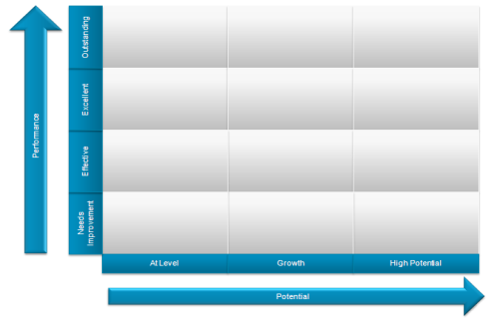
Performance and Potential Review
Performance & Potential
Succession Planning
Career Development Mapping
Appraisal
Q1
Q2
Q3
Ongoing
This activity is planned to take place over the first quarter of each year.
The Talent Development Team is responsible for providing data and training to business HR who then facilitate the review sessions
Notes:
8 minutes

Slide 5
Benefits of Performance & Potential Review
An initial means of identifying talent within the organisation bringing together management peer groups to discuss their direct reports.
What are the benefits?
  Allows a broad gathering of views allows for a more rounded perspective to be gained of an individual ahead of their appraisal.
  Drives consistency and a common understanding of the capability of individuals and their future potential within the organisation.
  Prompts early consideration of career development mapping activities, undertaken as part of the Talent Management Process.
  Feeds succession planning activity
For HR it:
  Provides the opportunity to challenge and provide feedback on individuals through your experience of them, adding quality to the conversation.
  Provides you with knowledge of who the talented individuals are within your area and what development and support they require.
Notes:
10 mins

Slide 6
Benefits of Performance & Potential Review
Comparing ratings against a normal distribution curve
Ensures a fair and consistent approach to ratings across the organisation
Discourages managers away from a bias of awarding above-average ratings to solid or marginal performers
Encourages positive challenge of poor performance.

Slide 7
Performance Categories
Definition : Rating based on actual performance over the previous 12 months
Performance Rating | Normal Distribution | Guidance Description
Outstanding | 0% - 5% | A role model for the organisation Is regarded as an outstanding performer by his/ her team, peers and managers. Consistently delivers above expectation, stretches the boundaries of the job, exceeds the expected levels of competency and has role modelled the expected behaviours. Is proactively developing themselves and those around them
Excellent | 10% - 20% | Consistently deliver above expectations, stretches the boundaries of the job, exceeds the expected levels of competency and demonstrates the behaviours expected. Is proactively developing themselves and those around them.
Effective | 60% - 70% | Consistently delivers against expectations, fulfils the level of competency required and demonstrates the behaviours expected. Has demonstrated both the development of self and those around them
Needs Improvement | 0% - 10% | Deliver some of the results required but not all (this could be due to new role/ recently promoted/ capability in current role). Fulfils some of the competencies required of the role but there are areas for development in terms of knowledge, skill or behaviour. Has the potential to do more to develop both self and those around them
Notes:
15 mins Describe what the meeting involves - Slides 6,7 & 8
Performance Categories
This slide shows the definition of performance, performance ratings and description as well as the expected distribution of ratings across this employee population.
Definition of Performance – we are looking at the ‘actual performance’ of each individual for the last 12 months. It is easy to fall into the trap of talking about 2-3 years work history however this is irrelevant. We should only focus on the last 12 months to ensure consistency and relevance for this years performance appraisal.
For each of the 5 ratings we have a guidance description – it is important to read these thoroughly to remind ourselves of what each rating is about to help ensure consistency of rating across the business (highlight some key words for each to draw out the essence of the rating).
There is also a guide around expected distribution of ratings.

Slide 8
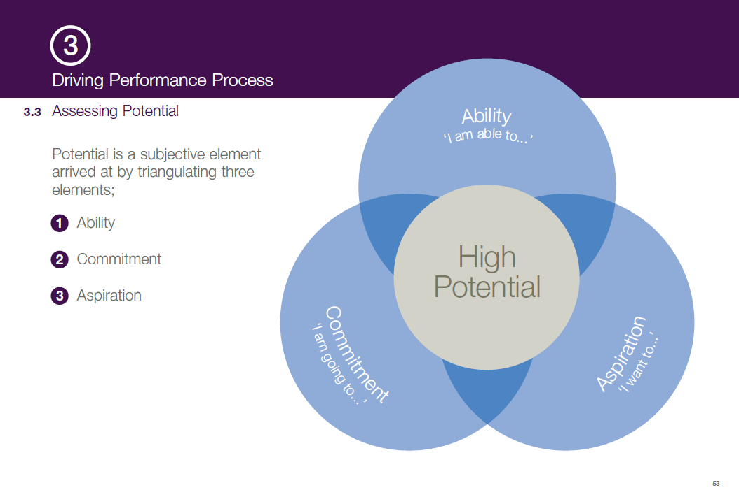
Potential Categories
Definition: Consideration of individual’s ability, commitment and aspiration to progress through the organisation.
Potential Rating | At Level | Growth | High Potential
Guidance Description | An individual has a significant contribution to make and are expected to operate at their current or similar level for a period of time | An individual has the potential to develop into a significantly larger role within their current job level, or into a role at the level above | An individual currently has the potential to take on a significantly bigger or wider role within the organisation, with at least two upward job level moves, and are ready for their initial move now or within three years
How might we measure potential?
Notes:
Potential Categories
When we talk about performance we are basing our discussion on examples of actual performance over the past 12 months, whereas our discussion about someone’s potential should centre around whether we see consider them to have the ability, commitment and aspiration to progress through the organisation in the future. There are three categories of potential;
At level – this relates to those managers that are considered to have a ‘significant contribution to make and are expected to operate at their current or similar level for a period of time’.
Growth – this category would apply to an ‘individual that has the potential to develop into a significantly larger role within their current job level, or into a role at the level above’ (I.e. Band D to BSM level).
High Potential – those individuals identified as having ‘the potential to take on a significantly bigger or wider role within the organisation, with at least two upward job level moves, and are ready for their initial move now or within three years’ should be assigned this potential category.
Point to Note: This is a guide – not everyone will fulfil these exacting descriptions but consideration should be given to these and realistic expectations should be set with individuals.

Slide 9
Performance & Potential Grid
Outstanding
Excellent
Performance
Effective
Needs
Improvement
At Level
Growth
High Potential
Potential
Notes:
Individuals are then plotted onto a grid. Those within the top six boxes are considered ‘talent’ and feed the ‘talent pools’ which in turn feed the succession planning activity.

Slide 10

Activity – Conducting a Review Session
Review of role play materials – 10 minutes
Mock Performance and Potential Review Session – 30 minutes
  1 member of the group will assume the role of the HR representative at the meeting, this role involves facilitating the meeting.
  The rest of the members will assume the role of a line manger.
  We are looking for some good debate so please share your ‘views’.
Record the ratings given on the wall chart
Group feedback– 15 minutes
Notes:
18 mins Undertake Session Activity – 1 hour Including feedback session

Slide 11
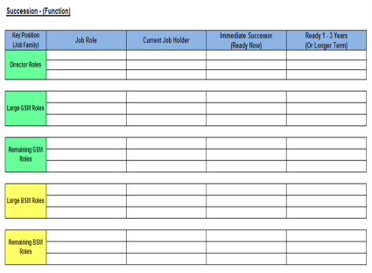
Talent Pipeline Activity
Performance & Potential
Talent & Succession Planning
Career Development Planning
Appraisal
Jan - Mar
Apr - Jun
Jul - Sep
Ongoing
Formal confirmation of talent pipeline
Aligns successors to key roles – ‘potentials’
Identification of ‘hot spots’ and actions
Provides information for manpower planning
Notes:
Succession planning discussion - What are the pitfalls of such a rigid approach, could there be a more fluid approach?

Slide 12


