Slide 1
Assessment Workshop
Bart Plange – Principal Administrator (Assessment Officer)
Matthew Kelleher– Assessments Officer
Manuela Dineva - Assessments Officer
Eliane Mukeba -Assessment Officer
Marin Zaharidov - Assessment Officer
Jossett Hector-Assessment Officer(Weekend)
Anita Chiafi -Assessment Officer(Weekend)

Slide 2

HOW TO CONTACT US
Assessments Hot-Desk Times:
  11am to 12pm
  1pm to 2pm
  3pm to 4pm
LondonAssessments@uwtsd.ac.uk

Slide 3
YOUR RESPONSIBILITIES
To submit your work on time
    Your deadline will always be at 23.59
To make sure the work is your own
    Avoid Academic Misconduct!
To make sure your work is ready for submission
    Do not upload your assessment if it is incomplete
    Check and re-check your file to make sure it is the assessment you wish to upload
What you should always do:
  Allow plenty of time to deal with unforeseen circumstances
  Check and re-check your submission deadline
  Check what is required for your submission (Module Handbook)
  Only submit your work when it is ready for final submission

Slide 4
London STUDENTS’ HALL - MOODLE
A page created especially for you on Moodle
  Assessment Schedules
  Step by step guides on:
        How to upload your assessments to Moodle
        How to deal with a late submission
        How to file for extenuating circumstances
        How to set up your IT account
  Timetables
  Attendance Policy, and much more!
  Please make full use of this page

Slide 5
NOTES TO REMEMBER
Deadlines are always at 23:59 of the assigned date in the assessment schedule
    DO NOT leave to ’23:58’ to upload your work. You might encounter difficulties trying to gain access
    In other words …. DO NOT leave it to the LAST MINUTE!
If you miss the deadline, or if you have any technical difficulties, you will need to send an email to London Assessments with your work. Please follow the procedure for ‘Submitting your work via email’
    Note: Penalties apply if a Late Submission!
You should ALWAYS use your University email address when communicating with us!
LondonAssessments@uwtsd.ac.uk

Slide 6
NOTES TO REMEMBER
London Assessments distinguishes between assessments submitted after the deadline and substitute assessments
A student may not request an assessment to be substituted after the deadline has elapsed
    You should only submit your work when it is your final version to avoid any disappointment
Because some students have previously sent a replacement assessment - with an attempt to avoid allegations of Academic Misconduct when they had become aware of a high similarity index - under normal circumstances substitute assessments will be rejected

Slide 7
LATE SUBMISSIONS
Please also refer to the relevant guide on the Students’ Hall Page

Slide 8
LATE SUBMISSIONS
Students are responsible for submitting their work on time.
In the event that work cannot be submitted by its deadline, you need to:
Send an email with your work to LondonAssessments@uwtsd.ac.uk
For your work to be considered, your email should contain:
      Your name
      Your student number
      The module name or code
      The assignment number (which assignment it refers to)
      Your assignment!

Slide 9
LATE SUBMISSIONS
London Assessments will ALWAYS respond to your email
    If you DO NOT receive a reply, you should assume that we have not received your email – so send it again until you get confirmation of the receipt!
    Always check your inbox for our replies (even if you are on holidays!)
    You will need our confirmation of receipt of your work (our confirmation email) in order to submit an Extenuating Circumstances request to the Academic Office
Late submissions also fall into the 23:59 rule

Slide 10
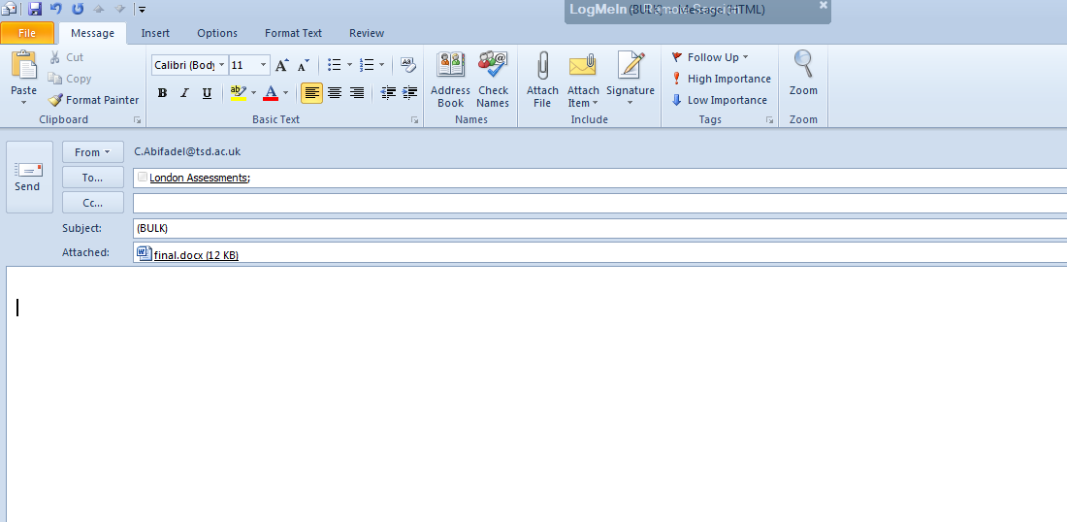
LATE SUBMISSION - EMAIL

Slide 11
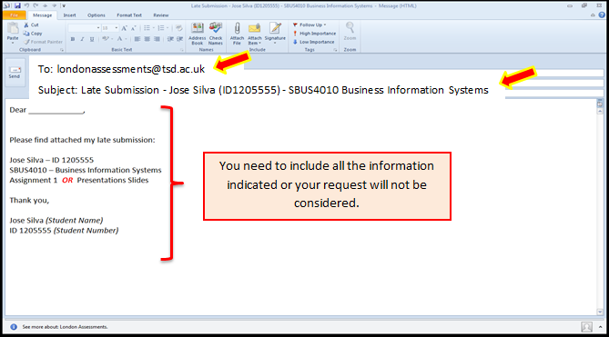
LATE SUBMISSION - EMAIL

Slide 12
LATE SUBMISSIONS - PENALTIES
If you submit your assessment late, your mark will be subject to the University’s rules and regulations:
    First Attempt Students
    Capped to 40% (50% for Level 7) if submitted within 1 week of the deadline
    Work handed beyond one week will NOT be accepted; this will be recorded as a non-submission and you will be given a mark of 0%
    Re-sit Students
    if submitted within 1 week of the deadline, a late penalty will be applied – the mark will be recorded as 0%. If an ECP outcome is to lift the penalty, the full mark capped to 40% (50% for Level 7) will be given
    Work handed beyond one week will NOT be accepted; this will be recorded as a non-submission and you will be given a mark of 0%
    For more detailed instruction please refer to the Students’ Hall in Moodle
IMPORTANT: The 23.59 rule also applies for late submissions

Slide 13
DRAFT SUBMISSION LINK
The draft submission link is for you to check your similarity score and similarity report before submitting your FINAL Assessment.
Please note you will not receive marks on this draft assessment .You may request feedback by contacting your lecturer(s) via email to check your Draft submission.
Please note that under NO CIRCUMSTANCES will any Assessment submitted to the draft submission link be accepted as your FINAL SUBMISSION.
PLEASE NOTE THAT SHOULD YOU SUBMIT YOUR FINAL ASSESSMENT IN THE DRAFT LINK, IT WILL NOT BE MARKED BY YOUR LECTURER AND WILL BE CONSIDERED AS NON-SUBMISSION
Please ensure you submit your FINAL Assessment to the FINAL Submission link.

Slide 14
PROVISIONAL FEEDBACK & RESULTS
Provisional feedback and results will be made available to students within 20 working days of the submission deadline.
Please note that these results are provisional until confirmed by the Examination Board. You will be able to view your FINAL MARKS on Moodle on Friday after the exam board which for this October 2022 term will be 10th February 2023 after 16:00pm.

Slide 15
EXTENUATING CIRCUMSTANCES
Please refer to the relevant guide on the Students’ Hall Page

Slide 16
EXTENUATING CIRCUMSTANCES
A student who believes that his/her performance in an assessment has been adversely affected by extenuating circumstances, may request that those circumstances are taken into account by the University
For consideration of the late submission penalty to be lifted, Students may file an Extenuating Circumstances Request with the Academic Office

Slide 17
EXTENUATING CIRCUMSTANCES
WHAT IS CONSIDERED
An application for extenuating circumstances may be considered if evidence is provided of:
  (a) an immobilising illness or period of hospitalisation that would affect your ability to meet a deadline or undertake an examination;
  (b) bereavement shortly before assessment resulting from the loss of a relative or close friend;
  (c) serious personal problems (where these relate to a third party, you must provide independent evidence of the impact on you); other problems that are beyond your control which compromise your ability to meet a deadline or undertake an examination

Slide 18
EXTENUATING CIRCUMSTANCES
WHAT IS CONSIDERED
In each case, the student must provide verifiable independent evidence
In the case of a medical issue, this would mean a Medical Certificate from a registered NHS GP, clearly identifying the start and anticipated end date of the medical issue

Slide 19
EXTENUATING CIRCUMSTANCES REQUESTS
Extenuating Circumstances requests are dealt with by the Academic Office and SHOULD NOT be sent to the London Assessments Team
All requests should be submitted to the Academic Office not more than 21 days after the deadline of the assessment, presentation or examination date.
Requests to lift the late submission penalty must be accompanied by the London Assessments’ confirmation that your work has been received and accepted for marking (e.g. our email response)

Slide 20
HOW TO SUBMIT YOUR EXTENUATING CIRCUMSTANCES REQUEST
Fill in new online Extenuating Circumstances Application Form
Students wishing to apply for Extenuating Circumstances should to login to their MyTSD account and access the form under the ‘Data Changes and Forms’ tab on the ‘Forms’ menu.
For additional guidance on how to file your request, please refer to the file "Student Guide on Extenuating Circumstances Online Application Form“ on London Students’ Hall on Moodle
Please note:
  Your request will only be considered if appropriate evidence is provided
  The Academic Office will review your request and respond it accordingly
  The previous Appendix SC01 version of the form will no longer be accepted.

Slide 21
EXTENUATING CIRCUMSTANCES
WHAT IS NOT CONSIDERED
The following are NOT normally considered to be extenuating circumstances:
  Loss of work as a result of theft or the breakdown of a computer or other electronic equipment;
      electronic back ups (save your work on different sources)
      hard copies
      drafts of work in progress
      managing the time allocated for completing the assessment
  Difficulty in gaining access to available materials such as books or videos;

Slide 22
EXTENUATING CIRCUMSTANCES
WHAT IS NOT CONSIDERED
  Long standing impairments or medical conditions, unless it can be demonstrated through evidence that there has been an increase in severity at the time of the assessment, such that the student’s academic performance may have been adversely affected;
Students should report long standing impairments and conditions to Student Services to ensure that, where appropriate, adjustments are made to the assessment regime and support arrangements are put in place well before the assessment period commences.

Slide 23
WHEN THINGS GO WRONG
  “I was trying to upload my work but Moodle did not work!!!!!”
  “I uploaded the incorrect file!!! Help me Help me !”
  “I lost my pen drive with all my assessments…”
  “I forgot to submit my work …”
  “My computer broke down, crashed”
  “I did not have access to the internet”
  “I was at work so I could not submit my assessment on Moodle”
  “I tried to upload my work but it says: file error, format not accepted. It was not my fault, the system crashed”
  “Please help! I uploaded my assessment from the other university!!!”
  “I need an extension, I have a very bad headache”
  “I missed my train and could not be here on time”

Slide 24
WHEN THINGS GO WRONG
  A Student sends an email requesting a late submission. After checking the submission link on Moodle, we can confirm that there was already a submission made, on time, by that Student.
      OUTCOME: The late submission cannot be accepted as there was already a submission made. After the deadline has elapsed, no re-submission can be made.
  A Student emails saying he/she cannot upload his/her work because Moodle is not responding
      OUTCOME: the Student has probably left it to the very last minute and as a result, was not able to submit his/her work. The student should send an email to London Assessments explaining what happened. In most cases, it will be treated as a late submission and penalized accordingly.

Slide 25
WHEN THINGS GO WRONG
  A Student emails at 00:10 saying that he/she was trying to re-submit his/her work but Moodle was not responding. Now that the deadline has passed, the file uploaded is not the correct one
      OUTCOME: The Student left it to the very last minute to re-submit, taking a risk. After the deadline has elapsed, no substitution of assessments can be made. The file uploaded is the one which will be sent for marking
  A Student sends a late submission 4 days after the deadline
      OUTCOME: His/her mark is capped to 40%, (50% for Level 7) unless extenuating circumstances apply.
  A Student sends a late submission 7 days after the deadline at 00:10
      OUTCOME: The work is not accepted and recorded as Zero NA, unless extenuating circumstances apply. Deadlines are at 23:59pm and the work was submitted beyond 1 week of its deadline

Slide 26
WHEN THINGS GO WRONG
  In nearly a week after the submission deadline had elapsed, a Student contacted us explaining that he/she had asked a friend to upload the assessment for him/her, but the FRIEND, uploaded his own assignment, which generated a similarity index of 96%.
    OUTCOME: The Student took a very high risk by providing a third person with his/her login details and relying on the friend to deal with his/her own responsibility.
    As a result, the friend made a mistake which put the Student in a very difficult and serious
    situation.
    From the assessment point of view, there is nothing that can be done here. The student’s work will be referred for Academic Misconduct investigation.
    A student should NEVER share his/her login details with someone else, nor should the Student rely on someone else to do their work.

Slide 27
ADDITIONAL IMPORTANT NOTES
  Complexity of Assessment Deadlines
    Unlike a conventional University UWTSD runs three terms a year beginning mid Oct, mid Feb and mid Jun. Every term represents a 16 week cycle. Students have 10 weeks of teaching, then during week 11 and 12 they submit assessments and sit examinations, by the end of week 16 all results will have been marked, moderated, sent to the External Examiner, considered by Examining Board and released to all students on the same day.
  Publishing of feedback
    Provisional Feedback and results for the mid-term submissions will be made available to you within 7 - 15 working days of the date of submission.
    Provisional Feedback and results for all end of term submissions including tests and exams will also be made available to you when it is ready.
    Final feedback and results will be released to all students on the same date through Moodle following the announcement of the Examining Board’s decision relating to your progression.
    This would normally be Wednesday, before a new term commences, hence feedback for the JUNE 2022 submissions will be released on 11TH June 2023. This is the same date where you will be able to view the JUNE 2022 classes timetable on the Students’ Hall page in Moodle.
  How to view your feedback and submit your work
    Guides on how to submit your work and view feedback on Moodle is available on Students’ Hall. Here is a small demonstration

Slide 28
REFERENCES
Academic Quality Handbook
  Chapter_13_Student_Cases
Students’ Hall page - Moodle

Slide 29
SUMMING UP
Always submit your work on time
  Allow time to complete
  Allow time to deal with problems
  Make sure your work is final
  Make sure your work is your own
  Do not leave everything to the last minute
Late Submissions
  To London Assessments
  Will be penalised accordingly
  Not allowed for RESIT Students
  Need to be submitted correctly
  The 23:59pm rule applies
  LondonAssessments@uwtsd.ac.uk
Extenuating Circumstances
  To the Academic Office
  Completed online Extenuating Circumstances Application Form in MyTSD account
  Confirmation that assessment was submitted
  With substantiating evidence
  Must be submitted not more than 21 days after the assessment deadline or date of a presentation/examination
In the event of a technical problem or query
  Contact London Assessments or IT Help desk well in advance
  Allow plenty of time BEFORE submission deadline to deal with your issues

Slide 30

EMAILS TO REMEMBER
Assessment Issues
    LondonAssessments@uwtsd.ac.uk
IT Issues
    LondonITServiceDesk@uwtsd.ac.uk
Academic Office
    aocases@uwtsd.ac.uk

Slide 31
HOW TO SUBMIT YOUR ASSESSMENT TO MOODLE
Please refer to the relevant guide on the Students’ Hall Page

Slide 32

Any Questions?

Slide 33


