Slide 1

Student name :Deborah Flores Rodrigues
Student number : 2336878
BMHP6029
Psychopathological Classifications and Provisions Component
Acknowledgement of the use of AI tools
I confirm that I have not used any AI tools in the research and creation of this assignment. I confirm that I have not presented any AI generated materials as my own work. I confirm I have copies of my drafts, notes, and other resources I used, which I may be asked to provide in evidence

Slide 2
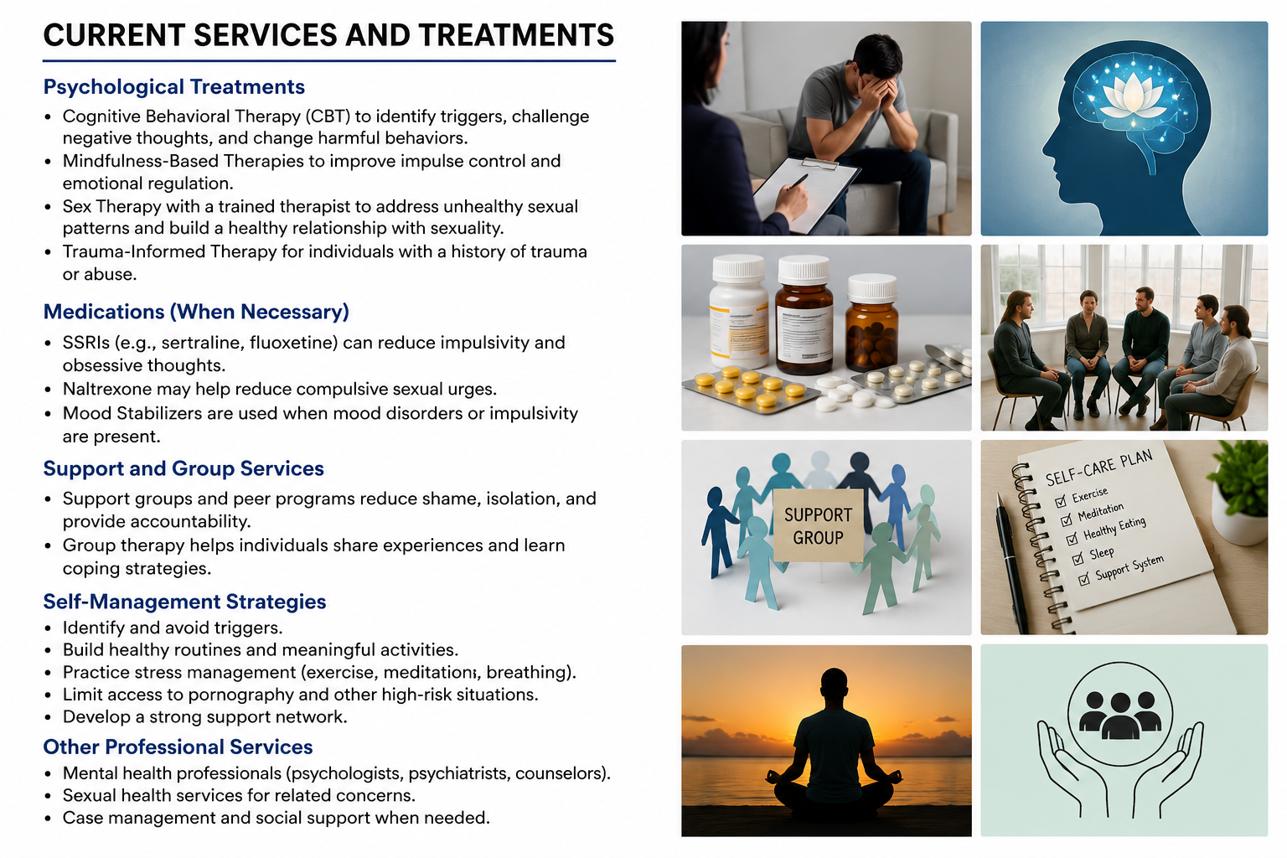
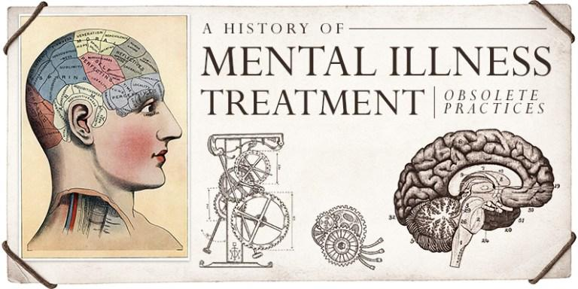

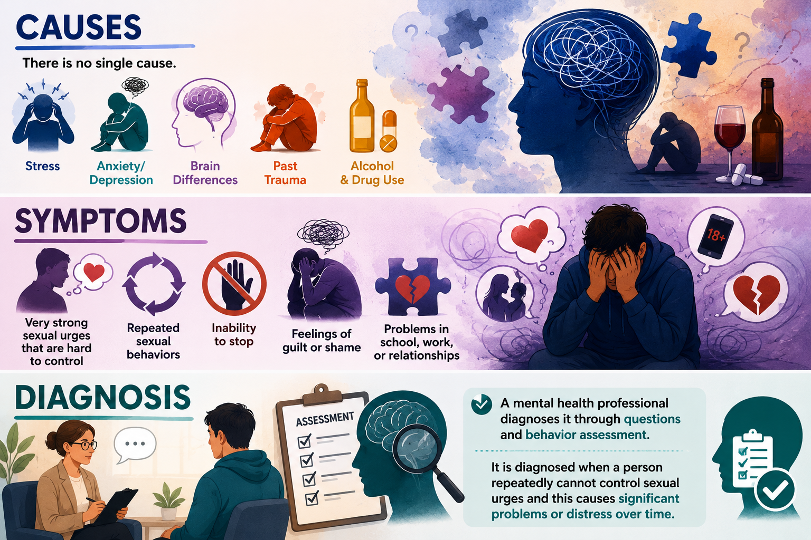

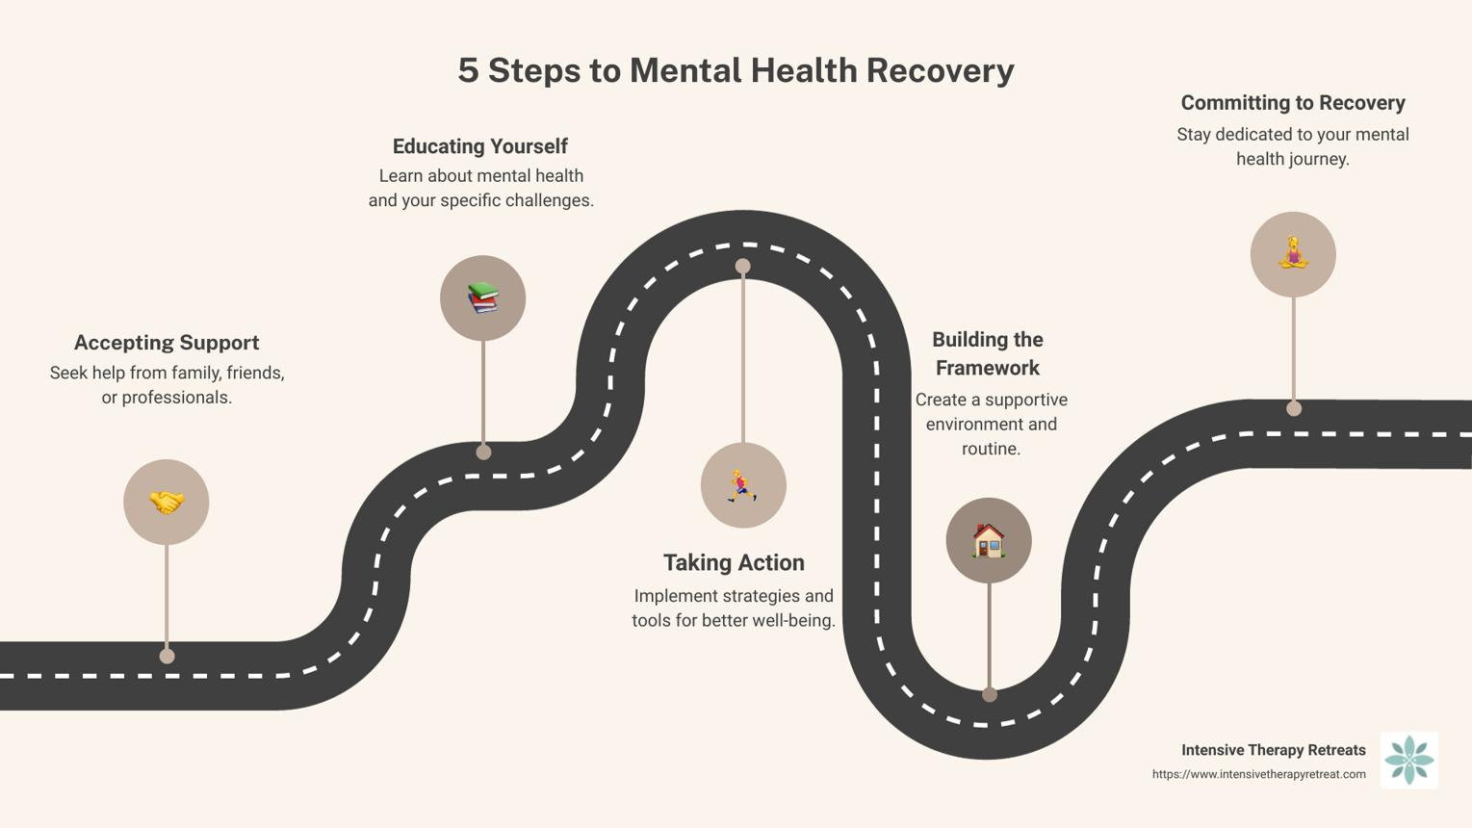
(Title -6C72 Compulsive sexual behaviour disorder)
Impulse control disorders
Introduction
Historical perspectives and treatments
Current services and treatments
Recommendations
How were people viewed in the past?
.Seen as having poor self-control.
.Often judged for their behaviour.
.Received little understanding or support.
How has this changed?
.Now recognised as a mental health condition.
.Greater awareness and understanding.
.Less stigma and more support available.
How did medical professionals view the disorder?
.Previously seen as a moral or behavioural problem.
.Not widely recognised as a medical condition.
.Today, professionals understand it can cause significant distress and affect daily life.
Current Treatments
.Psychological therapies (e.g., CBT).
.Counselling and support groups.
.Treatment for underlying mental .health conditions such as anxiety or ,depression.
Increase awareness and education about CSBD.
Promote early intervention and treatment.
Improve access to psychological therapies, especially CBT.
Encourage participation in support groups.
Address co-occurring mental health issues (e.g., anxiety, depression, trauma).
Reduce stigma and encourage help-seeking.
Citations: (World Health Organization, 2022; Kraus et al., 2018; Walton, Cantor and Lykins, 2017)
Broad category:
Impulse-control / behavioural addiction
Disorder + definition:
Compulsive Sexual Behaviour Disorder (CSBD) is when a person cannot control sexual urges and behaviors, even when it causes problems in life and distress.
How common:
Estimated about 1%–6% of people.
Diagnosed cases:
Very few officially diagnosed; likely under 1% in clinical settings.
Psychological Treatments
Cognitive Behavioural Therapy (CBT)
Mindfulness-Based Therapy
Sex Therapy
Trauma-Informed Therapy
Medications (When Needed)
SSRIs
Naltrexone
Mood Stabilizers
Support Services
Support Groups
Group Therapy
Self-Management Strategies
Avoid triggers and high-risk situations
Build healthy daily routines
Practice stress-management techniques
Develop a strong support network
Professional Services
Psychologists
Psychiatrists
Sexual Health Services
Social Support and Case Management
Causes, Symptoms, Diagnosis
(UCL, 2025)
(NHS, 2025)
Conclusions
Compulsive Sexual Behaviour Disorder (CSBD) is a recognised mental health condition that can have a significant impact on an individual's wellbeing and relationships. Evidence suggests that early intervention, psychological therapies, and access to appropriate support services can improve recovery outcomes. Continued awareness, research, and reduction of stigma are important to ensure effective treatment and support for those affected
(World Health Organization, 2022; Kraus et al., 2018; UCL, 2025).
Causes:
There is no single cause. It may be linked to stress, anxiety, depression, past trauma, brain differences, or alcohol and drug use.
(NHS,2024; RCPsych,2024; WHO2024)
Symptoms:
Very strong sexual urges that are hard to control, repeated sexual behaviors, inability to stop, feelings of guilt or shame, and problems in school, work, or relationships.
(NHS,2024; Cleveland Clinic,2024)
Diagnosis:
A mental health professional diagnoses it through questions and behavior assessment. It is diagnosed when a person repeatedly cannot control sexual urges and this causes significant problems or distress over time.
(WHO ,2024 ICD-11; RCPsych,2024)
World Health Organization, n.d.; Royal College of Psychiatrists, n.d.; Clinic, 2023)
(Lew-Starowicz and Coleman, 2022).
(World Health Organization, 2022)
(Kraus et al., 2018)
(Walton, Cantor and Lykins, 2017)
(Briken and Turner, 2022)
(Antons et al., 2022).

Slide 3
Reference
Antons, S. et al. (2022) ‘Treatments and interventions for compulsive sexual behavior disorder with a focus on problematic pornography use: A preregistered systematic review’, Journal of Behavioral Addictions, 11(3), pp. 643–666. Available at: https://doi.org/10.1556/2006.2022.00061 (Accessed: 7 July 2026).
Briken, P. and Turner, D. (2022) ‘What does “Sexual” mean in compulsive sexual behavior disorder? Commentary to the debate: “Behavioral addictions in the ICD-11”’, Journal of Behavioral Addictions, 11(2), pp. 222–225. Available at: https://doi.org/10.1556/2006.2022.00026 (Accessed: 9 July 2026).
Cleveland Clinic (n.d.) Compulsive Sexual Behavior Disorder (Hypersexuality). Available at: https://my.clevelandclinic.org/health/diseases/22690-sex-addiction-hypersexuality-and-compulsive-sexual-behavior(Accessed: 10 July 2026).
Kraus, S.W., Krueger, R.B., Briken, P., First, M.B., Stein, D.J., Kaplan, M.S., Voon, V., Abdo, C.H.N., Grant, J.E., Atalla, E. and Reed, G.M. (2018) ‘Compulsive sexual behavior disorder in the ICD-11’, World Psychiatry, 17(1), pp. 109–110. Available at: https://onlinelibrary.wiley.com/doi/10.1002/wps.20499 (Accessed: 12 July 2026).
Lew-Starowicz, M. and Coleman, E. (2022) ‘Mental and sexual health perspectives of the International Classification of Diseases (ICD-11) Compulsive Sexual Behavior Disorder: Commentary to the debate “Behavioral addictions in the ICD-11”’, Journal of Behavioral Addictions, 11(2), pp. 226–229. Available at: https://doi.org/10.1556/2006.2022.00032(Accessed: 15 July 2026).
Mayo Clinic (2023) Compulsive sexual behavior – Symptoms and causes. Available at: https://www.mayoclinic.org/diseases-conditions/compulsive-sexual-behavior/symptoms-causes/syc-20360434 (Accessed: 18 July 2026).
National Health Service (NHS) (2025) Addiction support. Available at: https://www.nhs.uk/live-well/addiction-support/(Accessed: 20 July 2026).
Royal College of Psychiatrists (n.d.) Compulsive sexual behaviour. Available at: https://www.rcpsych.ac.uk/mental-health/problems-disorders/compulsive-sexual-behaviour (Accessed: 22 July 2026).
University College London (UCL) (2025) Compulsive sexual behaviours and sex addiction. Available at: https://www.ucl.ac.uk/study/support-and-wellbeing/unwanted-behaviours/compulsive-sexual-behaviours-and-sex-addiction (Accessed: 25 July 2026).
Walton, M.T., Cantor, J.M. and Lykins, A.D. (2017) ‘An online assessment of personality, psychological, and sexuality variables associated with hypersexual behavior’, Archives of Sexual Behavior, 46(3), pp. 721–733. Available at: https://link.springer.com/article/10.1007/s10508-015-0608-x (Accessed: 26 July 2026).
World Health Organization (2022) International Classification of Diseases (ICD-11): Compulsive Sexual Behaviour Disorder. Available at: https://icd.who.int/ (Accessed: 28 July 2026).

