Slide 1
DS3: DIGITAL PORTFOLIO AND REFLECTION
STUDENT NAME: ALEXANDRA RAFAELA DUMITRU
STUDENT ID: 2540192

Slide 2
INTRODUCTION
This digital portfolio is created for Task 3 of the module.
It focuses on three completed digital skills activities.
It demonstrates development of practical digital skills.
It explores future application of newly developed skills.
Notes:
For the task 3 of Digital skills module, a digital portfolio and a reflection needs to be made. In which, I will explain the various set of skills I developed while performing the different tasks. I have chosen to discuss regarding three major tasks completed by me in this module. I also will discuss the way I intend to use the newly developed skills in my future study, work and daily life.

Slide 3
PORTFOLIO WORK EXAMPLES

Slide 4
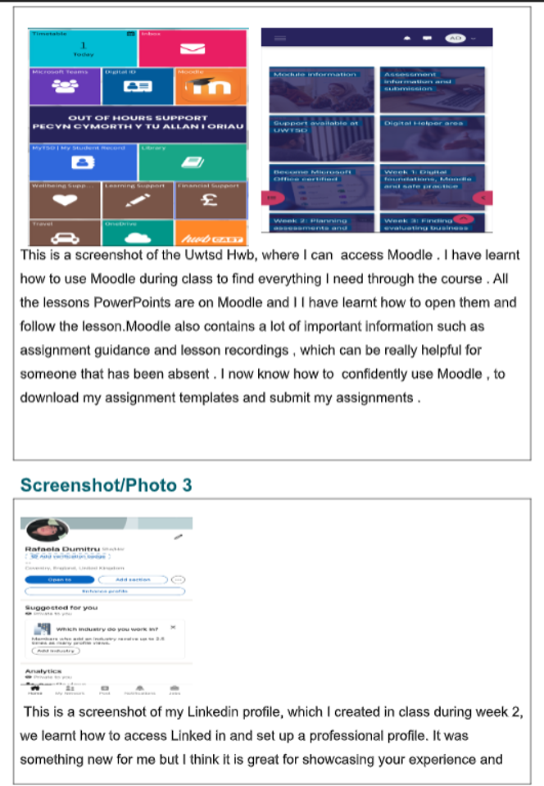
WORK 1: WORD TASK
Word task involved the following actions:
Completion of a templates showcasing My Digital Life
I attached important screenshots and wrote brief notes describing each of them.
Notes:
For this task, I was required to attach a set of screenshots showcasing my digital life. I chose to attach pictures of my LinkedIn account and the Moodle page. I was provided with a word template, which was used to structure the report.

Slide 5
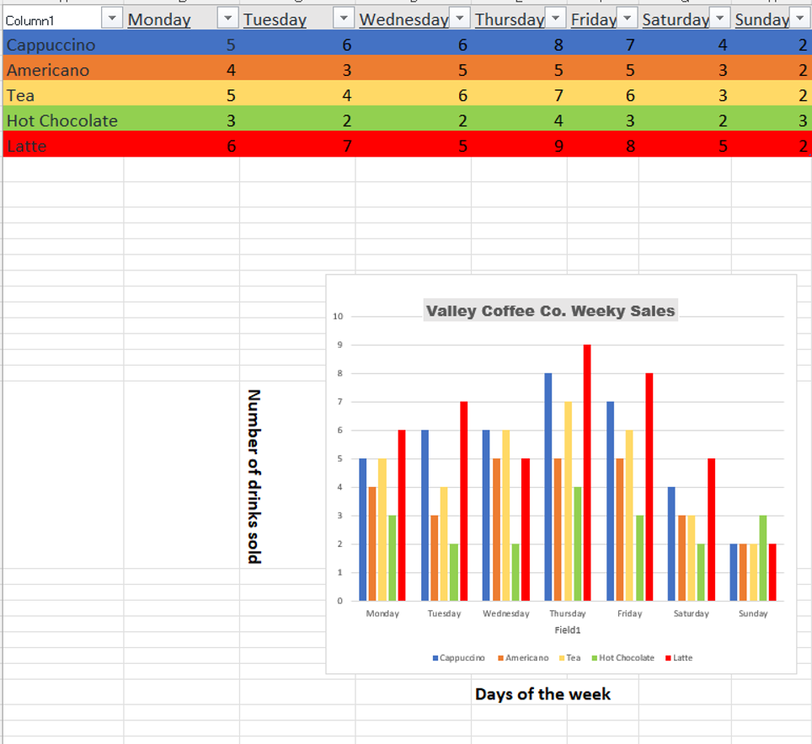
WORK 2: EXCEL TASK
Excel task involved entering sales data for Valley Coffee Co.
Formatting the excel table using different colours
Inserting a chart to visually represent the sales data.
Notes:
For the Excel task, I used the weekly sales data for Valley Coffee. It had five different types of drinks, which included Cappuccino, Americano, Tea, Hot Chocolate and Latte. I entered the data, in the excel, across tables and columns, formatted the doc with various colours and also inserted a clustered column chart.

Slide 6
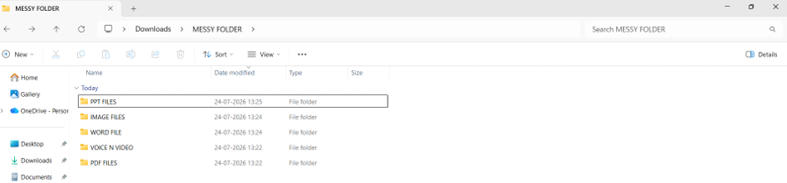
WORK 3: MESSY DOCUMENT
Messy Folder task involved organising files by type.
File named Messy Folder was downloaded from Week 1 materials.
The file content from the zip folder was extracted in a new folder.
The files were re-organised based on the file type.
Notes:
For this task (which was assigned for Week 1), after downloading the zip file from the portal, I extracted all the files to a new file, named as MESSY FOLDER. In which, I rearranged and grouped all the files, into specific folders based on their file type. Through this approach, I created five new folders.

Slide 7
MY DEVELOPMENT
I Developed Microsoft Word and Excel formatting skills.
It improved my digital file management and organisation abilities.
I initially lacked confidence when using unfamiliar digital tools.
However, weekly practice gradually increased my confidence and independence.
Notes:
While completing these tasks, I was able to develop a range of important digital skills. These include word formatting, excel formatting, file organisation. Initially during the start of the module, I felt slightly hesitant about learning the new skills, and using technology to perform the academic tasks. However, as I progressed gradually, and started solving the tasks step-wise, by completing the weekly activities, I gained my confidence. Now, I feel well-verse with various features in MS Excel and MS Word thus, indicating my personal growth in the area of digital skills.

Slide 8

REFLECTION
Word improved document formatting and structuring abilities.
Excel developed my data organisation and visualisation skills.
Folder activity strengthened my digital organisation and file management skills.
These tasks increased my confidence in using technology.
Notes:
I worked on some new digital skills and gained greater confidence with the technology when working on the three portfolio tasks.
The Word document task enabled me to develop skills using Microsoft Word that were very relevant to my work, such as working with Word templates, adding screenshots, structuring material and organising a document. I have also discovered how digital tools, like LinkedIn and Moodle can help me in my educational and career growth.
The Excel task was helpful, because it helped me in developing an understanding on ways to use a spreadsheet in the correct way. I Learned how to enter the sales data into rows and columns, format cells with various features and insert clustered column chart to present data visually. This helped me to improve my knowledge of using Excel and organise, analyse and calculate using quantitative data.
The messy folder activity, developed my organisation skills and efficiency in file arrangement. I learned how to retrieve files from a zip file and recognise the various types of files and store them in the correct folder.

Slide 9
CONCLUSION
  Digital skills will support my future academic studies.
  Word will help create professional and structured assignments.
  Excel will support workplace data and personal budgeting.
  File organisation will improve efficiency in everyday activities.
Notes:
This module has enabled me to gain useful digital skills that can be utilised in both the classroom, workplace and my personal life. I would use MS Word to type up well-structured assignments, and MS Excel to organise my research data and do calculations and make charts. I will also file my schoolwork based on modules in different folders to make it more convenient to access. At work, MS Work and MS Excel skills would be equally helpful. I can make use of Excel to organie my monthly budget and personal information on a digital basis in everyday life. These skills will assist me in completing my works with confidence and efficiency.

Slide 10
THANK YOU

