Slide 1



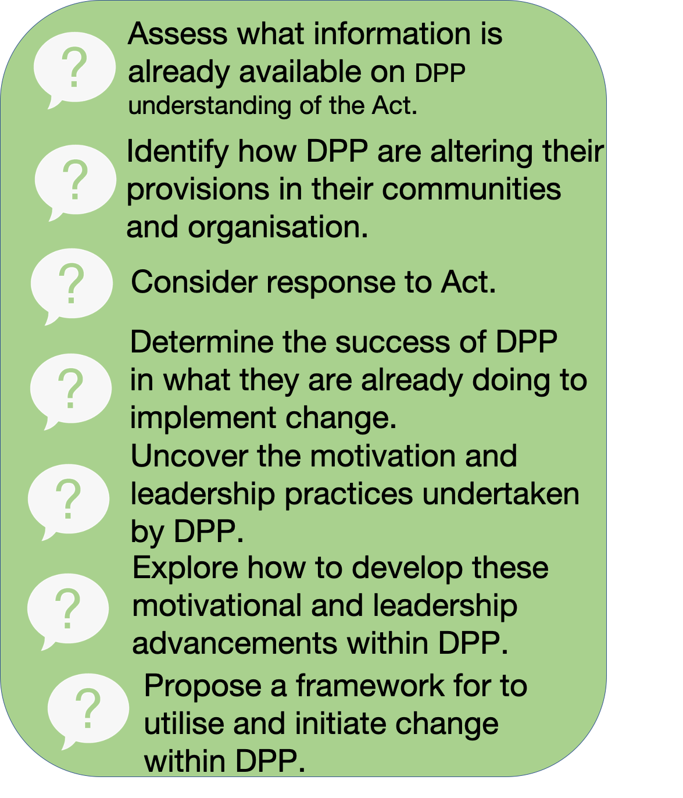
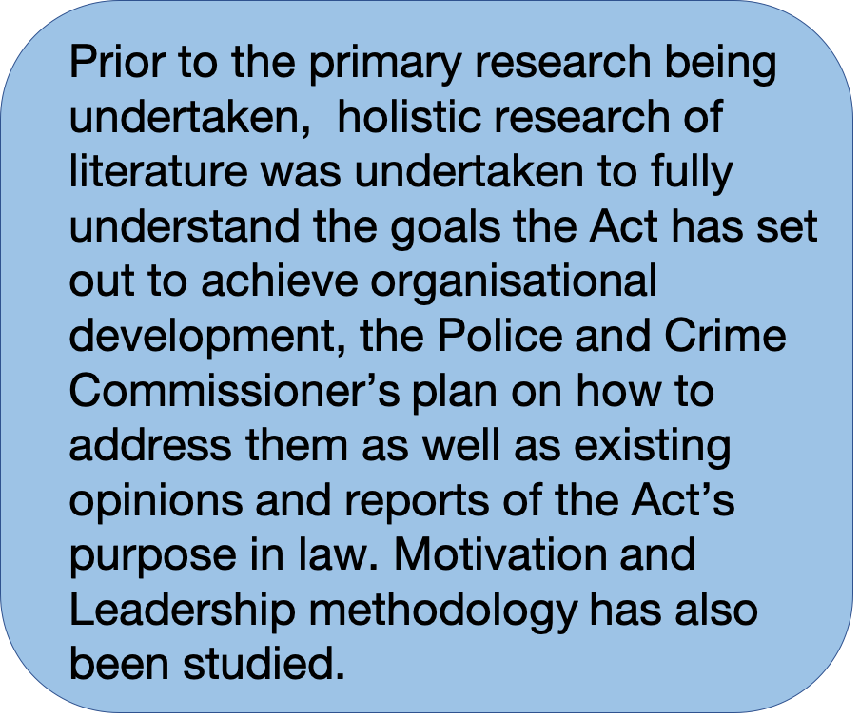
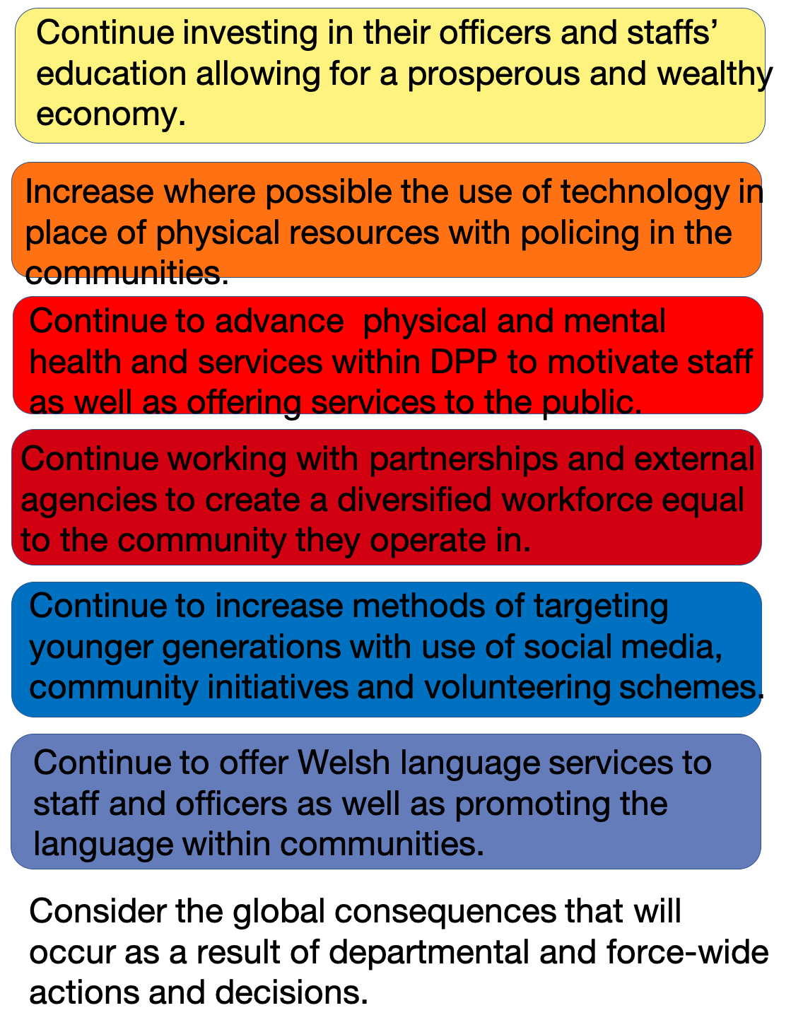

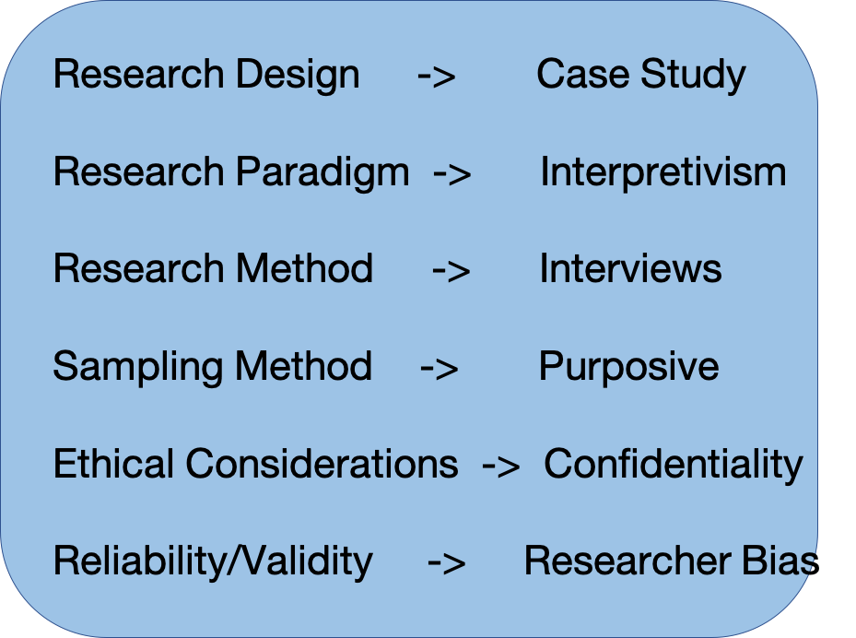



Background
Author- Rebecca Aston /Student number- 1802671
Recommendations
How the Well-Being of
Future Generations Act of Wales 2015
is impacting the provisions of
Dyfed-Powys Police
In a world where knowledge of world issues are at the forefront of public consciousness, with the new influx of legislation, how exactly is the Well-being of Future Generations Act 2015 impacting Dyfed-Powys Police?
Research Objectives
Literature
Review
Methodology
Welsh Government . (2020, January 24). The Wellbeing of Future Generations Act 2015 . Retrieved from WCMA : http://thewaleswewant.co.uk/sites/default/files/Goals_E.png
Government, W. (2015). Wellbeing of Future Generations Act 2015- The Essentials . Wales: Crown Copyright .
Dyfed-Powys Police . (2020, April 27). Dyfed-Powys Police. Retrieved from DYfed-Powys Police: https://www.dyfed-powys.police.uk

