Slide 1


Suicide and self-harm amongst men
Tamsin Stinchcombe

Slide 2

Mind (2019)
Mind (2019)
Mind (2019)

Slide 3


Remove the stigma of men discussing their mental health.
MANUP (2022)
Shout (2022)

Slide 4


125 lives are lost every week to suicide in the United Kingdom
Campaign Against Living Miserably (2022)
Support After Suicide Partnership (2022)

Slide 5


76% of suicides are by men and suicide is the biggest cause of death for men under 35
Men’s Health Forum (2022)

Slide 6

Opening up when we’re struggling can be the hardest thing, but if we have problems we need to share them
Mind (2022)
Steven Edwards (2016)

Slide 7

By 2030 we’ll reduce the rate of male suicides by 25%
Jonathan Forbes (2021)
Movember (2021)

Slide 8

#dontbottleitup (2017)
Rankin (2017)
84% of UK men say they bottle up their emotions

Slide 9
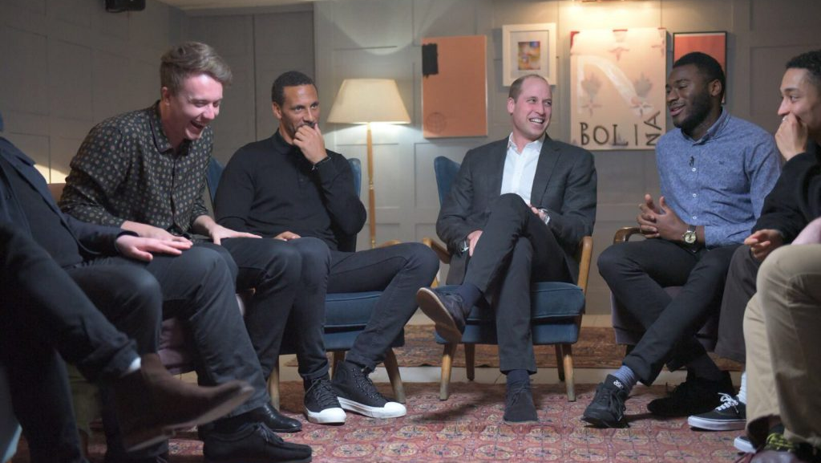
#BestManProject (2018)

Slide 10
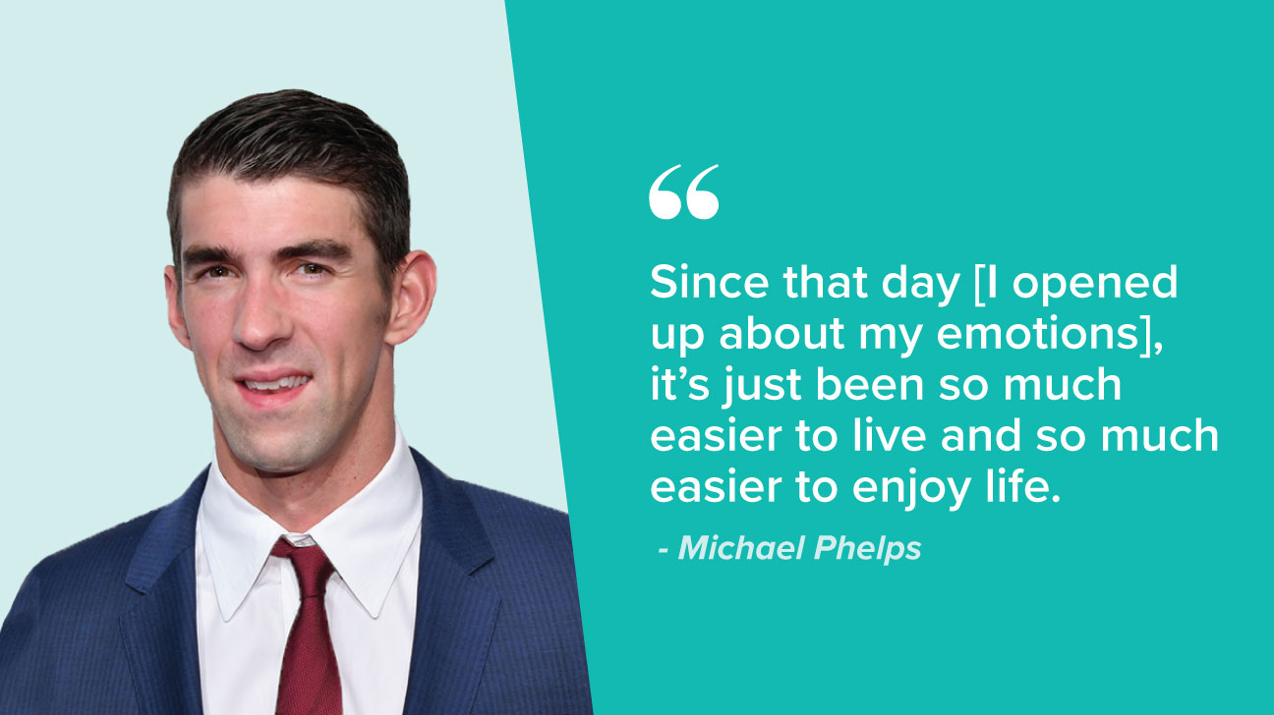
Conclusion

Slide 11
Reference List
Campaign against living miserably (2017) #DontBottleItUp. Available at: https://www.thecalmzone.net/2017/10/world-mental-health-day-dontbottleitup/ (Accessed on the 25th of April 2022).
Campaign against living miserably (2017) #DontBottleItUp. Available at: https://www.thecalmzone.net/2017/10/world-mental-health-day-dontbottleitup/ (Accessed on the 25th of April 2022).
Campaign against living miserably (2018) #BestManProject. Available at: https://www.thecalmzone.net/2018/01/watch-bestmanproject-goes-royal/ (Accessed on the 25th of April 2022).
Jonathan Forbes (2021) WHY I MO: JONATHAN FORBES. Available at: https://uk.movember.com/story/why-i-mo-jonathan-forbes?tag=real-stories (Accessed on the 27th of April 2022).
MANUP (2022) Men, Talking to Men. Available at: https://www.manup.how/ (Accessed on the 25th of April 2022).
Men’s Health Forum (2022) Men’s Health Week. Available at: https://www.menshealthforum.org.uk/mhw (Accessed on the 26th of April 2022).
Michael Phelps (2018) 10 Men Tell Us What They Wish Other Men Knew About Mental Health. Available at: https://www.healthline.com/health/mental-health/celebs-speak-out-men-mental-health (Accessed on the 26th of April 2022).
Mind (2019) Get it off your chest: a report on men’s mental health. Available at: https://www.mind.org.uk/about-us/our-policy-work/reports-and-guides/get-it-off-your-chest-a-report-on-mens-mental-health/ (Accessed on the 25th of April 2022).

Slide 12
Reference List (continued)
Mind (2022) What we do. Available at: https://www.mind.org.uk/about-us/what-we-do/ (Accessed on the 26th of April 2022).
Movember (2021) Movember. Available at: https://uk.movember.com/ (Accessed on the 27th of April 2022).
Rankin (2017) Rankin Shoots #dontbottleitup Spot for Topman to Spread Awareness of Male Mental Health Issues. Available at: https://www.lbbonline.com/news/rankin-shoots-dontbottleitup-spot-for-topman-to-spread-awareness-of-male-mental-health-issues (Accessed on the 25th of April 2022).
Shout (2022) shout 85258. Available at: https://giveusashout.org/ (Accessed on the 25th of April 2022).
Steven Edwards (2016) It’s okay to ask for help. Available at: https://www.mind.org.uk/information-support/your-stories/its-okay-to-ask-for-help/ (Accessed on the 26th of April 2022).
Support After Suicide Partnership (2022) Welcome. Available at: https://supportaftersuicide.org.uk/ (Accessed on the 25th of April 2022).

