Slide 1
Certificate of Higher Education in Skills for the Workplace
Effective Team Working & Communications
(BMSW 4002)
Functions of communication
Week 6

Slide 2

In this session…..
Overview of week 6 - 10
Discuss the functions of communication
Introduce component 2 assessment brief
Group work allocation.

Slide 3
Overview of week 6 - 10
Week 6 | Functions of communication
Week 7 | Communication process & Barriers
Week 8 | Communications Channels, Technology, & Ethics of communication
Week 9 | Communication in Organisation & Face to Face
Week 10 | Final assessment week

Slide 4
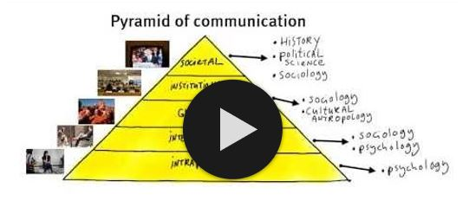
What is Communication?
Make notes while you watch the video below;
Watch this video

Slide 5
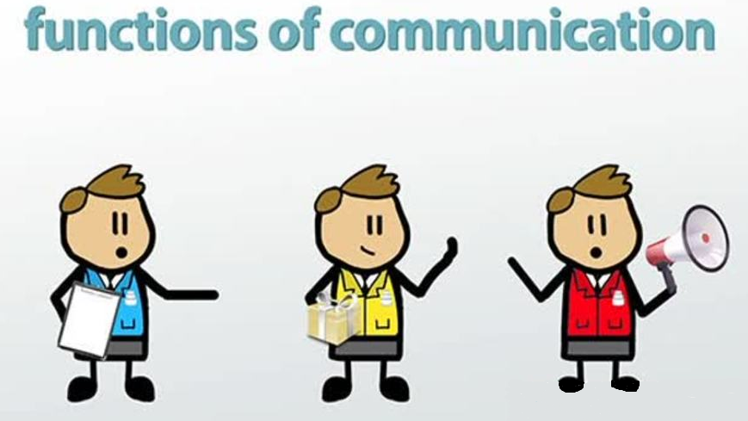

Slide 6
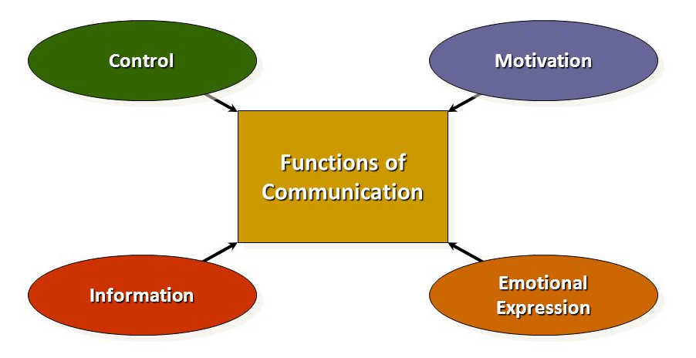
Functions of communication
(Robbins and Coulter, 2017).

Slide 7
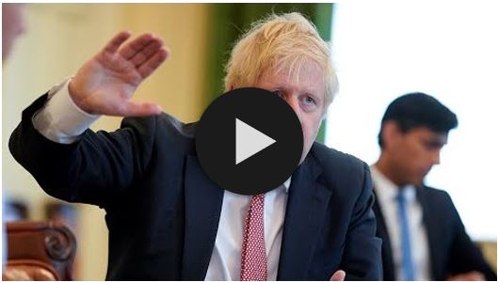
What makes this video effective in communicating its message?
Watch this video

Slide 8
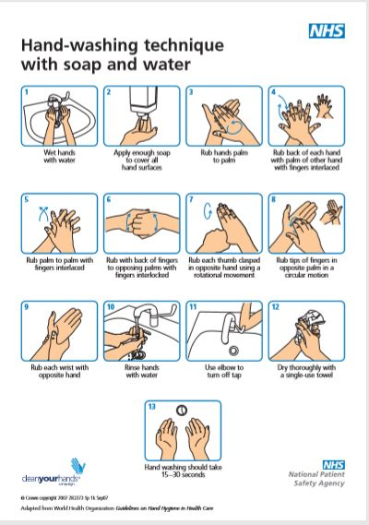

Here a person is reading a handwashing poster.
What is the channel of communication here?
What is the function of the poster?
Is it to – Motivate?
- Inform?
- Control?
- Comfort?

Slide 9
How do we communicate?
Most people think about speech when they think about communication but there are many other ways, we can also use to communicate with each other:
Facial expression
Gestures
Pointing / using hands
Writing / Drawing
Touch
Eye contact
For communication to be effective we also must be able to understand what others are trying to communicate to us:
Understanding language
Hearing
Ability to see
Reading skills
Ability to recognise and use information
Memory to recall and understand information

Slide 10
Activity
You are working in a care home as a senior healthcare assistant.
Communication is very important for you to prosper in your role and for your care home to deliver high quality services.
Identify one example related to each function of communication in your care home.
Share your ideas with the class.
(Robbins and Coulter, 2017).

Slide 11
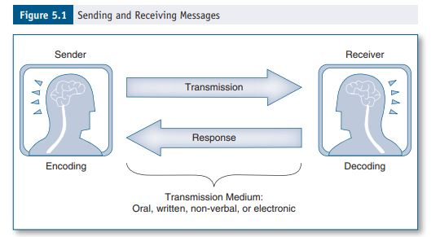
Inter-personal communication.
(Griffith and Dunham, 2015, p.93)

Slide 12
Develop an activity to promote inter-personal communication.
Dynes (2017) published a selection of materials to support health and social care professionals to develop communication skills with older people.
Use the chapter ‘Communication activities to support and improve communication skills’ – pdf (in class files and on Moodle week1)
Read through and choose one of the activities to use as a professional, briefly write (150 words) why you have chosen it and how you would develop it further.
Email your responses to your lecturer

Slide 13


Summary
Can you explain;
What is communication?
How do we communicate?
The functions of communication?

Slide 14
Component 2 Assessment
Assignment Title: | Component 2. Presentation – Strategies for Effective Communication in a Business Setting. | Word count (or equivalent): | 3 – 5 minutes per person Group Presentation
Submission deadline: | Slides to Turnitin- Group presentation slides to Turnitin Sunday 27th March by 3 pm Group Presentations- Week Commencing 28th March 2022
Let’s now look at the full assignment brief together.
Ensure that you read the full assessment brief which is available on the Module page in Moodle

Slide 15
Team Presentation Group Formation
The teams are pre-selected:
Your teams are as follows:
Team 1
.
.
.
Team 2
.
.
.
Team 3
.
.
.
Team 4
.
.
.
Team 5
.
.
.
Team 6
.
.
.
Team 7
.
.
.
Team 8
.
.
.
Team 9
.
.
.
Team 10
.
.
.

Slide 16
Assignment Brief Task 1
Task 1 - As a group/team you will produce a presentation which could be used as a training and development tool with new staff working at Rainbow Children’s Hospital to support families throughout their treatment.
The presentation must include:
Theories relating to models of communication.
The channels of communication that can be used by the organisation and channels that can be used to improve communication
The types of barriers that can prevent effective communication.
The impact of effective communication on staff and patients.
Within your report (presentation) you should link your points to theory and reference a minimum of eight (8) published literature sources.
You can use examples from your own professional experience to support or enhance your points.

Slide 17
Assignment Brief Task 2
Task 2 - The final slide in your presentation will be a ‘Teamwork Evaluation’ Slide.
USE THE TABLE PROVIDED IN THE BMSW_4002 Moodle WEEK10 folder
This slide will appear after the reference slide and does not need to be presented but must be included in your TURNITIN submission.
All members of the group must submit the group slides to the slide submission link on Moodle.
The presentation should present the most salient (important) points only and you must attend in person. Unless if given the permission by the Assessment team to present online, which will require that your camera must be turned on during online/virtual presentation.

Slide 18
Group Work – Activity.
Each lecture you will have time together as a team to work on your presentations.
As a team you must demonstrate co-operation and progress to your lecture during this time.
Being absent from a group working session with lead to an absent mark on the register.
Please join your group in the designated channel to being working together – get to know each other and begin to divide the workload.

Slide 19
References
Dynes, R., (2017), Positive Communication : Activities to Reduce Isolation and Improve the Wellbeing of Older Adults London: Jessica Kingsley Publishers.
Griffith, B., and Dunham, E., (2015), Working in Teams: moving from high potential to high performance Los Angeles: SAGE Publications.
MOOC ICS, (2013), 1.2 What is communication?, [video], Available at: https://youtu.be/S7CN9Trw43w (Accessed: 5 May 2020).
Robbins, SP. & Coulter MA. (2017) Management, Global Edition Harlow, United Kingdom: Pearson Education Limited. Available from: ProQuest Ebook Central. (Accessed: 7 May 2020).
Buchanan, D. & Huczynski, A. (2016) Organizational Behaviour, Pearson Education Limited. Harlow, United Kingdom. Available from: ProQuest Ebook Central.
The Telegraph, (2020), UK government explains ‘R value’ and importance of keeping it low to lift lockdown: Covid 19,[video] Available at: https://youtu.be/GJZ_Q8RGZWg (Accessed: 5 May 2020).

Slide 20

Next session
We will discuss;
The
Communication
Process and Barriers

