Slide 1


The Role of Human Resources in Promoting Diversity and Inclusion Through Flexible Working
WE HELP BUSINESSES GROW AND NURTURE A CONSUMER-FIRST MINDSET.
Marks
& Spencer
Viktoriya Koleva
Student ID : 2111874
University of Wales Trinity Saint David

Slide 2
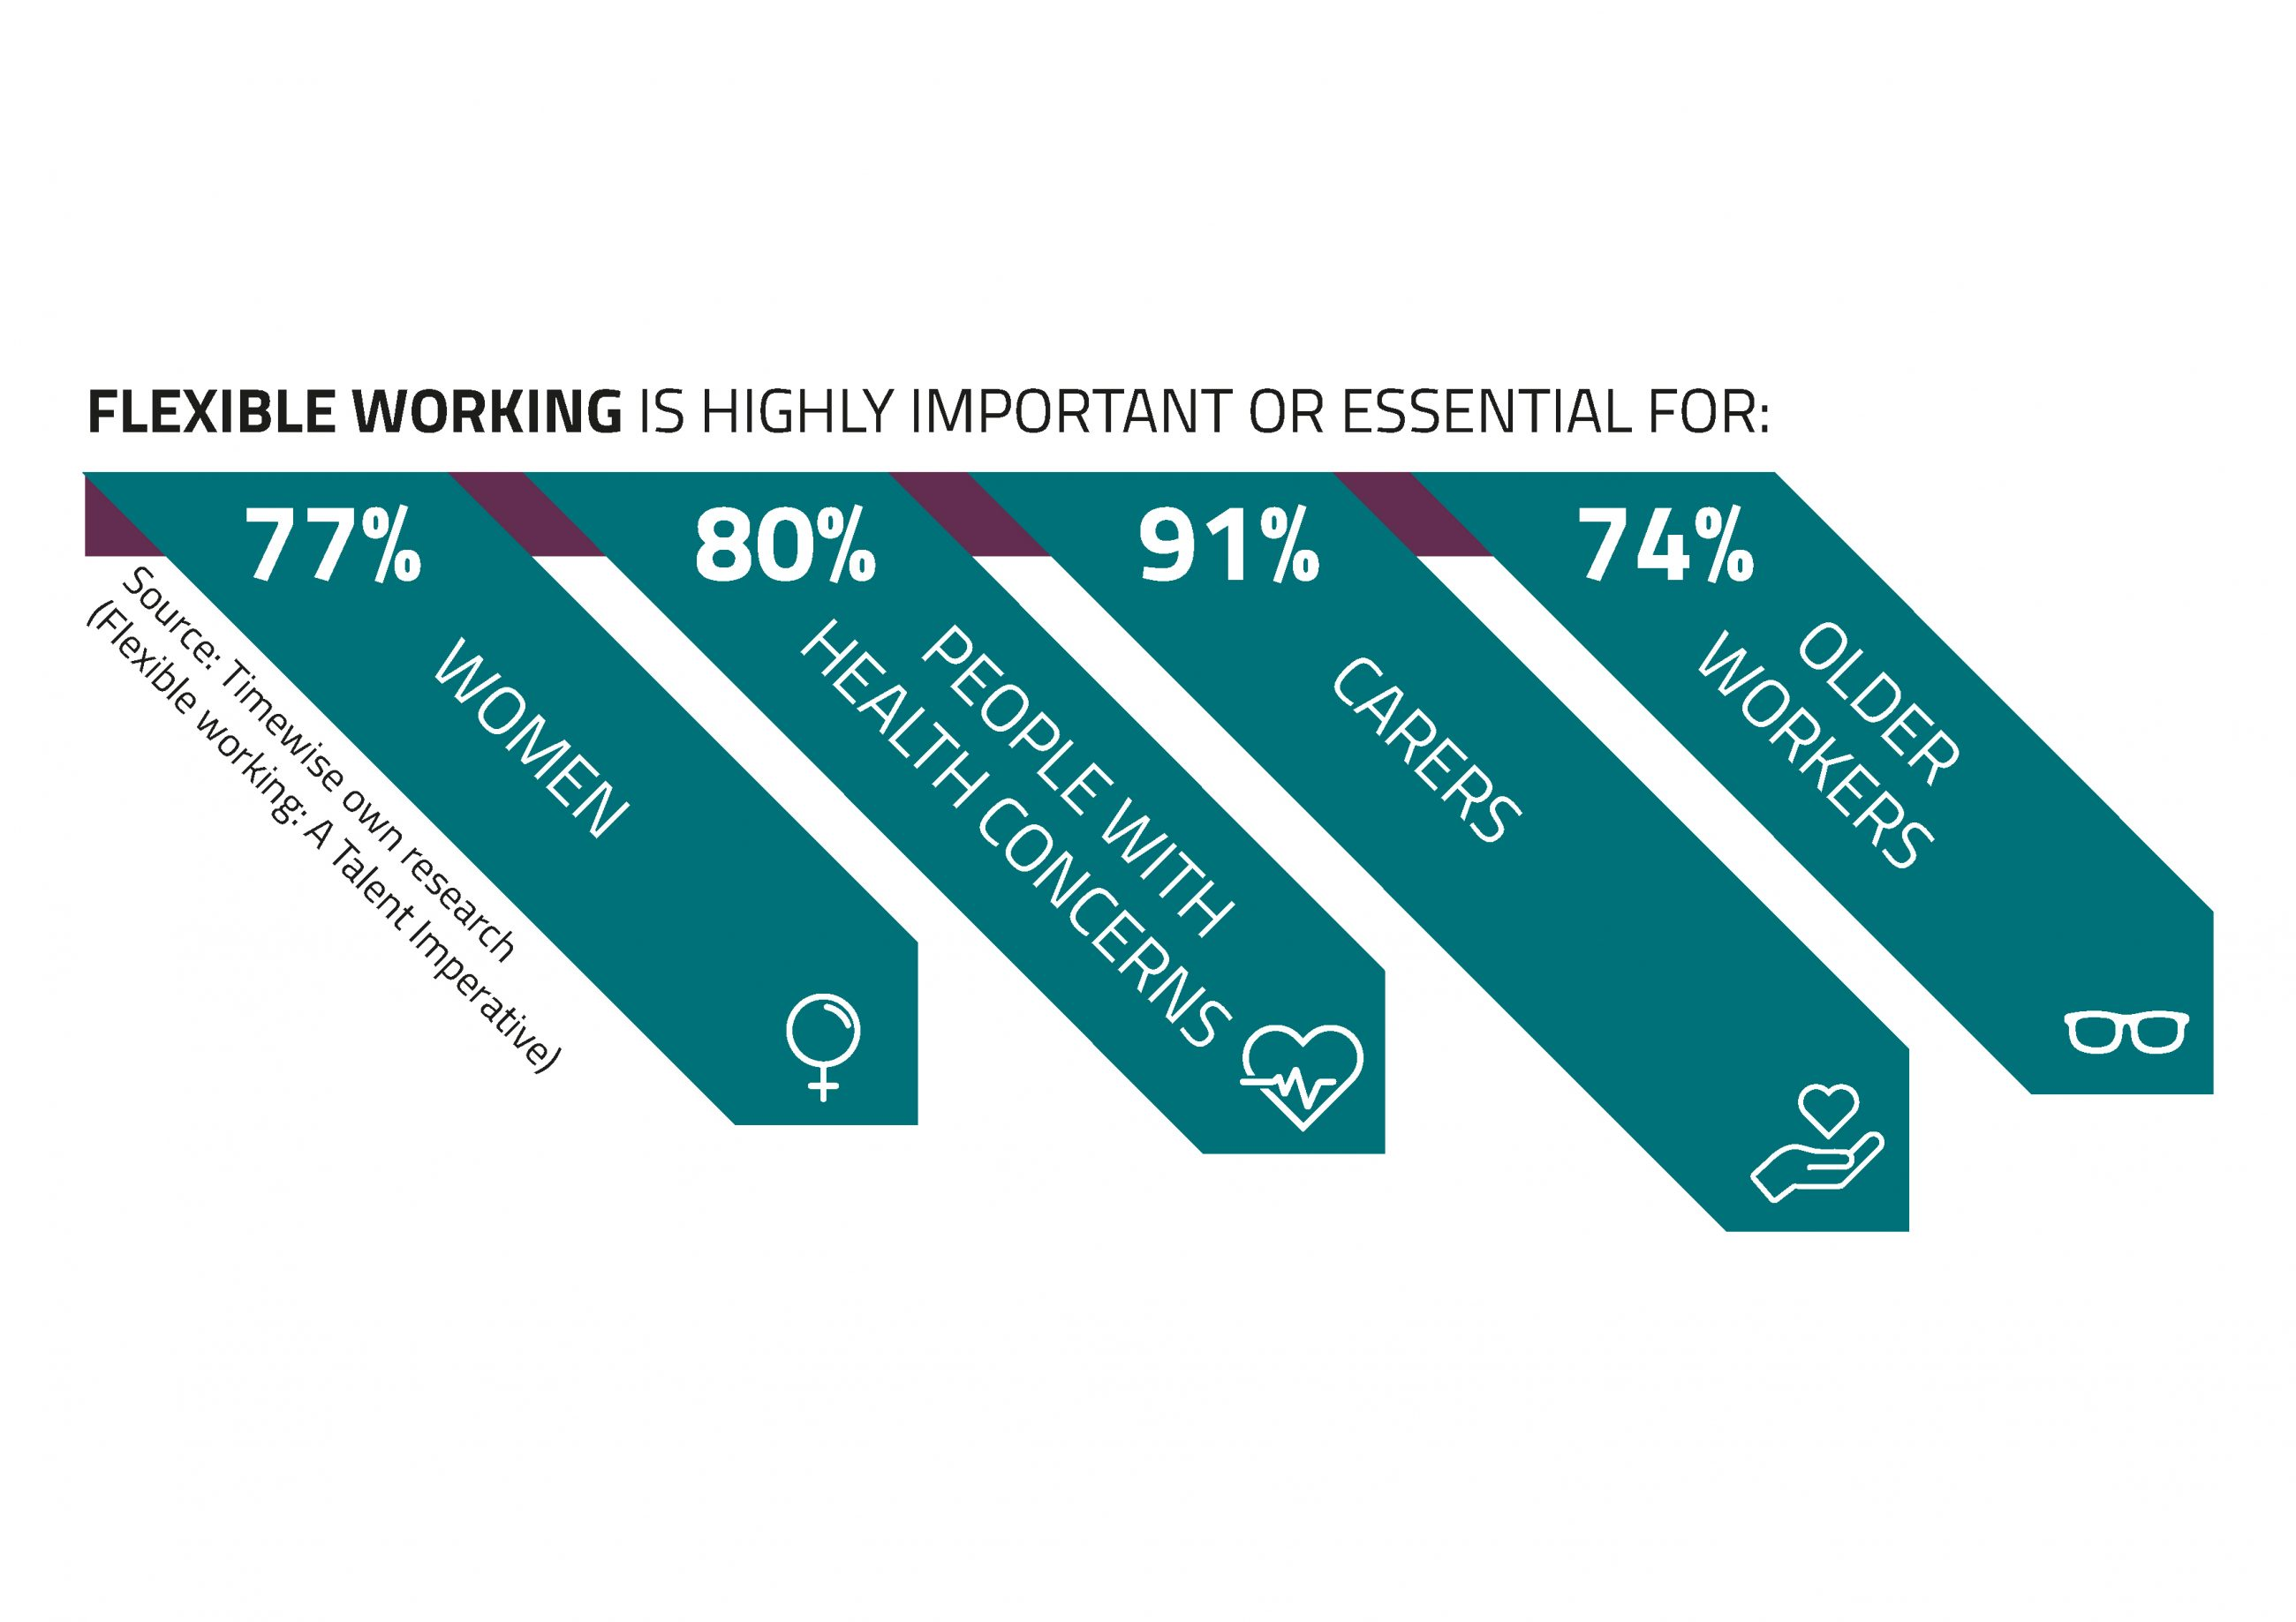
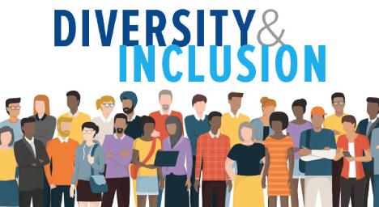
Table of Content
Introduction About us Flexible Working in Retail Industry Significance of Flexible Working Hours for Employees Significance of Flexible Working Hours for M&S (Organization) Role of HRM in Flexible Working Decision Diversity and Inclusion at Work Significance of Diverse and Inclusive Workplace Role of HRM in Promoting Diversity and Inclusion Recommendations Summary References | 3 4 5 6 7 8 9 10 11 12 13 14

Slide 3
Introduction
This is a case in favour of flexible working in relation to diversity and inclusion at workppace and within the chosen organisation (namely Mark & Spencer's)
A further analysis of the role of Human Resources in promoting diversity and inclusion through flexible working will also be illustrated.

Slide 4

About us
WE HELP BUSINESSES GROW AND NURTURE A CONSUMER-FIRST MINDSET.
M&S is a leading British retailer rendering quality retail services to millions of customers globally. their services and expertise comprises the following:
homeware
Clothing (KALYAN AND KUMAR 2019)
great value food

Slide 5

Flexible Working in Retail Industry
The retail industry is one where the changes in the workplace are most obvious.
Most of the employees have reviewed their work arrangements in light of the pandemic and investigated the possibility of working flexibly.

Slide 6
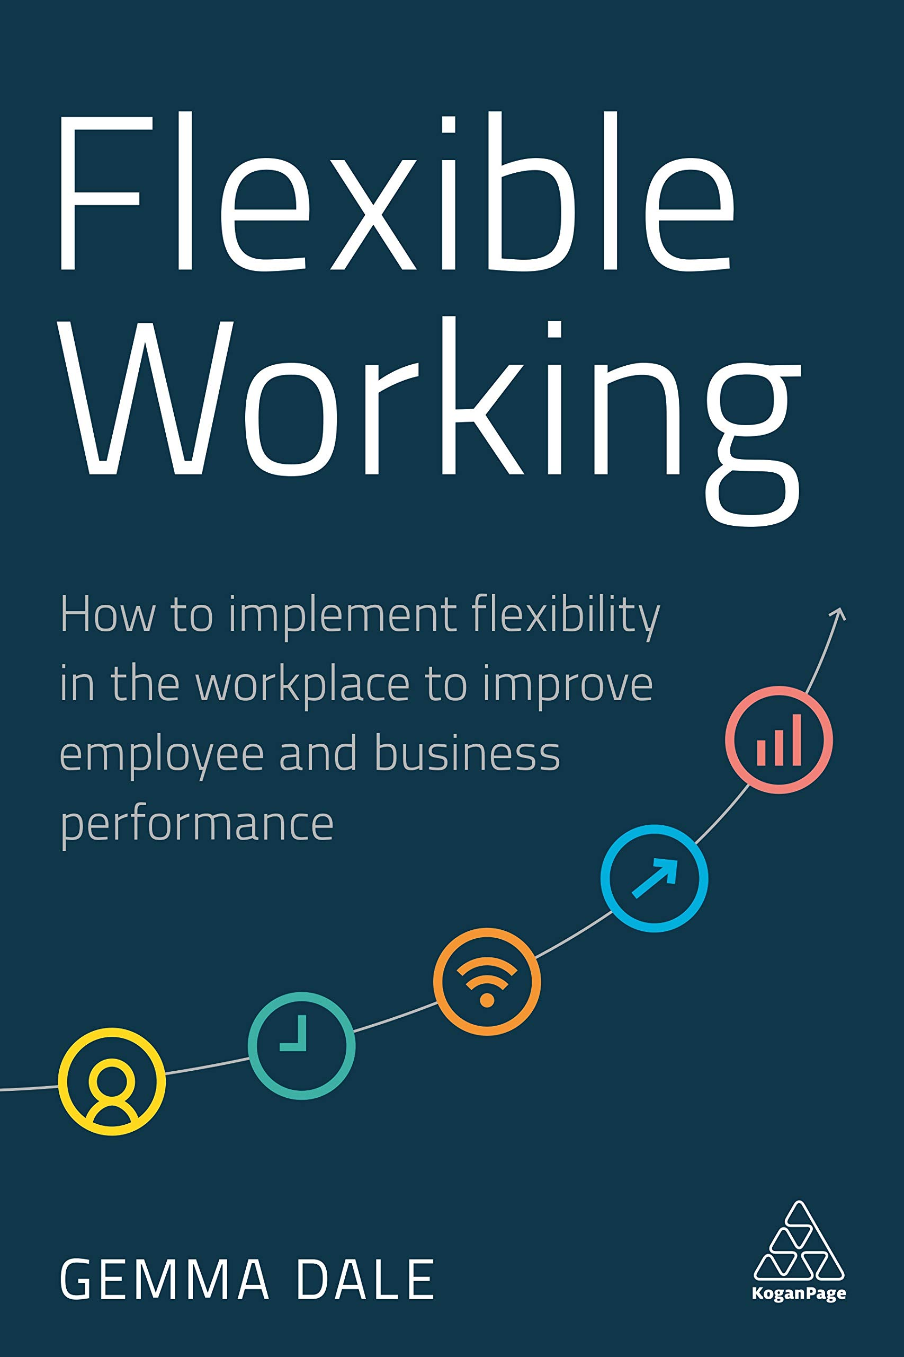
Significance of Flexible Working Hours for Employees
Understandably, consumer demand controls the work schedules of M&S's retail employees.
The epidemic has forced major personnel and FTE cutbacks, especially for companies in the retail sector.
The demand for personnel flexibility as a result is increased.
To combat this, employees returning from layoff search for alternative work schedules that better suit their needs or those of their families. There is a clear tension created by this.

Slide 7

Significance of Flexible Working Hours for M&S (Organisation)
Increased Productivity of the organisation
Enhanced recruitment and employee retention
Improved employee engagement levels within the organisation

Slide 8
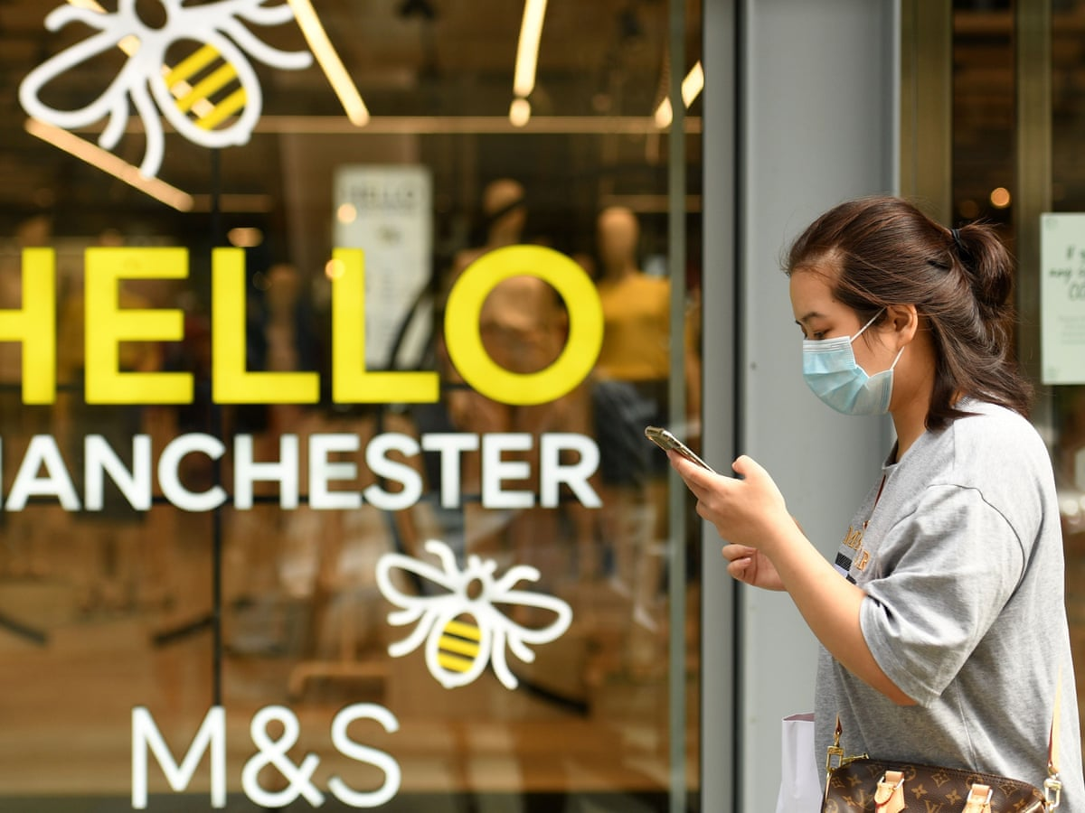
Role of HRM in Flexible Working Decision
Retail firms will undoubtedly experience difficulties in this area because many of them are already be balancing intricate rota/shift arrangements and lean workforces due to the COVID-19 outbreak
The HRM is also recommending adjustments to flexible working.
The HR team has to analyse what the plans entail for M&S in the retail industry and focuses on some important problems with inclusion and diversity. (Sang et al. 2022)

Slide 9

Diversity and Inclusion at Work
A diverse and inclusive workplace is something in which every professional feels equally included in and encouraged in all parts of the workplace.
Diversity and inclusion at the workplace must be practiced irrespective of where they're from or what they do for organisation. The phrase "all places" is crucial.

Slide 10
Significance of Diverse and Inclusive Workplace
1
2
3
Employee commitment and deepened trust are increased in Diversity and inclusion (D&I) environments. Additionally, D&I positions businesses to hire top talent from a diverse and frequently underutilized talent pool.
Additionally, it raises client satisfaction with their offerings.
D&I include more than just headcounts, rules, or programs.
D&I enables businesses to be more tolerant of many viewpoints, cultures, and ways of life, which enhances workplace culture.

Slide 11
Role of HRM in Promoting Diversity and Inclusion
WE HELP BUSINESSES GROW AND NURTURE A CONSUMER-FIRST MINDSET.
HR executives have the responsibility of enhancing processes for making unbiased decisions:
by coming up with creative solutions to deal with workplace bias
encouraging diverse workplace setting (Suciu et al. 2020)
This allows all employees equal opportunities from a career and professional perspective.
Workplace D&I is complicated, and the goal is not just to have a diverse workforce.

Slide 12
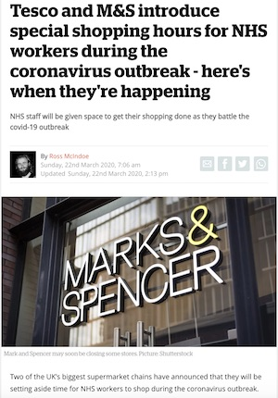
Recommendations for HRM to Promote Diversity and Inclusion Through Flexible Working
Establishing Communication Channels: To create a D&I workplace, employers must make a commitment to listening to their staff. To encourage constant and undivided communication amongst the employees choosing Flexible Working, this communication would also entail improving meetings and conferences via virtual platforms.
Celebrating D&I: HR needs to take the initiative in this area by organizing events that highlight staff diversity and strengthen the workplace. Additionally, SHRM advises setting up a location for meditation at work and concentrating HR efforts on more lonesome workers who work split shifts or remotely.
Hiring a Mentor: The appointment of a mentor is a great method to promote flexible working and demonstrate to employees that they can still achieve their professional objectives.
Letting flexibility work requires having well written policies around WLB: Written policies alone are insufficient since employees frequently worry about criticism for asking for flexibility. Training managers to accept and embrace D&I culture at work is a part of HR's responsibility. (Beigi et al. 2018)

Slide 13
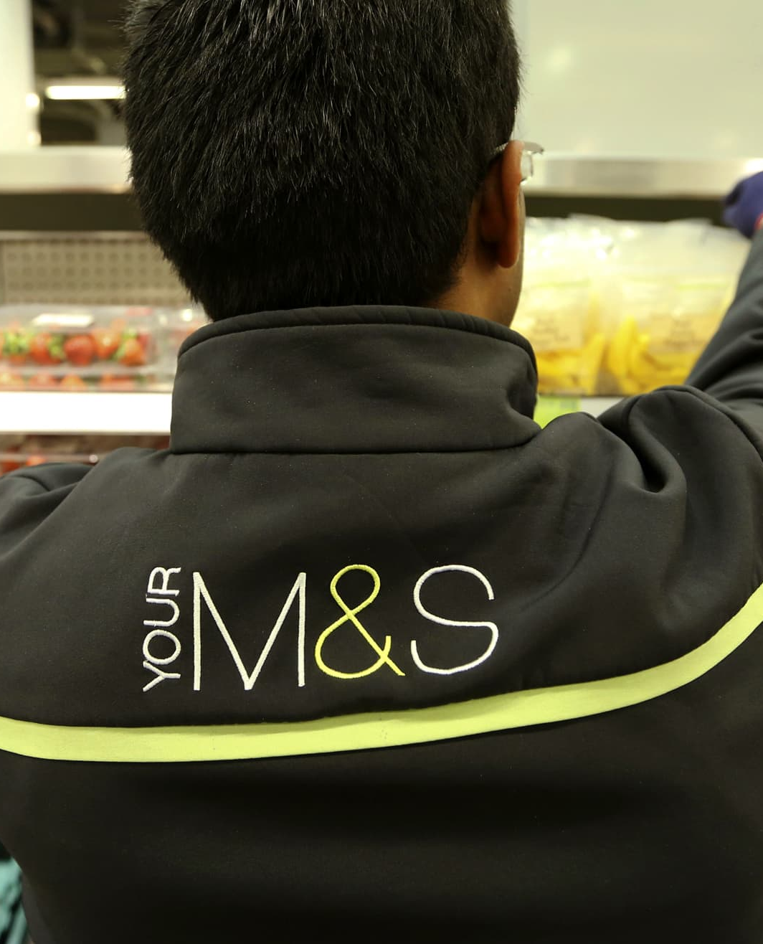
Summary
WE HELP BUSINESSES GROW AND NURTURE A CONSUMER-FIRST MINDSET.
Over 3k retail managers would get flexible work schedule options starting in January 2023, including the ability to spread out their work a 9-day compressed fortnight; work a 4-day compressed week, or hours over 5 days.
By 2025, M&S pledges to have senior management positions with at least 50 percent female representation plus 15 percent ethnic minority participation (D&I). M&S considers our strategies will help us meet this goal.

Slide 14
References
Beigi, M., Shirmohammadi, M. and Stewart, J., 2018. Flexible work arrangements and work–family conflict: A metasynthesis of qualitative studies among academics. Human Resource Development Review, 17(3), pp.314-336.
KALYAN, D.N.B. and KUMAR, D.N.N., 2019. A case study on benefits of quality of work life to employees and organizations in India. Iconic Research and Engineering Journals, 3(6), pp.147-152.
Sang, K., Calvard, T. and Remnant, J., 2022. Disability and academic careers: Using the social relational model to reveal the role of human resource management practices in creating disability. Work, Employment and Society, 36(4), pp.722-740.
Suciu, M.C., Noja, G.G. and Cristea, M., 2020. Diversity, social inclusion and human capital development as fundamentals of financial performance and risk mitigation. Amfiteatru Economic, 22(55), pp.742-757.

Slide 15

Thank You
WE HELP BUSINESSES GROW AND NURTURE A CONSUMER-FIRST MINDSET.
M&S

