Slide 1
Computer Forensics
Lecture 9-10
Lecturer: Assoc. Professor Carlene Campbell
Email: carlene.campbell@uwtsd.ac.uk
Website: www.knowledgewithprofit.com

Slide 2
Malware Forensics: Investigative Techniques & Analysis
Notes:
The session will cover key methods used in investigating malware incidents, drawing on industry standards and EC‑Council material
Content:
Define malware forensics and explain its importance.
Identify various types of malware and their behaviors.
Understand the forensic investigation process specific to malware incidents.
Learn key tools and techniques used in malware analysis.
Discuss legal and ethical considerations.
Explore emerging trends in malware research.

Slide 3
Introduction to Malware Forensics
Malware is malicious software that damages or disables computer systems and gives limited or full control of the systems to the malware creator for the purpose of theft or fraud
Malware programmers develop and use malware to do the following:
Attack browsers and track websites visited
Slow down systems and degrade system performance
Cause hardware failure, rendering computers inoperable
Steal personal information, including contacts
Erase valuable information, resulting in substantial data loss
Attack additional computer systems directly from a compromised system
Spam inboxes with advertising emails
Malware forensics involves the identification, analysis, and investigation of malicious software to determine:
Infection vector
Behaviour and functionality
Persistence mechanisms
Impact and scope
Attribute indicators
NOTE: “Malware analysis is not about deleting malware — it’s about understanding what it did.”
Notes:
Malware forensics supports criminal cases, incident response, and threat intelligence.
It links directly to earlier lectures (acquisition, volatility, documentation).
why understanding malware forensics is essential in today’s cyber threat landscape.
Attackers deploy malware as a key tool to compromise cybersecurity defenses. Consequently, it is vital for forensic analysts to thoroughly understand various aspects of malware programs. This includes their functionality, modes of propagation, areas of impact, outcomes, and the diverse techniques available for their detection and analysis. Such comprehensive knowledge is essential for effectively investigating and combating malware threats.

Slide 4
The Role of Malware in Cybercrime
Malware as a tool for espionage, data theft, and ransomware attacks.
Impact on businesses and critical infrastructures.
Cybercriminals use malware to steal data, disrupt operations, and gain unauthorized access.
How Cybercriminals Use Malware
Data Theft – Stealing personal, financial, and corporate information.
Financial Fraud – Accessing banking credentials and making unauthorized transactions.
System Disruption – Crashing networks, deleting files, or causing operational failures.
Espionage – Governments and organizations use malware for spying and intelligence gathering.
Extortion – Ransomware attacks demand payments to restore access to critical systems.
DDoS Attacks – Using botnets to flood websites and servers with excessive traffic, causing downtime.
Notes:
Malware is often:
“The delivery mechanism for broader criminal objectives.”
Malware enables:
Data theft (credentials, intellectual property)
Financial fraud
Espionage
System disruption
Ransomware extortion
Botnet-driven DDoS
Emphasize the real-world impact of malware attacks and the need for robust forensic methods.

Slide 5
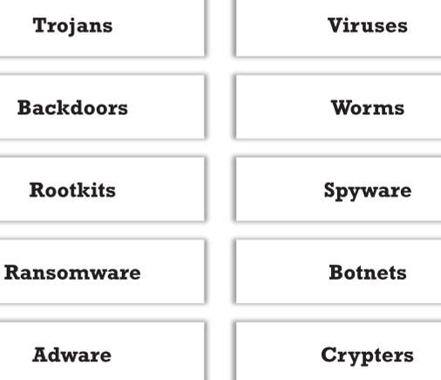
Types of Malware
Viruses: Self-replicating programs attached to files.
Worms: Standalone malware that replicates over networks.
Trojans: Disguised as legitimate software.
Ransomware: Encrypts data for payment.
Rootkits: Hide malicious presence
Loaders/Downloaders: Deploy secondary payloads
Notes:
Loaders and droppers are extremely common today.
Many modern attacks are multi-stage
Describe each type with examples and point out differences in propagation and behaviour.

Slide 6
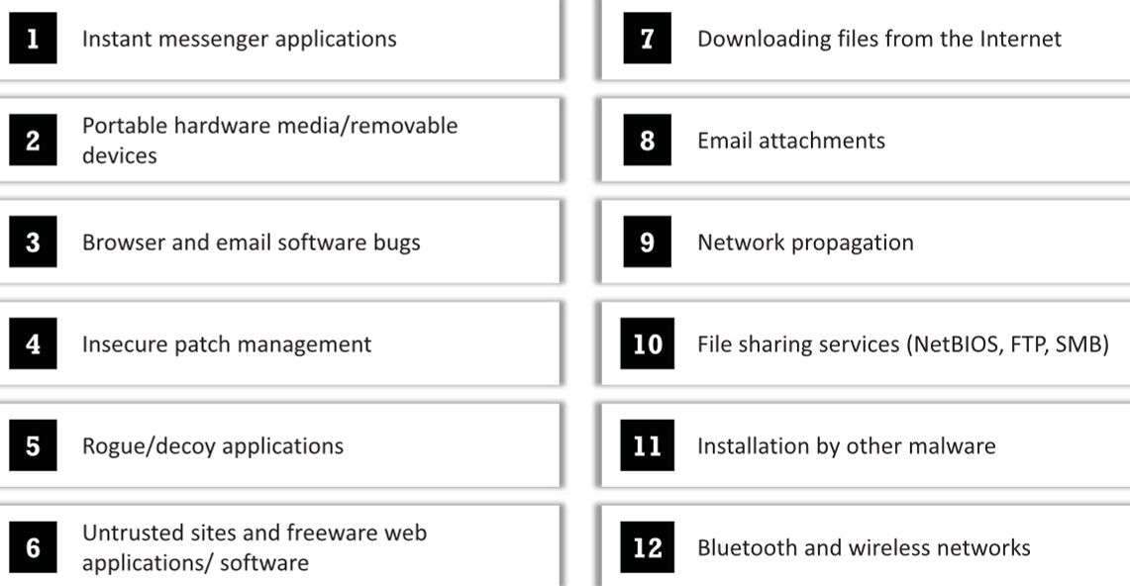
Different Ways for Malware to Enter a System
Notes:
advanced malware (APTs, rootkits) require specialized forensic approaches.

Slide 7
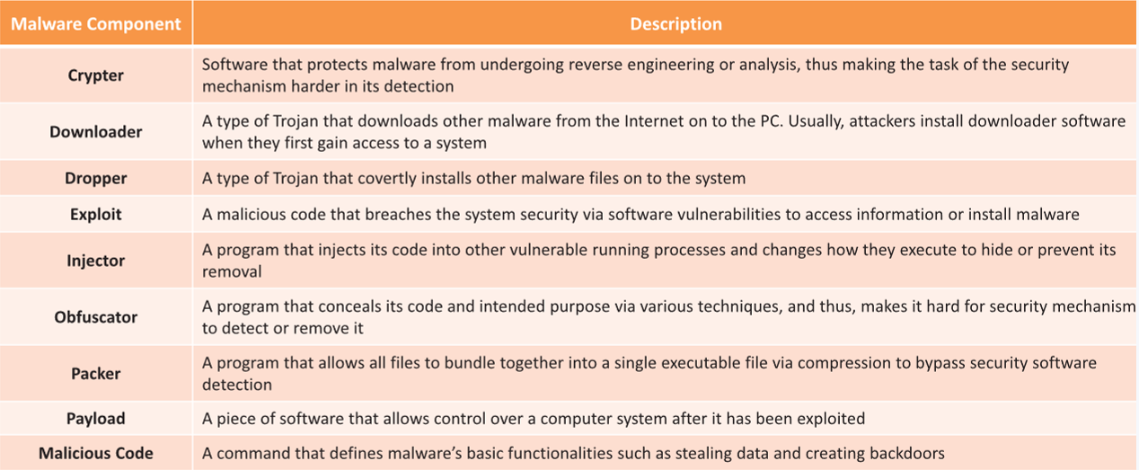
Components of Malware
The components of a malware software depend on the requirements of the malware author who designs it for a specific target to perform intended tasks
Exploited vulnerabilities in software.
Notes:
attackers gain initial access and understanding why these vectors is crucial for forensics.

Slide 8
The Malware Life Cycle
Stages: Delivery → Infection → Execution → Persistence → Propagation → Impact → Covering Tracks.
Delivery
  The malware is delivered to the target system via email attachments, malicious websites, infected software, or USB devices.
  Social engineering tactics, phishing, or exploit kits are often used.
Infection
  Once delivered, the malware exploits vulnerabilities in the system or tricks users into executing it.
  It may disguise itself as legitimate software or use drive-by downloads.
Execution
  The malware activates and starts running on the infected system.
  It may use system privileges, execute scripts, or run in the background to avoid detection.
Persistence
  The malware ensures it remains on the system after reboots or security scans.
  It may modify system files, create scheduled tasks, or use rootkits to hide.
Notes:
Go through each stage and describe how forensic investigators can capture evidence at different points.
Each stage plays a crucial role in the malware’s effectiveness and ability to compromise systems while evading detection.

Slide 9
The Malware Life Cycle
Stages: Delivery → Infection → Execution → Persistence → Propagation → Impact → Covering Tracks.
Propagation
  The malware spreads to other systems within the network or through external devices.
  Techniques include worm functionalities, file infections, or exploiting network vulnerabilities.
Impact
  The malware executes its intended malicious actions, such as stealing data, encrypting files (ransomware), or creating botnets.
  The final goal may be financial gain, espionage, or system destruction.
Covering Tracks
  Log manipulation or deletion – Malware may clear system and security logs to remove evidence of its activities and hide indicators of compromise.
  Artifact wiping – Temporary files, command history, and malware components may be deleted or overwritten to prevent forensic recovery.
  Obfuscation and self-deletion – Malware may encrypt, rename, or automatically delete itself after execution to evade detection and analysis.
Notes:
Go through each stage and describe how forensic investigators can capture evidence at different points.
Each stage plays a crucial role in the malware’s effectiveness and ability to compromise systems while evading detection.

Slide 10

Case Group Discussion
https://uwtsd.display.vevox.com#/present/885043/HOC2QFVKNXNBSGQLRZYT

Slide 11
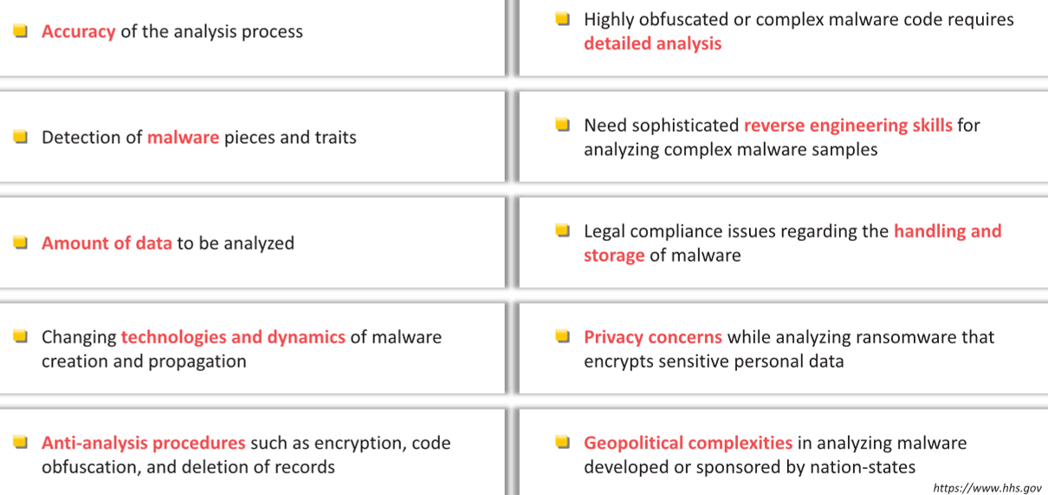
Malware Analysis Challenges
Notes:
the forensic significance of early infection indicators.
Infection methods: Exploitation, social engineering, automated execution.
Indicators: Suspicious file behaviors and registry modifications.

Slide 12
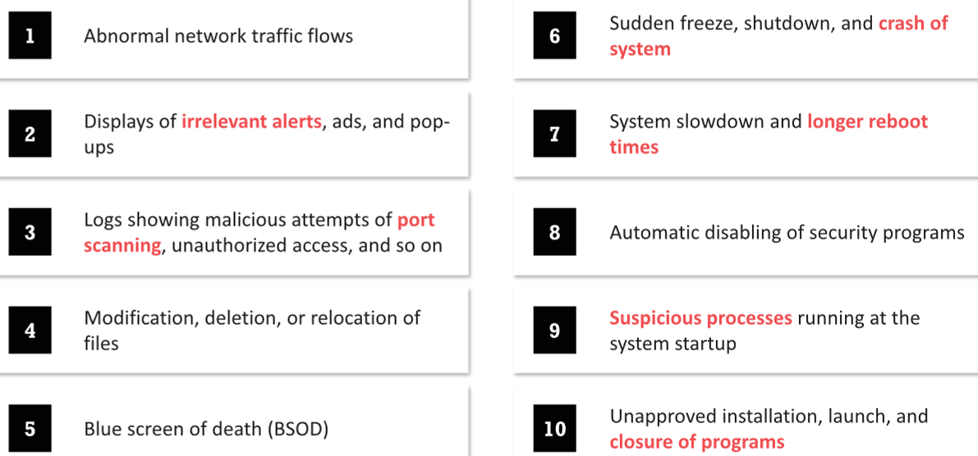
Indicators of Malware
Notes:
how malware remains active on a system and the challenges it creates for forensic investigators.
Execution: Running the malicious payload.
Persistence techniques: Scheduled tasks, registry keys, services

Slide 13
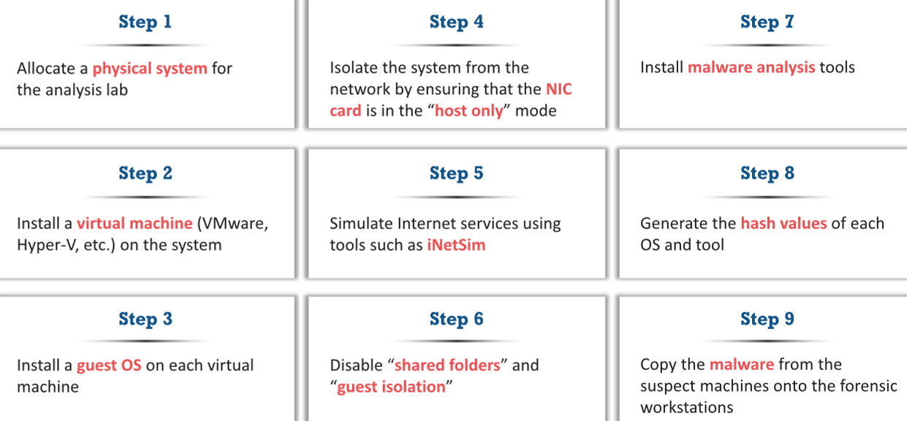
Preparing Testbed for Malware Analysis
Notes:
an overview of the forensic process and how it applies to malware investigations.
Phases: Identification, Collection, Analysis, Preservation, Documentation, Reporting.

Slide 14
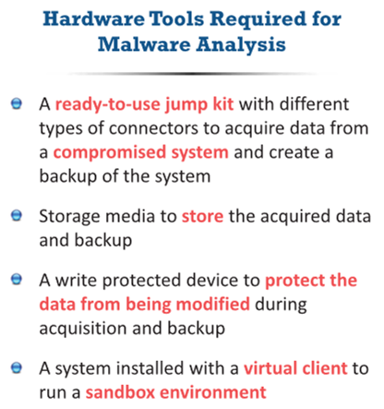
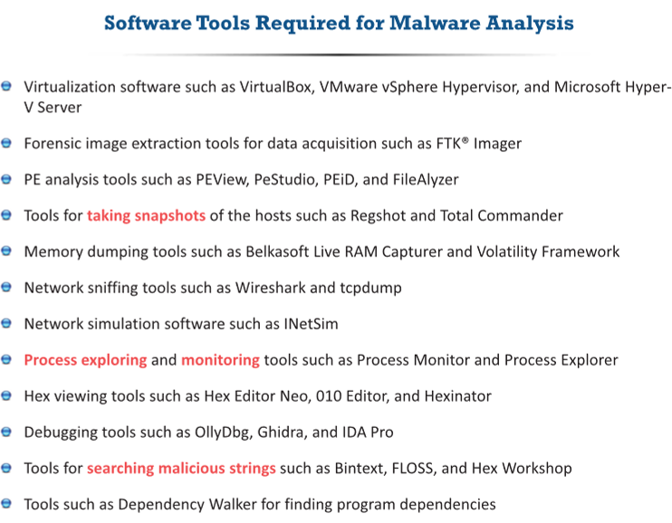
Malware Analysis Tools
Notes:
key differences when investigating malware versus static digital evidence
Specialized focus on volatile data, live system analysis, and dynamic behavior.
Emphasis on rapid evidence collection.

Slide 15
Documentation Before Analysis
The following are some of the documentations that an investigator should prepare before analyzing any executable file:
Full path and location of the file
Hash values (MD5 + SHA-256)
MAC-timestamp
The system information where file was stored, including the OS version, file system, user accounts, and IP address
References to the file within the file system or registry
Investigator details, who found the file and when
Details of forensic investigation tools
Note: Every executable must be hashed before analysis.
Re-hash after extraction if modified.
Notes:
the importance of proper evidence handling to ensure admissibility in legal proceedings.

Slide 16
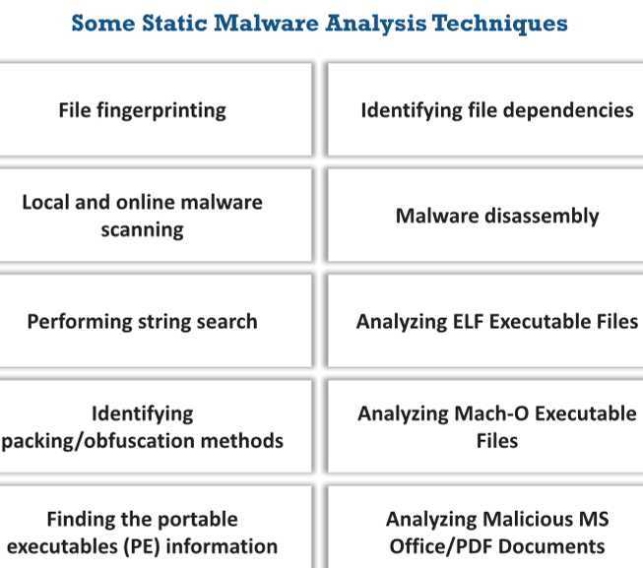
Static Analysis of Malware
Also known as code analysis
Analyzing malware without executing it. so, there is no need to create a safe environment
Methods: Disassembly, code analysis, signature matching.
It employs different tools and techniques to quickly determine if a file is malicious
Analyzing the binary code provides information about the malware functionality, its network signatures, exploit packaging technique, dependencies involved, etc.
Notes:
how static analysis helps reveal embedded strings, code structure, and potential signatures without risk.
It involves going through the executable binary code without executing it to have a better understanding of the malware and its purpose
Tools: IDA Pro, Ghidra, Hex-Rays.
It is recommended that both static and dynamic analyses be performed to obtain a detailed understanding of the functionality of the malware

Slide 17
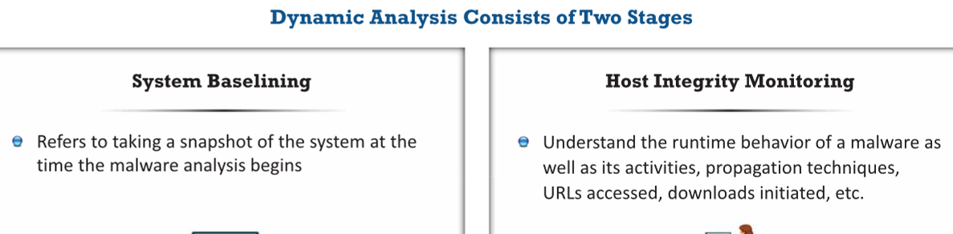
Dynamic Analysis of Malware
Also known as behavioral analysis
Analyzing behavior by executing malware in a controlled environment.
Techniques: Sandbox execution, behavioral monitoring.
This type of analysis requires a safe environment such as virtual machines and sandboxes to deter the spreading of malware
Important:
“Never analyse malware on your host machine.”
Snapshot rollback - allows investigators to quickly restore the system to that clean state after executing malware.
Notes:
Preparing a Safe Testbed
Isolated virtual machine
No internet or controlled network
Snapshot capability
Host-only networking
Monitoring tools installed
Sandbox execution is the process of running suspicious or malicious software in a controlled and isolated environment so that its behaviour can be observed without risking damage to the real system or network.
the benefits and risks of dynamic analysis and demonstrate how to interpret sandbox reports.
It involves executing the malware code to know how it interacts with the host system and its impact on the system after infection
Tools: Cuckoo Sandbox, VMWare.
For system baselining, investigators must take a snapshot of the baseline state of the forensic workstation prior to the malware execution
Run the malware on the Windows workstation for a certain period and take a second snapshot of the workstation
Compare the second snapshot with the baseline to detect the changes made to the system properties using tools such as WhatChanged Portable

Slide 18
Static vs Dynamic Analysis
Dynamic Analysis:
Execute in controlled environment
Monitor behaviour
Network connections
Registry changes
Static Analysis:
Examine without execution
Hashing
Strings analysis
Signature matching
Disassembly
“Static tells you what it could do.
Dynamic tells you what it actually does.”

Slide 19
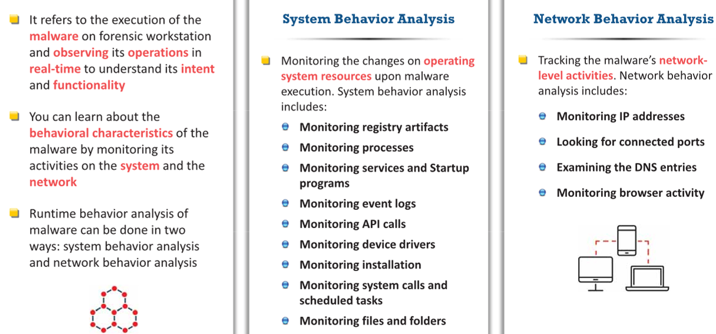
Host Integrity Monitoring
Dynamic Analysis: Reveals runtime behavior, riskier, requires a secure lab.
Notes:
Host Behaviour Monitoring
Monitor:
Registry changes
File creation
Scheduled tasks
Process injection
Services creation
Tools:
Process Monitor
Regshot
Autoruns
Tie back to:
Persistence mechanisms
Forensic artefact recovery
which method they think is more effective in various scenarios and why.
Static Analysis: Safer, can be done offline, limited by obfuscation.
Dynamic Analysis: Reveals runtime behavior, riskier, requires a secure lab.
Sandbox execution is the process of running suspicious or malicious software in a controlled and isolated environment so that its behaviour can be observed without risking damage to the real system or network.
Key idea:
The malware is executed in a virtual or isolated system (sandbox).
Investigators monitor its behaviour, file changes, network activity, and system modifications.
Any damage or infection remains contained within the sandbox environment.
Very short slide version:
Sandbox execution involves running malware in an isolated environment to safely observe its behaviour without affecting the host system.

Slide 20
Take a break
We’ll rejoin in 10 minutes
Notes:
Explore Password Cracking/Bypassing Techniques

Slide 21
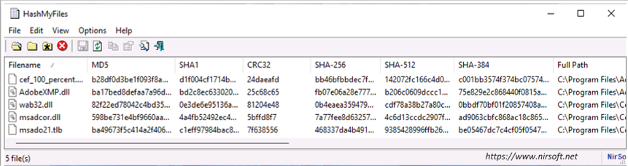
Static Malware Analysis: File Fingerprinting
It is recommended to compute the hash value for a given binary code before carrying out the investigation
You can use the computed hash value to periodically verify if any change is made to the binary code during analysis
Investigators can use tools such as HashMyFiles, mimikatz, and HashCalc to calculate various hash values of the malware file
You can also compare the computed hash value with that of the identified malware stored in databases, for example, VirusTotal, MalwareBazaar - online databases
Check file signatures
Examine entropy levels - analysing how random the data in a file appears.
Notes:
High entropy often indicates that the file is compressed, encrypted, or packed, which is common in malware used to hide malicious code.
Entropy analysis measures how random data in a file is to detect possible encryption, compression, or packing used to hide malware.
High entropy may indicate packing or encryption.
Importance of volatile memory analysis in capturing malware artifacts.
Tools: Volatility Framework.
File fingerprinting typically involves generating a unique identifier for a file through hashing algorithms
You can use file_fingerprinting.py, a Python script to check the integrity of the suspected malicious files

Slide 22
Analyzing Suspicious MS Office Document
Finding Suspicious Components
  Analyze the malicious Office document with oleid to detect any specific components that can be labeled as malicious/suspicious
  To use oleid, open a new terminal on the linux (Ubuntu) workstation and enter
  oleid ‘<path to the suspect document>’
Finding Macro Streams
  Parse the malicious Office document with oledump to identify the streams that contain macros
  Run the following command: python oledump.py ‘<path to the suspect document>’
Important:
“Macros remain one of the most common malware delivery vectors.”
Notes:
Office document analysis is extremely relevant in phishing investigations.
Tools:
oleid
oledump.py
Olevba
Indicators:
AutoOpen macros
Base64 strings
Obfuscated shellcode
Step through a live demo or recorded session

Slide 23
Analyzing Suspicious MS Office Document
Dumping Macro Streams
  Extract the contents of any macro stream with oledump by running the following command
  python oledump.py -s <stream number> ‘<path to the suspect document>’
Identifying Suspicious VBA Keywords
  Parse the malicious document with olevba to view the source code of all VBA macros and detect suspicious keywords and potential IoCs
  Run the following command: olevba ‘<path to the suspect document>’
  Here, the keywords and IOCs detected by olevba show that the macros in the Word document:
    have AutoOpen functionality
    contain shellcode and strings obfuscated with Base64 and dridex
    might download files named test.exe and sfjozjero.exe from http://germanya.com.ec/logs and store them in the temp directory
Notes:
Visual Basic for Applications (VBA)
Office document analysis is extremely relevant in phishing investigations.
Step through a live demo or recorded session

Slide 24
Case Group Discussion
https://uwtsd.display.vevox.com#/present/885043/HOC2QFVKNXNBSGQLRZYT

Slide 25
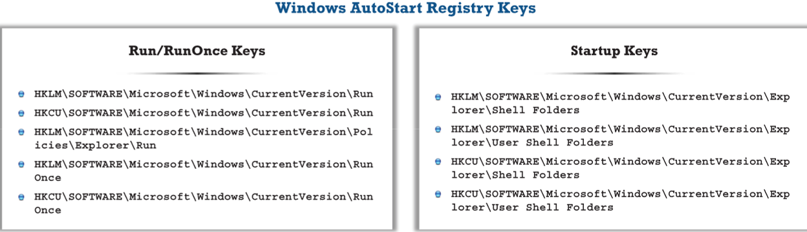
System Behavior Analysis: Monitoring Registry Artifacts
Malware manipulates the registry to ensure that it runs automatically whenever the computer boots, or the user logs in
By running the malware on a forensic workstation, you can observe its activity on the registry and look for specific keys or values that are read, created, modified, or deleted by it
Look for Windows AutoStart registry locations that are commonly targeted by malware to persist on the system
Notes:
When an attacker installs malware on the victim’s machine, it generates a registry entry
Consequently, various changes, such as the system becoming slower, various advertisements popping up, and so on, will be noticed
Use tools such as jv16 PowerTools, regshot, and Reg Organizer to examine the changes made by the malware to the system’s registry
Malware programs camouflage themselves as genuine Windows services or hide their processes to avoid detection
Some malware uses PEs to inject themselves into various processes
Process monitoring helps understand the processes that the malware initiates and takes over after execution
Use tools such as Process Monitor, Process Explorer, and OpManager to scan for suspicious processes
You can use process_usage.py, a Python script

Slide 26
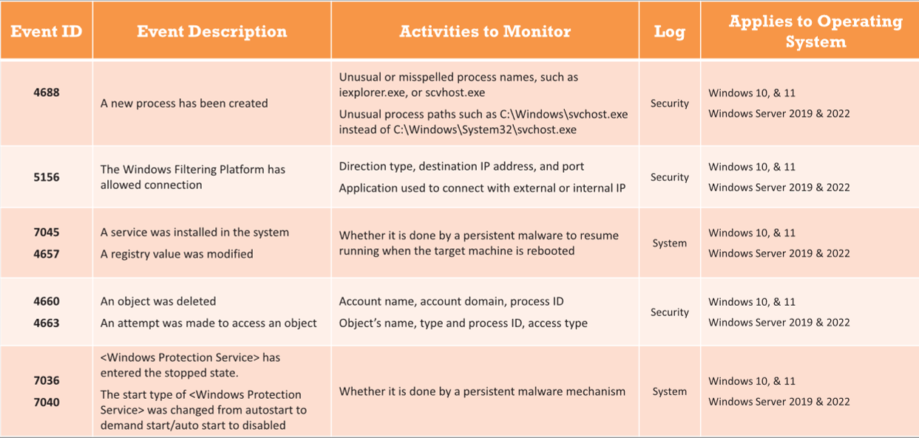
Key Event IDs to Monitor

Slide 27
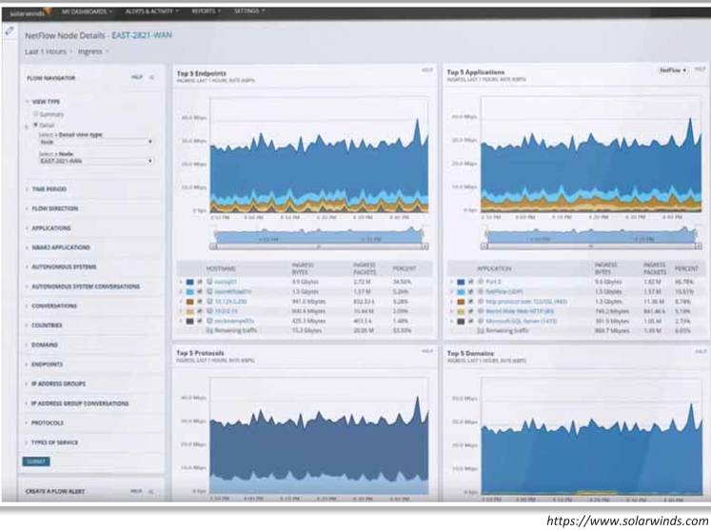
Network Forensics in Malware Analysis
Malware tries to communicate with the network for various activities, such as propagation, downloading malicious content, transmitting sensitive files and information, offering a remote control to attackers, etc.
Malware connect back to their handlers and send confidential information to the attackers
Use tools such as SolarWinds NetFlow Traffic Analyzer, Wireshark, and Capsa Network Analyzer to monitor network traffic going to malicious remote addresses and look for suspicious malware activities
Notes:
Network Behaviour Monitoring
Monitor:
Outbound connections
DNS requests
C2 traffic
Suspicious IP addresses
Tools:
Wireshark
NetFlow tools
Firewall logs
Explain Command & Control (C2):
Malware often phones home.
DNS queries often reveal staging servers.
Command and Control (C2) refers to the communication channel used by malware to receive instructions from an attacker’s remote server.
Through a C2 server, attackers can:
Send commands to infected systems (e.g., download more malware, steal data)
Control compromised machines remotely
Exfiltrate stolen information such as credentials or sensitive files
Very short slide version:
Command & Control (C2) is the communication mechanism that allows attackers to remotely control infected systems and receive stolen data.
how analyzing network packets can reveal C2 (Command & Control) traffic and other malicious activities
Role of network traffic analysis in malware detection.
Tools: Wireshark, Zeek.

Slide 28
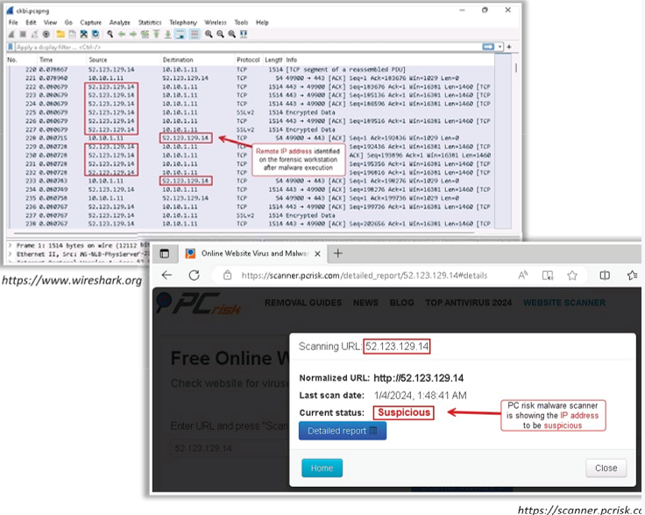
Monitoring IP Addresses
Run Wireshark on Windows forensic workstation
Execute the file that is suspected to be a malware on the workstation
Monitor the live network traffic to look for suspicious activities
Locate any remote IP address that the workstation is trying to communicate to
Scan the IP address via online malware scanning tools to know whether it is really suspicious
Notes:
explain how it will tie together the forensic methods

Slide 29
Ransomware Analysis - BlackCat (ALPHV)
BlackCat also known as ALPHV ransomware became a highly formidable and advanced ransomware as it performs operations faster and stealthier, including some techniques to extend its lifespan
BlackCat malware usually targets government, healthcare, education, hospitality, and manufacturing sectors
Attackers leverage ExMatter, a custom malware having self-deletion ability to automate the data exfiltration process during the operation
BlackCat has regularly been listed among the top ten most active ransomware groups by various research entities and was linked in an April 2022 FBI advisory as well
A professionalised cybercrime ecosystem is an organised network of cybercriminals who specialise in different roles to develop, distribute, and profit from cyber attacks
Notes:
BlackCat (ALPHV):
Ransomware-as-a-Service (RaaS)
Written in Rust
Uses AES/ChaCha20 encryption
Employs data exfiltration before encryption
Double extortion model (steal + encrypt).
Professionalised cybercrime ecosystem.
A professionalised cybercrime ecosystem refers to the organised and business-like structure of modern cybercrime, where different criminals specialise in specific roles to carry out cyber attacks.
Examples include:
Malware developers who create ransomware or attack tools
Access brokers who sell stolen network access
Money launderers who move and hide illegal profits
Very short slide version:
A professionalised cybercrime ecosystem is an organised network of cybercriminals who specialise in different roles to develop, distribute, and profit from cyber attacks.
https://securityintelligence.com
evidence collection process and explain the importance of each step.

Slide 30
BlackCat (ALPHV) Malware Analysis Attack Phases
Initial Access
  The malware initiates its operation by executing an obfuscated loader to decrypt AES-128 encrypted strings and their payload
  Those decrypted strings reveal the purpose of the component and indicate it is a loader
  Then the payload is executed in memory with command line arguments
Discovery, Credential Access, and Privilege Escalation
  After initial access, attackers use PowerShell and Command Prompt to obtain critical information about user accounts, permissions, and domain computers
  In this stage, the Sphynx version of BlackCat conducts activities such as retrieve list of volumes to navigate, mounts the unmounted volumes, perform network discovery, creates named pipe, and creates multiple child processes of itself
  Additionally, attackers obtain the domain administrator credentials through infections using different stealer malware such as Raccoon and Vidar to perform the next stages of exploitation
Notes:
Attack Phases
Initial Access
Discovery & Privilege Escalation
Lateral Movement
Shadow Copy Deletion
Data Exfiltration
Encryption & Ransom Note
Link to forensic artefacts:
Event logs
PowerShell history
vssadmin execution
Named pipes
Registry persistence
how the static analysis revealed critical evidence and discuss interpretation challenges.

Slide 31
BlackCat (ALPHV) Malware Analysis Attack Phases
Defense Evasion, Persistence, and Lateral Movement
  In this stage, attackers use the remote desktop protocol (RDP) to move internally within the network
  Also, the Sphynx variant of BlackCat conducts activities such as Obtains a list of shadow copies by using WMI COM Object functions Deletes the volume shadow copies by executing: vssadmin.exe Delete Shadows /all /quiet
  Executes the following query using WMI COM object functions to obtain information about an AD environment: SELECT DS_cn, DS_dNSHostName, DS_userAccountControl FROM DS_computer
  Additionally, attackers authenticate to Domain Controllers by using the account credentials having administrative privileges for lateral movement
Data Exfiltration and Covering Tracks
Encrypt and Create Ransom Note
Notes:
how the static analysis revealed critical evidence and discuss interpretation challenges.

Slide 32
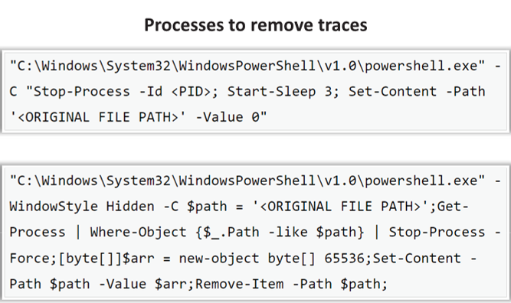
BlackCat (ALPHV) Malware Analysis
Data Exfiltration and Covering Tracks
  Attackers exfiltrate the sensitive data from target networks by using the ExMatter, a .NET data exfiltration tool before executing the ransomware
  Once the data exfiltration is done, ExMatter starts one of the following processes shown in the screenshots to remove its trace
Notes:
how the static analysis revealed critical evidence and discuss interpretation challenges.

Slide 33
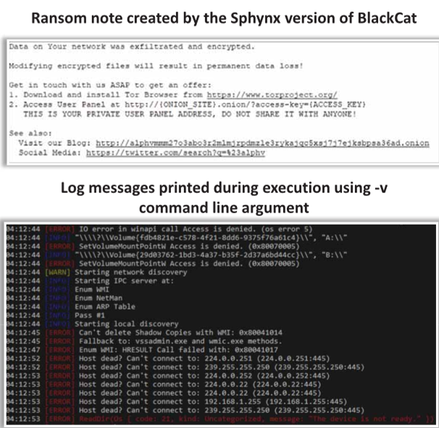
BlackCat (ALPHV) Malware Analysis
Encrypt and Create Ransom Note
  After successful data exfiltration, attackers encrypt the target systems
  This is carried out by the Sphynx version of BlackCat that creates a ransom note with a name containing alphanumeric characters such as 0diX0Z.txt
  This note is created in each directory containing the encrypted files
  The Sphynx version encrypts the files with AES or ChaCha20 ciphers and attaches a seven-character file extension containing characters between (a to z)
Notes:
how the static analysis revealed critical evidence and discuss interpretation challenges.

Slide 34
Case Group Discussion
https://uwtsd.display.vevox.com#/present/885043/HOC2QFVKNXNBSGQLRZYT

Slide 35
Emerging Trends in Malware Forensics
Integration of AI and machine learning for anomaly detection.
Fileless malware
Cloud forensics challenges.
Living-off-the-land techniques
Advanced memory forensics
Mobile and IoT malware investigations.
Future Directions and Research Areas
Predictive analytics in malware detection.
Collaborative threat intelligence platforms.
Advanced memory analysis techniques.
Note:
Memory forensics becoming increasingly important.
Disk-only analysis is no longer sufficient.
Notes:
Modern attacks try to avoid leaving evidence on disk, which is why memory analysis and behavioural detection are becoming increasingly important in digital forensics.
AI-Driven Malware Detection
Use of artificial intelligence and machine learning to identify malicious behaviour or anomalies in systems and networks that may indicate malware activity.
Example:
A security system detects unusual network traffic patterns and flags a computer as infected even though the malware signature is unknown.
Fileless Malware
Malware that operates directly in system memory (RAM) instead of installing files on disk, making it harder for traditional antivirus tools to detect.
Example:
An attacker sends a phishing email that runs a PowerShell command, which loads malware directly into memory without saving any file to the hard drive.
Cloud-Based Malware Persistence
A technique where attackers maintain access or store malicious components in cloud services (e.g., cloud storage, SaaS platforms) to survive system reboots or evade local detection.
Example:
Malware downloads commands from a Google Drive or Dropbox link controlled by the attacker.
Living-off-the-Land Techniques (LotL)
Attackers use legitimate system tools and built-in utilities (such as PowerShell, WMI, or command prompt) to perform malicious activities while avoiding detection.
Example:
An attacker uses PowerShell or Windows Management Instrumentation (WMI) to execute commands and move through a network without installing new tools.
Advanced Memory Forensics
The analysis of RAM memory dumps to identify hidden malware, running processes, encryption keys, or other artifacts that may not be stored on disk.
Example:
Investigators capture the system’s memory and discover an encryption key used by ransomware that was never written to disk.

Slide 36
How much do you remember?
https://uwtsd.display.vevox.com#/present/885043/HOC2QFVKNXNBSGQLRZYT

Slide 37
Summary
In this lecture, we discussed the malware concepts and different ways for malware to enter a system
Common techniques attackers use to distribute malware and various components of malware
Discussed malware forensics along with the types of malware analysis
How to analyze suspicious documents such as Word
Demonstrated how to perform system behavior analysis and network behavior analysis
Various phases involved in ransomware

Slide 38
Certification and Professional Development
Overview of relevant certifications (EC Council, SANS DFIR, GIAC, EnCase Certified Examiner).
Benefits of professional certifications in career advancement.
Notes:
pursue certifications and explain how these credentials can boost their careers.

Slide 39
Questions?

Slide 40
References
National Institute of Standards and Technology (NIST). Guide to Integrating Forensic Techniques into Incident Response (SP 800-86).
https://csrc.nist.gov/publications/detail/sp/800-86/final
National Police Chiefs’ Council (NPCC). Digital Forensics Guidance.
https://www.college.police.uk/guidance/digital-forensics
EC-Council. Computer Hacking Forensic Investigator (CHFI).
https://www.ec-council.org/train-certify/chfi/
Exterro. FTK® Digital Forensics Platform.
https://www.exterro.com/ftk-digital-forensics
Volatility Foundation.
https://www.volatilityfoundation.org
SANS Institute – Malware Analysis Resources.
https://www.sans.org
Computer Hacking Forensic Investigator (CHFI) – EC Council certified
System Forensics, Investigation and Response, Third Edition by Chuck Easttom. ISBN: 978-1-284-12184-1 Paperback 400 pages ● © 2019
Computer Forensics, Cybercriminals, Laws, and Evidence, Second edition by Marie-Helen Maras. ISBN: 978-1-4496-9222-3 © 2015.
Books: Practical Malware Analysis by Sikorski & Honig, The Art of Memory Forensics.
Websites: EC Council, SANS, Volatility Foundation.
Online courses and webinars.

