Slide 1

Programme Name: MSc Cybersecurity & Digital Forensics
Module Name: Enterprise Network Security
Module code: ACCA7032
Lecturer: Renuga Jayakumar
Student Name: Ashthaben Girishbhai Babariya
Student ID: 2507706

Slide 2
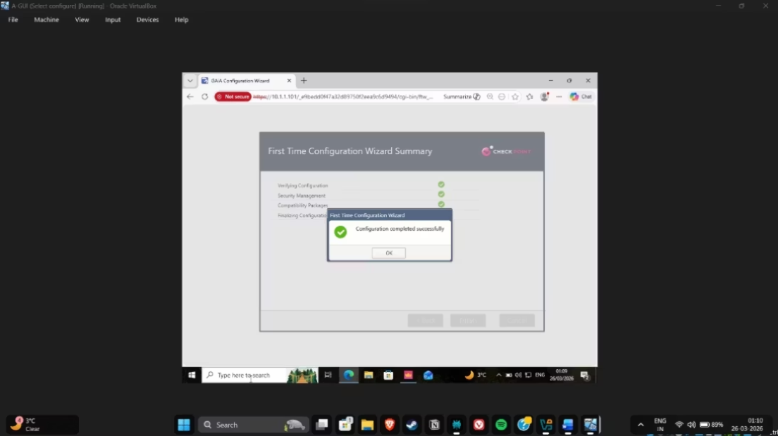
Network Topology
AD DS
DNS
Centralised identity, authentication, and access control across both domains
Reliable name resolution across both domains via integrated lookup zones
The lab setup represents a real-world company with multiple locations. It includes a main (parent) domain called SWANSEA.ACCA and a secondary (child) domain called LONDON.SWANSEA.ACCA. These two domains are linked together with a two-way trust, meaning both sides can share and access resources securely.
IIS
DHCP
Automated IP assignment per subnet, reducing manual configuration overhead
Internal web application hosting configured for security testing scenarios

Slide 3
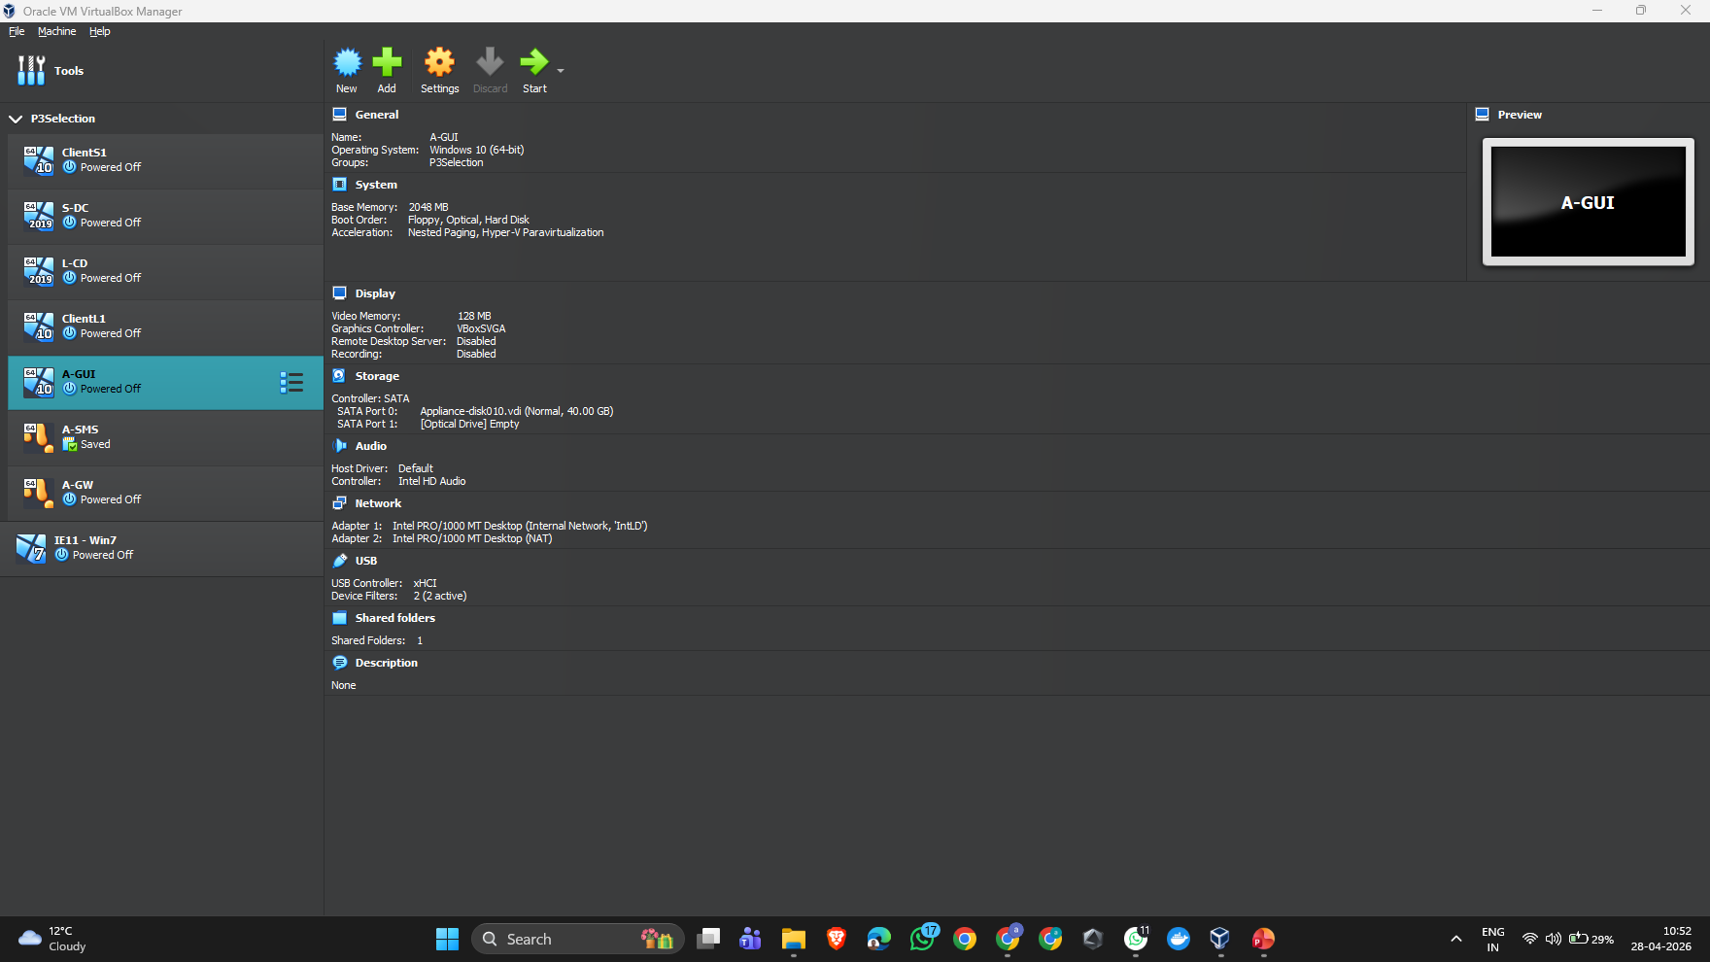
CTF Components
A-GUI: the interface used by admins to manage and control the system
A-SMS: the main server that handles and monitors overall security
A-GW: the gateway that protects the network and controls incoming and outgoing traffic
Clients: the end-user devices that connect to and use the network

Slide 4
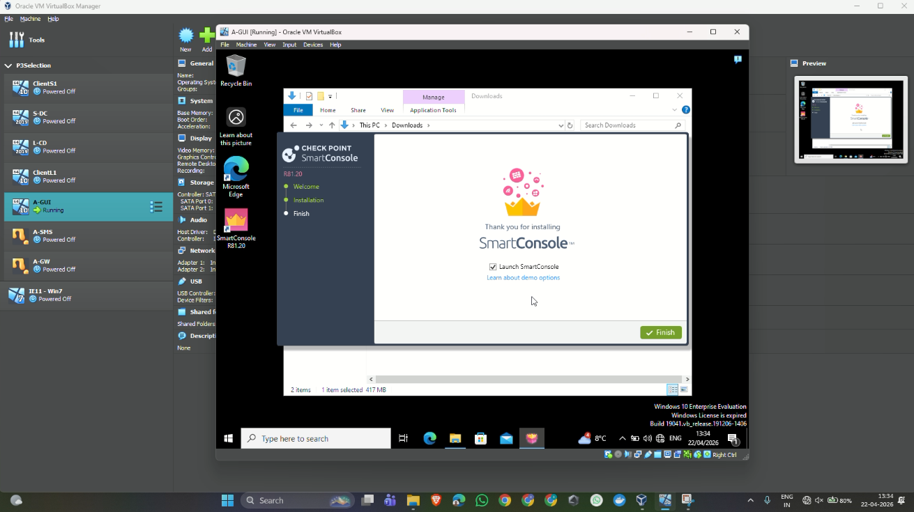
installation of Smart Console
SmartConsole is set up on the management system so everything can be controlled from one place. It gives a simple dashboard to build and manage security rules without much hassle. I can also keep an eye on network activity and review logs as they come in. On top of that, it makes it much easier to adjust firewall settings and apply updates, which helps keep the whole network secure and well managed.

Slide 5
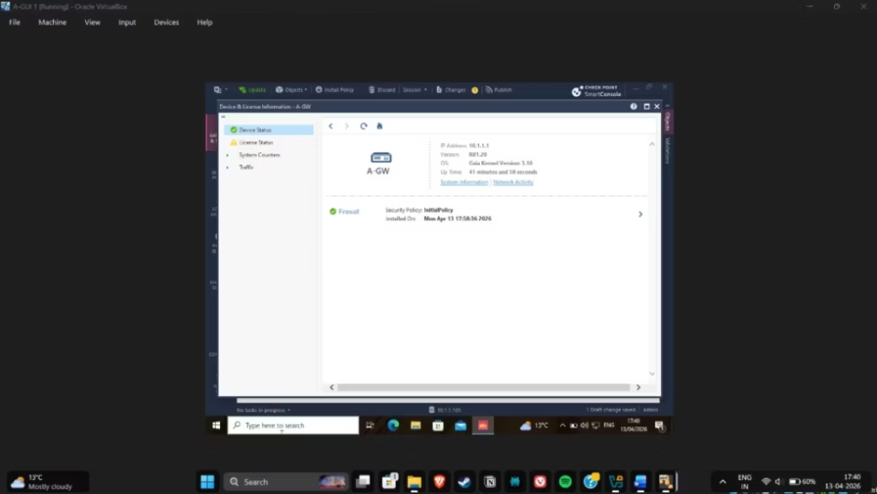
GAIA Security Architecture
01
02
A-GW — Security Gateway
A-SMS — Management Server
Filters perimeter traffic and enforces firewall policies at the network boundary
Centralised policy management, logging, and security reporting across the estate
The permanent licences for IPS, Anti-Malware, VPN, and Identity Awareness have been activated successfully. Network connectivity was then checked using ping tests, and the gateway status was reviewed to confirm everything is working as expected.
03
A-GUI — SmartConsole
Administrator interface for configuring, deploying, and auditing security rules

Slide 6
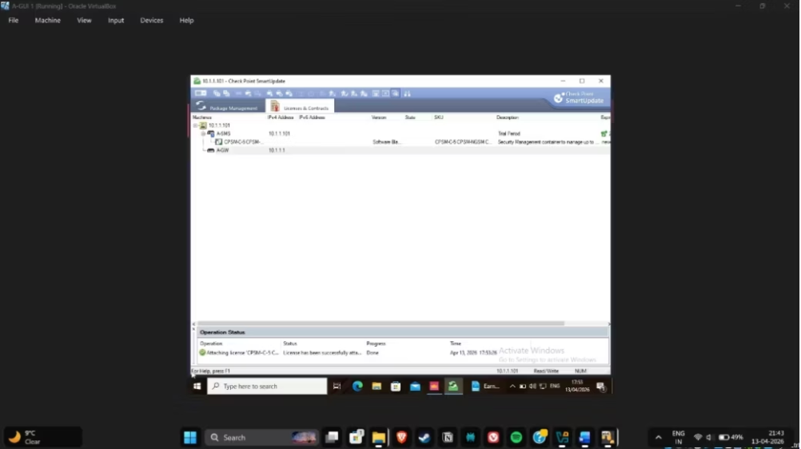

Firewall Rules & Advanced Security
IPS
Detects and blocks SQL injection and buffer overflow attacks in real-time
VPN
Encrypted tunnels securing communication between Swansea and London domains
Identity Awareness
Ties access control to individual users and AD roles for
granular enforcement
All rules follow a least-privilege model. HTTP permitted; Telnet blocked; SSH restricted to authorised administrators only.
Zero Trust
No implicit trust — every session must be authenticated regardless of network origin

Slide 7
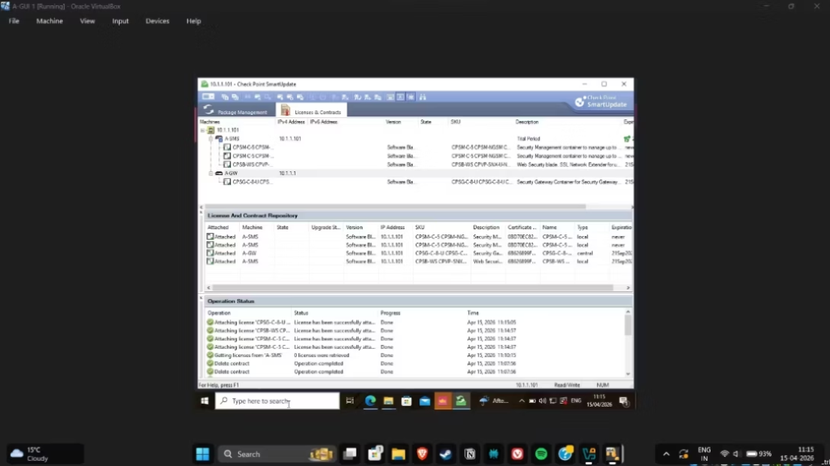
Testing & Verification
Connectivity
DNS Resolution
Firewall Controls
Ping tests confirmed host-to-host communication across both domains
Domain names correctly resolved to IP addresses in both forward and reverse zones
HTTP permitted; Telnet blocked; SSH restricted to authorised administrators only
All configurations were checked step by step using SmartConsole logs along with real-time network testing. Each rule was verified and behaved exactly as intended.

Slide 8
Gateway & Management Of Object
The Security Gateway works like the main line of defence for the network. It acts as a firewall, applying security rules to decide what traffic is allowed in or out. At the same time, it keeps an eye on all incoming and outgoing data, making sure nothing suspicious gets through. Its main purpose is to block unauthorised access and keep the network protected.
Object creation is used to organise different parts of the network in a simple way. Instead of writing complex rules every time, you can create objects that represent things like devices, networks, or users. These objects can then be reused when setting up policies, which makes the whole process easier and less time-consuming. For example, an object could represent an IP address, a subnet, a server, or even a group of users.

Slide 9
Installation Of Policy
Policy installation is the step where security rules are pushed from the Management Server to the gateway so they actually start working.
It’s important because it ensures those rules are applied instantly and allows you to control the entire network’s security from one central place.

Slide 10
Security Of Blade Policy
Blade policy installation is how different security features are applied to the gateway so they can start protecting the network. Each security blade—like Firewall, IPS, and Anti-Malware—has its own set of rules, and these need to be pushed to the gateway to become active.
This approach is useful because it adds multiple layers of protection instead of relying on just one. It also improves the system’s ability to detect and stop threats more effectively.

Slide 11
Blade Installation Errors
Policy Installation Failure
POPS UP when blade policy fails to install
General Causes
License problems
SIC (Secure Internal Communication) failure
Configuration errors
Connectivity issues (Gateway ↔ Management Server)
Effect
Security features may not work properly

Slide 12
Role-based policy
Role-based policy installation means security rules are applied based on who the user is, rather than just their IP address. It uses Identity Awareness to recognise users and assign access depending on their role.
For example, an admin might have full access, an employee gets only what they need for their work, and a guest is given very limited permissions.
This method is more flexible and secure because it focuses on user identity, making it easier to control access and keep track of activity across the network.

Slide 13
Conclusion
The project shows how enterprise network security can be successfully applied in practice, from deployment and testing through to the smooth integration of different security tools. It reflects how modern security principles are put into use within a real organisational environment.
Strong results across both parts of the assessment highlight key skills in setting up network services, designing security architecture, applying policies, and managing day-to-day security operations. These abilities are directly relevant to real-world roles in IT security.

