Slide 1
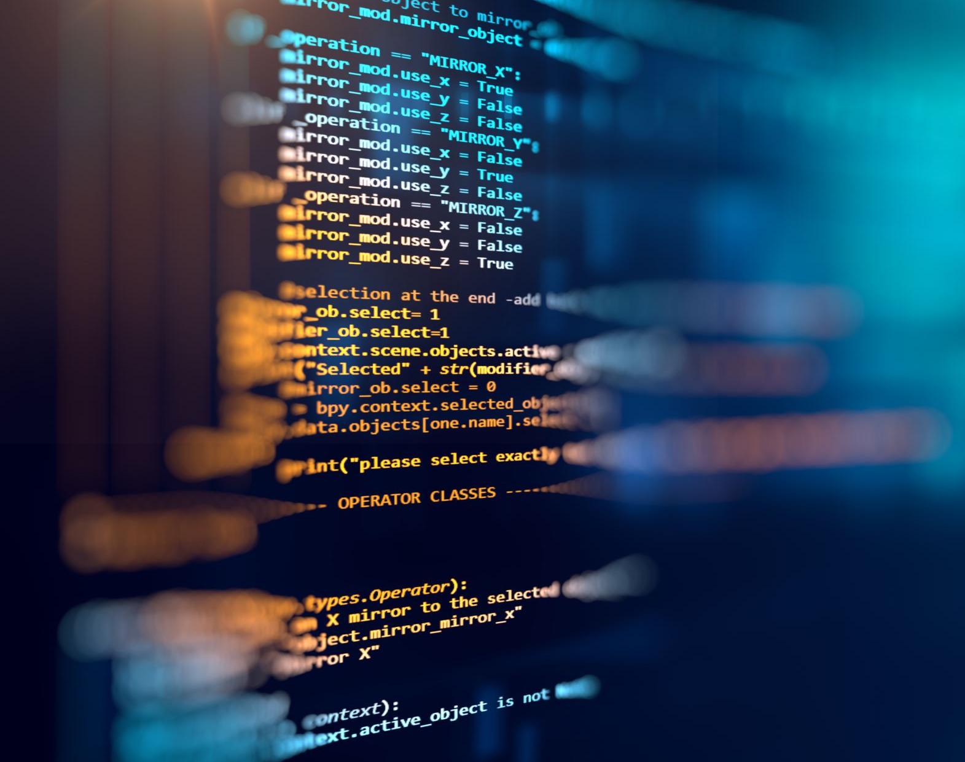
MODULE: DEVELOPING EMOTIONAL INTELLIGENCE SKILLS FOR THE WORKPLACE
MODULE CODE: BMSW6106
STUDENT NO: 2026780
NAME: ALEXANDRU NETOI
LECTURER: MD ASHIKUL KHAN

Slide 2

Table of Contents
Emotional Intelligence (EI) Concept
Potential Benefits of Emotional Intelligence
Different Types of Emotional Intelligence Skills
Reflection of Emotional Intelligence
Asses How to Use or Reason out about Your Own Emotions
How You Could Improve Your EI
Relevance of Emotional Intelligence in Workplace
Conclusion
References

Slide 3
Introduction
What is Emotional Intelligence (EI)?
Emotional intelligence is the process of effectively comprehending, managing, and harnessing emotions. It is essential for self-management, communication, and decision-making.
Why is it Important?
In the workplace, emotional intelligence (EI) contributes to the cultivation of healthier work environments, the improvement of productivity, and the establishment of stronger relationships. It is essential for personal development and effective leadership.
Notes:
Emotional intelligence is a human skill that helps in critical decision-making and reasoning. This particular skill is useful in the workplace. Emotional intelligence (EI) and its benefits highlight effective communication and self-management. Emotional intelligence assists people in becoming efficient in the workplace. A decent personal reflection regarding EI clears the overall concept.

Slide 4
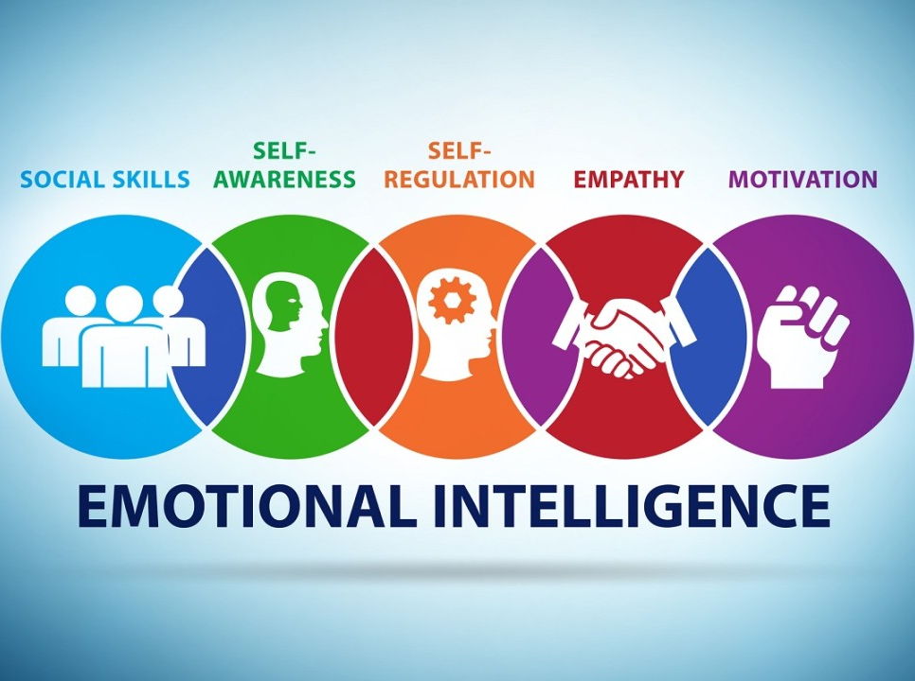
Emotional Intelligence (EI) Concept
Understanding Emotional Intelligence
Emotional intelligence is the unique capability to comprehend and manage emotions. It involves:
Self-awareness: Recognizing your emotions
Self-regulation: Managing emotional responses
Social Awareness: Understanding others' emotions
Empathy: Building meaningful relationships through emotional understanding
Notes:
Emotional intelligence is referred to as the unique ability which helps in understanding and managing emotions (Casino-García et al., 2021). Self-awareness and Self-regulation are two main fundamentals of EI which represent the quality of a human.
Emotional Intelligence (EI) encompasses managing one's own emotions as well as comprehending the emotions of others (Goleman, 2021).
Five essential components of emotional intelligence are self-awareness, self-regulation, motivation, empathy, and social skills. Individuals with elevated emotional intelligence can recognize their own emotions, interpret their significance, understand how these emotions affect their actions, and influence others as a result.

Slide 5
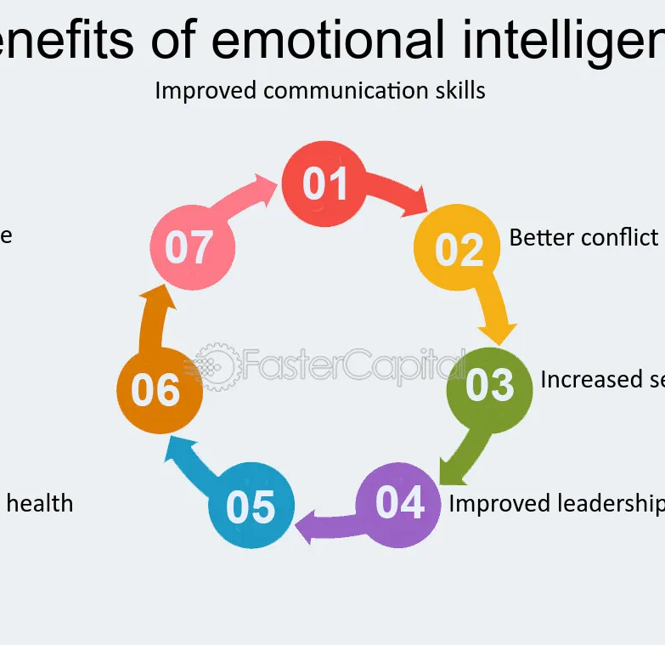
Potential Benefits of Emotional Intelligence
How Emotional Intelligence Adds Value
Improved Self-awareness: Enhances decision-making and stress management.
Better Communication: Fosters trust and cooperation, leading to better teamwork.
Resilience: Helps professionals navigate challenges and maintain mental well-being.
Emotional intelligence enables organizations to thrive through better collaboration, conflict resolution, and emotional regulation.
Notes:
Enhanced self-awareness can be considered as a potential benefit of EI which give importance to improving self-management (Paoletti and Ben-Soussan, 2021). Professionals can improve decision-making, stress management, and authenticity in interactions by understanding their behavioral patterns and triggers. Training in emotional intelligence helps individuals develop self-awareness by aiding them in identifying and comprehending their emotions, strengths, and opportunities for improvement.
Companies must foster the development of Emotional Intelligence (EI) as a crucial element for their well-being of physical and mental health of employees. Training in emotional intelligence provides individuals with the skills necessary to navigate social interactions, address conflicts, and build authentic relationships with co-workers and customers (Craemer, 2020).
In today's interconnected world, it is crucial to have effective communication and relationship-building abilities. EI helps in developing a fruitful relationship in the workplace which increases efficiency of employees. By utilising empathy, attentive listening, and flexibility, professionals can establish trust and cooperation, setting the groundwork for effective working partnerships. In a professional setting, leaders should possess self-awareness and the ability to have an objective perspective.
Resilience is the capacity to adjust and succeed despite facing challenges in the workplace (Baker et al., 2021). Social intelligence training aids professionals in building resilience by improving their abilities in emotional regulation, optimism, and stress management. Through developing a mindset focused on growth and implementing self-care techniques, people can overcome challenges more robustly, ultimately promoting a work environment characterised by determination and resilience. Team collaboration is a vital part which can be considered as one of the benefits of EI.

Slide 6

Different Types of Emotional Intelligence Skills
Self-awareness: Improves decision-making and stress management
Workplace relationships: Fosters authentic connections
Resilience: Enhances adaptability and stress management
Team collaboration: Promotes effective teamwork
Notes:
Different Types of Emotional Intelligence Skills
EI skills represents a constructive feedback and acknowledgement which helps in emphasising with other workers. Communication stresses recognition of conditions and then positively responding to them. These aspects that are used in communication are a vital part of EI skills (Drigas and Papoutsi, 2020).
Decision-making aims at being responsible as well as being able to apologise, the two of which derive from self-awareness and personal ethical standards.
It is vital to know that forgive and forget of others perceptions which is a fundamental EI skills. However, listening to other people is a vital step which increases communication and helps in EI.
Mental and Physical Health stress self-regulatory abilities to aid in improved empathy and self-confidence critical for healthy living (Mitsea et al., 2023). Forgiveness, forgetting and fostering thoughts in relationship management at work and in the personal life to depict social awareness.
Asses How to Use or Reason out about Your Own Emotions
Controlling the emotion is vital for increasing the EI skills. Self-concept has been utilised in various studies to assess how giftedness affects the adaptation of gifted children and teenagers, serving as a measure of their mental health and adaptation (Drigas et al., 2021).
Meeting new people can be an interesting step to maintaining emotions efficiently (Méndez Giménez et al., 2020).
Communicating with other people requires effective understanding of other’s feelings which also helps in controlling emotions.

Slide 7

Reflection of Emotional Intelligence
EI influences interpersonal and workplace relationships (Rechberg, 2020).
Self-awareness and relationship management enhance communication and leadership.
Understanding emotional requirements fosters a positive organizational culture (Costas,) 2021.
Notes:
Reflection of Emotional Intelligence
The discussion of Emotional Intelligence demonstrates how it influences interpersonal as well as working relationships to the highest degree (Rechberg, 2020). EI entails not only perceiving feelings and meaning-making on feelings but also regulating these feelings to facilitate successful interactions.
I found that self-awareness and relationship management go hand in hand with communication, conflict management and leadership. Self-processed employees with untamed EI in contrast perform poorly in Interpersonal relationship skills.
Interpersonal relationship skills are likely to neglect or misunderstand the emotional requirements of their fellow employees or clients thus resulting in conflicts and a poisoned organisational culture (Costas, 2021). For myself, the importance of emotional intelligence has been extremely beneficial in that I have grown especially more tolerant in social relations.

Slide 8

Assess How to Use or Reason out about Your Own Emotions
Controlling emotions is crucial for enhancing EI skills (Drigas et al., 2021).
Engaging with new people helps maintain emotional balance (Méndez Giménez et al., 2020).
Effective communication requires understanding others' feelings.
Notes:
Asses How to Use or Reason out about Your Own Emotions
Controlling the emotion is vital for increasing the EI skills. Self-concept has been utilised in various studies to assess how giftedness affects the adaptation of gifted children and teenagers, serving as a measure of their mental health and adaptation (Drigas et al., 2021).
Meeting new people can be an interesting step to maintaining emotions efficiently (Méndez Giménez et al., 2020).
Communicating with other people requires effective understanding of other’s feelings which also helps in controlling emotions.

Slide 9
How You Could Improve Your EI
Focus on self-awareness and self – regulation
Empathy as a leadership skill
Importance of active listening
Motivation as a driver for organizational goals
Notes:
How You Could Improve Your EI
The process of improving emotional intelligence requires plenty of attention as various aspects need to be followed. Self-awareness entails recognizing one's abilities, weaknesses, feelings, convictions, and drives (Henry and Jonathan, 2024). Leaders who are skilled at identifying and controlling their emotions are more capable of understanding others' emotions and inspiring employees. Recognising my shortcomings allows me to establish trust and transparency within my team.
Knowing the areas in which I need to improve can also help me advance my career by pushing my professional development. Self-regulation involves individuals controlling their emotions, actions, and urges (Inzlicht et al., 2021). The easier this becomes with increased self-awareness. I discovered that by identifying my emotions and understanding their cause, I can react in a suitable manner. Understanding another person's experiences and emotions is known as empathy. It has been identified as the most important leadership skill required in today's world by a global consulting firm (Connors, 2020).
I discovered that by listening attentively to my staff and making an effort to comprehend their desires and requirements. I can enhance engagement establish trust and better assist them in overcoming obstacles. The greater the appreciation my team receives, the more dedicated they will become, resulting in increased morale and a more robust company culture. Motivation is the capacity to motivate myself and others to take action. It is important to set a good example in this situation. I believe that leaders who are self-driven prioritise achieving organisational goals over receiving financial rewards.
Relevance of Emotional Intelligence in Workplace
The concept of EI applies to the workplace because it has direct implications on the performance of employees, organisational climate and staff management (Edward and Purba, 2020). In general, EI has been derived since it leads to improved interaction, teamwork, and dealing with adversity. It comes to creating a healthy organisational culture because employees with high EI levels are empathetic, adaptable, and self-aware.
The positive developmental effect that can be associated with emotional intelligence includes; organisational politics, management of conflict, and stress. This reduces emotional intelligence conflict and increases emotional intelligence. The workplace relationships of team members result in better productivity and more coherent people when a team has emotionally intelligent members (Kolot et al., 2020). With regard to performance, EI enhances organisational decision-making and stress-coping mechanisms.
The emotional intelligence of employees is beneficial for an organisation as it promotes professionalism, mutual respect, teamwork and ultimately higher levels of organizational commitment (Lee et al., 2022). High EI enables an employees to understand difficult systems, to be non-emotional during the worsening scenario and to make reasonable decisions for the organisation and the group.
In the concern of workplace culture EI enhances respect, and cooperation as well as the emergence of multicultural harmony among people. EI becomes crucial in leadership as it contributes to trust formation, team personal stake, and change management needed in organisations.

Slide 10

Relevance of Emotional Intelligence in Workplace
EI impacts employee performance, organizational climate, and staff management (Edward & Purba, 2020).
High EI fosters better teamwork and helps manage stress (Kolot et al., 2020).
EI promotes professionalism, mutual respect, and higher organizational commitment (Lee et al., 2022).

Slide 11

Conclusion
Emotional intelligence is a critical life skill that fosters personal and professional success. Its benefits are evident in improved communication, leadership, and organizational culture. Developing EI ensures better decision-making, healthier relationships, and a more productive workplace.
Notes:
In conclusion, emotional intelligence is a special skill which has a major role to play in daily lives of people. Various kinds of skills related to emotional intelligence help people to improve different aspects such as communication and leadership. The process of developing EI skills results an efficient productivity in the workplace which signifies the value.

Slide 12
References
Baker, F.R., Baker, K.L. and Burrell, J., (2021). Introducing the skills‐based model of personal resilience: Drawing on content and process factors to build resilience in the workplace. Journal of Occupational and Organizational Psychology, 94(2), pp.458-481.
Casino-García, A.M., Llopis-Bueno, M.J. and Llinares-Insa, L.I., (2021). Emotional intelligence profiles and self-esteem/self-concept: An analysis of relationships in gifted students. International Journal of Environmental Research and Public Health, 18(3), p.1006.
Connors, C.D., 2020. Emotional intelligence for the modern leader: A guide to cultivating effective leadership and organizations. Sourcebooks, Inc.
Costas, J., (2021). The Effect of Toxic Leadership on the Organizational Culture of a Church’s Leadership Team. Indiana Wesleyan University.
Craemer, M., (2020). Emotional intelligence in the workplace: How to use EQ to build strong relationships and thrive in your career. Sourcebooks, Inc.
Drigas, A. and Papoutsi, C., (2020). The Need for Emotional Intelligence Training Education in Critical and Stressful Situations: The Case of Covid-19. Int. J. Recent Contributions Eng. Sci. IT, 8(3), pp.20-36.
Drigas, A., Papoutsi, C. and Skianis, C., (2021). Metacognitive and metaemotional training strategies through the nine-layer pyramid model of emotional intelligence. International Journal of Recent Contributions from Engineering, Science & IT (iJES), 9(4), pp.58-76.
Edward, Y.R. and Purba, K., (2020). The effect analysis of emotional intelligence and work environment on employee performance with organizational commitment as intervening variables in PT Berkat Bima Sentana. Budapest International Research and Critics Institute-Journal (BIRCI-Journal) Vol, 3(3), pp.1552-1563.
Goleman, D., (2021). Leadership: The power of emotional intelligence. More Than Sound LLC.
Henry, E. and Jonathan, H., (2024). Emotional Intelligence: Harnessing the Power of Empathy and Self-Awareness in Leadership (No. 13671). EasyChair.
Inzlicht, M., Werner, K.M., Briskin, J.L. and Roberts, B.W., (2021). Integrating models of self-regulation. Annual review of psychology, 72(1), pp.319-345.

