Slide 1
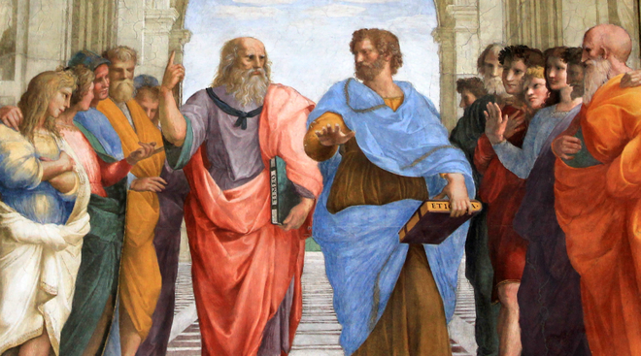

Lyceum
Joe Neal
1701080
Athens and Attika (HPAH5073)

Slide 2
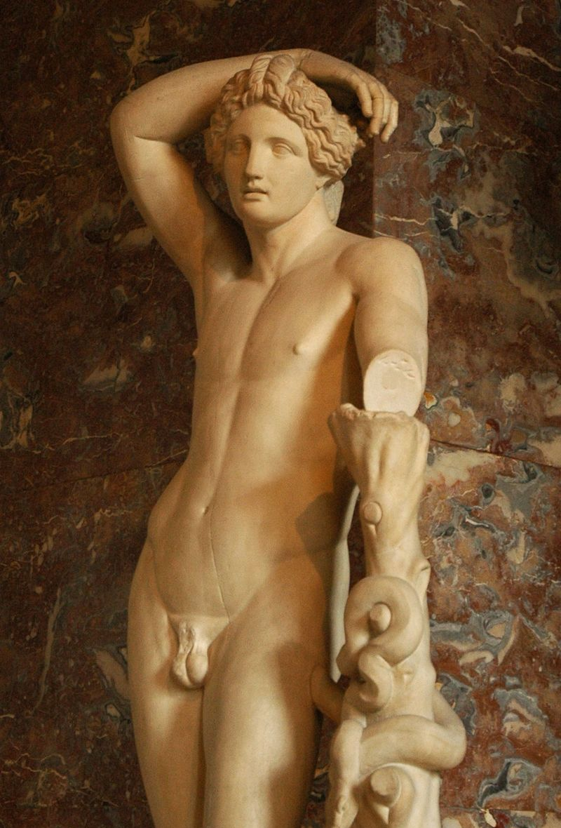
What was the Lyceum?
There was a gymnasium present to allow exercise and military practice
A temple to Apollo Lyceus (“wolf-god”). Both the temple to Apollo and the gymnasium were created during the archaic period (650-480 BCE)
A Peripatetic school, which is a type of philosophy derived from Aristotle.

Slide 3
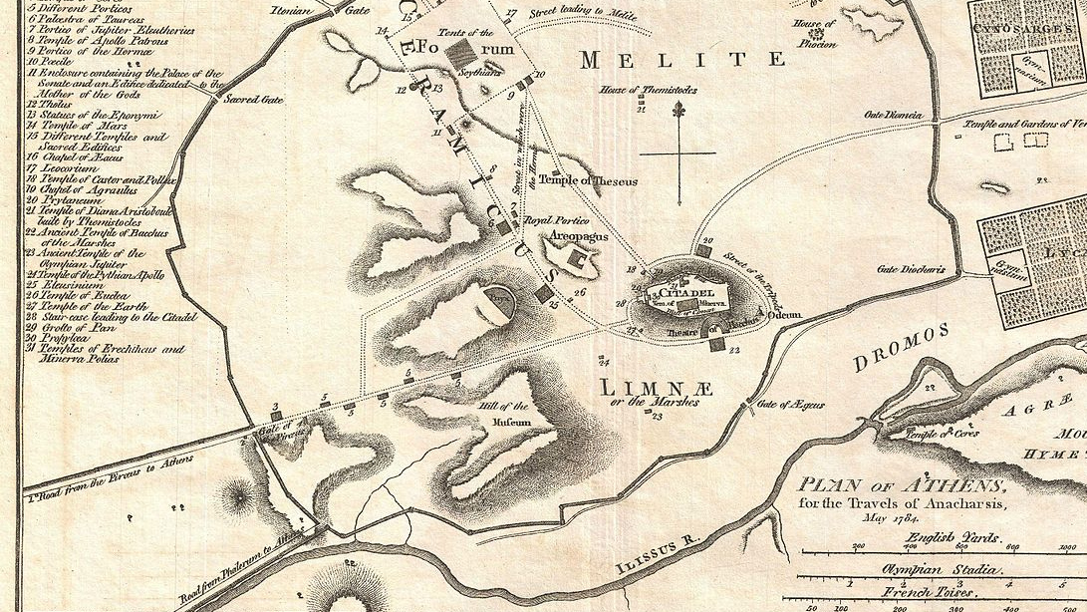
Location
The Lyceum

Slide 4
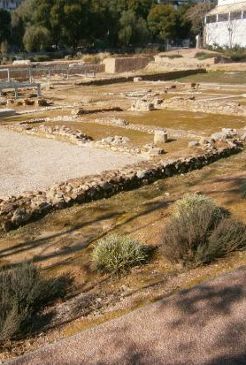
Founding of the Lyceum
Founded in 334 BCE by Aristotle after his return to Athens in 335/334BCE
Aristotle would teach Philosophy until 332 BCE when he fled Athens due to increasing anti-Macedonian feelings
It became equally as famous as being a grove dedicated to Apollo Lykeios, as well as the school founded by Aristotle

Slide 5
Classical period 510-323BCE
Socrates and other great minds would visit the Lyceum
The founding of Lyceum
The administration of Euboulos
Lykourgos, son of Lykophron of Boutadi, paid attention to the Lyceum

Slide 6
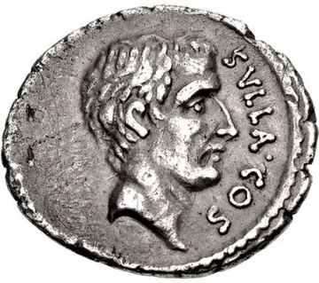
Hellenistic period
Roman period
Libraries like those at the Lyceum possibly influenced the idea of Roman libraries.
The first mithridatic war
Siege of Athens
The destruction of the Lyceum by Sulla in 86 BCE
The Lyceum could be seen as being pro-Macdonian due to Aristotle’s relationship with Alexander the Great
It would be burnt down by Philip V of Macedon in 200 BCE in a failed attempt to take Athens

Slide 7
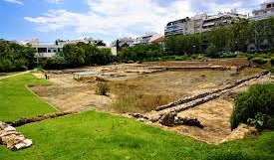
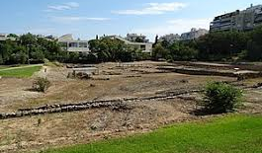
Modern day
The remains were discovered in 1996 in a park behind the Hellenic Parliament
The excavation site is in downtown Athens
Initial excavations discovered a gymnasium and a wrestling area

Slide 8
Conclusion
The Lyceum was an important hub of learning in the classical and Hellenistic period
It had close ties to Macedonia before the death of Alexander the Great in 323 BCE
It would continue to be in use until Sulla’s attack on Athens

