Slide 1
CertHE Applied Leadership and Management in the Workplace
Module: BMSK5010
Developing the Learning Organisation

Slide 2
Blended Learning ​
Session 6

Slide 3
Assessments & Feedback
Session Focus
Fair & Objective Assessments
Delivering and Receiving Feedback
Notes:
Purpose of the session:
Assessments
To understand the role of the appraisal interview in the performance management process
To examine the different approaches and styles of appraisal interviews
Feedback
Information about performance or behaviour that leads to action to affirm or develop that performance or behaviour

Slide 4
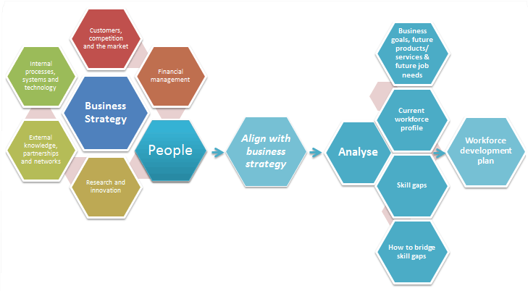
Aligning people development with business strategy
Notes:
Organisations are now operating in more complex competitive and challenging environments. Many of these challenges directly target the human side of business with the resulting implications for the HR function. These organisations must retain and optimise talent, that talent is often viewed as both the number one expense and asset of the business and the goal is to have the right person in the right job at the right time.
Successfully managing organisational change is a key requirement for business when you consider all the alliances, joint ventures, acquisitions and divesture's that occur and require strategy change.
The requirement placed upon HR functions and for those working within them have change significantly.
For an HR function to operate strategically some members within the department will need to work in the role of strategic business partners. Specifically these are partners will be required to
partner with middle and senior level managers, developing deep knowledge of the business requirements and challenges. They will develop access, credibility and trust with these leaders., identify and partner with clients to support strategic projects that directly address one or more business needs of the organisation.
By performing the first two accountabilities effectively some strategic business partners earn the right to consult with clients, in this accountability they are focusing not on specific projects but also on the needs of the entire organisation over a period of time. In this sense the strategic business partners contribute to the formation of business strategies, integrating and executing people initiatives in support of the organisations business plan
Strategic business partner: aligning people strategies with business goals by Dana Gaines Robinson, James Robinson 2005
Tom Grundy (1998) defines organisational effectiveness as “the capacity of the organisation to adapt rapidly to its external environment and to meet market and other external demands and with good results in business performance”. Grundy (1998) argues that integrating corporate strategy and HR matters into an organisation and people strategy fully reflects the focus on organising effectiveness and may prove more successful at building business performance over time.
Key to building organizational effectiveness is a skilful blend of HRM practices, organizational design and development to suit a specific organization in its particular context.

Slide 5
Assessments
Education
‘The wide variety of methods or tools that educators use to evaluate, measure, and document the academic readiness, learning progress, skill acquisition, or educational needs of students.’
(Assessment Definition, 2015)
‘The engine which drives student learning.’ (Cowan, 2005)
Workplace
‘A systematic procedure for measuring a trainee’s progress or level of achievement against defined criteria to make a judgement about a trainee’ (GMC, 2010)
Notes:
Essentially how we design our assessment influences how student will learn. We could think of ourselves as puppet masters – we can encourage or discourage certain behaviours and manipulate student learning. But as research evidences, students can also manipulate us.
“Students can escape bad teaching, but they can’t escape bad assessment.”
(David Boud, 1995)

Slide 6
Requirements of Assessment
Clear purpose
Fair
Clearly related to the learning that has taken place
Tests what should be assessed NOT what is easy to assess
Helps to improve performance if formative, or reliably sorts out the pass from the fail if summative
Multi-faceted
Reliable

Slide 7
The 21st Century Learner is …
Notes:
What is required
Students who learn throughout the year
Students who pay attention to the entire curriculum
Students who take feedback on board and use it to learn
Students who understand and engage with the material
What Happens!
They only learn/ revise right before exams
They try to find out what will be on the exam and focus on that
They memorize facts

Slide 8
Discussion
How well are students currently performing, what are they poor at?
What do students currently do with their time out of class and do they spend enough time which is distributed evenly enough learning?
How is learning behaviour influenced by the current assessment methods and tasks?
How might students’ learning time be captured in sufficient quantity and with an appropriate distribution across the course, without increasing tutor efforts?
What learning benefits might accrue from students doing some of the assessment for themselves and/or each other that tutors currently do for them?
(Gibbs, G., 1999)
Notes:
(Gibbs, G., 1999) Using Assessment Strategically to Change the Way Students. Assessment matters in higher education, p. 52.

Slide 9
Principles of Assessment
Principles and Methods of Assessment. (2015)
Notes:
Principles and Methods of Assessment. (2015). Principles and Methods of Assessment. [online] Available at: https://abdao.wordpress.com/ [Accessed 20 Apr. 2018].
Assessment is not all about grades.
Assessment definitely helps improve teaching and learning!
Assessment is the process of getting information about what and how the students learn, and using this information to guide instruction and boost learning.
Assessment gives feedback to teachers and students that help them both adjust their teaching and learning strategies to achieve learning goals.
Assessment should be aligned with goals/objectives, curriculum/instruction, and outcomes, so learning can be maximized.
Assessment helps us to PLAN (what do I want my students to learn?); to DO (How do I help them learn effectively?); to CHECK (Have we achieved goals and outcomes?), and to ACT (How do I use the information I gathered? What adjustments and refinements should I do?). This is the assessment cycle that helps continuously improve the teaching-learning process; this is the assessment cycle that makes assessment useful for its intended purposes: the assessment FOR learning, the assessment AS learning, and the assessment OF learning. PDCA ;-) (Who was this?)
3 main purposes of assessment:
Assessment FOR learning is an ongoing process that gauges and monitors student learning in order to inform instruction, as well as help students monitor and manage their own learning. It guides both teachers and students on what wise steps to take next. Formative assessments serve the purpose of assessment FOR learning.
Assessment AS learning is also an ongoing process that helps the students self-reflect on their learning, know their weaknesses and strengths, adjust their learning strategies, correct past errors, plan next best steps, and become independent, self-directed, metacognitive, and successful learners. Formative assessments, like self and peer assessments, serve the purpose of assessment AS learning.
Assessment OF learning measures the students’ competency; certifies learning; and provides evidence if program goals and objectives have been met and outcomes have been achieved. Summative assessments serve the purpose of assessment OF learning.

Slide 10
Purpose of Assessment
Assessment FOR learning
  ongoing process monitors student learning in order to inform Instruction, as well as help students monitor and manage their own learning.
Assessment AS learning
  students self-reflect on their learning, know their weaknesses and strengths, adjust their learning strategies, correct past errors..
Assessment OF learning
  measures the students’ competency; certifies learning
Notes:
3 main purposes of assessment:
Assessment FOR learning is an ongoing process that gauges and monitors student learning in order to inform instruction, as well as help students monitor and manage their own learning. It guides both teachers and students on what wise steps to take next. Formative assessments serve the purpose of assessment FOR learning.
Assessment AS learning is also an ongoing process that helps the students self-reflect on their learning, know their weaknesses and strengths, adjust their learning strategies, correct past errors, plan next best steps, and become independent, self-directed, metacognitive, and successful learners. Formative assessments, like self and peer assessments, serve the purpose of assessment AS learning.
Assessment OF learning measures the students’ competency; certifies learning; and provides evidence if program goals and objectives have been met and outcomes have been achieved. Summative assessments serve the purpose of assessment OF learning.

Slide 11
Types of Assessment
Formal assessment
Informal assessment
Formative assessment
Summative assessment
Authentic assessment
Traditional assessment
Peer and Self Assessment
Differentiated
Notes:
Formal assessment is the systematic, well planned data-based assessment that evaluates student learning. Formal assessment determines the students’ proficiency or mastery of the content, and can be used for comparisons relative to certain standards, or relative to other students’ performances.
Informal assessment is the casual/spontaneous content-based and performance-based form of assessment that measures the students’ performance and learning progress. Informal assessment is incorporated in the day-to-day classroom activities.
Formative assessment gives continuous feedback about students’ learning that informs instruction and helps students successfully manage their own learning; it guides both teachers and students about their next wise steps. Formative assessment occurs all throughout instruction.
Summative assessment certifies learning; it measures what the students have learned. Summative assessment data can be used to gauge students’ competency; assign grades; rank the students; and compare students’ performances vs. certain standards or vs. other students’ performances. Summative assessment is given after instruction.
Traditional assessment refers to customary method of measuring the students’ knowledge and skills, usually through standardized pen and paper tests.
Authentic assessment is the process of gauging the students’ learning by asking them to perform real-life tasks and meaningfully apply what they have learned.
Peer and self-assessments involve students taking responsibility of assessing their peer’s work and their own against a set of standards/criteria/rubric. They help students become reflective of their own learning and empower them to be more responsible in successfully directing and managing their own learning.
Differentiated assessment is the method by which teachers adjust and match assessment with the varied profiles, needs, and preferences of diverse students in order to bridge individual learning gaps, and meet the students’ individual learning needs.

Slide 12
Formal vs Informal Assessment
Have you had formal, and/or informal assessment
What was the difference in:
  The approach by the assessor
  How you felt about the assessment
Which did you prefer?
Notes:
Formal assessment is the systematic, well-planned data-based assessment that evaluates student learning. Formal assessment determines the students’ proficiency or mastery of the content, and can be used for comparisons relative to certain standards, or relative to other students’ performances.
Informal assessment is the casual/spontaneous content-based and performance-based form of assessment that measures the students’ performance and learning progress. Informal assessment is incorporated in the day-to-day classroom activities.

Slide 13
Formative or Summative
Formative | Summative
Aim is to enhance learning through providing feedback | Aim is to provide data for selection (e.g. next stage of education, employment)
Indicates what is good and why this is good; and how things could be improved | Quantifies and rewards achievement in meeting assessed criteria
Integral part of teaching and learning | Normally at the end of a block of learning
Affects what the student and the teacher does next. | Can provide information that has formative/diagnostic value
Doesn’t contribute to final mark, hence focus on educational impact. | Contributes to final mark, hence validity and reliability are important
Notes:
Formative assessment gives continuous feedback about students’ learning that informs instruction and helps students successfully manage their own learning; it guides both teachers and students about their next wise steps. Formative assessment occurs all throughout instruction.
Summative assessment certifies learning; it measures what the students have learned. Summative assessment data can be used to gauge students’ competency; assign grades; rank the students; and compare students’ performances vs. certain standards or vs. other students’ performances. Summative assessment is given after instruction.

Slide 14
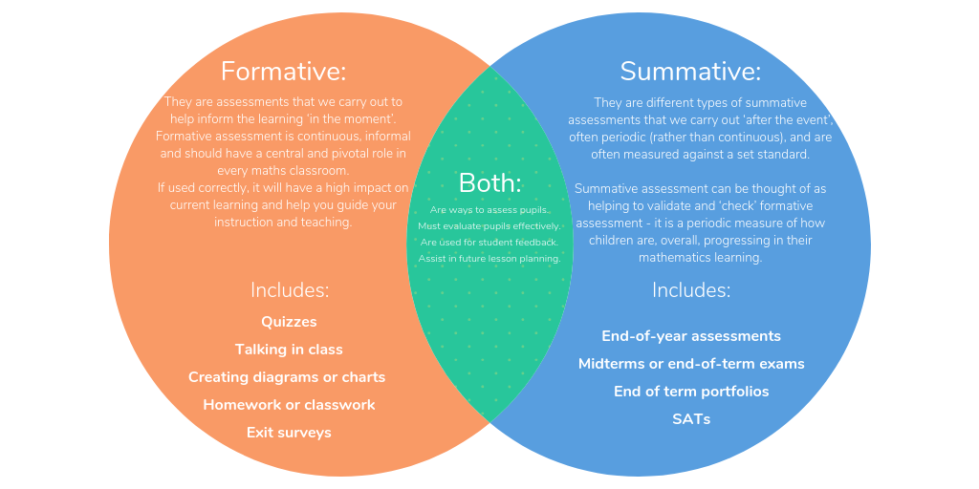
Formative or Summative
Notes:
Formative assessment gives continuous feedback about students’ learning that informs instruction and helps students successfully manage their own learning; it guides both teachers and students about their next wise steps. Formative assessment occurs all throughout instruction.
Summative assessment certifies learning; it measures what the students have learned. Summative assessment data can be used to gauge students’ competency; assign grades; rank the students; and compare students’ performances vs. certain standards or vs. other students’ performances. Summative assessment is given after instruction.

Slide 15
Authentic Assessments
The aspect of authenticity is important.
Authentic assessment can be defined as:
“An assessment requiring students to use the […] competencies, or combinations of knowledge, skills, and attitudes that they need to apply in the criterion situation in professional life.”
(Gulikers, Bastiaens, & Kirschner, 2004)
Notes:
Savery & Duffy (1995) define assessment authenticity as the similarity between cognitive demands (that thinking required of the assessment) and the cognitive demands in the criterion situation on which the assessment is based.
A criterion situation reflects or simulates a real-life situation that could confront students in future professional situations. Darling-Hammond and Snyder (2000) argued that dealing only with the thinking required is too narrow. In their view, students need to develop competencies because real life demands the ability to integrate and coordinate knowledge, skills, and attitudes, and the capacity to apply them in new situations (Van Merrienboer, 1997).
Birenbaum (1996) further specified the competency concept by emphasizing that students need to develop not only cognitive competencies (problem solving and critical thinking), but also meta-cognitive competencies (reflection, and social competencies such as communication and collaboration).

Slide 16
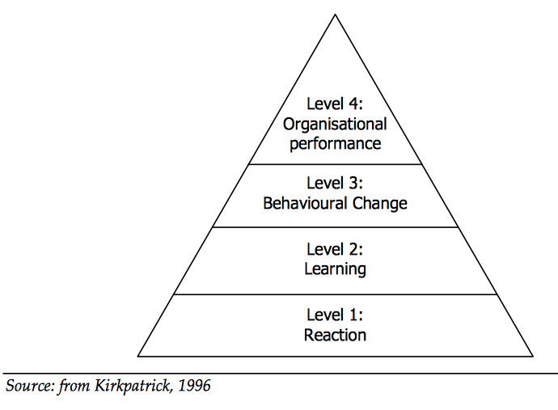
Kirkpatrick Assessments
Notes:
Level 1: Reaction
The degree to which participants find the training favorable, engaging and relevant to their jobs
Level 2: Learning
The degree to which participants acquire the intended knowledge, skills, attitude, confidence and commitment based on their participation in the training
Level 3: Behavior
The degree to which participants apply what they learned during training when they are back on the job
Level 4: Results
The degree to which targeted outcomes occur as a result of the training and the support and accountability package
Saturday, October 10, 2020
Home
Our Philosophy
Training & Events
Resources
Products
Consulting
Certified Only
Blog
About Us
Contact Us
Join Login
You are here: Our Philosophy » The New World Kirkpatrick Model
The Kirkpatrick Methodology | The Kirkpatrick Model | The New World Kirkpatrick Model | Kirkpatrick Foundational Principles | Glossary of Kirkpatrick Terms
The New World Kirkpatrick ModelThe original four levels of training evaluation have been clarified with the New World Kirkpatrick Model. Below is an outline of the updated Kirkpatrick Model of training evaluation with the original definitions and new explanations.
The New World Kirkpatrick Model
Level 1: Reaction
The degree to which participants find the training favorable, engaging and relevant to their jobs
Customer Satisfaction
The original definition measured only participant satisfaction with the training.
New World Additions:
Engagement
The degree to which participants are actively involved in and contributing to the learning experience
Relevance
The degree to which training participants will have the opportunity to use or apply what they learned in training on the job
Level 2: Learning
The degree to which participants acquire the intended knowledge, skills, attitude, confidence and commitment based on their participation in the training
Knowledge “I know it.”
Skill “I can do it right now.”
Attitude “I believe this will be worthwhile to do on the job.”
New World Additions:
Confidence “I think I can do it on the job.”
Commitment “I intend to do it on the job.”
Level 3: Behavior
The degree to which participants apply what they learned during training when they are back on the job
New World Addition:
Required Drivers
Processes and systems that reinforce, encourage and reward performance
of critical behaviors on the job
Level 4: Results
The degree to which targeted outcomes occur as a result of the training and the support and accountability package
New World Addition:
Leading Indicators
Short-term observations and measurements suggesting that critical
behaviors are on track to create a positive impact on desired results
Implement this model with a consideration of the Kirkpatrick Foundational Principles for maximum impact.

Slide 17
Workplace Assessments
Assessment for learning (formative)
Assessment of learning (summative)
Learning is at its most powerful when it is authentic (workplace)
Valid but not always reliable assessor (subjective versus objective)
Reliability when part of many
Learning by doing, reviewing, reflection

Slide 18
Millers Pyramid
(Miller, G. 1990)
Notes:
Miller (1990) developed a pyramid framework for describing levels of competence within a hierarchy of knowledge, application, and performance, with associated methods of assessment.
Bottom level of the pyramid entitled “knows”, refers to the recall of factual knowledge.
2nd level “knows how”, refers to the ability to apply the factual knowledge in a particular context. It implies that there is more to competence than knowledge alone.
3rd level, shows, relate to the ability to demonstrate competence in a practical, simulated environment; what a professional actually does in the workplace is at the top and
4th level of the pyramid, does.
Whilst this model was developed within a medical context it is very easy to apply it to any scenario of assessment and workplace based assessments. The model sets a framework for a succession of levels of competence that can guide the implementation of assessments.
However there are some important additional considerations the model does not fully describe. At the peak of the pyramid representing the ultimate goal in the workplace there is an implication that as assessment comes closer to the workplace the volume may reduce. In reality workplace based assessment represents the skills most relevant to professional life, and the point at which numerous component skills learned become combined into reasoning and professional competence.
Care must be exercised with the type of assessment. Research demonstrates that simulated environments do not always predict workplace performance. (Rethans et al, 1991)
Rethans, J.J., Sturman, F., Drop, R., van der Vleuten, C. (1991) Assessment of the performance of general practitioners by the use of standardised (simulated) patients. British Journal of Medical Practise, 41. pp 97-99
Miller, G., 1990. The Assessment Of Clinical Skills. [online] Winbev.pbworks.com. Available at: <http://winbev.pbworks.com/f/Assessment.pdf> [Accessed 11 September 2020].

Slide 19
Feedback
Feedback
Information about performance or behaviour that leads to action to affirm or develop that performance or behaviour
Purpose of Feedback
Enables recipient to recognise what they do well so they can continue doing it
Enables the recipient to understand where they need to develop and change
Notes:
Does feedback work?
Black and William (1998) – meta analysis of >250 studies of formative assessment with feedback since 1988 from all educational sectors
Feedback resulted in positive benefits on learning and achievement across all areas, knowledge and skill types and levels of education
Black P., Wiliam, D., (1998) Assessment and Classroom Learning. Assessment in Education, Vol. 5, No. 1, 1998. School of Education, London.

Slide 20
Feedback
‘Giving feedback is not just to provide a judgement or evaluation. It is to provide [develop] insight. Without insight into their own limitations, trainees cannot process or resolve difficulties’ (King 1999)
Allows individuals to identify what they have done/are able to do effectively
Provides alternative approaches to a task to improve effectiveness
Allows learners to identify ongoing learning needs
Both challenges and supports the individual

Slide 21
Feedback phrases
How do you think it went? (insight check)
What went well?
Examples of the good
What could be improved/how?
‘I noticed…’
‘If you were doing it again…’ (ask/suggest)
Identify gaps between current and desired performance
Agree a plan to fill that gap

Slide 22
Feedback
To be successful, recipients must:
possess a concept of the standard/reference level being aimed for
compare the actual (or current) level of performance with that standard
engage in appropriate action which leads to some closure of the gap
Notes:
For many students feedback seems to have little or no impact, despite the considerable time and effort put into its production. With a view to increasing its effectiveness, extensive theoretical and empirical research has been carried out into its structure, timing and other parameters.
For students to be able to apply feedback, they need to understand the meaning of the feedback statements. They also need to identify, with near certainty, the particular aspects of their work that need attention. For these to occur, students must possess critical background knowledge.
They must appropriate for themselves three fundamental concepts –
task compliance,
quality, and
criteria
and also develop a cache of relevant tacit knowledge.
Sadler, D. R., (1989) Beyond feedback: Developing student capability in complex appraisal. Griffith Institute for Higher Education, Griffith University, Brisbane

Slide 23
Good Feedback
Facilitates the development of self-assessment (reflection) in learning
Encourages dialogue around learning
Helps clarify what good performance is (goals, criteria, expected standards)
Provides opportunities to close gap between current & desired performance
Delivers high quality information to students about their learning
Encourages positive motivational beliefs and self-esteem
Provides information to teachers that can be used to help shape teaching
(Nicol and Macfarlane-Dick 2004)
Notes:
Before giving feedback
What is the intention for giving this feedback?
How do I feel about giving it?
How is the other person feeling; if they have had a stressful day, might be best left for another occasion.
It is important they are in the right frame of mind to accept it
Feedback should be
timely: given as close to the event as possible (taking account of the person’s readiness etc)
selective: addressing one or two key issues rather than too many at once
balanced: good and the bad
suggestions: not prescriptions
descriptive, non-judgemental, based on behaviour not personality
specific or focussed, in order to focus developmental feedback,avoid personal comments/avoid mixed messages
directed towards behaviour that can be changed
Nicol, D., Macfarlane, D. (2004). Rethinking Formative Assessment in HE: a theoretical model and seven principles of good feedback practice. IEEE Personal Communications - IEEE Pers. Commun.. 31.

Slide 24
Feedback Tactics
Do | Don’t
Do it close to the observation | Avoid inappropriate place/time
Describe the specific behaviour | Judge the person
Only comment on what you see | Generalise
Give examples of what was good and why | Break confidentiality
When identifying areas for improvement suggest alternatives | Be vague
Give follow-up actions for development | Avoid specifics

Slide 25
Work Based Example
Summative and formative components
Based on what has happened not what would happen
Explores reasoning
Questioning to ‘dig deep’
Promotes learning and new insights if used well
Just ticks the boxes if done badly

Slide 26
Reaction to Feedback
Up to the recipient what they do with feedback
Understand; clarification: examples and alternatives; keep notes
Allow time to sink in and get into perspective, reflect
Address areas for improvement
Important:
Not feel devastated by small criticisms
Not be defensive and make excuses

Slide 27
Impacts of Feedback
Denial
Anger
Blame
Rationalisation
Acceptance
Renewed action
What model can you associate with this?
Notes:
anger – ‘I’ve had enough of this’
denial – this reaction often accompanies the initial shock of feedback ‘I can’t see any problem with that’
blame – ‘It’s not my fault. What can you expect when the patient won’t listen?
rationalisation – finding excuses to try and justify their behaviour ‘I’ve had a particularly bad week’ ‘Doesn’t everyone do this?’
acceptance
renewed action
Feedback formats:
written/verbal individualised eg a particular assignment
written/verbal general feedback to a group eg on most common errors/successes on an exam paper
checklists/proforma eg headings of assessment criteria, with comments below
OR Simply
"Off the cuff" comments from others eg "You're really good at”
What model can you associate with this?
Answer: Kubler-Ross (1969)
Denial
Anger
Bargaining
Depression
Acceptance
Kubler-Ross was originally created for the stages of grief but, has been adapted and applied across a number of areas, particular surrounding change…

Slide 28
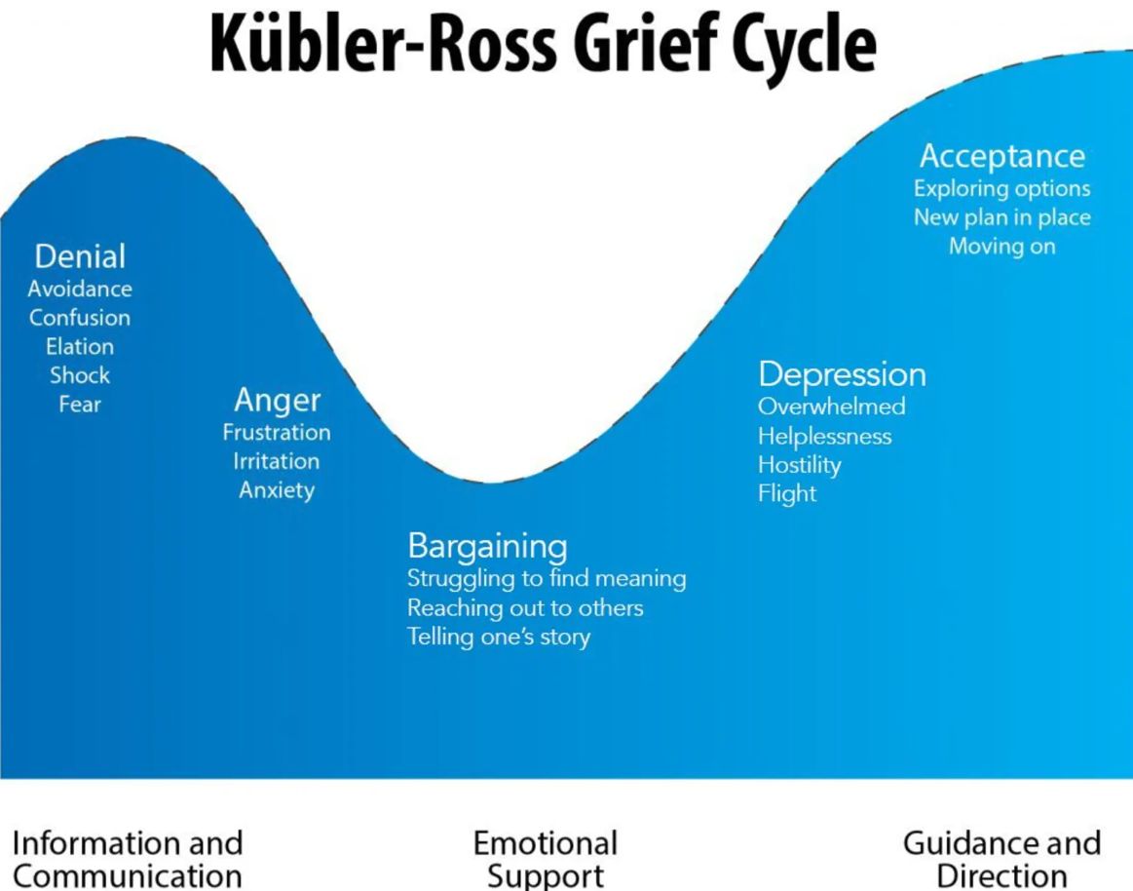
Notes:
anger – ‘I’ve had enough of this’
denial – this reaction often accompanies the initial shock of feedback ‘I can’t see any problem with that’
blame – ‘It’s not my fault. What can you expect when the patient won’t listen?
rationalisation – finding excuses to try and justify their behaviour ‘I’ve had a particularly bad week’ ‘Doesn’t everyone do this?’
acceptance
renewed action
Feedback formats:
written/verbal individualised eg a particular assignment
written/verbal general feedback to a group eg on most common errors/successes on an exam paper
checklists/proforma eg headings of assessment criteria, with comments below
OR Simply
"Off the cuff" comments from others eg "You're really good at”
What model can you associate with this?
Answer: Kubler-Ross (1969)
Denial
Anger
Bargaining
Depression
Acceptance

Slide 29
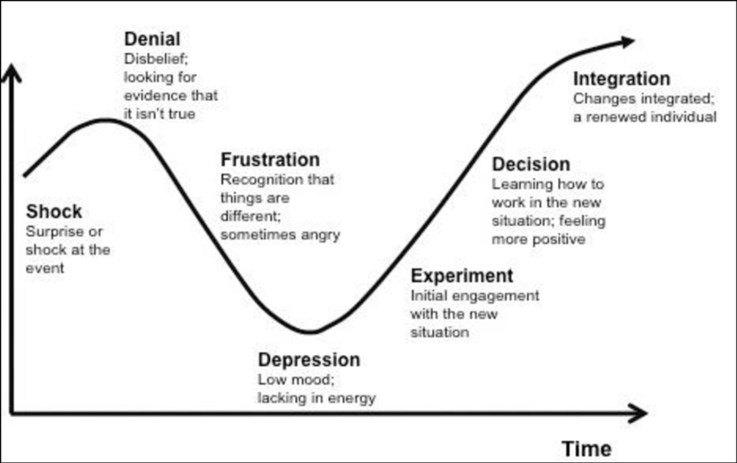
Kubler-Ross Model
Notes:
anger – ‘I’ve had enough of this’
denial – this reaction often accompanies the initial shock of feedback ‘I can’t see any problem with that’
blame – ‘It’s not my fault. What can you expect when the patient won’t listen?
rationalisation – finding excuses to try and justify their behaviour ‘I’ve had a particularly bad week’ ‘Doesn’t everyone do this?’
acceptance
renewed action
Feedback formats:
written/verbal individualised eg a particular assignment
written/verbal general feedback to a group eg on most common errors/successes on an exam paper
checklists/proforma eg headings of assessment criteria, with comments below
OR Simply
"Off the cuff" comments from others eg "You're really good at”
What model can you associate with this?
Answer: Kubler-Ross (1969)
Denial
Anger
Bargaining
Depression
Acceptance

Slide 30
Assessment & Feedback
Questions

Slide 31
References
Black, P. & William, D. (1998). Assessment and classroom learning. Assessment in Education. 5(1),7-74.
Cowan, J. (2005). Designing assessment to enhance student learning. Available at: http://www.enhancementthemes.ac.uk/docs/workshop/designing-assessment-to-enhance-student-learning-paper.pdf
(Gibbs, G., 1999) Using Assessment Strategically to Change the Way Students. Assessment matters in higher education, p. 52.
Gmc-uk.org. 2010. Standards For Curricula And Assessment Systems. [online] Available at: <https://www.gmc-uk.org/-/media/documents/Standards_for_curricula_and_assessment_systems_1114_superseded_0517.pdf_48904896.pdf> [Accessed 12 September 2020].
Nicol, D. & Macfarlane-Dick, D. (2004) Rethinking Formative Assessment in HE: a theoretical model and seven principles of good feedback practice.
[Online]: http://www.heacademy.ac.uk/assessment/ASS051D_SENLEF_model.doc
Sadler, D. R. (1989). Formative assessment5 and the design of instructional systems. Instructional Science. 18, 119-144.

