Slide 1




TUBERCULOSIS
ELOIDA KARINA CHAVEZ SIFURNTES 2437214
ROWENA DIAZ VALIENTE 2442792
KIZZY OWUSUWA POKU 2431278
LUCY GODSALVE 2442427
GLENN CATALAN 24427911

Slide 2
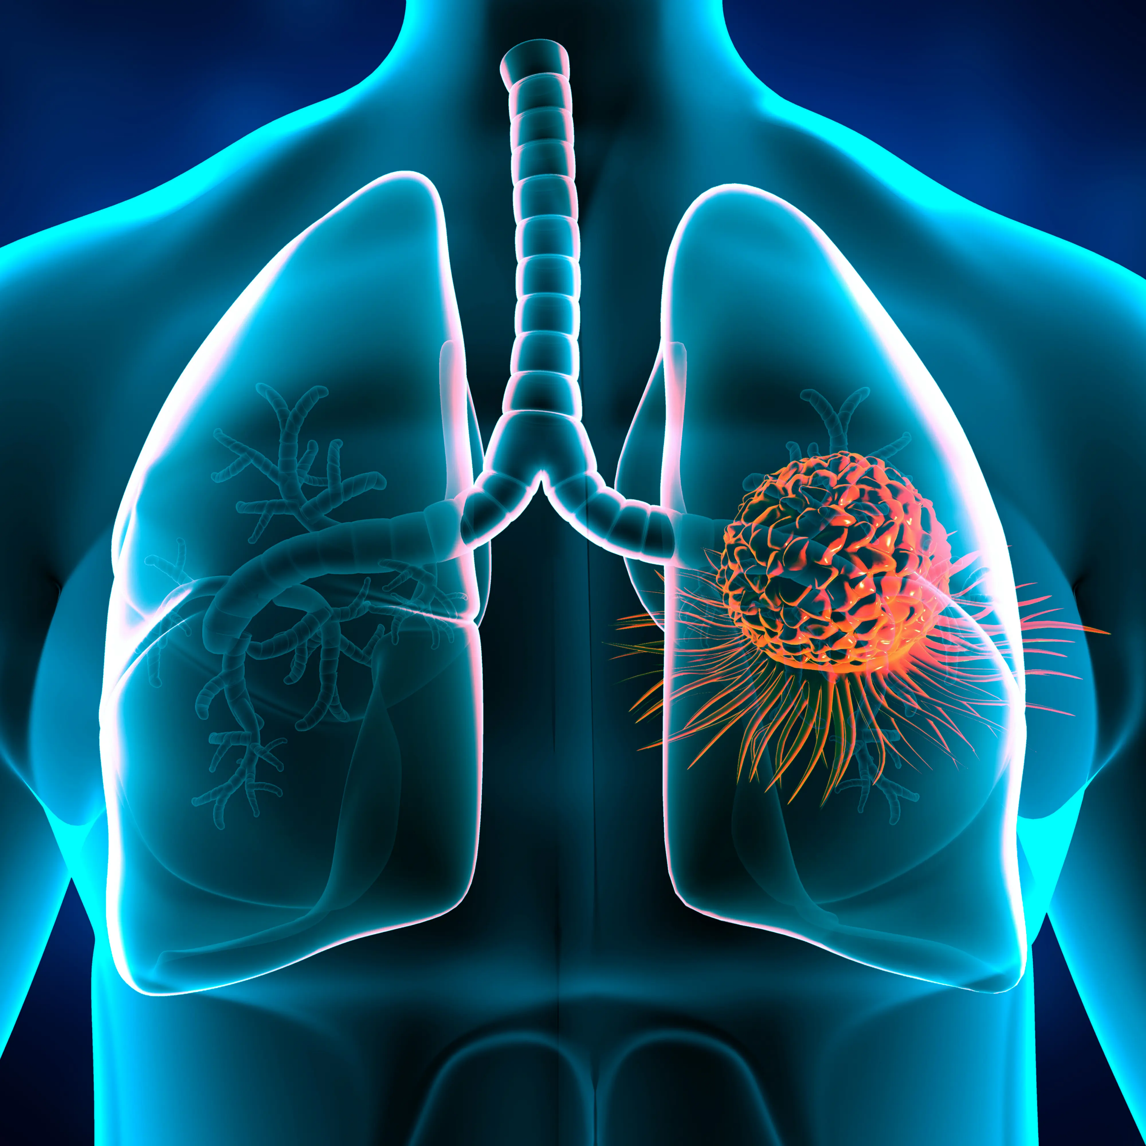

Tuberculosis (TB) is an infection caused by Mycobacterium tuberculosis. usually affects the lungs, but also ,capable to harm other areas of the body. TB is treatable with antibiotics if diagnosed early and managed properly.
SYMPTOMS OF TB INCLUDE:
• Cough lasting more than three weeks
• Feeling tired or exhausted
• Loss of appetite and weight loss
• General feeling of being unwell
According to the NHS, TB cases have been declining in recent years. However, it is still a public health issue. In 2020, approximately 4,700 new cases of tuberculosis were reported in England. This equals about 8 cases per 100,000 people (NHS, 2021).
TB does not affect all groups equally. Rates are notably higher in urban areas and among people who have moved from countries where TB is more common. Norbury et al. (2020) point out that TB remains one of the top causes of death worldwide, despite being both preventable and treatable.
In the UK, fewer people die from TB, but deaths still occur especially among vulnerable individuals. This includes people with comorbidities such as HIV or those with weakened immune systems. The UK death rate from TB is estimated to be less than 1 per 100,000 people (NHS, 2021).
To control TB, strong interventions are essential. It is important to ensure that everyone can access effective treatment, support, and follow-up care.
Notes:
2

Slide 3
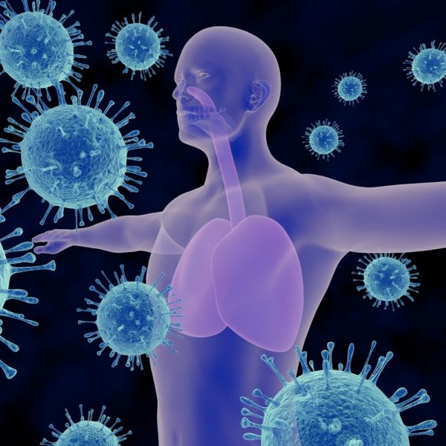
Effective TB surveillance involves the systematic collection, analysis, and interpretation of data related to TB infection and disease. This enables early identification of cases, which is essential for reducing transmission and improving individual health outcomes. According to WHO (2024), timely detection and notification allow for prompt public health action and support the goals of the End TB Strategy.
Surveillance systems also help track epidemiological trends, such as incidence rates, geographic distribution, and demographic risk factors. In the UK, for example, the National TB Surveillance System provides insights into diagnostic timelines and drug resistance patterns, informing targeted interventions (UKHSA, 2025).
Furthermore, surveillance data are vital for evaluating treatment success. By monitoring treatment adherence and outcomes, health authorities can identify gaps in care and improve clinical protocols. This feedback loop strengthens health systems and enhances patient support mechanisms (MacPherson et al., 2024).
Finally, TB surveillance informs evidence-based public health strategies and policy development. It supports resource allocation, program design, and legislative action. WHO’s updated guidance emphasizes the importance of digital, case-based surveillance to improve data quality and responsiveness (WHO, 2024).
In summary, TB surveillance is a cornerstone of effective disease control, enabling early intervention, strategic planning, and continuous improvement in public health responses.

Slide 4


Disease Prevention and Control:
Diseases can be prevented and controlled through different methods that help keep people healthy and stop infections from spreading.
In the case of tuberculosis (TB), it is important to detect the disease early through testing, provide the correct antibiotics, and protect individuals with the BCG vaccine.
Vaccines in general are highly effective because they train the body to recognize and fight off infections before a person becomes unwell.
Maintaining a healthy lifestyle such as healthy eating, exercising regularly, maintaining good hygiene, and avoiding smoking or excessive alcohol use also helps prevent many diseases and illnesses.
Medicines such as antibiotics, antivirals, and antifungal drugs are used to treat infections caused by bacteria, viruses, and fungi.
Keeping the environment clean by ensuring access to safe water, proper waste disposal, and plenty of fresh air also helps prevent the spread of diseases and illnesses. Keeping sick individuals separated from healthy people through quarantine or isolation helps prevent the spread of infections.
Wearing appropriate personal protective equipment (PPE), such as gloves, masks, and aprons, helps protect individuals especially doctors and nurses from germs.
All these measures work together to prevent diseases, control outbreaks, and keep the whole community healthy and safe.

Slide 5
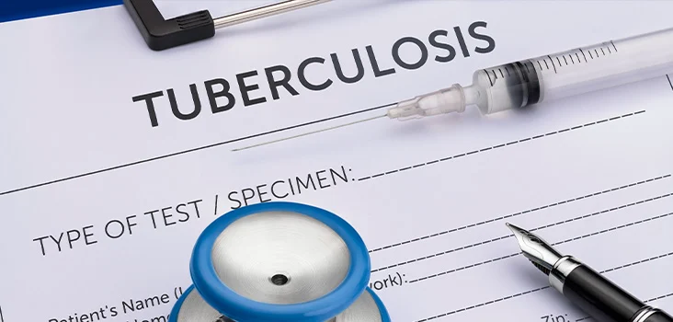
Strengthen disease surveillance and early detection
TB cases can be improved by expanding community level screening, especially in high-risk groups for example those who live in crowded conditions.
Develop strong data systems to track TB cases and treatment outcomes.
Use early detection strategies to reduce TB rates and improve overall public responses.
Increase collaboration between public health agencies and clinics.
Strengthen the healthcare system resilience
Making sure that health facilities have suitable resources such as labs, staff, medications to diagnose and treat TB.
Providing support for healthcare workers through training and well-being programs.
Provide mental health and wellbeing support for healthcare workers so that patient can receive quality care.
Invest in Vaccine development and distribution
Plan for equitable vaccine distribution, support research into new vaccines and encourage local partnership to fund vaccine research.
Increase funding for TB vaccine research to support the development of more effective and long-lasting vaccines.
Partnership between governments and private research to accelerate clinical trails.
Improve communication, training and education.
Educate communities about TB transmission and symptoms.
Encourage community leaders and local organisations to participate in TB education efforts to increase reach trust.
Reduce stigma and promote adherence.
Train healthcare workers on updated TB management guidelines.
Provide updated training for healthcare workers on new TB guidelines and developing treatments.

Slide 6
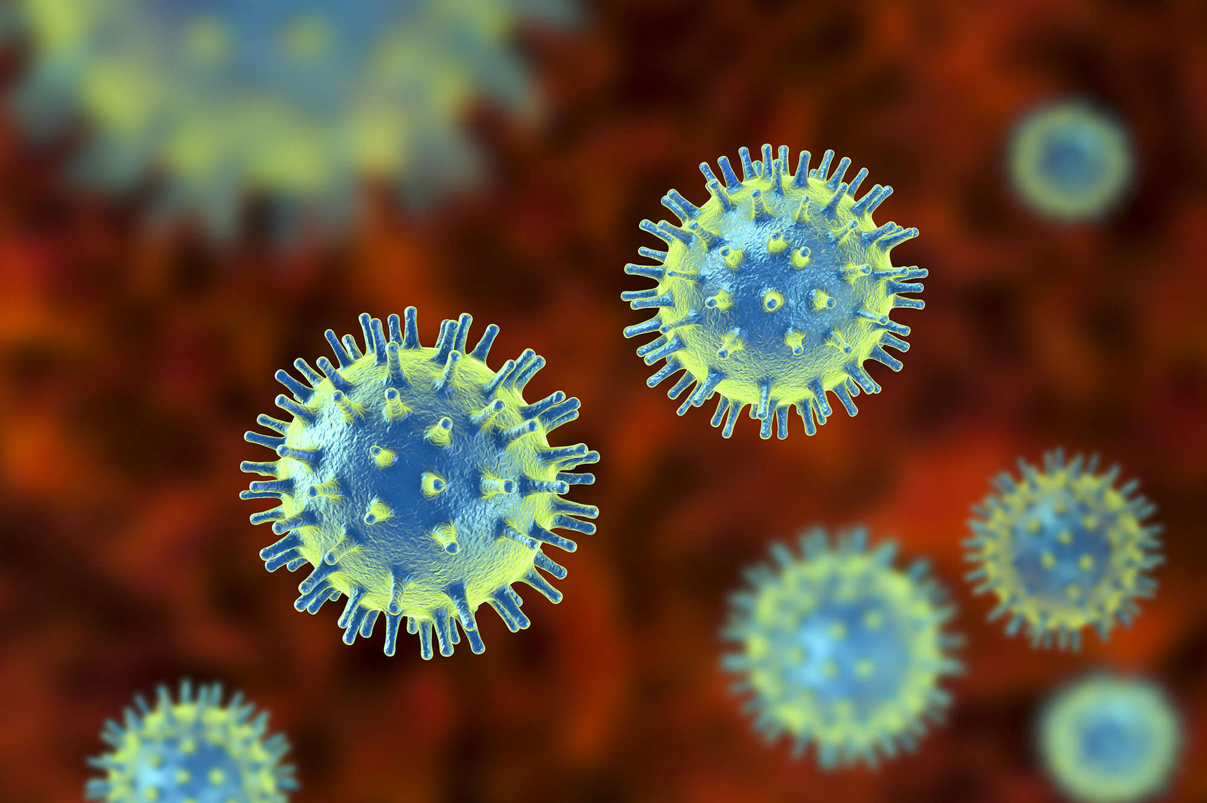

To effectively manage TB within Canal, View the following strategies can be implemented by:
Health education and awareness campaign
Conducting regular information for residents and staff about TB, it’s symptoms, prevention method and transmission.
Distribute leaflets or posters detailing proper hygiene practices, the importance of early symptoms reporting.
Hand hygiene
Install handwashing stations in Canal View equipped with soap and hand sanitizers especially in communal areas such as recreations rooms and dining room.
Sanitation and environmental hygiene
Implement a strict cleaning schedule to sanitize high touch surfaces (e.g., doorknobs, communal furniture and maintain living clean-living spaces.
Ensure proper ventilation in individuals flats and communal areas to reduce the risk of airborne transmissions.
Health monitoring and symptom screening etc.
Plan routine TB screening program for residents especially for those who are vulnerable or have recently travelled to high-risk areas.
Train healthcare professionals to identify TB symptoms early and to refer suspected cases for further diagnoses and treatment.
Provide regular medical check ups for residents to monitor their health and detect early signs of TB or other illness.

Slide 7
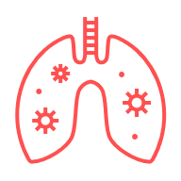
Conclusion
In summary, tuberculosis (TB) continues to be a major public health concern worldwide. Although significant progress has been made in reducing the incidence and mortality rates of TB through improved diagnostic methods, effective treatments, and vaccination programs, the disease still affects millions of people each year. The emergence of drug-resistant strains and the impact of social factors such as poverty, overcrowding, and limited access to healthcare make TB control particularly challenging. Early detection and prompt treatment are crucial for preventing transmission and improving patient outcomes. Surveillance systems play an important role in monitoring trends, identifying outbreaks, and evaluating the effectiveness of interventions.
Furthermore, public health strategies must address not only the medical aspects of TB but also the underlying social determinants that contribute to its spread. Education, community engagement, and support for vulnerable populations are essential components of a comprehensive approach to TB prevention and care. Continued research and innovation are needed to develop new diagnostics, drugs, and vaccines. Ultimately, global collaboration and sustained commitment from governments, healthcare providers, and communities are necessary to achieve the long-term goal of eliminating tuberculosis. By working together and addressing both clinical and social challenges, it is possible to reduce the burden of TB and protect public health for future generations

Slide 8


Reference
1NHS (2023) Tuberculosis (TB). Available at: https://www.nhs.uk/conditions/tuberculosis-tb/ (Accessed: 9 November 2025).
2WHO releases new guidance on Tuberculosis surveillance. https://www.who.int/news/item/29-05-2024-who-releases-new-guidance-on-tuberculosis-surveillance
3Tuberculosis diagnosis and microbiology, England, 2023. https://www.gov.uk/government/publications/tuberculosis-in-england-2024-report/tuberculosis-diagnosis-and-microbiology-england-2023
4Community-based active-case finding for tuberculosis: navigating a .... https://bmcglobalpublichealth.biomedcentral.com/articles/10.1186/s44263-024-00042-9
5Tuberculosis surveillance - World Health Organization. https://iris.who.int/bitstream/handle/10665/376612/9789240075290-eng.pdf?sequence=1
6World Health Organization (2023) Global tuberculosis report 2023. Geneva: WHO. Available at: https://www.who.int/publications/i/item/9789240070252 (Accessed: 9 November 2025).

