Slide 1
Lean supply chains

Slide 2
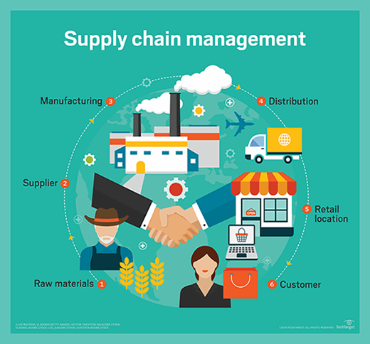
Supply chain management
Notes:
Supply chain management is a fairly recent practice applied. After the WWs the importance of logistic management was highlighted in complex and pressured environments. It is the management of the flow of goods and services and includes all processes that transform raw materials into final products. It is done in an effort by suppliers to develop and implement supply chains that are as efficient and economical as possible, feeding into each part of the chain.

Slide 3
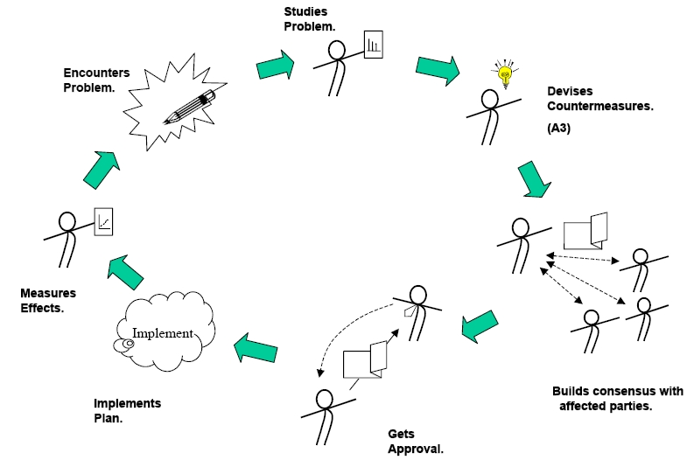
LEAN logistics
Plan
Do
Check
Act
Notes:
Businesses who want to streamline their processes by eliminating waste and non-value added activities. Companies have a number of areas in their supply chain where waste can be identified as time, costs, or inventory. To create a leaner supply chain companies must examine each area of the supply chain. They follow the PDCA framework.
Plan
Recognize an opportunity and plan a change.
Do
Test the change. Carry out a small-scale study.
Check
Review the test, analyze the results and identify what you’ve learned.
Act
Take action based on what you learned in the Check step: If the change did not work, go through the cycle again with a different plan. If you were successful, incorporate what you learned from the test into wider changes. Use what you learned to plan new improvements, beginning the cycle again.

Slide 4
Where waste occurs
Overproduction
Waiting
Transporting
Inappropriate processing
Unnecessary inventory
Unnecessary or excess motion
Defects
Notes:
Waste occurs in numerous stages including the procurement stage, where businesses are looking to new technologies to assist them in improving procurement processes, the manufacturing stage, which is popular as this is where significant improvement can be achieved. Warehouse processes should be examined to find areas of eliminating waste of resources and non-value added steps. Inventory control management is one of the most effective measures in reducing costs. The accumulation of inventory requires money and resources to store and maintain it. Transportation is also looked at, if shipping internationally there are usually areas where processes can be refined.

Slide 5
The textile industry
Garment manufacturing linked to global supply chains is a large source of employment in many developing and emerging economies.
It is problematic, as the supply chain is globally fragmented, with many suppliers located in different (likely in developing) countries, lacking transparency, especially when lower tiers are involved.
Notes:
Textile industries until fairly recently kept their distance from LEAN manufacturing is it was a philosophy developed by Toyota and used by heavy industry manufacturers. It was only until they were introduced into the Textile industry and produced decent results.

Slide 6
Problems in the textile industry
Pressures to reach social goals with changing consumer preference
Poor code of conduct
Environmental waste
Poor working conditions
Lack of employee training

Slide 7
Case Study
Based on the report; Lean manufacturing practices in textile industries–a case study, by Saleeshya, P.G., Raghuram, P. and Vamsi, N., 2012.
The report looked at a textile industry in Southern India looking at the lean manufacturing practices.
Notes:
The company has dying, weaving and processing divisions. The attention of this paper is on the weaving division. In this division the basic raw material yarn is converted into fabric. The weaving division has a monthly demand of 800,000 meters and has eight departments which are; planning, raw material storage, warping, sizing, drawing, weaving, quality control and rework

Slide 8
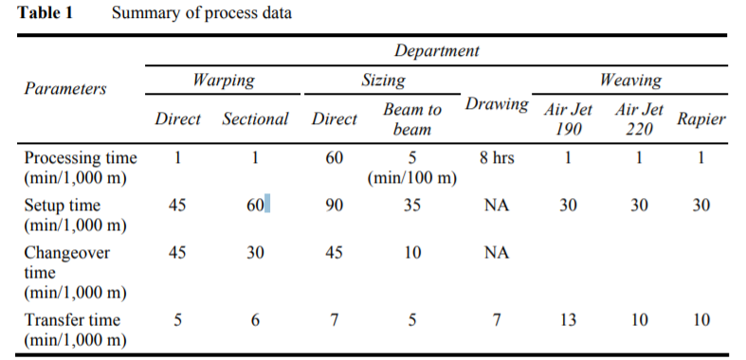
Value stream model
Notes:
The crucial parameters like cycle time (CT), changeover time (CO), number of operators, number of shifts, was noted. The data was gathered from raw material storage to dispatch and again from dispatch to raw material storage.

Slide 9
Analysis of wastage
Current demand = 800,000 meters/month
Current production = 500,000 metres/month
Takt time to produce 1 m of cloth = 3.24 secs
Operating time to produce 1m of cloth = 5.18 secs
Where & why, are resources such as time and effort wasted?

Slide 10
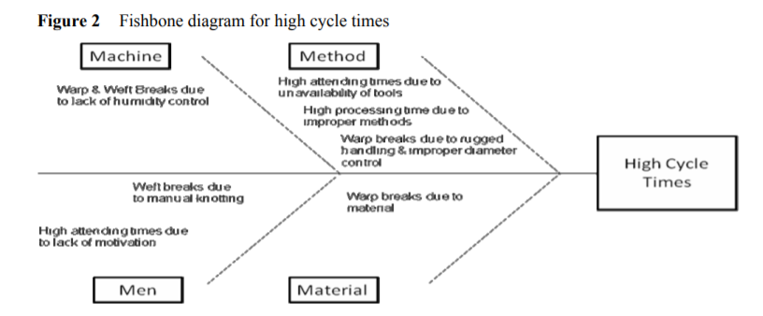
Identification of issues
5W (what, when, where, why and who) and 2H (how and how much) techniques.
Issues
  High cycle times
  Lack of standardisation
  Lack of worker awareness of the job

Slide 11
Implement changes
Select lean tools to eliminate bottlenecks
5s
Kaizen
Poka Yoke
Quality Circle
Kanban
Notes:
The five components of steps of 5S are: • Sort
• Set in order or straighten
• Shine
• Standardise
• Sustain
Kaizen is a Japanese philosophy that focuses on continuous improvement throughout all aspects of life. When applied to the workplace, kaizen continually improves all functions of a business, from manufacturing to management and from the chief executive to the assembly line workers
Poka yoke is a way to manufacture or assemble products with minimum or zero defects by practicing zero quality control (ZQC). It is based on the principle that defects are prevented by controlling the performance of a process so that there cannot be defects in the product.
Quality circle is the concept of quality circle is based on human resources management, which is considered as one of the key factors of on in the improvement of product quality and productivity. It implies the development of skills, capabilities, confidence and creativity of the people through cumulative process of education, training, work experience and participation
Kanban is a signalling system to trigger action. Kanban is used as a part pull system. It is demand scheduling which means, only produce product to replace the product consumed by its customers, and only produce product based on signals sent by its customers.

Slide 12
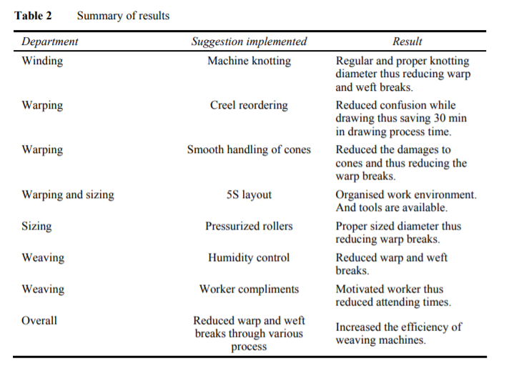
Improvements

Slide 13
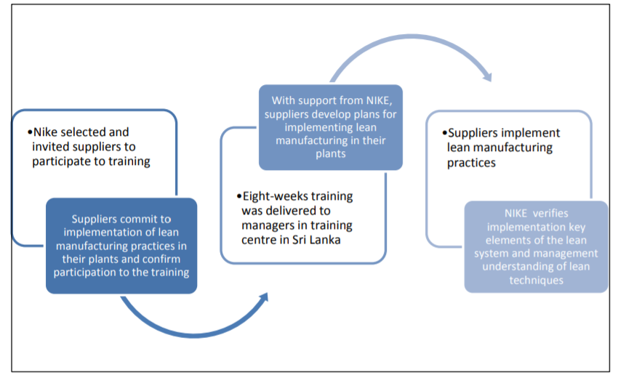

Leading the way?
Notes:
Nike introduced a supplier capability program on lean manufacturing: it included training on lean manufacturing techniques, promotion of the adoption of lean manufacturing practices, and assessment to certify the application of lean practices among participating suppliers. The objective of the program was to support suppliers in dealing more effectively shorter lead times and smaller order sizes, and in improving their overall efficiency, but it also resulted in improvements in working conditions.
The program focused on suppliers with a longer business relationship with Nike, many of which came from emerging and developing countries, including Thailand, India, China, Sri Lanka, Vietnam, Malaysia, among others.

Slide 14
For the financial year 2010-2011, Nike achieved:
50% reduction in defect rates
40% faster lead times
20% improvement in productivity
30% reduction in time taken to introduce a new model.
Notes:
While the program itself focused on lean management systems and practices, it also led to improvements in working conditions.

Slide 15
Conclusion
Wastage is a big issue in the textile industry.
More textile companies need to become familiar with it to improve their sustainability.
The case study proved its effectiveness and NIKE are proving this continuously.

Slide 16
References
Saleeshya, P.G., Raghuram, P. and Vamsi, N., 2012. Lean manufacturing practices in textile industries–a case study. International Journal of Collaborative Enterprise, 3(1), pp.18-37.
Köksal, D., Strähle, J., Müller, M. and Freise, M., 2017. Social sustainable supply chain management in the textile and apparel industry—A literature review. Sustainability, 9(1), p.100.
http://www.ilo.org/wcmsp5/groups/public/---asia/---ro-bangkok/---ilo-jakarta/documents/presentation/wcms_565091.pdf
https://www.shmula.com/lean-or-six-sigma/2822/

