Slide 1
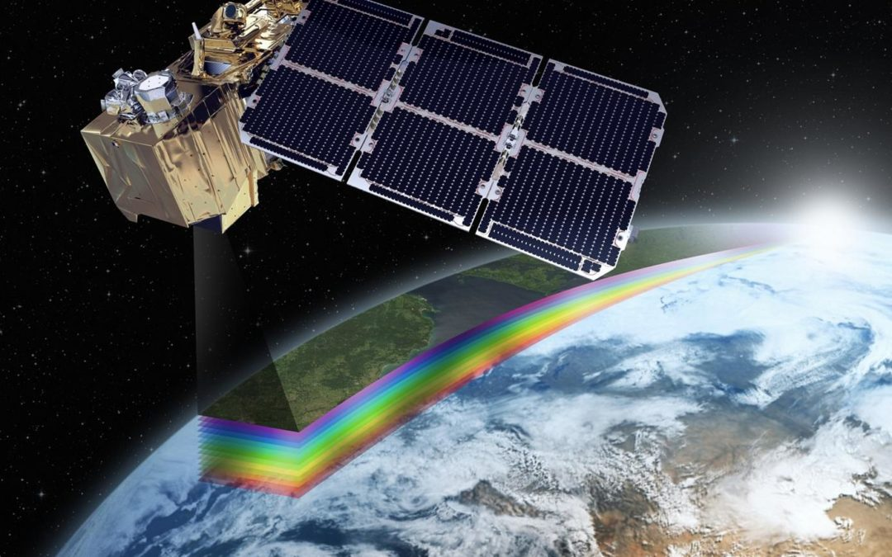
04/02/2026
ACNA6003:
Lecture 12
Spectrometer practical
Dr Alisdair Cunningham
Senior Lecturer
2025 / 2026
04/02/2026
Slide 1 / 14

Slide 2
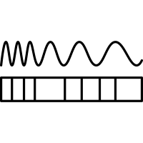
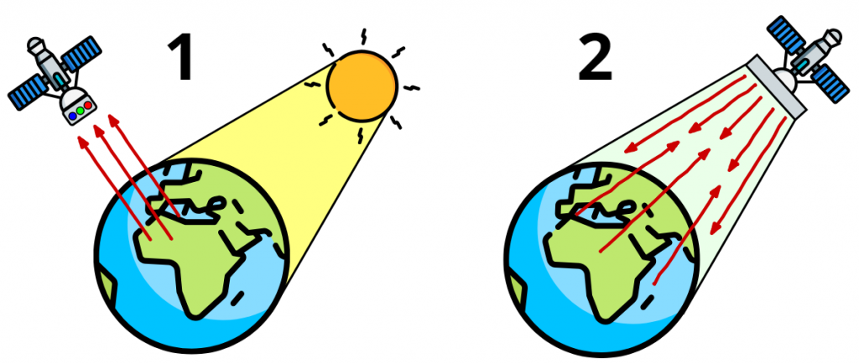
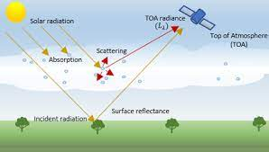
Module ACNA6003: 2025 / 2026 Spectral resolution: Radiance
04/02/2026
Many remote sensors receive and measure energy.
Typically, for Earth Observation (EO) sensors, radiation, or ‘radiance’ is received at the sensor.
This can be from the sun (passive sensors), or from the sensor, (active sensors)
Passive sensors, and
Active sensors
Note: The radiance received at a satellite sensor can be a combination of Earth surface, and atmospheric
A. Cunningham Lecture 12: Spectrometer practical
Slide 2 / 14

Slide 3
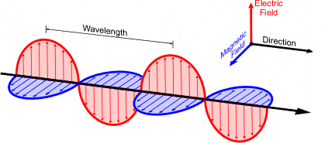
Module ACNA6003: 2025 / 2026 Spectral resolution: EM radiation
04/02/2026
For passive sensors that are measuring radiance reflected from the Earth’s surface (and atmosphere), the energy being received is electromagnetic radiation.
Electromagnetic radiation travels in waves, composed of electric, and magnetic energy, that travel in the same direction, perpendicular to each other.
The wavelength is the distance between the peaks of two subsequent crests of the electric signal.
A. Cunningham Lecture 12: Spectrometer practical
Slide 3 / 14

Slide 4
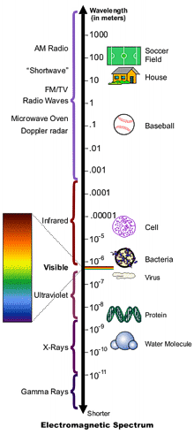
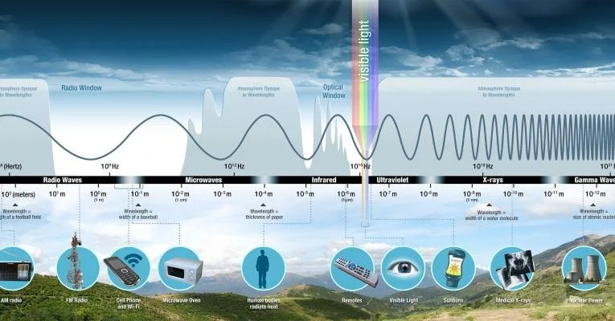
Module ACNA6003: 2025 / 2026 Electromagnetic Spectrum
04/02/2026
Electromagnetic radiation can travel at different wavelengths (the distance between crests), the full range of which is called the electromagnetic spectrum
A. Cunningham Lecture 12: Spectrometer practical
Slide 4 / 14
Notes:
Introduction to the Electromagnetic Spectrum - NASA Science https://science.nasa.gov/ems/01_intro/

Slide 5
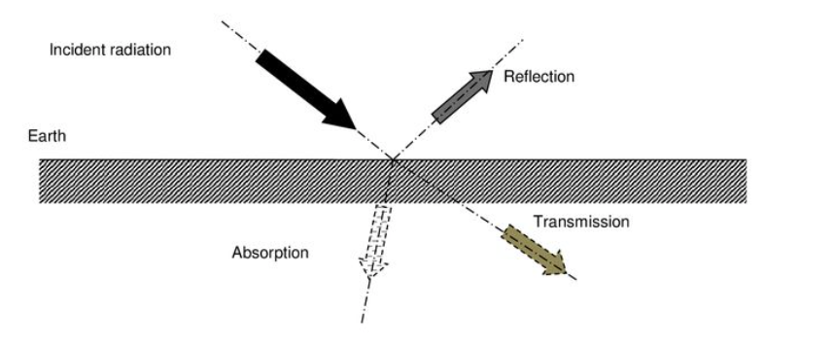
Module ACNA6003: 2025 / 2026 EM: Absorption and Reflection
04/02/2026
When EM radiation meets an object / surface, the molecules of that feature interact in one of three ways:
Absorption
Reflection
Transmission
A. Cunningham Lecture 12: Spectrometer practical
Slide 5 / 14

Slide 6
Module ACNA6003: 2025 / 2026 EM: Absorption and Reflection
04/02/2026
Therefore, the amount of energy received can then vary from the amount emitted back to the sensor (reflected), depending on how much transmission occurs, and how much is absorbed. For example…
If the incident radiation is 100 Wm², and the feature absorbs 20 Wm², and 10 Wm² is transmitted, 70 Wm² is reflected.
Reflectance = IR – (A + T)
100 – (20 + 10)
= 70 W/m²
IR = 100 W/m²
T = 10 W/m²
A = 20 W/m²
A. Cunningham Lecture 12: Spectrometer practical
Slide 6 / 14

Slide 7
Module ACNA6003: 2025 / 2026 EM: Absorption and Reflection
04/02/2026
Therefore, the amount of energy received can then vary from the amount emitted back to the sensor (reflected), depending on how much transmission occurs, and how much is absorbed. For example…
If the incident radiation is 100 Wm², and the feature absorbs 20 Wm², and 10 Wm² is transmitted, 70 Wm² is reflected.
Reflectance = IR – (A + T)
600 – (560 + 20)
= 20 W/m²
IR = 600 W/m²
T = 20 W/m²
A = 560 W/m²
A. Cunningham Lecture 12: Spectrometer practical
Slide 7 / 14

Slide 8
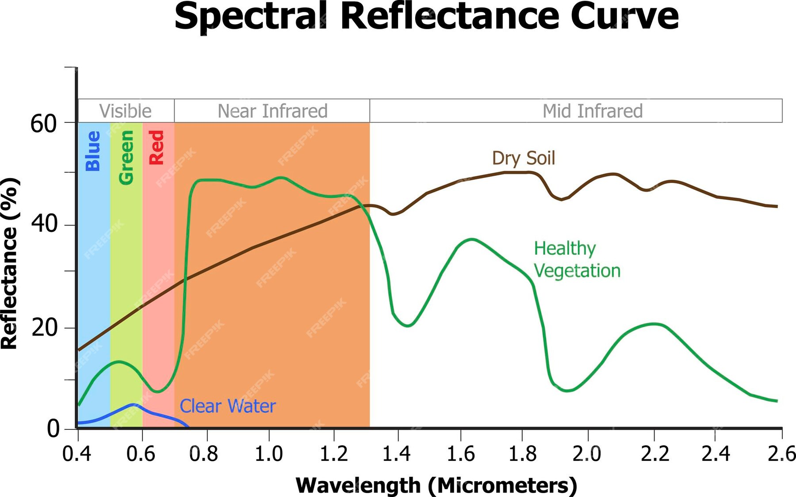
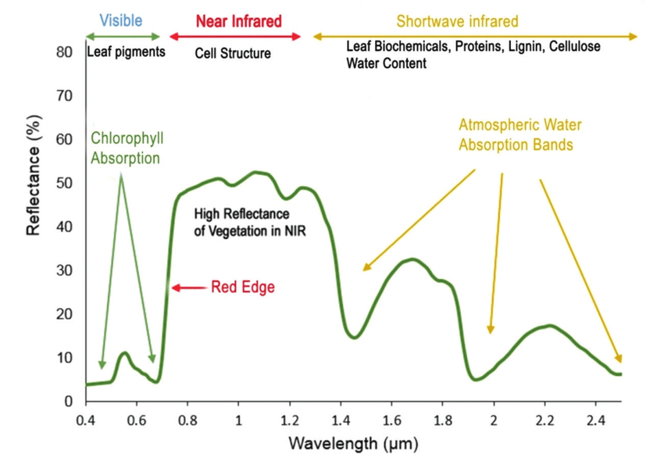
Module ACNA6003: 2025 / 2026 Spectral reflectance
04/02/2026
The key aspect is, each surface, depending on what it is composed of, will interact differently with the incident radiation across all the wavelengths.
Each wavelength interacts differently with an object, depending on the chemical and biophysical properties of the surface feature.
The pattern of reflected energy across all the wavelengths is called the spectral reflectance.
A. Cunningham Lecture 12: Spectrometer practical
Slide 8 / 14

Slide 9
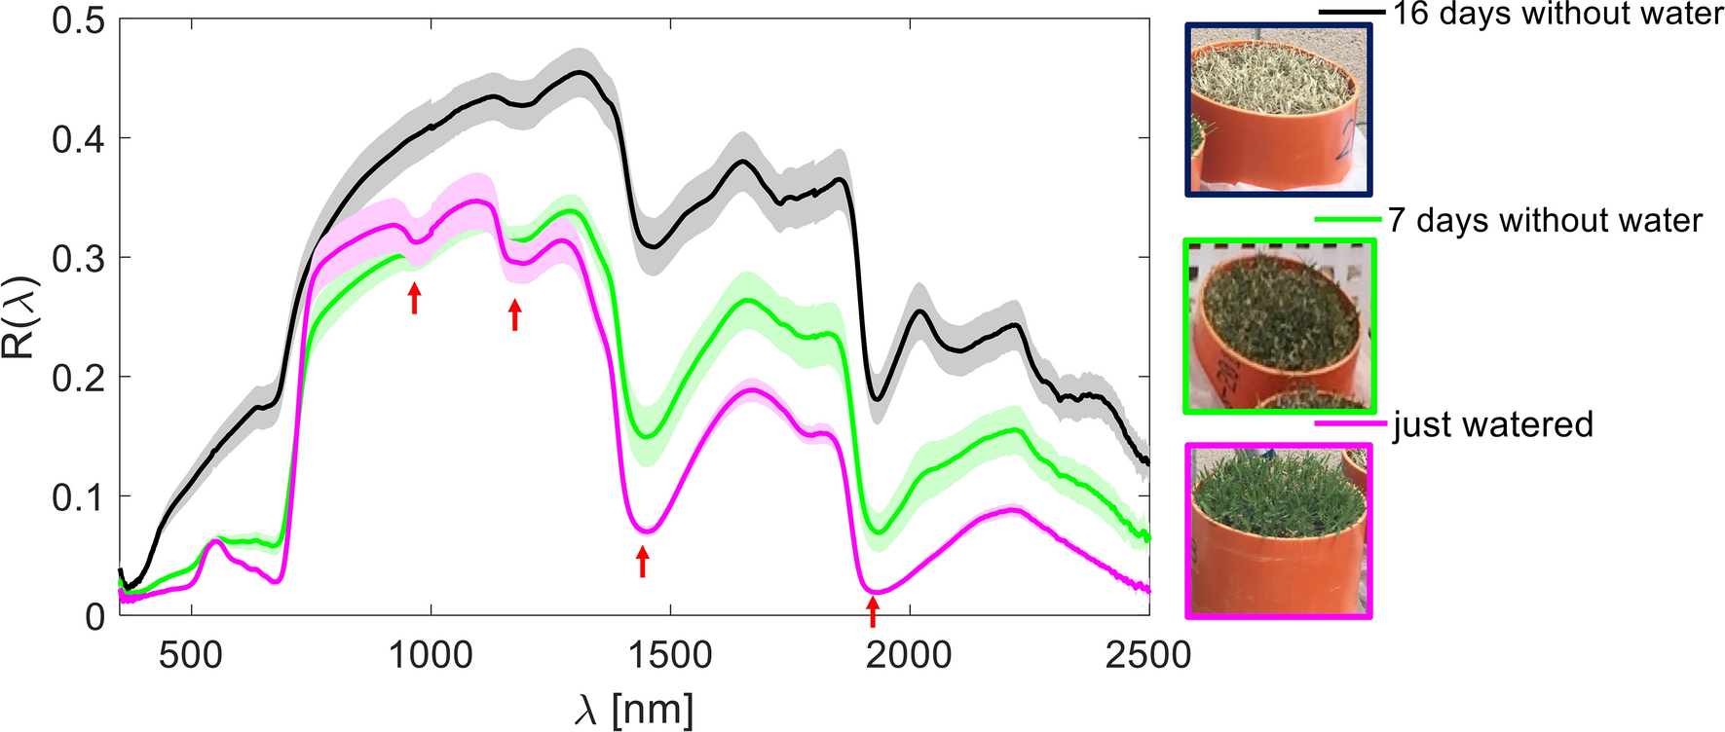
Module ACNA6003: 2025 / 2026 Spectral reflectance
04/02/2026
Because the composition of the feature affects the spectral reflectance, measuring the spectral reflectance can then be used to infer the composition / state of the object.
For example, high absorption in spectral regions sensitive to water absorption indicate a higher presence of water content.
Source: Caturegli, L., Matteoli, S., Gaetani, M., Grossi, N., Magni, S., Minelli, A., Corsini, G., Remorini, D. and Volterrani, M., 2020. Effects of water stress on spectral reflectance of bermudagrass. Scientific Reports, 10(1), p.15055.
A. Cunningham Lecture 12: Spectrometer practical
Slide 9 / 14
Notes:
Caturegli, L., Matteoli, S., Gaetani, M., Grossi, N., Magni, S., Minelli, A., Corsini, G., Remorini, D. and Volterrani, M., 2020. Effects of water stress on spectral reflectance of bermudagrass. Scientific Reports, 10(1), p.15055.

Slide 10
Module ACNA6003: 2025 / 2026 Spectral reflectance
04/02/2026
By focussing on specific regions of the spectral reflectance curve, the properties of the feature can be inferred.
Therefore, spectral regions are often selected for analysis purposes.
A. Cunningham Lecture 12: Spectrometer practical
Slide 10 / 14

Slide 11
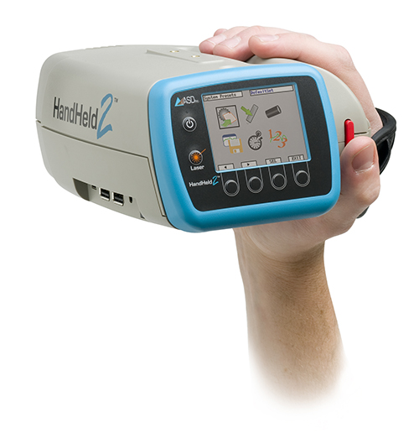
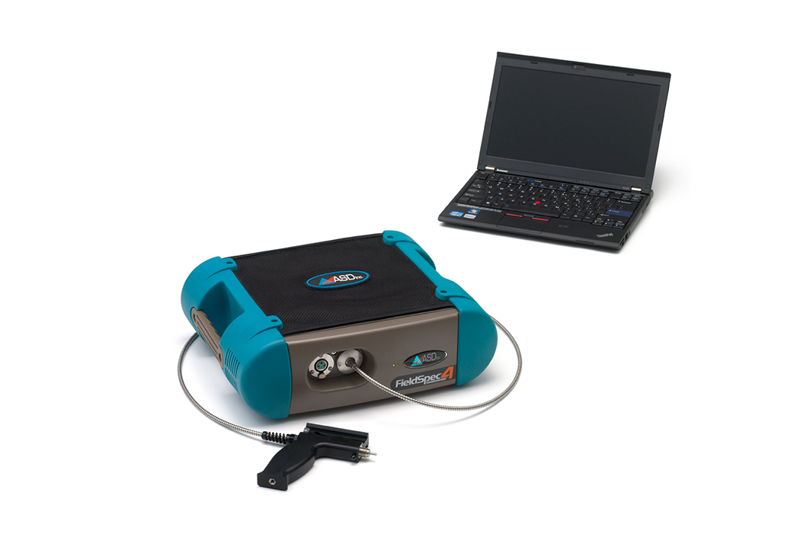
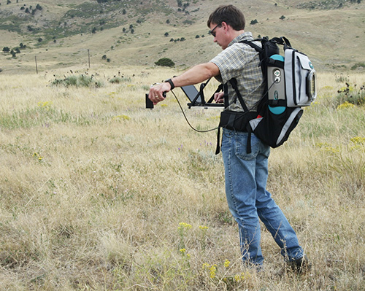
Module ACNA6003: 2025 / 2026 Spectroradiometers
04/02/2026
A spectroradiometer is a device designed to capture the varying intensities (amplitude) of light across wavelengths
This can be done either in a laboratory setting or in the field
It is more difficult to control the illumination conditions outside whereas a lab is a more controlled environment
A. Cunningham Lecture 12: Spectrometer practical
Slide 11 / 14

Slide 12
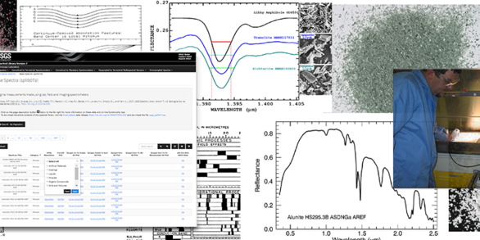
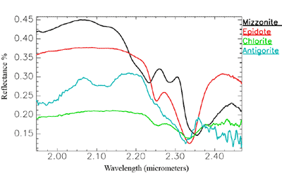
Module ACNA6003: 2025 / 2026 Spectral library
04/02/2026
Spectral libraries are created as a reference dataset with which to compare field measurements or satellite spectra, in order to identify / classify features
The USGS have compiled thousands of spectra of vegetation, minerals, and man-made surfaces, in Spectral Library Version 7:
Base Spectra (splib07a) (usgs.gov)
Kokaly, R.F., Clark, R.N., Swayze, G.A., Livo, K.E., Hoefen, T.M., Pearson, N.C., Wise, R.A., Benzel, W.M., Lowers, H.A., Driscoll, R.L., and Klein, A.J., 2017, USGS Spectral Library Version 7: U.S. Geological Survey Data Series 1035, 61 p., https://doi.org/10.3133/ds1035.
A. Cunningham Lecture 12: Spectrometer practical
Slide 12 / 14
Notes:
Image source: Spectroscopy Lab | U.S. Geological Survey (usgs.gov) https://www.usgs.gov/labs/spectroscopy-lab

Slide 13
Module ACNA6003: 2025 / 2026 Next Session
04/10/2023
The next lecture will cover:
Digital Elevation models
Suggested activities:
  Visit the USGS spectral library: Base Spectra (splib07a) (usgs.gov)
  Visit the ECOSTRESS spectal library: ECOSTRESS Spectral Library - Version 1.0 — ECOSTRESS Speclib (nasa.gov)
  Visit the Copernicus Browser and start exploring imagery: https://dataspace.copernicus.eu/browser/
Suggested reading:
Spectral Signature Cheatsheet in Remote Sensing - GIS Geography https://gisgeography.com/spectral-signature/
Lillesand, T., Kiefer, R.W. and Chipman, J., 2015. Remote sensing and image interpretation. John Wiley & Sons.
A. Cunningham Lecture 12: Spectrometer practical
Slide 13 / 14
Notes:
Meerdink, S. K., Hook, S. J., Roberts, D. A., & Abbott, E. A. (2019). The ECOSTRESS spectral library version 1.0. Remote Sensing of Environment, 230(111196), 1–8.
Baldridge, A. M., S.J. Hook, C.I. Grove and G. Rivera, 2009.. The ASTER Spectral Library Version 2.0. Remote Sensing of Environment, vol 113, pp. 711-715

Slide 14
Module ACNA6003: 2025 / 2026 Questions
04/02/2026
Any questions?
Please contact via:
Email: a.cunningham@uwtsd.ac.uk
Teams: “ACNA6003 GIS and Remote Sensing Technologies 25/26_GRP”
ACNA6003 GIS and Remote Sensing 2024/25_GRP | General | Microsoft Teams
A. Cunningham Lecture 12: Spectrometer practical
Slide 14 / 14

