Slide 1
Academic and Employability Skills (ACE)
Report Writing

Slide 2
Reports
What do you think a report is?
Have you written a report or an essay before? If so, when, and what type of report or essay was it?

Slide 3
What is a report?
A document written for a clear purpose and to a particular audience, with specific information and evidence applied to a particular problem, topic, or issue.
Unlike an essay which usually does not contain headings, a report has a clearly structured format making use of sections and headings so that the information is easy to locate and follow.

Slide 4
What is a report?
When writing a report you will usually need to follow a brief which provides you with instructions and guidelines.
The report brief may outline the purpose, audience and problem or issue that your report must address, together with any specific requirements for format or structure.
Sometimes, you might be given a template to use. If you are offered a template: USE IT

Slide 5
Steps for Report Planning
1. Start with a plan
Think about what your report
needs to cover before you start
writing. If you have a template,
use it to make notes for each
Section.
2. Understand the purpose
Why are you writing the report?
What is the situation or problem?
What are you expected to achieve?
3. Gather your information
What information do you already
have?
What information is missing?
4. Do your research
Find reliable sources to fill any gaps.
Make notes and keep track of where
your information comes from.
5. Plan your structure
Decide what sections your report will
have (e.g., introduction, findings,
conclusion, recommendations).
Organise your ideas in a clear order
before writing.

Slide 6
Structuring your report
A good structure helps your reader understand your ideas and makes your report more effective.
Structure means the order of your information and the headings/subheadings you use to guide the reader.
Divide your report into clear, logical sections so the reader can follow your thinking.
For Task 3, you already have a template. Use the template to organise your report.

Slide 7
How to Break Your Report Into Clear Sections
Most reports use a simple numbering system to show how the information is organised.
Main sections use whole numbers:
1, 2, 3, 4
(Each one is a big idea.)
Sub-sections use decimal numbers:
1.1, 1.2, 1.3
(These explain parts of the big idea in section 1.)
Smaller sub-sections can be added if needed:
1.1.1, 1.1.2, 1.1.3
This numbering helps the reader see how all the ideas fit together and makes your report easy to follow.
NOTE: Not all reports need sub-sections or sub-sub sections! It depends on the complexity of your topic and report. Your Task 3 is already sectioned for you in the template.

Slide 8

Title page
Should briefly and clearly describe the purpose of the report. Other details you may include could be your name, the date and for whom the report is written.
TIP: If you don't know what your module code is, what your lecturer's name is, or how to spell it, LOOK IT UP! It will be on Moodle or on your timetable!
Academic and Employability Skills Report
Name:
Student ID:
Module Code:
Module:
Lecturer:
Submitted on:

Slide 9
Table of Contents
The contents page should list the different sections and/or headings together with the page numbers. It:
should be presented in such a way that the reader can quickly scan the list of headings and locate a particular part of the report.
number section headings and subheadings in addition to providing page references.
use a consistent numbering system throughout.
Should include the page the references will appear on (ALWAYS their own page)
Tip: You will need to UPDATE your TOC after you have finished writing and editing and are ready to submit. Your template already has the headings in a TOC for you.

Slide 10
Table of Contents Example
Table of Contents
1 Introduction 3
2. Motivation 4
2.1 Intrinsic Motivation 4
2.2 Extrinsic Motivation 5
Importance of Motivation 5
3.1 Importance of Motivation at
University 6
3.2 Importance of Motivation at
Work 6
4 Techniques for Motivation 7
Conclusion 8
References 7

Slide 11
Updating Your Table of Contents
Locate the table of contents (This is usually at the beginning of the document.)
Right-click (or use menu options) on the table of contents
In Word: Right-click the TOC → “Update Field”
Choose the type of update
- Update page numbers only – if you haven’t changed headings but the content length changed.
- Update entire table – if you’ve added, removed, or renamed headings.
5. Confirm the update, Click “OK” (Word)
6. Verify
7. Check that all headings and page numbers are correct.

Slide 12
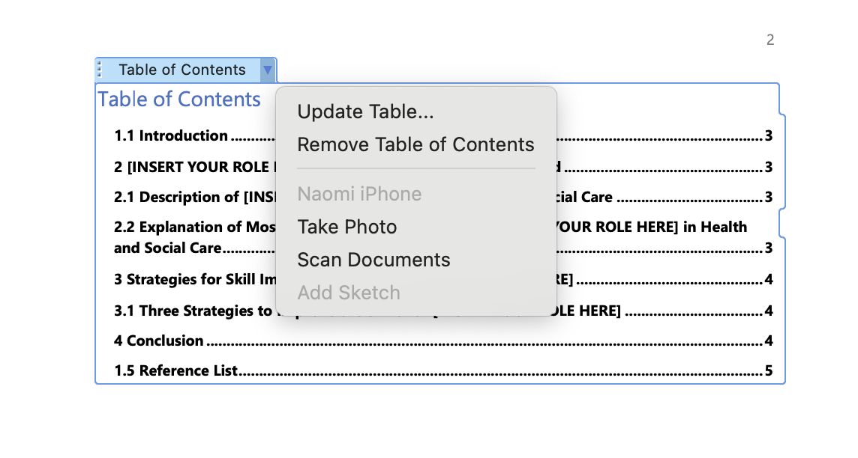
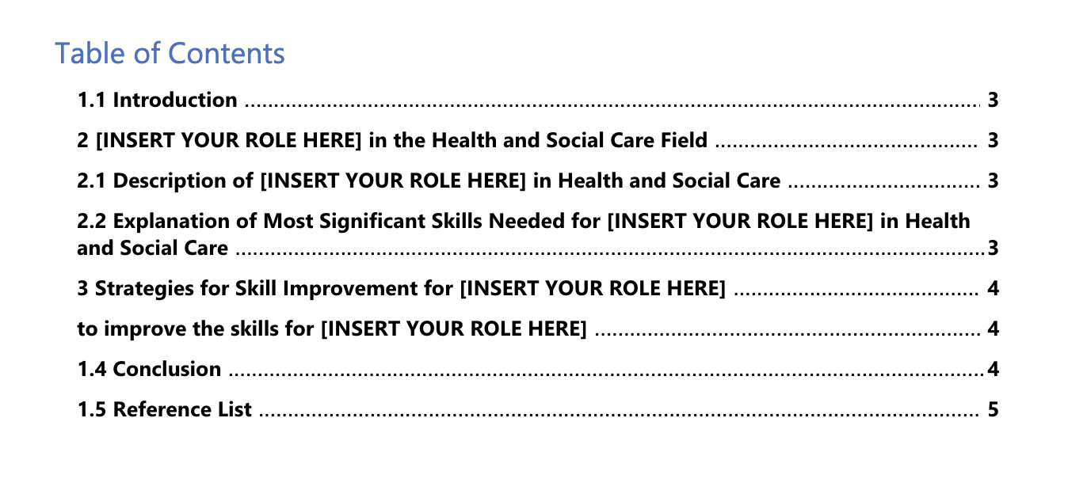
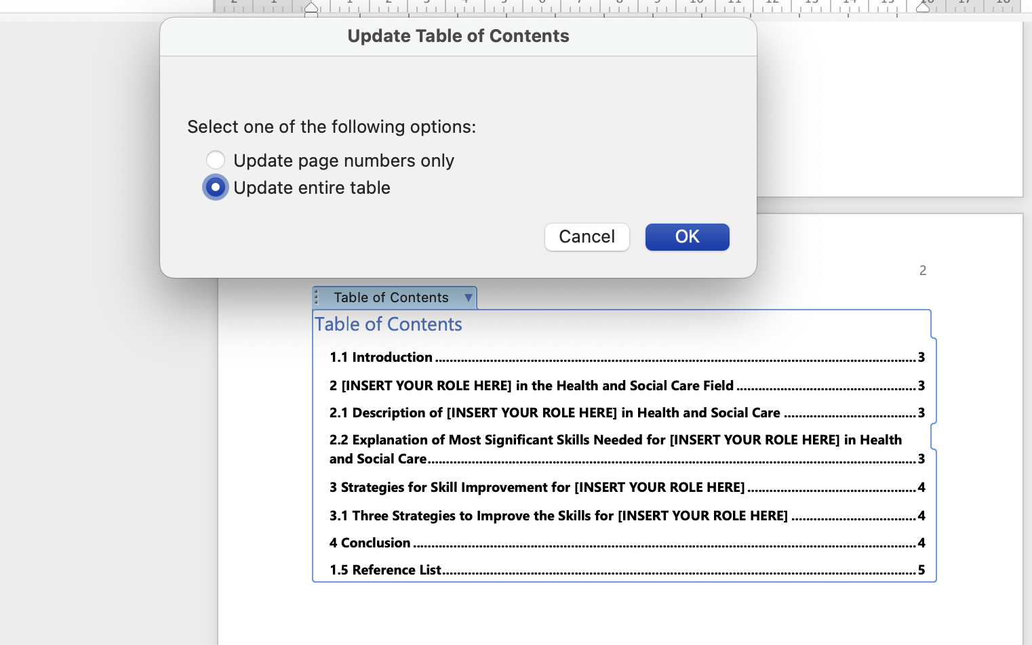
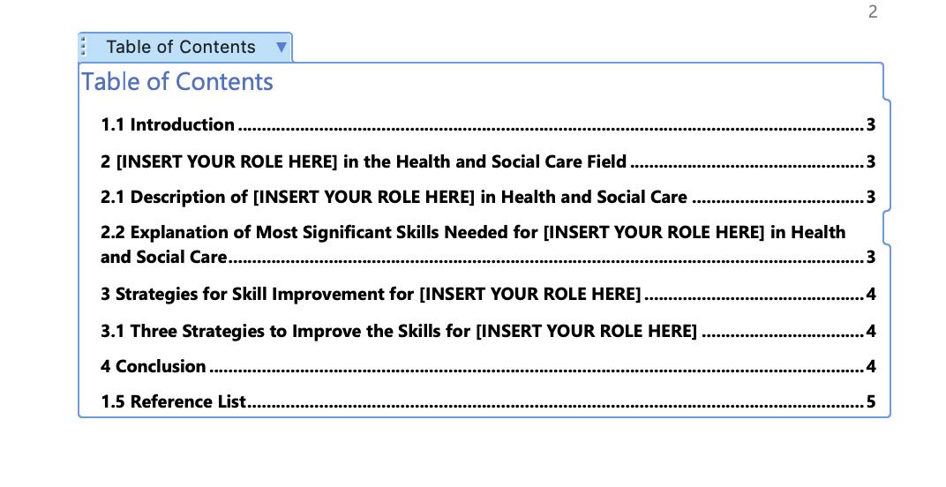

Slide 13
Introductions
In pairs / small groups, discuss the following:
Why is an introductory section important in a piece of writing? How does it help the readers?
What do you think should go in an introduction? What is the purpose of each sentence/part in an introduction?
What % of the whole work should an introduction be?

Slide 14
Introduction
Comes AFTER the Table of Contents
Should give the context and scope of the report/essay
States your report /essay objectives clearly
Gives a brief general background to the subject of the report
In an essay, it should inform the reader of your overall argument (thesis statement) near the end of the introduction.
GENERAL
SPECIFIC

Slide 15
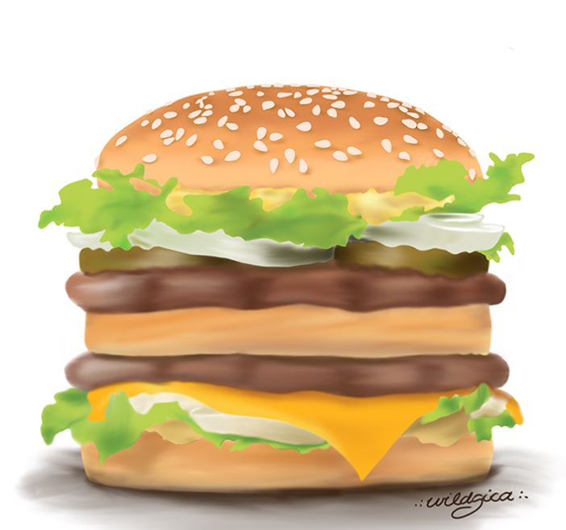
Introductory paragraph
An introductory paragraph contains:
Opening sentence
Background details
Statement of aims
Outline
It moves from general to specific

Slide 16
Opening Statement/Sentence
The first sentence of the introductory paragraph introduces the topic/theme to the readers.
It helps readers know what the topic is.
It should be quite general.
It should NOT be something like "This report will discuss..." (this comes at the end of your introduction!)
For example:
Topic: Report on important academic skills
Opening statement/sentence :
There are many essential skills students in higher education need to learn and use.

Slide 17
Opening Statement/Sentence
Can you come up with an opening sentence for this topic? (Please note, this is an EXAMPLE topic, NOT the same topic as your assessment)
Topic: Report on the importance of technology for students at university
Opening statement/sentence examples :
The use of technology continues to develop so that it is vital in many different areas of life.
Technology is a central part of how people live and work, and students are no exception
As technology continues to advance, it influences life in diverse ways.

Slide 18
Background details
With this part the writer gives a few more details on the topic.
These do not need to be extensive! Only offer the details the reader must know to understand your essay or report.
For Task 3, this might be one or two sentences which defines your chosen role and/or maybe a statistic which tells the reader how many of your chosen role are currently operating in the U.K. or why people usually choose to do your role. It could also be a sentence or two about the importance of your role for the NHS.
If your introduction is only 100-150 words long, your background details do NOT need to be extensive!
These can sometimes include definitions or key concepts/terms (if needed), sometimes it might include a little information (e.g. important dates or facts) on the topic.
Notes:
Source: Oshima & Hogue (2007).

Slide 19
Background Details: EXAMPLE
Please note, this example is NOT on the same topic you need to write about for your ACE report.
EXAMPLE Topic: Report on the importance of technology for students at university. The opening sentence is in bright blue.
As you see above, the writer has moved from general in the beginning to more specific towards the end. They have provided some basic examples of technology at university, without yet specifying which aspects of technology at university they will explore.
Technology continues to play an increasingly significant role in various aspects of daily life. Nowadays, technology is particularly significant in the life of a university student. Over the years, the use of technology by university students has increased (Smith, 2021), resulting in a need for students to understand how to use technology in order to succeed at school (Baker, 2023). It is highly unlikely that technology will not offer a solution to a university student’s problem, whether it is related to the subject they are studying, working on assignments, student union, researching, reading materials or academic support.

Slide 20
Statement of aims and outline
A statement of aims states the main idea of the entire essay or report.
A statement of aims also uses appropriate signposting language such as:
The main ideas discussed in this work are…
This work will describe, evaluate and analyse…
Example:
1) This report will look at the significance of technology for students at university.
The statement of aims may also indicate the organisation of the essay. This outline can be written as a separate sentence, or combined within the statement of aims as 2) does.
2) This report will explore the importance of technology for university students by first examining the impact of technology on lesson delivery and materials, and then by demonstrating the way in which technology facilitates support for students in their studies. Finally, it will suggest the ways in which students’ use of technology will continue to develop.

Slide 21
WORKSHEET
With a partner, decide which of the below Introduction is the opening sentence, background details, statement of aims, and outline. Imagine this is a report about the importance of motivation for a university student.
Opening sentence? Background details?
Statement of Aims? Outline?
Motivation plays a role in many aspects of life, from maintaining hobbies to success in the workplace. Motivation is particularly crucial in determining a university student’s academic success and overall well-being. University life comes with challenges such as academic pressure, time management, and personal responsibilities, making motivation essential for staying engaged and performing well. Both intrinsic motivation, driven by personal interest and growth (Smith, 2018), and extrinsic motivation, influenced by grades and career goals (Smith, 2018), contribute to student success. This report explores the significance of motivation in university, its impact on academic achievement and mental health, and strategies for sustaining it. It will define motivation, examine its effects on performance, and suggest practical ways for students and educators to foster a motivating learning environment.

Slide 22
Topic: Importance of Motivation for University Students
Motivation plays a role in many aspects of life, from maintaining hobbies to success in the workplace. Motivation is particularly crucial in determining a university student’s academic success and overall well-being. University life comes with challenges such as academic pressure, time management, and personal responsibilities, making motivation essential for staying engaged and performing well. Both intrinsic motivation, driven by personal interest and growth (Smith, 2018), and extrinsic motivation, influenced by grades and career goals (Smith, 2018), contribute to student success. This report explores the significance of motivation in university, its impact on academic achievement and mental health, and strategies for sustaining it. It will define motivation, examine its effects on performance, and suggest practical ways for students and educators to foster a motivating learning environment.
Opening sentence Background details
Statement of Aims Outline
Worksheet Answer

Slide 23
Activity 2
Go to the worksheet and complete Activity 2 with a partner.

Slide 24
Activity 2 Answers
Introduction A is weaker and Introduction B is stronger.
Why is Introduction A weaker?:
Most of all: the structure is very disorganised-it starts with the report’s aim which should be towards the end of the introduction and switches to background details, then back to a (sort-of) outline, then back to background details (when it explains what the methods are)
It doesn’t give a clear outline so that the reader understands what will be discussed first, second, third, etc.
It uses “I” and other personal pronouns, even though it is not a reflective report
It does not provide a citation for the definition
It is overly vague with its background details (“Time management is very significant in the workplace for many reasons “) remember: general does not mean vague!

Slide 25
Activity 2 Answers Continued
Why is Introduction B stronger?:
It has a clear opening statement which does not immediately give all the report’s arguments
It provides a cited definition of time management and a few background details for the reader to understand a little bit more about the topic so that when they read the arguments they have a little more context to understand the body of the report.
It gives a clear statement of aims and outline, so the reader understands what the report is trying to achieve overall, how it's going to achieve this, and the order it is going to achieve this in.

Slide 26
Conclusion
Shows/summarises the overall significance of what has been covered.
May remind the reader of the most important points that have been made in the report or highlight what you consider to be the most central issues or findings.
Usually moves from specific to the report or essay into a more general context.
No new material should be introduced in the conclusion. This includes any citations, because you should not be including any new ideas which need support.
SPECIFIC
GENERAL

Slide 27
Conclusion Continued
A conclusion can have many components, but the main ones are to:
Restate the Objective of the Report
This summarises the main point(s) of the report​
Summarise Main Points​
Briefly recap the core findings or points discussed in the report, reinforcing the main takeaways without rehashing every detail, or repeating parts word for word​
Include a Final Thought or Closing Statement​
End with a strong, concise statement that reinforces the importance of the topic or suggests a final takeaway for the reader.​
This can be a call to action, or a thought-provoking insight to leave a lasting impression.​

Slide 28
Activity 3
Go to Activity 3 and complete it with a partner

Slide 29
Activity 3 Answer
Recap of objective summary of main points final, more general thought
In conclusion, effective time management is essential for both individual employees and the overall success of a company. As this report has shown, time management not only helps employees improve their personal productivity and well-being but also contributes to the efficiency and performance of the organization as a whole. The Pomodoro Technique and the Eisenhower Matrix are two practical methods that can support better time management practices, offering employees clear strategies to prioritize tasks and focus on what matters most. Ultimately, adopting effective time management practices can lead to improved outcomes in the workplace, but it is up to individuals and organizations to make this a priority in order to thrive in an increasingly fast-paced world.

Slide 30
Activity 4
Go to Activity 4 and complete the activity with a partner

Slide 31
Activity 4 Answers
Conclusion B is the weaker conclusion
Conclusion A is the stronger conclusion
Why? Conclusion B is weaker because:
Vague
Lacks clear structure
Ends by restating points made in the report rather than offering a broader, reflective thought.
It also includes an overly general citation.
Although we haven’t read the report attached to the conclusion, we can guess that new information might have been added given the reader has included a citation-new information should NOT be added to a conclusion

Slide 32
Reference list
This comes last in your report on its own separate page after the conclusion. It should be titled "References"
It is important that you give precise details of all the work by other authors which has been referred to within the report.
References should be listed in alphabetical order of the authors' names.
USE THE MATERIALS WE PROVIDE YOU WITH IN WEEK 3. Do not write your references without referring to a guide. You can use Cite Them Right, you can use the Powerpoint materials from Week 3, you can even GOOGLE ‘Harvard Referencing Website’ or ‘Harvard Referencing Book’ at worst, but please make sure you are following some sort of guidance and providing complete references.
A list of links and nothing else is NOT a reference list.

Slide 33
Further Reading list
Gravett, S. (1998) The Right Way to Write Reports, Kingswood: Right Way
Heritage, K. (1997) Report Writing in a Week, London: Hodder & Stoughton
Robinson, Z., Pedley-Smith, S. (2010) A Student’s Guide to Writing Business Reports, Wokingham: Kaplan
University of Leicester (2023) Writing reports Available at: http://www2.le.ac.uk/offices/ld/resources/writing/writing-resources/reports (Accessed: 15th of June 2023)

