Slide 1
Introduction to health and social care
LCHS4003
Salma Farah 2322675

Slide 2

Community midwifery services
Community midwifery services refer to healthcare services provided by midwives.
It focuses on the continuum of care from pregnancy, childbirth and the postpartum period to neonatal care.
Midwifery became legally recognised in Britian in 1902

Slide 3
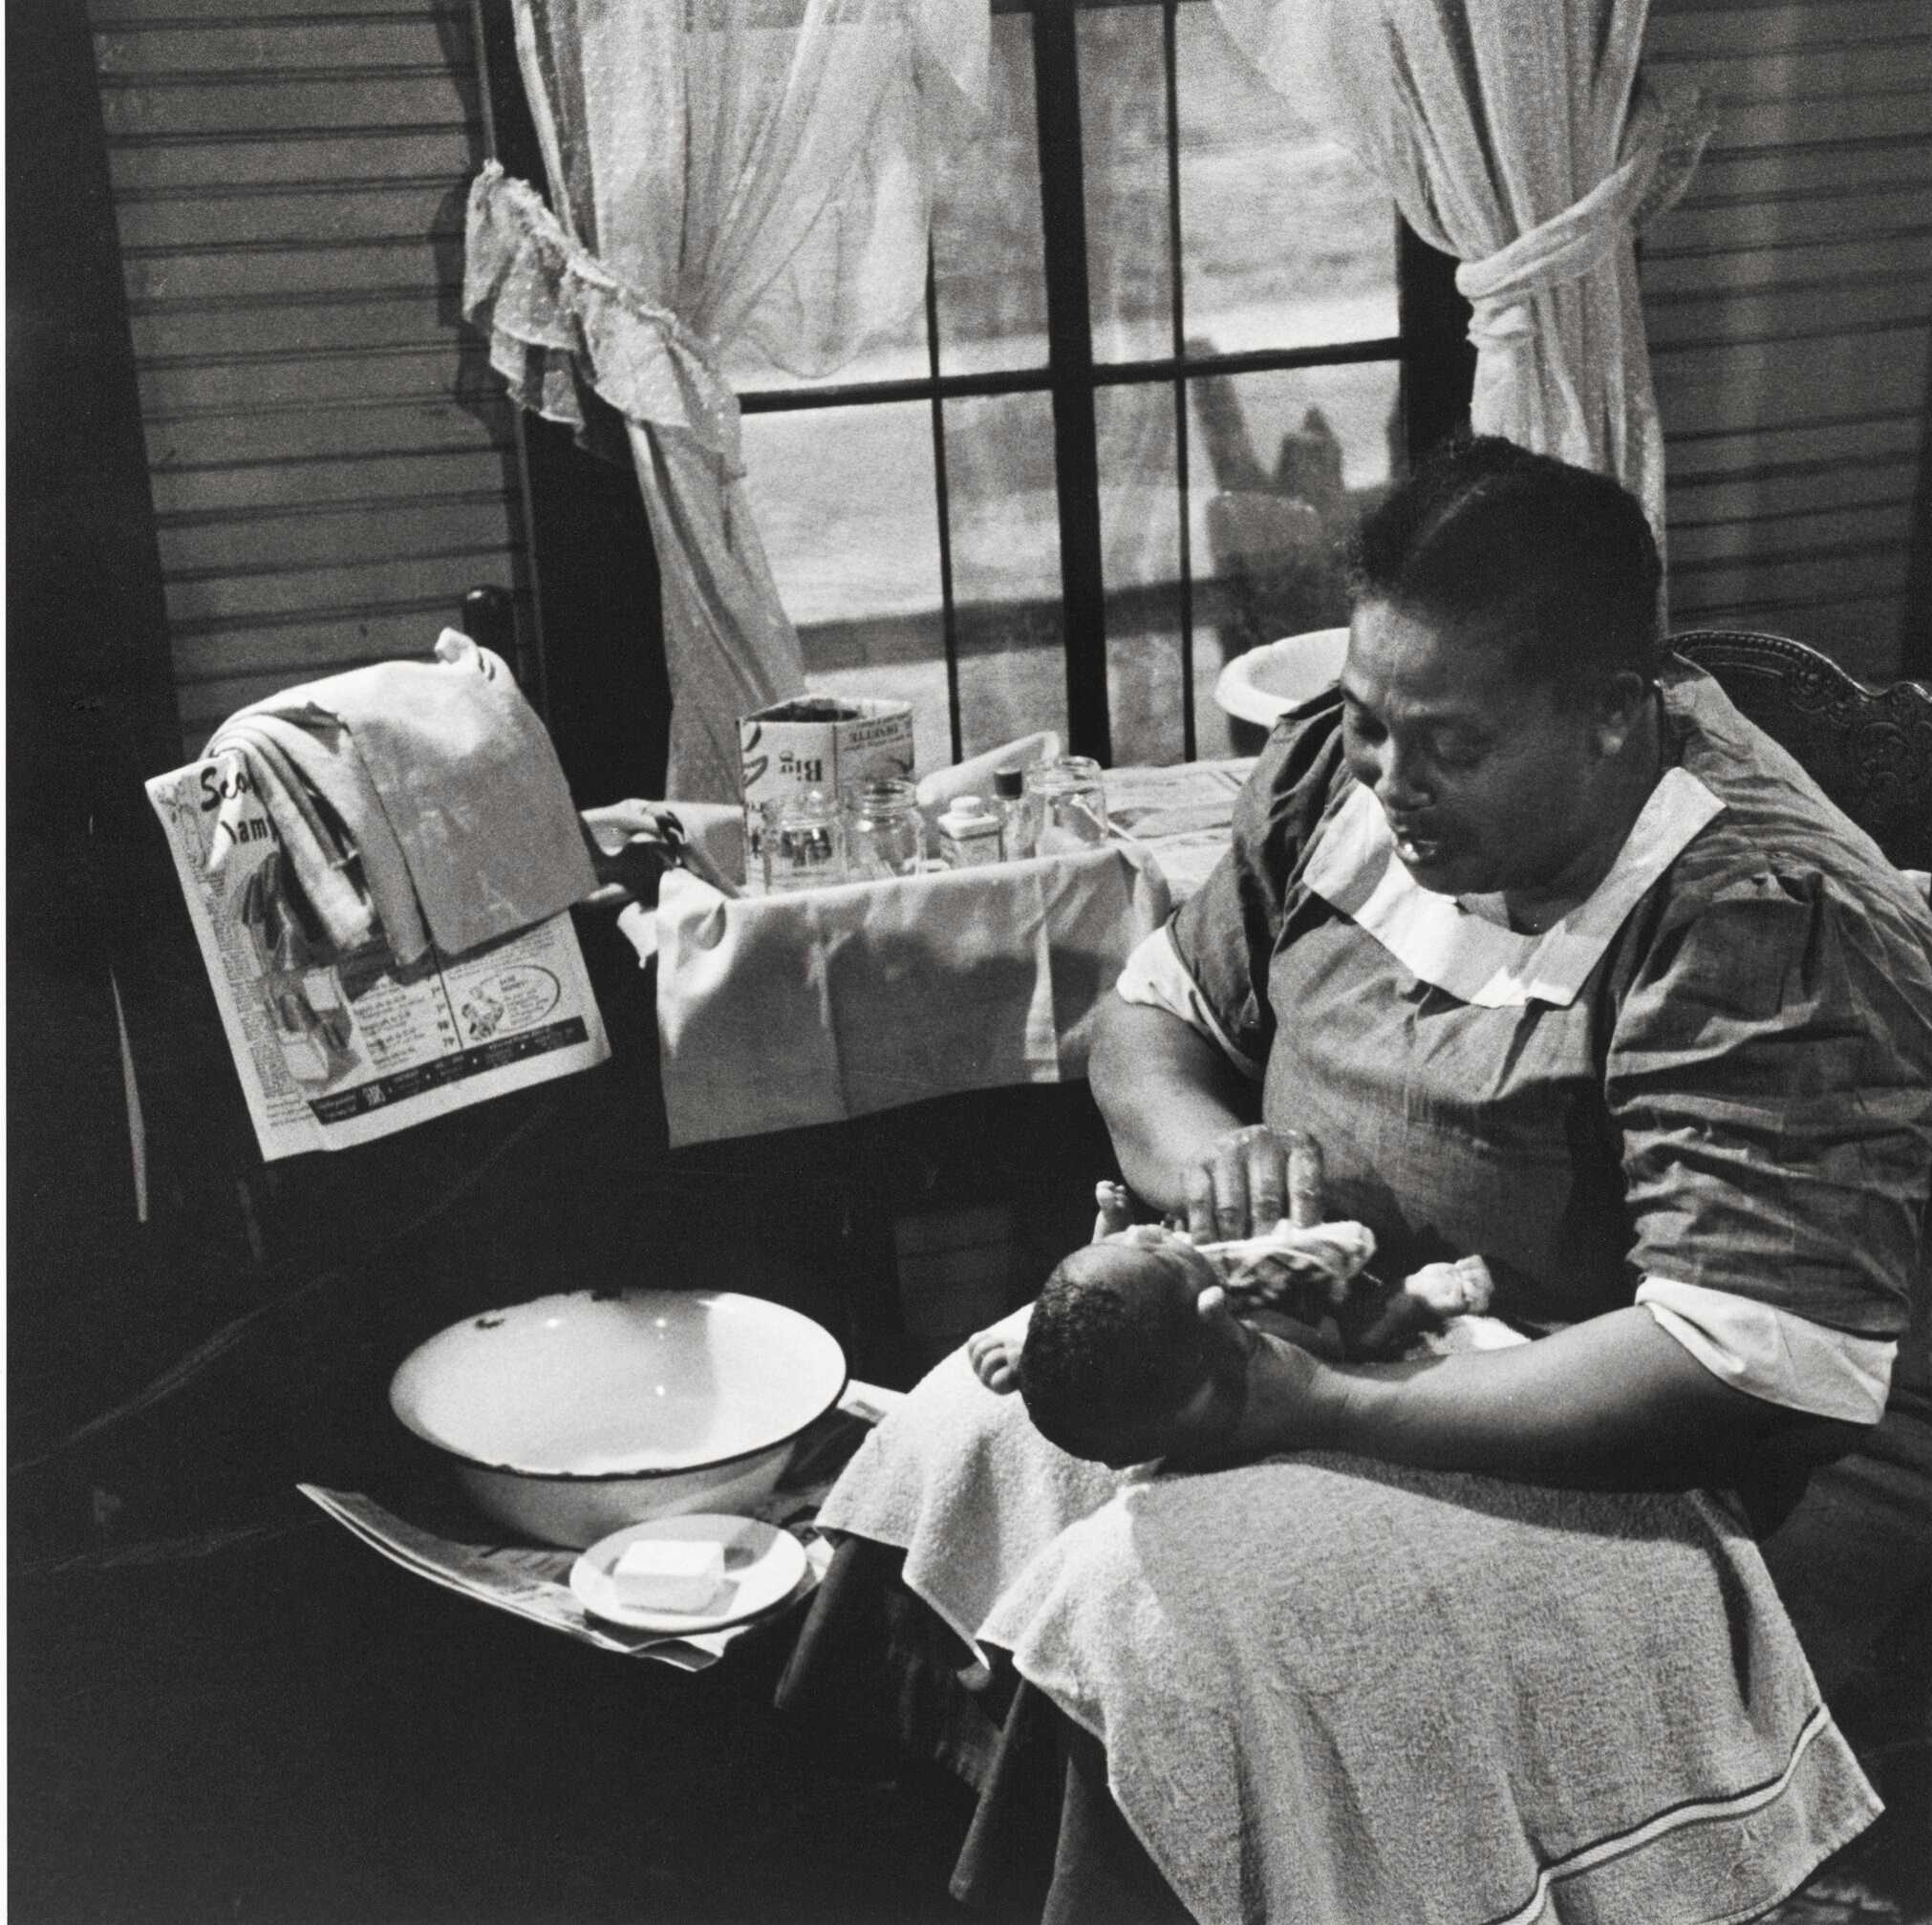
Midwifery in the 20th century
until the mid-1930’s, the majority of working-class women in Britain were attended in childbirth not by a professional but by a local woman” (Leap and Hunter 1993:1).
Developer in midwifery in the 20th century reflects the ongoing struggle for recognition and status.
Women didn’t always get the rightful choice of who helps deliver their baby

Slide 4
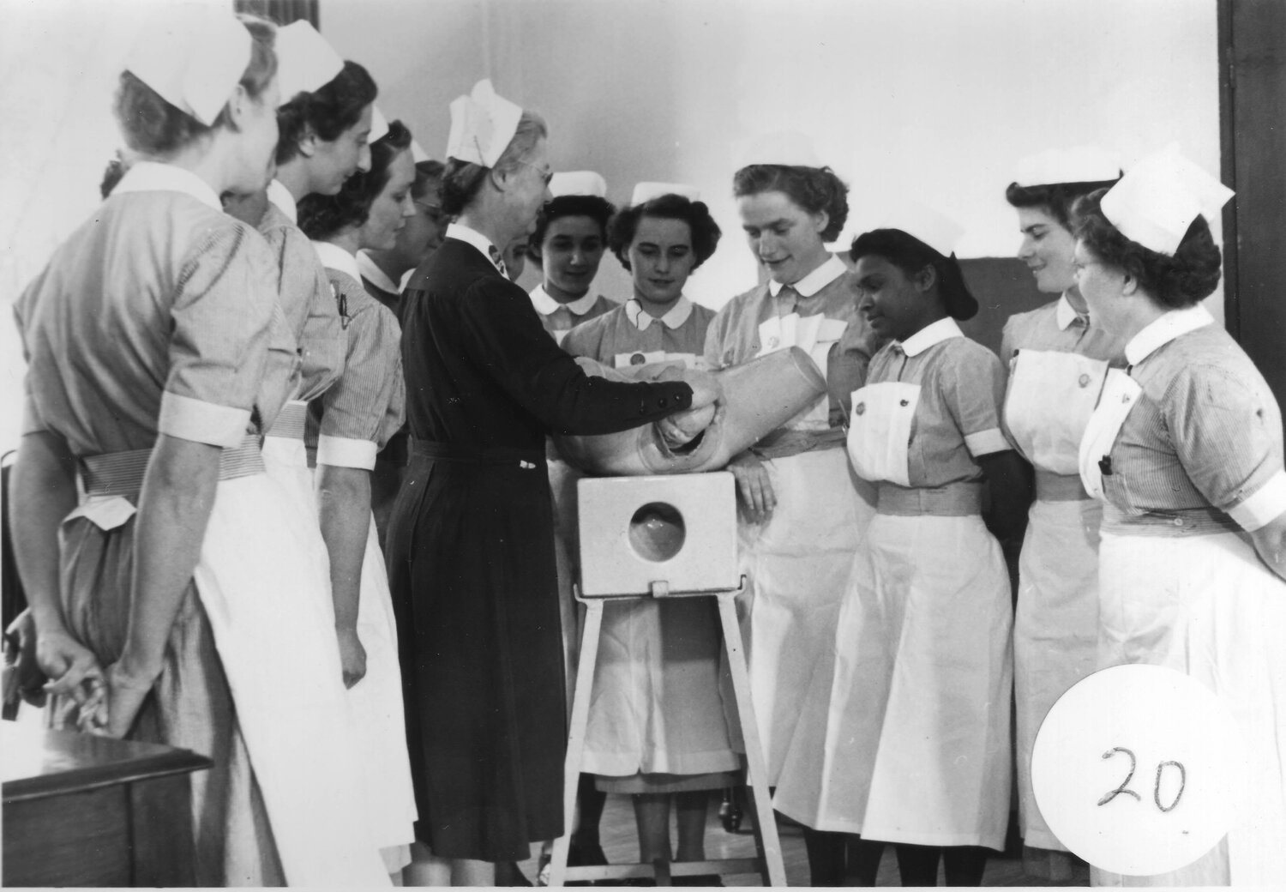
Midwifery in the 20th century
The National Health Service (NHS) Act in 1946 provided free access for all women to doctors as well as midwives;
There is considerable evidence of the positive impact of midwifery care on outcomes for women having babies.
However the future of midwifery practice will need to continue to change as resources, expectations and opportunities do.
(Cochrane Review, Sandall 2015).

Slide 5

Midwifery in the 21st century
Women are now given choices regarding their care and birth settings.
Midwifery practices is regulated by the nursing council to ensure midwives are properly trained and registered.
Midwives provide care in various settings such as, birth centres, patient homes etc.

Slide 6

Midwifery in the 21st century positive changes
Improving maternal health
Increasing accessibility
Educating and empowering women
Promoting continuity of care

Slide 7


Slide 8
Reference list
Social History of Medicine, Volume 25, Issue 2, May 2012, Pages 380–399, https://doi.org/10.1093/shm/hkr138
Published:
23 October 2011
Clair border 23 January 2024 performances of maternity services in England

