Slide 1




Research Methods
Qualitative

Slide 2

REASEARCH METHODS
If we think of a research project as a new house, then at this stage, you will have already drawn up the building plans – ontology, epistemology, methodology –
and now you must decide which tools you need to build the house.
Notes:
Many students make the mistake of deciding their methods before they have the design in place. It’s important therefore that your methods follow your design and that the methods which you choose are the tools suitable for testing you’re your hypothesis or research question.

Slide 3

Notes:
Many students make the mistake of deciding their methods before they have the design in place. It’s important therefore that your methods follow your design and that the methods which you choose are the tools suitable for testing you’re your hypothesis or research question.

Slide 4
Step One: Choose your Research Paradigm
Post-Positivistic
Quantitative
Constructivist
Qualitative
Pragmatism
Mixed Methods

Slide 5
Notes:
Many students make the mistake of deciding their methods before they have the design in place. It’s important therefore that your methods follow your design and that the methods which you choose are the tools suitable for testing you’re your hypothesis or research question.

Slide 6
Ontology
In social science and education studies, ontology refers to the study of what exists or what is considered “real” in the social world — for example, whether social phenomena (like learning or identity) exist independently of individuals or are created through human interaction. It shapes how researchers understand the nature of reality and, consequently, how they approach their investigations.

Slide 7
Epistemology
In social science and education studies, epistemology concerns how we come to know and understand the world — what counts as valid knowledge and how that knowledge is acquired. It shapes the researcher’s approach to evidence, interpretation, and the relationship between what’s known and what is being studied.

Slide 8
Paradigm
A paradigm is a framework or overarching worldview that guides how research is understood and conducted — including its assumptions about reality (ontology), knowledge (epistemology), and methods. It shapes the kinds of questions researchers ask, how they interpret data, and what they consider to be valid evidence.

Slide 9
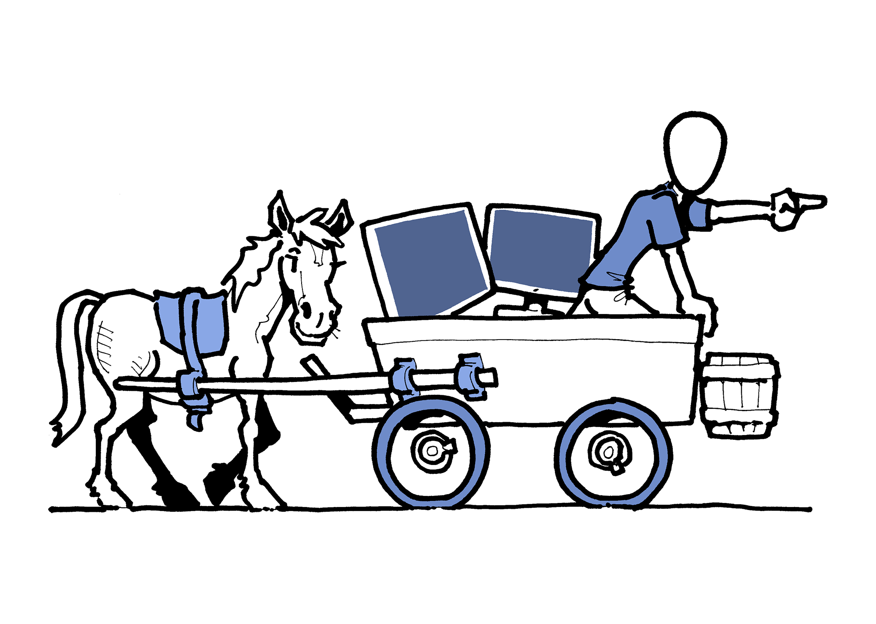
Your research question(s)/hypothesis are the horse and your methods are the cart –
Your methods must follow from the question you wish to ask or the hypothesis you wish to test.

Slide 10

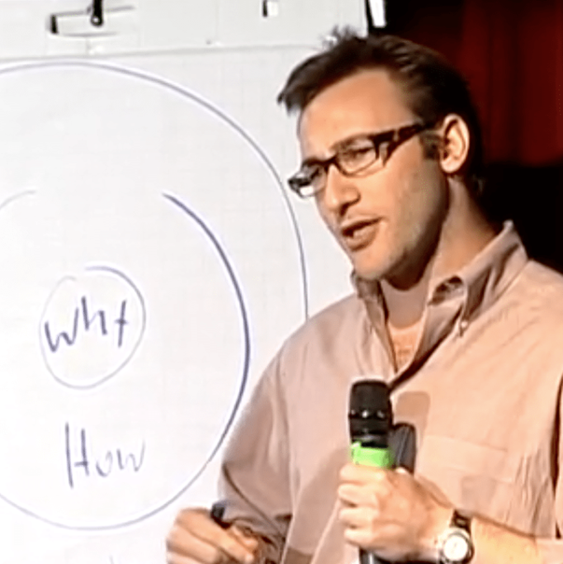
Simon Sinek
Notes:
If we understand WHY it encourages us to “Delve deeper and linger longer”. You will be spending hours on your dissertation so it’s therefore very very important that you have a clarity and you have really thought out what your going to do. My PhD changed as I went on.

Slide 11

Simon
Sinek –
WHY?

Slide 12
Research Methods
In order to undertake your research
you need to identify the methods you will be adopting:
Methods is concerned with
how you will turn research questions into answers
and is closely linked to the purpose of your research.

Slide 13
Step One: Choose your Research Paradigm
Post-Positivistic
Quantitative
Constructivist
Qualitative
Pragmatism
Mixed Methods

Slide 14
Step Two Choose your Research Method – Strategy 1. or 2.
1. Qualitative Examples
In-depth interviews
Focus groups
Observation
Surveys
Secondary research
Ethnography
Action Research
2. Quantitative Examples
Surveys
Experiment
Systematic observation
Secondary research

Slide 15
Criticism
Some academics have called for a relaxing of the qualitative/ quantitative research distinction because they can militate against effective research.
Punch (2009) & Connolly (2016)
Methods which generally generate words.
Methods which generally generate numbers.
Methods which can generate either words or numbers.
Notes:
Palaiologou, I (2016) Doing Research in Education. London: SAGE; Punch K.F. (2009) Introduction to Research Methods in Education. London: SAGE

Slide 16


Slide 17

Open questions
Dependable
Qualitative
Qualitative data
Numeric data
Closed questions
Quantitative
Valid
Survey
In-depth interviews

Slide 18
Open
questions
Qualitative
data
In-depth
interviews
Qualitative
Valid
Closed
questions
Numeric
data
Quantitative
Dependable
Survey

Slide 19

“Not everything that can be counted counts, and not everything that counts can be counted”
Discuss
Albert Einstein

Slide 20
Step 3. Choose your Method Examples
Post-Positivistic Quantitative
A Survey Design
Highly Structured Questionnaires
Constructivism
Qualitative
A Case Study Design
Multiple methods of data collection - Interviews, Participant Observation. Documents
Pragmatic
Mixed Methods
See earlier examples
Both quantitative and qualitative methods adopted

Slide 21

1). STRATERGIES of
INQUIRY

Slide 22
Strategies of Inquiry
Qualitative Examples
Case Study
Ethnography
Phenomenology
Life History
Clinical Research
Action research

Slide 23
Ethnography
Data collected through observations and interviews, which are then used to draw conclusions about how societies and individuals function.
Principles
Methods
Focuses on the social interaction of people in a given environment. And an understanding of their culture, norms….
Context specific: e,g a culture, organisation , village , community ….
Immersive : It provides the researcher with an understanding of how those people / culture see the world and how they interact with everything around them.
Participant observation which might include the following:
  Observation
  Unstructured conversations, interviews
  Living in a community and experiencing everyday life
  Documentary analysis
  Artefacts

Slide 24


Slide 25
Phenomenology
Understanding the lived experiences of participants, and interpreting these experiences as a researcher
Principles
Methods
In-depth understanding of the lived experience of people to understanding a phenomena e.g. anger, happiness etc
It aims to describe, understand and interpret the meanings of experiences of human life.
It focuses on research questions such as what it is like to experience a particular situation. ... Phenomenology has roots in both philosophy and psychology
In-depth Interviews:
  Unstructured
  Structured
Focus Groups

Slide 26


Slide 27


Slide 28
Participatory Action Research
Action research is a research method that aims to simultaneously investigate and solve an issue.
Principles
Methods
A democratic approach, researching own practice or engaging and facilitating research with practitioners themselves
Anticipation that the knowledge produced will be acted upon to improve practice/outcomes
Methodological tools for data collection can be diverse ,
Depending on your problem / research issue you could choose to use Qualitative or Quantitative methods

Slide 29


Slide 30
TASK
Skim read The National Strategy for Educational Research and Enquiry (NSERE): and makes notes on the following: (MOODLE)
Introduction
Aims and Objectives
Evidence Informed Education

Slide 31



Slide 32
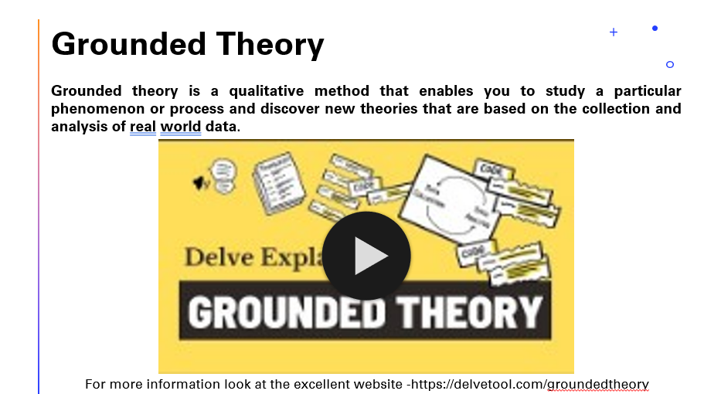
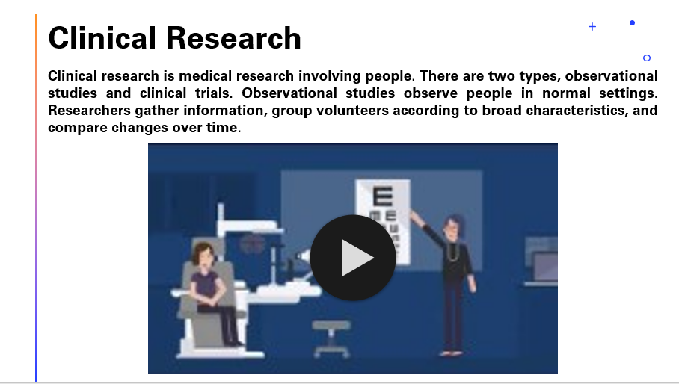
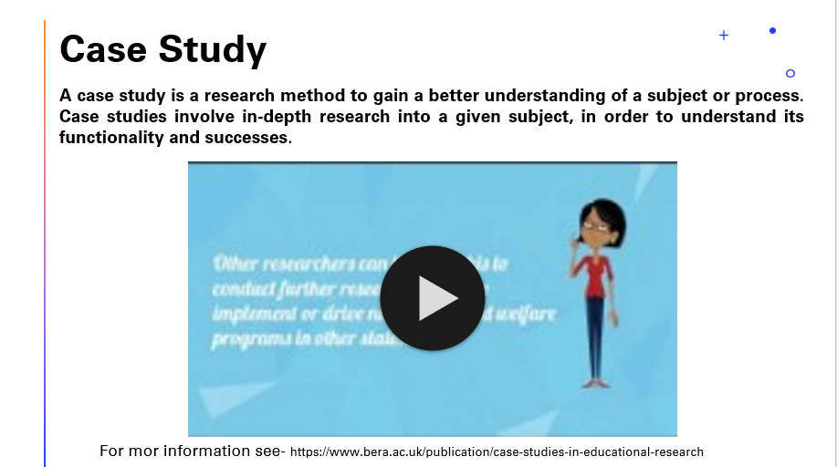
See the video’s at the
end of the presentation

Slide 33
2). Research methods qualitative

Slide 34
Qualitative Methods
The actual tools/steps taken when you conduct research into a subject or a topic.
Interviews
Focus Groups
Observation
Documentary Analysis

Slide 35
Interviews
In-depth interview
The in-depth interview is one of the most common types of qualitative research methods. It involves a personal interview with a single person.
This method provides a great opportunity to capture rich, descriptive data about people’s behaviours, beliefs etc.
Depth interviews are typically performed face to face. In addition, you can pay attention to the body language to understand better his/her answers.
Interviewing takes time to organize.

Slide 36
Pros and Cons
Consider the Pros and Cons of an Interview ?

Slide 37
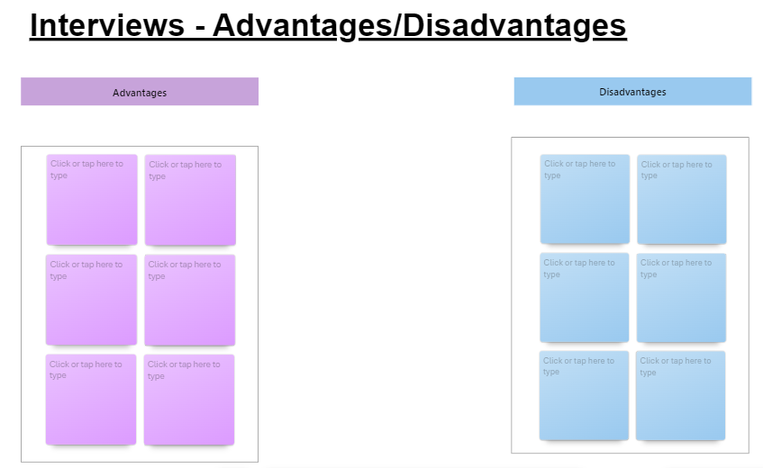

Slide 38
Advantages
Disadvantages
Information is gathered directly from knowledgeable people.
There is flexibility to explore new ideas and issues that were not anticipated during the research design.
Inexpensive and simple to conduct.
Glimpse into respondents' tone, gestures.
Deep and free response
Not appropriate if quantatative data is needed.
May be biased if informants are not carefully selected.
Can be susceptible to interviewer biases.
May be difficult to prove validity of findings.

Slide 39
Focus Groups
Focus Groups
Focus groups are facilitated group discussions. The facilitator is the person guiding the discussion. Carry out a focus group study if you want to understand people’s views and experiences.
A focus group normally includes a limited number of participants (around 6 to 12 from) within your target market.
Focus groups use group dynamics to get shared experiences of people with similar characteristics. This is different from an interview study, where the focus is on individuals.
Use focus groups when: you want to get a breadth of understanding you have open-ended questions about your phenomena

Slide 40
Advantages
Disadvantages
group dynamics can promote discussion and debate
they provide a breadth of shared experiences from people with similar characteristics
Confirms insights obtained through other qualitative methodologies.
Higher potential for insights.
staff needed – you will need a facilitator who encourages discussion and possibly also a separate note-taker
it might be difficult to get the users you need together in one room at the same time
Focus group studies are not a time-saving alternative to interview studies.

Slide 41
Observation
Observation
A choice between Non-participant observation. Researcher is not part of the activity taking place, but simply observes. Participant observer. Researcher takes part in community, organization, or activity. Researcher attempts to learn what it is like to be part of the community, organization, or participate in the activity.
Overt / covert? If you are an overt, non-participant observer (i.e. ‘fly-on-the wall), how will you deal with interested children

Slide 42
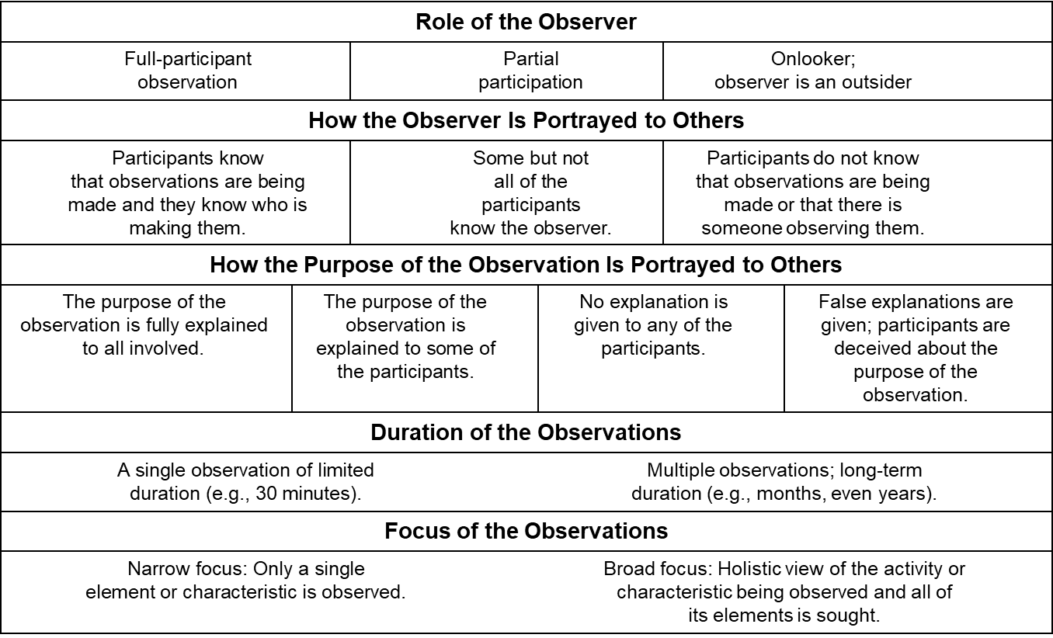

Slide 43

How well do you observe?

Slide 44
How well do you observe?
How many chairs? What colour are they?
6 Red, Yellow, Green/Blue, Purple
What did the signs say
  Thou shalt not park, Phillips 66, No Hunting, No Lifeguard on Duty, Exit
What did you see in the background?
Road, Hills
What sort of place are you ?
Garage, Dr. Surgery, House
How does the picture make you feel?

Slide 45
Advantages
Disadvantages
Observation research provides the researcher the opportunity to watch what people actually do rather than relying on reports of what they say they do.
This approach can avoid much of the biasing factors caused by the interviewer and question structure associated with the survey approach.
Only behavior and physical personal characteristics can usually be examined. The researcher does not learn about motives, attitudes, intentions, or feelings.
Observation research can be time consuming and costly if the observed behavior occurs rather infrequently.
Interpretation of data may be a problem
Possible invasion of privacy
What are the ethical issues???

Slide 46
Extra Help with
Stratergies

Slide 47

Grounded Theory
Grounded theory is a qualitative method that enables you to study a particular phenomenon or process and discover new theories that are based on the collection and analysis of real world data.
For more information look at the excellent website -https://delvetool.com/groundedtheory

Slide 48

Case Study
A case study is a research method to gain a better understanding of a subject or process. Case studies involve in-depth research into a given subject, in order to understand its functionality and successes.
For mor information see- https://www.bera.ac.uk/publication/case-studies-in-educational-research

Slide 49

Clinical Research
Clinical research is medical research involving people. There are two types, observational studies and clinical trials. Observational studies observe people in normal settings. Researchers gather information, group volunteers according to broad characteristics, and compare changes over time.

