Slide 1
HPAH5046/6046
The Life and Times of Caesar and Cicero
The Second Triumvirate

Slide 2
Sources for the Second Triumvirate
Augustus (AD 14), Res Gestae
Suetonius (ca. likely written after AD 120), Life of Divus Augustus.
Plutarch (written in early second century AD), Life of Antony.
Appian (lived AD 95-165), The Civil Wars.
Cassius Dio (lived AD 155-235?), Roman History.
Cicero’s Letters end in 43 BC (for obvious reasons).

Slide 3
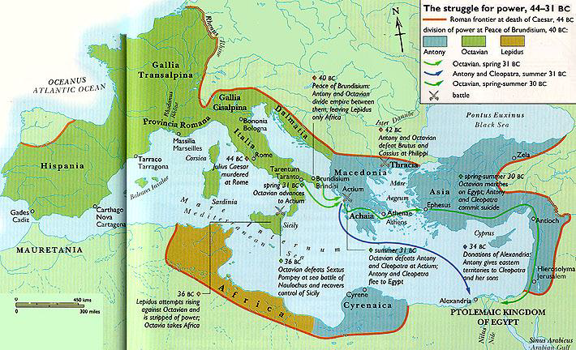
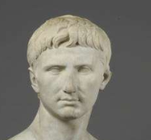
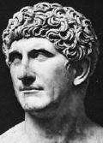
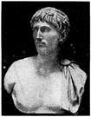
The Treaty of Brundisium – 40 BC

Slide 4
Key events
Sextus Pompey comes back from Spain and seizes Sicily – put on list of the proscribed.
  Followers from proscribed, fugitives, slaves, remnants of Pompeian faction.
  Fleet largely manned by slaves.
  Disruption of grain shipments to Rome.
40 BC: Antony marries Octavia (Octavian’s sister).
In 39 BC triumvirs acknowledge position of Sextus Pompey in Sicily, Sardinia and Corsica.
37 BC: Triumvirate renewed (5 years). Agrippa trains a new fleet. Antony begins a relationship with Cleopatra and starts his unsuccessful Parthian Campaign.

Slide 5
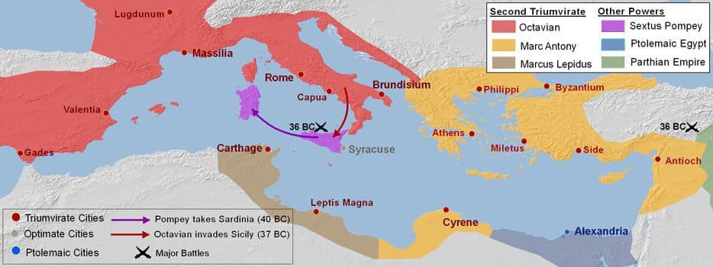

Slide 6
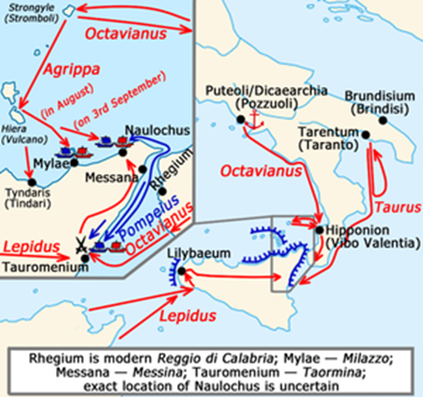
Sextus Pompey’s last stand
Relations breakdown quickly, damaging conflict involving 200,000 men and 1,000 ships.
Final defeat of Sextus Pompey in 36 BC (he is killed in 35 BC).
“Having thus spoken, he exacted tribute from Sicily to the amount of 1600 talents, appointed propraetors for Africa and Sicily, and assigned a division of the army to each of these provinces.” – Appian Civils Wars 5.129.

Slide 7
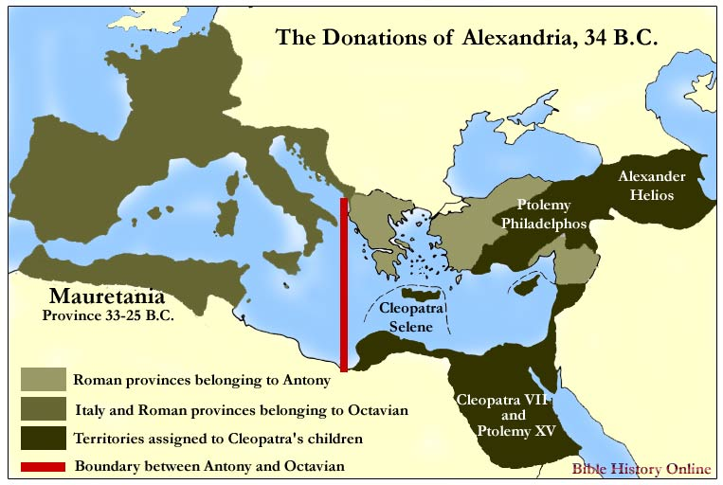
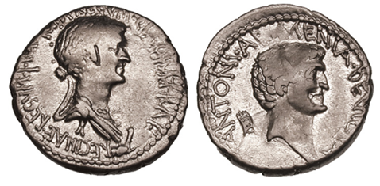
Donations of Alexandria
“…in the first place he declared Cleopatra Queen of Egypt, Cyprus, Libya, and Coele Syria, and she was to share her throne with Caesarion. Caesarion was believed to be a son of the former Caesar, by whom Cleopatra was left pregnant. In the second place, he proclaimed his own sons by Cleopatra Kings of Kings, and to Alexander he allotted Armenia, Media and Parthia (when he should have subdued it), to Ptolemy Phoenicia, Syria, and Cilicia.” – Plutarch Antony 54.4.
Mark Antony & Cleopatra. 34 BC. AR Denarius. Alexandria mint. Bust of Cleopatra draped & diademed; bare head of Antony right; Armenian tiara behind – RSC 1.

Slide 8
Strained relations
“It was deposited in the hands of the vestal virgins, who refused to deliver it up, and sent word to Caesar, that if he wished he should come and seize it himself, which he did… Caesar specially pressed what Antony said in his will about his burial; for he had ordered that even if he died in the city of Rome, his body, after being carried in state through the forum, should be sent to Cleopatra at Alexandria.” – Plut. Antony 58.3-4.
32 BC: Antony divorces Octavia.
  “As for Octavia, she was thought to have been treated with scorn….” – Plut. Antony 54.1.
32 BC: Octavian reads Antony's will in the Senate. The Senate declares war on Egypt and Cleopatra.

Slide 9
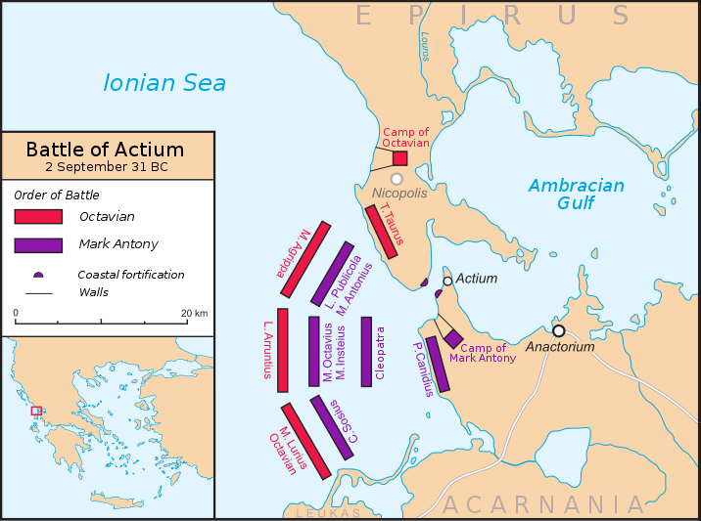
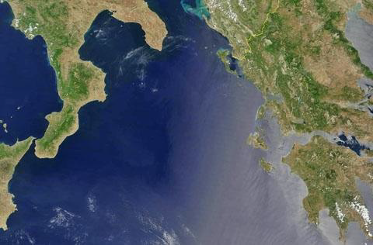
Battle of Actium
“[Antony] …running himself through the belly he dropped upon the couch. But the wound did not bring a speedy death. Therefore, as the blood ceased flowing after he had lain down, he came to himself and beseeched the bystanders to give him the finishing stroke. But they fled from the chamber, and he lay writhing and crying out, until Diomedes the secretary came from Cleopatra with orders to bring him to her in the tomb.” – Plutarch Antony 76.4-5.
2nd of September 31 BC.
Antony’s ships bigger and sturdier – Octavian’s speedier.
Octavian attempts to encircle Antony’s ships.
Octavian’s tactics ramming.
Antony’s tactics to use volleys of missiles and to use grappling hocks.
Cleopatra prematurely retreats.
Use of flaming missiles and jars of charcoal and pitch.

Slide 10
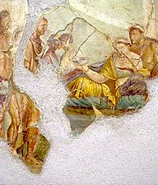
Death of Cleopatra
“It is said that the asp was brought with those figs and leaves and lay hidden beneath them… and baring her arm she held it out for the bite. But others say that the asp was kept carefully shut up in a water jar, and that while Cleopatra… irritating it with a golden distaff it sprang and fastened itself upon her arm. But the truth of the matter no one knows; for it was also said that she carried about poison in a hollow comb and kept the comb hidden in her hair.” – Plutarch Antony 86.1-2.
House of Giuseppe II, Pompeii

Slide 11
Bibliography
Draycott, J. 2022. Cleopatra’s Daughter. Art Apollo Book.
Sampson, G. C. 2017. Rome, Blood & Politics: Reform, Murder and Popular Politics in the Late Republic 70-27 BC. Pen & Sword.

