Slide 1
BMHP5016
Principles of Health & Social Care
Theories on Human Growth and Development

Slide 2
Growth and Development
Human growth and development are important to the principles of health and social care because they provide a foundation for delivering personalized and effective care that addresses the specific needs of individuals at different stages of life.
This knowledge enables care providers to promote well-being, support independence, and enhance the overall quality of life for their clients.

Slide 3
Growth and Development
Growth and development occur across the life stages and focuses on the physical, intellectual, emotional and social changes that humans go through.

Slide 4
GROWTH
Growth predominately concentrates on the physical changes that take place across different parts of the body.
Growth is measured using a range of intervals such as height and weight. Centile charts are used to measure changes in growth.
Different centile charts are used to measure the height and weight of boys and girls because of the difference in growth patterns, for example, boys tend to be heavier and taller.

Slide 5
DEVELOPMENT
Development refers to the orders of sequence that humans follow and mainly focuses on the attainment of skills and abilities.
The main developmental milestones are physical, social, intellectual and emotional.

Slide 6

Online Activity
Complete the online activities related to growth and development:
https://www.healthandcarelearning.wales/resources/gcse-hsc-childcare-double-award-unit-1-211-human-development-across-the-lifecycle/

Slide 7
Importance of Milestones
Health and Social Care professionals use growth and developmental milestones in order to measure whether an individual is in line with the expectation of others at the same age.
If an infant or child is not meeting a specific milestone, such as an infant still not being able to sit up by 12 months, this may indicate a developmental condition that requires further investigation.

Slide 8
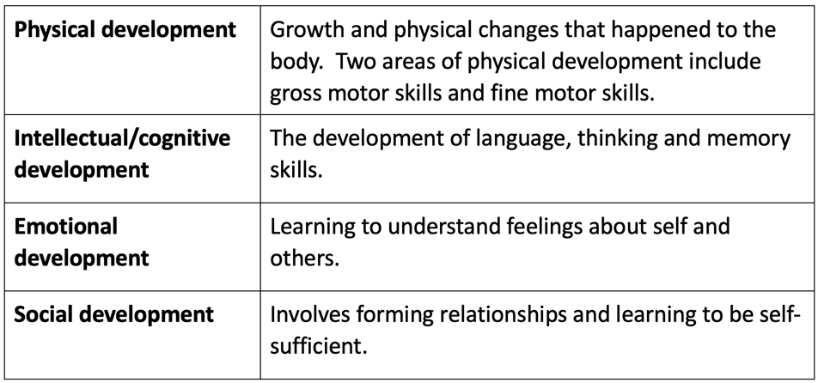
Types of Development:

Slide 9
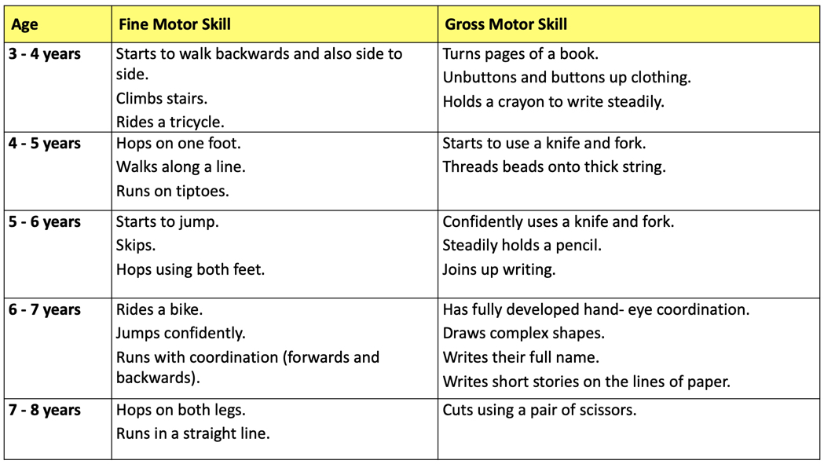
Physical Development in Early Childhood (3-8 years)

Slide 10
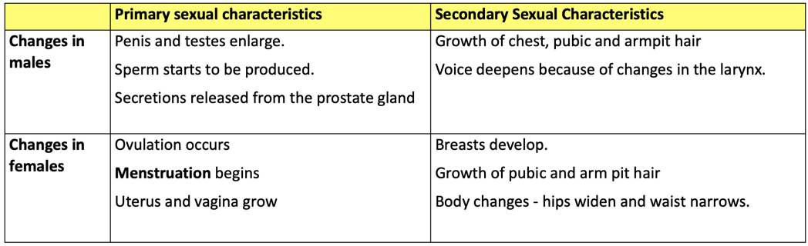
Physical Development in Adolescence
(9-18 years)

Slide 11
When are you an adult?
https://www.youtube.com/watch?v=AESkozhaT4s

Slide 12
Physical Changes in Early Adulthood (19-45 years)
During early adulthood stage an individual reaches physical maturity (by the age of 28). This is known as maturation. Adults have reached their peak level of physical strength and their full height and weight by this time. As the adult reaches the end of this life stage, stamina and strength start to slowly decline :(
Characteristics of Physical Maturity During Early Adulthood include:
Hand-eye coordination is at its best
Individuals have grown to full height
Maximum physical strength and stamina have been reached
Women are at their most fertile
Later phase of early adulthood, perimenopause may occur

Slide 13
Physical Changes in Later Adulthood (65+ years)
As individuals age, the likelihood of infections and diseases increases. This can be because of changes to organs such as the heart and the musculoskeletal system.
Along with this stamina, strength and suppleness starts to decline, alongside mobility and use of fine motor skills that control coordination and dexterity.

Slide 14
Examples of Physical Change in Adults 65+
Stamina, strength and suppleness start to decline
Mobility becomes more of a challenge
Difficulties with fine motor skills that control coordination and dexterity
Skin loses elasticity, resulting in wrinkles
Hearing loss
Greying and thinning of hair
Eyesight deteriorates
Hair loss.
Difficulty with gross motor skills

Slide 15
The Impact of Ageing
During later adulthood, an individual may experience a deterioration in their cognitive ability. Ageing influences how the individual processes information which affects their memory and recall of information.
The older population are more likely to suffer falls because of a deterioration in mobility and balance. Senses also start to deteriorate which results in poor sight and hearing.

Slide 16
The Impact of Ageing
However, there is an increase in the UK of people in later adulthood taking up gentle exercise to combat illness and keep in physical shape. Swimming and taking part in gentle circuit exercise can help maintain good heart health and coordination.
Exercise also improves positive mental health and increases social interaction.
The improved understanding, we now have about food and nutrition ensures that people within later adulthood can sustain a healthy lifestyle. The combination of exercise and diet can result in longevity.
Independently research a UK initiative that increases the health and well being of the elderly population

Slide 17
Intellectual Development
Intellectual development refers to the development of language, memory and thinking skills.
There are a number of different types of intellectual development, they include:
Memory
Moral development
Problem solving
Language development
Abstract thinking

Slide 18
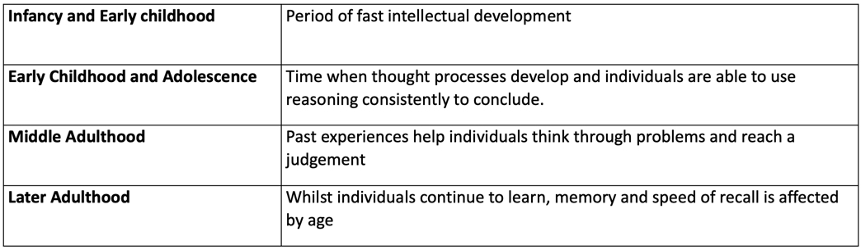
Stages of Intellectual Development During Each Life Stage

Slide 19
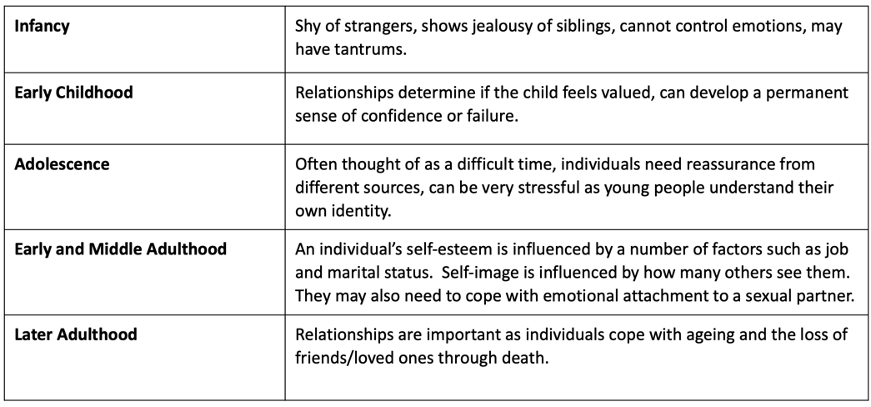
Emotional Development

Slide 20
Understanding Child Brain Development
https://learning.nspcc.org.uk/child-health-development/childhood-trauma-brain-development

Slide 21

Importance of Milestones
Choose a milestones activity to complete – ensure you answer the questions
Feedback some findings to the class
Emotional Development | Human Development Across the Life Cycle (uk.s3.amazonaws.com)

Slide 22
Some BIG Theories
-Freud's Stages of Psychosexual Development
-Erik Erikson's Theory of Psychosocial Development
-Piaget's Theory of Cognitive Development
-Kohlberg’s Theory of Moral Development

Slide 23
Research Activity
-Freud's Stages of Psychosexual Development
-Erik Erikson's Theory of Psychosocial Development
- Piaget's Theory of Cognitive Development
-Kohlberg’s Theory of Moral Development
Research how these theories can be used to inform health and social care practice

Slide 24
Freud's Stages of Psychosexual Development
Proposed by psychoanalyst Sigmund Freud(1856-1939), the theory of psychosexual development describes how personality develops during childhood. While the theory is well-known in psychology, it is also one of the most controversial.
Freud believed that personality develops through a series of childhood stages in which the pleasure-seeking energies of the id become focused on certain erogenous areas.
This psychosexual energy or libido (sexual drives or instincts) is described as the driving force behind behaviour.

Slide 25
Freud's Stages of Psychosexual Development
These are called psychosexual stages because each stage represents the fixation of libido on a different area of the body.
As a person grows physically certain areas of their body become important as sources of potential frustration (erogenous zones),pleasure or both.

Slide 26
More Freud
Freud believed that life was built round tension and pleasure. He also believed that all tension was due to the build up of libido (sexual energy) and that all pleasure came from its discharge.
Psychoanalytic theory suggested that personality is mostly established by the age of five. Early experiences play a large role in personality development and continue to influence behaviour later in life. If these psychosexual stages are completed successfully, the result is a healthy personality.
If certain issues are not resolved at the appropriate stage, fixation can occur. A fixation is a persistent focus on an earlier psychosexual stage.
Until this conflict is resolved, the individual will remain "stuck" in this stage.
For example, a person who is fixated at the oral stage may be over-dependent on others and may seek oral stimulation through smoking, drinking, or eating.

Slide 27
Erik Erikson's Theory of Psychosocial Development
Erik Erikson's (1902-1994) theory of psychosocial development is one of the best-known theories of personality in psychology.
Much like Sigmund Freud, Erikson believed that personality develops in a series of stages.
Unlike Freud's theory of psychosexual stages, Erikson's theory describes the impact of social experience across the whole lifespan.

Slide 28
Erik Erikson's Theory of Psychosocial Development
One of the main elements of Erikson's psychosocial stage theory is the development of ego identity.
Ego identity is the conscious sense of self that we develop through social interaction.
According to Erikson, our ego identity is constantly changing due to new experiences and information we acquire in our daily interactions with others

Slide 29
Erikson's Theory of Psychosocial Development Contd…
In addition to ego identity, Erikson also believed that a sense of competence motivates behaviours and actions. Each stage in Erikson's theory is concerned with becoming competent in an area of life.
If the stage is handled well, the person will feel a sense of mastery, which is sometimes referred to as ego strength or ego quality.
If the stage is managed poorly, the person will emerge with a sense of inadequacy.

Slide 30
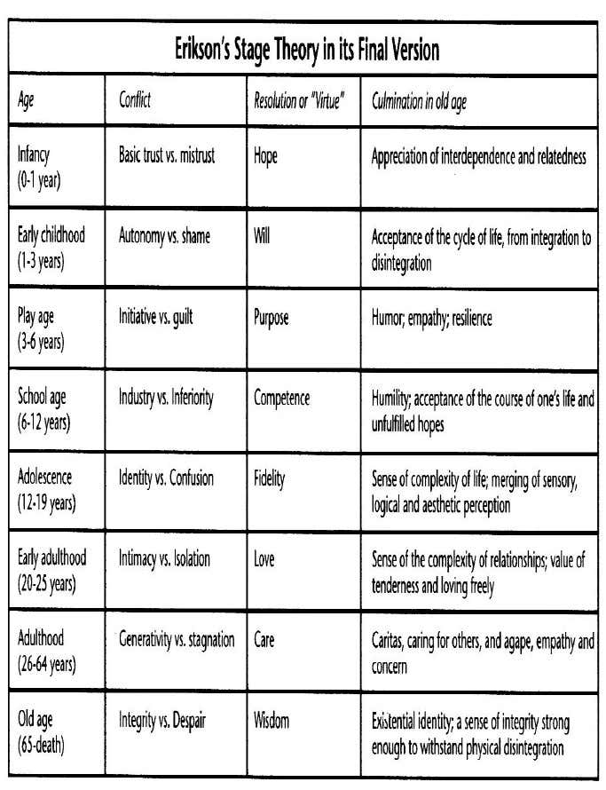
Erikson's Theory of Psychosocial Development

Slide 31
Piaget's Theory of Cognitive Development
https://www.youtube.com/watch?v=IhcgYgx7aAA

Slide 32
Kohlberg's Theory of Moral Development
Moral development is a major topic of interest in both psychology and education. One of the best known theories was developed by psychologist Lawrence Kohlberg(1927-1987) who modified and expanded upon Jean Piaget's work to form a theory that explained the development of moral reasoning.
Kohlberg's theory of moral development outlined six stages within three different levels. Kohlberg extended Piaget's theory, proposing that moral development is a continual process that occurs throughout the lifespan.

Slide 33
"The Heinz Dilemma” (example)
A woman was near death from cancer. There was one drug that the doctors thought might save her. It was a form of radium that a chemist in the same town had recently discovered. The drug was expensive to make, but the chemist was charging ten times what the drug cost him to make.
He paid $200 for the radium and charged $2,000 for a small dose of the drug. The sick woman's husband, Heinz, went to everyone he knew to borrow the money, but he could only get together about $ 1,000 which is half of what it cost. He told the chemist that his wife was dying and asked him to sell it cheaper or let him pay later. But the chemist said: "No, I discovered the drug and I'm going to make money from it." So Heinz got desperate and broke into the man's store to steal the drug-for his wife. Should the husband have done that?" (Kohlberg, 1963).

Slide 34
More Heinz
Kohlberg was not interested so much in the answer to the question of whether Heinz was wrong or right, but in the reasoning for each participant's decision.
The responses were then classified into various stages of reasoning in his theory of moral development.

Slide 35
Level 1: Pre-conventional Morality
Stage one: Obedience and Punishment:
The earliest stage of moral development is especially common in young children, but adults are also capable of expressing this type of reasoning. At this stage, children see rules as fixed and absolute. Obeying the rules is important because it is a means to avoid punishment.
Stage 2 - Individualism and Exchange
At this stage of moral development, children account for individual points of view and judge actions based on how they serve individual needs. In the Heinz dilemma, children argued that the best course of action was the choice that best-served Heinz’s needs. Reciprocity is possible at this point in moral development, but only if it serves one's own interests.

Slide 36
Level 2: Conventional Morality
Stage 3: Interpersonal Relationships
Often referred to as the "good boy-good girl" orientation, this stage of moral development is focused on living up to social expectations and roles. There is an emphasis on conformity, being "nice," and consideration of how choices influence relationships.
Stage 4: Maintaining Social Order
At this stage of moral development, people begin to consider society as a whole when making judgments. The focus is on maintaining law and order by following the rules, doing one’s duty and respecting authority.

Slide 37
Level 3: Post-conventional Morality
Stage 5: Social Contract and Individual Rights
At this stage, people begin to account for the differing values, opinions and beliefs of other people. Rules of law are important for maintaining a society, but members of the society should agree upon these standards.
Stage 6: Universal Principles
Kolhberg’s final level of moral reasoning is based upon universal ethical principles and abstract reasoning. At this stage, people follow these internalized principles of justice, even if they conflict with laws and rules.

Slide 38
The final stage of human development
Dying is a natural part of the human life cycle and human development. Human development encompasses the entire lifespan, from birth to death, and each stage in this cycle has its unique characteristics, challenges, and milestones. Dying is the final stage of human development, representing the end of life.

Slide 39
Coping with grief and loss
Grief is a subjective state of emotional, physical and social responses to the loss of a valued entity.
The loss may be real e.g. death of a loved one, loss of personal possessions or it may be perceived by the individual alone, unable to be shared by others or identified by others.
However, grief can be expressed by people very differently.
Some people do not experience an intense reaction while others can develop a complex grief reaction.
Most people experience fluctuating reactions for a period of time

Slide 40
5 Stages of Grief: Kubler-Ross Model
https://www.youtube.com/watch?v=Q2BJsOQypuw

Slide 41
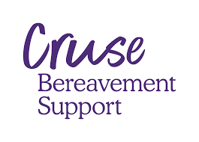


Available Support
NHS Bereavement Services
Cruse Bereavement Care
Samaritans
Child Bereavement UK
Local Hospices
Bereavement Counselling Services
Funeral Directors and Registrars
GriefChat
Support Groups
Online Resources
Employee Assistance Programs (EAPs)
Religious and Faith-Based Support

Slide 42
Essay Support and Academic Feedback
Ensure your reference are relevant to what you are writing about
Limit the word 'the' where not necessary e.g. 'the partnership working is important because'
Use link words effectively – on the other hand is to show an alternative or different view/perspective. Moreover, or furthermore builds upon an argument
Tips on writing a powerful conclusion https://www.youtube.com/watch?v=uV5u-Anf9Fc
All points or opinions expressed must be backed up by credible literature
Try to show alternative perspectives, criticality, and other opinions
Consider the use of technology – It is the future!

Slide 43
https://us.sagepub.com/sites/default/files/upm-assets/106359_book_item_106359.pdf
https://www.pearsonschoolsandfecolleges.co.uk/FEAndVocational/HealthAndSocialCare/BTEC/BTECNationalsHealthandSocialCare2016/Samples/Student-Book-1/BTEC-National-in-Health-and-Social-Care-Unit-01-web-ready.pdf
https://www.academia.edu/35548065/Theories_of_Human_Growth_and_Development_Developmental_Psychology
https://www.academia.edu/35548065/Theories_of_Human_Growth_and_Development_Developmental_Psychology

Slide 44
Doka, K. (2002). Disenfranchised Grief. In K. J. Doka (Ed.), Living with Grief: Loss in Later Life (pp. 159-168). Washington, D.C.: The Hospice Foundation of America.
Gilbert, K. (2007, August 26). HPER F460/F450: Ambiguous Loss and Disenfranchised Grief, unit 9 notes. Retrieved from http://www.indiana.edu/~famlygrf/units/ambiguous.html
Gire, J. (2014). How Death Imitates Life: Cultural Influences on Conceptions of Death and Dying. Online Readings in Psychology and Culture, 6(2). Retrieved from https://scholarworks.gvsu.edu/cgi/viewcontent.cgi?referer=https://www.google.com/&httpsredir=1&article=1120&context=orpc
Is broken heart syndrome real? (2017, December 12). American Heart Association. Retrieved from http://www.heart.org/HEARTORG/Conditions/More/Cardiomyopathy/Is-Broken-Heart-Syndrome-Real_UCM_448547_Article.jsp#.Ww3GkUgvyM8
Kersting, K. (2004, November). A New Approach to Complicated Grief. Monitor on Psychology, 35(10). Retrieved from https://www.apa.org/monitor/nov04/grief.aspx
Klass, D., Silverman, P. R., & Nickman, S. L. (1996). Continuing bonds: New understandings of grief. Philadelphia, PA: Taylor & Francis.
Major Depressive Disorder and the “Bereavement Exclusion”. (n.d.) American Psychiatric Association. Retrieved from http://www.dsm5.org/Documents/Bereavement%20Exclusion%20Fact%20Sheet.pdf
Wakefield, J. C. (2013). DSM-5 grief scorecard: Assessment and outcomes of proposals to pathologize grief. World Psychiatry. Retrieved from http://www.ncbi.nlm.nih.gov/pmc/articles/PMC3683270
Why we need to take pet loss seriously. (2018, May 22). Scientific American. Retrieved from Dishttps://www.scientificamerican.com/article/why-we-need-to-take-pet-loss-seriously
Stroebe, S.M. (2008) Handbook of Bereavement Research and Practice: Advances in Theory and Intervention. Washington (D.C.): American psychological Association.
Jacobs, S (1993) Pathologic Grief: Maladaptation to Loss. Washington, DC: American Psychiatric Press.

