Slide 1




Clydach Community Council
Presentation of placement
Clydach Community Council (2021).

Slide 2
Clydach Community Council was established under the Local Government Act 1972 (LGA 1972)
Clydach Community Council (2021).
It is served by 16 Community Councillors who each represent individual wards.
The council is funded by "precept" a sum collected with the council tax each year.

Slide 3
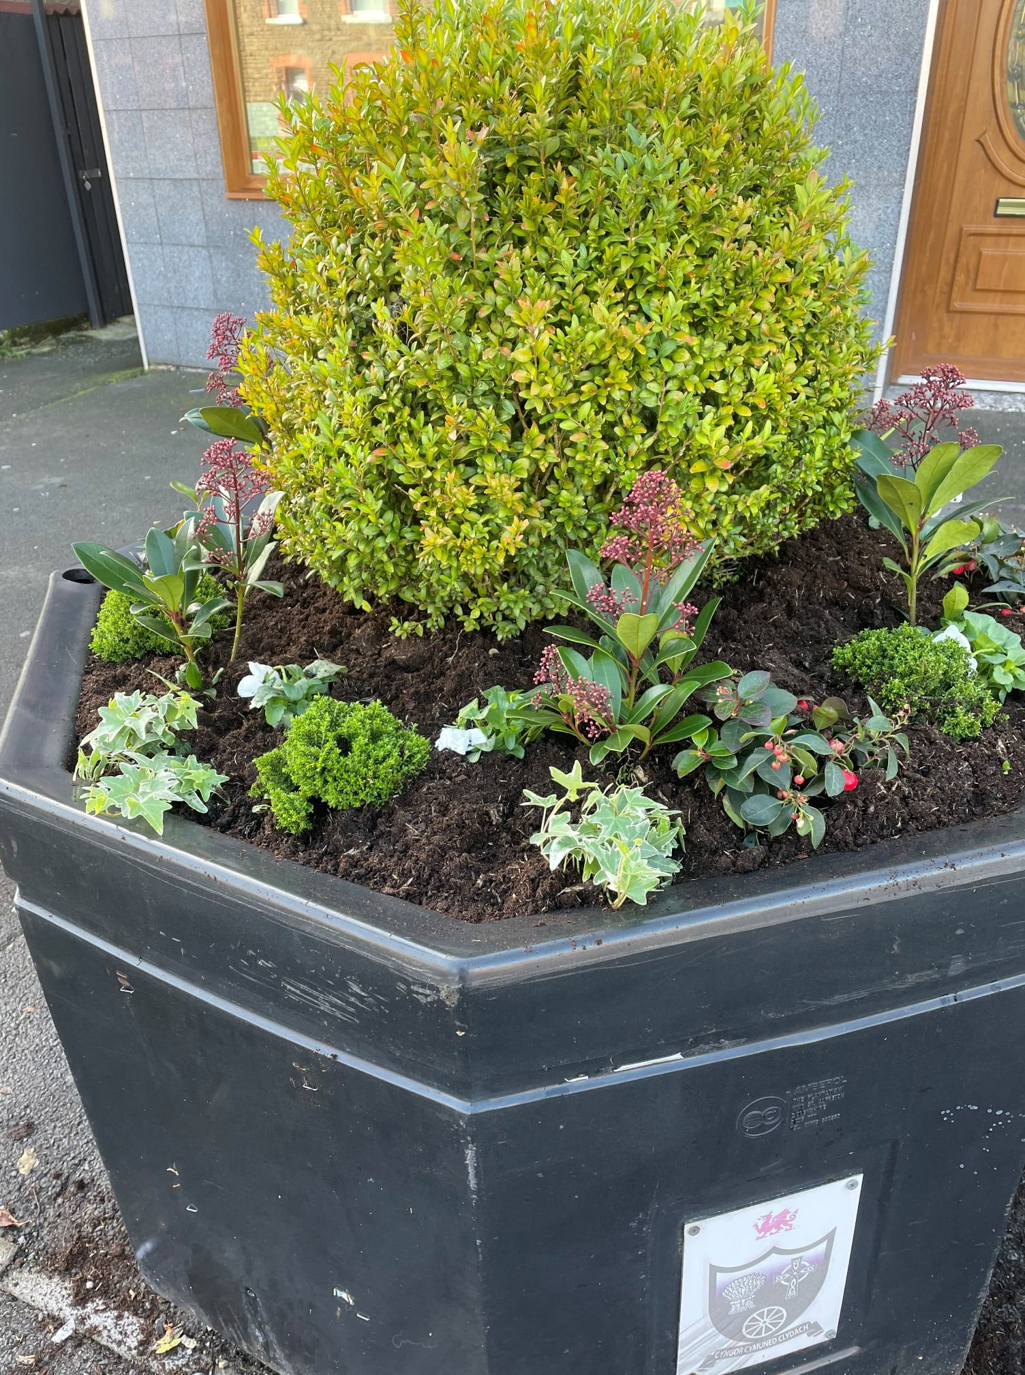
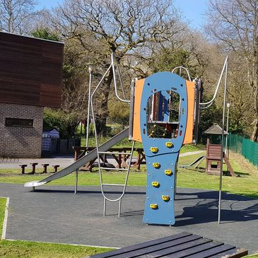
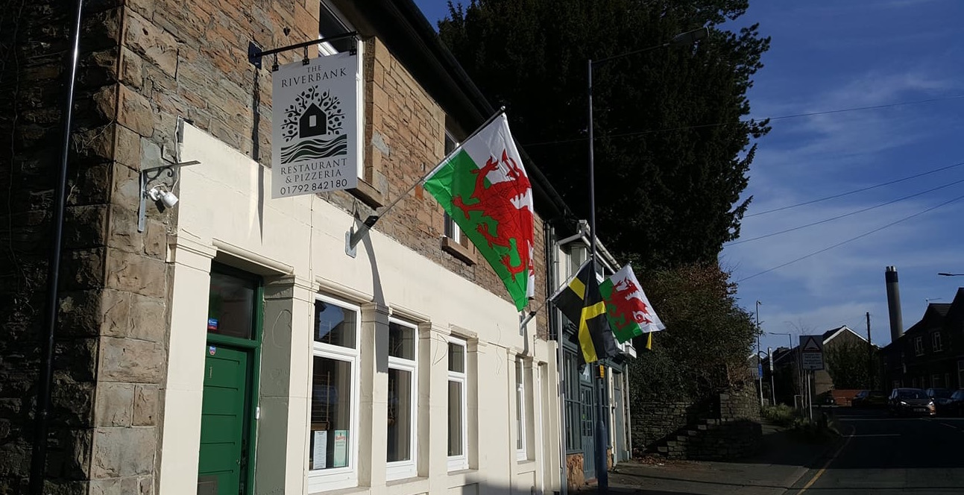
Community Councils are the voice of the residents, enhancing the quality of life in the community.
They maintain flower beds, hanging flags and Christmas trees, litter picking, installing Defibrillators plus a whole host of other things.
(Clydach Community Council. b,2021)
Manages two community halls, a play area, and maintains plots of land throughout Clydach.
(Clydach Community Council.b, 2021)
(Clydach Community Council. b, 2021).

Slide 4
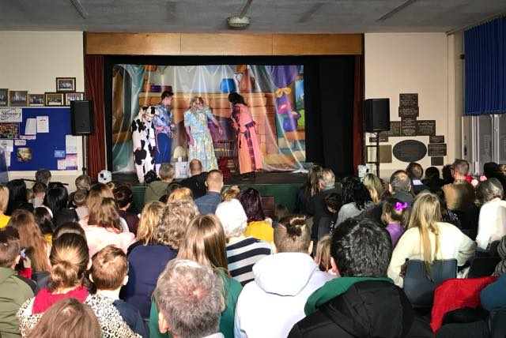
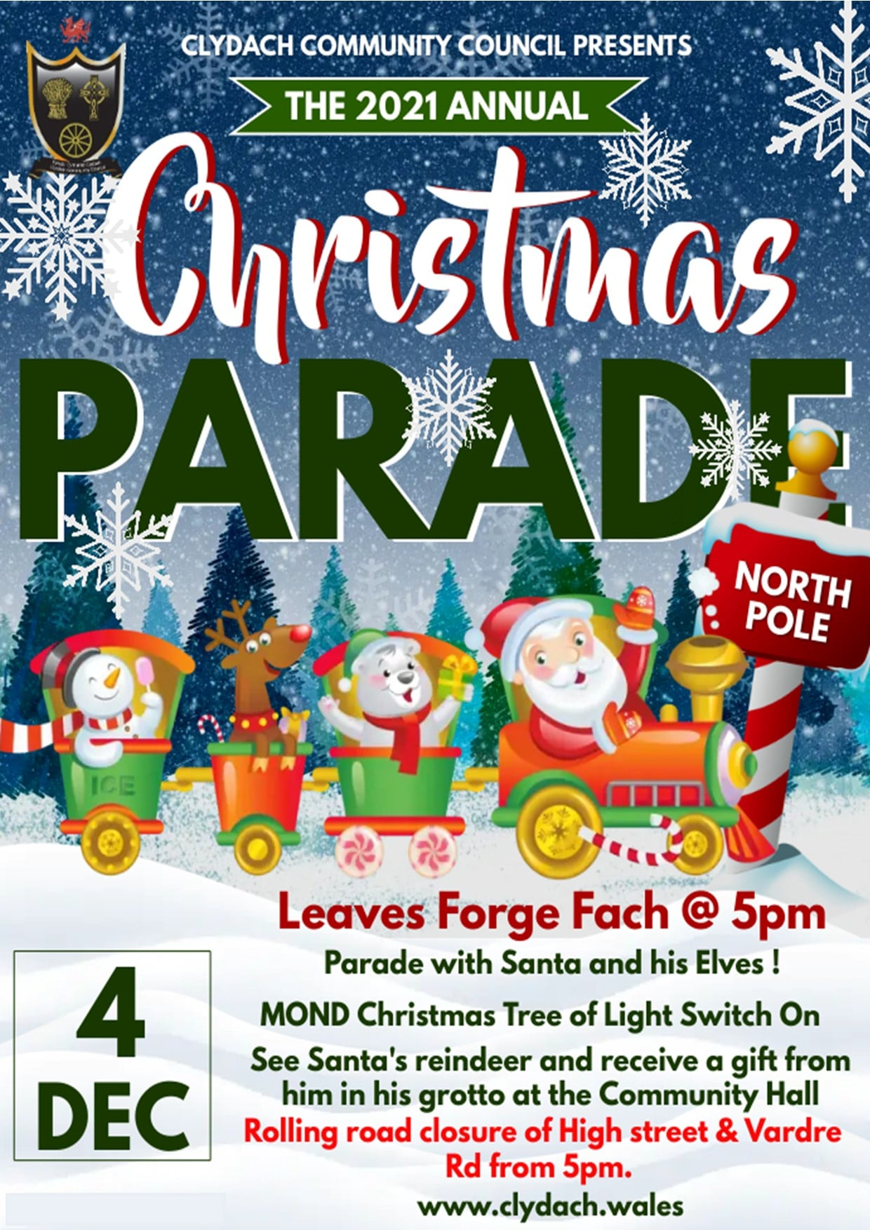

The council hosts numerous events. Any profit is put back into the community by giving grants to local organisations.
Events include: - Panto, Easter Egg Hunt, Summer Festival, Fireworks Display, Christmas Parade.
(Clydach Community Council. b, 2021).
(Clydach Community Council. b, 2021).
Organizations can apply for a grant of up to £300
(Clydach Community Council. b, 2021).

Slide 5
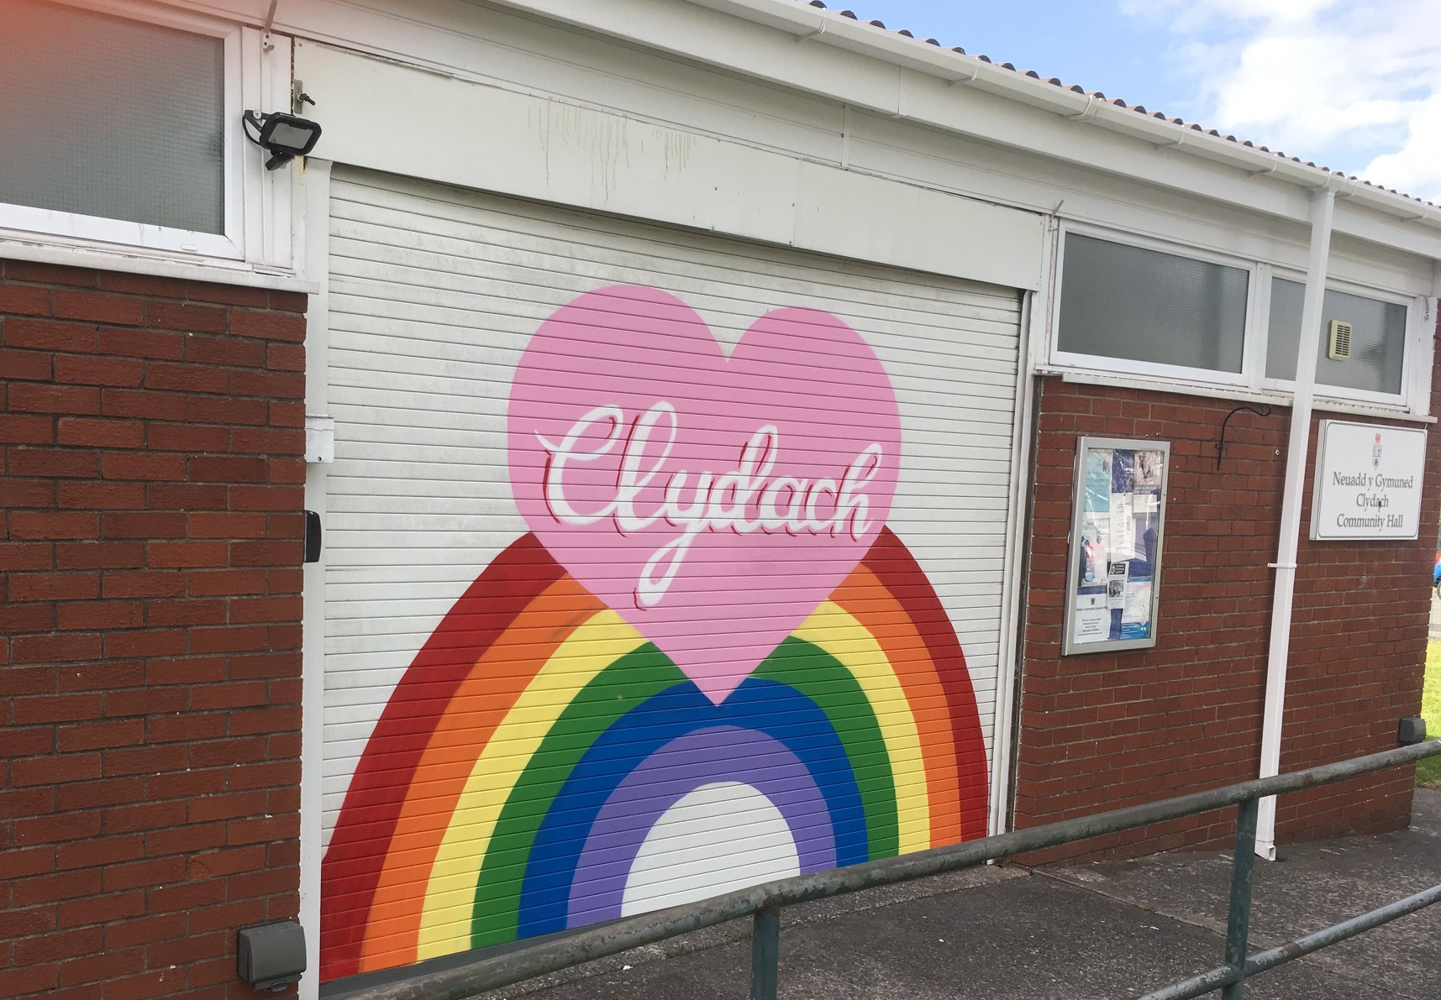
Covid
The Council coordinated support for vulnerable individuals
Doing essential shopping, picking up medication and regular phone calls
Every home in Clydach was informed there was help available via leaflets, social media and health services
They provide a list of local places that would deliver fresh produce and take away meals
(Clydach Community Council. 2020)

Slide 6
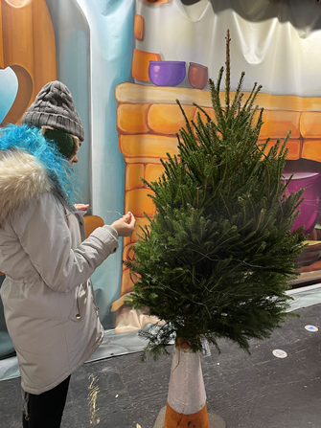
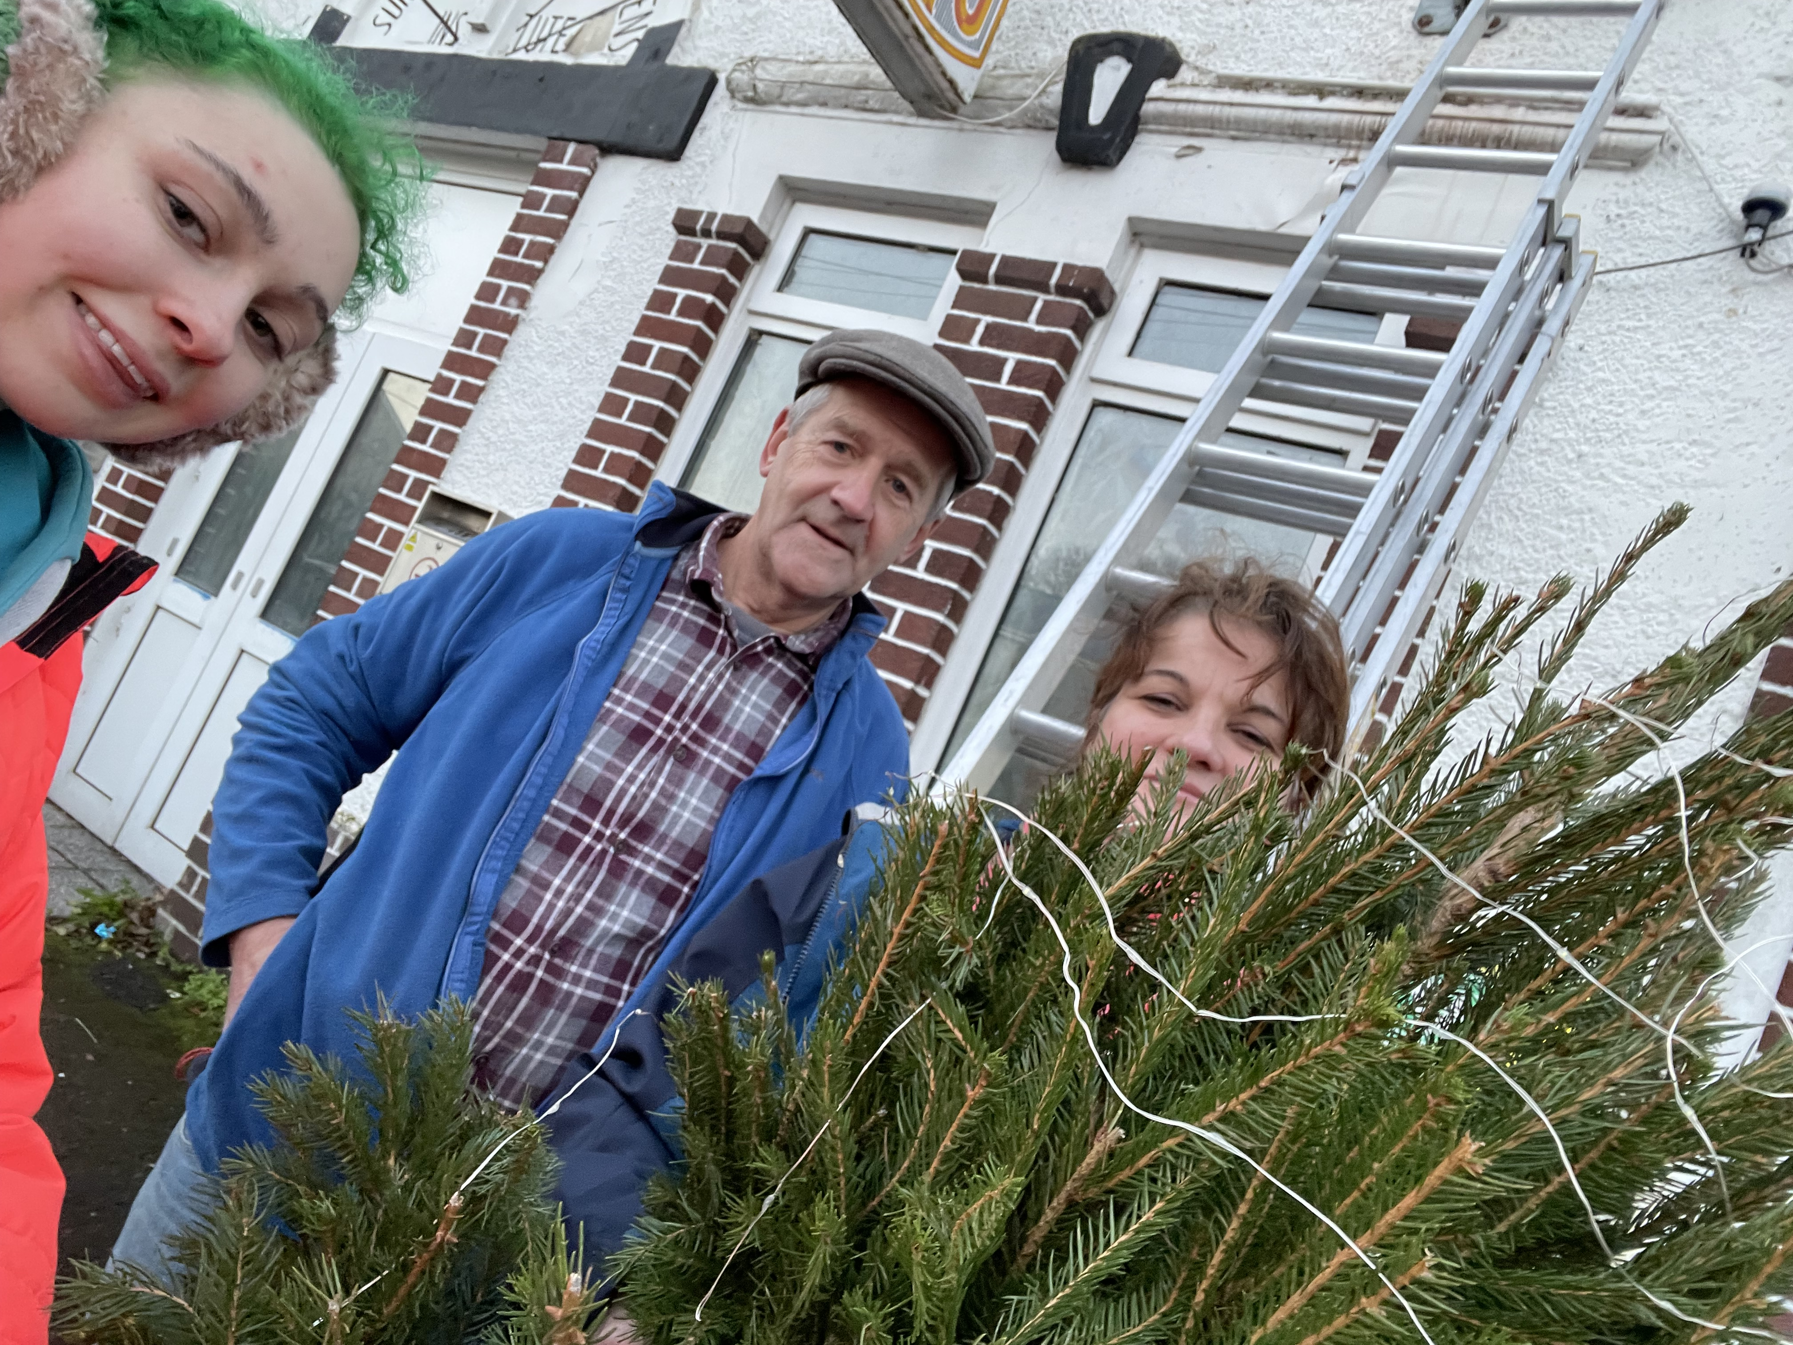
To become a councillor, you must have lived or worked within Clydach for the past 12 months, be prepared to attend council meetings and work with others to improve Clydach.
Councillors can receive an allowance of £150 per year
You apply via an online application form, if you are successful you are invited to an interview.
(Clydach Community Council. b, 2021).

Slide 7

My Project, setting up a homework club
Homework club provides an environment for children to study
Provide free access to online resources, printing, and photocopying
Universities can join forces with homework clubs which benefits students and the pupils
Benefits for pupils; Improved exam results, Increased confidence
Benefits for volunteers; gaining skills, Enhance their CV.
St Agnes C.E. Primary School (2021

Slide 8
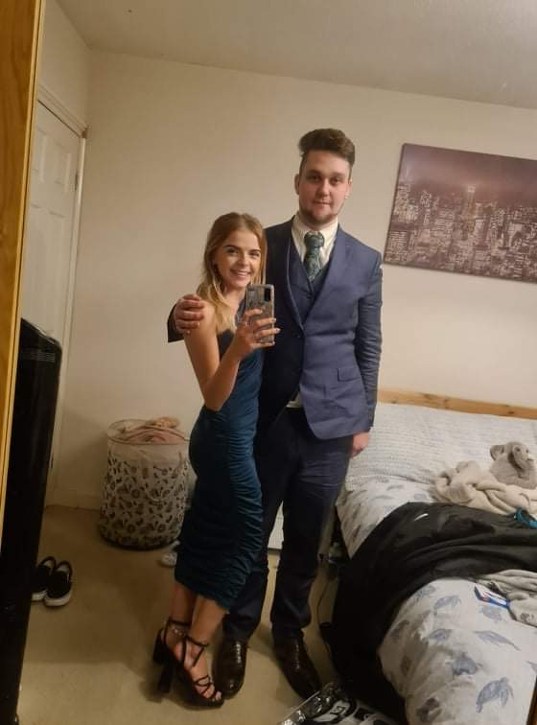
My project, Setting up Clothes library
Allowing people to borrow clothes for special occasions, like proms, weddings, and job interviews.
This not only supports people on low incomes, reusing clothes reduces the impact of what we buy and are saving them from landfills. (ASTOUL, 2020).
(Iestyn &Shelby 2021)

Slide 9
Challenges
Lack of organisation, changing times at the last minute or giving you very short notice.
The lack of respect some councillors have.
Not a traditional counselling setting, however, helping skills are beneficial.
I am grateful that I have been given the opportunity to develop my projects as I believe they will really benefit the community.

Slide 10
References
ASTOUL, E. (2020). How Second-Hand Shopping Can Save The Planet - Green With Less. Retrieved 2 December 2021, from https://greenwithless.com/second-hand-shopping-planet/
Cardiff Homework Clubs, (2021). Retrieved 2 December 2021, from http://cardiffhomeworkclubs.co.uk/
Clydach Community Council (2021). Clydach Community Council. Retrieved 29 November 2021, from https://clydach.wales/.
Clydach Community Council, (2021). CLYDACH COMMUNITY COUNCIL PROJECTS, Retrieved 30 November 2021, from https://clydach.wales/projects
Clydach Community Council. (2021). EVENTS ORGANISED BY CLYDACH COMMUNITY COUNCIL, Retrieved 1 December 2021, , from https://clydach.wales/events
Clydach Community Council. (2021).c, Clydach Community Council Vacant Seats
Retrieved 3 December 2021, from https://clydach.wales/council-vacancies
Clydach Community Council,, (2020). CAN YOU BE A CLYDACH COVID-19 VOLUNTEER?, Retrieved 4 December 2021, from https://clydach.wales/volunteering-1
Clydach Community Council., (2021). About The Fund. Retrieved 1 December 2021, from https://clydach.wales/community-fund
Clydach Community Council,b, (2021) photos. [Facebook page]. Facebook. Retrieved 6 December 2021, from https://www.facebook.com/clydachcc.
Community councils (2021). Law.gov.wales. Law.gov.wales. Retrieved 29 November 2021, from https://law.gov.wales/community-councils.
Homework Club - Term 4 2021. Trybooking.com. (2021). Retrieved 1 December 2021, from https://www.trybooking.com/events/landing/810552.
Iestyn & Shelby (2021) my own photo, permission granted, taken 31 October 2021
St Agnes C.E. Primary School. (2021). St-agnes.manchester.sch.uk. Homework Club. Retrieved 1 December 2021, from https://www.st-agnes.manchester.sch.uk/year-6-circles/homework-club/

