Slide 1
Data Center Tehcnologies
Server Architecture

Slide 2
Virtualization
Process of converting physical IT resource into virtual IT resource
IT resources that can be virtualized:
    Servers
    Storage
    Network
    Power

Slide 3
Server Virtualization Components
Server virtualization comprises several components working in synergy to deliver a holistic solution.
Main components
  Hypervisor
  Virtual Machine
  Virtual Switching
  Management Tools

Slide 4
Virtual Machine
A virtual machine is a software construct operating on top of the hypervisor.
Virtual machines emulate operation of the physical computing environment and rely on the hypervisor for access to the physical server resources.
Virtual machines can also be created within the virtualization environment running on top of the server operating system(host operating system).
Notes:
. Server virtualization can also be viewed as a form of hardware abstraction. When abstracted from the underlying physical server hardware, virtual machines can be easily moved around, copied, paused, and so on.

Slide 5
Hypervisor
  Software that creates and manages virtual machines to allow multiple operating systems to run on a host computer at the same time.
  Manage & controls VMs(software implementation of physical computer)
Two types
  Type 1
  Type 2
Notes:
Hypervisor:
software used to generate virtual server instances of a physical server
its limited to one physical server
can assign resources to virtual servers that it generates with resource pool of the physical server

Slide 6
Hypervisors
Type 1
Type 2
Bare metal hypervisor
Runs directly on hardware
Requires a management software
Examples of type 1 hypervisors
    VMWare ESXi( Management software: Ie ESXi = vCenter/vSphere)
    Microsoft Hyper-V
Hosted hypervisor as it runs on top of a host OS
Used on client desktop, laptop
Accessed through software interface
Examples
    Oracle Virtual Box
    VMWare Player/Work Station
    Microsoft Virtual Server

Slide 7
Virtual Machine

Slide 8
Virtual Switches
In pre-server virtualization
  Servers were attached through either IEEE 802.1Q VLAN trunks or single-VLAN switch ports sending their network traffic toward the data center access layer switches, which in turn forwarded it to its destination.
Virtual switches took care of forwarding the network traffic between the virtual machines residing on the same or different physical hosts.

Slide 9
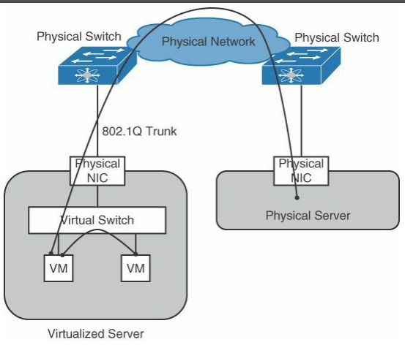
virtual machines migrate between physical hosts connected to different physical switches. In this case, virtual switches make sure to maintain configuration consistency for the virtual machine attachment points in term of network and security settings.

Slide 10
Management Tools
Increase in amount of virtual servers also resulted in increased administration overhead
Virtualization management tool is also referred to as virtual machine manager
Help create, edit, clone, start, stop, and move virtual machines
Through a set of application programming interfaces, known as apis, virtual machine management tools also provide a programmatic way of interacting with server virtualization environment.
Examples:
  Vmware’s vcenter and microsoft’s system center.
  For linux-based open hypervisors, kvm and xen.

Slide 11
Server Virtualization
Four types
    Full
    Para
    Hardware Assisted
    Operating System-level Virtualisation

Slide 12
Full Virtualization
Hypervisors run directly on host computer
Completely abstracts from physical hardware & separates from other guest OS
Guest OS think they are running directly on the hardware
Hypervisor does full binary translation

Slide 13
Para Virtualization
Hypervisor runs directly on host computer
Does not completely abstract guest OS
Some privileged instructions are replaced with hyper-calls(system calls, virtual driver)
Guest OS can directly communicate with hardware

Slide 14
Hardware Assisted
The CPU is enhanced with facilities to support virtualization(hardware support for virtualization)
It provides an additional ring Ring -1 where the virtualization software runs
Allows guest user to directly access the hardware
Example: Intel Virtualisation Technologies (VTx) and AMD Pacifica (AMD-V)

Slide 15
Operating System Level Virtualization
Host operating system itself perform the functions of the hypervisor
Kernel enables multiple environment
Operates under the same kernel but have their own resources
All the guest os should of same OS family as host.
Example: OpenVZ

Slide 16
Acknowledgement
Santana, G. A. A., 2014. Data Center Virtualization Fundamentals. s.l.:Cisco Press.

