Slide 1
the Han dynasty has more influence on china than the Qin, discuss
Jack Glascott, December 2019

Slide 2
Introduction
Qin (221-207 BCE)
Han (206 BCE – 220 CE)
How we decide
Three points of comparison
  Political and economic
  Social Structure and identity
  Legacy
Conclusion
The decision – Qin or Han
Q and A

Slide 3
An introduction – the basics
Qin
Han
Duration 15 years
Conflict and expansion
Legalism
Unified China
Economic growth
Productivity growth
Duration 426 years
Conflict and expansion
Education/Imperial examination
Confucianism
Extended China
Economic growth
Internationalisation

Slide 4
Political and economic

Slide 5
Political and Economic
Qin |  | Han
 |  |  | 
Unified china | Punitive system of government - strict | Extended boundaries | Threatened by rebellions and external threats
Rule of law - legalism | Book burning | International | Descent through the male line
Lingqu Canal – linking economic centres | Executions of intellectuals Tyrannical and cruel | Silk trading route established
Currency, weights and measures standardised | Heavy taxation | Ceramics as a source of exports and protected | Four year civil war (206-202 BCE) Chu and Han states
Infrastructure developed to manage water | Conquered rivals by force | Inventions - seismograph | When Han dynasty collapsed 18 separate kingdoms had already declared their independence
Improved agricultural productivity | Too much pressure on the Emperor to run everything | Lower taxes
Military capability |  | Full time army
Notes:
Yingzheng (the first emperor) conquered the other six dukes through ten years of wars and brought an end to riotous Warring States Period (476 BC - 221 BC) in 221 BC. He was the foundation of Qin Dynasty(221 BC - 206 BC), the first unified, multi-national, autocratic and power-centralized state in Chinese history, making Xianyang, a city near Xi'an in Shaanxi Province, as his capital city. For the first time in history, all China became a unified empire.
He abolished where nobility where given rights to hereditary titles, territories and slaves
Practicing a new form of province country system where officials were appointed and by merit, contribution and ability
Although his reign lasted little more than a decade, it had a defining influence on Chinese civilization.
new legal system with 36 districts across his empire all focused on a central authority. Meaning his government administration was strong and that there was little crime in the empire.
He standardised currency, script, weights and measures so trade was plentiful in his empire. This also meant he could send clear messages to his districts, stabilising government.
He worked on large-scale civil projects like the Great Wall or Lingqu Canal
These projects further unified and strengthened the empire security-wise.
He made roads wider and more sophisticated/expanded. These roads were used for imperial messages, trade and transport, such as the transportation of supplies to the Great Wall during construction. Advanced roads inside his (QSH) empire further unified it and strengthened his rule

Slide 6
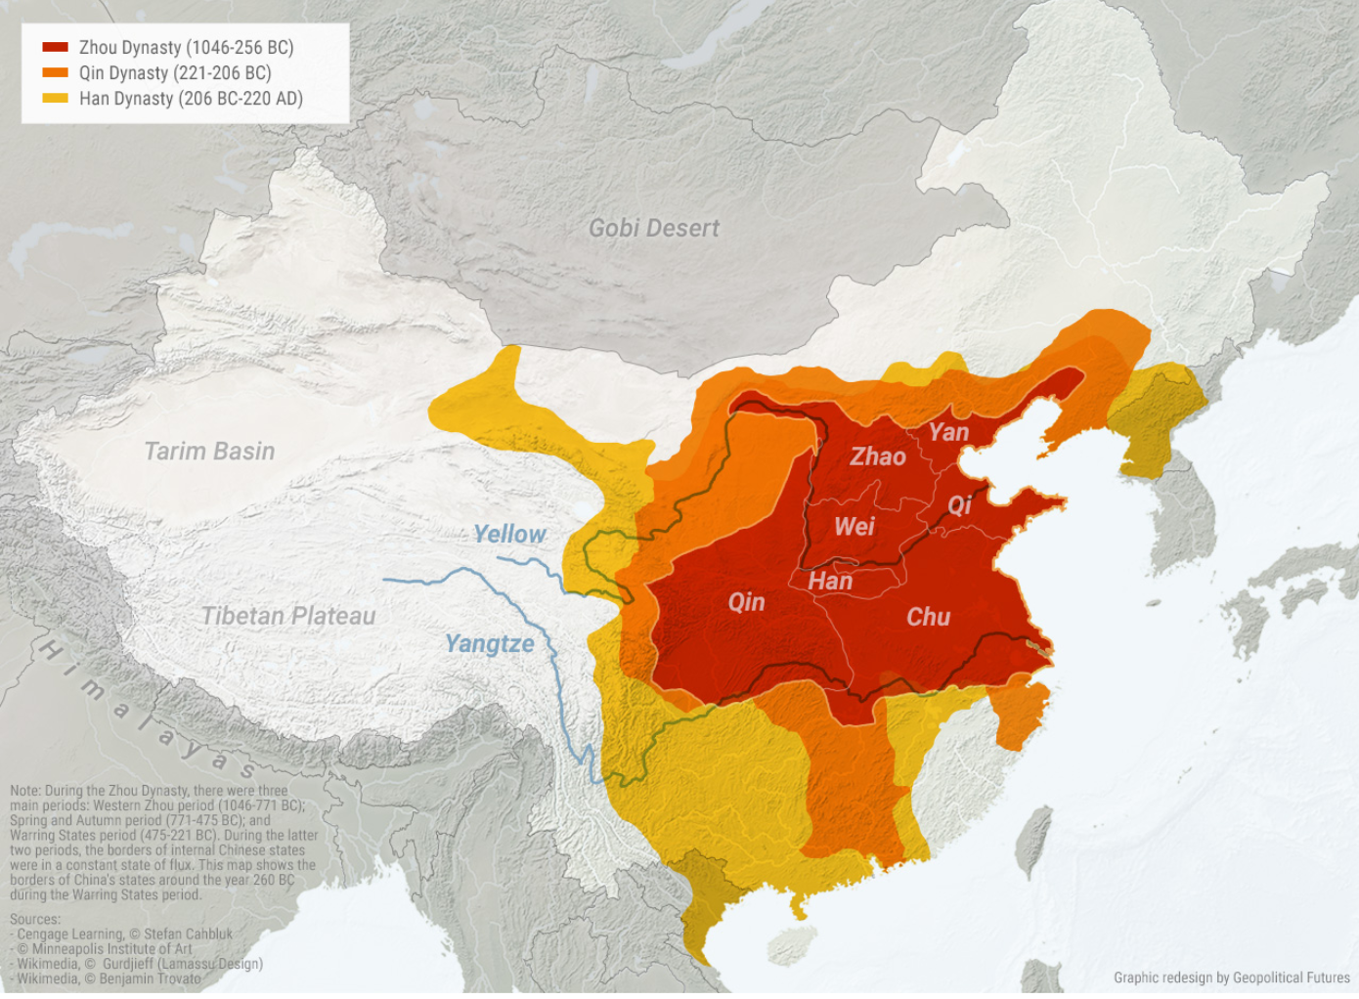
The Han Dynasty extended the borders of unified China. This, as today, is centred around the round the Yellow and Yangtze rivers
Notes:
QSH used ideas to direct and control water flow. One way he did this was building islands in rivers. This meant one side of water could continue its flow, while the other could be distributed to farms and villages. Such an idea resulted in larger crop production and a reduced risk of floods. Hence, people could make money, build burgeoned communities and there were fewer chances of the internal empire collapsing

Slide 7
Social Structure and Identity
Notes:
Confucius emphasized the role of the arts and humanities (especially music and poetry) in broadening human nature and aiding li (etiquette, the rites) in bringing us back to what is essential about humanity.
His opponent Mozi, however, argued that music and fine arts were classist and wasteful, benefiting the rich over the poor.

Slide 8
Social Structure and Identity
Qin |  | Han
 |  |  | 
Legalism – maintained law and order | Punitive system of government | Confucian focus on responsibility and behaviour | Warlords and Breakdown into Regions
Standardised writing – improved trade | Unpopular due to doctoral nature | Silk road and links to Rome and the Middle East led to exchange of ideas | The Weakening of the Xiongnu
Established a census | Ordered destruction of all literature other than about farming/plantation | Peace, prosperity | the empire's collapse sent the country into disarray for nearly four centuries.
Consolidated power | Other forms of thought banned | Respected scholars and tolerated criticism | Internal Corruption
 |  | Literature and historiography | Internal Conflict Over Taxation
 |  | Imperial examinations
Notes:
Han
When selecting his administrators, Emperor Wu, followed the Confucian principle of appointing men on the basis of merit rather than birth.
He instituted a regular system of written examinations. In this manner he ensured that only those who were adept in Confucian principles were appointed to senior administrative posts.
Qin
During the Qin Dynasty, any books which did not support the Legalist philosophy were burned and writers, philosophers, and teachers of other philosophies were executed. The excesses of the Qin Dynasty's legalism made the regime very unpopular with the people of the time. After the Qin were overthrown, Legalism was abandoned in favour of Confucianism and this influenced the development of the culture of China significantly.
Confucius emphasized the role of the arts and humanities (especially music and poetry) in broadening human nature and aiding li (etiquette, the rites) in bringing us back to what is essential about humanity.
His opponent Mozi, however, argued that music and fine arts were classist and wasteful, benefiting the rich over the poor.

Slide 9
Legacy

Slide 10
Legacy
Qin |  | Han
 |  |  | 
Great Wall | Ruthlessness | People see themselves as ‘Han Chinese’ | Xian – mythical afterlife paradise
Terracotta Army | Resources spent on the glory of the first Emperor | Silk route trading and export established – Pax Sinica
The name ‘China’ |  | Paper & writing
Unified China |  | Confucian Philosophy
Military development and innovation |  | Wu Family Shrine
the overall infrastructure for national economic development |  | The Golden Age of China
Harmonising measurement units to allow for consistent, state-wide economic development |  | "the people of Han"
Lingqu canal in the south to connect the major waterways and prevent flooding

Slide 11
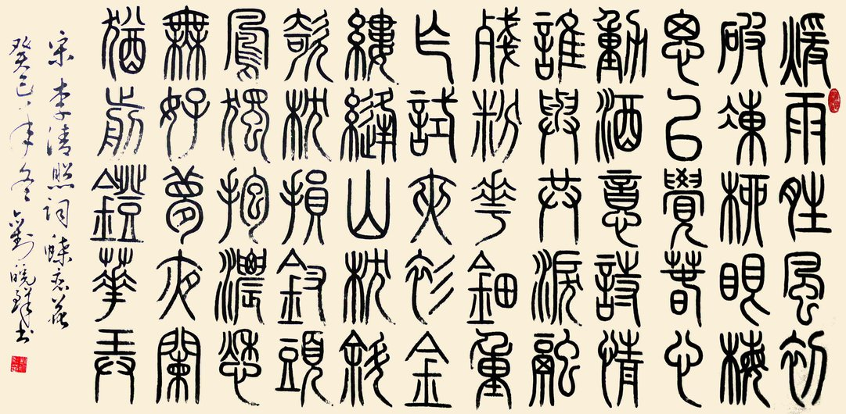

Slide 12
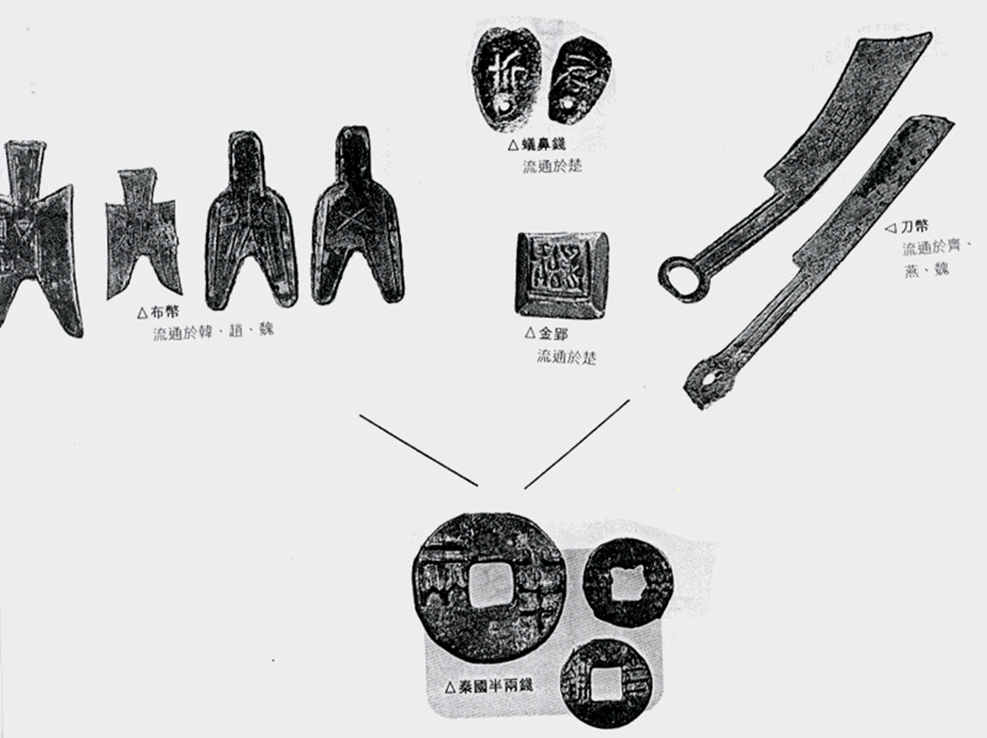

Slide 13
Qin Dynasty v Han Dynasty
Your vote

Slide 14
Conclusion

Slide 15
Questions and Answers
Your say

Slide 16
Thank you

