Slide 1
The Diversity within Judaism
Orthodox, Conservative and Reform Denominations

Slide 2
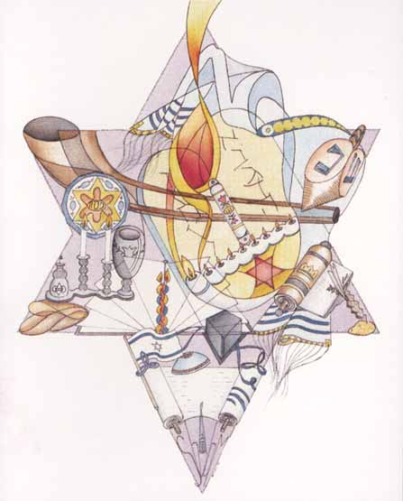

Slide 3
Orthodox Judaism:
‘Torah-True Judaism’
Traditional orthodoxy seeks to preserve the religious traditions and practices of the Jewish faith.
Orthodoxy emerges from rabbinic Judaism.
Acceptance of the Torah (oral and written) as divinely revealed: the Torah was given in its entirety by God to Moses on Mount Sinai.
All its details are accurate and true; it is literally ‘the word of God’, sent from heaven (Torah min ha-shamayim) and written down by Moses.
The Torah therefore remains authoritative and is subject to literal interpretation.

Slide 4
Origins of Orthodox Judaism
Late 18th century: responses to the Enlightenment (= Jews with full civil rights and freedom to be full members of the wider community).
Enlightenment: encouragement of rationalism and the promotion of reason, tolerance and morality. It involved the modernization of Judaism in order to achieve political and social integration.
The term ‘orthodox’ is first used in Germany in 1807 by Reformers for traditionalists who oppose ‘reform’ changes in Jewish life.
Particularly prevalent among Eastern European Jews during the 18th-19th centuries.
It comprises many trends, including numerous Hasidic sects and mitnagdim (opponents of Hasidism, Lithuanian emphasis on intensive study of the halakhah).

Slide 5
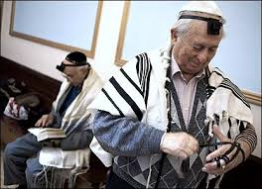
Development of Orthodox Judaism
Some attempts at integration (traditional Judaism and modern values): synthesis between tradition and general culture.
Neo-orthodox movement (e.g., the German rabbi Samson Raphael Hirsch, Azriel Hildesheimer): ‘Tprah with the way of the land’.
This leads to more ‘centrist’ orthodoxy in Western and Eastern Europe.

Slide 6
Orthodox Judaism in America
Rapid expansion following the migration of orthodox scholars from Eastern Europe.
Establishment of rabbinic schools (yeshivot) during the first decades of the 20th century.
Over 40 such schools in the USA today
- Yeshiva University (New York)
- Hebrew Theological College (Chicago)
Combination of traditionalist and modernist orthodox Jews.

Slide 7
Orthodox Judaism in Israel
The only formally organized religious body of the state.
Rabbinical courts have jurisdiction over matters of personal status (e.g. marriage regulations)
The courts are presided over by the two Chief Rabbis (Sephardi and Ashkenazi).
Sephardim = South European, North African, Middle Eastern
Ashkenazim = North European
Orthodox religious councils control: ritual baths, synagogues, promotion of religious education.
State school system and state religious school system.

Slide 8
Orthodox in the Diaspora
France: large orthodox communities
United Kingdom: the United Synagogue controls a large network of congregations (large community on the traditional right in Gateshead).
Spain and Portugal: Federation of Synagogues and Jews Congregation.
It seems preferable to describe Orthodoxy by listing its various groups rather than seeking a definition. There is no overall direction or central control in orthodox Judaism.

Slide 9
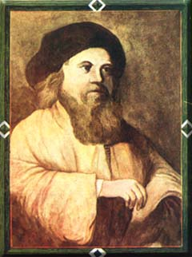
Hasidim
Founded by Israel ben Eliezer (1700-1760), also known as Baal Shem Tov (‘the Master of the Good Name’).
Hasidim = ‘the pious’, with emphasis on personal piety and mystical worship.
. Spread to Poland, the Ukraine and Lithuania.
Ruled by tzaddikim (spiritual leaders): linked to miracles.
19th and early 20th centuries: hundreds of Hasidic dynasties flourished in Eastern Europe.
After the Holocaust most of the remaining Hasidic Jews escaped to Israel and USA.

Slide 10
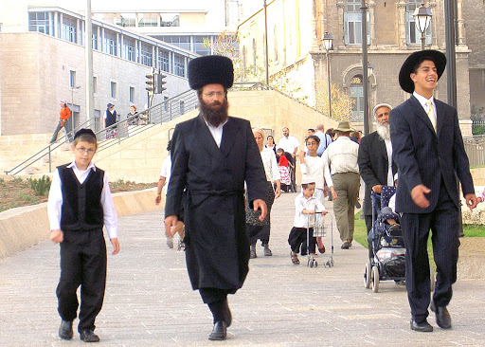
Hasidic Jews
Groups include: Belz, Klausenburg-Zanz, Lubavich, Satmar.
Each group preserves its own particular traditions.
Distinctive type of dress worn by noblemen during the 18th century.

Slide 11
Hasidic Jews
Males
Bearded with side-curls behind their ears.
Black clothing (including black hat over black skull-cap) with white shirts without a tie.
Ritual fringes attached to their undergarments.
Sabbath wear includes black silk coat and fur hat.
Females
Strict adherence to rules of modesty.
Skirts that cover their knees, long sleeves and high necklines.
Married women wear wigs: she must conceal her hair so that she is no longer a temptation to other men.

Slide 12
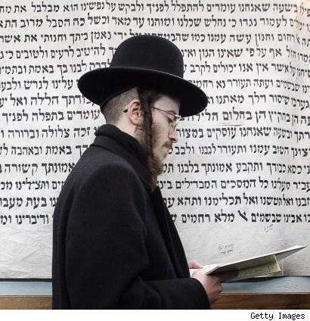
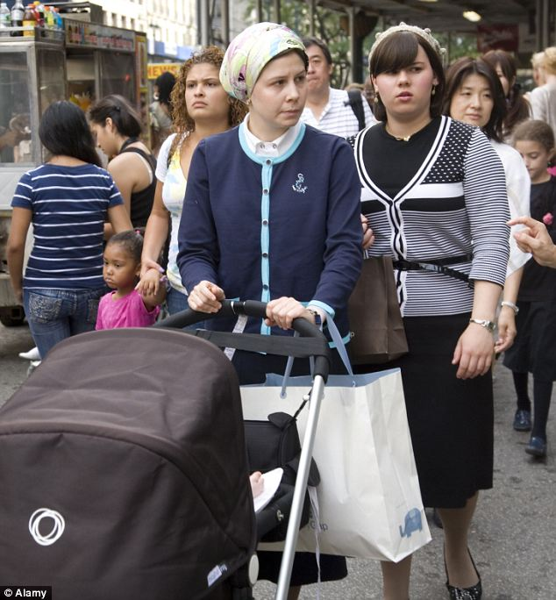
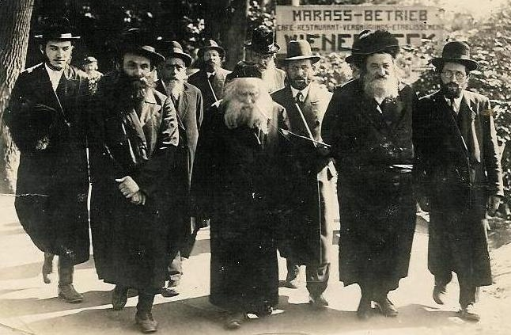

Slide 13
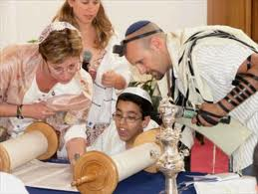
Conservative Judaism
‘Middle of the road’ stance to observance of the Jewish law (adjustment to contemporary needs and secular society).
Founded in the 19th century by Zacharias Frankel (1801-75): ‘an evolving religious way of life’.

Slide 14
Conservative Judaism and Worship
Dissatisfaction with traditional services; lack of knowledge of Hebrew (hymns and prayers offered in vernacular languages).
Changes include:
- alteration of the early morning benediction in which the worshipper thanked God for not having created him a woman
- prayers for peace extended to all humanity
- the Amidah was only recited on high holy days.

Slide 15
Conservative Judaism and Torah
Conservative Jews maintain that the truths in the Torah and later Jewish writings come from God, but were transmitted and shaped by human authors; acceptance that the Torah should be observed but that it can be adapted.

Slide 16
Conservative Judaism and Torah
‘We accept the results of modern scholarship. We agreed that historical development of the tradition had taken place, and that the tradition continues to develop. We all agreed on the indispensability of the halakhah for Conservative Jews, but a halakhah which responds to changing times and changing needs.’

Slide 17
Conservative Judaism
This movement is particularly strong and influential in the United States, largely in response to the more liberal developments in Reform Judaism, This is the largest denomination of American Jews:
- around 850 congregations
- around 1,500,000 members
Radio and television programmes, museums, day schools).
Majority vote for the ordination of women in 1983.

Slide 18
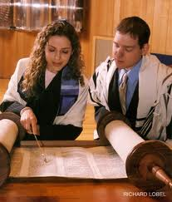
Reform Judaism
On the left of the religious spectrum (consequence of secular education and interaction with Gentiles).
Israel Jacobson (19th century) initiated several liturgical and educational reforms in Germany.
Spread from Germany to Austria, Denmark and UK (1842: establishment of West London Synagogue).
Emphasis on ethical and universal ideals of Judaism: universalism and acculturation.

Slide 19
Reform Judaism and Worship
Reform temples (not synagogues) established in Europe.
Adaptation of Jewish worship to contemporary standards.
More participation in prayer and introduction of new prayers (in the vernacular) that were less particularistic in nature.
Influence of Protestant Christianity: choir (with Western music), hymns, shorter service).
First woman rabbi ordained was Regina Jonas (1935) but she died during the Holocaust. However, it was in 1972 that the first woman was ordained a rabbi in the USA.
Contemporary Reform developments: prayer books contain reflection on the Holocaust, the State of Israel, and the need for ‘inclusivist’ language.

Slide 20
Reform Judaism and Torah
Adoption of critical methods for the study of the Bible.
The Torah can be traced to different sources from different periods; focus on the ‘spirit’ rather than the ‘letter’ of the Law.
Abandonment of many Jewish laws about food, clothing and everyday living.
New ethical and spiritual values were being ‘revealed’.
Focus on ethical way of life rather than rituals and ceremonies as an expression of holiness.

Slide 21
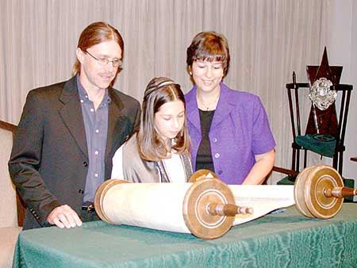
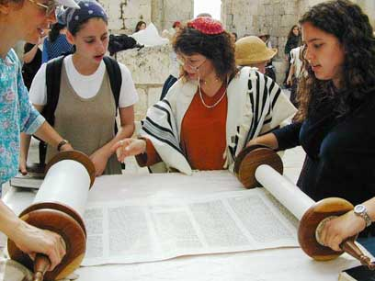
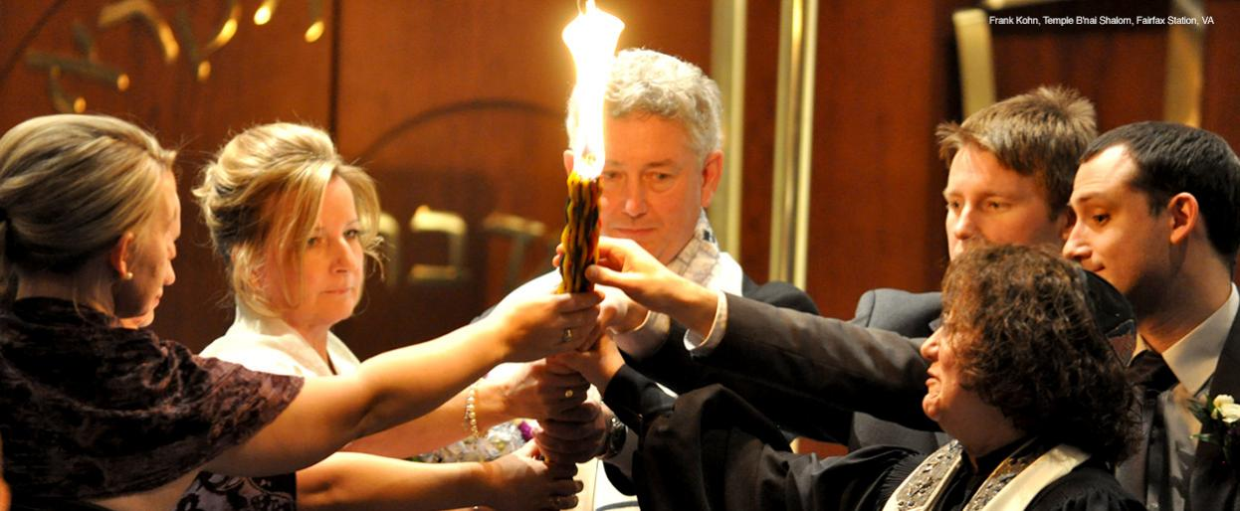

Slide 22
Reform Judaism in the USA
First established in 1824 (South Carolina), increased considerably due to German migration in the 19th century,.
Establishment of the Union of American Hebrew Congregations (1873) and the Hebrew Union College in Cincinnati (1875).
Around 35% of all American Jews belong to the Reform movement.
Reform Judaism is also prevalent in South Africa, Asia, Australia and Europe (including 15% of British Jews).

