Slide 1
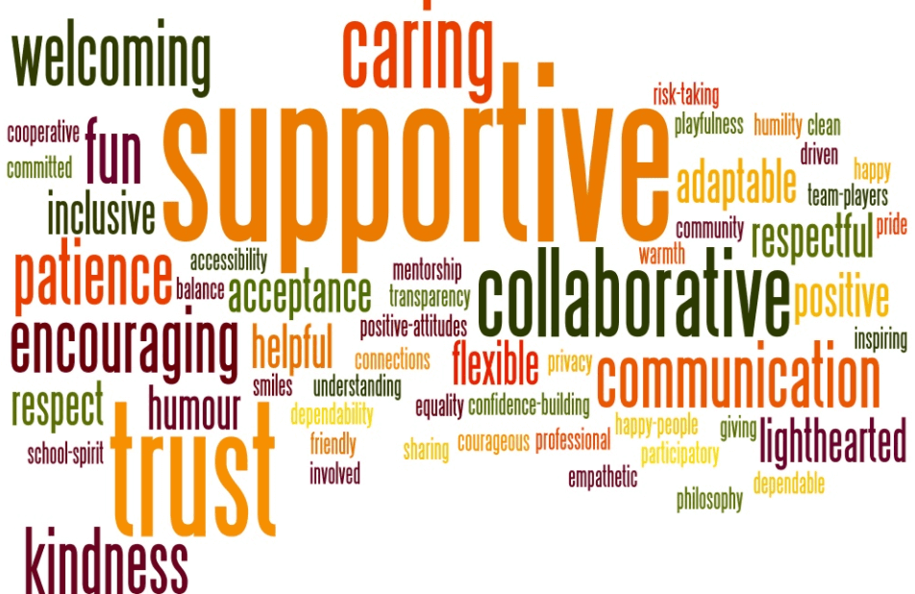

Workplace Culture and its Impact on Organisational Efficiency
Mohammed Miah: 2129058
Task 2 Oral Presentation
Module Code: BMSW 5105
Culture inside Google
Lecture: Aderemi Ojebode
This Photo by Unknown Author is licensed under CC BY

Slide 2
Table of Content
Executive Summary | Slide 3
Introduction | Slide 4
Organisational Culture at Google | Slide 5
Innovation and Risk-Taking | Slide 6
Flat Hierarchy and Cooperative Environment | Slide 7
Employee Benefit | Slide 8
Ethos at Google | Slide 9
Values of Google | Slide 10
Triple Bottom Line (TBL) Approach | Slide 11
Corporate Social Responsibility (CSR) | Slide 12
Conclusion | Slide 13
Reference | Slide 14

Slide 3

Executive Summary
The goal of Google's foundation was to organise knowledge worldwide and make it widely useful and available to everyone.
This report explores the intricacies of Google's organisational culture, moral principles, and values, as well as the driving force behind this company's advancement into the digital era.

Slide 4

Introduction
In 1998, Google was founded by Stanford PhD students Larry Page and Sergey Brin.
Their goal was to create a more advanced search engine, leading to the creation of the revolutionary Google search engine.
The name "Google," which came from the word "googol," stood for their intention to organise a significant quantity of internet data.
Google quickly became the most popular search engine worldwide, revolutionising online information access.
With the introduction of innovations like YouTube, Gmail, and Google Maps, Google revolutionised the digital landscape.
Google's ecosystem, which includes Android and Google Workspace, is essential to the daily lives of millions of individuals in the modern world. Azeem (2021).
Beyond its range of products, Google has created unique organisational values that support research, innovation, and a sensitive consideration for its consumers.
The company culture at Google, which is based on its core principles, is one of continuous innovation and has influenced the way the firm interacts with its partners, staff, and the general public. Begga (2023).
The report not only dissects the elements that have driven Google to the top of the digital industry, but it also explores the intricacies of its organisational culture, ethos, and values, exploring the ways in which these principles will shape job and technology going forward.

Slide 5

Organisational Culture at Google
An organization's organisational culture is made up of the shared beliefs, behaviours, and practises that define it. It is often recognised that Google has a typical organisational culture that is fun, flexible, and progressive.
The company's culture, which is characterised by an emphasis on the interaction between technology and society, includes philosophical and technological developments.
Several key characteristics define the organisational culture of Google (Bortolotti, 2015).

Slide 6

Innovation and Risk-Taking
The secret to Google's success is its unwavering focus on revolution and acceptance of taking calculated risks.
Google encourages innovation among its staff members by encouraging them to think beyond the box and valuing it as vital to the company's survival (Bowers, 2017).
This inventive culture permeates every aspect of the organisation, from product expansion to problem-solving techniques.
Employees were encouraged to question the status quo by Google's founders, Larry Page and Sergey Brin. Creative goods and services are in oversupply due to the ability to attempt new things and follow ambitious ideas.
By providing access to the enormity of the internet, Google Search, the company's flagship product, transformed the way people obtain information.
Gmail revolutionised email communication with its unparalleled storage capacity and user-friendly features. Thanks to Google Maps, which revolutionised navigation, people may now traverse the world from the comfort of their electronics (Büschgens, 2013).
Numerous additional services, such Google Photos and Google Home, have been developed as a result of Google's inventive culture and are all intended to improve user experiences and streamline daily activities (Chatman, 2016).

Slide 7

Flat Hierarchy and Cooperative Environment
Flat hierarchies and a collaborative spirit characterise Google's organisational structure.
Unlike typical organisational arrangements where hierarchy can stifle creativity and collaboration, Google's approach is refreshingly egalitarian.
Workers are encouraged to freely exchange ideas with one another, regardless of their position within the company (Hogan, 2014).
Professional environments are not exempt from this cooperative atmosphere, where virtual collaboration is crucial.
Google works with teams worldwide to ensure effective communication and cooperation through digital tools and stages.

Slide 8

Employee Benefit
Google has implemented measures to ensure a positive work-life dynamic, as it recognises the significance of maintaining a balance between work and personal commitments. The corporate world exhibits work-life balance in the following ways (Steiber, 2013).
Google has always supported working remotely, especially where it makes sense for employees to do so as it reduces travel time and enhances their overall work-life balance.
Google offers its employees competitive paid time off and vacation assistance. They provide a range of vacation packages, such as travel, sick leave, and time off. Taking appropriate time off from work contributes to and preserves a good work-life balance.
Google aims to provide friendly work environments where employees may relax and take advantage of numerous amenities while working.
It entails offering fitness facilities, wellness initiatives, and recreational areas. These facilities promote safer and more fulfilling working environments.
Google recognises the importance of mental health and provides resources to support employees' emotional wellness.
Access to counselling services, stress management classes, and mental health courses for staff members fosters a positive work environment where mental health is respected.
Google promotes work-life balance, provides flexibility, and places a high priority on employee well-being.
Their approach creates a lively atmosphere by providing a range of choices, enabling regulations, and on-site facilities. By boosting productivity, work satisfaction, and long-term commitment, maintaining this equilibrium improves the lives of individuals and the business.

Slide 9

Ethos at Google
Mission-Based Strategy: Google aims to make all knowledge on the globe beneficial, globally accessible, and classified. The company's statement in this respect has a positive effect on the world since it gives accurate information, fortifies international relations, and encourages people to communicate pertinent facts and information.
User-Centric Attention: Google places a high value on the user experience; the firm carefully considers the needs and preferences of its users while creating its products and services. Google ensures that users have a smooth and enjoyable experience by designing its user interfaces, algorithms, and product features with the user in mind.
Duties and Ethical Behaviour: Corporate responsibility and ethical behaviour are highly regarded at Google. The firm aims to promote diversity and inclusivity, address societal challenges, and protect user privacy through initiatives like Google.org. The company's core values are aligned with this ethos, which directs Google's decision-making procedures.

Slide 10

Values of Google
Pay attention to the user: Google's first goal is to understand and satisfy user needs. It sustains the company's worldwide endeavours to supply and create solutions and products that are easy to use
Innovation is at the core of Google's ethos; they test out new technology, encourage innovation, and spearhead advancements in the sector.
Integrity: Google upholds the greatest ethical standards. This quality emphasises moral behaviour, transparency, and integrity. Google's commitment to integrity builds relationships and long-term success by fostering trust among employees, partners, and users.
Respect for One Another: As a company that encourages diversity and inclusion, Google supports an inclusive workplace where people from various backgrounds and viewpoints may coexist amicably.
Teamwork: - The cornerstones of Google's success are collaboration and team spirit. Workers are constantly motivated to support, encourage, and capitalise on each other's weaknesses.

Slide 11
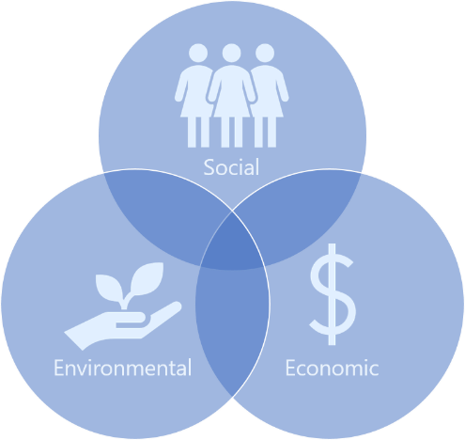
Triple Bottom Line (TBL) Approach
Economic, social, and environmental performance are evaluated using the TBL framework. The TBL strategy aligns with Google's management philosophy (Alhaddi 2015).
Economic Sustainability: Google offers chances to its staff, which leads to a highly motivated workforce. They guarantee the financial stability of their employees by offering them competitive compensation, benefits, and opportunities for specialist growth.
Environmental Sustainability: With programmes like Google Green, the company promotes environmentally sustainable behaviour and works to mitigate its impact on the environment.

Slide 12

Corporate Social Responsibility (CSR)
Corporate social responsibility, or CSR for short, is the promise a company makes to respect moral principles, promote economic development, and enhance the quality of life for its customers and employees. A list of some of the company's main CSR initiatives is provided below.
Ethical Workplace Practises: Google fosters a sustainable workplace through its dedication to moral behaviour, honesty, and dignity. Ethical behaviour contributes to a positive work environment by protecting employees' wellbeing and morale.
Community Engagement: By sponsoring educational programmes, digital literacy projects, and technology access in underserved areas, Google helps social well-being outside of the workplace.
Google's learning initiatives, including Google for Education, encourage high-quality education by giving educators and students access to digital resources that improve learning possibilities worldwide.
Gender Equality: Google's commitment to diversity and presence promotes gender equality in the workplace by supporting it among its staff.
Economic advancement: Google contributes to the well-being of its workers by offering competitive pay, opportunities for advancement in the workplace, and a positive work atmosphere.
Collaborations to Achieve the Goal: Google works with a wide range of institutions, governmental bodies, and nonprofit organisations to achieve and advance common educational objectives, technology accessibility, environmental sustainability, and social well-being.

Slide 13

Conclusion
Google's success can be attributed to its corporate culture, guiding principles, and benchmarks. The organisation has created a genuinely unique and impactful work environment through its commitment to creativity, user-focused methods, moral conduct, respect, and teamwork.
Examined through the lenses of practises like the TBL framework, corporate social responsibility, and the Sustainable Development Goals, it is evident that Google actively promotes sustainability both inside its own organisation and for the benefit of its employees and the wider public.
Additionally, by pinpointing areas for improvement and supporting certain suggestions, Google can improve both the atmosphere of its workplace and its efficiency.
The key elements of an inspiring, empowering, and highly skilled work environment are preserving work-life balance, encouraging inclusivity, supporting social responsibility initiatives, advocating for lifelong learning, enhancing broadcast networks, acknowledging employee contributions, funding employee well-being, and funding employee recognition.
Google's organisational culture affirms the company's commitment to excellence, innovation, and social responsibility. Adhering to these values and consistently improving its workplace practises, Google is positioned not just to maintain its leadership position in the global technology industry but also to serve as an example for other organisations seeking to foster positive and orderly work environments.
As Google continues on its path, it will have the opportunity to shape not only the direction of technology but also the nature of work itself, setting an important precedent for future generations.

Slide 14

Reference
Alhaddi, H., 2015. Triple bottom line and sustainability: A literature review. Business and Management studies, 1(2), pp.6-10.
Azeem, M., Ahmed, M., Haider, S. and Sajjad, M., 2021. Expanding competitive advantage through organizational culture, knowledge sharing and organizational innovation. Technology in Society, 66, p.101635.
Bagga, S.K., Gera, S. and Haque, S.N., 2023. The mediating role of organizational culture: Transformational leadership and change management in virtual teams. Asia Pacific Management Review, 28(2), pp.120-131.
Bortolotti, T., Boscari, S. and Danese, P., 2015. Successful lean implementation: Organizational culture and soft lean practices. International Journal of Production Economics, 160, pp.182-201.
Bowers, M.R., Hall, J.R. and Srinivasan, M.M., 2017. Organizational culture and leadership style: The missing combination for selecting the right leader for effective crisis management. Business horizons, 60(4), pp.551-563.
Büschgens, T., Bausch, A. and Balkin, D.B., 2013. Organizational culture and innovation: A meta‐analytic review. Journal of product innovation management, 30(4), pp.763-781.
Chatman, J.A. and O’Reilly, C.A., 2016. Paradigm lost: Reinvigorating the study of organizational culture. Research in Organizational Behavior, 36, pp.199-224.
Hogan, S.J. and Coote, L.V., 2014. Organizational culture, innovation, and performance: A test of Schein's model. Journal of business research, 67(8), pp.1609-1621.
Steiber, A. and Alänge, S., 2013. A corporate system for continuous innovation: the case of Google Inc. European Journal of Innovation Management, 16(2), pp.243-264.

