Slide 1

BMSW4003 – Digital skills and Research metods
How do students use technology to collaborate at UWTSD?
SEYED NAVID NASIRPOUR
FLAVIUS PRUNA – 2129728
CRISTINA SERBAN - 2128929

Slide 2

INTRODUCTION:
DEFINITION OF TECHNOLOGY:
Education technology is the combined use of computer hardware, software and educational theory and practice to facilitate learning.(Hashim, H. (2018)
IMPORTANCE OF TECHNOLOGY:
Talk in real life
Increased security
Easier sharing of information
DEFINITION OF COMMUNICATION:
Educational communication is an umbrella term that encompasses all speaking, listening and relation construct and concepts that relate to learning.(Elfadni, M.A.F. (2019)
IMPORTANCE OF COMMUNICATION:
Creates bonds
Improves teamwork
Builds up trust
QUESTION:
Are students confident in using technology to collaborate?
FLAVIUS PRUNA - 2129728

Slide 3

RATIONALE:
Good communication creates teams and improves teamwork.
Communication builds up trust/reliability between people.
Technology is making real time communication possible.
Technology has made the communication more secured then ever.
FLAVIUS PRUNA-2129728

Slide 4

Proposed Method:
Questionnaire MS FORMS
FLAVIUS PRUNA- 2129728

Slide 5



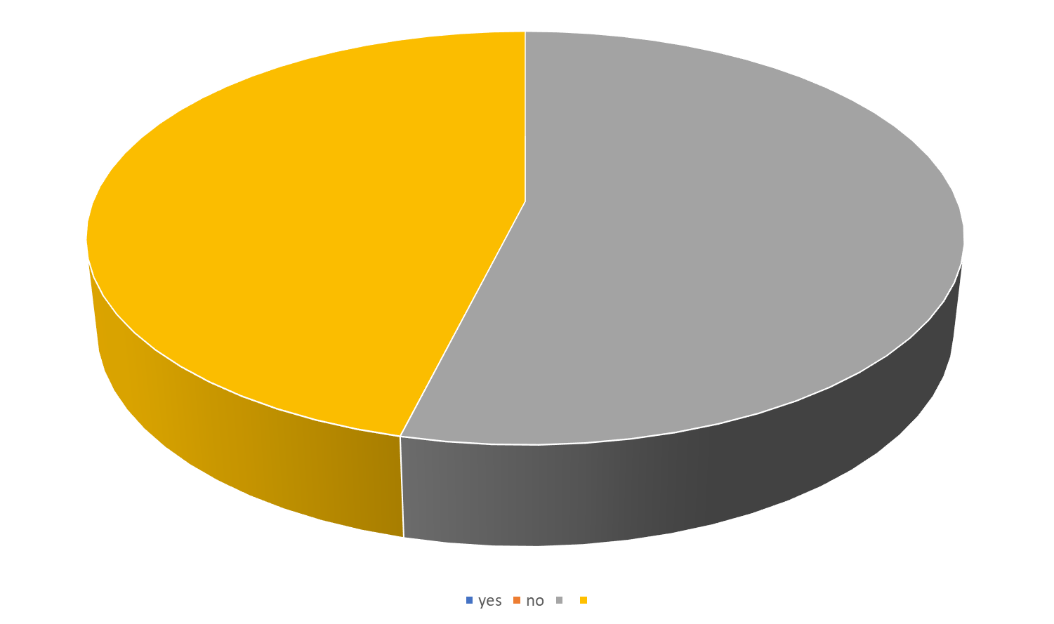
Ethical consideration
34,70% of people says that technology
is not helping because:
Are make the people too be dependent on technology to do things for them.
Decreases people's ability to think for themselves.
Lowers the quality of relationships by reducing personal interactions
65,30% of people says that technology helps:
To keep them better informed
To communicate
To contribute to a better quality of life.
To makes people to feel more productive in their personal life.(Suri, H., (2020).
Cristina Serban 2128929

Slide 6

Research timeline
A table listing important events for successive years within a particular historical period
Definition
Week 1 | Week 2 | Week 3 | Week 4 | Week 5 | Week 6 | Week 7 | Week 8 | Week 9 | Week 10
Module introduction | Finding and understanding information | Research design | Research Skill - Ethics | Research Skills - Writing a proposal | Practical Assessment | Research - Data Collection | MS Excel, Research - Analysis | Structured session. | Final Report Completion Workshop
Cristina Serban 2128929​

Slide 7


Hypothesis
I think technology is good because:
can be helpful in life for example , with technology can be save the time , cost access to information , starting new business .
I think technology is bad because :
With technology people forget to spend time with each other.
Make the people to be obesity with phone laptops game .
Children forget to spend time with their friends and to play with them .
Cristina Serban 2128929

Slide 8
Reference List:
Hashim, H. (2018). Application of technology in the digital era education. International Journal of Research in Counseling and Education, 2(1), 1-5.
Elfadni, M. A. F. (2019). The Importance Of Communication Skills Of Educational Leaders On Management. International Journal of Advanced Research in Education and Society, 1(1), 30-34
Suri, H., (2020). Ethical considerations of conducting systematic reviews in educational research. Systematic Reviews in Educational Research, pp.41-54.

