Slide 1
Health, Wellbeing and Sustainable Development in Health and Social Care
Student name : Oana Livadaru
Student id :2316786

Slide 2
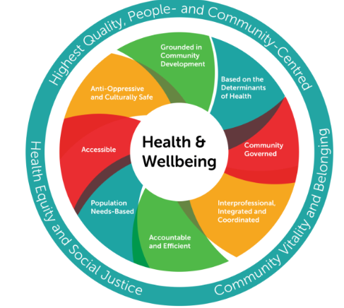
INTRODUCTION
People have the right to health and well-being.
Improved long term health outcomes result from long term sustainable development (Lakioti et al., 2025)
More emphasis is now placed on a more holistic approach in healthcare.
Public policy interventions work to improve public health.
Focus is always being placed on equitable and available health care for all.
Lakioti et al., 2025
Notes:
Health and wellbeing represent a fundamental component for the development of human beings and their quality of life. Given the growing challenges encountered in recent times, in the field of healthcare, caused by environmental changes, chronic and evolving disease patterns and the process of population aging, there have been changes (Lakioti et al., 2025). The purpose of this conference is to present an analysis regarding the relationship between the dimensions of health and Wellbeing for the sustainability practices and policies on health and Social care.

Slide 3
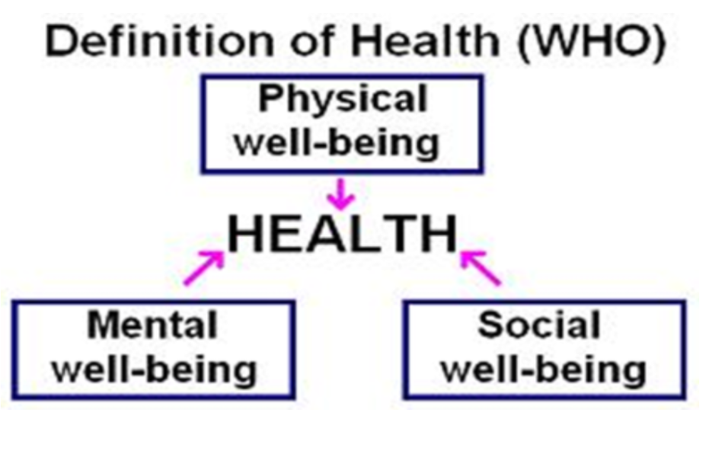
Understanding Health
WHO states health is complete physical, mental, social Wellbeing (World Health Organisation, 2025)
Health not just absence of illness.
Physical health means how your body works as well as physical fitness.
Mental health is the state of your mind & soul to live a fulfilling life.
Social health is your ability to interact and connect with others.
World Health Organisation, 2025
Notes:
From WHO guidelines, we can understand that the health is described as a perfect wellbeing in all areas that integrate the human being’s life, that is, physical, psychic, socil but it is important that, to describe health as a total Wellbeing, we avoid to compare its definition to only as “not suffering diseases” (World Health Organisation, 2025). This concept entails that everything influences how health can happen; social, economic or environmental conditions, as well as, social interactions. Physical, mental and social health.

Slide 4
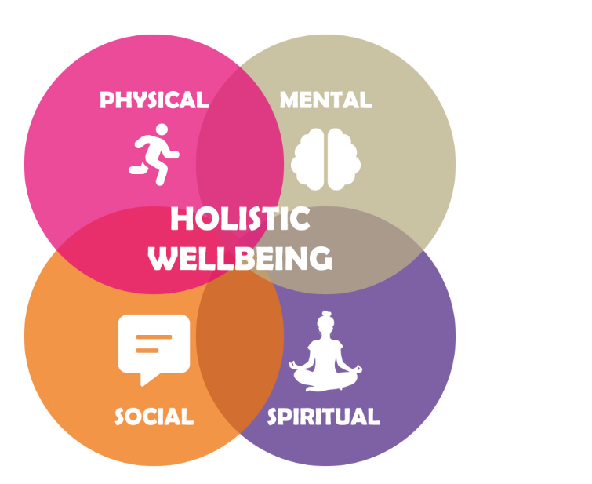
Understanding Wellbeing
Holistic wellbeing encompasses physical, mental and emotional health (Fatima et al., 2025)
This helps build resilience and improve satisfaction in life
Promotes social wellbeing and overall healthy life style
Fatima et al., 2025
Notes:
Wellbeing refers to an approach of a wide range of perspectives regarding human life and activities, for instance: It concerns about mental, physical, emotional well being it is concerned with social wellbeing or family and communities relationships; its important to foster an environment that could improve resilient people and a higher level of satisfaction and positive results in people’s life in terms of wellbeing, as it promote a successful lifestyle (Fatima et al., 2025). Wellbeing has gained importance as an indispensable complement to health among the world's healthcare providers.

Slide 5
Sustainable Development in HEALTHCARE
Considers needs now as well as needs of future.
Supports economic, environmental and social considerations (Padilla‐Rivera et al., 2025)
Uses healthcare effectively and economically.
Takes care of the environment.
Develops the health of people in the long term.
Notes:
It defines a form of development that is characterised by the use of resources at a responsible pace, so that present generations have what they need, without prejudicing what future generations require to survive. This approach implies the development of three pillars on an equitable basis: ecological, social, and economic; they also influence more in the use of resources so they can be used in the healthcare system in a proper way (Padilla‐Rivera et al., 2025). It aims to maintain the efficiency in using health care sources while protecting nature and to ensure that citizens have a positive and durable life expectancy.

Slide 6
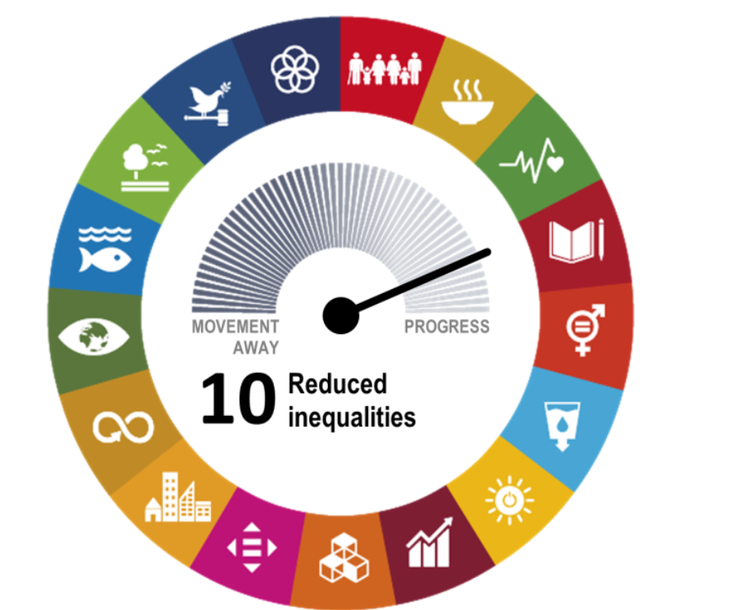
WHO Sustainable Development Goals
Healthcare helps address a variety of SDGs.
The relevant SDGs are : Good health and wellbeing (SDG 3)
Clean water and sanitation (SDG 6)
Reduce inequalities (SDG 10), and Climate action (SDG 13) [55, 56, 64] (Babacan, 2025)
Babacan, 2025
Notes:
Since there is some WHOSDGs relevant for the sustainability process that affect and are affected by the healthcare system, for instanced such asSDGs3(Good Health and Wellbeing), SDGs6(Clean Water and Sanitation) and SDGs10 (Reduced inequalities) are some SDGs that reflect our actual needs to reach a fair society (Babacan, 2025). There are more SDGs that represent an important part to take into consideration to promote the health wellbeing of all the people on the earth, such asSDG13(Climate Action).

Slide 7
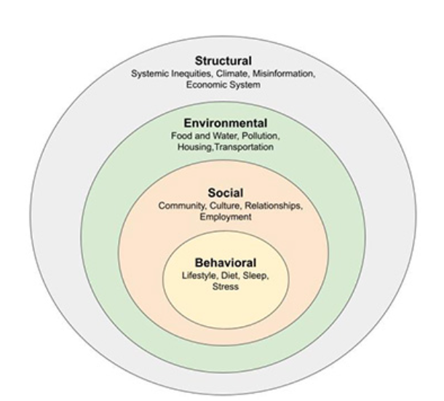
Integrated Health and Wellbeing Approaches
Focus on individual needs and preferences – Person centred care.
Understanding the need to take care of the body and the mind.
Focus on prevention not treatment.
Taking into account social and environmental factors when making care plans (Chomać-Pierzecka et al., 2025)
Which results in improved patient health and quality of life.
Chomać-Pierzecka et al., 2025)
Notes:
The biggest focus of holistic treatment is on the relationships that connect biological, psychological and social components that affect health outcomes. A combined approach and service helps to bring a wider perspective and understanding of the whole person, which in turn improves patient satisfaction, care effectiveness and overall well-being (Chomać-Pierzecka et al., 2025)

Slide 8
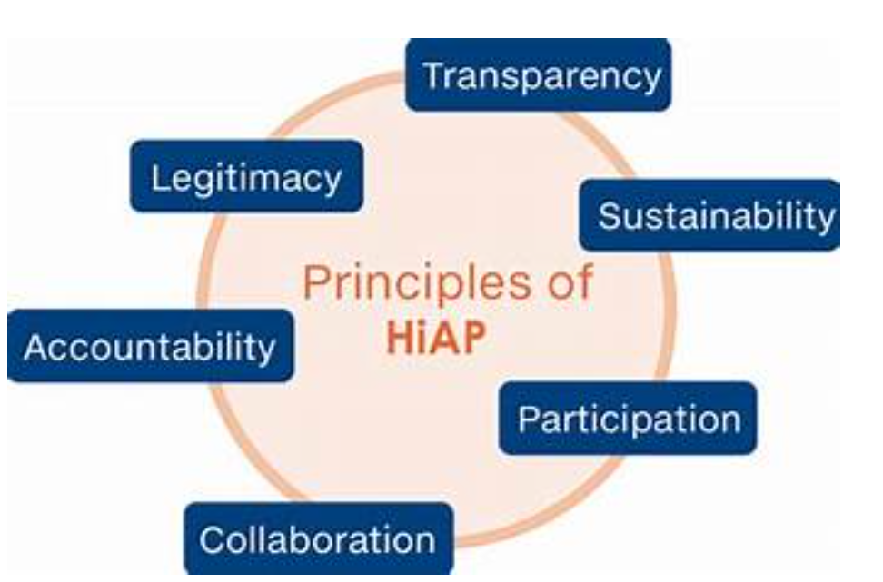
Sustainable Development Frameworks in Health Policy
Health in All Policies (HiAP)
Participation in intersectoral action for health: a WHO policy tool.
Incorporating health issues into all public policies (housing, education, economy) (Ragheb et al., 2026)
Working to tackle social and environmental determinants of health.
Designed to improve the health of the population in a sustainable manner.
Ragheb et al., 2026
Notes:
Health in All Policies is a policy tool endorsed by the WHO, which seeks to integrate health issues into policymaking in other policy areas including housing, employment and environment ((Ragheb et al., 2026). Here the idea is that non-health policies make a difference to health, and working together across sectors, the creation of more equitable and healthy societies can be enhanced.

Slide 9
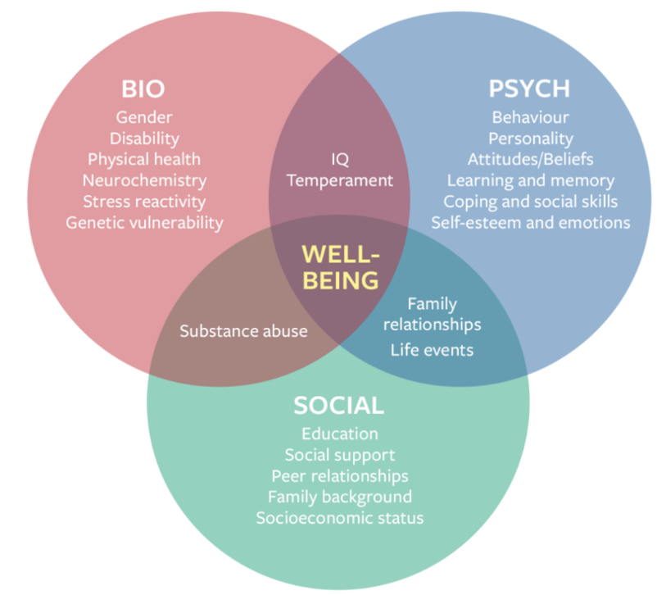
Theoretical Perspective - Biopsychosocial Model
Engel's Biopsychosocial Model
Biological processes that can help or hinder health or illness.
Psychological processes that impact health (emotions, thoughts, beliefs, coping) (Lopez-Cruz, 2025)
Health impact of social processes (family, culture, socioeconomic status).
Whole-person approach to health.
Lopez-Cruz, 2025
Notes:
The biopsychosocial model was proposed by George L. Engel, and provides a more comprehensive understanding of illness and health care than the biomedical model. It recognises that there is a complex interaction between biological, psychological and social factors, allowing health care workers to evaluate and treat individuals as whole persons (Lopez-Cruz, 2025)

Slide 10
Policy and Governance
NHS LT Plan priorities ‘integrated care’ and ‘preventative measures’ (Wood et al., 2026)
Building greater awareness and resources for mental health care services.
policy frameworks that ensure the health and well-being of the public.
Governance procedures to provide safe and quality health service delivery and an appropriate system of accountability.
Notes:
Targeted policy interventions, like the NHS Long Term Plan, are purposefully driving the health sector to adopt more integrated, preventative and community-based approaches (Wood et al., 2026). Good governance is essential to make health care services safe, effective and accessible and to address the needs of a modern people, like the increasing awareness of mental health issues.

Slide 11
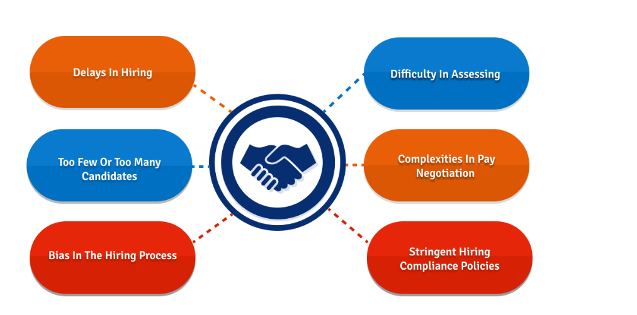
Challenges to Implementation
Underdfunded and budget limitations.
Expansion of health care needs.
Problems with recruitment and retention of the workforce (Mane et al., 2024)
A complicated regulatory system and burden.
Digital inclusion and access to all the people.
Mane et al., 2024
Notes:
Although there are policies in place for an integrated and sustainable system, there are still significant challenges to be addressed for effective implementation (Mane et al., 2024). There are a number of significant barriers that need to be overcome for the reforms to bring the full benefits; these include financial constraints, stretched staff, increasing demand, the complexity of regulating a large number of providers and disparities of access to digital resources.

Slide 12
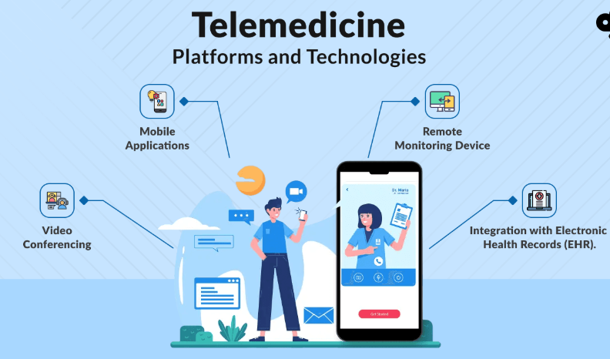
Service delivery and holistic care model
Modern Healthcare Delivery with Telehealth as an access to services (Koneru, 2025).
Wellness programs that encourage healthy lifestyle.
Local support is made available to the community in a way that makes an improvement.
Collaborative multi-disciplinary teams are also support the patients' seamless journeys.
Koneru, 2025
Notes:
Health services are provided has changed in a dramatic manner. Consultations are now available by telemedicine, wellness programmes actively encouraging people to adopt health promoting behaviours and initiatives are happening closer to home (Koneru,2025). Multidisciplinary teams with close collaboration of them assure coordinated and personalised patient care.

Slide 13
Public Health Initiatives
Promoting Healthier Communities
Directed campaigns to lower the smoking rate.
Obesity prevention/reduction and healthy eating programs.
Promoting physical activity for people of all ages (World Health Organisation, 2023)
Efforts to enhance the environment locally and minimise exposure to health risks.
To strengthen community capacity building to own their health.
Notes:
Public health has long been known to have an important role to play in enhancing the well-being of populations. Public health units implement campaigns and programs to help prevent disease and promote healthier environments for people and communities to live in, through such initiatives as smoking cessation, healthy weight, physical activity and environmental health (World Health Organisation, 2023).

Slide 14
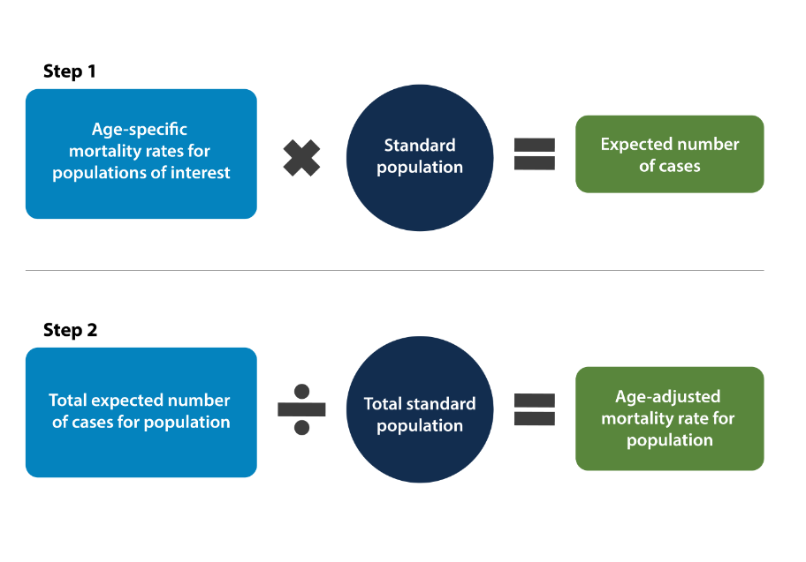
Equity and Access
Being aware of the effects of socio-economic factors in health.
Accessibility to health services in rural/remote communities.
Addressing racial/ethnic inequities in health.
Striving to provide all citizens with universal health care.
Formulating specific services for specific vulnerable and under-served population segments (Velmurugan et al., 2026)
Velmurugan et al., 2026
Notes:
There are persistent inequalities in health which are often substantial and some groups suffer from poorer health than others. Policy development: everyone should be free from discrimination in access to a good health service to quality to quality health services in that all people – rich and poor, in town and country or minority and majority race – should have free access, with particular focus on providing the most benefit where there is a deficit in services (Velmurugan et al., 2026)

Slide 15
CONCLUSION & RECOMMENDATION
While policy is leading the change, there are important issues to be addressed in implementation.
Expand the resources and funding for prevention and community-based health services.
Improve the co-ordination and support of mental health and social care.
Invest in health workforce and minimise administrative burden.
Notes:
In conclusion, a holistic strategy that uses policy to drive change within travel and services, alongside a significant long-term investment, greater integration, an empowered workforce and a focus on equity and sustainability, will deliver successful improvements in health outcomes for people and the environment in the longer term.

Slide 16
REFERENCES
Babacan, H., 2025. From crisis to policy action: Tackling climate change through SDG 13. The International Journal of Community and Social Development, 7(2), pp.205-221.
Chomać-Pierzecka, E., Błaszczak, B., Godawa, S. and Kęsy, I., 2025. Human safety in light of the economic, social and environmental aspects of sustainable development—Determination of the awareness of the young generation in poland. Sustainability, 17(13), p.6190.
Fatima, A., Mazhar, A., Fatima, I. and Farhan, M., 2025. HOLISTIC HEALTH DYNAMICS: HOW PHYSICAL AND MENTAL WELL-BEING INFLUENCE EACH OTHER. EMOTIONAL WELL-BEING AND MENTAL HEALTH IN HIGHER EDUCATION, p.111.
Koneru, S.H., 2025. Securing the Modern Healthcare Ecosystem: Endpoint Management for Medical Environments. Journal of Computer Science and Technology Studies, 7(4), pp.71-78.
Lakioti, E., Pagonis, N., Flegkas, D., Itziou, A., Moustakas, K. and Karayannis, V., 2025. Social factors and policies promoting good health and well-being as a sustainable development goal: current achievements and future pathways. Sustainability, 17(11), p.5063.
Lopez-Cruz, O., 2025. The Engel’s Biopsychosocial Model in Engineering: Humanistic Education for Engineers, a Systemic View and Practice. International Journal, 13(4), pp.164-174.
Mane, P., Gurav, Y., Yadav, A., Bhagat, H., Yesugade, A., Pisal, D.S. and Thorat, M.S., 2024. Healthcare Workforce Management: Addressing Challenges in Recruitment, Retention, and Training. South East Eur J Public Health, 23, pp.120-34.
Padilla‐Rivera, A., Hannouf, M., Assefa, G. and Gates, I., 2025. Enhancing environmental, social, and governance, performance and reporting through integration of life cycle sustainability assessment framework. Sustainable Development, 33(2), pp.2975-2995.
Ragheb, C., Shankardass, K. and Noonan, L.L., 2026. Self-study tool for integrating health equity into Health in All Policies (HiAP) initiatives. Canadian Journal of Public Health, 117(2), pp.384-390.
Velmurugan, R., Bhuvaneswari, R. and Thirumalaisamy, R., 2026. Inclusive Innovation: Designing Health Enterprises for Underserved Populations. In Ethical Business Modeling for Healthcare Entrepreneurship (pp. 133-160). IGI Global Scientific Publishing.
Wood, K., Ahmad, N., Woods, G., Shoker, H. and Hughes, J., 2026. Invisible patients, unsustainable practice: insights from 20 000 wounds to drive solutions across integrated care systems. British Journal of Healthcare Management, pp.1-24.
World Health Organization, 2023. Promoting physical activity for older people: a toolkit for action. World Health Organization.
World Health Organization, 2025. From loneliness to social connection: Charting a path to healthier societies: Report of the WHO Commission on Social Connection.

Slide 17
Thank you

