Slide 1
A demonstration of leadership skills required within my role as a TAP, in response to an increased workload
Mask Fit Testing by Vicki Angulatta

Slide 2
Contents
Introduction
What is mask fit testing and when would we use it?
Leadership skill required to be a mask fit tester
Recording data
Equipment used
Conclusion

Slide 3
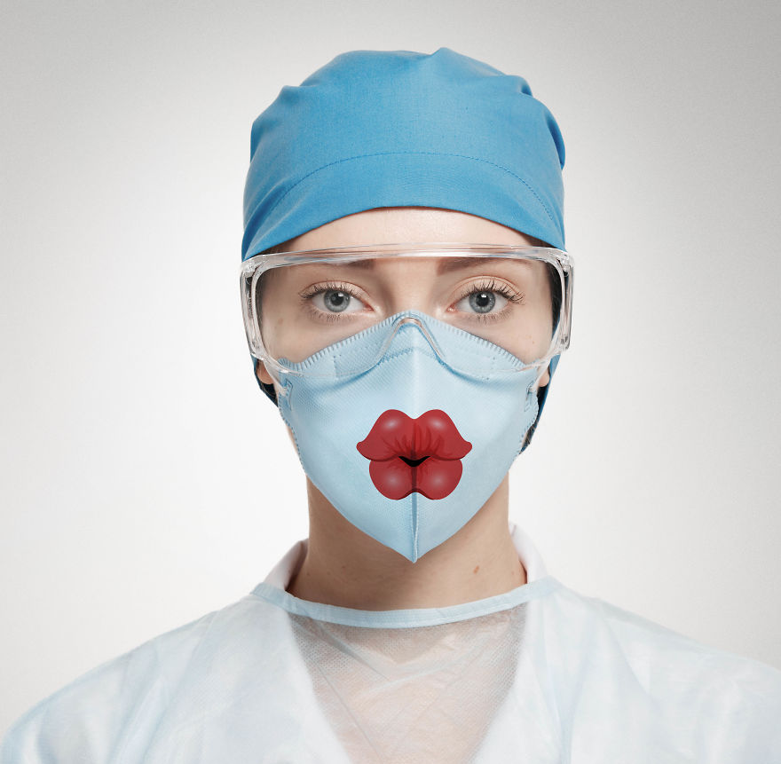
Introduction
Becoming mask fit tester
Implications of being a tester
Becoming the only tester in therapies in UHL
Notes:
I became a fit mask tester in 2020 when Covid hit as I was volunteered by my line manager. He wanted someone to hand who was able to do this but not a qualified member of staff in case they were redeployed to the Covid wards, ITU etc…
As you can imagine, when Covid hit, the vast majority of front line staff were mask fit tested for reasons of safety. A lot of my team had already been tested due to the area that we work in but everyone was retested to ensure that the personal protective equipment (PPE) that they were using was still effective. There wasn’t necessarily a record of when people were tested previously. The number of people that needed testing increased quite dramatically, which initially had a an impact on my day to day job as time was needed to be taken out of my day to ensure that anyone who needed the mask fit testing, received it. A number of my day to day tasks were delegated to my counterpart, Steve, and to some of the qualified members of staff. This did initially have an impact on our work in general but as our patients started isolating at home, our ward based work decreased massively, outpatient work pretty much stopped, unless necessary and the Pulmonary Rehabilitation Unit closed completely during this time. Our time was then focussed on working out virtual solutions to aspects of care so as there was less patient traffic coming through the hospital, so, this enabled me to use the time to do the testing. Also, we were not redeployed so that also helped me to utilise the time to do the testing.
Not as impressive as it sounds. In the last few years, a lot of the testers have changed jobs or left the Trust and unbeknown to me, I was the only person in Therapies in UHL who was trained to do the testing. It was apparently also unknown to anyone outside of my team as nobody else seemed to remember that I had done the training so was not asked to do any testing, This could also be due to therapies having to order new testing equipment. Since the end of the Pandemic, my testing has been limited to the people on my team, when they need retesting or testing the rotational staff as they come through our unit. Initially it had a massive impact on my work, but they were very strange times, anyway so not all of the change was due to this.

Slide 4
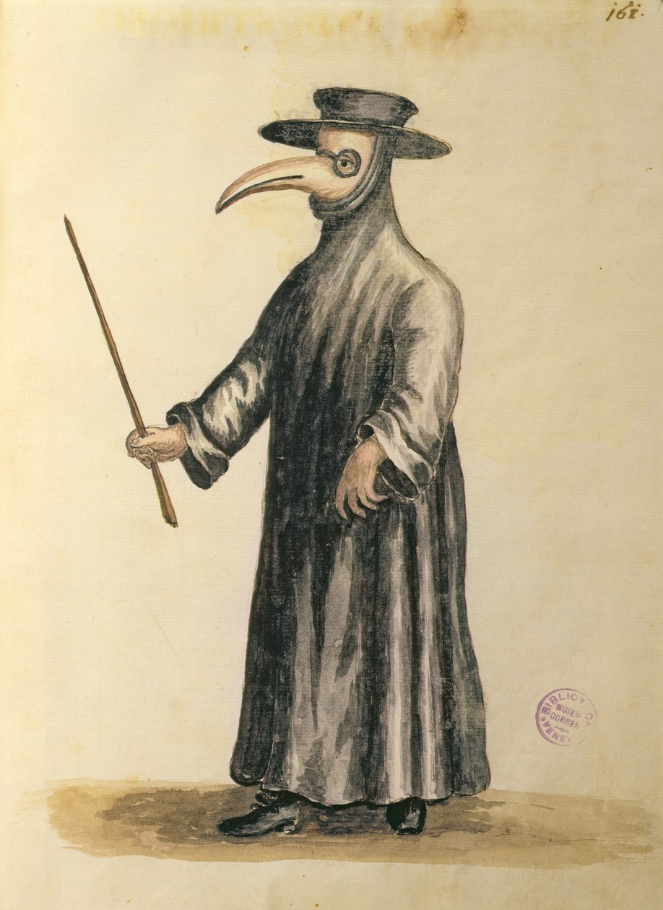
What is Mask Fit Testing and when would we use it?
What is mask fit testing?
Why do we use it?
When would we use it in a hospital setting?
NHS Health Education England, (2020). COSHH (2020). Health and Safety at Work Act 1974, (2014). WHO, (2022)
Notes:
According to NHS England “Fit testing is a method for checking that a specific size of tight fitting face-piece matches the wearers facial features and seals adequately to the wearers face. It will also help to identify unsuitable face pieces that should not be used”. When testing we use a qualitative test that is just a pass / fail procedure that is designed to test for leakage using taste or smell, but does not test the amount of leakage. There is also a quantitative test that provides numerical measure of the fit but this is more difficult to carry out and require specialised equipment.
It is requirement by Law that Personal protective equipment (PPE) be provided by an employer in a workplace setting, when required. It is stated in the Health and Safety at Work Act (1974) and The Control of Substances Hazardous to Health Regulations 2020 (COSHH, 2020), state that “Every employer shall ensure the exposure of his employees to substances hazardous to health is either prevented or, where this is not reasonably practicable, adequately controlled”. It is to protect us and also to stop the spread of diseases.
We would use this when we know that we are about to be exposed contagious or transmissible hazards. The World Health Organisation (WHO) says that “Biological agents transfer from person to person by direct or indirect contact. Health workers maintain close contact with patients. Thus, they need PPE that protects them from potential transmission”. Again, we remember the pandemic when any of us working with Covid+ patients were fit tested but mask fit testing is also used to prevent the spread of more common or garden illnesses like flu or TB.

Slide 5
Leadership skills required to be a mask fit tester
Organisational skills & flexibility
Communication skills
Collaboration skills
Accountability
UCL, (2021)
Notes:
Organising time during a working day to get groups together for the testing can prove difficult as everyone has their own caseload and not everyone works full time so organising a time can be difficult, trying to be as flexible is an advantage but this has to be weighed up with managing my own caseload and potentially delegating tasks to other members of staff. Keeping track and making sure that everybody’s tests are up to date and they have been tested within the last 3 years is also my responsibility. At least, those within my team. It is up to the individual to keep track of when they need retesting.
There are a number of steps during the testing that each person has to be walked through, it starts off easy with normal breathing, then deep breathing, talking and bending over and all of these things have to be timed, whilst also continuing to dose the person being tested so as a tester you are constantly telling the person what to do and when to do it.
Trying to organise a place to do the testing can also prove difficult. Having to find an available room that can be booked out for a block of time can be challenging so forging relationships with the people in charge of these rooms is a must.
According to University College London (UCL, 2021)“As a fit tester, you have duties under Health and Safety at Work Legislation because if you do not carry out a fit test properly the wearer could be exposed to substances hazardous to health due to facepiece leakage”. It is my responsibility to make sure that the test is done correctly, if not the implications could be disastrous (e.g. someone catching TB whilst wearing a mask that didn’t fit properly).

Slide 6
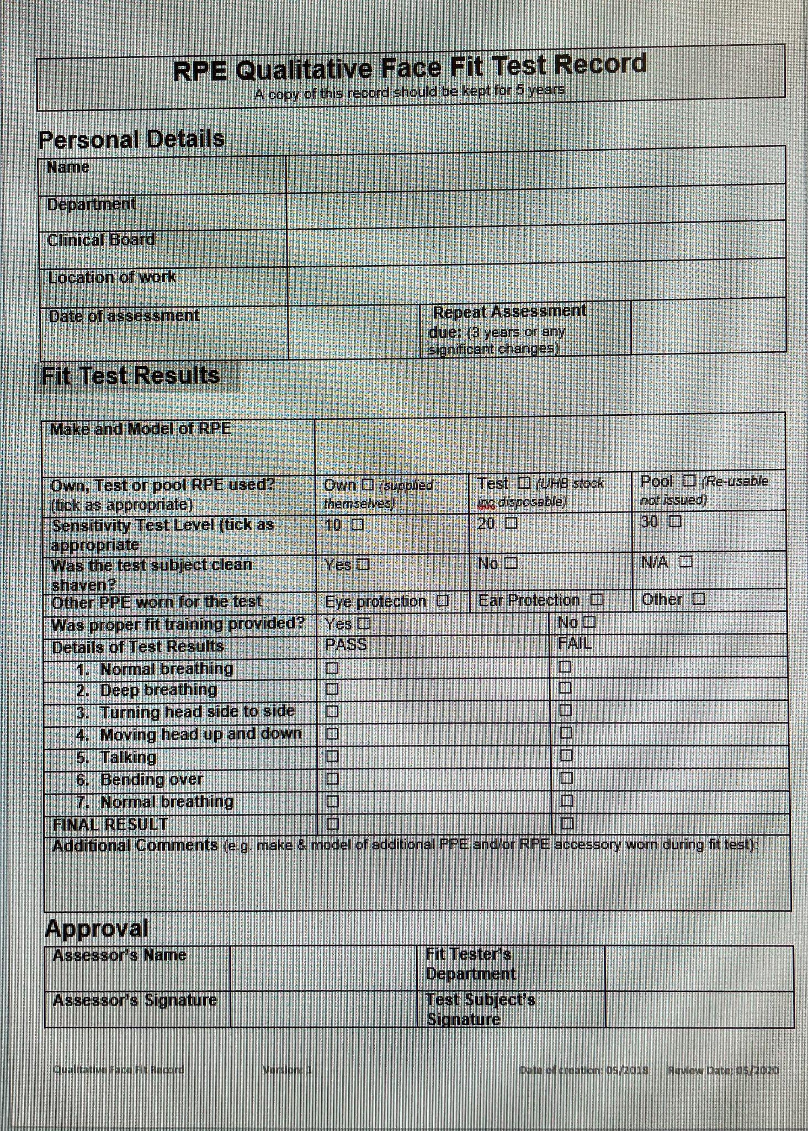
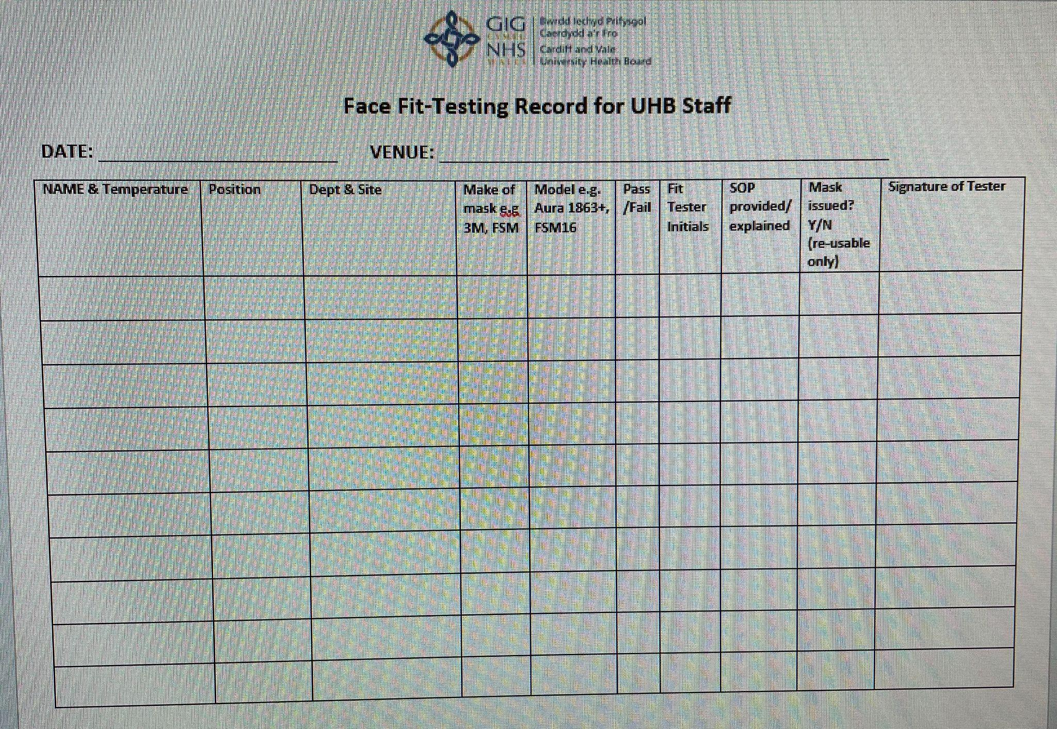
Recording Data
Forms that capture the data.
The information is uploaded to a database.
Notes:
The first document records the member of staff, their position, their department, the site they were tested on, they make of the mask being tested as well as the model, then there is a box to say whether they passed or failed the test using that particular mask. If they fail then we try a different style of mask.
The second document deals with the test itself and whether the member of staff was clean shaven etc… and then you have to tick step of the test so you can see where the test failed, if indeed, it did.
Once the member of staff has passed a test then the details are recorded on a database so we can keep track of who was tested and when and what mask they require. I haven’t uploaded a copy of the database as it has staff details on there but there are categories for rotational band 5s, rotational band 6s and the different departments. If the person fails all of the masks then they are sent to UHW for further testing.

Slide 7
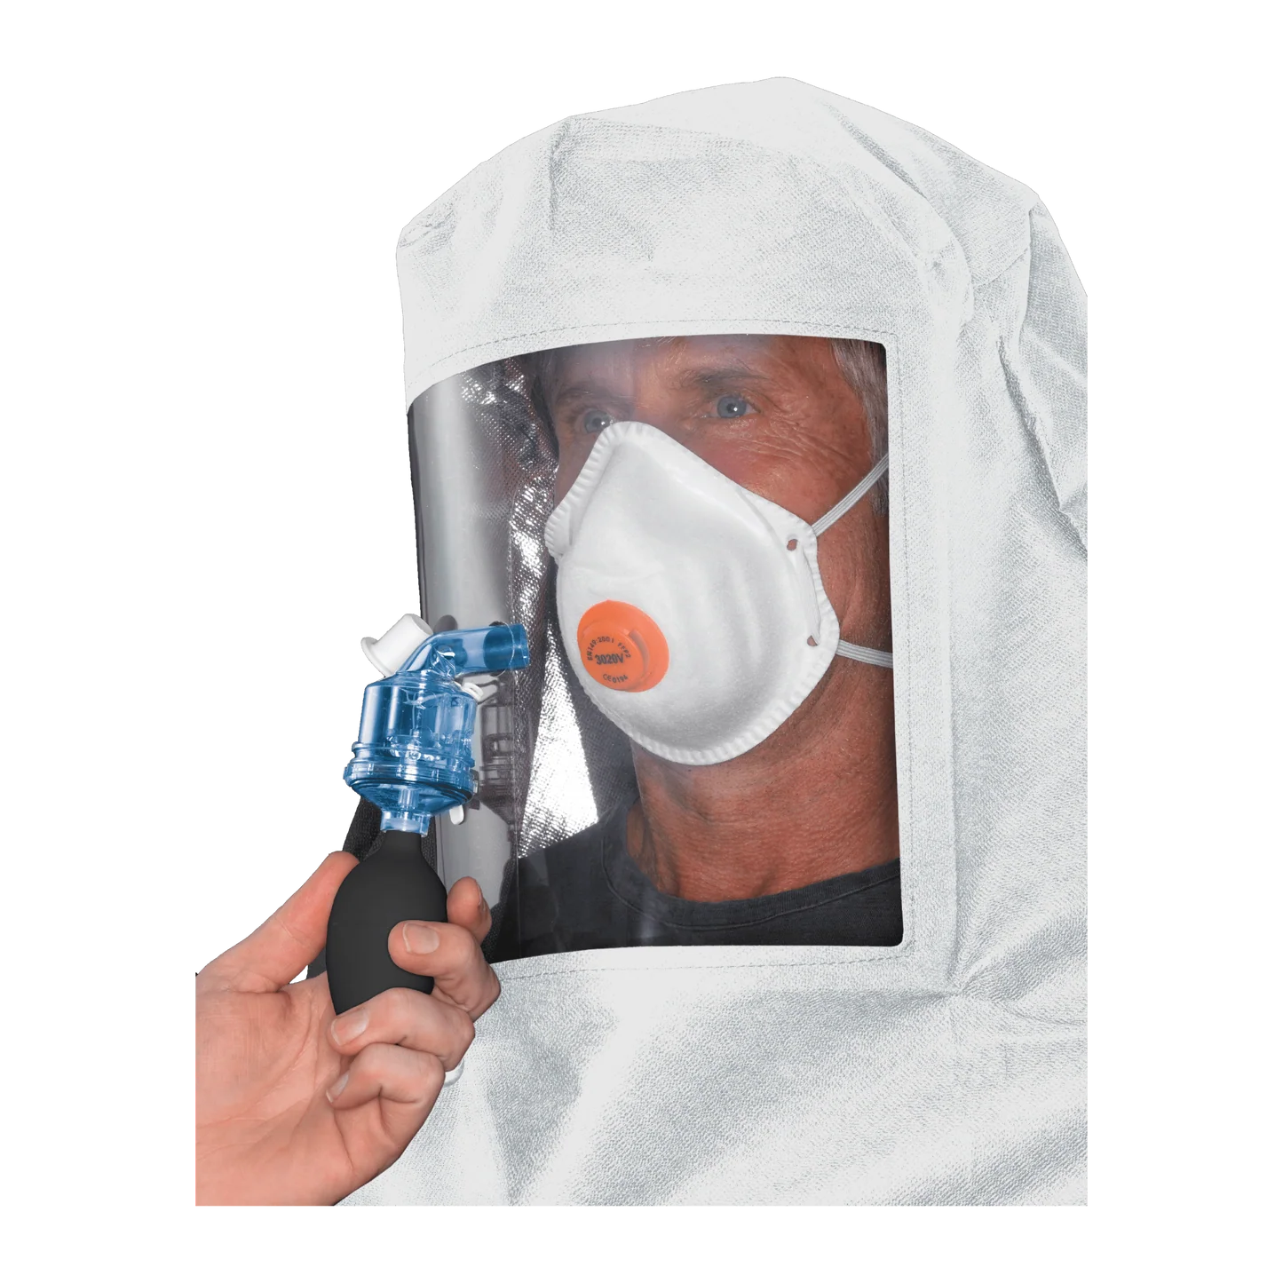
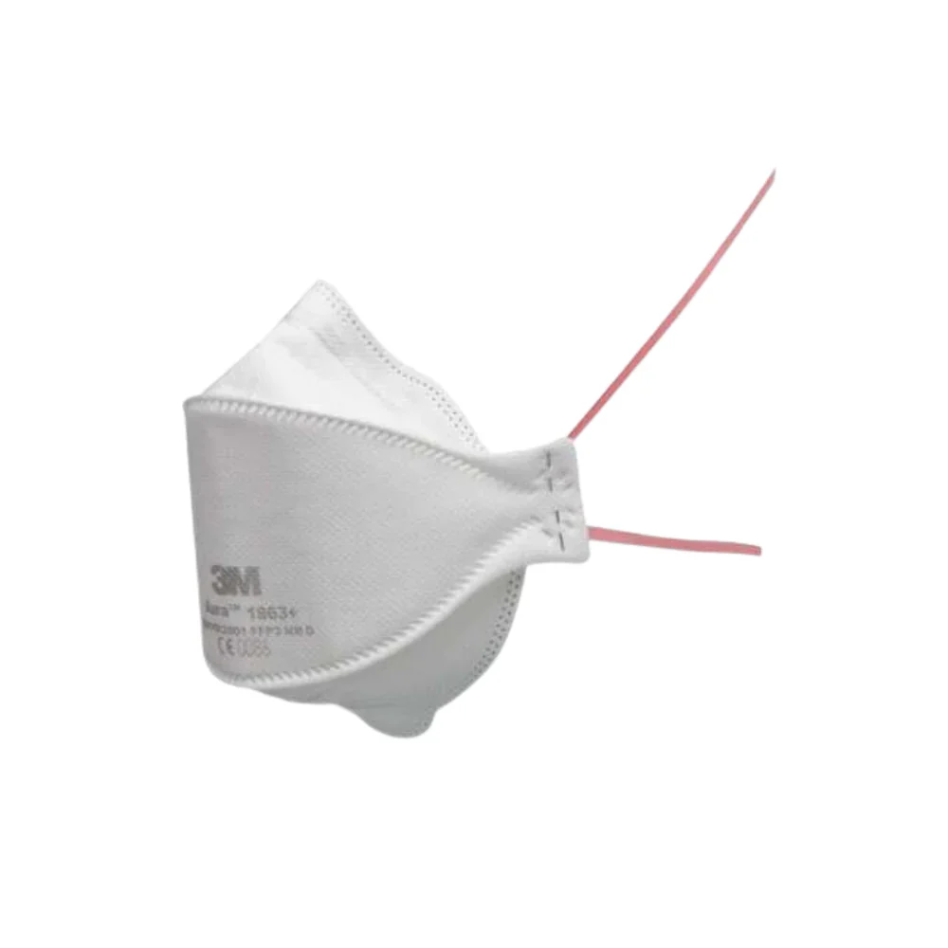
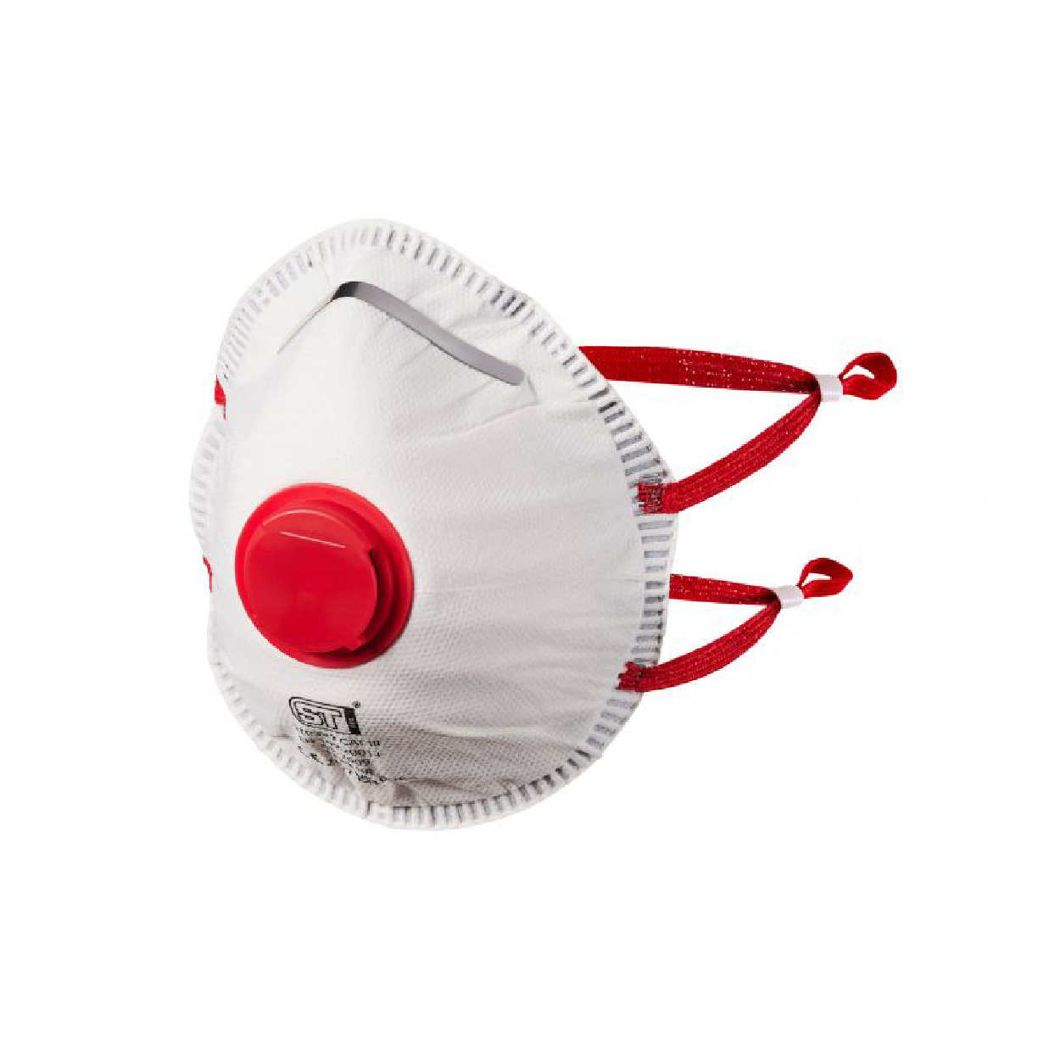
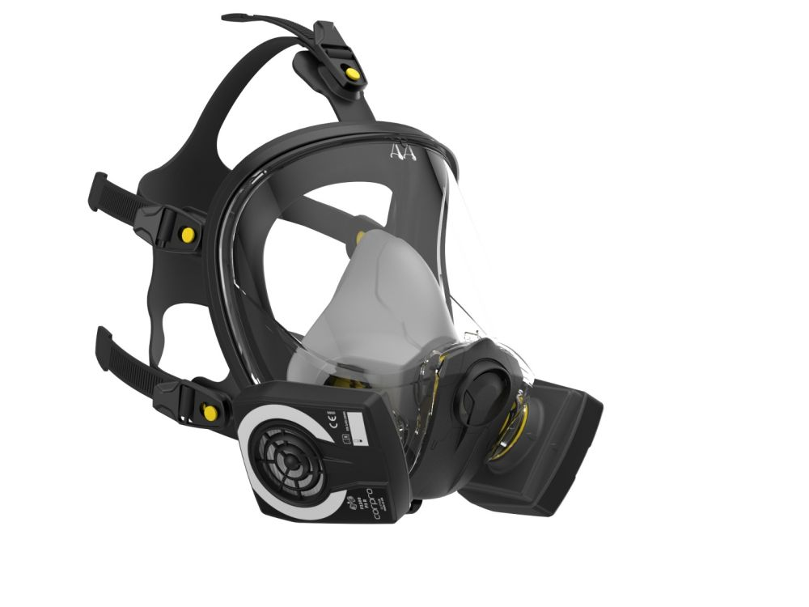
Equipment used
Options…
Notes:
On the right of the screen is the equipment used for the qualitative testing, which is what we do.
Aura 9330 - this is the standard mask that most people use.
Valved mask, more solid in design
Full face mask. Ours don’t actually have a built in visor and if a visor is required then these are separate pieces of equipment and do not always fit over the bulky 3rd option.
No facemask is really comfortable but the the first option is the better one so I would hope to pass the test for this. It is also disposable as is the second mask but the third option, you have to keep hold of and use repeatedly so you have to find somewhere to safely store it. This is not ideal when working on a ward.

Slide 8
Conclusion
Mask fit testing is necessary for a safe working environment
It is not a job that is required to be carried out by a qualified member of staff
It forces me to use my leadership skills to arrange, execute and record the testing
It has helped develop my confidence in an area that was previously alien to me and to be more confident in my own ability
Tzu, L (1993)
Notes:
No person should be put at risk just by simply doing their job. We have to try to mitigate any and all hazards as we are able and proper mask testing is imperative to keeping staff safe.
By training HCSWs to do the job, it freed up qualified staff to get on with their jobs in a very uncertain and scary and potentially life threatening time.
The organisational skills required and co-ordinating of group testing is the hardest part of this job. Trying to accommodate people from different teams, with different schedules can prove to be trying.
Being accountable for someone else’s well being was a scary prospect but knowing that a job done well was not just protecting staff members but it had further reaching benefits as patients could then be treated effectively. It ensured that “business carried on as usual” during a time when the world was coming to a standstill.
I will finish with a quote by Lao Tzu which is “A leader is best when people barely know he exists, when his work is done, his aim fulfilled, they will say : we did it ourselves”. Which I have taken to mean that you don’t need titles to be a leader, you don’t need to be loud and for everyone to know that you are in charge. You need to see what needs to be done and do it effectively. People will follow voluntarily if you quietly show results.

Slide 9

Questions??

Slide 10
References
NHS Health Education England, (2020) What do I need to know about Fit Testing for FFP3 (and FFP2/N95), Respiratory Protective Equipment for Dental Practice?. Available at: https://www.england.nhs.uk/south/wp-content/uploads/sites/6/2020/07/hee-fit-testing-overview.pdf (Accessed: 06/11/2025)
The National Archives, (2002) The control of Substances Hazardous to Health Regulations 2002. Available a: https://www.legislation.gov.uk/uksi/2002/2677//regulation/7 (Accessed: 06/11/2025)
The National Archives, (2014) The Health and Safety at Work Act 1974. Available at: https://www.legislation.gov.uk/ukpga/1974/37/section/2 (Accessed 06/11/2025)
Tzu, L. (2003) Tao Te Ching, London, Penguin Books Ltd

Slide 11
References continued
University College London, (2021) Responsibilities of a Face Fit Tester. Available at https://www.ucl.ac.uk/safety-services/policies/2021/nov/responsibilities-face-fit-tester (Accessed: 08/11/2025)
World Health Organisation, (2022) Health Products, Policy and Standards: PPE and the Healthcare workforce. Available at: https://www.ucl.ac.uk/safety-services/policies/2021/nov/responsibilities-face-fit-tester (Accessed: 06:11/2025)

