Slide 1
Psychological Lifespan Development: Supporting Jenny (Age 16)
Module: Psychology in Health and Social Care (LCHS4010)
Module lead: Farah Wiita
Nama : Usama Bin Tariq

Slide 2

Jenny's Psychological Lifespan Development and Support Plan
1. Overview
Adolescence is a critical period of life development during which people go through significant emotional, cognitive, and social transformations. During this time, young people develop their sense of self, independence, and interpersonal connections. However, this maturation process might be impacted by challenging living circumstances.
The case of 16-year-old Jenny, who has been taking care of her mother for the past five years after her father passed away, is examined in this presentation. Jenny has taken on a lot of home and administrative duties because her mother has memory issues and mobility issues.
This lecture uses John Bowlby's Attachment Theory to comprehend the possible effects of these experiences on Jenny's growth and wellbeing. The idea will be applied to investigate how Jenny's relationships and emotional growth may have been impacted by her prior experiences. Additionally, while taking into account the impact of biological and environmental factors, the presentation will offer doable support techniques to enhance Jenny's well-being.

Slide 3
An Overview of Attachment Theory
John Bowlby created attachment theory to explain the significance of early emotional connections between children and their caretakers. Children develop deep emotional ties with caregivers who offer security, consolation, and support, according to Bowlby (1969). Emotional growth and subsequent relationships are greatly influenced by these early bonds.
Secure attachment, which arises when a caregiver continuously attends to a child's needs, is one of the key ideas of attachment theory. Children that have stable attachments frequently grow up to be self-assured, emotionally stable, and to form wholesome relationships. On the other hand, a kid who endures emotional neglect, loss, or uneven care may develop an insecure attachment. The internal working model, which describes the opinions people form about themselves and other people as a result of early attachment experiences, is another crucial idea. These ideas have an impact on how people view relationships and control their emotions throughout their lives.

Slide 4

Application of Attachment Theory to Jenny's Circumstance
Because Jenny's home circumstances have altered dramatically over the course of her childhood and adolescence, attachment theory is extremely pertinent to her scenario. She was probably deeply affected emotionally by her father's death five years ago. A young person's sense of security and emotional stability may be impacted by losing a parent while they were young.
In addition, Jenny has become her mother's caregiver. This could result in what is frequently called "role reversal," in which the youngster assumes duties that are typically carried out by adults. Although Jenny's acts show maturity and responsibility, they could also lead to stress and emotional strain. From an attachment perspective, Jenny might feel responsible, anxious, and concerned about her mother's welfare. Her emotional development and her capacity to concentrate on common adolescent activities like education, friendships, and personal development may be impacted by these emotions.

Slide 5

Jenny's Experiences' Effect on Her Growth
Several possible effects on Jenny's development can be found using attachment theory.
First of all, Jenny might be under emotional strain as a result of her father's passing and her continued duty to take care of her mother. Lack of emotional stability and support can make adolescents more susceptible to anxiety or depression.
Second, Jenny's chances for social growth can be restricted by her caregiving duties. Teenagers typically devote effort to forming friendships and honing their social skills. But Jenny's obligations at home can limit the amount of time she can engage in activities or spend with her friends. Thirdly, Jenny can encounter identity issues, which are typical of adolescence. Early adoption of adult responsibilities may have an impact on her self-perception and future social role.
Despite these difficulties, Jenny might also grow into a person with good problem-solving abilities, empathy, and perseverance.

Slide 6

Influences of Nature and Nurture
Both biological and environmental factors—often referred to as nature and nurture—have an impact on Jenny's development.
Adolescent physical and neurological changes are examples of biological variables. During this phase, the brain is still developing, especially in regions that control emotions and make decisions. Emotional well-being and coping skills may be impacted by high levels of stress during this time. Jenny's development is also greatly influenced by her surroundings. These include her father's passing, her caring duties, and the emotional atmosphere in the home. Financial strains or a lack of social support could have an additional negative impact on her wellbeing .Jenny's psychological growth and general well-being are shaped by a combination of biological and environmental factors.

Slide 7

Jenny's Support Techniques
Jenny's wellbeing could be enhanced by a number of useful support techniques based on attachment theory.
First of all, Jenny might receive both practical and emotional support if she had access to young carer support services. These services provide opportunity to meet other young carers who have similar experiences as well as guidance and counseling.
Second, Jenny might be able to deal with her sadness and mental strain with the aid of counseling or psychological support. She can express her emotions and create coping mechanisms in a secure setting with the help of a professional.
Thirdly, her school's educational support could help make sure that her caring obligations don't interfere with her academic success. Schools might offer extra academic support or deadline flexibility. Lastly, Jenny's caring load might be lessened if her mother received community care services. Assistance with household chores and administrative duties may be provided by social services or home care support.

Slide 8
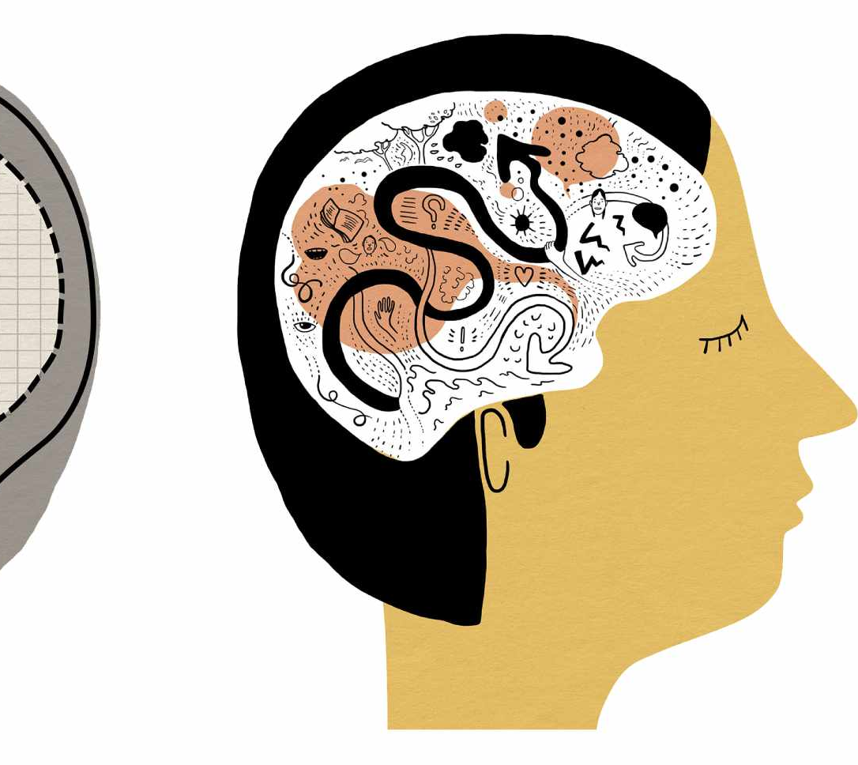
Assessment of Attachment Theory
Because attachment theory emphasizes the significance of early relationships and emotional security, it is helpful in comprehending Jenny's emotional experiences. The idea aids social workers and health care providers in understanding how young people may be impacted by emotional stress, caring duties, and loss.
The hypothesis does, however, have certain drawbacks. It may not fully take into account broader social variables including economic situations, community support, or cultural variations because it places a heavy emphasis on early childhood connections. Furthermore, as human growth is complicated, a single theory might not be able to fully account for all facet of a person's experiences. Attachment theory is nonetheless a useful paradigm for comprehending emotional development and directing support tactics in health and social care settings, despite these drawbacks.

Slide 9

In conclusion
Jenny's predicament serves as an example of how difficult living situations can affect teenage development. Her wellbeing may be significantly impacted emotionally and socially by the death of her father and her caregiving obligations.
Understanding how these events might impact Jenny's relationships and emotional stability is possible through the application of attachment theory. Professionals can create efficient support plans by acknowledging the impact of both biological and environmental elements.
Jenny's obligations might be lessened and her general well-being could be enhanced by giving her mother access to community care, counseling, young carer programs, and educational support. The goal of these interventions is to promote Jenny's growth and provide her the chance to go through a balanced and healthy adolescence.

Slide 10
References (Harvard Style)
Bowlby, J. (1969) Attachment and Loss: Volume 1 – Attachment. London: Basic Books.
Berk, L. (2018) Development Through the Lifespan. 7th ed. Boston: Pearson.
Cassidy, J. and Shaver, P. (2016) Handbook of Attachment: Theory, Research and Clinical Applications. New York: Guilford Press.
Santrock, J. (2019) Life-Span Development. 17th ed. New York: McGraw-Hill.
Becker, S. (2017) Young Carers and Their Families. Bristol: Policy Press.
Department of Health and Social Care (2021) Young Carers and Support Services. London: UK Government.

