Slide 1

Digital Skills And Research Methods
(LCHS4002_ BIRM)
By Adji Makangila and Donna Shilunga

Slide 2

Introduction
Is there a need to provide training on how to use technology to collaborate at UWTSD?
In this piece of research we are going to discuss and investigate information to find out if there is a need to provide training on how to use technology for collaboration at the University of Wales Trinity Saint David.

Slide 3

Research Found
Hinrichsen, J. and Coombs (2013) says “Information and communication technologies (ICTs) are affecting education at all levels, including higher education and most economic sectors”. Therefore, ICT has been a systematic way of encouraging students to develop digital skill that enable them to operate at the new technology system impacting in their learning. This is because most student will use their ICT digital skill in order to make it easy when doing their assignments by using Microsoft programs and it is more advantaged when researching information for their study’s module provided by the university.

Slide 4
Research Found
Ben Youssef, A., Dahmani, M. and Ragni, L.(2022) “Fourth, several recent studies indicate that universities need to adopt an open approach to data to make information more accessible and to make universities more transparent and accountable”. This shows that providing training for the use of technology can improve the learning skills of student and collaborate in a modern way with the university system of teaching. UWTSD provide accessible information for students on their website and the student union provide support on how to access important information using the university website. For example; training students on how to access information on library and using Microsoft outlook to communicate with students and teachers.

Slide 5


Research Found
Kalin, J. (2012) Mentioned that “collaborative technology promote social learning within classroom.” this is useful as students can share information using technology such as; Mobiles phone, laptops and tablets. Therefore, it is important to provide technology training in order to ensure that students and lecturers collaborate in the way that meet the learning purposes. Connect students shared their framework activities. For example; when using a group presentation and that students can have the skills to submit their work by using available technology such as; Microsoft team, power point and turning in facility provided at UWTDS.

Slide 6

Ethical Considerations
(Martin 2012)” Over the last decades, the desire to integrate scientific research and technological development has increased the importance of, and has changed the nature of, collaborations between universities and industry“ This statement shows that university and business might have different vision in what regards data and program usage. For example; UWTSD will provide program that have a different vision when designing a website and includes programmed that meet the aims and objectivity of students needs in order to collaborate. For example; online library, outlook Microsoft and team Microsoft helping students to do research and communicates. While in other side, a retails business organisation might have another vision of data programmed that work best for their business purposes when operating with client during the sale record accountability as an example.

Slide 7
Ethical Consideration
Greater, C. (2010) mentioned that a large number of vulnerable people needs training on how to use technology in order to deal with their day to day collaboration. Elderly people find it difficult to keep up with range of new technology and training that could be an important tools to empower their abilities. In today’s society even to call for emergency service, technology is needed when making usage of mobile phone to call for 999. Vulnerable adults such as ; people with dyslexia condition and adults in the early age of dementia need enough support order to improve they technology skills when involving in an educational program at any level. The world today is mastered by the usage of technology for collaboration. Therefore training is needed to help people manage well in a modern society.

Slide 8
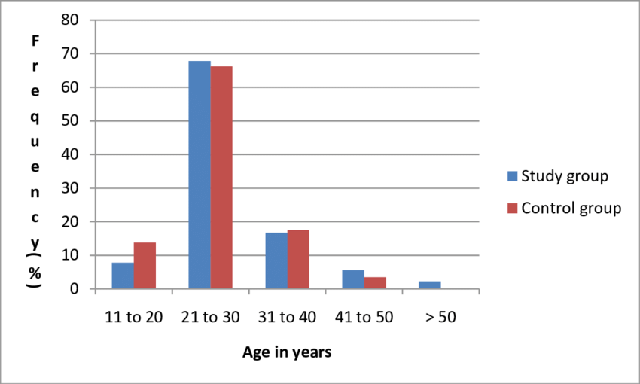
Research Proposal
Based on the information collected from our ethical considerations, it will be better asking Students and lecturers at UWTSD to find out if there is a need to provide training on how to use technology. This is because it is easy to have access to them. We suggest that more students and lecturers can participate on survey which will give us a clear image of the finding information at UWTDS.
What to ask?
Open questions
Close question
Rank order question and
Likert scale questions.
In order to gather as much information that will help us represent our data using a chart or diagram.

Slide 9
Research Proposal
How to ask questions?
We will ask question related to the topic of our research and to the right individual students and lecturers facing the reality of using technology at UWTSD. This well help us have an idea and suggest the result of our hypothesis.
Due to the types of our questions, the topic of our research and the targeted audience we suggest to take part in our survey, we believe that our finding will be accurate when referring to the information found from the ethical consideration from different peer group of people attending at UWTSD. We suggest that there will be a large number of people with age advanced, disabilities or illnesses as well as new students with no technological skill will need trainng on how to sue technology to collaborate.

Slide 10
References
Hinrichsen, J. and Coombs, A.( 2013). The five resources of critical digital literacy: a framework for curriculum integration. Research in Learning Technology, 21. PP.34-36. 3 March 2022.
Ben Youssef, A., Dahmani, M. and Ragni, L.(2022). ICT use, digital skills and students’ academic performance: exploring the digital divide. Information, 13(3), p.129. https://doi.org/10.3390/info13030129
Kalin, J. (2012) Student Perceptions and Use of Collaborative technologies, International journal for the scholarship of teaching and Learning: v6 n1, p.23. 10 January 2012.
Hillerbrand, R. and Werker, C.(2019). Values in university–industry collaborations: the case of academics working at Universities of Technology. Science and Engineering Ethics, 25(6), pp.1633-1656.
RENTZ, M. and VON HOENE, A.N.N.E.(2010). Online coaching for caregivers: using technology to provide support and information. Alzheimer's Care Today, 11(3), pp.206-209.

