Slide 1
Education around the world
‘Effective learning is facilitated by social interaction’ harkin et al (2001)
Hayley Tobin
P145417
(Hyland and Merrill, 2003)

Slide 2

What group of learners will your vision of education support?
Post Secondary School Age
Independent Learning
Discover hobbies and interests
Changes
Development of Growth
Career Path?

Slide 3

The national curriculum
Philip O’Hear and John White (1991)
Lacks proper reasoning
Too structured in terms of subjects
Devalues ‘wider curriculum of the school’
Dislike how assessments are set out (O’Hear and White, 1993)

Slide 4
hOW WILL MY CURRICULUM DIFFER?
Modern Curriculum
Set of Subjects
Pupils Learn the same things
Pupils don’t decide what they are taught
Includes Key Stages
Standards are set that pupils must reach
New Curriculum
No set subjects
Pupils can learn different things
Pupils can learn what they are interested in
Doesn’t have key stages
No standards are set

Slide 5
STUDY IN SPAIN
SPANISH LANGUAGE
CULTURE -> ARTISTIC HERATIGE -> ARCHITECTURE -> MUSIC -> FOOD
HISTORY OF SPAIN
GEOGRPAHY OF SPAIN (DonQuigote, 1989-2018)

Slide 6
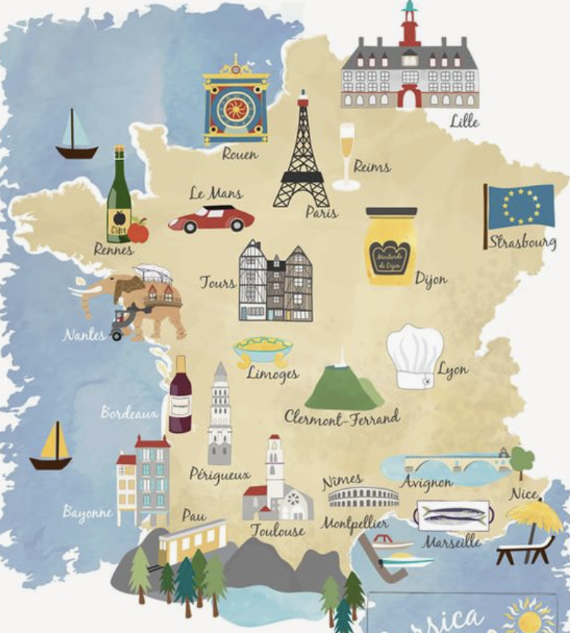
STUDY IN FRANCE
Religion -> Catholicism
Morals and Values
High-end Fashion
French Cuisine
Art
Architecture
History of France
French Language (Zimmerman, 2017)
(Pinterest.co.uk)

Slide 7
How will learning be organized?
City Campuses and Libraries available for students for personal work and workshops
Students will learn in different environments
Teacher as a guide and facilitator
Teacher will plan daily activities based on the interests of the students
Learning will be activity based, enabling students to have hands-on experiences

Slide 8
jOHN dEWEY AND Lev Vygotsky
Teaching should be planned in effective ways
Subject matter should be connected to students
Consider the needs, desires and interests of students
Sociocultural theory; students play an active role in their own learning
Teacher facilitate ‘meaningful’ leanring

Slide 9
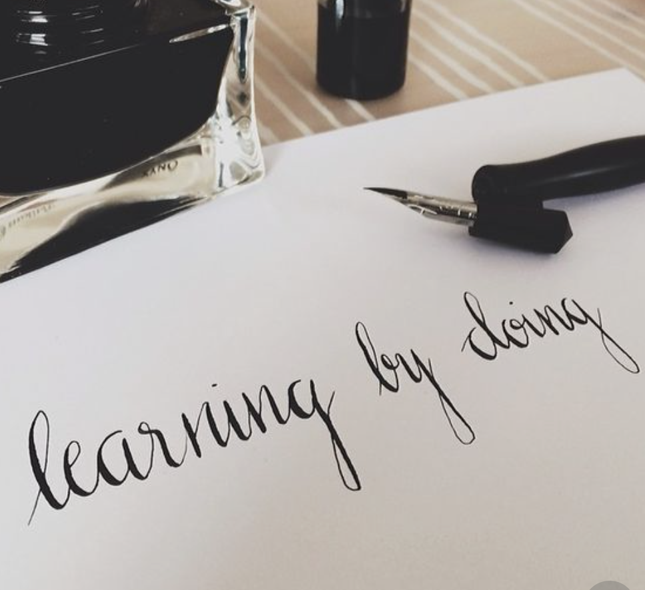
The progressive movement (John Dewey)
Student activities should be meaningful
Learning by doing
Values experience over learning facts
Equips individuals with social competence
Correlation between interaction and experience
Knowledge takes place in concrete situations
Hands-on collaborative learning (Dworkin, 1967)
https://www.youtube.com/watch?v=V5NaCC7rF1Y
(Pinterest.co.uk)

Slide 10
Traditional education
vs
Progressive education
Teacher-led instruction
All students required to learn at the same pace
Focus more on facts, ideas and information
Students expected to sit, listen and assimilate information from a lesson
Knowledge is absorbed through lectures, worksheets and tests
Teacher-facilitated instruction
Student learn at their own pace
More opportunity for students to explore and inquire; focuses on what students think
Students learn by experience; teachers think of activities that facilitate learning of a concept
Knowledge is constructed through direct experience and social interaction

Slide 11
EXPERIENTIAL LEARNING – David Kolb
Concrete experience
Students have an experience
Students reflect on observation about that experience
Students analyze responses and formulate new ideas
Students actively tests these ideas in new situations
Reflective Observation
Active Conceptualization
Active Experimentation
(Kolb and Kolb, 2005)

Slide 12
SUMMARY – Key points
Helps the individual grow as a person
Offers the individual further experience and life skills from independent learning
Relies heavily on social interaction and hands-on experiences
Enables individuals to gain skills
Gives individuals a better understanding of different cultures and the world
Makes individuals time to think about their chosen career path

Slide 13
Reference list
Hyland, T. and Merrill, B. (2003) The Changing Face of Further Education. London: Routledge
O’Hear, P. and White, J. (1993) Assessing the National Curriculum. London: Paul Chapman Publishing Ltd
Dworkin, M. (1967) Dewey on Education: Selections, no.3. Teachers College Press.
Zimmerman, Kim. (2017) French Culture: Customs and Traditions [Online] Available at: https://www.livescience.com/39149-french-culture.html Accessed on: 21st Oct 2018.
Don Quigote (1989-2018) Spanish Culture [Online] Available at: https://www.donquijote.org/spanish-culture/ Accessed on: 21st Oct 2018.
Kolb, A. & Kolb, D. (2005). Learning Styles and Learning Spaces: Enhancing Experiential Learning in Higher Education. Academy of Management Learning & Education, 4, 193-212.
Dewey, J. (1897). My pedagogic creed. The school journal. LIV(3): 77-80.
Dewey, J. (1938). Education and experience. New York: Simon and Schuster.
Kolb, A. & Kolb, D. (2005). Learning Styles and Learning Spaces: Enhancing Experiential Learning in Higher Education. Academy of Management Learning & Education, 4, 193-212.
Roberts, T.G. (2003). An Interpretation of Dewey’s Experiential Learning Theory. Retrieved from ERIC.

