Slide 1

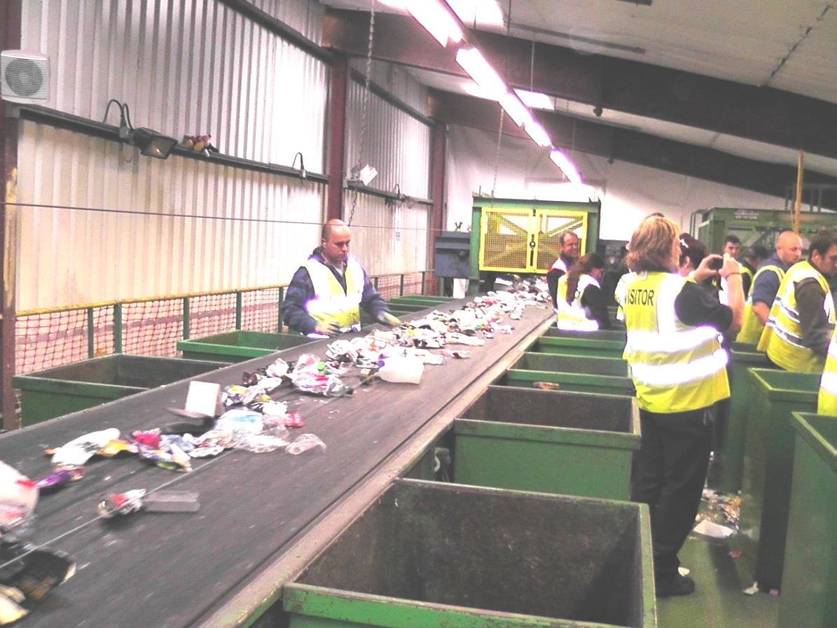
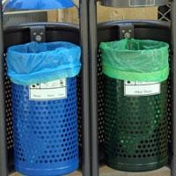
Future availability of resources
BSc Architecture – The Modern World

Slide 2


Slide 3

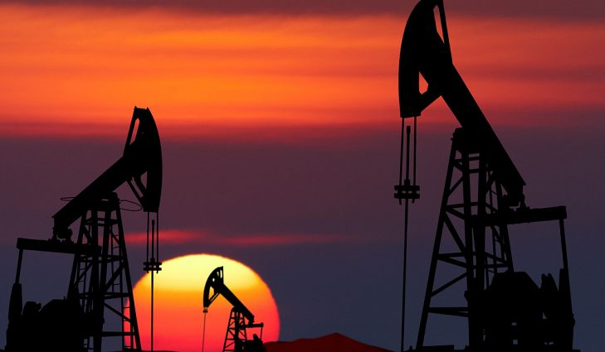
Demand for resources
Sources: Daily Mail / World Atlas

Slide 4




Equality in use of resources
Sources: BBC / Creative Commons

Slide 5
Consequence of resource exploitation
Socioeconomic
Environmental
Political

Slide 6
Energy
Global energy supply is dominated by coal, oil and gas
  Produces ⅓ of global GHG emissions
More than 1.3bn people lack access to electricity
Citizens demand clean, reliable electricity
Renewables increasingly cost-effective

Slide 7
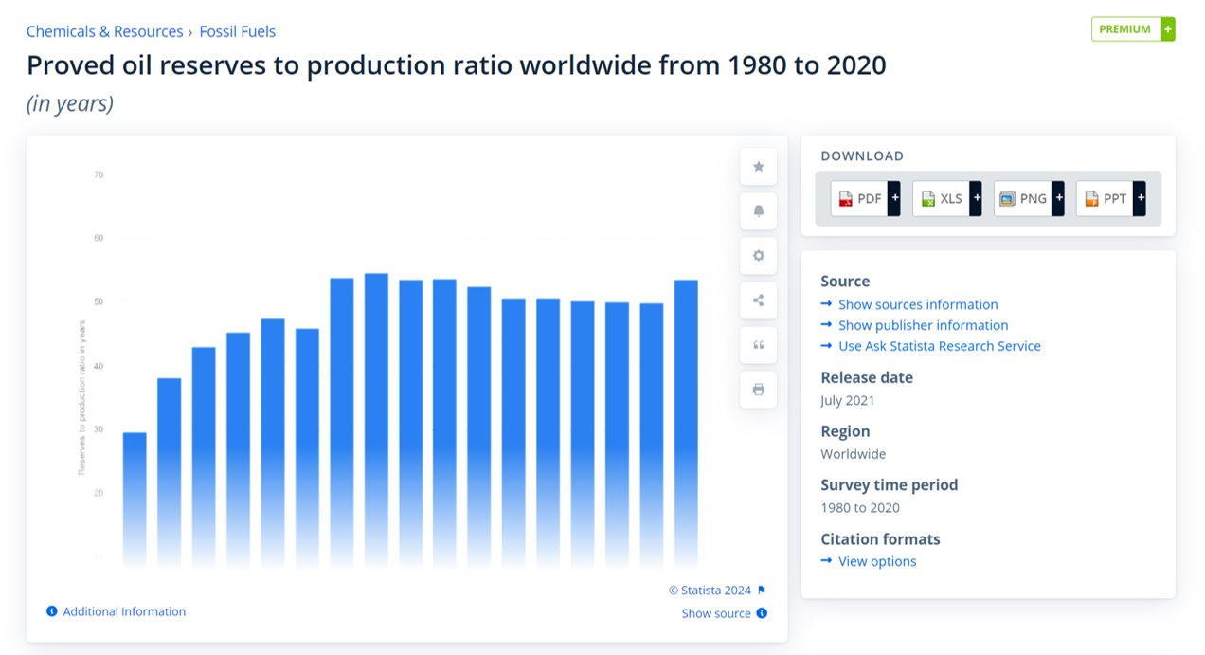
Reserves to production ratio – 53.5 years
Source: Statista, 2024

Slide 8
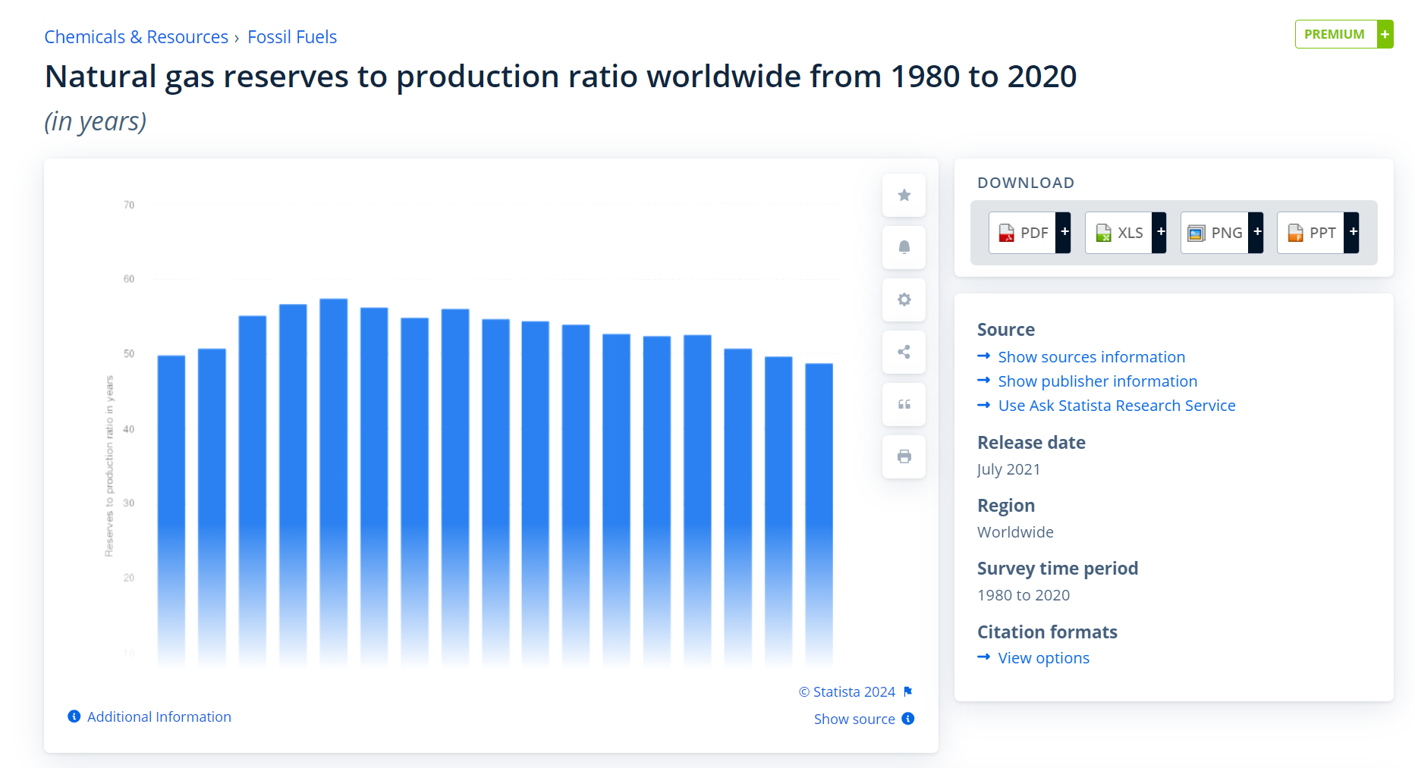
Reserves to production ratio – 48.8 years
Source: Statista, 2024

Slide 9
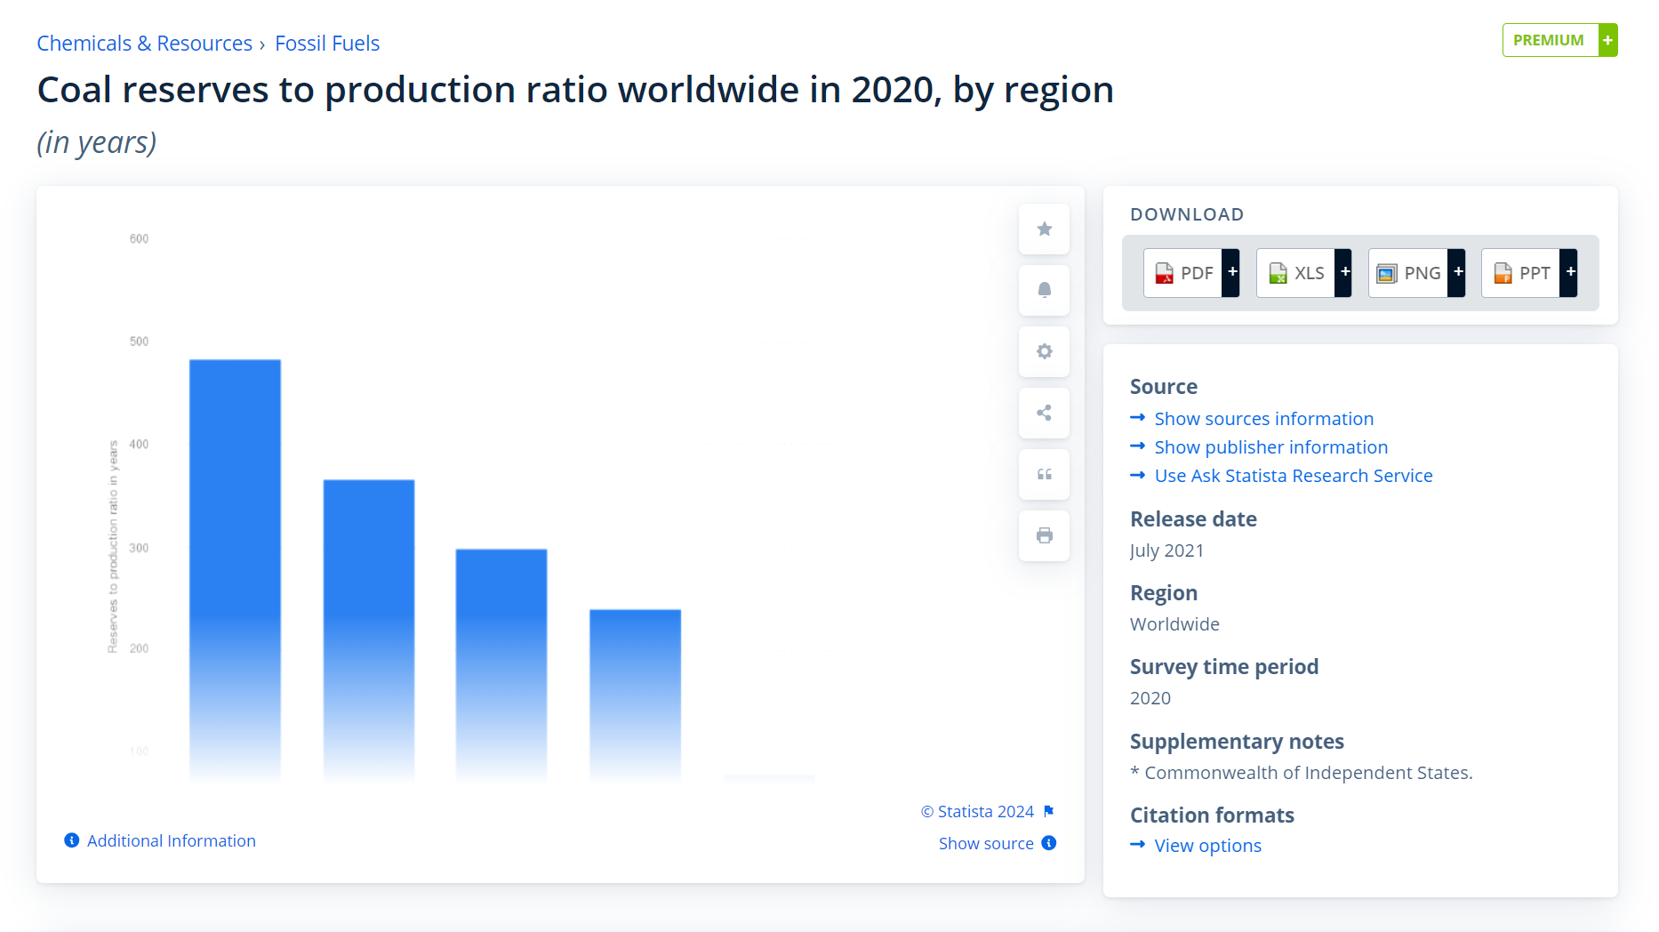
Reserves to production ratio – 484 years in North America
Reserves to production ratio elsewhere – 60 years
Source: Statista, 2024

Slide 10
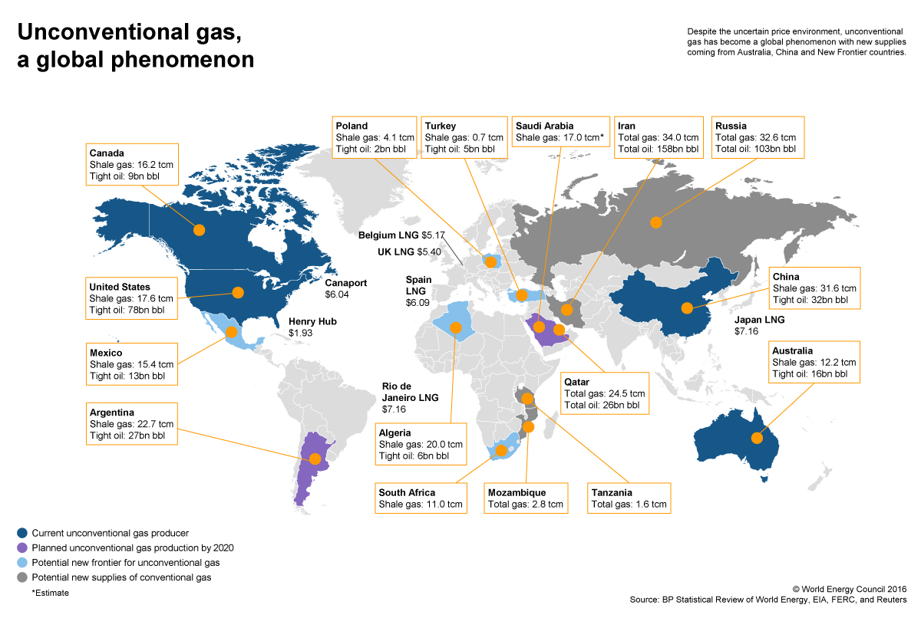

Slide 11
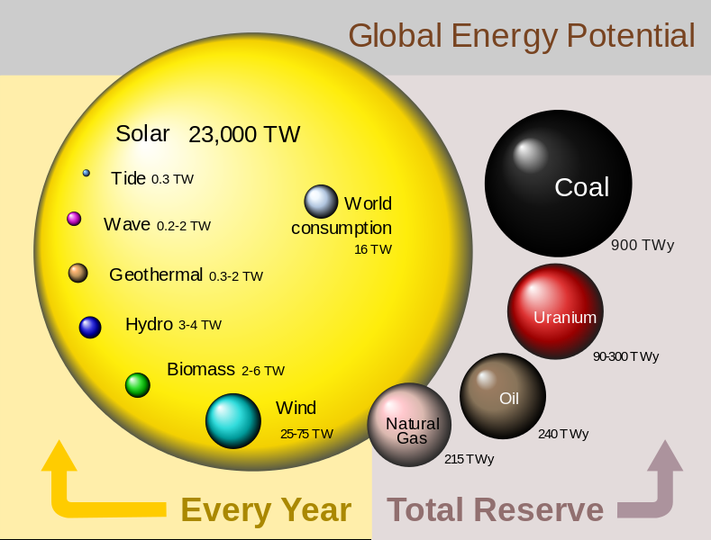

Slide 12
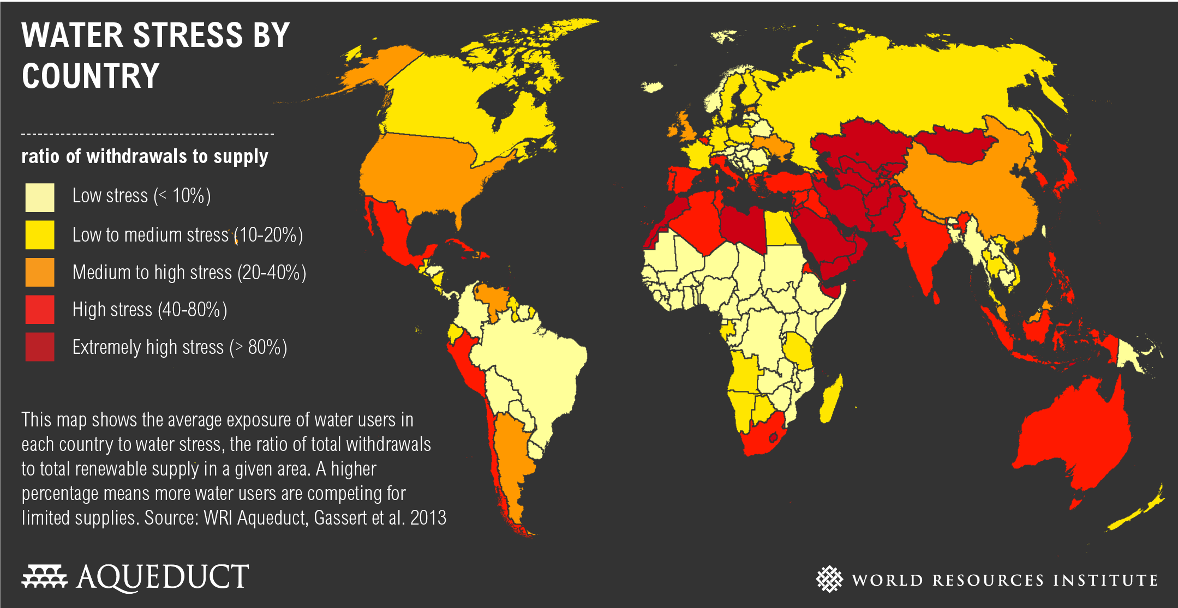
Water

Slide 13
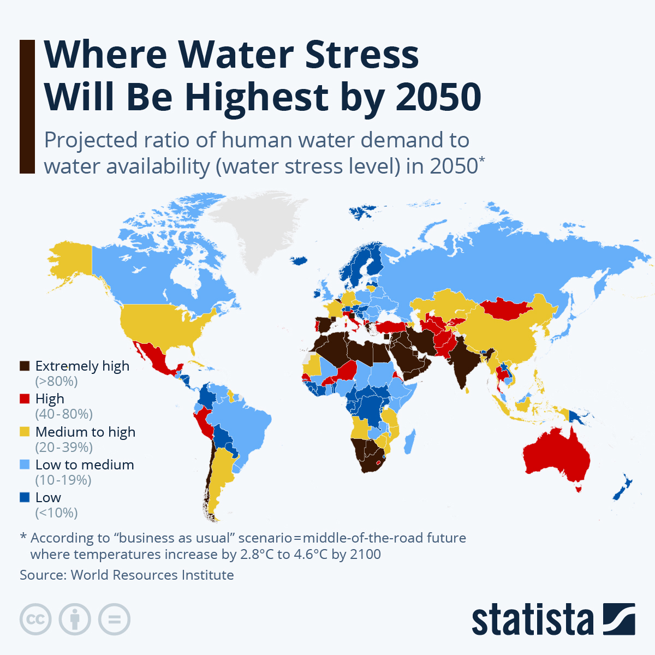
Future scenario
Source: Statista, 2025

Slide 14
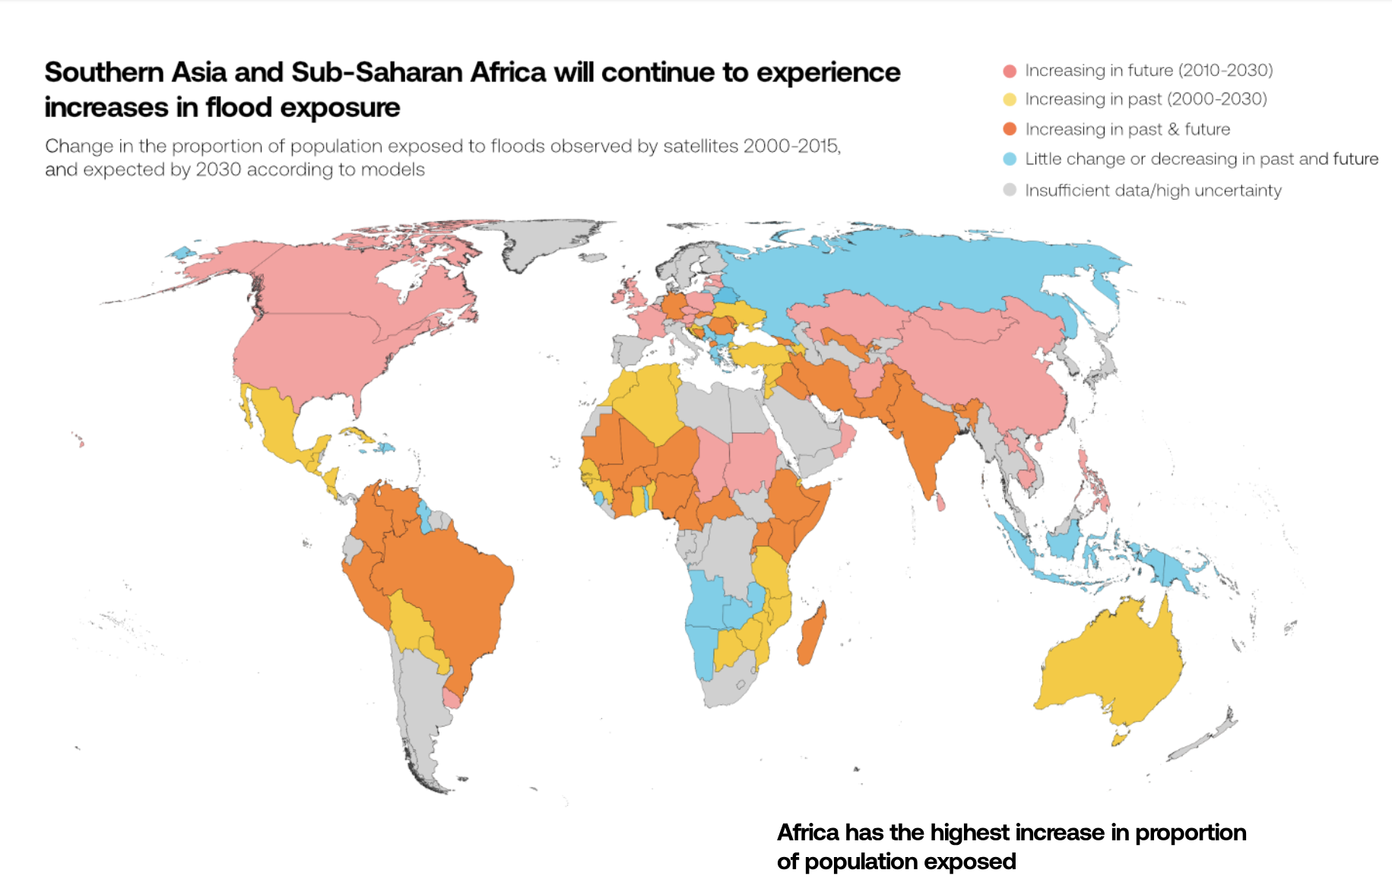
Source: Global Flood Database

Slide 15
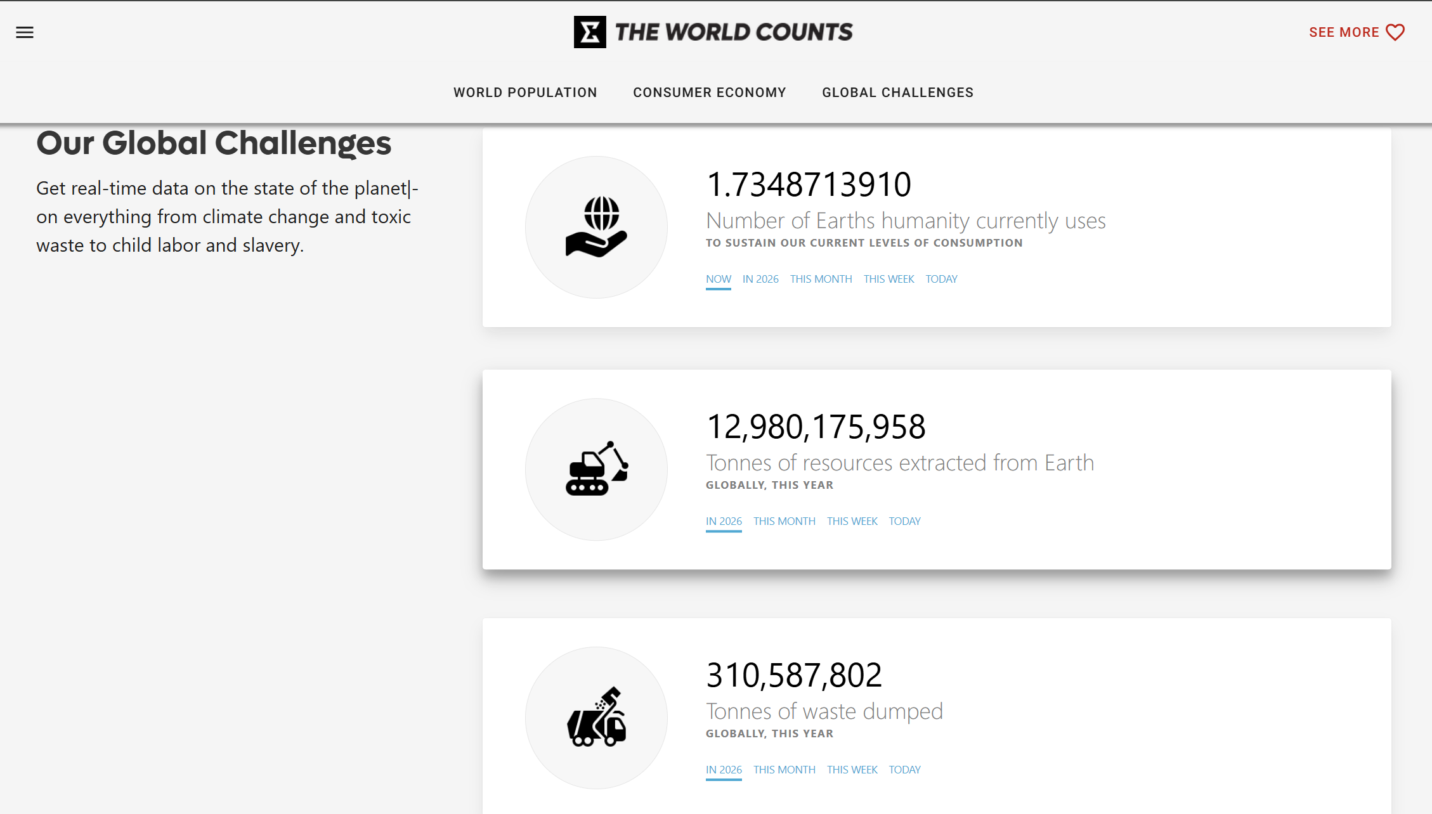
Resource depletion

Slide 16
Top 5 facts: Total mining on Earth
Its mined for our sake
It goes into our products
Lifetime supply
Numbers are going up
Increased negative impacts

Slide 17
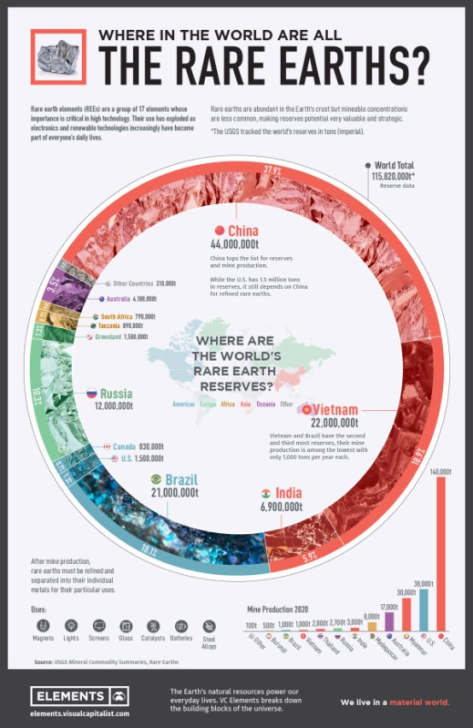
Rare Earth Elements (REE)

Slide 18
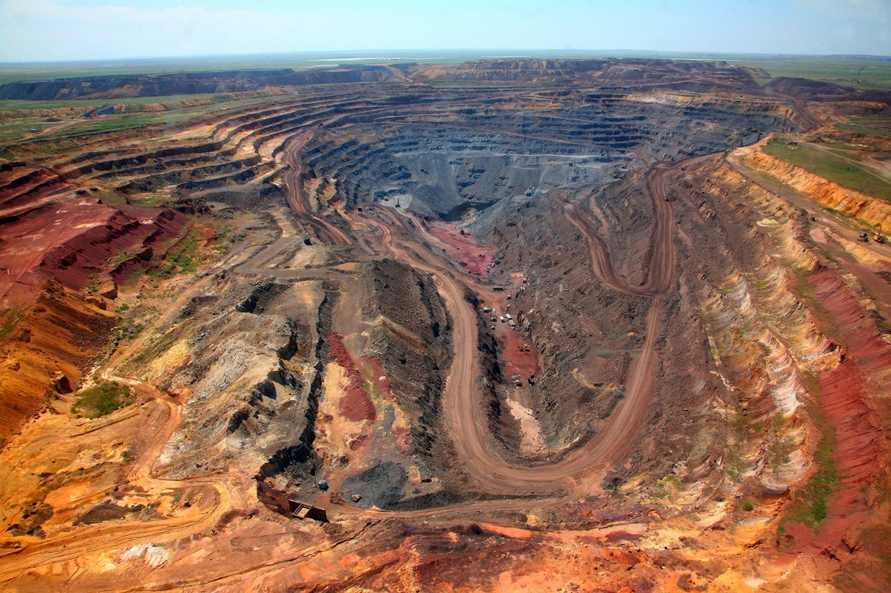
Rare Earth Element mining:
Baotou, China
Source: Guardian Liberty Voice, 2014

Slide 19
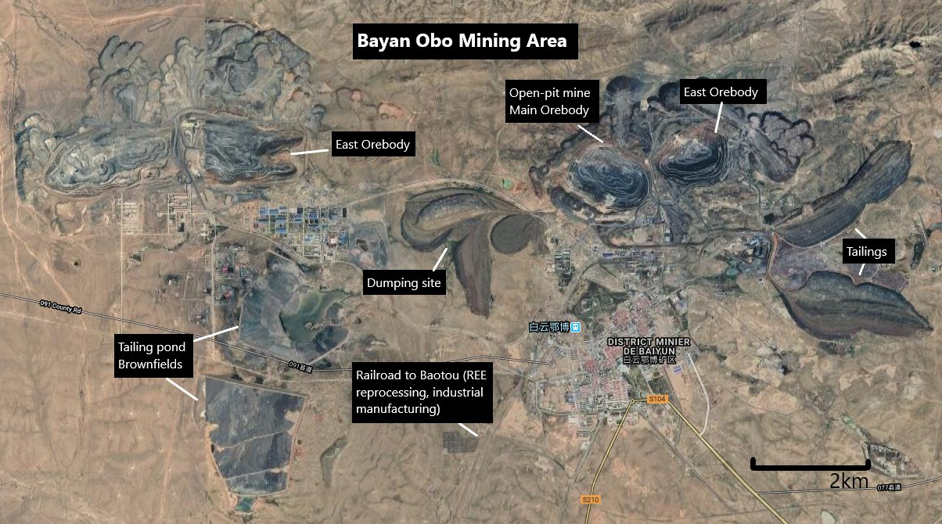
Environmental problems
Source: Environmental Justice Atlas, 2025

Slide 20
Critical mineral raw materials
Antimony | Magnesium
Baryte | Natural graphite
Beryllium | Natural rubber
Bismuth | Niobium
Borate | Phosphate rock
Cobalt | Phosphorus
Coking coal | Scandium
Fluorspar | Silicon metal
Gallium | Tantalum
Germanium | Tungsten
Hafnium | Vanadium
Helium | Platinum group metals
Indium | Heavy & light REE
Source: EC Communication, 2017

Slide 21
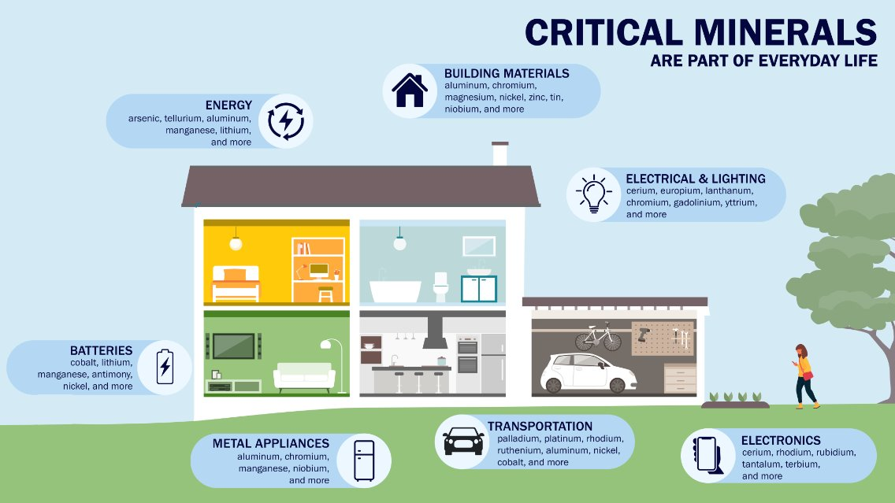
Source: Bureau of Ocean Energy Management

Slide 22
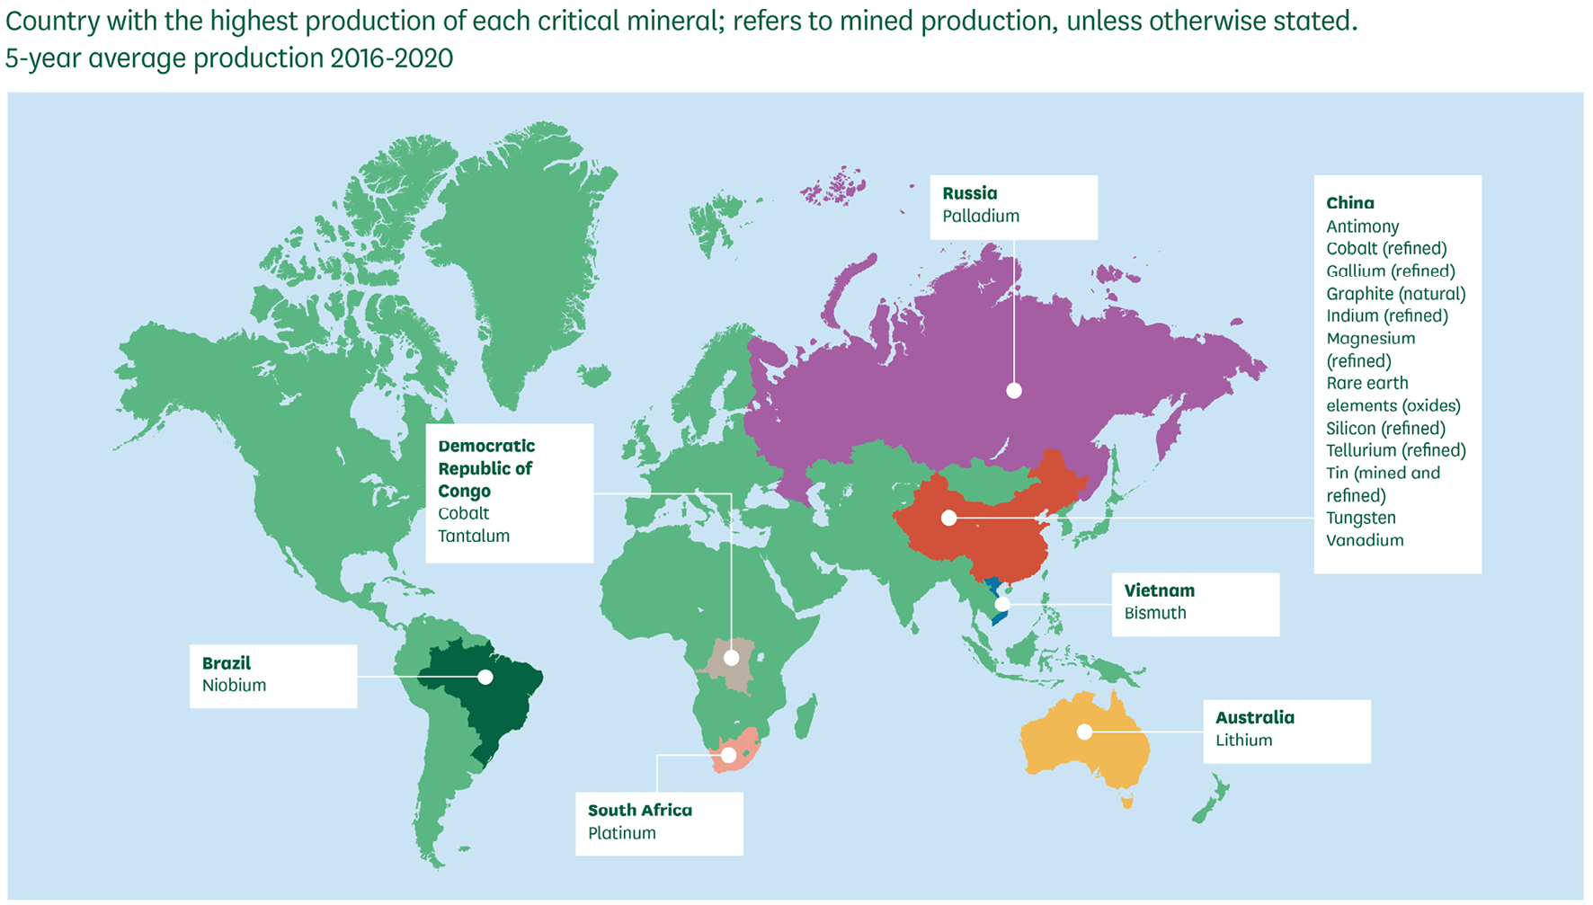
Where are they found?
Source: Resilience for the Future: The UK’s Critical Minerals Strategy based on data from the UK Critical Minerals Intelligence Centre, 2022

Slide 23
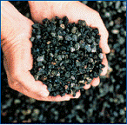
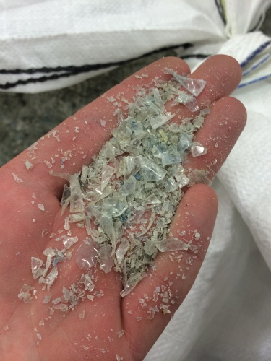

Reimagining construction materials
Source: Concrete Basics / The Engineer / Material Transformations

Slide 24
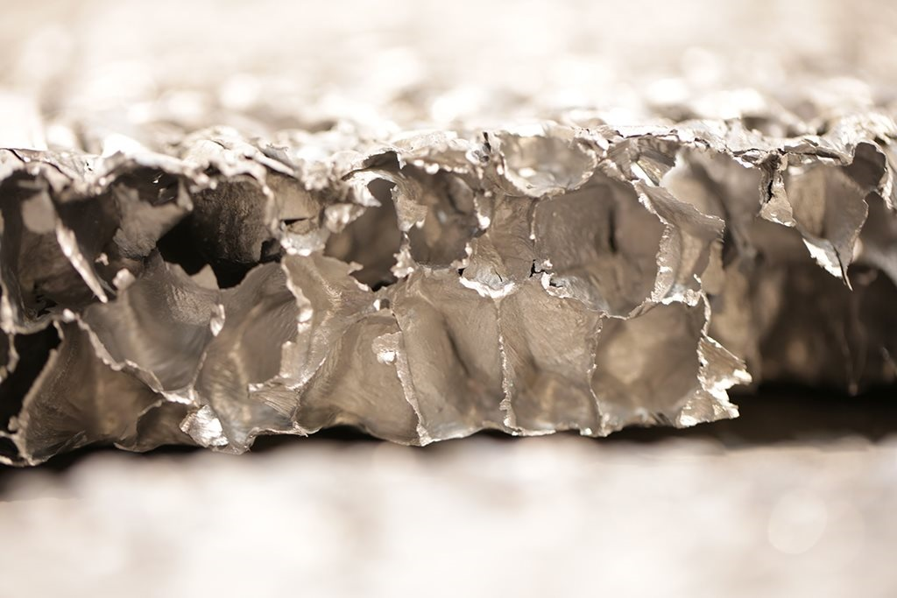


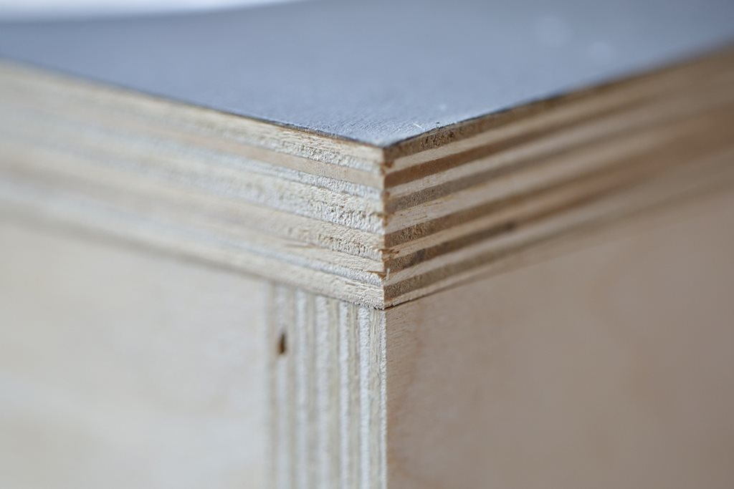
Innovations in materials?

Slide 25
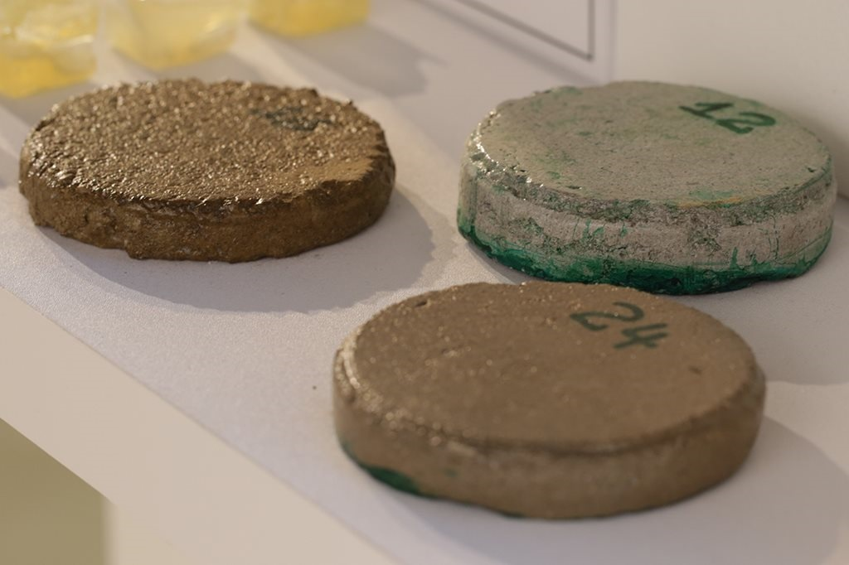

Innovations in materials?
Source: Construction News

Slide 26
Useful information
World Resources Institute (www.wri.org)
World Economic Forum (www.weforum.org)
World Energy Council (www.worldenergy.org)
European Commission
British Geological Survey – Minerals UK
UK Quality Ash Association (www.ukqaa.org.uk)
Construction News (www.constructionnews.co.uk)

